Slide 1
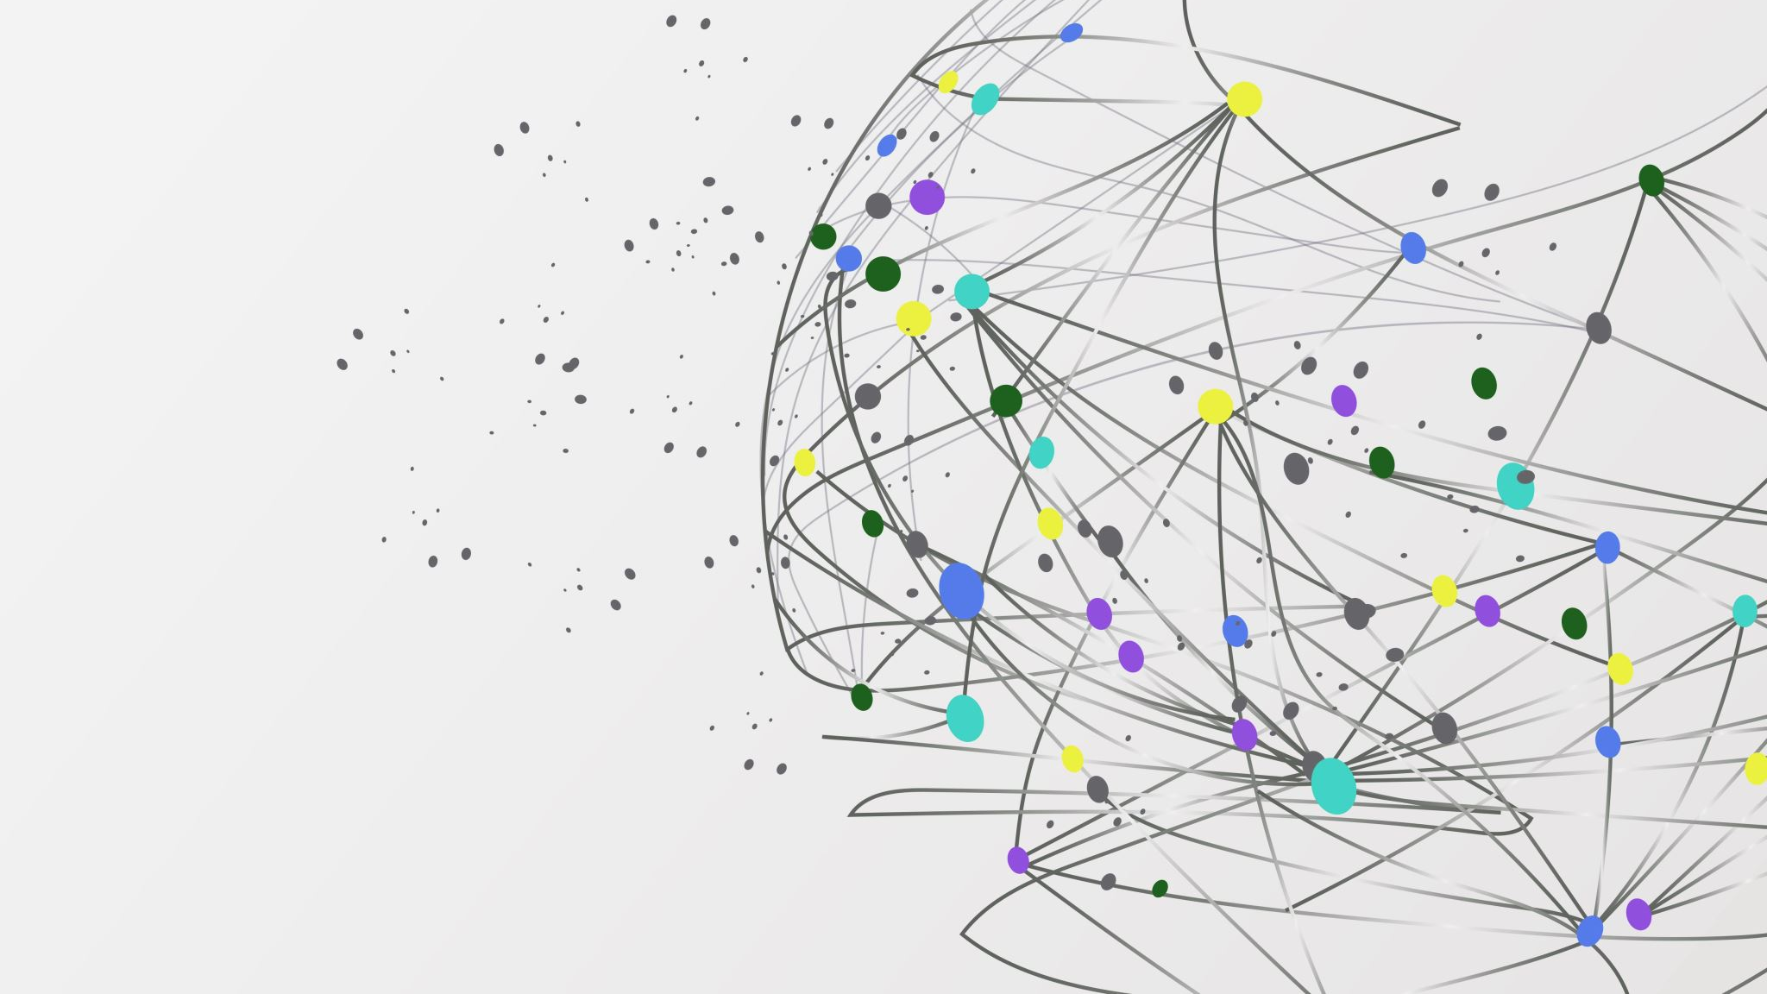

The Librarians
Dexter Estrada
Kevin Ngo (Lead)
Kyle Louderback
Nicholas Semaan

Slide 2


Progress
Name | Job
Kyle | Connections between front/backend (forms.html) Updates to login Building test cases
Kevin | Connections b/w front/backend Building test cases
Dexter | Revising schema Building test cases
Nicholas | Continue building index.html, about.html, layout.html, form.html, register.html, login.html Building test cases

Slide 3
Progress
About Page
Revised Schema
Adjusted logins
Still researching test plans

Slide 4
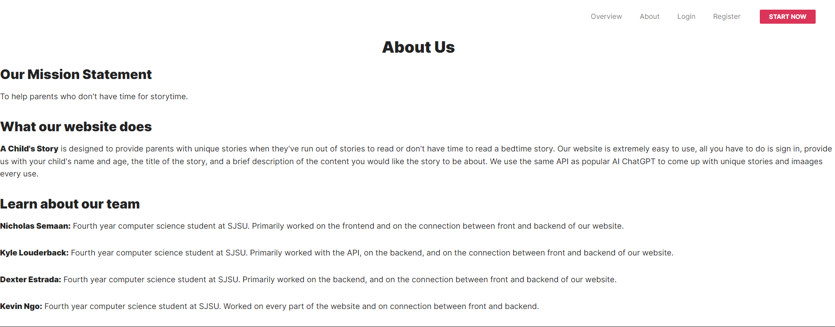
About Page

Slide 5
Milestones
M2: Registration, Login/Logout, About, and Form features are completed.
Need to connect
M3: Book Generation feature is completed
Need to iron out and connect
M4: Preview and Download features are completed.
M5: Share feature is completed.

Slide 6
Test Plans
Prepare the database with standardized entries for testing
Currently evaluating uses of selenium, unittesting

Slide 7

Partner Feedback:
Team Treehouse
Feedback
UI is clean and modern
Registration/login still iffy?
A help/how-to-use guide

Slide 8
Response to Feedback
Our Feedback
A how-to-use guide is a good idea
Explaining how it works maybe, content field might not be immediately clear
Users/logins have had a revision, perhaps it works better now

