Slide 1
THE LIBRARIANS
Dexter Estrada
Kevin Ngo
Kyle Louderback
Nicholas Semaan

Slide 2
PROGRESS
​MILESTONES | COMPLETED
Registration, Login/Logout, About, and Form | DONE
Book Generation feature | DONE
Preview and Download features | DONE
Share feature | IN PROGRESS
Additional Nice to Have Features | IN PROGRESS

Slide 3
THIS WEEK
HOSTING
Deploy to Azure
Multiple Sessions Issue
BUGS/TESTING
Fixed Login/Registration Errors
PROMPT RESEARCH
Engineer the best prompt for books
Engineer the best prompt for images

Slide 4
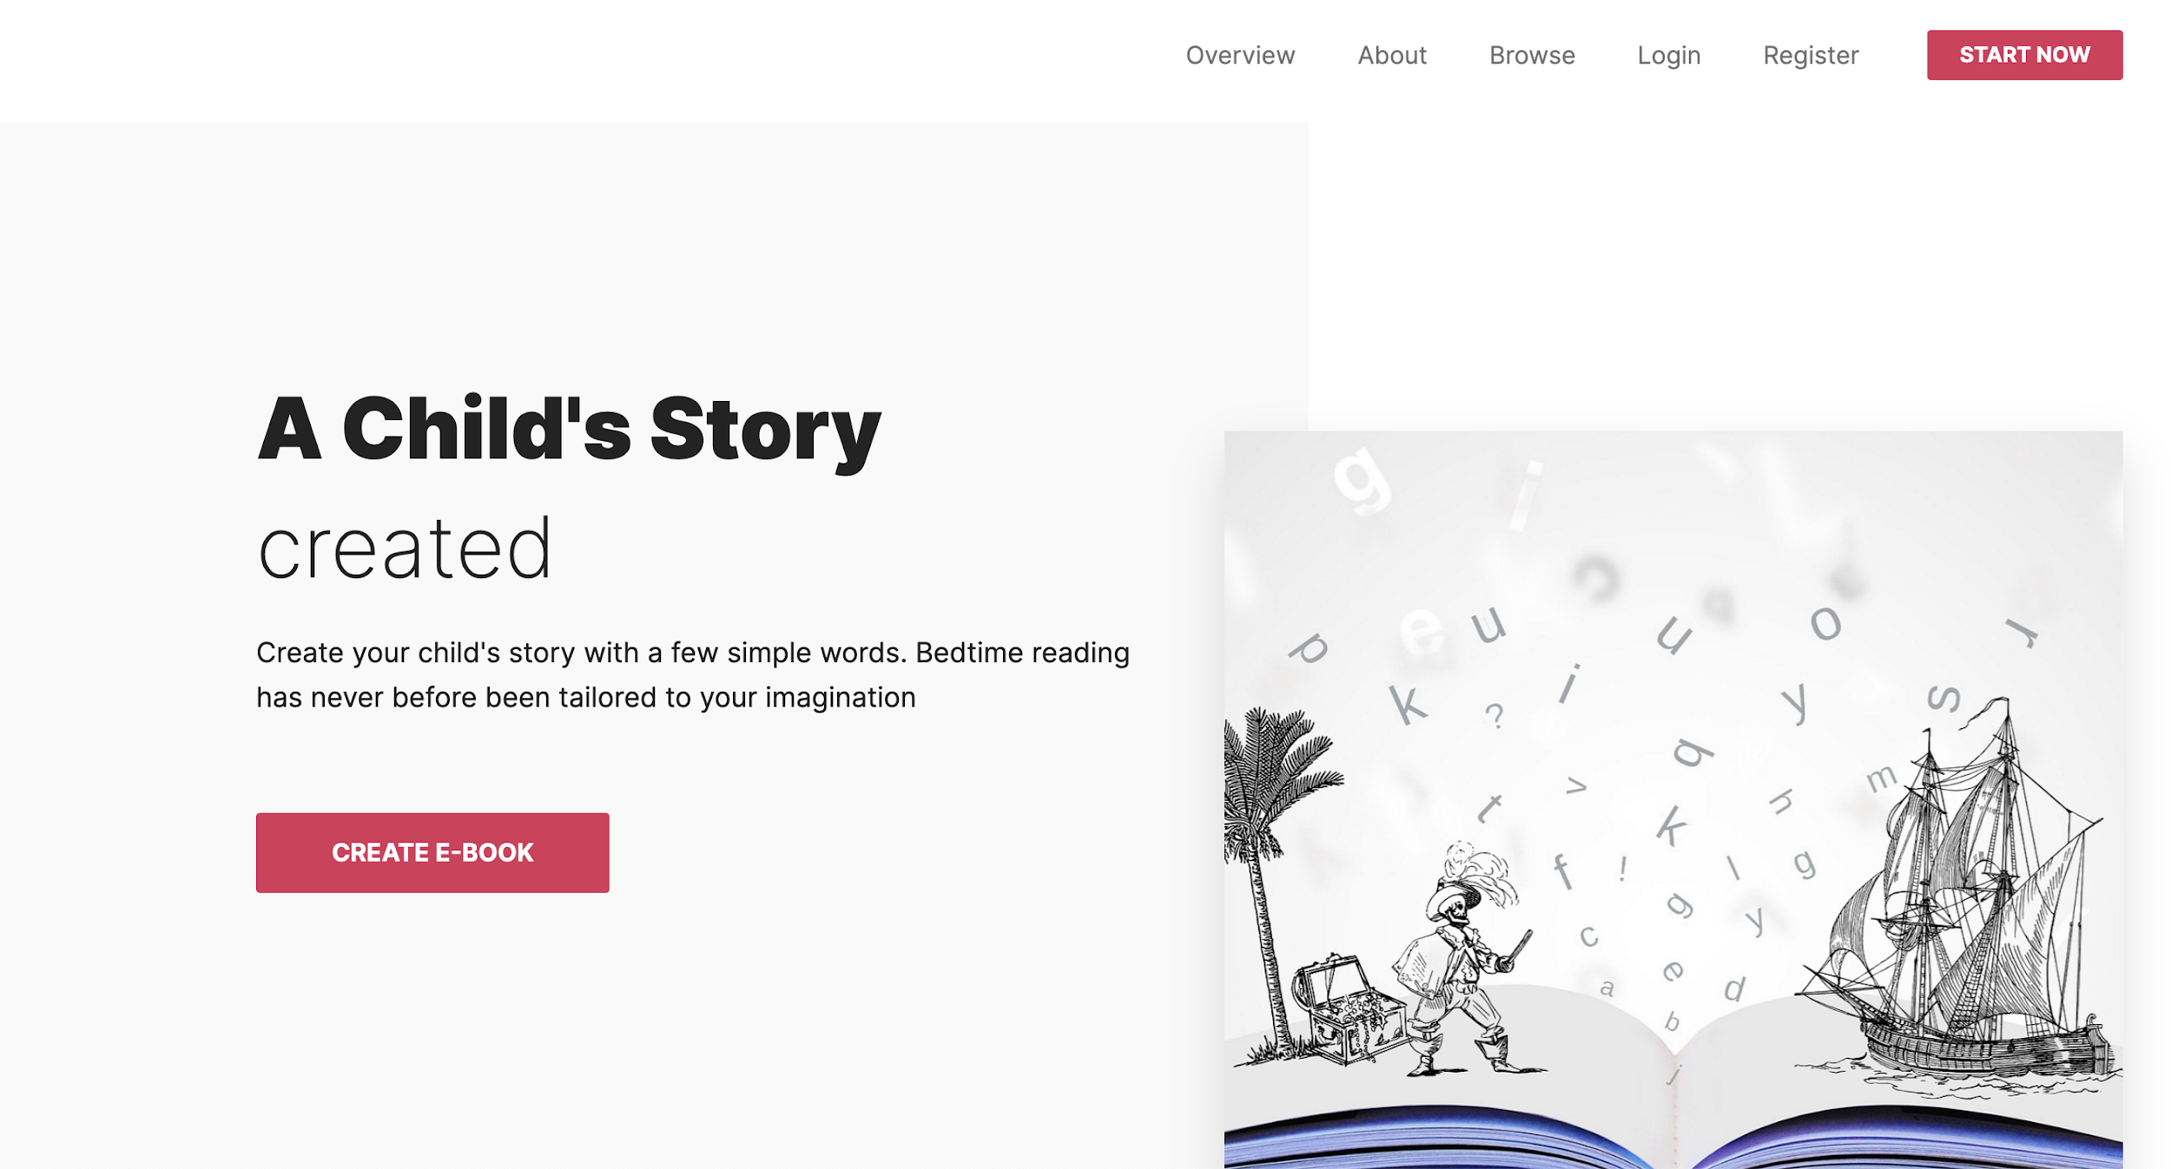
HOSTING
https://flask-ebook3.azurewebsites.net/
Azure
Session issues prevent login for multiple users on Azure, but not locally.
Working on fix, but open to ideas.

Slide 5
FEEDBACK
FOR PARTNER | FROM FoodReal
Runs well on my M1 Mac We like the interface Want to know how you will implement testing | No build issues About page can use margins Slick UI Azure login/registration issues Clean up wording on Expert Instructions

