Slide 1
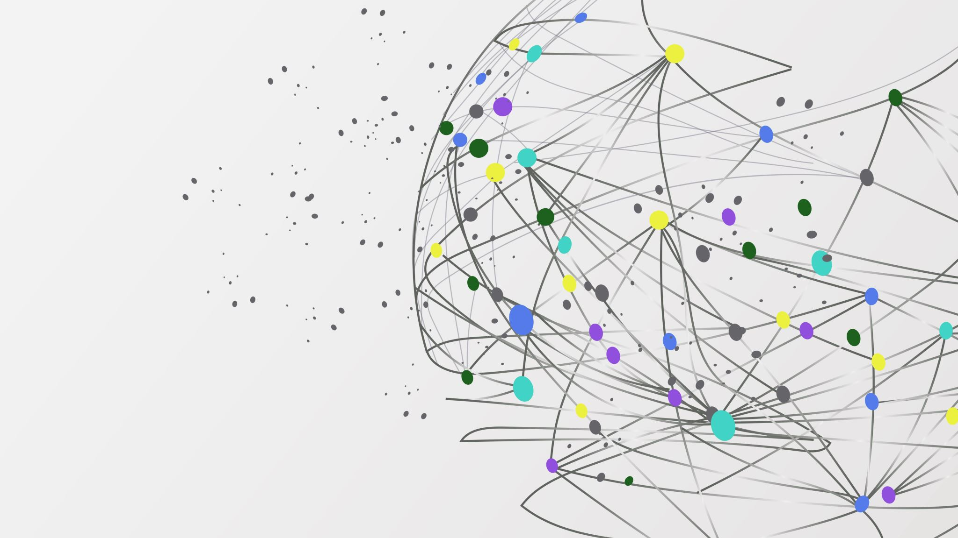

The Librarians
Dexter Estrada
Kevin Ngo
Kyle Louderback
Nicholas Semaan (Lead)

Slide 2


Progress
Name | Job
Kyle | Updates to login Building test cases
Kevin | Working on browse page Building test cases
Dexter | Revising schema Building test cases
Nicholas | Continue building index.html, about.html, layout.html, form.html, register.html, login.html Building test cases

Slide 3
Progress
About Page completed
Revised Schema to be clearer
Adjusted logins
Started testing

Slide 4
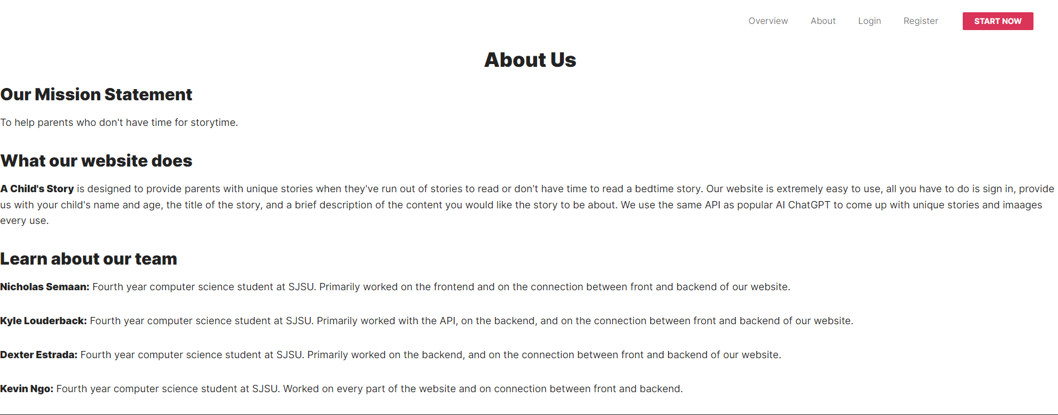
About Page

Slide 5
Milestones
M2: Registration, Login/Logout, About, and Form features are completed.
Need to connect
M3: Book Generation feature is completed
Need to iron out and connect
M4: Preview and Download features are completed.
M5: Share feature is complete.

Slide 6
Test Plans
Registration Test:
Test that new user can successfully register
Login Test:
Test that users can successfully login with valid credentials
Logout Test:
Test that users can successfully logout
Book Creation Test:
Test that logged-in user can create a new book using valid inputs
Preview Test:
Test that user can successfully preview the generated book
Download Test:
Test that user can successfully download the generated book as a pdf
Share Test:
Test that user can successfully share the generated book on social media

Slide 7
User Friendliness
Possible Ways to boost User Friendliness:
Tutorial Page
Record a video on how to use the page
Book creation examples
Possibly include examples of previous books
Possibly include background text on book creation bubbles

Slide 8

Response to Team Treehouse Feedback
Our Feedback
Revised registration and login to work better
A how-to-use guide is a good idea
Explaining how it works, content field might not be immediately clear
Possibly included in tutorial video if implemented

Slide 9
Partner Feedback:
Team Audiovision
Feedback
Suggestions:
Documentation is good on master branch
steps 6 and 7 can be omitted from the Installation
a guide on how to create a book
Good:
User registration and login work perfectly
UI is clean
Fixes:
broken links in footer
creating a book not working?
(left the page after 4 mins)

Slide 10
Response to Team Audiovision Feedback
Our response to
Suggestions:
We will update our installation doc accordingly
A guide is a good idea to boost user friendliness
Fixes:
Broken links will be looked at and fixed
Book creation should be working but we will check the timing

