Slide 1
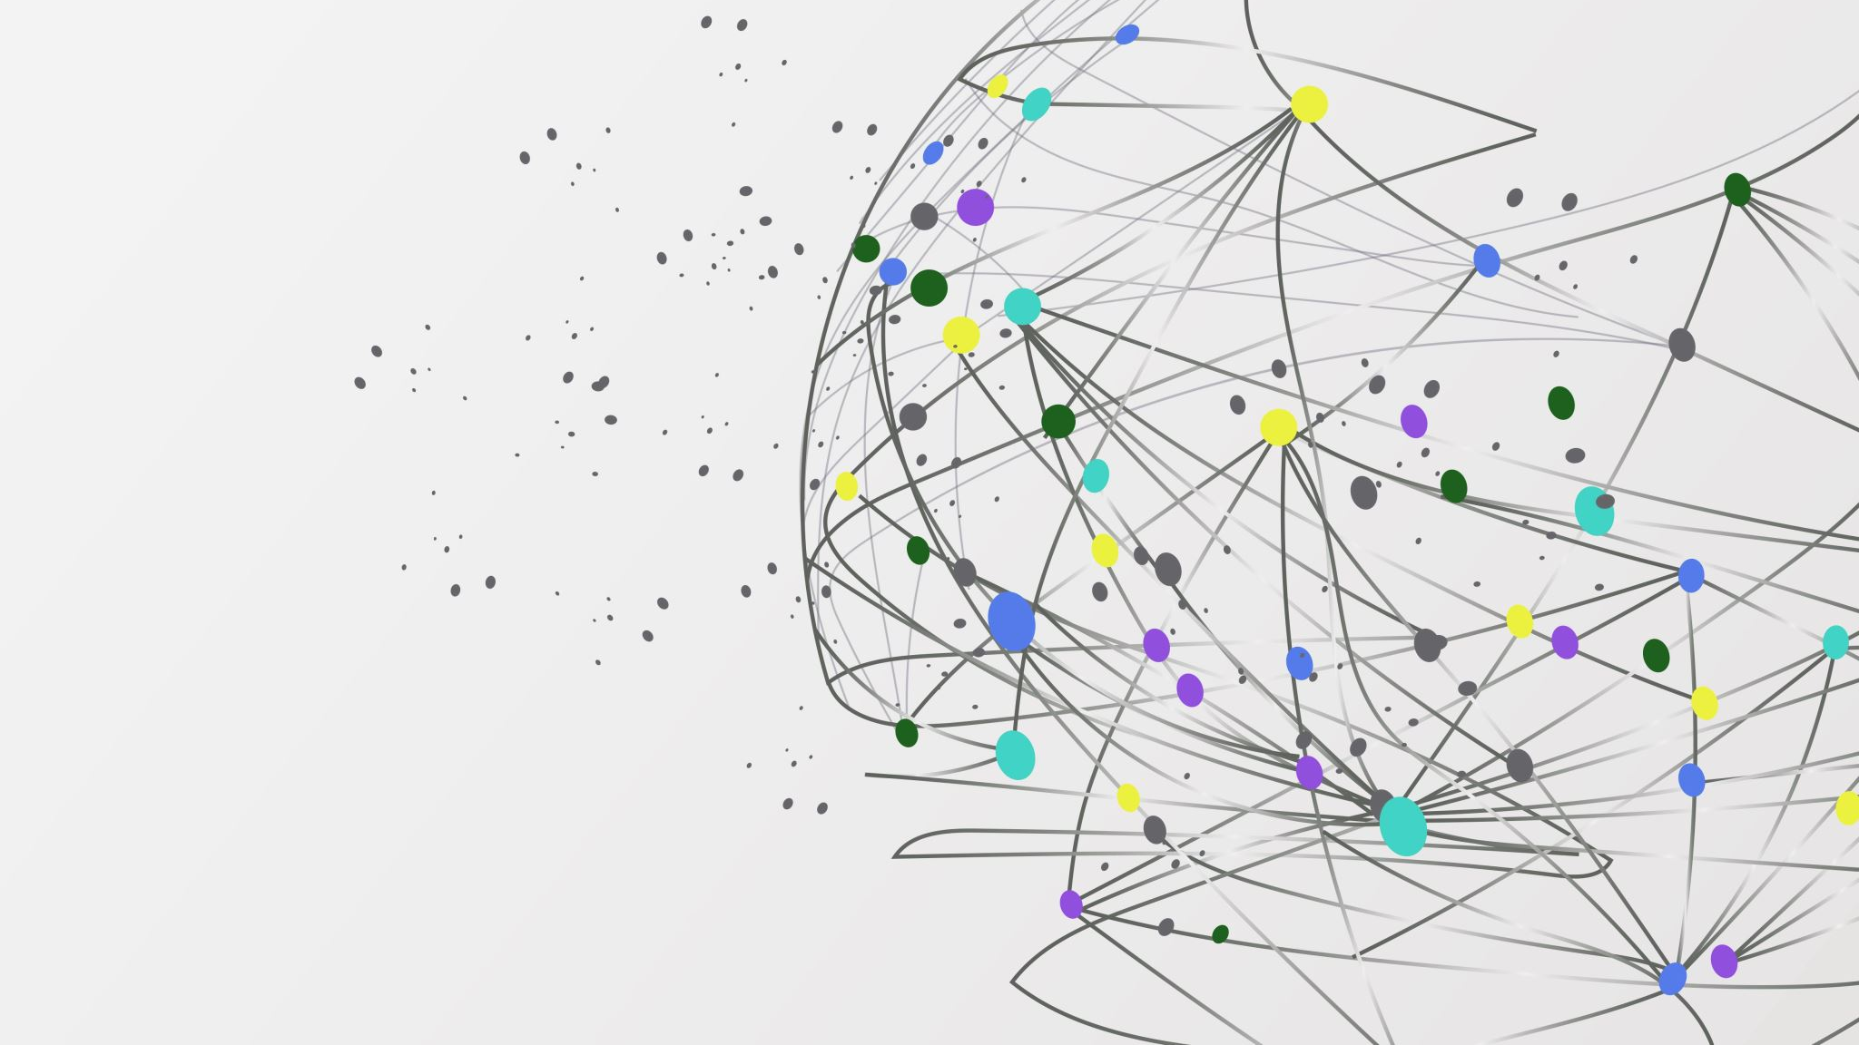

The Librarians
Dexter Estrada (Lead)
Kevin Ngo
Kyle Louderback (Lead)
Nicolas Semaan

Slide 2


What We Accomplished
Name | Job
Kyle | Setup app.py, basic Flask app structure Setup routes for “/” and “/about”
Kevin | Researched library for social sharing that works with Flask Framework
Dexter | Started building out and mapping models.py Setup Virtual Environment
Nicolas | Started building index.html, about.html, layout.html

Slide 3


ER Models

Slide 4
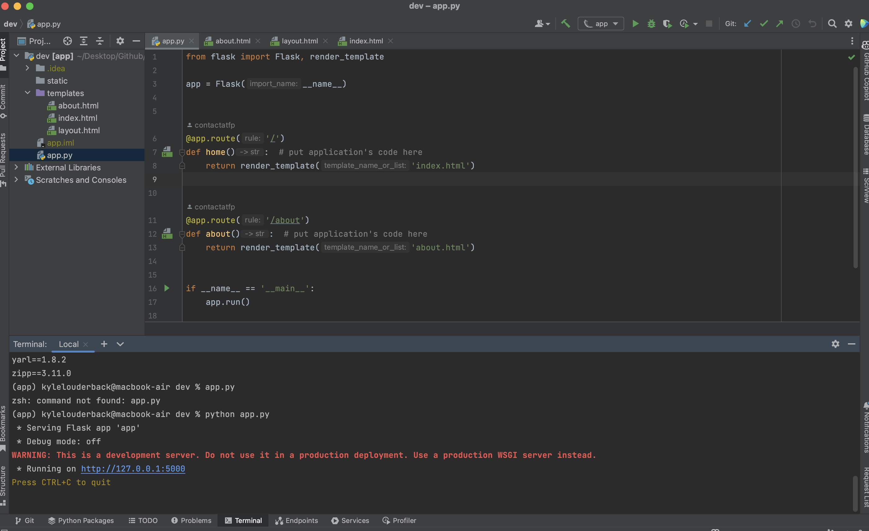

Slide 5
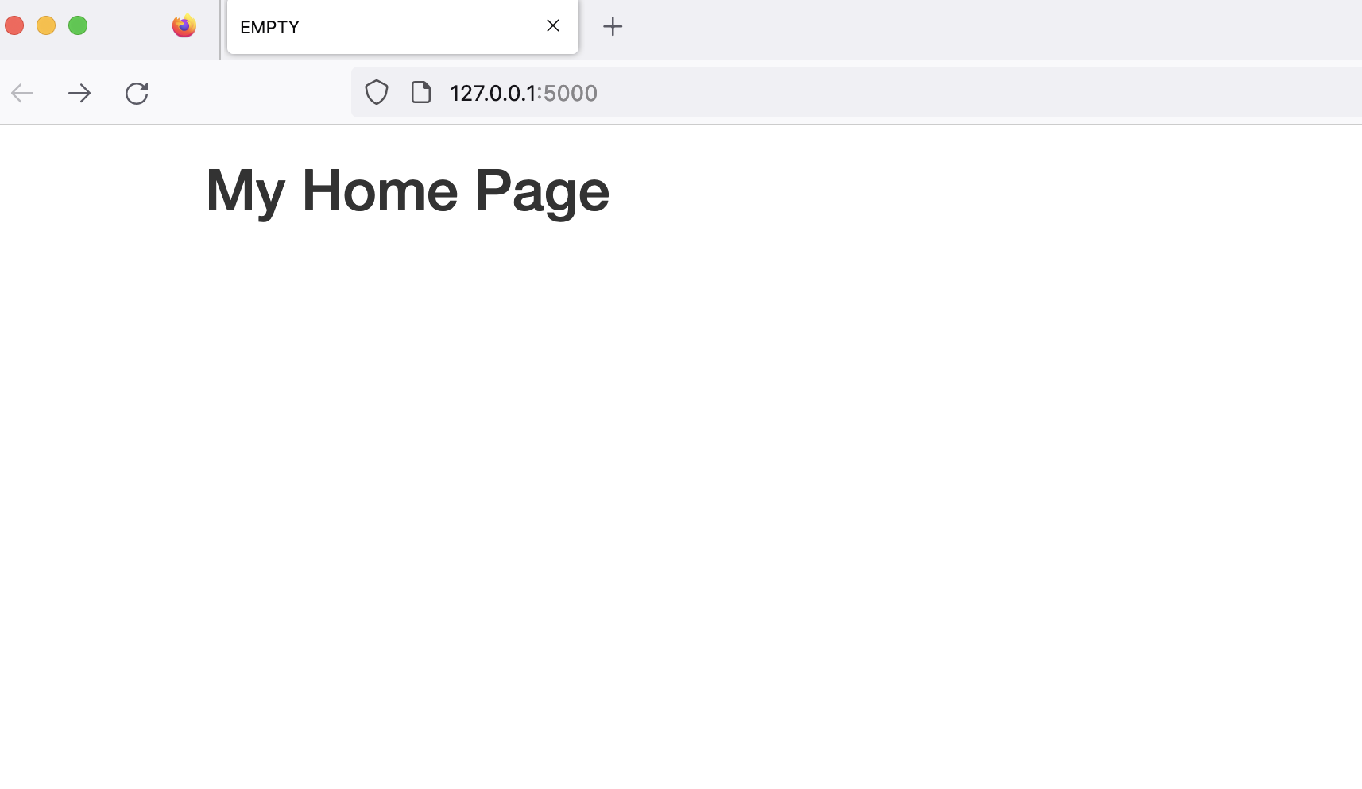
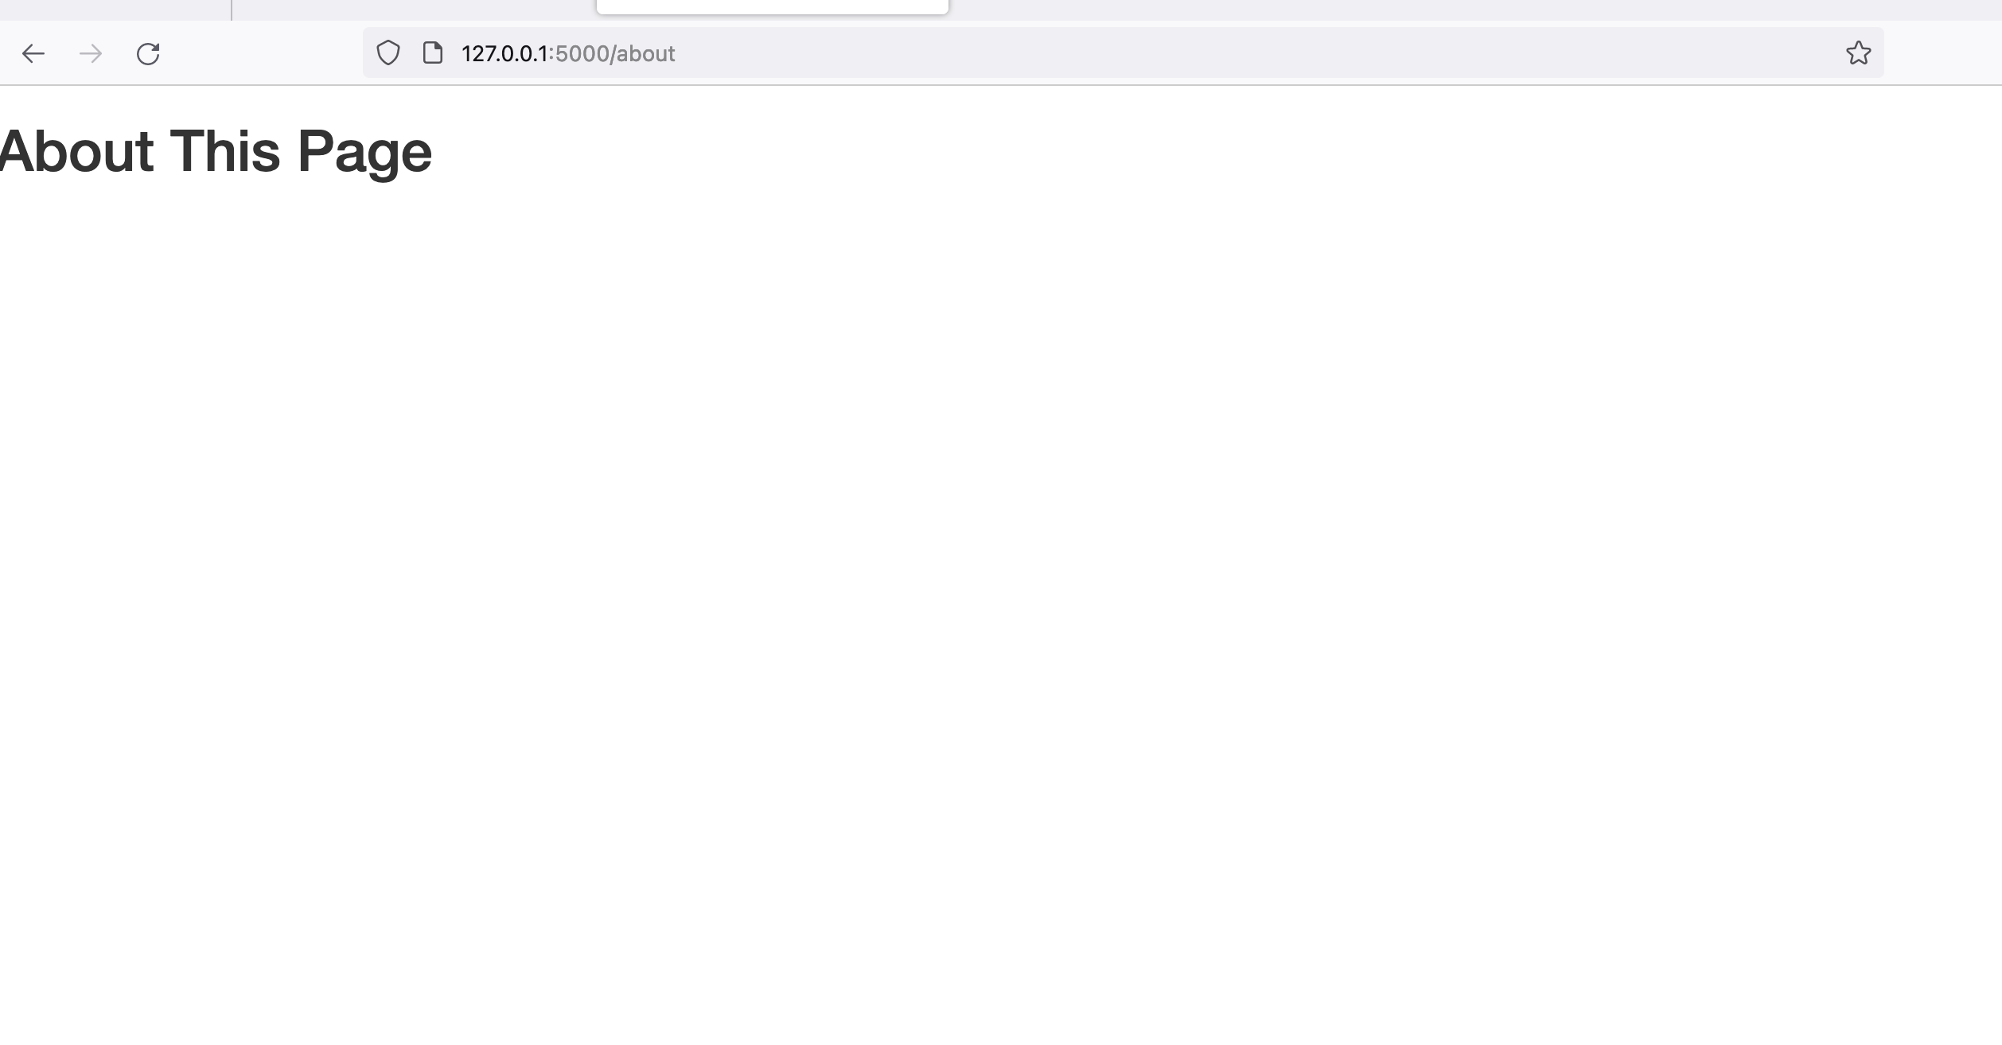
Template Rendering to URLs

Slide 6
Feedback
Implement a featured stories page
Create a rating system
Use a keyword tagging system

