Slide 1
THE LIBRARIANS
Dexter Estrada
Kevin Ngo
Kyle Louderback
Nicholas Semaan

Slide 2
PROGRESS
​MILESTONES | COMPLETED
Registration, Login/Logout, About, and Form | DONE
Book Generation feature | DONE
Preview and Download features | DONE
Share feature | IN PROGRESS
Additional Nice to Have Features | IN PROGRESS

Slide 3
THIS WEEK
HOSTING
Our Azure credits ran out
Switching back to local SQLite db (from hosting Postgres on Azure)
BUGS/TESTING
Fixed Login/Registration Errors
Test our SQLite db deployment
PROMPT RESEARCH
Engineer the best prompt for books and images

Slide 4
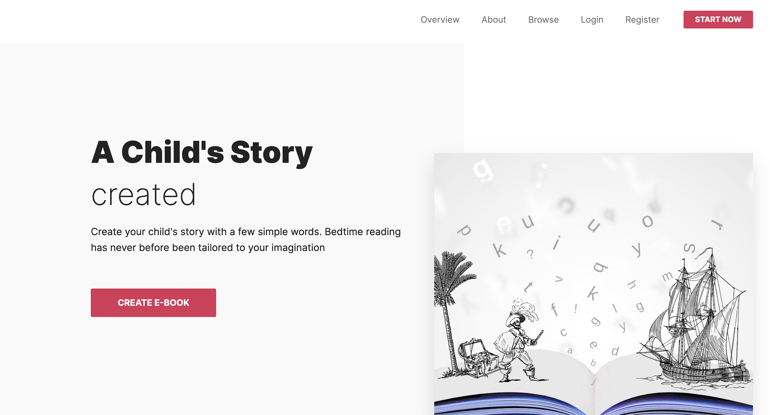
HOSTING
https://flask-ebook3.azurewebsites.net/
Azure credits ran out, going to figure out what steps to take next
Session issues prevent login for multiple users on Azure, but not locally.
Working on fix, but open to ideas.

Slide 5
FEEDBACK
FOR PARTNER | FROM Team Gladiators
Seller page is inconsistent with the other pages Text readability issues Some buggy UI elements (duplicates) | Great UI and easy to setup Website is super simple and easy to navigate Really love the idea of being able to create unique stories

