Slide 1
THE LIBRARIANS
Dexter Estrada
Kevin Ngo
Kyle Louderback
Nicholas Semaan

Slide 2
PROGRESS
​MILESTONES | COMPLETED
Registration, Login/Logout, About, and Form | DONE
Book Generation feature | DONE
Preview and Download features | DONE
Share feature | DONE

Slide 3
THIS WEEK
HOSTING
Moved hosting to another account
Using Azure Storage to store generated images
BUGS/TESTING
Fixed Registration Bug
Tested our SQLite db deployment
FRONTEND
Added images to browse section
Cleaned up pages

Slide 4
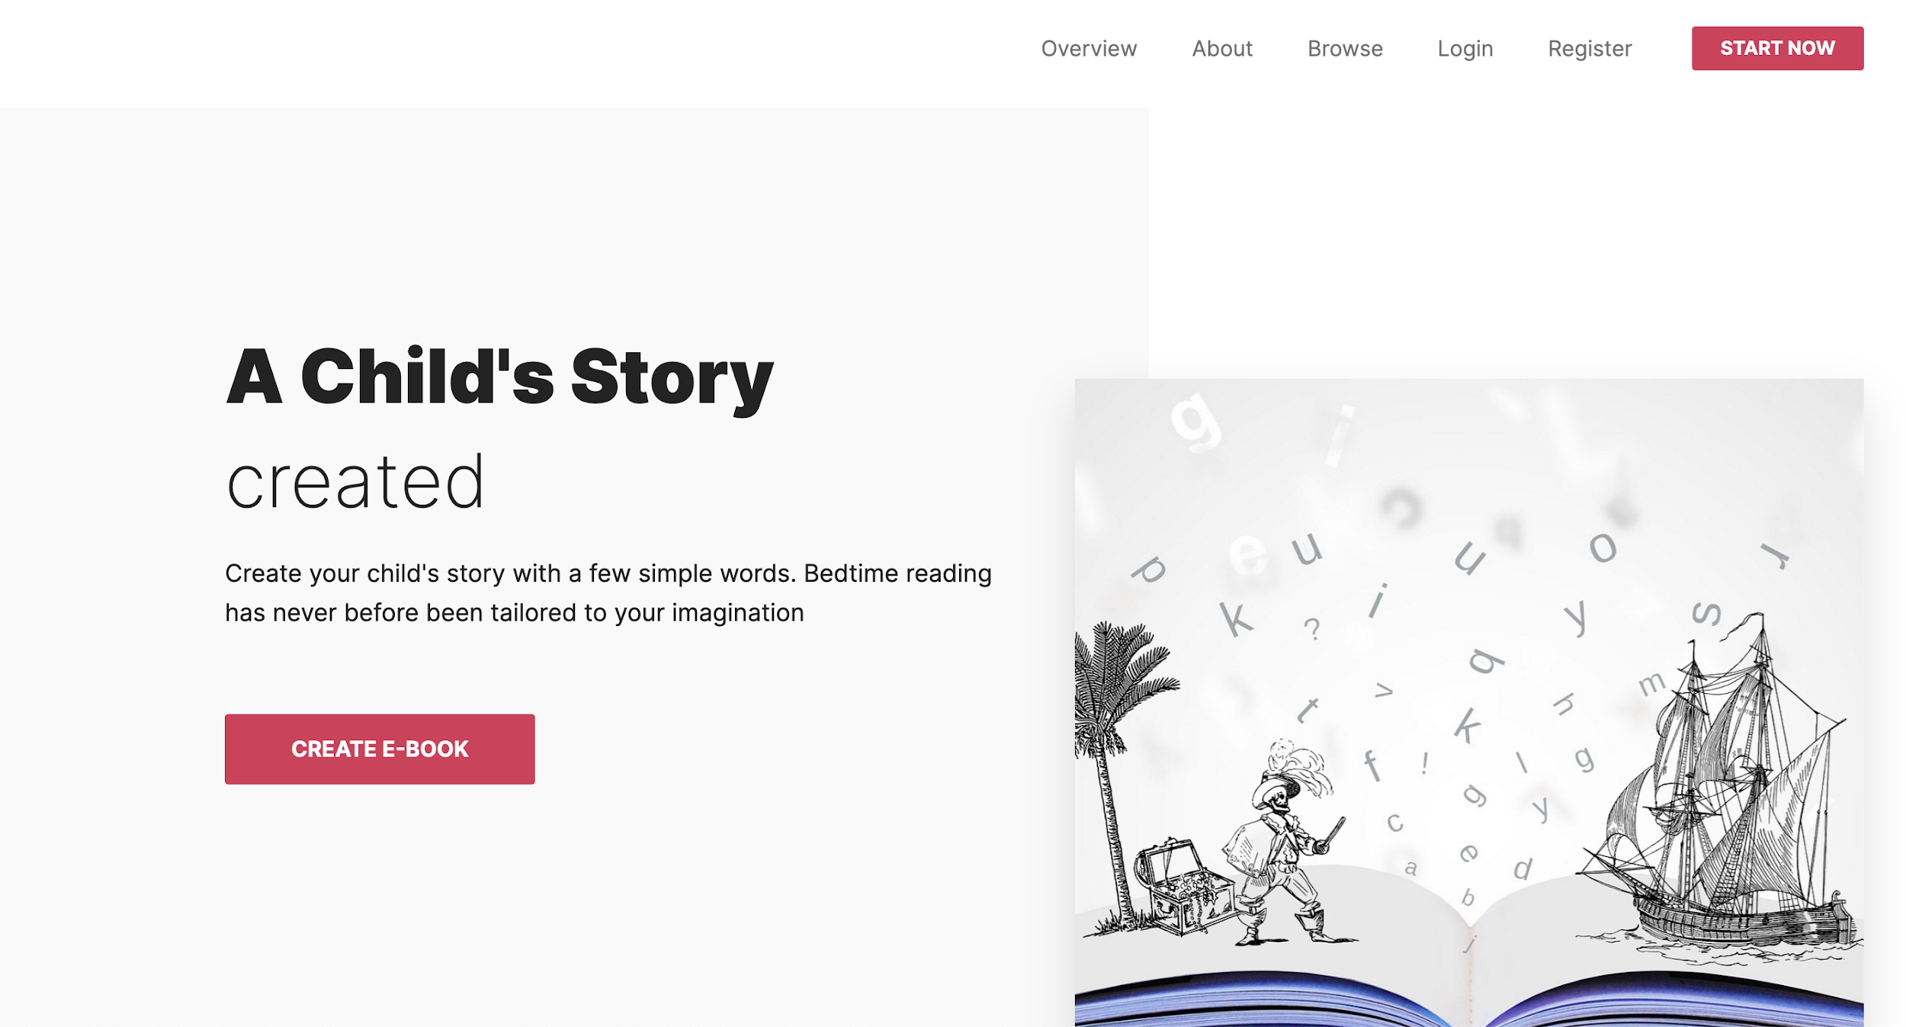
HOSTING
https://quickstory.azurewebsites.net/
Moved hosting to another Azure account.
Session issues still prevent login for multiple users on Azure, but not locally.
Guest users can still preview stories

Slide 5
FEEDBACK
FOR PARTNER | FROM Deepcourse
Quiz scores page looks better with a table or timeline Fill in the blank is too strict with grading Add to quiz feature that you need minimum 4 flashcards for it to work Add password requirements before first submission Can’t verify identity during password reset Compare answers with answer key | Footer for browse page does not sticks to the bottom Footer for About page does not have full width Forget password feature does not exist. If not exists, then it is fine to remove the button

