Slide 1
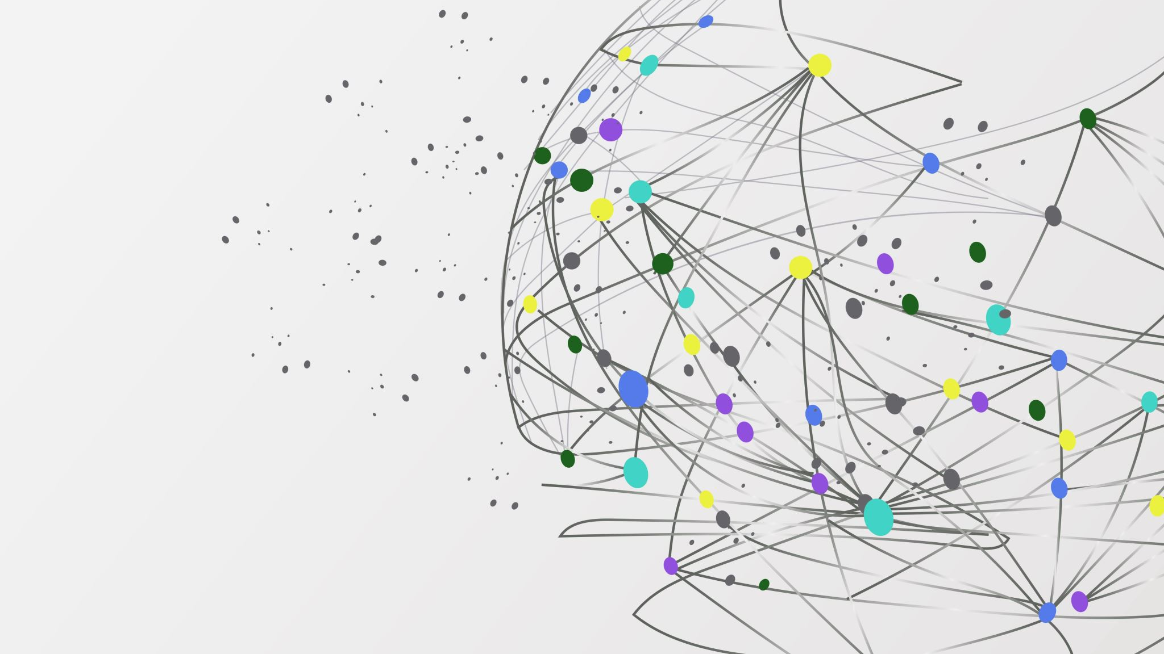

The Librarians
Dexter Estrada (Lead)
Kevin Ngo
Kyle Louderback
Nicholas Semaan

Slide 2


Progress
Name | Job
Kyle | Update README.md to match project description
Kevin | Build forms.py
Dexter | Build models.py Update project instructions
Nicolas | Continue building index.html, about.html, layout.html, form.html, register.html, login.html

Slide 3
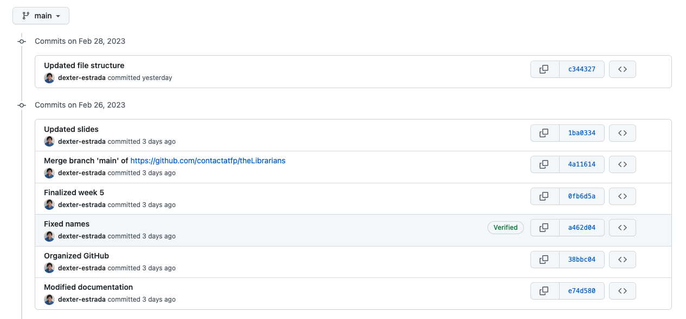
Progress
Fixed documentation based on Feedback
Adjusted documentation to GitHub https://github.com/contactatfp/theLibrarians

Slide 4


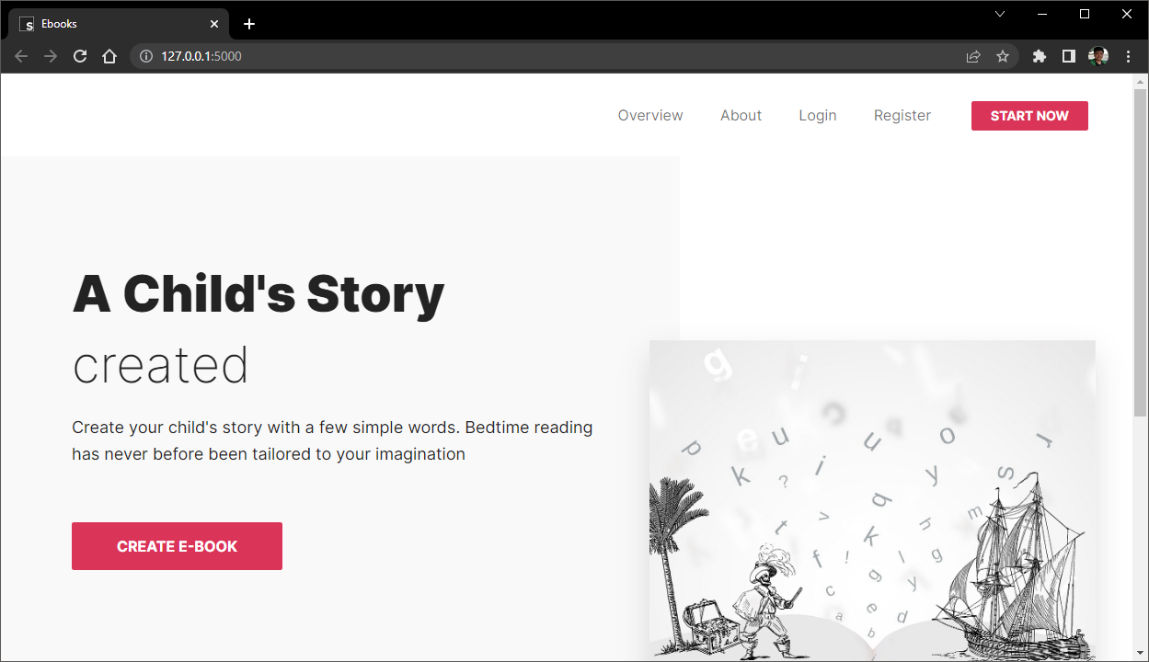
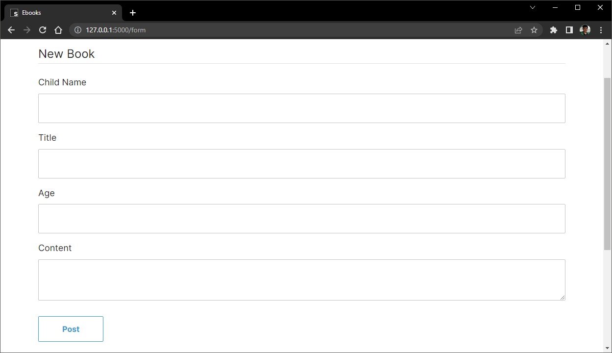
Features: Book Generation
Use Case: A user wants to generate a book and clicks on the Book link in the navigation bar. They are taken to the Book page where they fill out the form with details about the characters and settings they want in their book. The form includes fields for character names, ages, and story settings.

Slide 5
Test Plans
Registration: Verify that users can successfully create an account by filling out the registration form with their username, email, and password.
Login/Logout: Verify that users can successfully log in and out of their account to access the other features of the application.
Book Generation: Verify that the application successfully generates a children's book based on user input, including character names, ages, and story settings.
Preview: Verify that users can successfully preview the generated book and make changes if necessary.
Download: Verify that users can successfully download the generated book as a PDF.
Share: Verify that users can successfully share the generated book on social media.

Slide 6

Luna R’s Feedback
Feedback
Good idea to use openAI API
The page looks very clear and straightforward
Operation is not very complicated
You can try to let user add some images when making a new book
There is a writing error

Slide 7

Response to Feedback
Our Feedback
Thank you for your feedback. We agree that the page should be simple enough for a parent to use.
We will consider user-submitted images when generating a book.
We have noted the writing error and have fixed the issue.

