Slide 1
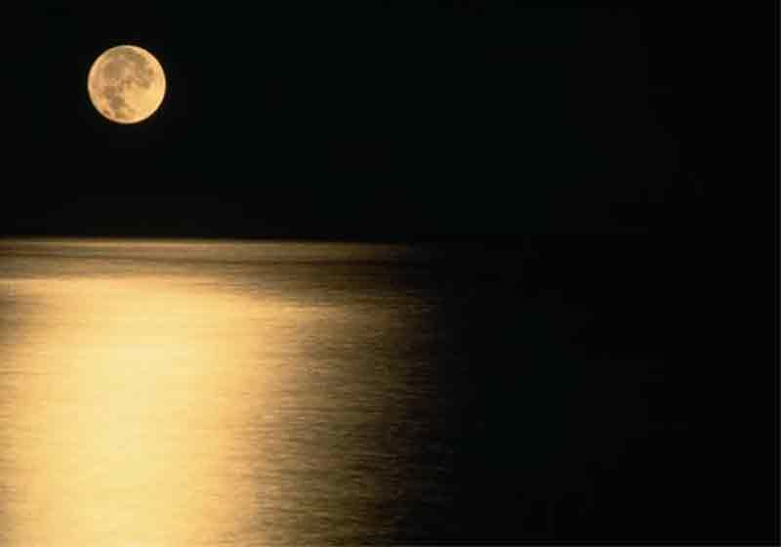
I wanted to be....
MOON LIGHT....
To bright on night of Your missunderstaded Love

Slide 2
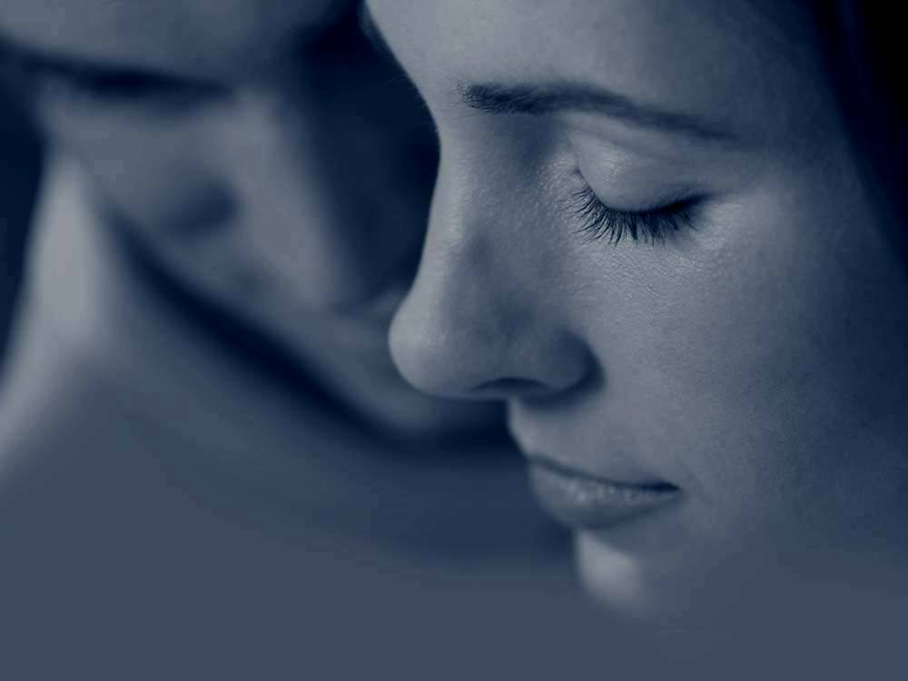
SILENCE...
To make keep silence the voices that deafen Your Loving Heart

Slide 3
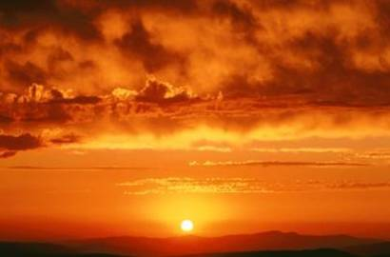
TO BE AT DAWN...
To build one more day of happiness
For You

Slide 4
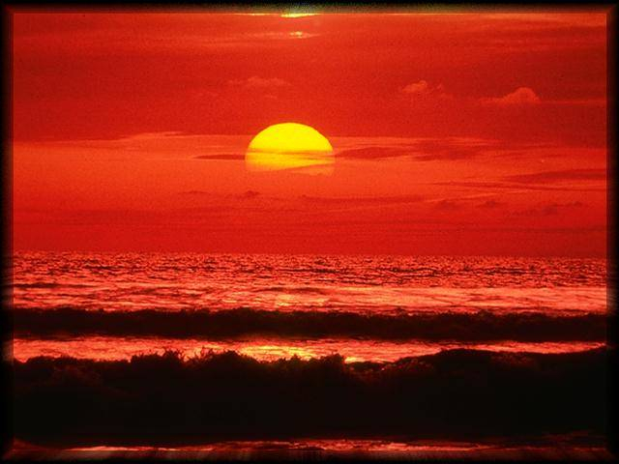
LIGHT...
To help to those who live in darkness

Slide 5
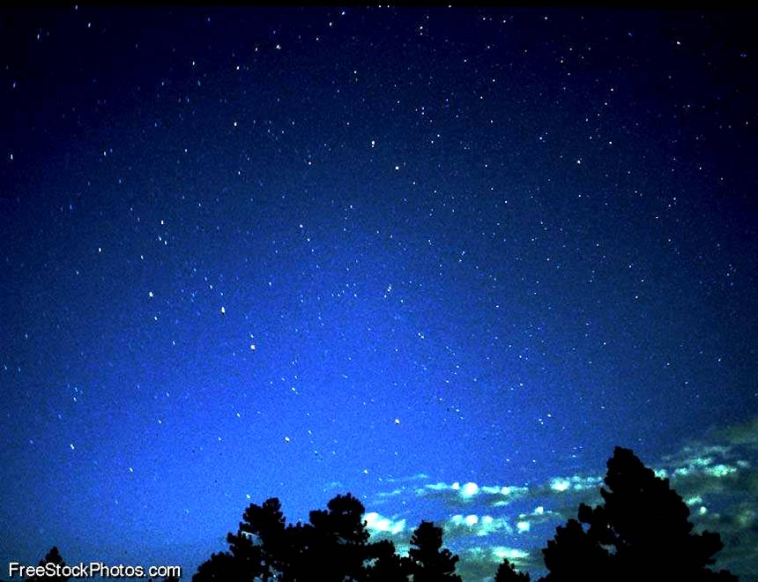
NIGHT...
To cherish You after your tired daily work

Slide 6
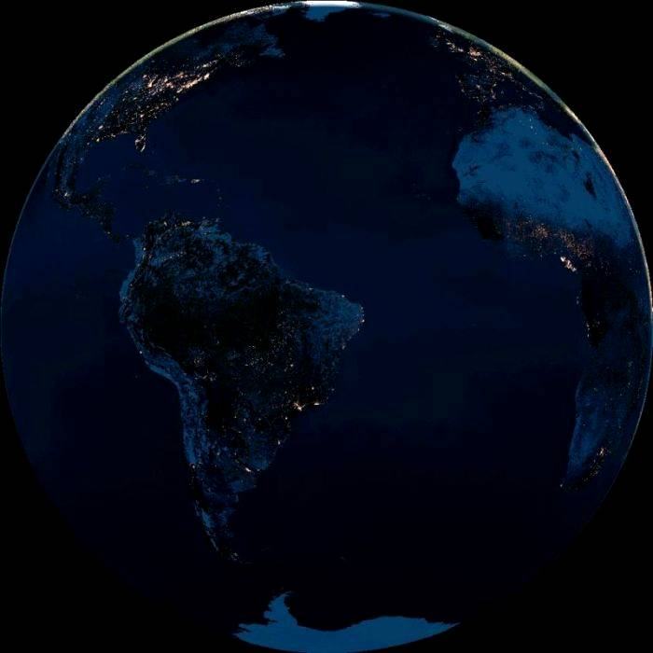
LIFE...
To reborn the souls of those who are dieying without knowing You

Slide 7
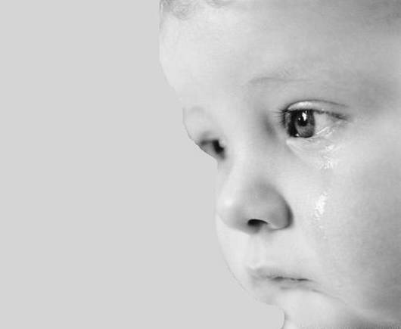
TEARS...
To make cry the insensitive hearts because they do not remember Your Love

Slide 8
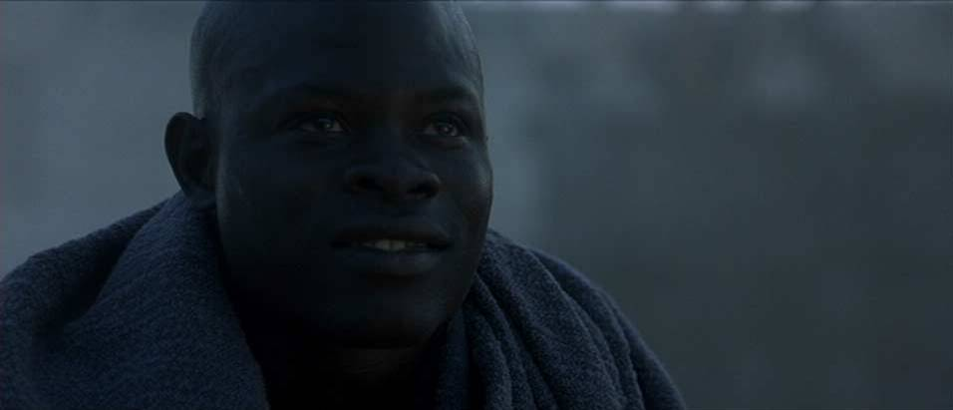
SMILE...
To sweeten bitter people’s lips

Slide 9
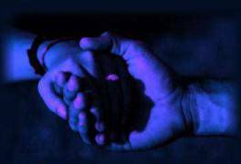
LOVE...
To unite people...
And tell them that we are just one of them, that God is inside of us and that there is hope because You saved us!!!!!

Slide 10
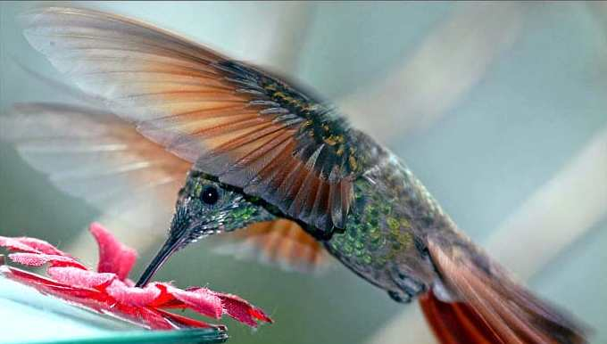
Really, dearest Master...
We only want to improve to be as you asked to us,
And as this little bird...
To go into Your window
And give you a big kiss and a big hug
And wish You today
A beautiful Happy Birthday
beloved greatest Master

