Slide 1


In the middle of the darkness ...
HAD COME the LIGHT

Slide 2
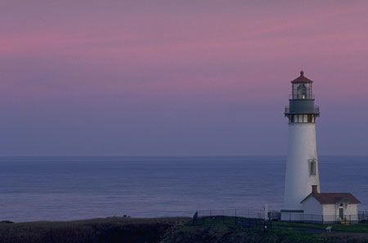


We were waiting for the grace for going back to our Home because as we forgot the Way we were lost here down.
But You descended here to help us, forgetting all Your comfort and joy, to give us the chance again to elevate our souls to be One with the Most High.
Thank You, Thank You, Thank You, Thank You, Thank You! Once again!!!!!!!

Slide 3
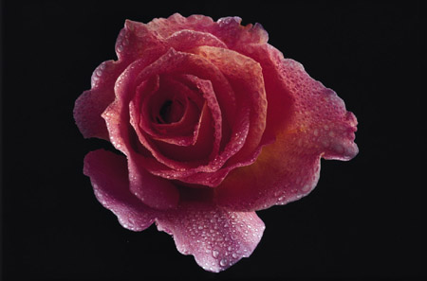
Oh, Dearest and beloved Supreme Master!
Your Panamanian Children want to express physically and spiritually our deep feelings of Love and gratitude and we wish You a wonderful time, health and Love!!!!!

Slide 4
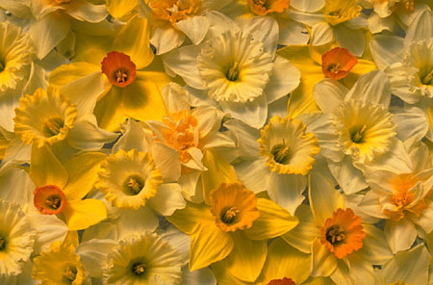
Happy, Happy, Happy Birthday and Mother’s Day!!!!!
To the most wonderful and lovely Master and Mother,
Supreme Master Ching Hai

