Slide 1
Feature Driven Development (FDD)
TEAM NEO
ANUSUYA MANICKAVASAGAM (A0163300Y)
LYDIA LIU HUAN (A0163289U)
MUNI RANJAN (A0163382E)
PRADEEP KUMAR (A0163453)

Slide 2
Content
History
Definition
Our Case
Primary Roles
Five Processes
Milestones
Pros and Cons

Slide 3
History
Original Creator: Jeff De Luca
Singapore in late 1997
FDD evolved from an actual project
Bank Loan Automation
Luca was Project manager
50 members developer team
Peter Coad : Chief Architect
- 1990’s object-oriented analysis and design expert
Notes:
Support activities for requirements specification and development

Slide 4
What is Feature and FDD?
Feature:
- Small function expressed in client-valued terms (form of a customer requirement).
- No more than two weeks to complete. If it appears to take longer, feature will be broken up into a set of smaller features.
- Expression: <action><result><object> eg: Calculate the total of a sale, Validate the password of a user
Features are to FDD as use cases are to the Rational Unified Process and user stories are to Scrum.
FDD:
- FDD is an agile software development process
- FDD is a client-centric, architecture-centric and pragmatic
- FDD was created to easily scale to much larger projects and teams
- FDD combines key advantages of other popular agile approaches along with other industry-recognized best practices
Notes:
they're a primary source of requirements and the primary input into your planning efforts.

Slide 5
Our case – product nEO
VISION
To create a safe environment for infants whose parents are working.
OBJECTIVE
To create a smart monitoring system to alert parents if there are any distress situations.
DATA MODELING
Gather and analyze the audio data to train systems to achieve high accuracy in classifying the child crying data.

Slide 6
Primary Roles
Six Roles
Project Manager
Chief Architect
Development Manager
Chief Programmers
Class Owners (aka Developers)
Domain Experts
Notes:
Class assigned to specific developer
Class owner responsible for all changes in implementing new features
Class Ownership does not imply exclusivity but only responsibility

Slide 7
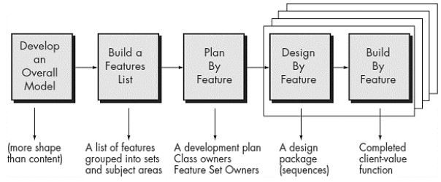
Five Processes
Design Activities
Deliver the System
Features by Feature
Notes:
Project wide upfront design activities. Goal: not to design the system in its entirety but instead is to do just enough initial design that you are able to build on
Goal: Deliver real, completed, client-valued function as often as possible

Slide 8

Plan by Feature
In our product NEO context:
- Analyze sounds of babies
- Predict crying moments of babies
- Provide registration of users
- Send notification to users
- Preview clips to users

Slide 9

Reporting & Milestones
FDD emphasizes the ability to provide accurate, meaningful, and timely progress information to all stakeholders within and outside the project.
Feature Millstones

Slide 10

Pros & cons
Risk Reduction via iteration of design & build in small chunks.
Clarity of requirements and better understanding of system to be built is gained through the Develop Overall Model process.
Not as powerful on smaller projects.
High reliance on chief programmer. He act as coordinator, lead designer, and mentor.
Notes:
1. Visibility of progress and results

Slide 11
References
http://sliitmscfdd.wikidot.com/introduction-to-fdd
http://agilemodeling.com/essays/fdd.htm
https://en.wikipedia.org/wiki/Feature-driven_development
https://blogs.msdn.microsoft.com/nickmalik/2005/04/10/a-direct-comparison-between-fdd-and-traditional-wbs/

Slide 12


