Slide 1

AKASHAY HIRE (A0178512A), APURV GARG (A0178205E), PRADEEP KUMAR (A0163453H), MUNI RANJAN (A0163382E), XIANG XUEMENG (A0178419R), LIANG SHIZE (A0178178M), GENG HUI (A0178516W)

Slide 2
On A Timeline
2015 – Started working with Autodesk first ML project as Sr. SDET
2016 – Released first version of design graph a 3D shape based search application
Highly interesting domain & I decided to pursue academic degree
Took entrance exam same year in National University of Singapore
Started my Academic Journey of 2.5 years at NUS
In Autodesk started working as Engineering Manager for Data Reporting platform Token flex
1

Slide 3
My NUS Journey
Jan 2017-June 2017 – Covered Basic Data Analytics, Campaign Management and CRM
July 2017 – Dec2017 – Text Mining, Web Analytics, Time Series, Decomposition, Decision trees and other classification
Jan 2018 – June 2018 – Data Visualization (Tableau), Unsupervised learning
July 2018 –Dec 2019– Operations Research, Service Analytics, Research module on Video Analytics
Jan 2019 – Apr 2019 – Final year project, Violet event detection ensemble technique using Audio and Video

Slide 4
Study Charter In NUS
3 Module Every Semester
Open Data Research
Business/Product domain analytics
Hypothesis/Validation
Exam at the Semester End

Slide 5
Solution
A technology-driven retail store which orders, delivers, manage inventory in a seamless manner
TAKE DELIVERY ORDER TILL 10 PM
DELIVER NEXT MORNING BEFORE 8 AM
NO DELIVERY CHARGES
1

Slide 6
Market Validation
Launched Website
On 5th March
www.morningmartlah.com
Covered 1 Condo
532 units
Parkview Apartment
10 Customers
4 recurring
Positive Feedback and validates
our hypothesis
1

Slide 7
Market Size
S$6.52 Billion Food Products
S$500M
Dairy Products
S$250M
Drinking Milk Products
https://gain.fas.usda.gov/Recent%20GAIN%20Publications/Retail%20Foods_Singapore_Singapore_6-29-2018.pdf
DBS - FnB_SG_Consumer_Midstream_2016-05
1

Slide 8


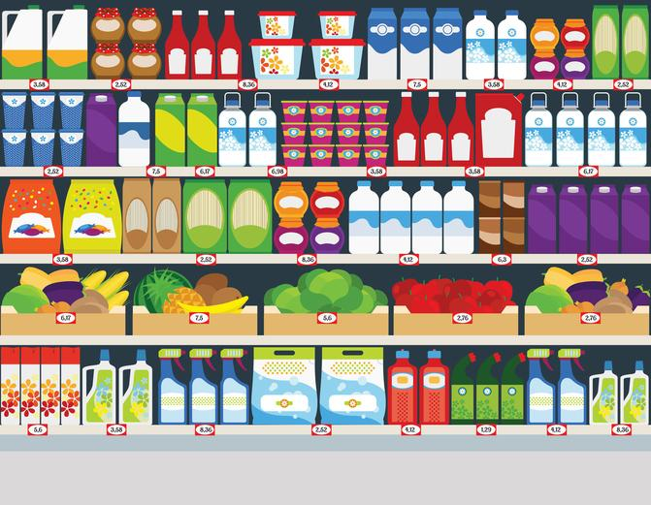
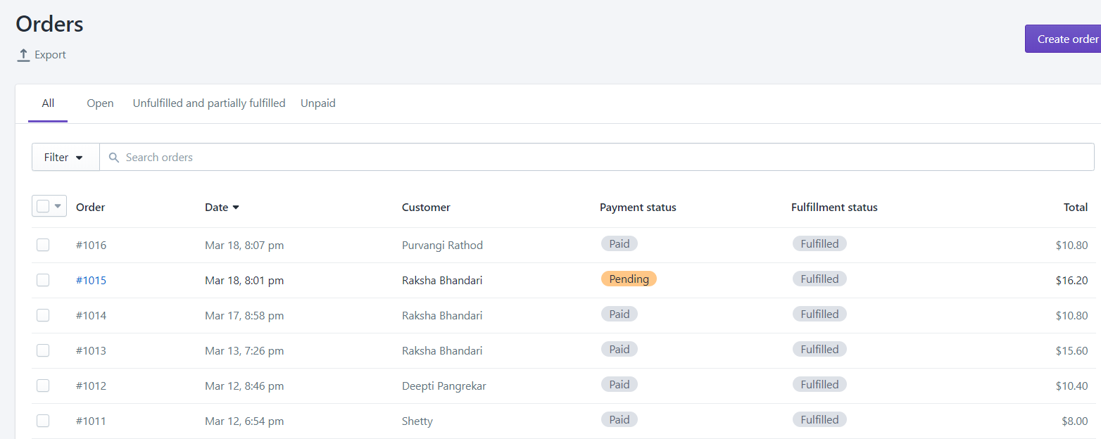
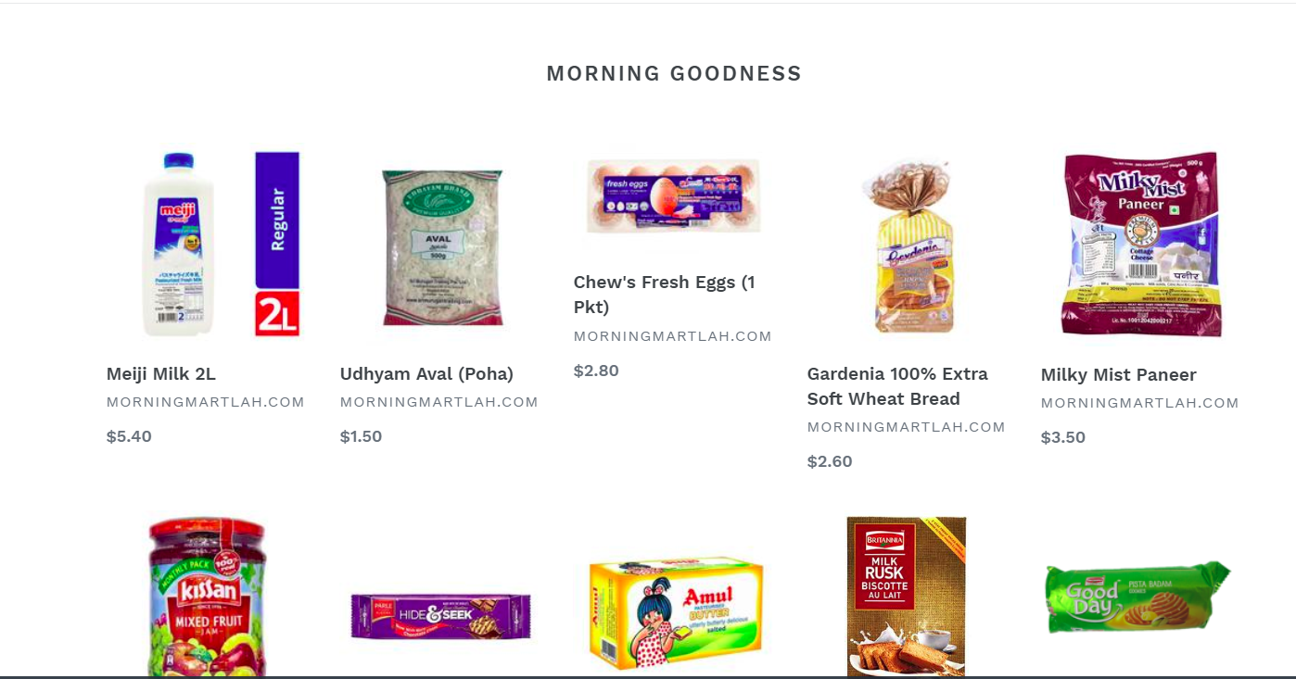
Product
VALUE CHAIN FRAMEWORK
1

Slide 9
Business Model
We make profit by charging the margin in wholesale price v/s retail, card discounts by able to convince customers to subscribe to the daily, twice a week, once a week, ad-hoc delivery options
20% Purchase Margin
10% expense in delivery
5% Technology
5% Profit
1

Slide 10



Competition
1

Slide 11
Competitive Advantage
Solves current challenges with Competitors
Unique Optimized Supply Chain Solution
Easier than now for Customers
Empower Small Marts/Store
1

Slide 12
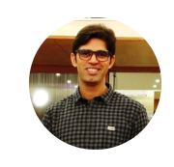





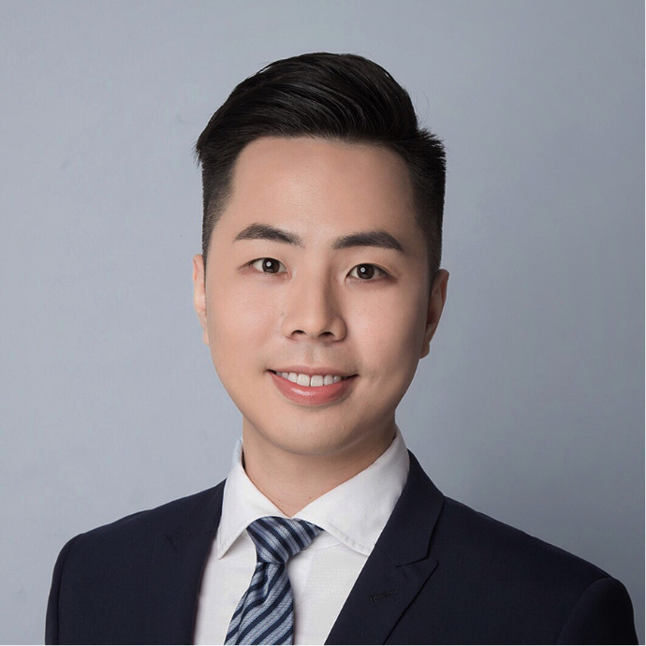
Team
Akshay Hire, CEO
Chief Executive Officer
Pradeep Kumar, CPO
Chief Product Officer
Apurv Garg, CDO
Chief Digital Officer
Muni Ranjan, CDS
Chief Data Scientist
Geng Hui, Chief HR
Chief Human resources Officer
Xiang Xuemeng, CTO
Chief Technology Officer
Shize Liang, CMO
Chief Marketing officer
1

Slide 13


AKASHAY HIRE (A0178512A), APURV GARG (A0178205E),
PRADEEP KUMAR (A0163453H), MUNI RANJAN (A0163382E),
XIANG XUEMENG (A0178419R), LIANG SHIZE (A0178178M),
GENG HUI (A0178516W)
1

