Slide 1



Infant Smart Monitoring System (Phase 2)
Team Name: Neo | EBAC4 | 27/08/2018
[e0146864, e0146946, e0147017, e0146771] @u.nus.edu

Slide 2
AGENDA
Recap
Phase 2 Objectives-Status
Updated Modeling
Results Comparisons
Web App Development
Demo
Challenges
Future Plan

Slide 3
RECAP
Defined the business objective
Built corresponding system diagram
Initial Data Gathering
Audio Feature Extraction
Applied Simple Modelling
Result Analysis
Research in future techniques

Slide 4
APPROACH
Audio Stream Analysis
Intel Robotic Development Kit
Test and Deploy
Data analysis and Modeling

Slide 5


Phase 2 Objectives achieved
Planned Objectives | Status
Deploy on realsense
Live Stream Capture
Data improvements
Improve accuracy
Unplanned Objectives | Status
End to End System

Slide 6
Data Improvements
1

Slide 7
Initial Data Exploration
Current dataset has been taken from public git repo dataset:
https://github.com/karoldvl/ESC-50/tree/master/audio
https://github.com/giulbia/baby_cry_detection/tree/master/data/301 - Crying baby
Total Sample size | 2540
Crying Baby Data set | 580
Non Crying data consists of | Animal sounds, baby laugh, machine & others

Slide 8
Modeling
2

Slide 9
Data Modeling- achieved in Phase I
Based on: Yizhar Lavner, R. C. (2016). Baby cry detection in domestic environment using deep learning. ICSEE. IEEE.
Feature Extracted as MFCC, ZCR, Spectral Roll off, STE, Harmonic and Pitch
Outlier detected using box plots and removed
Applied Random Forest, Logistics regression, SVM & Neural Network

Slide 10
Modeling Approach
The dataset was divided into training and test dataset
Data was tried in different ratios like 70:30, 80:20 & 90:10
Initially neural network model was fitted with three different solvers: Adam, SGD & lbfgs. Adam was better among the three solvers, however random forest was giving better results due to low volume of data.
SVM gave least accuracy as compared to others including Logistic Regression.

Slide 11
Result Comparison
3

Slide 12
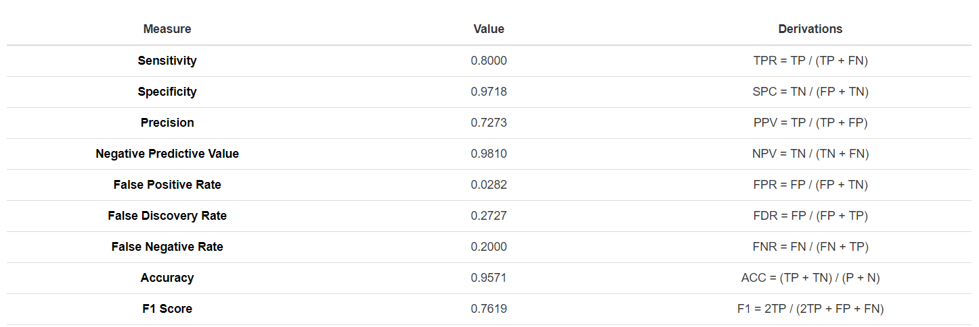
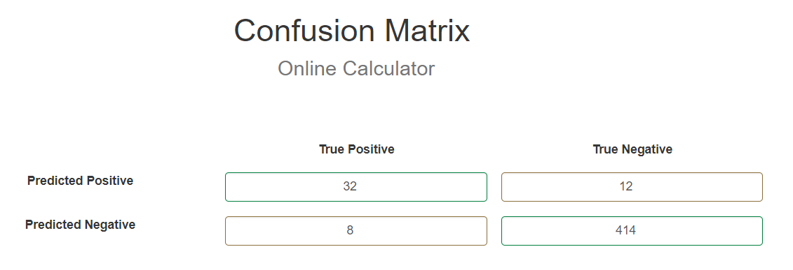
Phase I- result analysis

Slide 13
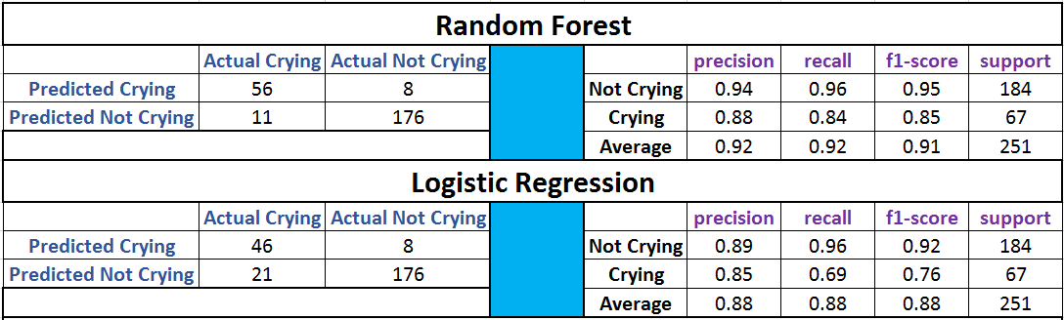
Phase II-Result comparison with different Analytics Engine

Slide 14
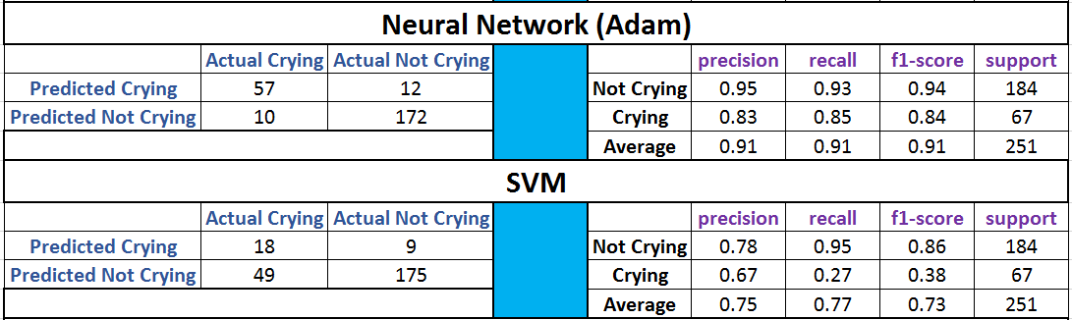
Phase II-Result comparison with different Analytics Engine

Slide 15
Web Development
4

Slide 16
Web Development
Built a frontend/backend interface to capture audio and to decide cry/no cry.
Generate Alerts over SMS using Twilio integrated with the Python code.
Web application using NodeJS and ReactJS to display data on dashboard.
Technical Stack – Python/NodeJS/JavaScript

Slide 17
Demo
5

Slide 18
Challenges
6

Slide 19
Challenges
Collection of large dataset with crying and non-crying dataset.
Manual tagging of dataset into crying and non-crying
Mimicry of crying dataset to be tagged as non-cry.
Context switching and parallel work hampers productivity

Slide 20
Next Milestone
7

Slide 21
Next Milestone
Phase 1
User problem definition
Task identifications
Initial data gathering
Study the paper
Feature Understanding
Initial Prototype to extract feature/modeling
Phase 2
Models Deployed on intel realsense board
Data enhancement
Live Stream capture and data gathering
Initial Neural Network Modeling
Updated Modelling Assessment
Phase3
Finalize the modelling train/improvement
End to End system validation
Feedback Loop
Ensemble Methods using Video**
Final Project Report

Slide 22
Monthly Project Plan
User Problem
Deploy on realsense board
Live Stream capture support
Project Plan
Neural Network Model
Data finding
Deploy on the board
Data Exploration
Milestone 3
Alert notify
Attach clip
End 2 End deploy
Initial Modelling
Fixing bugs and E2E system
2018
Month 1
2
3
4
5
6
7
8
9
10
11
12
April
Milestone 1
August
December
Milestone 2
Milestone 3
Notes:
If we are not getting accuracy from machine learning classfiers like SVM, naïve baiyes random forest, we will try deep learning methods.

Slide 23
Project Documentation
https://bitbucket.org/teamneo/myhappybaby
https://trello.com/#
https://docs.google.com

Slide 24
THANKS!
Q/A

