Slide 1
Kitsune: An Ensemble of
Autoencoders for Online
Network Intrusion Detection
Yisroel Mirsky, Tomer Doitshman, Yuval Elovici and Asaf Shabtai
Ben-Gurion University of the Negev

Slide 2
THE PROBLEM STATEMENT

Slide 3
•Neural networks have become an increasingly popular solution for network intrusion detection systems (NIDS).
•Their capability of learning complex patterns and behaviors make them a suitable solution for differentiating between normal traffic and network attacks.
•However, a drawback of neural networks is the amount of resources needed to train them.

Slide 4
•Meaning that an expert must label the network traffic and update the model manually from time to time.
•Kitsune is a plug and play NIDS which can learn to detect attacks on the local network, without supervision, and in an efficient online manner.
•Kitsune’s core algorithm (KitNET) uses an ensemble of neural networks called autoencoders to collectively differentiate between normal and abnormal traffic patterns.

Slide 5
•KitNET is supported by a feature extraction framework which efficiently tracks the patterns of every network channel.
•The paper evaluations show that Kitsune can detect various attacks with a performance comparable to offline anomaly detectors, even on a Raspberry PI.

Slide 6
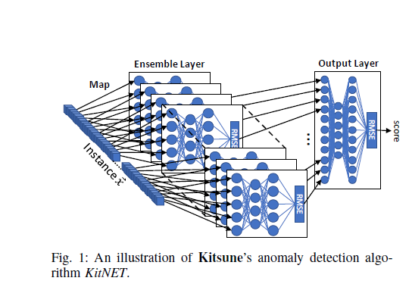

Slide 7
I. INTRODUCTION

Slide 8
•An NIDS is a device or software which monitors all traffic passing a strategic point for malicious activities. When such an activity is detected, an alert is generated, and sent to the administrator.
•Conventionally an NIDS is deployed at a single point, for example, at the Internet gateway. This point deployment strategy can detect malicious traffic entering and leaving the network, but not malicious traffic traversing the network itself.

Slide 9
•To resolve this issue, a distributed deployment strategy can be used, where a number of NIDSs are be connected to a set of strategic routers and gateways within the network.
•One popular approach is to use an artificial neural network (ANN) to perform the network traffic inspection.

Slide 10
•The benefit of using an ANN is that ANNs are good at learning complex non-linear concepts in the input data.
•This gives ANNs a great advantage in detection performance with respect to other machine learning algorithms
•The prevalent approach to using an ANN as an NIDS is to train it to classify network traffic as being either normal or some class of attack

Slide 11
•The following shows the typical approach to using an ANN-based classifier in a point deployment strategy:
1) Have an expert collect a dataset containing both normal traffic and network attacks.
2) Train the ANN to classify the difference between normal and attack traffic, using a strong CPU or GPU.
3) Transfer a copy of the trained model to the net-work/organization’s NIDS.
4) Have the NIDS execute the trained model on the observed network traffic.

Slide 12
•In general, a distributed deployment strategy is only practical if the number of NIDSs can economically scale according to the size of the network.
•It is also not practical to embed the NIDSs directly into inexpensive routers (i.e., with simple hardware).

Slide 13
Ideal characteristics of distributed NIDS
a)Online Processing. After the training or executing the model with an instance, the instance is immediately discarded. In practice, a small number of instances can be stored at any given time, as done in stream clustering [12].

Slide 14
Unsupervised Learning. Labels, which indicate explicitly whether a packet is malicious or benign, are not used in the training process. Other meta information can be used so long as acquiring the information does not delay the process.

Slide 15
Low Complexity. The packet processing rate must exceed the expected maximum packet arrival rate. In other words, we must ensure that there is no queue of packets awaiting to be processed by the model.

Slide 16
In this paper, we present Kitsune: a novel ANN-based NIDS which is online, unsupervised, and efficient. A Kitsune, in Japanese folklore, is a mythical fox-like creature that has a number of tails, can mimic different forms, and whose strength increases with experience. Similarly, Kitsune has an ensemble of small neural networks (autoencoders), which are trained to mimic (reconstruct) network traffic patterns, and whose performance incrementally improves overtime.

Slide 17
The architecture of Kitsune’s anomaly detection algorithm (KitNET) is illustrated in Fig. 1. First, the features of an instance are mapped to the visible neurons of the ensemble.
Next, each autoencoder attempts to reconstruct the instance’s features, and computes the reconstruction error in terms of root mean squared errors (RMSE).

Slide 18
Finally, the RMSEs are forwarded to an output autoencoder, which acts as a non-linear voting mechanism for the ensemble. We note that while train-ing Kitsune, no more than one instance is stored in memory at a time.
KitNET has one main parameter, which is the maximum number of inputs for any given autoencoder in the ensemble. This parameter is used to increase the algorithm’s speed with a modest trade off in detection performance.

Slide 19
The reason we use autoencoders is because (1) they can trained in an unsupervised manner, and (2) they can be used for anomaly detection in the event of a poor reconstruction.
The reason we propose using an ensemble of small autoencoders, is because they are more efficient and can be less noisier than a single autoencoder over the same feature space.

Slide 20
From our experiments, we found that Kitsune can increase the packet processing rate by a factor of five, and provide a detection performance which rivals other an offline (batch) anomaly detectors.

Slide 21
In summary, the contributions of this paper as follows:
A novel autoencoder-based NIDS for simple network de-vices (Kitsune), which is lightweight and plug-and-play. To the best of our knowledge, we are the first to propose the use of autoencoders with or without ensembles for online anomaly detection in computer networks. We also present the core algorithm (KitNET) as a generic online unsupervised anomaly detection algorithm, and provide the source code for download.1

Slide 22
A feature extraction framework for dynamically main-taining and extracting implicit contextual features from network traffic. The framework has a small memory footprint since the statistics are updated incrementally over damped windows.

Slide 23
Features Extracted for Kitsune: Whenever a packet arrives, we extract a behavioral snapshot of the hosts and protocols which communicated the given packet. The snapshot consists of 115 traffic statistics capturing a small temporal window into
(1) the packet’s sender in general
(2) the traffic between the packet’s sender and receiver. Specifically, the statistics summarize all of the traffic.

Slide 24
In order to extract the current behavior of a data stream, we must forget older instances. The naive approach is to maintain a sliding window of values. However, this approach has a memory and runtime complexity of O(n), in contrast to O(1) for an incremental statistic. Furthermore, the sliding window approach does not consider the amount of time spanned by the window. For example, the last 100 instances could have arrived over the last hour or in the last few seconds

Slide 25
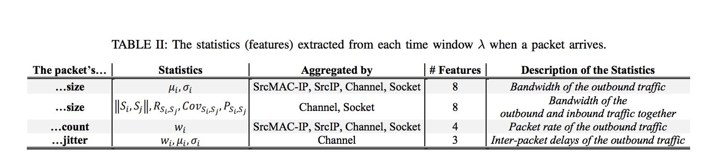

Slide 26
An online technique for automatically constructing the ensemble of autoencoders (i.e., mapping features to ANN inputs) in an unsupervised manner. The method involves the incremental hierarchal clustering of the feature-space (transpose of the unbounded dataset), and bounding of cluster sizes.

Slide 27
Experimental results on an operational IP camera video surveillance network, IoT network, and a wide variety of attacks. We also demonstrate the algorithm’s efficiency, and ability to run on a simple router, by performing benchmarks on a Raspberry PI.

Slide 28
KitNET is available for download at: https://github.com/ymirsky/KitNET-py.
2
of packet content [18] or the kNN algorithm [19]. These methods are either very simple and therefore produce very poor results, or require accumulating data for the training or detection.

Slide 29
III. BACKGROUND:
AUTOENCODERS

Slide 30
•Autoencoders for anomaly detection – reconstruction error TBC
•Autoencoders are the foundation building blocks of Kitsune.
•We note that autoencoders can be deep (have many hidden layers).

Slide 31
In general, deeper and wider networks can learn concepts which are more complex. However, as shown above, deep networks can be computationally expensive to train and execute.
This is why in KitNET we ensure that each autoencoder is limited to three layers with at most seven visible neurons.

Slide 32
THE KITSUNE NIDS
Working
•Kitsune NIDS covers the packet preprocessing framework, the feature extractor, and the core anomaly detection algorithm.
•Kitsune is a plug-and-play NIDS, based on neural net-works, and designed for the efficient detection of abnormal patterns in network traffic.

Slide 33
It operates by (1) monitoring the statistical patterns of recent network traffic, and (2) detecting anomalous patterns via an ensemble of autoencoders. Each autoencoder in the ensemble is responsible for detecting anomalies relating to a specific aspect of the network’s behavior. Since Kitsune is designed to run on simple network routers, and in real-time, Kitsune has been designed with small memory footprint and a low computational complexity.

Slide 34
Components
Kitsune’s framework is composed of the following components:
•Packet Capturer: The external library responsible for acquiring the raw packet ex wireshark.
•Packet Parser: The external library responsible for parsing raw packets to obtain the meta information required by the Feature Extractor. Example libraries: Packet++3, and tshark.

Slide 35
•Feature Extractor (FE): The component responsible for extracting n features from the arriving packets to create creating the instance . The features of describe the packet, and the network channel from which it came.
•Feature Mapper (FM): The component responsible for creating a set of smaller instances (denoted as v) from , and passing v to the in the Anomaly Detector (AD). This component is also responsible for learning the mapping, from to v.

Slide 36
•Anomaly Detector (AD): The component responsible for detecting abnormal packets, given a packet’s representation
•Since the Packet Capturer and Packet Extractor are not the contributions of this paper, we will focus on the FE, FM, and AD components.

Slide 37
•We note that FM and AD components are task generic (i.e., solely depend on the input features), and therefore can be reapplied as a generic online anomaly detection algorithm. Moreover, we refer to the generic algorithm in the AD component as KitNET.

Slide 38
•KitNET has one main input parameter, m: the maximum number of inputs for each autoencoder in KitNET’s ensemble.
•This parameter affects the complexity of the ensemble in KitNET. Since m involves a trade-off between detection and runtime performance, the user of Kitsune must decide what is more important (detection rate vs packet processing rate).

Slide 39
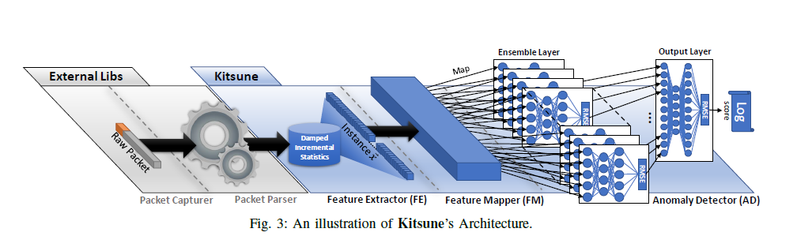
Process flow
The process which occurs when a packet acquired

Slide 40
1) The Packet Capturer acquires a new packet and passes the raw binary to the Packer Parser.
2) The Packet Parser receives the raw binary, parses the packet, and sends the meta information of the packet to the FE. For example, the packet’s arrival time, size, and network addresses.

Slide 41
3) The FE receives this information, and uses it to retrieve over 100 statistics which are used to implicitly describe the current state of the channel from which the packet came. These statistics form the instance , which is passed to the FM.
The Packet++ project can be found on GitHub: https://github.com/seladb/PcapPlusPlus

Slide 42
4) The FM receives ...
Train-mode: ...and uses to learn a feature map. The map groups features of ~x into sets with a maximum size of m each. Nothing is passed to the AD until the map is complete. At the end of train-mode, the map is passed to the AD, and the AD uses the map to build the ensemble architecture (each set forms the inputs to an autoencoder in the ensemble).
Exec-mode: ...and the learned mapping is used to create a collection of small instances v from ~x, which is then passed to the respective autoencoders in the ensemble layer of the AD.

Slide 43
5) The AD receives v...
Train-mode: if and uses v to train the ensemble layer. The RMSE of the forward-propagation is then used to train the output layer. The largest RMSE of the output layer is set as and stored for later use.
Exec-mode: and executes v across all layers. If the RMSE of the output layer exceeds , then an alert is logged with packet details.
6) The original packet, , and v are discarded.

Slide 44
Feature Extractor (FE)
•Feature extraction is the process of obtaining or engineering a vector of values which describe a real world observation.

Slide 45
•In network anomaly detection, it is important to extract features which capture the context and purpose of each packet traversing the network. For example, consider a single TCP SYN packet. The packet may be a benign attempt to establish a connection with a server, or it may be one of millions of similar packets sent in an attempt to cause a denial of service attack (DoS). As another example, consider a video stream sent from an IP surveillance camera. Although the contents of the packets are legitimate, there may suddenly appear a consistently significant rise in jitter. This may indicate the traffic is being sniffed in a man-in-the-middle attack.

Slide 46
•These are just some example of attacks where temporal-statistical features could help detect anomalies. The challenge with extracting these kinds of features from network traffic is that (1) packets from different channels (conversations) are interleaved, (2) there can be many channels at any given moment, (3) the packet arrival rate can be very high. The naive approach is to maintain a window of packets from each channel, and to continuously compute statistics over those windows. However, it clear how this can become impractical in terms of memory, and doesn’t scale very well.

Slide 47
•Kitsune includes a framework for high speed feature extraction of temporal statistics, over a dynamic number of data streams (network channels). The framework has a small memory footprint since it uses incremental statistics maintained over a damped window.

Slide 48
•Using a damped window means that the extracted features are temporal (capture the re-cent behavior of the packet’s channel), and that an incremental statistic can be deleted when its dampening weight becomes zero (saving additional memory). (A damped window model associates weights with the data in the stream, and gives higher weights to recent data than those in the past.)

Slide 49
C. Feature Mapper (FM)
The purpose of the FM is to map n features (dimensions) into k smaller sub-instances, one sub-instance for each autoencoder in the Ensemble Layer of the AD.

Slide 50
D. Anomaly Detector (AD)
As depicted in Fig. 3, the AD component contains a special neural network we refer to as a KitNET (Kitsune NETwork). KitNET is an unsupervised ANN designed for the task of online anomaly detection. KitNET is composed of two layers of autoencoders: the Ensemble Layer and the Output Layer.

Slide 51
Now that we know how to obtain the distance matrix D incrementally, we can perform agglomerative hierarchal clustering on D to find f. Briefly, the algorithm starts with n clusters, one cluster for each point represented by D. It then searches for the two closest points and joins their associated clusters. This search and join procedure repeats until there is one large cluster containing all n points. The tree which represents the discovered links is called a dendrogram (pictured in Fig. 4). For further information on the clustering algorithm, we refer the reader to [34]. Typically, hierarchal clustering cannot be performed on large datasets due to its complexity.

Slide 52
We will now detail how KitNET operates the Ensemble and Output Layers.
TBC
1) Initialization:
2) Train-mode:
3) Execute-mode:
4) Anomaly Scoring:

Slide 53
The output of KitNET is the RMSE anomaly score s 2 [0; 1)], as described in section III-E. The larger the score s, the greater the anomaly. To use s, one must determine an anomaly score cutoff threshold . The naive approach is to set to the largest score seen during train-mode, where we assume that all instances represent normal traffic. Another approach is to select probabilistically.

Slide 54
Concretely, one may (1) fit the outputted RMSE scores to log-normal or non-standard distribution, and then (2) raise an alert if s has a very low probability of occurring. A user of KitNET should decide the best method of selecting according to his/her application of the algorithm. In section V, we evaluate Kitsune’s detection capabilities based on its raw RMSE scores.

Slide 55
Evaluation
•The goal of Kitsune is to provide a light weight IDS which can handle many packets per second on a simple router.
•Given this goal, kitsune was evaluated in detecting attacks in a real IP camera video surveillance network (affecting the availability and integrity of the video uplinks).

Slide 56
Evaluation Metrics
•The output of an anomaly detector (s) is a value on the range of [0; 1), where larger values indicate greater anomalies (e.g., the RMSE of an autoencoder).
•This output is typically normalized such that scores which have a value less than 1 are normal, and greater than 1 are anomalies.
•The detection performance of an algorithm, on a particular dataset, can be measured in terms of its true positives (T P ), true negatives (T N), false positives (F P ), and false negatives (F N).

Slide 57
https://www.hindawi.com/journals/scn/2018/5483472/
https://medium.com/value-stream-design/online-machine-learning-515556ff72c5
https://www.cps-spc.org/2018/schneider.pdf

