Slide 1
Comparison of metaphorical usages of adjectives with the meaning “round” in British English and Castillian Spanish
Presented by Volkova Anastasia

Slide 2
Data collecting: English
collocation, frequency, metaphor
table, 216, 1
trip, 103, 1
tie, 51, 0
face, 48, 0
replay, 41, 0
corners, 30, 0
match, 28, 0
robin, 20, 0
victory, 20, 0
matches, 17, 0
neck, 17, 0
town, 17, 0
draw, 16, 0
figures, 16, 0
tower, 16, 0
hole, 15, 0
head, 14, 0
mile, 14, 1
cake, 13, 0
eyes, 13, 0
arches, 12, 0
clash, 11, 0
house, 11, 0
brackets, 10, 0
figure, 10, 0
numbers, 10, 1
ones, 10, 0
ship, 10, 0
shot, 10, 1
tin, 10, 0
thing, 9, 0
win, 9, 0
game, 8, 0
midnight, 8, 1
number, 8, 1
people, 8, 0
room, 8, 0
window, 8, 0
breasts, 7, 0
encounter, 7, 0
performance, 7, 1
ball, 6, 0
back, 6, 0
things, 6, 0
corner, 5, 0
hat, 5, 0
heat, 5, 0
holes, 5, 0
home, 5, 0
pond, 5, 0
run-off, 5, 0
shape, 5, 0
tablers, 5, 1
tables, 5, 1
trips, 5, 1
blob, 4, 0
battle, 4, 0
church, 4, 0
churches, 4, 0
defeat, 4, 1
earth, 4, 0
glass, 4, 0
glasses, 4, 0
heads, 4, 0
knockout, 4, 1
neckline, 4, 0
negotiations, 4, 1
objects, 4, 0
peg, 4, 0
plastic, 4, 0
replays, 4, 0
stem, 4, 0
stone, 4, 0
stones, 4, 0
teabags, 4, 0
ties, 4, 0
tombs, 4, 0
top, 4, 0
towers, 4, 0
camp, 3, 0
brush, 3, 0
building, 3, 0
boxes, 3, 0
balls, 3, 0
arches, 3, 0
aggregate, 3, 0
cheeses, 3, 0
christmas, 3, 1
circle, 3, 0
condition, 3, 1
contest, 3, 0
cup-tie, 3, 0
cutter, 3, 0
ends, 3, 0
faces, 3, 0
file, 3, 0
globe, 3, 0
houses, 3, 0
lawn, 3, 0
loaf, 3, 0

Slide 3
Data collecting: Spanish
collocation, frequency, metaphor
mesa, 3891, 1
mesas, 1903, 1
negocio, 942, 1
forma, 833, 0
números, 274, 1
formas, 270, 1
bordes, 264, 0
punta, 219, 1
esquinas, 212, 0
ojos, 177, 0
cuello, 148, 0
molde, 139, 0
rostro, 135, 0
número, 129, 1
cabeza, 115, 0
viaje, 114, 1
puntas, 95, 0
cara, 90, 0
cifras, 77, 1
piedras, 74, 0
cifra, 70, 1
cuerpo, 68, 0
gafas, 68, 0
cepillo, 65, 0
casa, 63, 0
piedra, 60, 0
tierra, 60, 0
objeto, 58, 0
bulto, 57, 0
día, 55, 1
bato, 52, 0
partido, 53, 1
película, 49, 1
rey, 49, 1
lentes, 47, 0
luna, 47, 0
semillas, 47, 0
cosa, 46, 0
letra, 46, 1
año, 44, 1
disco, 44, 0
copa, 43, 0
novela, 43, 1
obra, 43, 1
objetos, 41, 0
rocas, 41, 0
hojas, 40, 0
manchas, 40, 0
pedro, 40, 0
ventana, 39, 0
grados, 38, 0
carita, 36, 0
naglas, 36, 0
recipiente, 36, 0
moldes, 35, 0
producto, 35, 1
ángulos, 34, 0
historia, 34, 1
líneas, 34, 0
pero, 34, 0
gusano, 33, 0
noche, 33, 1
personajes, 33, 1
espejo, 32, 0
final, 32, 1
gusanos, 32, 0
mundo, 32, 1
rostros, 32, 0
tabla, 32, 0
agujero, 31, 0
superficie, 31, 0
base, 30, 0
cama, 30, 0
pan, 30, 0
templo, 30, 0
fajardo, 29, 0
bordes, 27, 0
cantos, 27, 1
capitán, 27, 0
escote, 27, 0
figuras, 27, 0
grano, 27, 0
figura, 27, 0
grano, 27, 0
parte, 27, 0
diseño, 27, 0
libro, 27, 1
ligamento, 27, 0
escudo, 26, 0
orejas, 26, 0
punto, 26, 1
pies, 25, 0
sombrero, 25, 0
aspecto, 24, 1
células, 24, 0
dolores, 24, 0
garcía, 24, 0
personajes, 24, 1
canciones, 23, 1
nariz, 23, 0

Slide 4
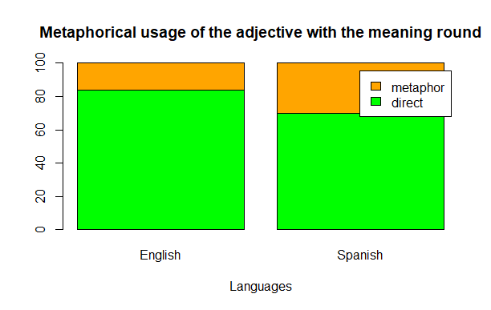
Comparing metaphorical usages

Slide 5
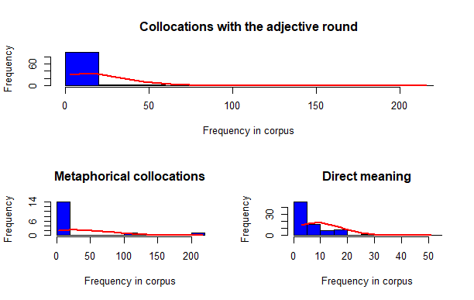
English

Slide 6
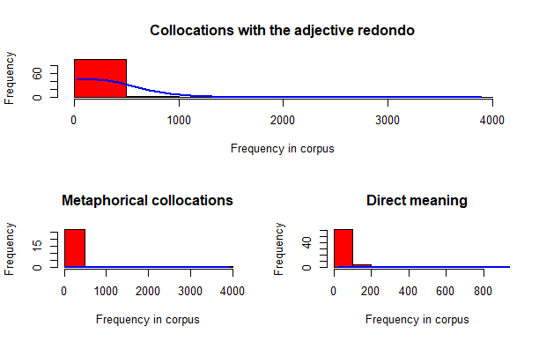
Spanish

Slide 7
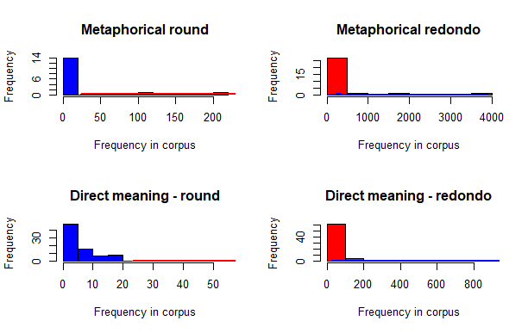

Slide 8
Thank you for attention!

