Slide 1
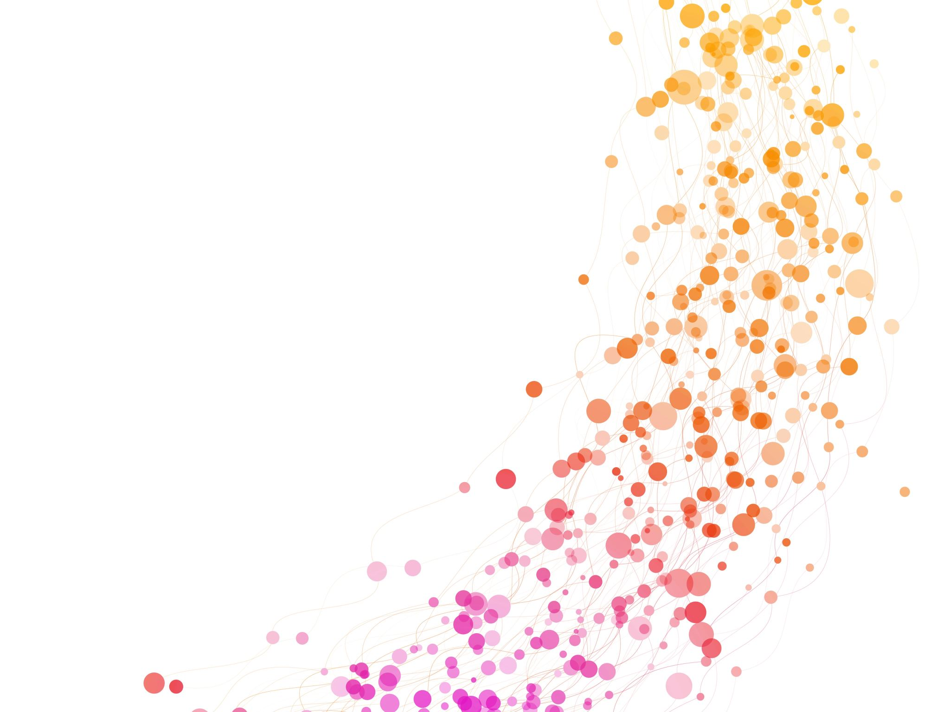
Image Cancer Classifier
1) Perceptron (Classical Supervised Machine Learning)
2) Quantum Convolutional Neural Network (QCNN) – Quantum Deep Learning
Machine Learning & Quantum Deep Learning

Slide 2
Problem: classifying esophageal cancer images in a binary manner from a dataset
Machine Learning & Quantum Deep Learning

Slide 3
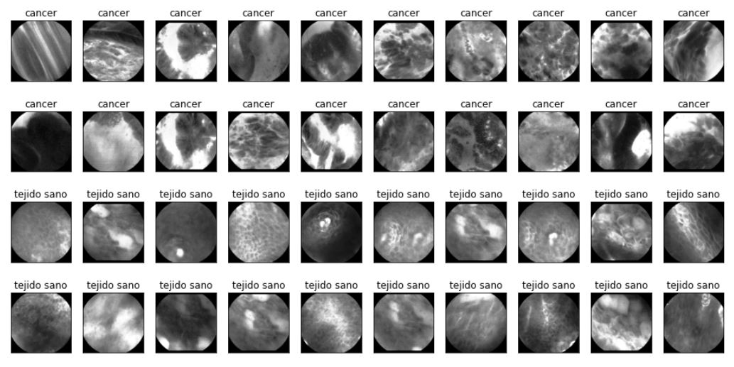
DataSet = 5063 [3, 260, 260] images
Data Challenge by Mauna Kea (Challenge Link: https://challengedata.ens.fr/participants/challenges/11/)
Machine Learning & Quantum Deep Learning

Slide 4
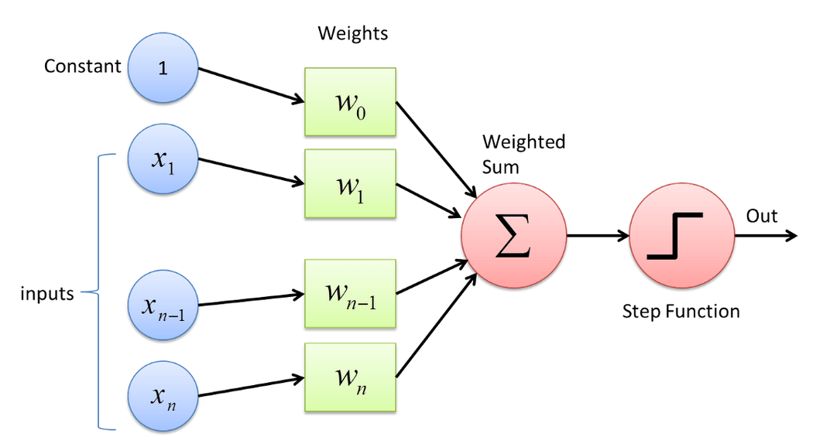
Perceptron
Supervised Learning Binary Classifier.
One-Layer Neural Network
Machine Learning & Quantum Deep Learning

Slide 5
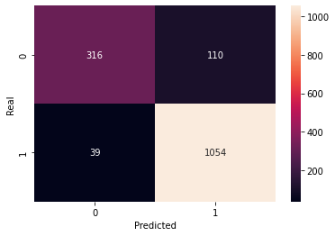
Perceptron Results
Training set
X: (3544, 67600)
Y: (3544,) Healthy Tissue: 1043 Cancer: 2501
Test set
X: (1519, 67600)
Y: (1519,) Healthy Tissue : 426 Cancer: 1093
Training Set Accuracy: 95.49%
Test Set Accuracy: 90.19%
Confusion Matrix
Machine Learning & Quantum Deep Learning

Slide 6
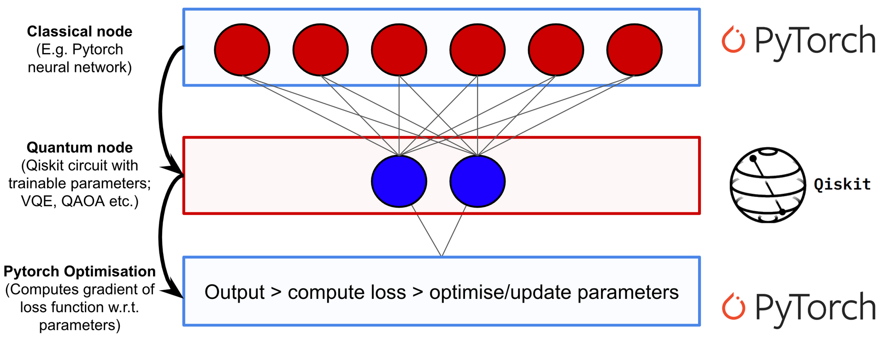
Hybrid Neural Network
Machine Learning & Quantum Deep Learning

Slide 7
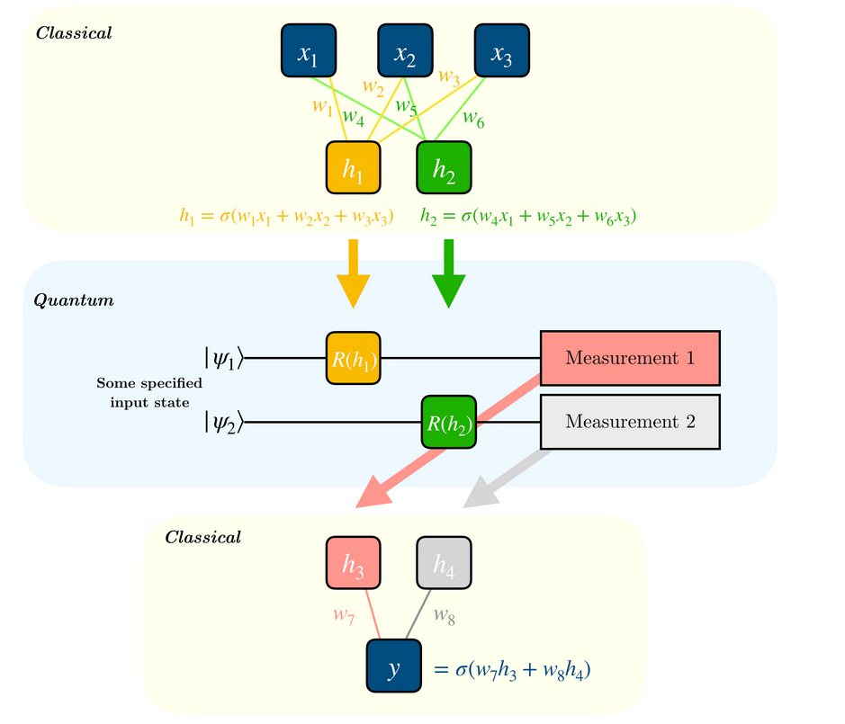
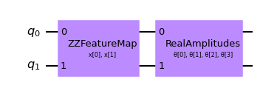
Quantum Node & Circuit
Machine Learning & Quantum Deep Learning

Slide 8
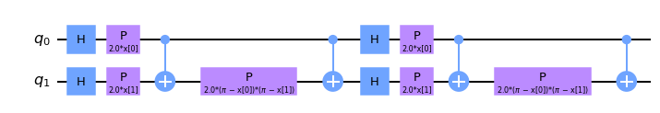
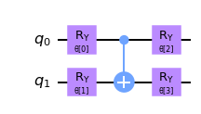
Quantum Node & Circuit Decompose
ZZFeature Map Circuit Graph
RealAmplitudes Circuit Graph
There are CNOT gates in the circuits like ZZFeatureMap and RealAmplitudes, thus the QNN makes use of entanglement.
Machine Learning & Quantum Deep Learning

Slide 9
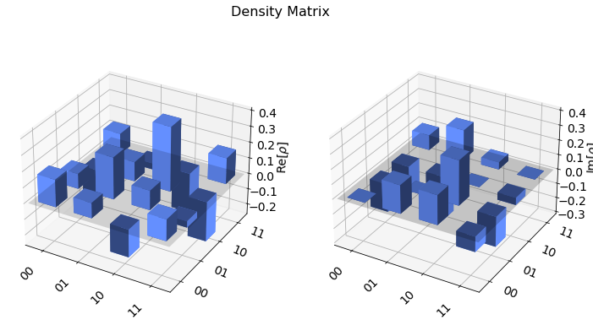
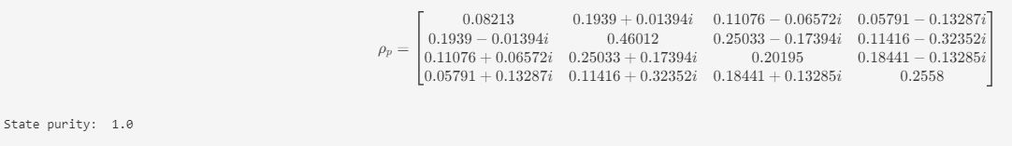
Quantum Entanglement Check
Density Matrix for random parameters between -1, 1
Machine Learning & Quantum Deep Learning

Slide 10
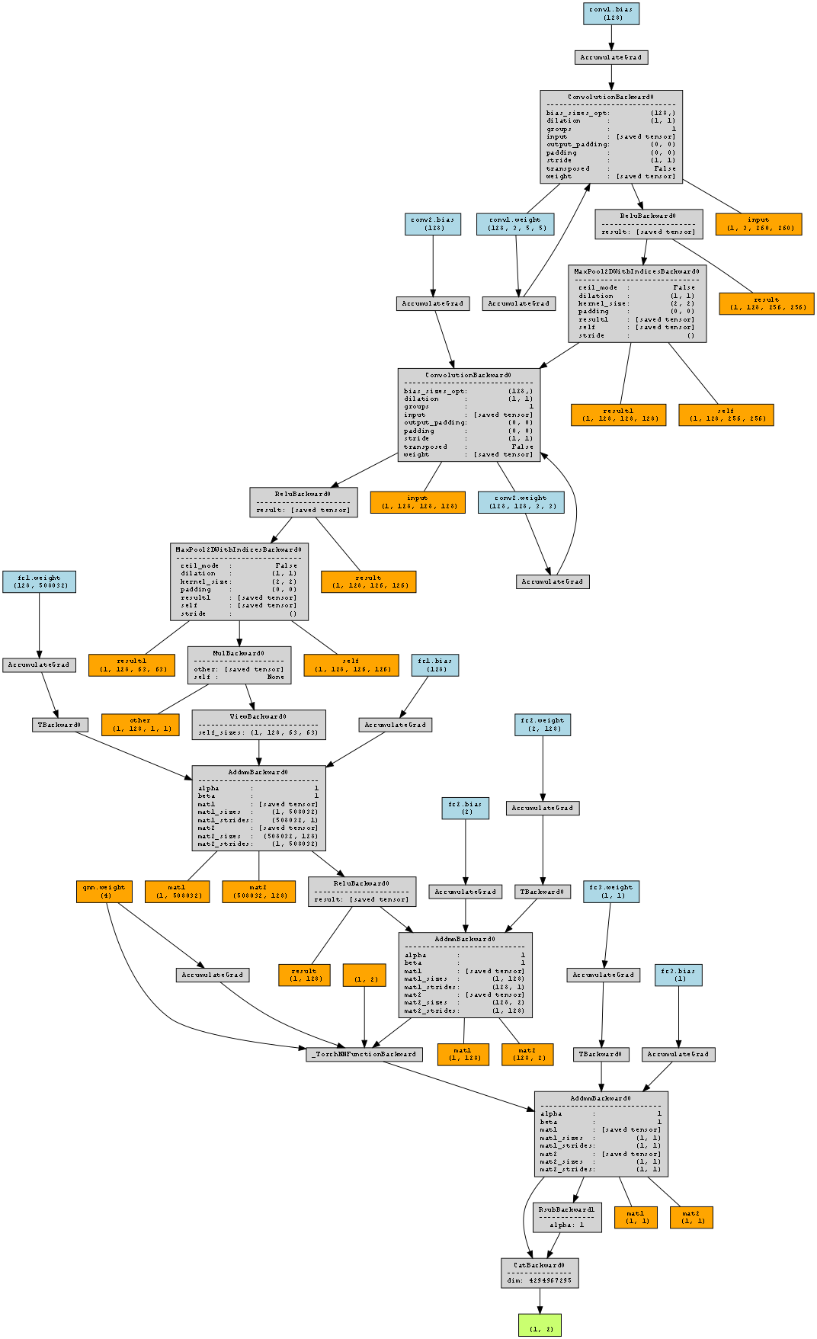
Net Overwiew
Net(
(conv1): Conv2d(3, 128, kernel_size=(5, 5), stride=(1, 1))
(conv2): Conv2d(128, 128, kernel_size=(3, 3), stride=(1, 1))
(dropout): Dropout2d(p=0.5, inplace=False)
(fc1): Linear(in_features=508032, out_features=128, bias=True)
(fc2): Linear(in_features=128, out_features=2, bias=True)
(qnn): TorchConnector()
(fc3): Linear(in_features=1, out_features=1, bias=True) )
Machine Learning & Quantum Deep Learning

Slide 11
Net Overview Summary
----------------------------------------------------------------
Layer (type) Output Shape Param #
================================================================
Conv2d-1 [-1, 128, 256, 256] 9,728
Conv2d-2 [-1, 128, 126, 126] 147,584
Dropout2d-3 [-1, 128, 63, 63] 0
Linear-4 [-1, 128] 65,028,224
Linear-5 [-1, 2] 258
TorchConnector-6 [-1, 1] 4
Linear-7 [-1, 1] 2
================================================================
Total params: 65,185,800
Trainable params: 65,185,800
Non-trainable params: 0
----------------------------------------------------------------
Input size (MB): 0.77
Forward/backward pass size (MB): 83.38
Params size (MB): 248.66
Estimated Total Size (MB): 332.82
Machine Learning & Quantum Deep Learning

Slide 12
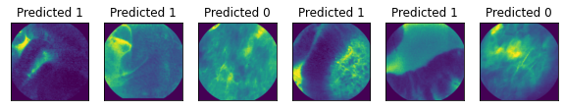
QCNN Results
Training set:
3291 images. Input Tensor[3, 260, 260]
Test set:
1772 images. Input Tensor[3, 260, 260]
Predicted Output:
Training Set Accuracy: 99.82%
Test Set Accuracy: 98.8%
Machine Learning & Quantum Deep Learning

Slide 13
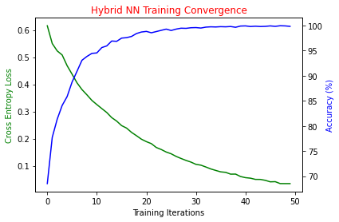
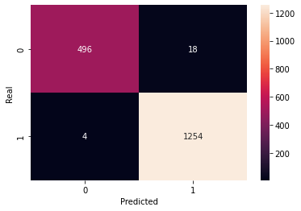
QCNN Results
Machine Learning & Quantum Deep Learning

Slide 14
Observations
-The hybrid neural network has better accuracy than the perceptron. Recall that the input to the perceptron is a matrix representing grayscale images while the input to the neural network is a [3, 260, 260] tensor.
-By vectorizing the image, the Perceptron losses information about the image, although it can be reconstructed. The hybrid neural network works with the complete information of the image.
-Could be possible to optimize hyperparameters and architecture of the quantum convolutional neural network.
-The quantum circuit could be improved with more layers.
-At the end, Quantum Entanglement is parameter binded
-This model is built only with educational purposes.
Machine Learning & Quantum Deep Learning

Slide 15
References
Hybrid quantum-classical Neural Networks with PyTorch and Qiskit: https://qiskit.org/textbook/ch-machine-learning/machine-learning-qiskit-pytorch.html
Torch Connector and Hybrid QNNs: https://qiskit.org/documentation/machine-learning/tutorials/05_torch_connector.html
The Quantum Convolution Neural Network: https://qiskit.org/documentation/machine-learning/tutorials/11_quantum_convolutional_neural_networks.html
Esophagus Cancer Classifier : https://github.com/AnIsAsPe/ClassificadorCancerEsofago
5.Machine Learning & IA for the Working Analyst - Colegio de Matemáticas Bourbaki - Mexico
- https://www.colegio-bourbaki.com/
LinkedIn: Colegio Bourbaki
6. Qiskit Slack Channel (qiskit.slack.com) - Special Thanks to Owen Lockwood & Anton Dekusar
Machine Learning & Quantum Deep Learning

