Slide 1
Learning Compositional Rules via Neural Program Synthesis
Maxwell Nye, Armando Solar-Lezama,
Josh Tenenbaum, Brenden Lake

Slide 2
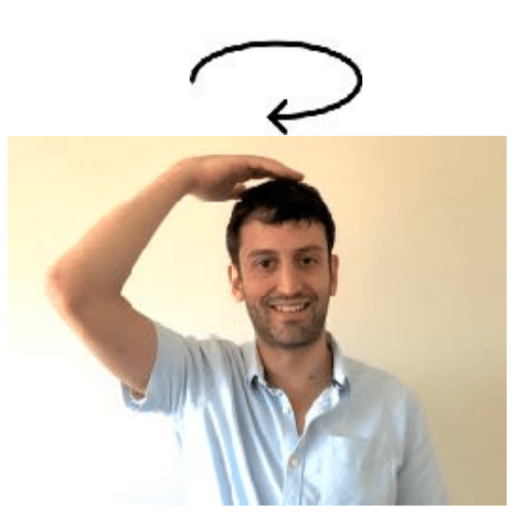
Systematic compositionality
The algebraic capacity to understand and produce novel combinations from known components
(Chomsky, Montague, Fodor, Marcus, Pinker, etc.)
One-shot learning:
“This is how you dax”
Can you then:
Dax twice?
Dax and then jump?
Walk around while you dax?
Dax vigorously?

Slide 3
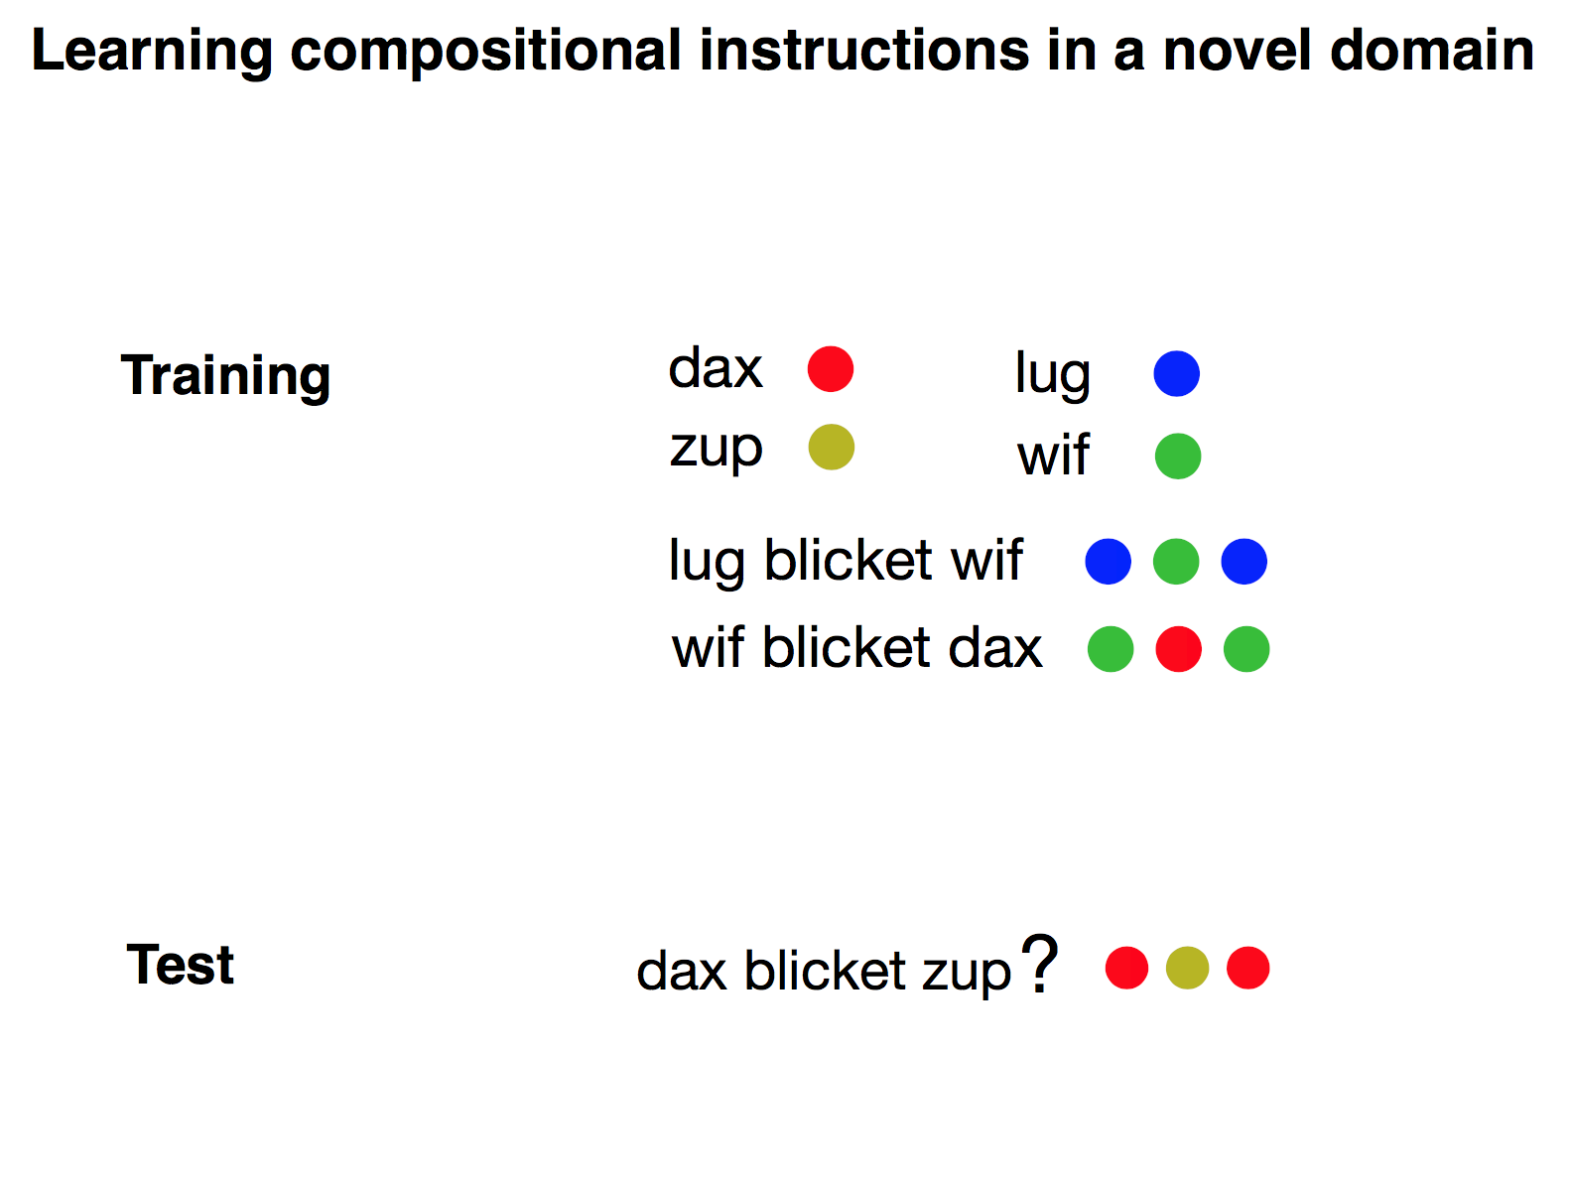
Lake et al. 2019

Slide 4
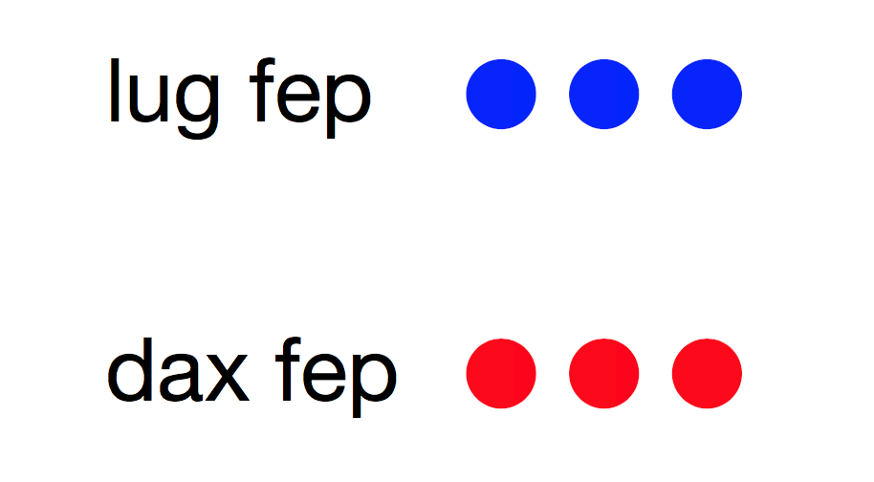
Lake et al. 2019

Slide 5
Lake et al. 2019

Slide 6

?
Lake et al. 2019

Slide 7
Lake et al. 2019

Slide 8
Lake et al. 2019

Slide 9
?
Lake et al. 2019

Slide 10
Lake et al. 2019

Slide 11
Lake et al. 2019

Slide 12
Lake et al. 2019

Slide 13
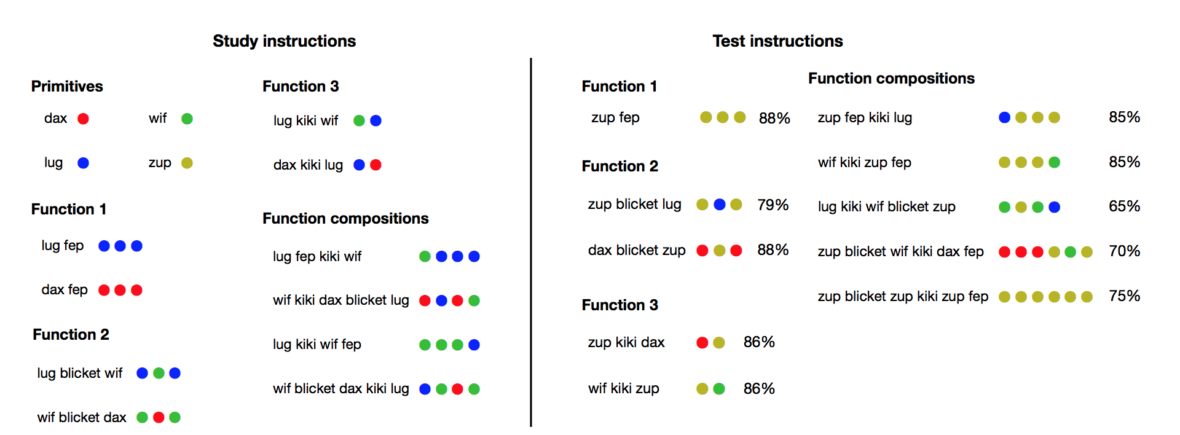
Compositional few-shot learning
Lake et al. 2019

Slide 14
What would a compelling model demonstrate?
Notes:
Two things:

Slide 15
What would a compelling model demonstrate?
Compositional generalization

Slide 16
What would a compelling model demonstrate?
Compositional generalization

Slide 17
What would a compelling model demonstrate?
Compositional generalization
fast (domain general) inference

Slide 18
What would a compelling model demonstrate?
Compositional generalization
fast (domain general) inference
Fast & general

Slide 19
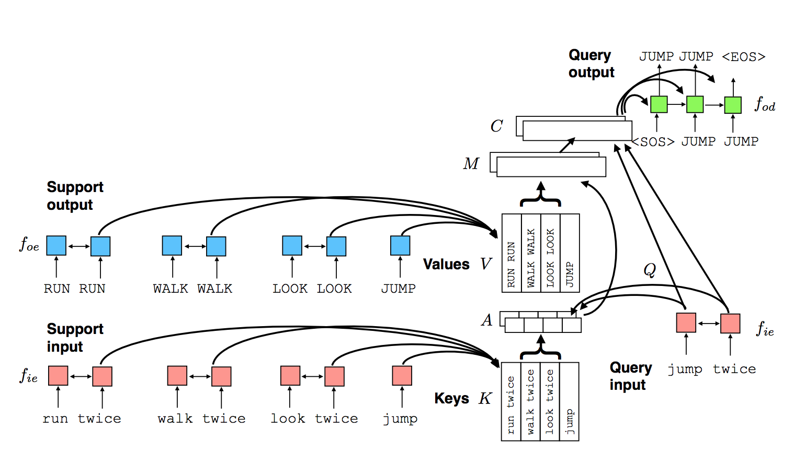
Previous neural approaches:
vanilla seq to seq networks fail [Lake and Baroni, 2018]
Meta seq-to-seq learning with external memory (learned implicit rules):
some success, but limits in compositionality
[Lake, NeurIPS 2019]
Notes:
So previous approaches, while fast and general, fail on the compositionality
Mixed success
need explicit symbolic composiitonality

Slide 20
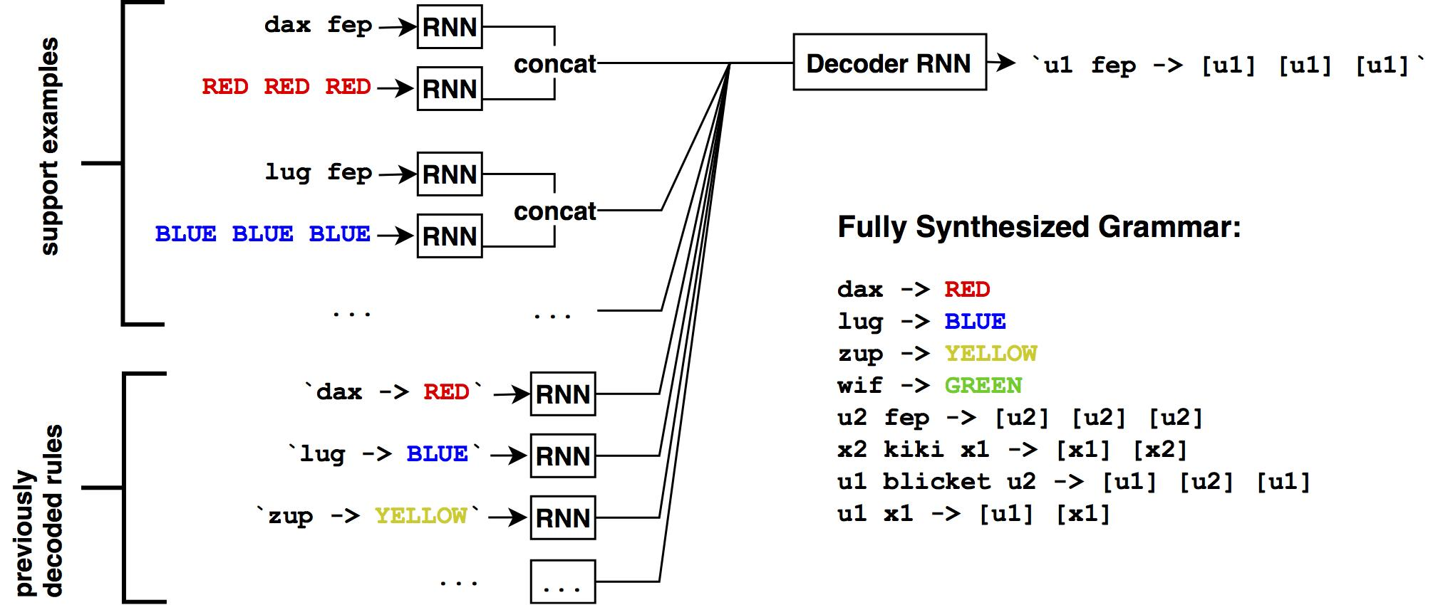
Idea : structure knowledge as a program
Given examples...
our system produces a program...
Grammar =
which can be applied to held-out examples:
Grammar.apply(`zup fep`)
Notes:
show steps of application with a simpler example

Slide 21
Idea : structure knowledge as a program
Given examples...
our system produces a program...
Grammar =
which can be applied to held-out examples:
Grammar.apply(`zup fep`)
Notes:
show steps of application with a simpler example

Slide 22
Idea : structure knowledge as a program
Given examples...
our system produces a program...
Grammar =
which can be applied to held-out examples:
Grammar.apply(`zup fep`)
= [zup][zup][zup]
Notes:
show steps of application with a simpler example

Slide 23
Idea : structure knowledge as a program
Given examples...
our system produces a program...
Grammar =
which can be applied to held-out examples:
Grammar.apply(`zup fep`)
= [zup][zup][zup]
Notes:
show steps of application with a simpler example

Slide 24
Idea : structure knowledge as a program
Given examples...
our system produces a program...
Grammar =
which can be applied to held-out examples:
Grammar.apply(`zup fep`)
= [zup][zup][zup]
=
Notes:
show steps of application with a simpler example

Slide 25
Idea : structure knowledge as a program
Given examples...
our system produces a program...
Grammar =
which can be applied to held-out examples:
Grammar.apply(`zup fep`)
= [zup][zup][zup]
= ✅
Notes:
show steps of application with a simpler example

Slide 26
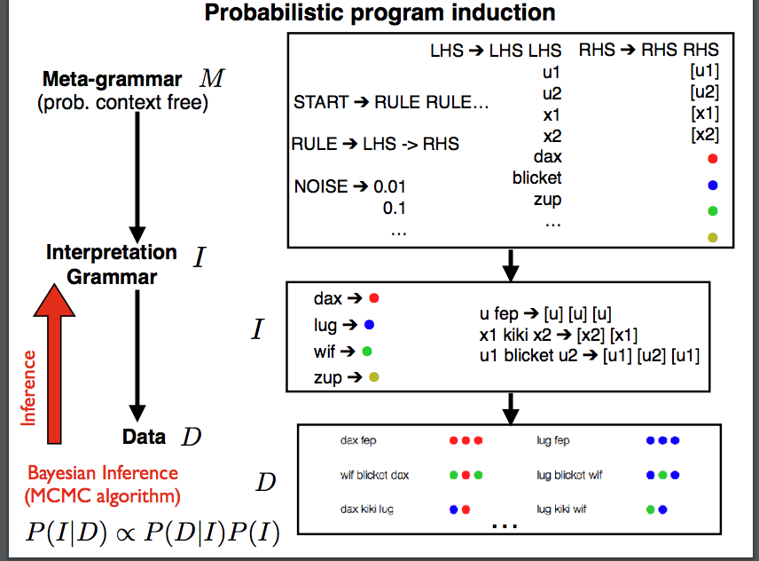
Limitations:
Search is slow and expensive
Often requires hand-designed inference machinery
Notes:
And you can do the same thing for
These models have compositionality, but not fast inference

Slide 27
Limitations:
Search is slow and expensive
Often requires hand-designed inference machinery
Proposal: Programs as representation, neuro-symbolic synthesis as inference procedure
Notes:
And you can do the same thing for

Slide 28
Neural inference for program learning
Train program inference network with samples from a generative model
Synthesizing long code is hard!
New technique:
REPL-based synthesis
Key ideas:
Learn policy and value function
using a symbolic REPL to execute and assess partial programs
Previous work:
Inference compilation (Le et al, 2016)
DeepCoder (Balog et al, 2016)
RobustFill (Devlin et al, 2017)
DreamCoder (Ellis et al, 2018)
SketchAdapt (Nye et al, 2019)
Write, Execute, Assess:
Program Synthesis with a REPL
Kevin Ellis*, Maxwell Nye*, Yewen Pu*, Felix Sosa*,
Josh Tenenbaum, Armando Solar-Lezama
NeurIPS 2019
Notes:
a bunch of citations of synth work
we use REPL.
key idea of REPL is x to learn a policy and value function, and build partial programs iteratively by using a symbolic REPL
In this case, it’s like meta-learning??

Slide 29
Neuro-symbolic inference
Grammar so far:
Notes:
maybe want to show iterative nature

Slide 30
Neuro-symbolic inference
Add to grammar and repeat
Grammar so far:
Notes:
maybe want to show iterative nature

Slide 31
Neuro-symbolic inference
Notes:
maybe want to show iterative nature

Slide 32
Results:
Given examples...
our system produces a program...
Grammar =
which can be applied to held-out examples:
Grammar.apply(`zup blicket wif kiki dax fep`)
Notes:
Go through short simple example above, show long example here

Slide 33
Results:
Given examples...
our system produces a program...
Grammar =
which can be applied to held-out examples:
Grammar.apply(`zup blicket wif kiki dax fep`)
Notes:
Go through short simple example above, show long example here

Slide 34
Results:
Given examples...
our system produces a program...
Grammar =
which can be applied to held-out examples:
Grammar.apply(`zup blicket wif kiki dax fep`)
= [dax fep][zup blicket wif]
Notes:
Go through short simple example above, show long example here

Slide 35
Results:
Given examples...
our system produces a program...
Grammar =
which can be applied to held-out examples:
Grammar.apply(`zup blicket wif kiki dax fep`)
= [dax fep][zup blicket wif]
Notes:
Go through short simple example above, show long example here

Slide 36
Results:
Given examples...
our system produces a program...
Grammar =
which can be applied to held-out examples:
Grammar.apply(`zup blicket wif kiki dax fep`)
= [dax fep][zup blicket wif]
= [dax][dax][dax][zup][wif][zup]
Notes:
Go through short simple example above, show long example here

Slide 37
Results:
Given examples...
our system produces a program...
Grammar =
which can be applied to held-out examples:
Grammar.apply(`zup blicket wif kiki dax fep`)
= [dax fep][zup blicket wif]
= [dax][dax][dax][zup][wif][zup]
Notes:
Go through short simple example above, show long example here
Add colors on left hand side

Slide 38
Results:
Given examples...
our system produces a program...
Grammar =
which can be applied to held-out examples:
Grammar.apply(`zup blicket wif kiki dax fep`)
= [dax fep][zup blicket wif]
= [dax][dax][dax][zup][wif][zup]
= ✅
Notes:
Go through short simple example above, show long example here

Slide 39
Results:
Given examples...
our system produces a program...
Grammar =
which can be applied to held-out examples:
Compositional generalization ✅
Fast inference ✅
Notes:
Go through short simple example above, show long example here

Slide 40
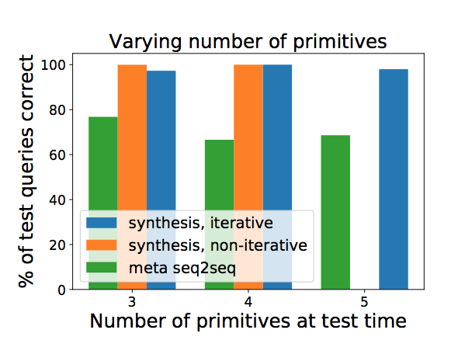
Results:
synthesis (Ours)
synthesis (RNN)
meta seq-to-seq
(trained on 4 primitive colors)
Notes:
Redo labels
synthesis (ours)
synthesis (RNN)
mention time!!

Slide 41
Discussion:
Using programs as representation → compositional generalization
Neuro-symbolic program synthesis → fast & general inference
Trained via meta-learning

Slide 42
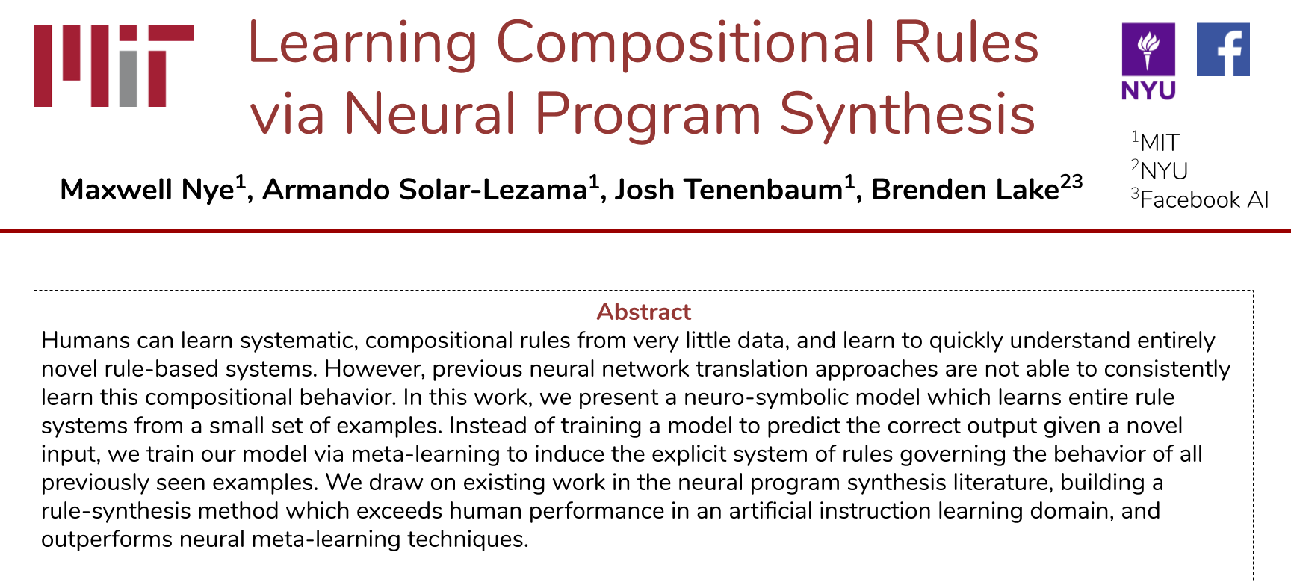
Check out our poster!

