Slide 1

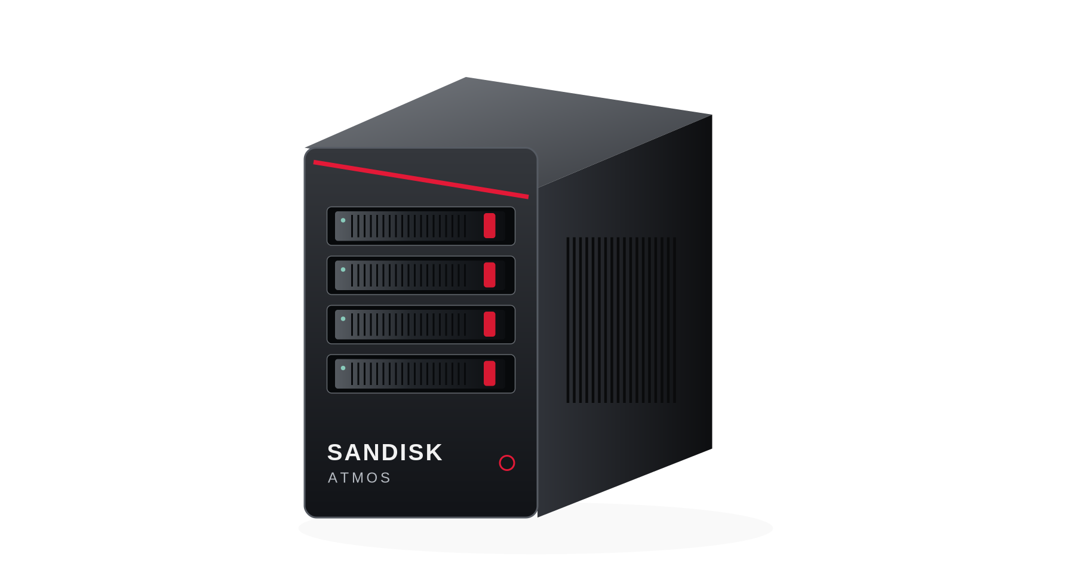
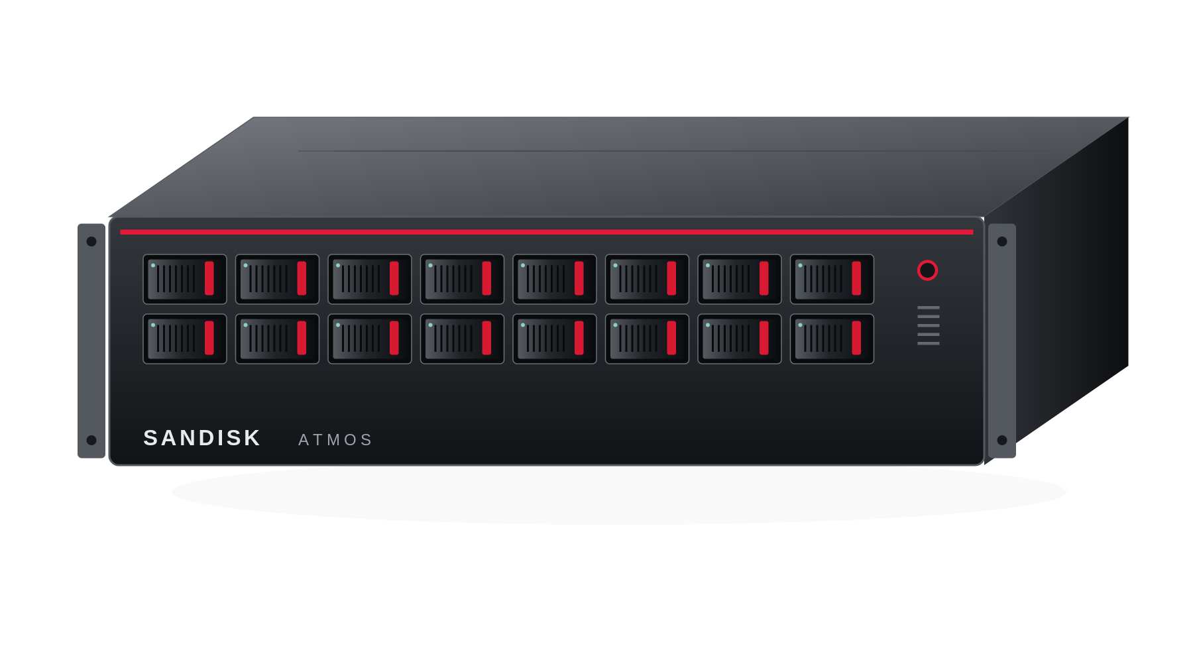
SANDISK
Sandisk ATMOS AI Appliance Portfolio
CERTIFIED APPLIANCE
4 / 8 / 16 / 24-device family
TURNKEY SOFTWARE
AI OS + Model Services + Operator
Serving Manager, SDK and Control Center
HYPOTHETICAL PRODUCT DESIGN
KNOWLEDGE AGENT
Ingest -> retrieve -> rerank -> cite
Governed tools, evaluation and audit
ONE SUPPORT ROUTE
Signed packs, upgrades and rollback
Sandisk triage + coordinated OEM support
01
Notes:
Open with the product decision, not PCIe bandwidth. The proposed opportunity is a SanDisk-branded private knowledge and inference service built on an OEM platform. The current attached PRD controls scope: five commercial profiles over four device densities, with the Knowledge Agent as the flagship. This is not the earlier three-way MoE execution portfolio. Present slides 1–16; use slides 17–25 only for questions. No physical ATMOS performance, approved price or OEM certification is asserted. The appliance illustrations are hypothetical design studies. Request approval for D8/E16 evidence and product ownership—not launch.
EVIDENCE
[I1] Supplied ATMOS AI Appliance Portfolio PRD v2
Sandisk_ATMOS_AI_Appliance_Portfolio_PRD_v2_Linked.docx
Controlling input: five commercial profiles; four-device topology; Knowledge Agent; nine software products; lifecycle and use-case inventory. All ATMOS hardware values are internal targets.
[I2] Supplied ATMOS Leadership Proposal v2
Sandisk_ATMOS_AI_Appliance_Leadership_Proposal_v2.pptx
Presentation input. Reordered and rebuilt; its repeated cautionary notes do not constitute hardware, pricing or service measurements.
All ATMOS hardware, prices, performance and support terms are proposed until physically qualified and commercially approved. Budget amounts are not supplier quotations. Full evidence and use-case details are in the linked PRD v3.

Slide 2
SANDISK
BACKGROUND
LLM In The Box
Private AI workstations and edge appliances bring inference directly to sensitive data and users, enabling knowledge assistants, search, document processing, and local copilots where privacy, latency, connectivity, or cloud cost matter. The opportunity is to sell a turnkey, supported service—not just accelerator hardware—with certified workloads, governance, lifecycle management, and predictable operations. Win where measured local service quality and total cost beat the customer’s cloud or existing on-prem alternatives.
DEMAND | bring AI to the data
SUPPLY | a system, not a chip
SCOPE | bounded enterprise AI
Private documents, predictable service and controlled updates drive local deployments. EPRI is a documented deskside example.
Spark, RTX, Station and turnkey platforms already compete. Delivery also requires OEM qualification, certified models, inventory and field support.
Target search, reranking, document work and qualified private generation. Exclude training, graphics and safety-critical control.
SanDisk opening: resident model/data capacity + certified knowledge services + one accountable lifecycle.
02
Notes:
Presenter guidance
Opening thesis: productize a governed local knowledge service, not a universal GPU replacement. “GPT-in-a-box” is generic shorthand for a privately deployed supported model service; it does not promise OpenAI GPT weights. Edge here includes controlled office/departmental or regional deployments, not every industrial real-time controller. Supply/logistics items are proposed delivery obligations; no GPU shortage, lead time, market CAGR or share forecast is claimed. A public HBF standards milestone does not certify an ATMOS appliance.
Evidence basis: internal V3 requirements are retained. Public material reviewed 7 October 2026. Published/vendor-reported ≠ independently matched benchmark. ATMOS numbers are targets or calculations, never achieved performance. OEM order is an advisory recommendation, not a partnership.
Sources
[I1] SanDisk ATMOS AI Appliance Strategy / PRD v3
SanDisk_ATMOS_AI_Appliance_Strategy_PRD_v3.docx
[S02] NVIDIA customer story — EPRI
https://www.nvidia.com/en-us/case-studies/epri/
[S14] HPE — Private Cloud AI / enterprise AI solutions
https://www.hpe.com/us/en/newsroom/press-release/2025/03/hewlett-packard-enterprise-introduces-new-enterprise-ai-solutions-with-nvidia-to-accelerate-time-to-value-for-generative-agentic-and-physical-ai-models.html
[S15] Nutanix — GPT-in-a-Box 2.0
https://www.nutanix.com/press-releases/2024/nutanix-accelerates-enterprise-adoption-of-generative-ai
[S20] SanDisk / SK hynix — HBF OCP specification
https://www.sandisk.com/company/newsroom/press-releases/2026/2026-08-03-Sandisk-and-sk-hynix-advance-global-standardization-of-hbf

Slide 3
SANDISK
DEMAND
Demand is proven with NVIDIA Edge revenue.
Q2 FY2027 • quarter ended 26 July 2026 • market-platform reporting, USD billions.
$96.221B
$89.023B
$7.198B
Total revenue
Data Center
Edge Computing
Edge = 7.48% of total (calculated)
NOT DISCLOSED
Banking / insurance / energy / retail shares
Spark-only or RTX AI-workstation-only sales
Revenue attributable to named customers
Data Center
Edge
The filing links Edge growth to Blackwell workstations and notes consumer-PC price pressure.
Do not call all Edge Computing “enterprise edge AI”; do not allocate it using customer-logo counts.
03
Notes:
Presenter guidance
Amounts are taken from the 10-Q market-platform table. Calculate 7198/96221×100 = 7.480696%. Edge includes a broader product scope than the proposed enterprise knowledge appliance. No vertical split is inferred. Do not add the historical Professional Visualization figure to this recast category or annualize one quarter as a forecast.
Evidence basis: internal V3 requirements are retained. Public material reviewed 7 October 2026. Published/vendor-reported ≠ independently matched benchmark. ATMOS numbers are targets or calculations, never achieved performance. OEM order is an advisory recommendation, not a partnership.
Sources
[S01] NVIDIA FY2027 Q2 Form 10-Q
https://www.sec.gov/Archives/edgar/data/1045810/000104581026000075/nvda-20260726.htm

Slide 4
SANDISK
COMPETITIVE GAP MAP
The opportunity: capacity economics inside a managed service.
An occupied market: privacy, local models, high memory and turnkey operations are already available.
LOCAL DEVELOPER
LARGE LOCAL COMPUTE
MANAGED ENTERPRISE
DGX Spark / GB10
RTX workstations
DGX Station
High-memory Mac Studio
HPE Private Cloud AI
Nutanix GPT-in-a-Box
Fast iteration and broad GPU software.
A strong control for small, active models.
Large working memory and local model capability.
Capacity is not an empty category.
Integrated operations, serving and lifecycle.
Turnkey is table stakes.
ATMOS GAP TO PROVE
Larger resident catalog / richer evidence at moderate query demand
Certified CPU + NPU work allocation, local governance, modular capacity and a supported OEM appliance.
Position ATMOS as a candidate for resident knowledge capacity—not as the fastest or only private-AI box.
04
Notes:
Presenter guidance
This is a qualitative positioning map, not a price/performance plot or a claim that competitors lack a capability. Mac Studio is included because the current Apple specification supports high-memory local configurations; no matched inference score is assigned. HPE/Nutanix establish that private-AI management and turnkey deployment already exist. The ATMOS opportunity remains conditional on service-level value.
Evidence basis: internal V3 requirements are retained. Public material reviewed 7 October 2026. Published/vendor-reported ≠ independently matched benchmark. ATMOS numbers are targets or calculations, never achieved performance. OEM order is an advisory recommendation, not a partnership.
Sources
[I1] SanDisk ATMOS AI Appliance Strategy / PRD v3
SanDisk_ATMOS_AI_Appliance_Strategy_PRD_v3.docx
[S10] NVIDIA DGX Spark hardware guide
https://docs.nvidia.com/dgx/dgx-spark/hardware.html
[S11] NVIDIA RTX PRO 6000 Blackwell Workstation Edition
https://www.nvidia.com/en-us/products/workstations/professional-desktop-gpus/rtx-pro-6000/
[S12] NVIDIA DGX Station development guide — system overview
https://docs.nvidia.com/dgx/dgx-station-development-guide/overview.html
[S14] HPE — Private Cloud AI / enterprise AI solutions
https://www.hpe.com/us/en/newsroom/press-release/2025/03/hewlett-packard-enterprise-introduces-new-enterprise-ai-solutions-with-nvidia-to-accelerate-time-to-value-for-generative-agentic-and-physical-ai-models.html
[S15] Nutanix — GPT-in-a-Box 2.0
https://www.nutanix.com/press-releases/2024/nutanix-accelerates-enterprise-adoption-of-generative-ai
[S21] Apple — Mac Studio technical specifications
https://www.apple.com/mac-studio/specs/

Slide 5
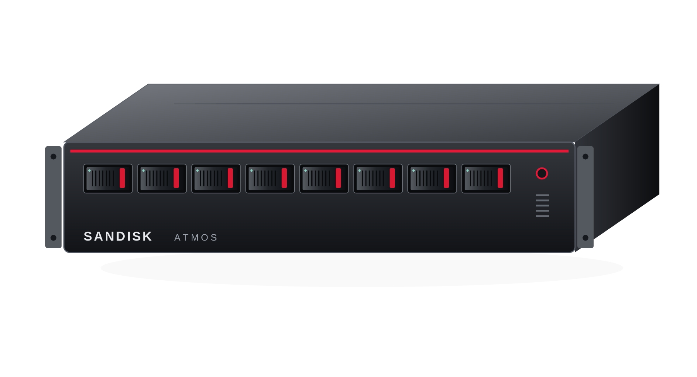
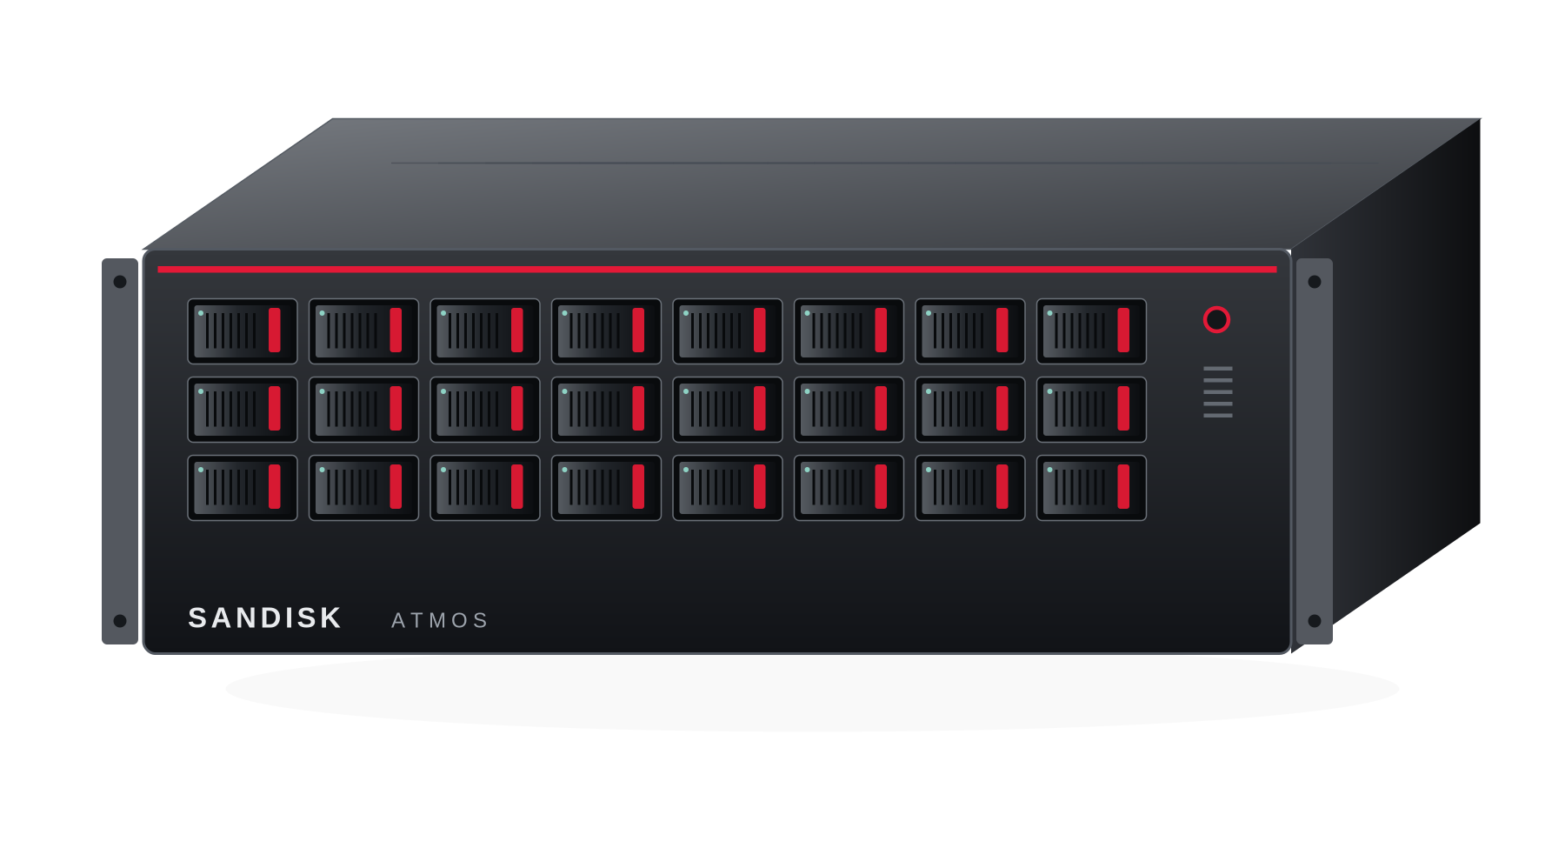
SANDISK
ATMOS-E3S PORTFOLIO
Sandisk Offerings
Three Tiers, Five profiles and One supported software platform.
Preserve the product family; prioritize D8 and E16 proof before widening the catalog.
DERIVATIVE
FIRST PROOF
FIRST PROOF
STRETCH
WORKSTATION 4
DEPARTMENTAL / ENTERPRISE 8
ENTERPRISE 16
ENTERPRISE 24
512 GB nominal HBF
1.024 TB nominal HBF
2.048 TB nominal HBF
3.072 TB nominal HBF
W4 / local developer and secure small-team service
D8 / teams and site services
E8 / same capacity + enterprise lifecycle
E16 / multi-service production and complete-replica HA
E24 / six-domain capacity expansion only after E16 proof
05
Notes:
Retain W4, D8, E8, E16 and E24. D8 and E8 have the same device resource and performance targets; E8 adds qualified enterprise integration and lifecycle. Fund D8/E16 proof first. W4 requires separate office power, acoustic and commercial tests; it is not a graphics workstation. E24 is a gated six-domain stretch product. Nominal HBF capacities are 512, 1,024, 2,048 and 3,072 GB; study allocations are 400, 800, 1,600 and 2,400 GB. None is a coherent GPU memory pool. The renderings do not establish an OEM mechanical design.
EVIDENCE
[I1] Supplied ATMOS AI Appliance Portfolio PRD v2
Sandisk_ATMOS_AI_Appliance_Portfolio_PRD_v2_Linked.docx
Controlling input: five commercial profiles; four-device topology; Knowledge Agent; nine software products; lifecycle and use-case inventory. All ATMOS hardware values are internal targets.
[I2] Supplied ATMOS Leadership Proposal v2
Sandisk_ATMOS_AI_Appliance_Leadership_Proposal_v2.pptx
Presentation input. Reordered and rebuilt; its repeated cautionary notes do not constitute hardware, pricing or service measurements.
All ATMOS hardware, prices, performance and support terms are proposed until physically qualified and commercially approved. Budget amounts are not supplier quotations. Full evidence and use-case details are in the linked PRD v3.

Slide 6
SANDISK
SPECIFICATION
Named SKUs. Explicit system and service profiles.
Five commercial profiles share four device densities; Enterprise 8 adds production integration and serviceability.
Subsystem | W4 | D8 / E8 | E16 | E24 / stretch
Host CPU | 1 high-lane EPYC 9135-class; 16 cores | 1 EPYC 9355P-class; 32 cores | 2 EPYC 9355-class; 32 cores each | 2 high-lane sockets; three groups/root study
Host DRAM | 128–256GB ECC | 256–512GB ECC | 512GB–1TB ECC | 1TB+ ECC
Data NVMe | 2 × 1.92TB mirror | 2 × 3.84TB mirror | 2 × 7.68TB mirror | 2 × 15.36TB mirror
Service network | 25GbE; 100GbE option | 100GbE; E8 redundant paths | Dual 100/200GbE | Dual 200/400GbE
ATMOS topology | 1 four-device domain | 2 domains | 4 domains | 6 domains
Enclosure | Pedestal / short-depth study | 2U/3U candidate | 4U conservative; 2U if proven | 4U+; no density promise
Device-only power | 120–160W target | 240–320W target | 480–640W target | 720–960W target
Whole-node TCO input | 0.45kW assumption | 0.8 / 0.9kW assumption | 1.5kW assumption | 2.2kW assumption
Workstation: local catalog + APIs. Departmental: projects, quotas and separate queues. Enterprise: identity, audit, backup and support.
06
Notes:
These are reference configurations for an OEM RFI, not validated BOMs. Processor models may be replaced by equivalent supported Intel or AMD configurations. The 30–40 W per-device power target is from the supplied PRD and excludes host CPU, DIMMs, switches, networking and fans. Mirrored NVMe pairs expose approximately one drive's nominal capacity before reserves. Four-device domains consume 16 host lanes each: 16/32/64/96 for the four device counts. Published E3.S storage or CXL bay support does not establish E3.S 2T ATMOS power, x4 routing, reset or firmware interoperability.
EVIDENCE
[I1] Supplied ATMOS AI Appliance Portfolio PRD v2
Sandisk_ATMOS_AI_Appliance_Portfolio_PRD_v2_Linked.docx
Controlling input: five commercial profiles; four-device topology; Knowledge Agent; nine software products; lifecycle and use-case inventory. All ATMOS hardware values are internal targets.
[S25] Supermicro X14 Petascale family
https://www.supermicro.com/en/products/petascale-grace-storage
Up to 32 E3.S or 16 E3.S plus eight fixed E3.S 2T CXL Type-3 bays; dual Xeon 6700/6500. These are distinct storage/CXL options, not ATMOS-certified bays.
[S26] Dell PowerEdge R7725
https://www.dell.com/en-us/shop/ipovw/poweredge-r7725
Candidate dual-socket enterprise host with published E3.S options. Exact 2T/x4 accelerator population, power, backplane and pricing are quote/qualification items.
[S27] HPE DL345 Gen12 24 E3.S x4 cabling
https://cdn.support.hpe.com/hpesc/public/docDisplay?docId=sd00005966en_us&page=GUID-58709B31-F99E-4D9E-B660-2B3A9935540B.html&docLocale=en_US
Source-listed HPE technical document; retain as an OEM-returned verification item, not independently confirmed ATMOS compatibility.
[S28] AMD EPYC 9355P specifications
https://www.amd.com/en/products/processors/server/epyc/9005-series/amd-epyc-9355p.html
32 cores, single socket, PCIe Gen5 x128, 12 memory channels. Candidate host CPU, not mandatory for every OEM.
All ATMOS hardware, prices, performance and support terms are proposed until physically qualified and commercially approved. Budget amounts are not supplier quotations. Full evidence and use-case details are in the linked PRD v3.

Slide 7
SANDISK
SERVICE CONTRACT
What the customer receives out of the box
A complete private-AI service platform, not an accelerator kit
OEM-qualified appliance
ATMOS AI OS
Certified AI services
CPU, ECC DRAM, switches, ATMOS E3.S, NVMe, networking, redundant power
Hardened image, drivers, runtime, Kubernetes, signed updates and recovery
Embeddings, retrieval, reranking, document AI and qualified LLM endpoints
Enterprise Knowledge Agent
Control Center
Enterprise support
Ingestion, hybrid retrieval, citations, governed tools and evaluation
Fleet, SLO, usage, thermals, updates, audit and support bundles
Production/LTS releases, CVE response, OEM field service coordination
07
Notes:
Every number is a proposed qualification target. Freeze the exact 8B-class checkpoint at G0. G1 uses FP8 weights, BF16 activation/KV, 2,048 input and 256 output tokens, an 8,192-token total cap, a warm resident model, no prefix-cache hit and no speculation. Start with one complete four-device replica per domain and four active decode sequences per replica. The scale-out ladder is a requirement, not measured linear scaling. TTFT includes queueing. Report request-average TPOT separately from inter-token latency tails; desired p99 ceilings are 5 seconds and 120 ms. R1 uses one million chunks and bounded reranking. Do not assume G1 and R1 maxima hold simultaneously.
EVIDENCE
[I1] Supplied ATMOS AI Appliance Portfolio PRD v2
Sandisk_ATMOS_AI_Appliance_Portfolio_PRD_v2_Linked.docx
Controlling input: five commercial profiles; four-device topology; Knowledge Agent; nine software products; lifecycle and use-case inventory. All ATMOS hardware values are internal targets.
All ATMOS hardware, prices, performance and support terms are proposed until physically qualified and commercially approved. Budget amounts are not supplier quotations. Full evidence and use-case details are in the linked PRD v3.

Slide 8
SANDISK
Architecture
The Turnkey Architecture behind the appliance.
Customer inference, policy and data remain local; SanDisk operates the release and support plane.
SANDISK-OPERATED
CUSTOMER TRUST BOUNDARY
Release services
Local Control Center
Gateway + Knowledge Agent
Catalog • entitlement • signed bundles
RBAC • policy • updates • diagnostics
HTTPS API • ACLs • bounded workflows
pull / import
Support services
Local artifacts + durable state
Serving Manager + ATMOS runtime
PSIRT • cases • compatibility lab
OEM escalation
Registry cache • models • indexes
Audit • configuration • backups
Certified CPU/NPU paths
Whole model groups • local KV
08
Notes:
PROPOSED TECHNICAL DESIGN — appendix to the controlling V3 strategy, not a supported-product announcement.
V3 requires no mandatory cloud dependency for contracted offline service. New design: a separate SanDisk release/support plane and customer-local control/data/execution plane. Release delivery is outbound pull or signed offline import; it is not a remote command channel. A local administrator approves deployment. No prompts, documents, private weights or KV leave by default. Optional external generation is an explicitly approved endpoint, never hidden failover. Customer data repositories and the SanDisk software registry are distinct.
SOURCE BASIS
[B1] SanDisk ATMOS AI Appliance Strategy PRD v3
SanDisk_ATMOS_AI_Appliance_Strategy_PRD_v3.docx
Controlling product baseline: sections 7-14; native/retrieval-only service roles, nine software products, HA, security, lifecycle and offline operation.

Slide 9
SANDISK
AI CAPACITY PORTFOLIO
Enterprise Knowledge Agent
Packaged components, stable contracts and operations—not a requirement for the customer to assemble an inference platform.
EXPERIENCE AND KNOWLEDGE
SERVING AND DEVICE EXECUTION
TRUST AND FLEET OPERATIONS
Knowledge Agent / UI
Search, RAG, approved workflows
Gateway
Auth, quota, API policy and accounting
Control Center
Fleet, SLO, updates and cases
SDK / API portal / notebooks
Python, REST, examples and profiling
Serving Manager
KServe/llm-d candidate; replicas, queues
Identity / secrets / network
OIDC/SAML, RBAC, vault, TLS/mTLS
Knowledge plane
Connectors, parsers, ACLs and indexes
Model Services / ATMOS runtime
Certified operators and memory plans
Supply chain / policy / evidence
Signing, SBOM, policy and audit
Certified ModelPacks
Weights, tokenizer, kernels and tests
AI OS + Device Service
DRA/CDI/operator, DMA, P2P, firmware
Enterprise Support
Prod/LTS, CVEs, OEM escalation
ATMOS runtime/driver/operator, HBF placement and workload adapters must be delivered/qualified; upstream projects do not establish ready ATMOS support. PRD 3-4 / 12.
09
Notes:
Companion document: Sandisk_ATMOS_AI_Appliance_Portfolio_PRD_v2_Linked.docx. Section 4, bookmark PRD_04.
Keep both files together. Full-document link is the portable fallback if a viewer ignores bookmark fragments. Office security policies can require confirmation for local links.
Slide 4: The software is the product: deliver an integrated stack. All ATMOS specifications and economic scenarios require qualification.
PRD v2 is the controlling proposal, not an approved product or measured result. All ATMOS specifications, prices, node counts, supported models and service levels are planning requirements pending final silicon, OEM qualification, model certification and matched customer service measurements. The linked companion's text/tables are unchanged.
The PRD names nine software products: AI OS, Device Service, Model Services, Certified ModelPacks, Serving Manager, Knowledge Agent, Control Center, SDK and Enterprise Support. Candidate gateway/serving components are Envoy AI Gateway or equivalent, KServe LLMInferenceService, llm-d or Sandisk-packaged alternatives. Those projects supply patterns/components, not an ATMOS-certified backend. Sandisk must own the device/runtime and signed distribution and select/name the NPU compiler/runtime partner. ModelPack binds executable preparation separately from weights-as-data; no custom compiler CLI is claimed available. Readiness depends on signed pack, ABI, per-device memory fit, golden correctness and warmup. Customer-safe configuration and supported SDK extensions are different from firmware/kernel or unchecked binaries.
PRD: 3. Turnkey Offering: What the Customer Receives
Sandisk_ATMOS_AI_Appliance_Portfolio_PRD_v2_Linked.docx#PRD_03
PRD: 4. Turnkey Technical Architecture
Sandisk_ATMOS_AI_Appliance_Portfolio_PRD_v2_Linked.docx#PRD_04
PRD: 7. What Customers Can Configure, Extend or Not Change
Sandisk_ATMOS_AI_Appliance_Portfolio_PRD_v2_Linked.docx#PRD_07
PRD: 12. Security and Compliance Requirements
Sandisk_ATMOS_AI_Appliance_Portfolio_PRD_v2_Linked.docx#PRD_12
[R16] PRD reference: KServe LLMInferenceService with Envoy AI Gateway
https://kserve.github.io/website/docs/model-serving/generative-inference/llmisvc/llmisvc-envoy-ai-gateway
Source supplied with PRD; no ATMOS interoperability, engagement or certification implied.
[R17] PRD reference: KServe and llm-d generative inference architecture
https://developers.redhat.com/articles/2026/04/21/kserve-llm-d-optimized-gen-ai-inference
Source supplied with PRD; no ATMOS interoperability, engagement or certification implied.

Slide 10
SANDISK
ATMOS / WHAT SANDISK MUST BUILD
The backend and support system are part of the product.
Reuse Linux, Kubernetes and service components; own the ATMOS contract and customer lifecycle.
EXECUTION
EXPERIENCE
OPERATIONS
AI OS
Device Service
Model Services
Certified ModelPacks
Serving Manager
Knowledge Agent
Control Center
SDK
Enterprise Support
Signed platform; DMA/isolation; native kernels, active state and device fabric.
Golden tests; admission and quotas; governed sources, citations and bounded workflows.
Fleet and SLO views; APIs; entitlement, CVE response, updates, rollback and OEM cases.
OEM reuse reduces platform work. It does not supply ATMOS software, certification or prime support for free.
10
Notes:
The nine software products are preserved from the PRD. Reuse commodity Linux, Kubernetes, gateway and observability components where appropriate, but contract the actual ATMOS backend and maintain the supported distribution. Tenstorrent's public vLLM plugin is precedent, not an ATMOS commitment. SanDisk must own service QA, signed model packages, APIs, lifecycle and the customer support boundary. The support backend also needs entitlement, an artifact repository, offline mirrors, a compatibility lab, product security response, redacted diagnostics, case management and OEM dispatch. OEM reuse does not remove this work.
EVIDENCE
[I1] Supplied ATMOS AI Appliance Portfolio PRD v2
Sandisk_ATMOS_AI_Appliance_Portfolio_PRD_v2_Linked.docx
Controlling input: five commercial profiles; four-device topology; Knowledge Agent; nine software products; lifecycle and use-case inventory. All ATMOS hardware values are internal targets.
[S36] NVIDIA AI Enterprise support
https://www.nvidia.com/en-us/data-center/products/ai-enterprise-suite/support/
Support, enterprise lifecycle and escalation are incumbent capabilities. ATMOS needs funded operational equivalents, not only a UI.
[S37] Kubernetes device plugins
https://kubernetes.io/docs/concepts/extend-kubernetes/compute-storage-net/device-plugins/
Resource discovery and allocation; labels alone do not implement NPU execution, multi-device model readiness or state replication.
[S39] Tenstorrent vLLM plugin
https://github.com/tenstorrent/vllm-tt-plugin
Native platform-backend precedent only; ATMOS model/operator/memory support must be contracted and validated.
[S41] KServe LLMInferenceService / Envoy AI Gateway
https://kserve.github.io/website/docs/model-serving/generative-inference/llmisvc/llmisvc-envoy-ai-gateway
Candidate service/gateway integration pattern; Sandisk retains responsibility for certified ATMOS deployment.
All ATMOS hardware, prices, performance and support terms are proposed until physically qualified and commercially approved. Budget amounts are not supplier quotations. Full evidence and use-case details are in the linked PRD v3.

Slide 11
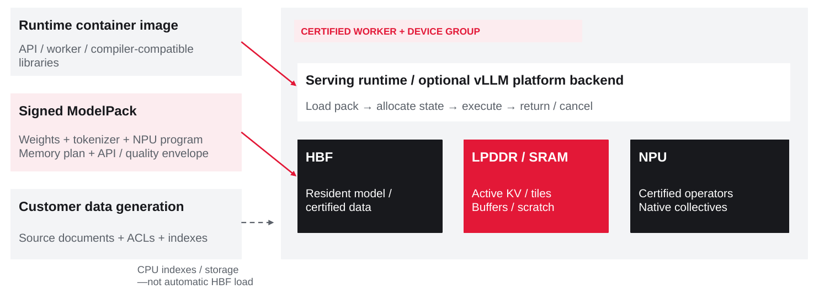
SANDISK
ATMOS / WHAT SANDISK MUST BUILD
Native runtime and Ownership
Reuse Linux, Kubernetes and service components; own the ATMOS contract and customer lifecycle.
OEM reuse reduces platform work. It does not supply ATMOS software, certification or prime support for free.
11
Notes:
The nine software products are preserved from the PRD. Reuse commodity Linux, Kubernetes, gateway and observability components where appropriate, but contract the actual ATMOS backend and maintain the supported distribution. Tenstorrent's public vLLM plugin is precedent, not an ATMOS commitment. SanDisk must own service QA, signed model packages, APIs, lifecycle and the customer support boundary. The support backend also needs entitlement, an artifact repository, offline mirrors, a compatibility lab, product security response, redacted diagnostics, case management and OEM dispatch. OEM reuse does not remove this work.
EVIDENCE
[I1] Supplied ATMOS AI Appliance Portfolio PRD v2
Sandisk_ATMOS_AI_Appliance_Portfolio_PRD_v2_Linked.docx
Controlling input: five commercial profiles; four-device topology; Knowledge Agent; nine software products; lifecycle and use-case inventory. All ATMOS hardware values are internal targets.
[S36] NVIDIA AI Enterprise support
https://www.nvidia.com/en-us/data-center/products/ai-enterprise-suite/support/
Support, enterprise lifecycle and escalation are incumbent capabilities. ATMOS needs funded operational equivalents, not only a UI.
[S37] Kubernetes device plugins
https://kubernetes.io/docs/concepts/extend-kubernetes/compute-storage-net/device-plugins/
Resource discovery and allocation; labels alone do not implement NPU execution, multi-device model readiness or state replication.
[S39] Tenstorrent vLLM plugin
https://github.com/tenstorrent/vllm-tt-plugin
Native platform-backend precedent only; ATMOS model/operator/memory support must be contracted and validated.
[S41] KServe LLMInferenceService / Envoy AI Gateway
https://kserve.github.io/website/docs/model-serving/generative-inference/llmisvc/llmisvc-envoy-ai-gateway
Candidate service/gateway integration pattern; Sandisk retains responsibility for certified ATMOS deployment.
All ATMOS hardware, prices, performance and support terms are proposed until physically qualified and commercially approved. Budget amounts are not supplier quotations. Full evidence and use-case details are in the linked PRD v3.

Slide 12
SANDISK
ATMOS / CUSTOMER EVIDENCE
Named users show where local AI is already being used.
Public customer stories—not purchase records, installed-base estimates or ATMOS customer commitments.
Organization / vertical
Named local platform
Documented activity
ATMOS-relevant boundary
EPRI / energy
Dell Pro Max GB10
DGX Spark platform
Power Chat local document assistant
Knowledge workflow is relevant; published results are on GB10.
CYRAN AI / geospatial
DGX Spark
GPU JPEG2000 processing of large satellite scenes
Metadata / report retrieval is a candidate; image decoding is not the launch target.
Arup / engineering
DGX Spark
GNN structural-design surrogates
Engineering knowledge is adjacent; do not claim simulation replacement.
Aible / enterprise AI
DGX Spark → Google Cloud
Air-gapped agent prototyping; cloud production path
Proof of local evaluation, not a measured on-prem production fleet.
Lowe’s / retail
Dell RTX workstations;
separate edge servers
Digital twins; edge computer vision
Product knowledge is an adjacent use; store count is not workstation count.
EPRI / energy
DGX Station GB300
Local weather-model execution
Confirms Station use; weather timing is not generation TTFT.
Do not turn a cloud case into an edge deployment—or a simulation result into an LLM benchmark.
12
Notes:
Presenter guidance
Keep evidence labels narrow. The EPRI hardware is a Dell GB10 implementation, not proof of a NVIDIA-branded unit purchase. Aible is explicitly a prototype-to-cloud pattern. Lowe’s has multiple execution environments; do not assign its entire GenAI stack or store estate to RTX workstation hardware. These cases establish workflow activity, not units sold or revenue.
Evidence basis: internal V3 requirements are retained. Public material reviewed 7 October 2026. Published/vendor-reported ≠ independently matched benchmark. ATMOS numbers are targets or calculations, never achieved performance. OEM order is an advisory recommendation, not a partnership.
Sources
[S02] NVIDIA customer story — EPRI
https://www.nvidia.com/en-us/case-studies/epri/
[S03] NVIDIA customer story — CYRAN AI / IIT Delhi
https://www.nvidia.com/en-us/case-studies/cyran-iit-delhi/
[S04] NVIDIA customer story — Arup
https://www.nvidia.com/en-us/case-studies/arup/
[S05] Google Cloud customer story — Aible
https://cloud.google.com/customers/aible
[S06] NVIDIA customer story — Lowe’s
https://www.nvidia.com/en-gb/case-studies/lowes/

Slide 13
SANDISK
ATMOS / VERTICAL PRIORITY
Prioritize vertical workflows with public demand signals.
The requested industry revenue split is unavailable. The actionable alternative is a workload-led prospect map.
Vertical / V3 rank
Public company signal
Platform evidence
Share of NVIDIA Edge
Candidate ATMOS entry
Finance / insurance · 1
Nasdaq
L40 + NIM / Retriever; no Spark or edge-location proof
Not disclosed
E8/E16: policy, claims and investigation evidence
Industrial knowledge · 2
Arup (engineering)
Spark GNN design work; factory-knowledge fit is an adjacent hypothesis
Not disclosed
D8/E16: manuals and quality-record search
Energy / utilities · 3
EPRI
GB10 local knowledge service
Not disclosed
D8/E8: engineering / procedure assistant
Government · 5
ThinkDeep / French agencies
Sovereign document / agent platform; no Spark unit count
Not disclosed
E16: controlled evidence and offline operations
Telecom · 6
Amdocs
DGX Cloud / NIM agents; not proof of edge hardware
Not disclosed
E16/E24: regional ticket and runbook catalog
Retail · 7
Lowe’s
RTX workstations + store-edge systems; mixed workloads
Not disclosed
D8/E16: product / associate knowledge
Finance, manufacturing knowledge and energy lead the V3 priority; qualification and a funded buyer decide.
13
Notes:
Presenter guidance
V3’s rank is a qualitative near-term product/ROI prioritization, not market-size share or measured returns. The industrial row pairs V3’s manufacturing-knowledge priority with adjacent engineering evidence from Arup; that does not establish an Arup factory-knowledge deployment. Nasdaq names L40 hardware and self-hosted embedding services, but no Spark system or Edge revenue mapping. The rightmost column is our proposed ATMOS use-case mapping, not reported customer adoption.
Evidence basis: internal V3 requirements are retained. Public material reviewed 7 October 2026. Published/vendor-reported ≠ independently matched benchmark. ATMOS numbers are targets or calculations, never achieved performance. OEM order is an advisory recommendation, not a partnership.
Sources
[I1] SanDisk ATMOS AI Appliance Strategy / PRD v3
SanDisk_ATMOS_AI_Appliance_Strategy_PRD_v3.docx
[S01] NVIDIA FY2027 Q2 Form 10-Q
https://www.sec.gov/Archives/edgar/data/1045810/000104581026000075/nvda-20260726.htm
[S02] NVIDIA customer story — EPRI
https://www.nvidia.com/en-us/case-studies/epri/
[S04] NVIDIA customer story — Arup
https://www.nvidia.com/en-us/case-studies/arup/
[S06] NVIDIA customer story — Lowe’s
https://www.nvidia.com/en-gb/case-studies/lowes/
[S07] NVIDIA customer story — Nasdaq
https://www.nvidia.com/en-us/case-studies/nasdaq/
[S08] NVIDIA customer story — ThinkDeep AI
https://www.nvidia.com/en-eu/case-studies/thinkdeep-sovereign-ai-agents-automate-public-services/
[S09] NVIDIA customer story — Amdocs
https://www.nvidia.com/en-eu/case-studies/amdocs-builds-generative-ai-agents-for-telecom/

Slide 14
SANDISK
ATMOS / BACKUP / COMPLETE MARKET PRIORITIZATION
Sixteen market packs, ranked by near-term proof and delivery fit.
Qualitative program prioritization—not market-size estimates, measured ROI or promised payback.
01 Finance / insurance
09 Healthcare knowledge
02 Manufacturing
10 Oil / gas / mining
03 Energy / utilities
11 Geospatial / defense
04 Legal / professional
12 Media / entertainment
05 Government / sovereign
13 Automotive
06 Telecommunications
14 Architecture / engineering
07 Retail
15 Semiconductor
08 Higher education
16 Robotics
Keep scope on documents, retrieval, features and approved inference—not training, rendering, trading or machine control.
14
Notes:
The complete order is a planning judgment and can change with customer access and evidence. The PRD retains all 92 explicitly listed use-case labels and adds implementation/KPI detail. Healthcare was a source solution pack; oil/gas and several complementary industries appeared as wave-only markets and receive clearly marked new detail. Keep finance to evidence and review, healthcare to knowledge/document assistance, and robotics/industrial deployments outside real-time safety control. Broad GPU spending in an industry is not an ATMOS market-size estimate.
EVIDENCE
[I1] Supplied ATMOS AI Appliance Portfolio PRD v2
Sandisk_ATMOS_AI_Appliance_Portfolio_PRD_v2_Linked.docx
Controlling input: five commercial profiles; four-device topology; Knowledge Agent; nine software products; lifecycle and use-case inventory. All ATMOS hardware values are internal targets.
All ATMOS hardware, prices, performance and support terms are proposed until physically qualified and commercially approved. Budget amounts are not supplier quotations. Full evidence and use-case details are in the linked PRD v3.

Slide 15
SANDISK
MARKET PRIORITIZATION
Launch a repeatable workflow—not sixteen vertical products.
Prioritize near-term proof of business value; reuse one governed Knowledge Agent platform.
01 FINANCE / INSURANCE
02 MANUFACTURING
03 ENERGY / UTILITIES
Policy, KYC/AML evidence and claims-document assistance.
Measure reviewer time, accepted fields and citation quality.
Manuals, quality records, work instructions and service cases.
Measure evidence-finding time and correct-version retrieval.
Engineering studies, procedures and local technical knowledge.
Measure research time, groundedness and offline service.
NEXT
Legal • government • telecom • retail • higher education • healthcare knowledge
PRD appendix: all 92 listed use cases, plus healthcare and selective markets, with scope, KPI and explicit exclusions.
15
Notes:
This is a qualitative near-term program ranking, not measured ROI. Consider task value, repeatability, operator fit, connector readiness, ease of proving benefit and procurement/security friction. Finance, manufacturing and energy are proposed first design-partner areas. Legal, government and telecom may move earlier with a ready customer. The ranking intentionally refines the source's government-first ordering, while preserving every use-case label. Healthcare is knowledge assistance, not diagnosis; industrial/robotics packs are not safety controllers. The PRD contains all 92 explicitly listed use cases, each with delivery scope and an acceptance/value KPI.
EVIDENCE
[I1] Supplied ATMOS AI Appliance Portfolio PRD v2
Sandisk_ATMOS_AI_Appliance_Portfolio_PRD_v2_Linked.docx
Controlling input: five commercial profiles; four-device topology; Knowledge Agent; nine software products; lifecycle and use-case inventory. All ATMOS hardware values are internal targets.
[S30] Nasdaq / NVIDIA customer story
https://www.nvidia.com/en-us/case-studies/nasdaq/
Vendor-published Nasdaq account reports 30% faster response and 30% improved accuracy. Not ATMOS data, matched benchmark or disclosed hardware-cost baseline.
[S31] EPRI / NVIDIA customer story
https://www.nvidia.com/en-us/case-studies/epri/
Power Chat on GB10: 35 output tokens/s single user and about 150 aggregate across ten users after warm-up. Model is gpt-oss-120b; workload/prefix caching differs from proposed G1 profile.
[S32] ThinkDeep sovereign public-service agents
https://www.nvidia.com/en-in/customer-stories/thinkdeep-sovereign-ai-agents-automate-public-services/
Document-heavy public administration example. French administration handles >100M documents annually; not all processed by this AI platform and not ATMOS traffic.
[S33] Amdocs amAIz customer story
https://www.nvidia.com/en-gb/case-studies/amdocs-builds-generative-ai-agents-for-telecom/
Vendor-reported domain RAG token/latency reductions; application and model changes confound hardware-only attribution. No ATMOS saving inferred.
All ATMOS hardware, prices, performance and support terms are proposed until physically qualified and commercially approved. Budget amounts are not supplier quotations. Full evidence and use-case details are in the linked PRD v3.

Slide 16
SANDISK
ATMOS / SKU → CUSTOMER OUTCOME
W4 and D8/E8 serve different operational scales.
Proposed example workflows derived from the PRD—not deployments attributed to the named NVIDIA customers.
W4 | private matter / engineering desk
D8 / E8 | insurance claims evidence
4 modules
8 modules
A specialist keeps confidential reference collections local. Start with retrieval-only; add a certified generator when useful.
A department shares policy and document intelligence through quotas, versioned collections and controlled queues.
Approved files → cited search → draft summary
Claim file + policy → rerank → reviewer evidence
Prove: time to accepted evidence, ACL correctness,
local operation and acceptable office acoustics.
Prove: reviewer acceptance, citation quality,
case-preparation time and recovery behavior.
R1 target ≥5 QPS • G1 target ≥40 output tok/s
R1 target ≥10 QPS • G1 target ≥80 output tok/s
Appliance images: V3 concepts only. R1 and G1 are separate qualification profiles—not combined workload results.
D8 and E8 have the same capacity/performance envelope; E8 adds the production integration and support profile.
16
Notes:
Presenter guidance
Preserve the PRD’s exact W4/D8/E8 names; there is no D4 SKU in the controlling document. Images reuse the accepted V3 hypothetical appliance illustrations, not shipping hardware. Workflow descriptions are proposed examples. R1 and G1 are separate test profiles from V3 §5 and cannot run at their maxima simultaneously by assumption. W4 is not a service-HA system. E8 does not gain throughput merely by changing its commercial support tier. Neither workflow makes autonomous legal, engineering-safety or claims-payment decisions.
Evidence basis: internal V3 requirements are retained. Public material reviewed 7 October 2026. Published/vendor-reported ≠ independently matched benchmark. ATMOS numbers are targets or calculations, never achieved performance. OEM order is an advisory recommendation, not a partnership.
Sources
[I1] SanDisk ATMOS AI Appliance Strategy / PRD v3
SanDisk_ATMOS_AI_Appliance_Strategy_PRD_v3.docx

Slide 17
SANDISK
ATMOS / SKU → CUSTOMER OUTCOME
E16 and E24 scale shared services—not single-token speed.
Add complete serving groups and durable operations. Device count is not user count or an HA guarantee.
E16 | bank policy and investigation service
E24 | regional telecom knowledge hub
16 modules
24 modules
Multiple business teams share approved policy, KYC and investigation knowledge with tenant isolation and audit.
Several service catalogs and retained generations support regional runbooks, ticket similarity and batch summaries.
Tenant identity → governed evidence → cited answer
Tickets + manuals → evidence → operator draft
Use complete replicas across nodes for N+1.
Measure retained peak capacity after a failure.
Prove catalog residency, freshness, handle time
and safe upgrades—not network control.
R1 target ≥20 QPS • G1 target ≥160 output tok/s
R1 target ≥30 QPS • G1 target ≥240 output tok/s
Appliance images: V3 concepts only. R1 and G1 are separate qualification profiles—not combined workload results.
E24 is a gated stretch profile. Confirm six-domain communication, thermals, real demand and service economics.
17
Notes:
Presenter guidance
Use cases follow the V3 finance and telecom catalog. They are not claims that Nasdaq or Amdocs bought ATMOS. E16 is the initial enterprise proof profile; E24 only advances after lower-density qualification. Complete service replicas, control quorum and durable source/index/audit protection are separate. A node with more unique shards does not automatically survive a node or device loss. Source KPI targets are preserved and apply separately to G1 and R1.
Evidence basis: internal V3 requirements are retained. Public material reviewed 7 October 2026. Published/vendor-reported ≠ independently matched benchmark. ATMOS numbers are targets or calculations, never achieved performance. OEM order is an advisory recommendation, not a partnership.
Sources
[I1] SanDisk ATMOS AI Appliance Strategy / PRD v3
SanDisk_ATMOS_AI_Appliance_Strategy_PRD_v3.docx

Slide 18
SANDISK
ATMOS / BANDWIDTH HEATMAP
Bandwidth heatmap: local feed, device fabric and network.
Local memory feed, device transport and service Ethernet are different resources; none is LLM throughput.
LOCAL MEMORY / ONE ENGINE
ATMOS / INDEPENDENT DOMAIN SUMS (T)
Spark LPDDR5x · P
SKU
Local HBF
read sum
Host uplinks
coded sum
Service network
(GbE)
0.273 TB/s
RTX WS GDDR7 · P
W4
0.8 TB/s
~63 GB/s
25 / 100
1.792 TB/s
D8 / E8
1.6 TB/s
~126 GB/s
100*
Station GPU HBM · P
up to 7.1 TB/s
E16
3.2 TB/s
~252 GB/s
2 × 100/200
ATMOS HBF / module · T
~0.200 TB/s
E24
4.8 TB/s
~378 GB/s
2 × 200/400
PCIe screen: 1 domain = Gen5 x16 → 4 × Gen5 x4. *E8 adds redundant network paths; E24 remains stretch.
Adding ATMOS modules increases independent resource capacity; it does not make one coherent high-bandwidth memory.
18
Notes:
Presenter guidance
Published local-memory values are architecture specifications, not measured effective kernel delivery. HBF ~200GB/s is a target whose access pattern and NPU data path need proof. Four independent local-read targets per domain sum arithmetically; a request may not exploit the sum. Gen5 coded rate = 32GT/s ×128/130 ×16 lanes /8 ≈63.015GB/s per direction, before transaction overhead. 1/2/4/6 domains produce ~63/126/252/378 coded GB/s in independent uplinks, not one client or NPU path. One four-device domain uses the same 16 root lanes as four direct x4 links. Station 7.1TB/s applies to its HBM tier only.
Evidence basis: internal V3 requirements are retained. Public material reviewed 7 October 2026. Published/vendor-reported ≠ independently matched benchmark. ATMOS numbers are targets or calculations, never achieved performance. OEM order is an advisory recommendation, not a partnership.
Sources
[I1] SanDisk ATMOS AI Appliance Strategy / PRD v3
SanDisk_ATMOS_AI_Appliance_Strategy_PRD_v3.docx
[S10] NVIDIA DGX Spark hardware guide
https://docs.nvidia.com/dgx/dgx-spark/hardware.html
[S11] NVIDIA RTX PRO 6000 Blackwell Workstation Edition
https://www.nvidia.com/en-us/products/workstations/professional-desktop-gpus/rtx-pro-6000/
[S12] NVIDIA DGX Station development guide — system overview
https://docs.nvidia.com/dgx/dgx-station-development-guide/overview.html

Slide 19
SANDISK
ATMOS / PARTNERSHIP PREFERENCE
Match each SKU to an OEM qualification strategy.
Recommended engagement order, not a supplier ranking by measured performance, price or committed delivery.
SKU / stage
First inquiry
Parallel / alternate
Why this order
Hard condition
W4 / derivative
Supermicro +
qualified integrator
Dell OEM; HPE OEM
when customer-aligned
Investigate a purpose-built pedestal / short-depth carrier
No assumption that a normal workstation has four ATMOS bays
D8 / engineering lead
Supermicro
X14-family study
Dell OEM / R7725
feasibility
Public E3.S / 2T CXL design experience supports a technical inquiry
Storage or CXL fit is not NPU certification
E8 / entry production
Dell OEM
enterprise inquiry
Supermicro; HPE where
installed-base-led
Branding, lifecycle and field-support contract are central
Same device envelope as D8; no invented speed uplift
E16 / enterprise lead
Dell OEM +
Supermicro finalist
HPE Virtual OEM for
customer-standard estates
Select on complete 16-device evidence and support scope
Per-domain isolation and full-load N+1 validation
E24 / stretch
Supermicro
co-design inquiry
Dell / HPE only with
qualified 24-device path
Six-domain density is a new qualification, not a slot-count upgrade
Hold until E16, power, service and demand gates pass
Use one common RFI. Every candidate must prove E3.S 2T/x4, sustained thermals, topology, firmware and support.
19
Notes:
Presenter guidance
This is a new advisory engagement recommendation layered onto V3, not a claim in the source that one vendor is inherently faster or cheaper. Supermicro’s X14 reference uses Intel CPUs and has specific storage/CXL bay variants; it is not the same as the PRD’s AMD CPU study BOM. Accept an OEM-supported equivalent only after review. Dell’s published40-drive R7725 layout is a storage topology, not the proposed downstream ATMOS switch domain. HPE’s Virtual OEM is a commercial integration route, not product-level interoperability. W4 requires its own acoustic and carrier study. No OEM agreement exists in the supplied evidence.
Evidence basis: internal V3 requirements are retained. Public material reviewed 7 October 2026. Published/vendor-reported ≠ independently matched benchmark. ATMOS numbers are targets or calculations, never achieved performance. OEM order is an advisory recommendation, not a partnership.
Sources
[I1] SanDisk ATMOS AI Appliance Strategy / PRD v3
SanDisk_ATMOS_AI_Appliance_Strategy_PRD_v3.docx
[S16] Supermicro — NVMe / X14 platform overview
https://www.supermicro.com/en/products/nvme
[S17] Dell — OEM Solutions
https://www.dell.com/en-us/shop/lp/oem-solutions
[S18] Dell — R7725 40-E3.S topology
https://infohub.delltechnologies.com/en-us/l/nvme-and-i-o-topologies-for-next-generation-dell-poweredge-servers-1/poweredge-r7725-populated-with-40-nvme-e3-s-drives-3/
[S19] HPE — Virtual OEM
https://www.hpe.com/us/en/oem/virtual-oem.html

