Slide 1
ATMOS Product Introduction …
2026

Slide 2
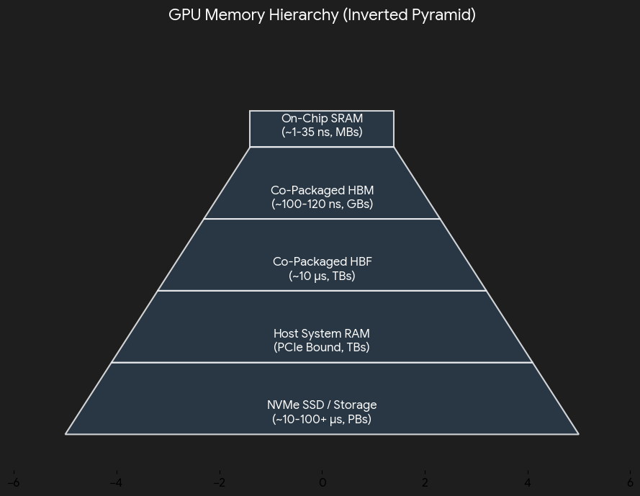
Background – HBF as a xPU Memory Tier !
﻿﻿LLMs are getting larger (in terms of parameters & size), leading to an explosion in “memory size”
﻿﻿HBF: (High Bandwidth Flash, based on SLC NAND)
  HBF can scale to match HBM Bandwidth, and 8x capacity
  Latency is in “us” as compared to ”ns” for DDR
  HBF to augment LPDDR, GDDR, HBM etc.
    For storing static LLM model weights
Inference is 2 workloads, namely Prefill and Decode:
  Prefill is compute bound aka TOPS
  Decode is memory bandwidth bound (need to read in all ACTIVE Weights) to generate the next token
HBF Tier
(capacity)

Slide 3
Introduction
﻿﻿SanDisk is contemplating building a discreet xPU solution based on HBF
  This is a PCI-e based card and supports x16 connectivity to the host.
  The “focus” of this product is for primarily LLM inferencing workloads.
ALL major OEM/ODM have a server (4-8 RU based), which can house 8-10 such cards
  The server/node has a PCI-e Switch(no NVLink required) which is used for inter-card communication.
The server/node is the “building block” for sizing, scaling and deploying LLMs
  If the LLM exceeds the limit for a “building block” i.e. server, then RACK Scale becomes the next “building block”.
  SanDisk solution with 1TB HBF capacity can significantly extend the scaling of a server (for certain workloads).
We demonstrate the value of “above” and use the industry leader discreet GPU card (RTX 6000 Pro Blackwell) as a comparison
  Since this would be a future (estimated 2028 introduction), we estimated the next generation RTX-NG capability:
    144 GB of GDDR8, 2000 TOPS (compute capability), and 2.2TB/s of GDDR8 Bandwidth (600W).
    For SanDisk ATMOS card, 128GB of LPDDR @ 400GB/s and 1TB HBF @ 1.6TB/s (200W).

Slide 4
Challenges in deploying enterprise LLMs on premises
LLMs continue to get larger (in terms of parameters & size), and no longer FIT into a single GPU
Sizing
Number of users and the TPS (& TTFT)required for each user (if the AI application is user facing)
What is the ”context length” (size for max ?) for each user
Then size the minimum xPUs needed and the most optimal way to deploy the LLM (Tensor or Pipeline or Data Parallelism; for MoE models perhaps Expert Parallelism)
﻿﻿Scaling
Addition users once the AI application is deployed (move from node level to rack scale ?)
Will adding more nodes (with xPUs) scale linearly or need to re-shard the model ?
The AI Application is a “batch processing app” (longer TTFT acceptable), is there a better way to scale ?
And the TCO ($/Million Tokens) & the Software for Deployment !

Slide 5
LLM Inference Workloads: Latency-Sensitive vs Latency-Tolerant( Batch)
Latency-Sensitive (per-user TPS)
Extreme Throughput
(Max VRAM Saturation)
Voice Assistants
(Ultra-low TTF)
Latency-tolerant (Aggregate TPS)
Customer Chatbots
(Streaming UX)
High TPS
(High multi-user/queue)
Require System Throughput (TPS)
IDE Autocomplete
(Fast inter-token)
High-volume Enterprise Batch
(Offline Analytics)
Enterprise RAG
(Balanced Latency)
Low/Moderate TPS
(Deep or single-stream)
Log and Telemetry Analysis
(Anomaly Detection, Parsing)
Small / Short Context
(e.g., 8B / 8K)
Medium / Mid Context
(e.g., 70B / 32K)
Large / Long Context
(e.g., 405B / 128K+)
Scale Complexity (Increasing Model Size & Context Length)

Slide 6
Experiments across these 2 workloads
Llama-3-8B parameter model (8k,16k,32k) – Latency Sensitive
DeepSeek v4 pro (MoE) model which has 1.6T Parameter, with 49B active per query (128k,512k,1M) – Latency Tolerant (Batch)

Slide 7
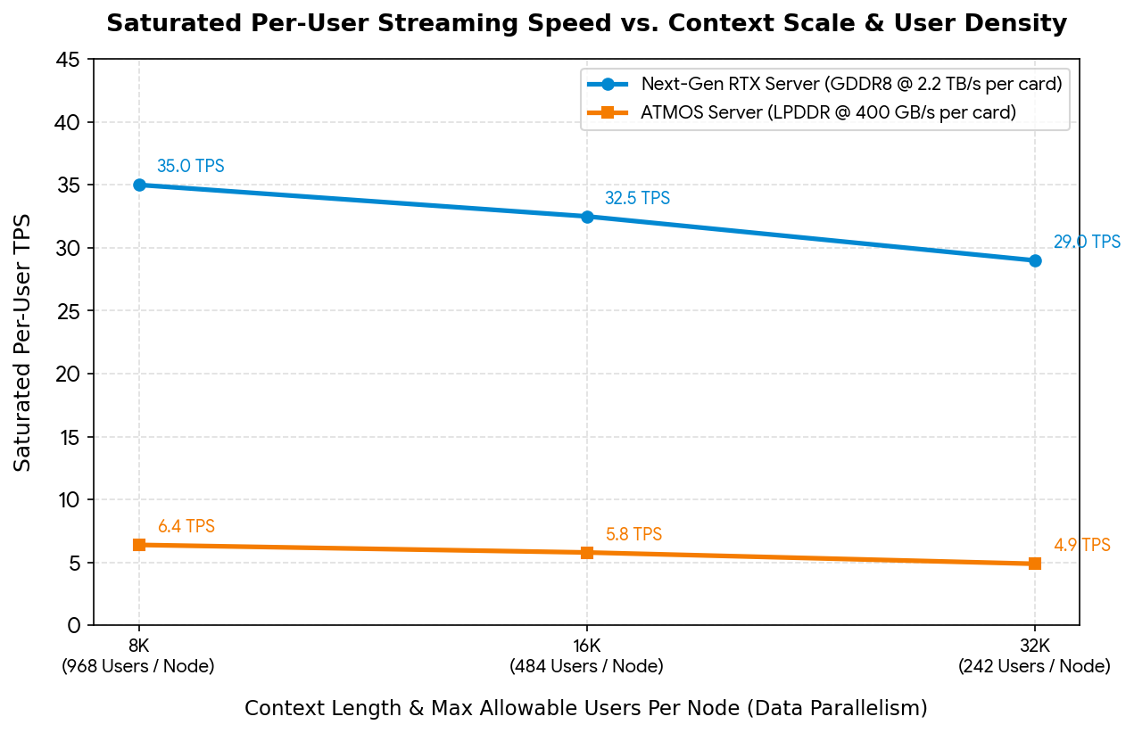
Latency-Sensitive workload
Llama-3-8B parameter model
(max context length – 128k tokens)
Data Parallelism across both
(model FITS into each card)
TTFT(8k) 64ms vs 250ms
(7,744.0 ms vs 30,250.0 ms)
(8k - Saturated @968 users)
RTX-NG wins !

Slide 8
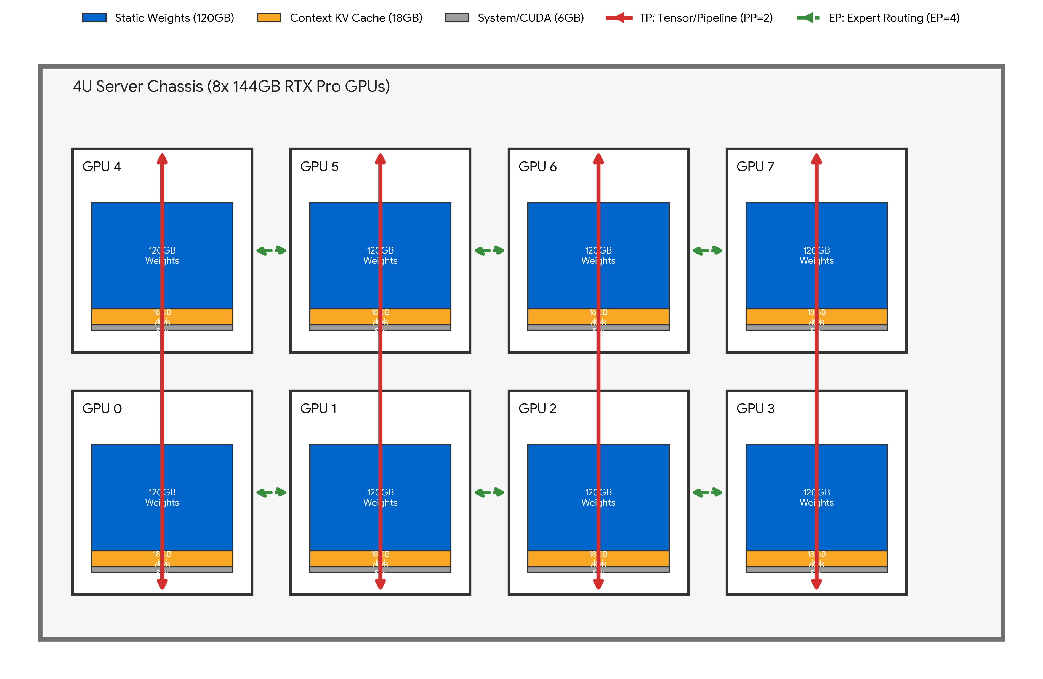
Latency-Tolerant (batch) workload – For RTX-NG
DeepSeek-V4 (1.6T MoE) model
Requires: 800 + 160 = 960GB
The MoE Experts (FP4): ~800 GB.
The Critical Layers (FP8): ~160GB.
The model needs to be sharded across all 8 RTX-NG cards
Expert Parallelism = 4
Tensor Parallelism = 2
Each token generated requires communication across all GPUs

Slide 9
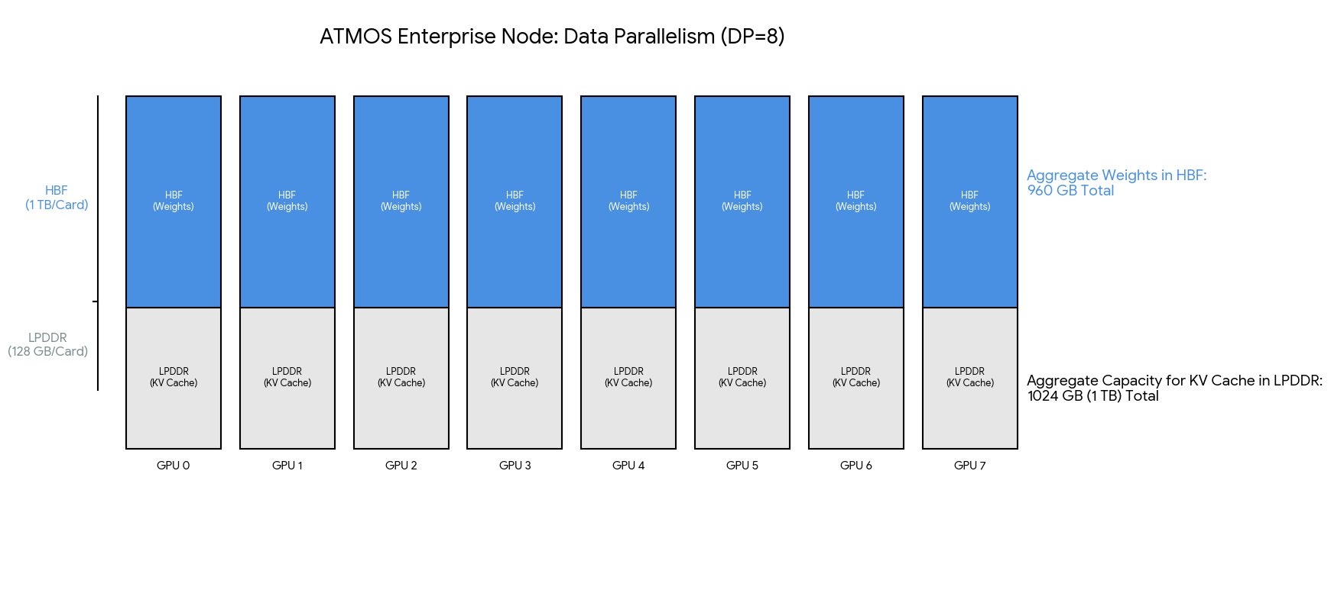
Latency-Tolerant (batch) workload - ATMOS
DeepSeek-V4 (1.6T MoE) model
Data Parallelism = 8
ALL weights in HBF (960GB)
128 GB of LPDDR for KV Cache
Each token generated requires zero communication across xPUs

Slide 10
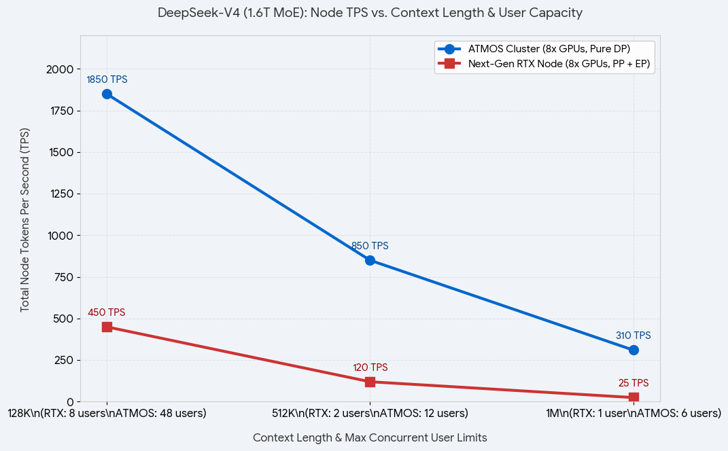
Latency-Tolerant (batch) workload
DeepSeek-V4 (1.6T MoE) model
(max context length – 1M tokens)
450 TPS vs 1850 TPS
TTFT(128k) 3.8s vs 0.8s
ATMOS wins !

Slide 11
Feedback & Discussion
LLMs & use case(s)
Which LLMs do you currently deploy on premises
LLM serving for Online OR Offline/Batch processing
Which OEM/ODM do you use (Dell, HPE, Cisco-UCS etc.)
Which xPU vendors are currently deployed
What are your current challenges ?
Would ATMOS fit into your use cases ?
ATMOS – Software Stack
LLM Repository for Pre-Compiled Models
Inference Engine: vLLM; SGLang (?); TensorRT-LLM (?)
Framework: PyTorch; JAX ?
Which CUDA-Like Libraries ?
ATMOS Base:
  Driver; Compiler; Runtime; Optimizer & Tools
  Open Source ? Which OS ? (Ubuntu/RHEL)

Slide 12
BACKUP

Slide 13
Results – raw (Llama 8B model)
8K Context Window🔸 Unsaturated TTFT (1 user)~64.0 ms~250.0 msRTX’s 2000 TOPS processes prompt matrices ~3.9x faster.🔸 Saturated TTFT (968 users)~7,744.0 ms~30,250.0 msCompute queues stack up uniformly as total prompt loads inflate.🔸 Saturated ITL (per user)~28.6 ms / token~156.3 ms / tokenRTX reads KV data over a 2.2 TB/s bus vs. ATMOS's 400 GB/s LPDDR.
16K Context Window🔸 Unsaturated TTFT (1 user)~128.0 ms~500.0 msProcessing workload doubles precisely with the prompt size.🔸 Saturated TTFT (484 users)~7,680.0 ms~30,000.0 msConstant scale; half the users submit twice the prompt length.🔸 Saturated ITL (per user)~30.8 ms / token~172.4 ms / tokenAttention matrices stretch out, increasing the retrieval latency overhead.
32K Context Window🔸 Unsaturated TTFT (1 user)~256.0 ms~1,000.0 ms (1.0s)Large context size pushes single-user ATMOS prefill to a full second.🔸 Saturated TTFT (242 users)~7,680.0 ms~30,000.0 msAggregate node compute remains fully saturated.🔸 Saturated ITL (per user)~34.5 ms / token~204.1 ms / tokenSlower LPDDR strains under deeper 32K context lookups.

Slide 14
Data – raw (deepseekv4 – 1.6T)
Performance & Bottleneck Analysis
(8x GPUs, PP + EP) Next-Gen RTX Node
(8x GPUs, Pure DP) ATMOS Enterprise Node
Performance & Bottleneck Analysis
128KTTFT
TPS3.8 seconds
~450 TPS0.8 seconds
~1,850 TPSRTX: Pipeline bottlenecks (PP) and Expert Parallelism (EP) hops across consumer PCIe slots add latency during prefill.
ATMOS: Runs unified data parallelism (DP); massive interconnect bandwidth speeds up token ingest.
512KTTFT
TPS18.5 seconds
~120 TPS3.2 seconds
~850 TPSRTX: Memory pooling overhead forces small micro-batching. Activation caching slows to a crawl.
ATMOS: High VRAM headroom accommodates huge batches comfortably, keeping generation lanes wide.
1MTTFT
TPS52.0 seconds
~25 TPS7.9 seconds
~310 TPSRTX: Near-serial processing limits performance. Prefill experiences severe latency while processing the massive 1M token window.
ATMOS: Hardware handles the complex attention matrices efficiently, keeping processing time within operational limits.

Slide 15
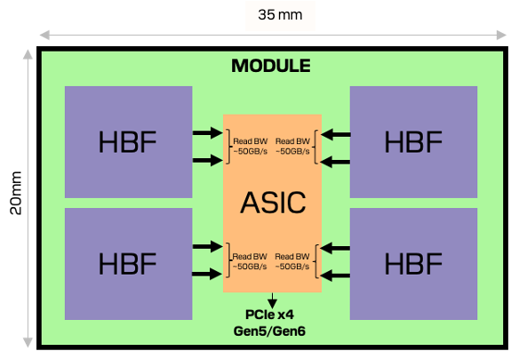
IMA Card
8-16GB LPDDR5X
@ 50GB/s
IMA PCIe Full Length Add-In Card
Up to 128GB
@ 200 GB/s
Module 1
Module 2
Module 8
Up to 32 MB
64 TOPS/TFLOPS
(INT8/FP8)
NPU (FP8): 512 TFLOPS
HBF Capacity: 1 TB
BGA
 | Capacity | Read BW | Write BW | Access (min)
HBF | 1 TB | 1.6 TB/s | 64 GB/s | 4KB
DRAM | 64-128 GB | 400 GB/s | 400 GB/s | 32B
SRAM (SoC) | 256 MB | 4 TB/s | 4 TB/s | 64B
SRAM (NPU) | 96 MB | >10 TB/s | >10 TB/s

Slide 16
Technical Specifications (ATMOS) – 10X Capacity @ 1/3th Power
Component | Specification | ATMOS (8 Modules) | UNDER CONSIDERATION ------ATMOS (4 Modules)
HBF Capacity | Unified Memory Fabric | 1024 GiB | 512 GiB
HBF Bandwidth | Read/Write Peak | 1600/96 GiB/s | 800/48 GiB/s
NPU Modules | Configurable | 8 Modules | 4 Modules
Compute Power | TOPS Range (INT8/FP8/BF16) | 512 TOPS | 256 TOPS
Power Profiles | Performance/Efficiency | <200W / ~100W (Active Air Cooled) | <100W / ~80W
Host Interface | PCIe Connectivity | Gen5 x16 (Gen 6 opt) | Gen5 x16
Form Factor | Physical Design | FH-FL, Dual-slot | FH-FL, Dual-slot
Persistence | Non-volatile Model Storage (Data at Rest Encryption) | Encryption: AES-XTS 256 | Encryption: AES-XTS 256
DRAM | LPDDR5 | 64-128 GB | 32-64 GB

Slide 17
TARGET VERTICALS
Financial Sector -→ DELL (OEM) → JPMC, GS etc
Healthcare Sector → HPE (OEM) → Athena, others ?
Telecom Sector → CISCO/UCS (OEM) → Comcast, At&T, Verizon, …. BT ..all across the world
HOW ABOUT HPC- MARKETS
1. is use of LLMs being adopted ?
2. are there any Transformer based models (other than LLMs) which fit ATMOS profile ?

Slide 18
ASKs…
What are the OS (Ubuntu/RHEL/Windows) you bundle with your solutions ?
What are the models(LLMs and others) most commonly deployed for your verticals ?
What level of support do you bundle with your solutions ?
What Inference Engines NVIDIA Dynamo, vLLM or SGLang ?
What CUDA-like libraries are a must-have (cuGraph etc..) for your solutions ?
Should we open source our drivers/compilers/tools etc ?
Which 3rd party Solution providers/ISV/VARs should we engage with ?

