Slide 1
SANDISK
ATMOS / BACKGROUND
GPT-in-a-box is real. Win the workload, not the category.
Local, governed inference is a product opportunity—not a claim that the market lacks private AI.
DEMAND | bring AI to the data
SUPPLY | a system, not a chip
SCOPE | bounded enterprise AI
Private documents, predictable service and controlled updates drive local deployments. EPRI is a documented deskside example.
Spark, RTX, Station and turnkey platforms already compete. Delivery also requires OEM qualification, certified models, inventory and field support.
Target search, reranking, document work and qualified private generation. Exclude training, graphics and safety-critical control.
WHY SANDISK
Public HBF standardization is a strategic entry point.
The product still has to prove better service economics on capacity-oriented work—without presenting HBF as extra GPU memory.
SanDisk opening: resident model/data capacity + certified knowledge services + one accountable lifecycle.
[I1] [S02] [S14] [S15] [S20]
INTERNAL CONCEPT • 7 OCT 2026 • PUBLIC EVIDENCE + UNQUALIFIED ATMOS TARGETS
DETAIL: V3 §1
M01
Notes:
Presenter guidance
Opening thesis: productize a governed local knowledge service, not a universal GPU replacement. “GPT-in-a-box” is generic shorthand for a privately deployed supported model service; it does not promise OpenAI GPT weights. Edge here includes controlled office/departmental or regional deployments, not every industrial real-time controller. Supply/logistics items are proposed delivery obligations; no GPU shortage, lead time, market CAGR or share forecast is claimed. A public HBF standards milestone does not certify an ATMOS appliance.
Evidence basis: internal V3 requirements are retained. Public material reviewed 7 October 2026. Published/vendor-reported ≠ independently matched benchmark. ATMOS numbers are targets or calculations, never achieved performance. OEM order is an advisory recommendation, not a partnership.
Sources
[I1] SanDisk ATMOS AI Appliance Strategy / PRD v3
SanDisk_ATMOS_AI_Appliance_Strategy_PRD_v3.docx
[S02] NVIDIA customer story — EPRI
https://www.nvidia.com/en-us/case-studies/epri/
[S14] HPE — Private Cloud AI / enterprise AI solutions
https://www.hpe.com/us/en/newsroom/press-release/2025/03/hewlett-packard-enterprise-introduces-new-enterprise-ai-solutions-with-nvidia-to-accelerate-time-to-value-for-generative-agentic-and-physical-ai-models.html
[S15] Nutanix — GPT-in-a-Box 2.0
https://www.nutanix.com/press-releases/2024/nutanix-accelerates-enterprise-adoption-of-generative-ai
[S20] SanDisk / SK hynix — HBF OCP specification
https://www.sandisk.com/company/newsroom/press-releases/2026/2026-08-03-Sandisk-and-sk-hynix-advance-global-standardization-of-hbf

Slide 2
SANDISK
ATMOS / CUSTOMER EVIDENCE
Named users show where local AI is already being used.
Public customer stories—not purchase records, installed-base estimates or ATMOS customer commitments.
Organization / vertical
Named local platform
Documented activity
ATMOS-relevant boundary
EPRI / energy
Dell Pro Max GB10
DGX Spark platform
Power Chat local document assistant
Knowledge workflow is relevant; published results are on GB10.
CYRAN AI / geospatial
DGX Spark
GPU JPEG2000 processing of large satellite scenes
Metadata / report retrieval is a candidate; image decoding is not the launch target.
Arup / engineering
DGX Spark
GNN structural-design surrogates
Engineering knowledge is adjacent; do not claim simulation replacement.
Aible / enterprise AI
DGX Spark → Google Cloud
Air-gapped agent prototyping; cloud production path
Proof of local evaluation, not a measured on-prem production fleet.
Lowe’s / retail
Dell RTX workstations;
separate edge servers
Digital twins; edge computer vision
Product knowledge is an adjacent use; store count is not workstation count.
EPRI / energy
DGX Station GB300
Local weather-model execution
Confirms Station use; weather timing is not generation TTFT.
Do not turn a cloud case into an edge deployment—or a simulation result into an LLM benchmark.
[S02] [S03] [S04] [S05] [S06]
INTERNAL CONCEPT • 7 OCT 2026 • PUBLIC EVIDENCE + UNQUALIFIED ATMOS TARGETS
DETAIL: V3 §15–17
M02
Notes:
Presenter guidance
Keep evidence labels narrow. The EPRI hardware is a Dell GB10 implementation, not proof of a NVIDIA-branded unit purchase. Aible is explicitly a prototype-to-cloud pattern. Lowe’s has multiple execution environments; do not assign its entire GenAI stack or store estate to RTX workstation hardware. These cases establish workflow activity, not units sold or revenue.
Evidence basis: internal V3 requirements are retained. Public material reviewed 7 October 2026. Published/vendor-reported ≠ independently matched benchmark. ATMOS numbers are targets or calculations, never achieved performance. OEM order is an advisory recommendation, not a partnership.
Sources
[S02] NVIDIA customer story — EPRI
https://www.nvidia.com/en-us/case-studies/epri/
[S03] NVIDIA customer story — CYRAN AI / IIT Delhi
https://www.nvidia.com/en-us/case-studies/cyran-iit-delhi/
[S04] NVIDIA customer story — Arup
https://www.nvidia.com/en-us/case-studies/arup/
[S05] Google Cloud customer story — Aible
https://cloud.google.com/customers/aible
[S06] NVIDIA customer story — Lowe’s
https://www.nvidia.com/en-gb/case-studies/lowes/

Slide 3
SANDISK
ATMOS / REVENUE BOUNDARY
NVIDIA discloses Edge revenue—not its vertical allocation.
Q2 FY2027 • quarter ended 26 July 2026 • market-platform reporting, USD billions.
$96.221B
$89.023B
$7.198B
Total revenue
Data Center
Edge Computing
Edge = 7.48% of total (calculated)
NOT DISCLOSED
Banking / insurance / energy / retail shares
Spark-only or RTX AI-workstation-only sales
Revenue attributable to named customers
Data Center
Edge
The filing links Edge growth to Blackwell workstations and notes consumer-PC price pressure.
Do not call all Edge Computing “enterprise edge AI”; do not allocate it using customer-logo counts.
[S01]
INTERNAL CONCEPT • 7 OCT 2026 • PUBLIC EVIDENCE + UNQUALIFIED ATMOS TARGETS
DETAIL: V3 §15
M03
Notes:
Presenter guidance
Amounts are taken from the 10-Q market-platform table. Calculate 7198/96221×100 = 7.480696%. Edge includes a broader product scope than the proposed enterprise knowledge appliance. No vertical split is inferred. Do not add the historical Professional Visualization figure to this recast category or annualize one quarter as a forecast.
Evidence basis: internal V3 requirements are retained. Public material reviewed 7 October 2026. Published/vendor-reported ≠ independently matched benchmark. ATMOS numbers are targets or calculations, never achieved performance. OEM order is an advisory recommendation, not a partnership.
Sources
[S01] NVIDIA FY2027 Q2 Form 10-Q
https://www.sec.gov/Archives/edgar/data/1045810/000104581026000075/nvda-20260726.htm

Slide 4
SANDISK
ATMOS / VERTICAL PRIORITY
Prioritize vertical workflows with public demand signals.
The requested industry revenue split is unavailable. The actionable alternative is a workload-led prospect map.
Vertical / V3 rank
Public company signal
Platform evidence
Share of NVIDIA Edge
Candidate ATMOS entry
Finance / insurance · 1
Nasdaq
L40 + NIM / Retriever; no Spark or edge-location proof
Not disclosed
E8/E16: policy, claims and investigation evidence
Industrial knowledge · 2
Arup (engineering)
Spark GNN design work; factory-knowledge fit is an adjacent hypothesis
Not disclosed
D8/E16: manuals and quality-record search
Energy / utilities · 3
EPRI
GB10 local knowledge service
Not disclosed
D8/E8: engineering / procedure assistant
Government · 5
ThinkDeep / French agencies
Sovereign document / agent platform; no Spark unit count
Not disclosed
E16: controlled evidence and offline operations
Telecom · 6
Amdocs
DGX Cloud / NIM agents; not proof of edge hardware
Not disclosed
E16/E24: regional ticket and runbook catalog
Retail · 7
Lowe’s
RTX workstations + store-edge systems; mixed workloads
Not disclosed
D8/E16: product / associate knowledge
Finance, manufacturing knowledge and energy lead the V3 priority; qualification and a funded buyer decide.
[I1] [S01] [S02] [S04] [S06] [S07] [S08] [S09]
INTERNAL CONCEPT • 7 OCT 2026 • PUBLIC EVIDENCE + UNQUALIFIED ATMOS TARGETS
DETAIL: V3 §16–17
M04
Notes:
Presenter guidance
V3’s rank is a qualitative near-term product/ROI prioritization, not market-size share or measured returns. The industrial row pairs V3’s manufacturing-knowledge priority with adjacent engineering evidence from Arup; that does not establish an Arup factory-knowledge deployment. Nasdaq names L40 hardware and self-hosted embedding services, but no Spark system or Edge revenue mapping. The rightmost column is our proposed ATMOS use-case mapping, not reported customer adoption.
Evidence basis: internal V3 requirements are retained. Public material reviewed 7 October 2026. Published/vendor-reported ≠ independently matched benchmark. ATMOS numbers are targets or calculations, never achieved performance. OEM order is an advisory recommendation, not a partnership.
Sources
[I1] SanDisk ATMOS AI Appliance Strategy / PRD v3
SanDisk_ATMOS_AI_Appliance_Strategy_PRD_v3.docx
[S01] NVIDIA FY2027 Q2 Form 10-Q
https://www.sec.gov/Archives/edgar/data/1045810/000104581026000075/nvda-20260726.htm
[S02] NVIDIA customer story — EPRI
https://www.nvidia.com/en-us/case-studies/epri/
[S04] NVIDIA customer story — Arup
https://www.nvidia.com/en-us/case-studies/arup/
[S06] NVIDIA customer story — Lowe’s
https://www.nvidia.com/en-gb/case-studies/lowes/
[S07] NVIDIA customer story — Nasdaq
https://www.nvidia.com/en-us/case-studies/nasdaq/
[S08] NVIDIA customer story — ThinkDeep AI
https://www.nvidia.com/en-eu/case-studies/thinkdeep-sovereign-ai-agents-automate-public-services/
[S09] NVIDIA customer story — Amdocs
https://www.nvidia.com/en-eu/case-studies/amdocs-builds-generative-ai-agents-for-telecom/

Slide 5
SANDISK
ATMOS / COMPETITIVE GAP MAP
The opportunity: capacity economics inside a managed service.
An occupied market: privacy, local models, high memory and turnkey operations are already available.
LOCAL DEVELOPER
LARGE LOCAL COMPUTE
MANAGED ENTERPRISE
DGX Spark / GB10
RTX workstations
DGX Station
High-memory Mac Studio
HPE Private Cloud AI
Nutanix GPT-in-a-Box
Fast iteration and broad GPU software.
A strong control for small, active models.
Large working memory and local model capability.
Capacity is not an empty category.
Integrated operations, serving and lifecycle.
Turnkey is table stakes.
ATMOS GAP TO PROVE
Larger resident catalog / richer evidence at moderate query demand
Certified CPU + NPU work allocation, local governance, modular capacity and a supported OEM appliance.
Position ATMOS as a candidate for resident knowledge capacity—not as the fastest or only private-AI box.
[I1] [S10] [S11] [S12] [S14] [S15] [S21]
INTERNAL CONCEPT • 7 OCT 2026 • PUBLIC EVIDENCE + UNQUALIFIED ATMOS TARGETS
DETAIL: V3 §1,15
M05
Notes:
Presenter guidance
This is a qualitative positioning map, not a price/performance plot or a claim that competitors lack a capability. Mac Studio is included because the current Apple specification supports high-memory local configurations; no matched inference score is assigned. HPE/Nutanix establish that private-AI management and turnkey deployment already exist. The ATMOS opportunity remains conditional on service-level value.
Evidence basis: internal V3 requirements are retained. Public material reviewed 7 October 2026. Published/vendor-reported ≠ independently matched benchmark. ATMOS numbers are targets or calculations, never achieved performance. OEM order is an advisory recommendation, not a partnership.
Sources
[I1] SanDisk ATMOS AI Appliance Strategy / PRD v3
SanDisk_ATMOS_AI_Appliance_Strategy_PRD_v3.docx
[S10] NVIDIA DGX Spark hardware guide
https://docs.nvidia.com/dgx/dgx-spark/hardware.html
[S11] NVIDIA RTX PRO 6000 Blackwell Workstation Edition
https://www.nvidia.com/en-us/products/workstations/professional-desktop-gpus/rtx-pro-6000/
[S12] NVIDIA DGX Station development guide — system overview
https://docs.nvidia.com/dgx/dgx-station-development-guide/overview.html
[S14] HPE — Private Cloud AI / enterprise AI solutions
https://www.hpe.com/us/en/newsroom/press-release/2025/03/hewlett-packard-enterprise-introduces-new-enterprise-ai-solutions-with-nvidia-to-accelerate-time-to-value-for-generative-agentic-and-physical-ai-models.html
[S15] Nutanix — GPT-in-a-Box 2.0
https://www.nutanix.com/press-releases/2024/nutanix-accelerates-enterprise-adoption-of-generative-ai
[S21] Apple — Mac Studio technical specifications
https://www.apple.com/mac-studio/specs/

Slide 6
SANDISK
ATMOS / WORKLOAD FIT HEATMAP
Choose the workload where extra resident capacity has a job.
Qualitative fit screen: “candidate” means a pilot is justified—not that ATMOS is faster or cheaper.
Workload
Spark / RTX
Station / GPU server
Managed private AI
ATMOS W4–E24
One small interactive model
Established
control
Established
control
Established
control
Must beat a
low-cost control
Graphics, training, simulation
Established
control
Established
control
Platform dependent
Outside
launch scope
Large resident model / evidence catalog
Capacity/config
dependent
Established
control
Established
control
ATMOS
candidate
Governed departmental RAG
Application stack
required
Application stack
required
Established
control
ATMOS
candidate
Rich reranking / batch document work
Benchmark
required
Established
control
Established
control
ATMOS
candidate
Ultra-low token latency at large context
Model / load
dependent
Established
control
Backend
dependent
Not a broad
launch promise
Keep an optimized CPU/DRAM control. Small indexes often do not justify another accelerator tier.
[I1] [S10] [S11] [S12] [S14] [S15]
INTERNAL CONCEPT • 7 OCT 2026 • PUBLIC EVIDENCE + UNQUALIFIED ATMOS TARGETS
DETAIL: V3 §6,16–17
M06
Notes:
Presenter guidance
Fit judgments combine the preserved PRD scope with public competitor capability categories. They are not benchmark ranks, customer demand percentages or numerical ROI scores. A GPU or managed platform can win in every row if its measured total service cost is lower. HBF only helps when the certified kernels actually exploit useful local data/model residency; storage size alone is not the benefit.
Evidence basis: internal V3 requirements are retained. Public material reviewed 7 October 2026. Published/vendor-reported ≠ independently matched benchmark. ATMOS numbers are targets or calculations, never achieved performance. OEM order is an advisory recommendation, not a partnership.
Sources
[I1] SanDisk ATMOS AI Appliance Strategy / PRD v3
SanDisk_ATMOS_AI_Appliance_Strategy_PRD_v3.docx
[S10] NVIDIA DGX Spark hardware guide
https://docs.nvidia.com/dgx/dgx-spark/hardware.html
[S11] NVIDIA RTX PRO 6000 Blackwell Workstation Edition
https://www.nvidia.com/en-us/products/workstations/professional-desktop-gpus/rtx-pro-6000/
[S12] NVIDIA DGX Station development guide — system overview
https://docs.nvidia.com/dgx/dgx-station-development-guide/overview.html
[S14] HPE — Private Cloud AI / enterprise AI solutions
https://www.hpe.com/us/en/newsroom/press-release/2025/03/hewlett-packard-enterprise-introduces-new-enterprise-ai-solutions-with-nvidia-to-accelerate-time-to-value-for-generative-agentic-and-physical-ai-models.html
[S15] Nutanix — GPT-in-a-Box 2.0
https://www.nutanix.com/press-releases/2024/nutanix-accelerates-enterprise-adoption-of-generative-ai

Slide 7
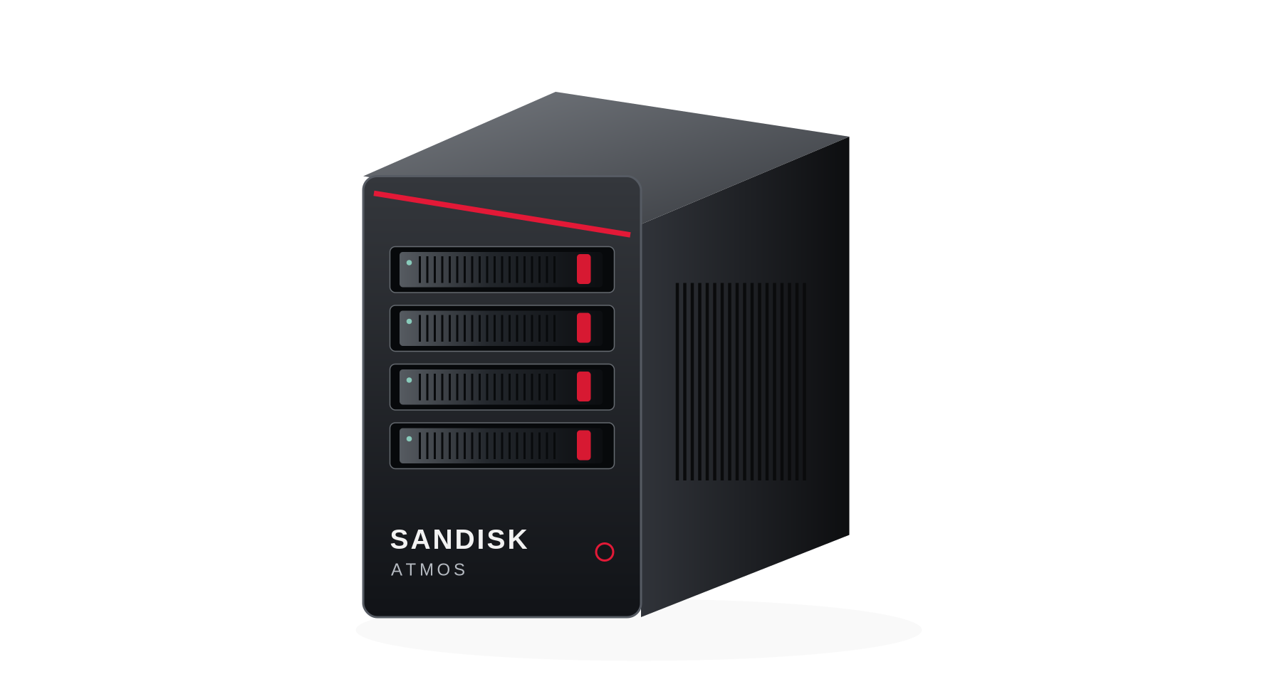
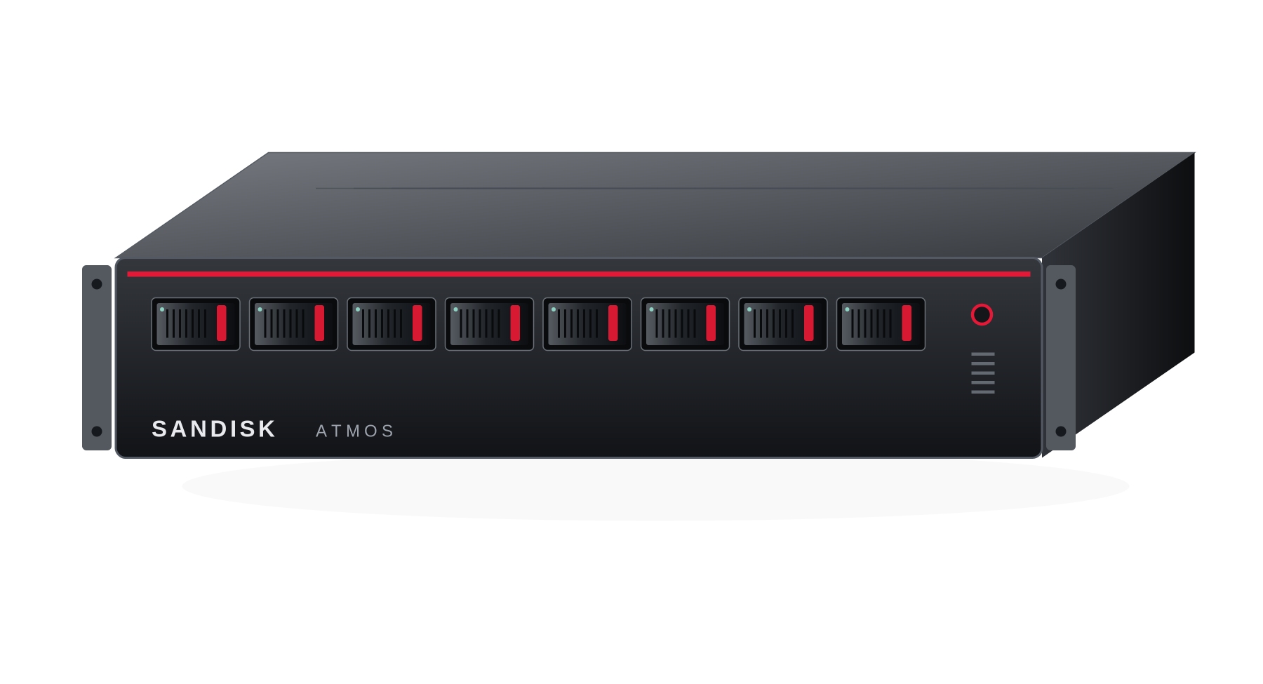
SANDISK
ATMOS / SKU → CUSTOMER OUTCOME
W4 and D8/E8 serve different operational scales.
Proposed example workflows derived from the PRD—not deployments attributed to the named NVIDIA customers.
W4 | private matter / engineering desk
D8 / E8 | insurance claims evidence
4 modules • 400 GB HBF study allocation
8 modules • 800 GB HBF study allocation
A specialist keeps confidential reference collections local. Start with retrieval-only; add a certified generator when useful.
A department shares policy and document intelligence through quotas, versioned collections and controlled queues.
Approved files → cited search → draft summary
Claim file + policy → rerank → reviewer evidence
Prove: time to accepted evidence, ACL correctness,
local operation and acceptable office acoustics.
Prove: reviewer acceptance, citation quality,
case-preparation time and recovery behavior.
R1 target ≥5 QPS • G1 target ≥40 output tok/s
R1 target ≥10 QPS • G1 target ≥80 output tok/s
Appliance images: V3 concepts only. R1 and G1 are separate qualification profiles—not combined workload results.
D8 and E8 have the same capacity/performance envelope; E8 adds the production integration and support profile.
[I1]
INTERNAL CONCEPT • 7 OCT 2026 • PUBLIC EVIDENCE + UNQUALIFIED ATMOS TARGETS
DETAIL: V3 §2,5,16
M07
Notes:
Presenter guidance
Preserve the PRD’s exact W4/D8/E8 names; there is no D4 SKU in the controlling document. Images reuse the accepted V3 hypothetical appliance illustrations, not shipping hardware. Workflow descriptions are proposed examples. R1 and G1 are separate test profiles from V3 §5 and cannot run at their maxima simultaneously by assumption. W4 is not a service-HA system. E8 does not gain throughput merely by changing its commercial support tier. Neither workflow makes autonomous legal, engineering-safety or claims-payment decisions.
Evidence basis: internal V3 requirements are retained. Public material reviewed 7 October 2026. Published/vendor-reported ≠ independently matched benchmark. ATMOS numbers are targets or calculations, never achieved performance. OEM order is an advisory recommendation, not a partnership.
Sources
[I1] SanDisk ATMOS AI Appliance Strategy / PRD v3
SanDisk_ATMOS_AI_Appliance_Strategy_PRD_v3.docx

Slide 8
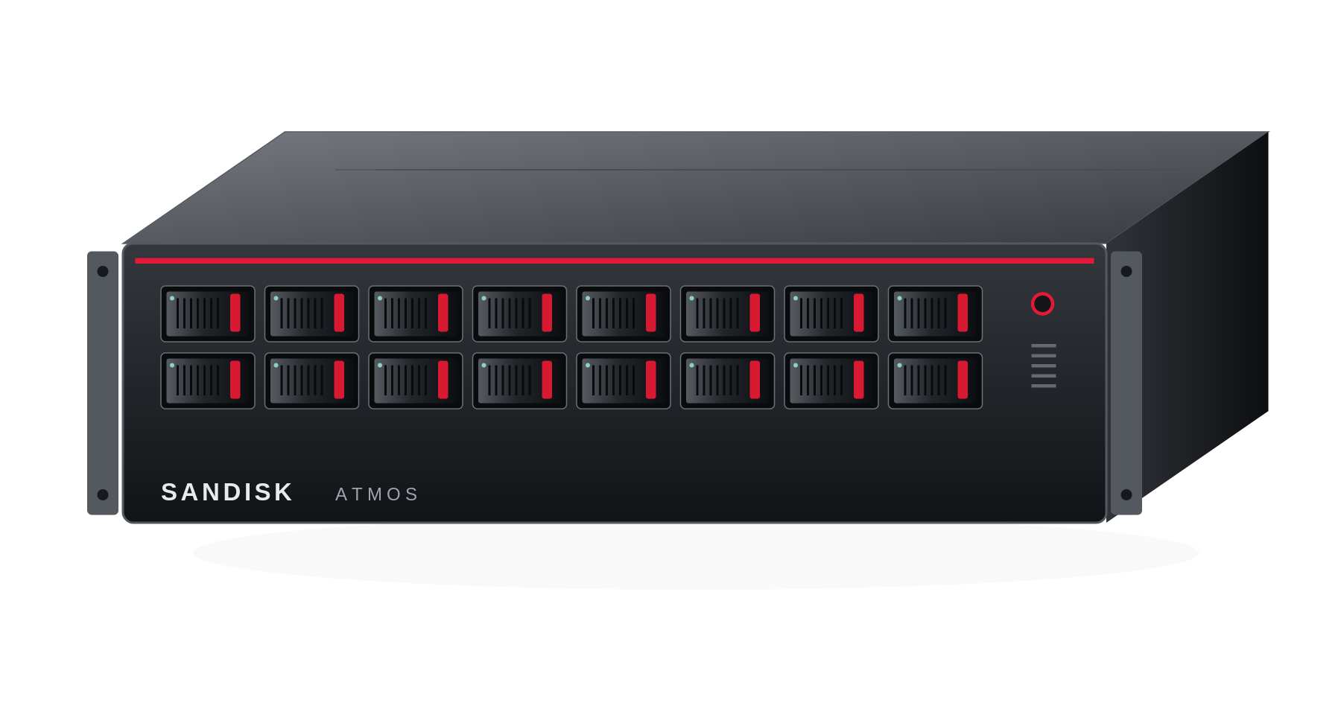
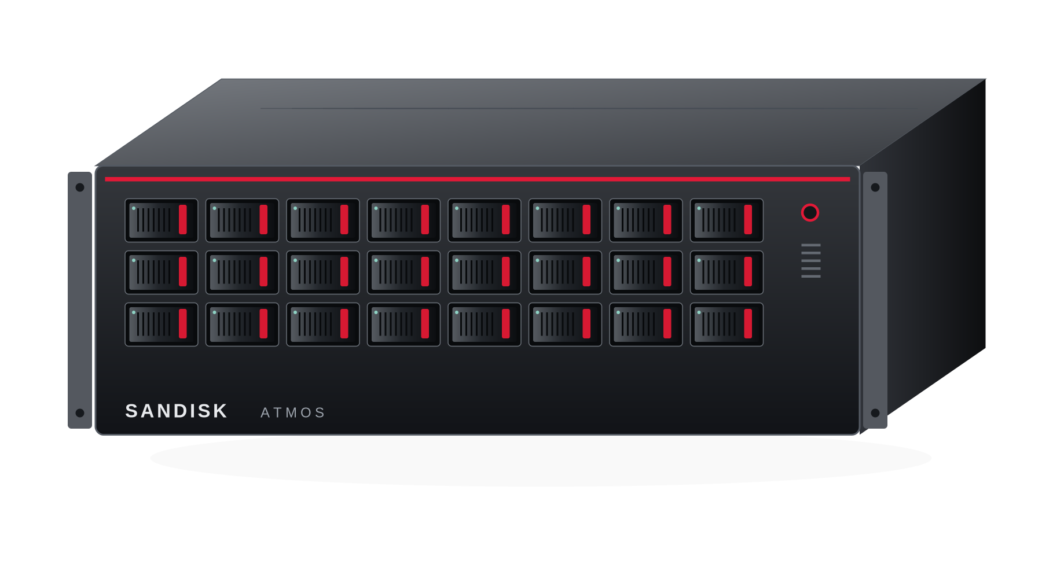
SANDISK
ATMOS / SKU → CUSTOMER OUTCOME
E16 and E24 scale shared services—not single-token speed.
Add complete serving groups and durable operations. Device count is not user count or an HA guarantee.
E16 | bank policy and investigation service
E24 | regional telecom knowledge hub
16 modules • 1.6 TB HBF study allocation
24 modules • 2.4 TB HBF study allocation
Multiple business teams share approved policy, KYC and investigation knowledge with tenant isolation and audit.
Several service catalogs and retained generations support regional runbooks, ticket similarity and batch summaries.
Tenant identity → governed evidence → cited answer
Tickets + manuals → evidence → operator draft
Use complete replicas across nodes for N+1.
Measure retained peak capacity after a failure.
Prove catalog residency, freshness, handle time
and safe upgrades—not network control.
R1 target ≥20 QPS • G1 target ≥160 output tok/s
R1 target ≥30 QPS • G1 target ≥240 output tok/s
Appliance images: V3 concepts only. R1 and G1 are separate qualification profiles—not combined workload results.
E24 is a gated stretch profile. Confirm six-domain communication, thermals, real demand and service economics.
[I1]
INTERNAL CONCEPT • 7 OCT 2026 • PUBLIC EVIDENCE + UNQUALIFIED ATMOS TARGETS
DETAIL: V3 §2,5,9,16
M08
Notes:
Presenter guidance
Use cases follow the V3 finance and telecom catalog. They are not claims that Nasdaq or Amdocs bought ATMOS. E16 is the initial enterprise proof profile; E24 only advances after lower-density qualification. Complete service replicas, control quorum and durable source/index/audit protection are separate. A node with more unique shards does not automatically survive a node or device loss. Source KPI targets are preserved and apply separately to G1 and R1.
Evidence basis: internal V3 requirements are retained. Public material reviewed 7 October 2026. Published/vendor-reported ≠ independently matched benchmark. ATMOS numbers are targets or calculations, never achieved performance. OEM order is an advisory recommendation, not a partnership.
Sources
[I1] SanDisk ATMOS AI Appliance Strategy / PRD v3
SanDisk_ATMOS_AI_Appliance_Strategy_PRD_v3.docx

Slide 9
SANDISK
ATMOS / RESOURCE HEATMAP
Memory heatmap: resident capacity ≠ active working memory.
P = published hardware specification. T = internal target. Shading indicates volume only—not performance.
System / evidence
Resident / main memory
Active-state memory
Host / system DRAM
Meaning
DGX Spark / GB10 · P
128 GB unified
Shares the 128 GB
LPDDR5x pool
Same unified pool
One CPU/GPU memory architecture
RTX PRO 6000 WS · P
96 GB GDDR7
Same 96 GB GPU
pool; less weights
OEM host RAM
separate
Workstation Edition reference
DGX Station GB300 · P
748 GB coherent total
252 GB HBM3e +
496 GB CPU LPDDR5x
Included in
748 GB total
HBM and CPU tiers differ
ATMOS W4 · T
512 / 400 GB HBF*
32–64 GB LPDDR
aggregate
128–256 GB
4 devices; 1 domain
ATMOS D8 / E8 · T
1,024 / 800 GB HBF*
64–128 GB LPDDR
aggregate
256–512 GB
8 devices; 2 domains
ATMOS E16 · T
2,048 / 1,600 GB HBF*
128–256 GB LPDDR
aggregate
512 GB–1 TB
16 devices; 4 domains
ATMOS E24 · T
3,072 / 2,400 GB HBF*
192–384 GB LPDDR
aggregate
1 TB+
24 devices; 6 domains; stretch
*Nominal / application study allocation. LPDDR range = 8–16 GB per module; all ATMOS capacities are distributed.
Do not sum HBF + LPDDR + host DRAM into “GPU memory.” Placement, reserve and the native runtime still decide fit.
[I1] [S10] [S11] [S12]
INTERNAL CONCEPT • 7 OCT 2026 • PUBLIC EVIDENCE + UNQUALIFIED ATMOS TARGETS
DETAIL: V3 §2–3,6
M09
Notes:
Presenter guidance
The two classes of memory cannot be ranked as substitutes. The heat scale colors numerical nominal capacity only. ATMOS active-state figures are sums of local LPDDR targets, not a pool transparently accessible to every NPU. GPU rows share model weights, cache and temporary state inside their execution memory; not all of it is free KV. The Station total includes CPU LPDDR. RTX Workstation data must not be mixed with RTX Server Edition specifications.
Evidence basis: internal V3 requirements are retained. Public material reviewed 7 October 2026. Published/vendor-reported ≠ independently matched benchmark. ATMOS numbers are targets or calculations, never achieved performance. OEM order is an advisory recommendation, not a partnership.
Sources
[I1] SanDisk ATMOS AI Appliance Strategy / PRD v3
SanDisk_ATMOS_AI_Appliance_Strategy_PRD_v3.docx
[S10] NVIDIA DGX Spark hardware guide
https://docs.nvidia.com/dgx/dgx-spark/hardware.html
[S11] NVIDIA RTX PRO 6000 Blackwell Workstation Edition
https://www.nvidia.com/en-us/products/workstations/professional-desktop-gpus/rtx-pro-6000/
[S12] NVIDIA DGX Station development guide — system overview
https://docs.nvidia.com/dgx/dgx-station-development-guide/overview.html

Slide 10
SANDISK
ATMOS / BANDWIDTH HEATMAP
Bandwidth heatmap: local feed, device fabric and network.
Local memory feed, device transport and service Ethernet are different resources; none is LLM throughput.
LOCAL MEMORY / ONE ENGINE
ATMOS / INDEPENDENT DOMAIN SUMS (T)
Spark LPDDR5x · P
SKU
Local HBF
read sum
Host uplinks
coded sum
Service network
(GbE)
0.273 TB/s
RTX WS GDDR7 · P
W4
0.8 TB/s
~63 GB/s
25 / 100
1.792 TB/s
D8 / E8
1.6 TB/s
~126 GB/s
100*
Station GPU HBM · P
up to 7.1 TB/s
E16
3.2 TB/s
~252 GB/s
2 × 100/200
ATMOS HBF / module · T
~0.200 TB/s
E24
4.8 TB/s
~378 GB/s
2 × 200/400
PCIe screen: 1 domain = Gen5 x16 → 4 × Gen5 x4. *E8 adds redundant network paths; E24 remains stretch.
Adding ATMOS modules increases independent resource capacity; it does not make one coherent high-bandwidth memory.
[I1] [S10] [S11] [S12]
INTERNAL CONCEPT • 7 OCT 2026 • PUBLIC EVIDENCE + UNQUALIFIED ATMOS TARGETS
DETAIL: V3 §3,6
M10
Notes:
Presenter guidance
Published local-memory values are architecture specifications, not measured effective kernel delivery. HBF ~200GB/s is a target whose access pattern and NPU data path need proof. Four independent local-read targets per domain sum arithmetically; a request may not exploit the sum. Gen5 coded rate = 32GT/s ×128/130 ×16 lanes /8 ≈63.015GB/s per direction, before transaction overhead. 1/2/4/6 domains produce ~63/126/252/378 coded GB/s in independent uplinks, not one client or NPU path. One four-device domain uses the same 16 root lanes as four direct x4 links. Station 7.1TB/s applies to its HBM tier only.
Evidence basis: internal V3 requirements are retained. Public material reviewed 7 October 2026. Published/vendor-reported ≠ independently matched benchmark. ATMOS numbers are targets or calculations, never achieved performance. OEM order is an advisory recommendation, not a partnership.
Sources
[I1] SanDisk ATMOS AI Appliance Strategy / PRD v3
SanDisk_ATMOS_AI_Appliance_Strategy_PRD_v3.docx
[S10] NVIDIA DGX Spark hardware guide
https://docs.nvidia.com/dgx/dgx-spark/hardware.html
[S11] NVIDIA RTX PRO 6000 Blackwell Workstation Edition
https://www.nvidia.com/en-us/products/workstations/professional-desktop-gpus/rtx-pro-6000/
[S12] NVIDIA DGX Station development guide — system overview
https://docs.nvidia.com/dgx/dgx-station-development-guide/overview.html

Slide 11
SANDISK
ATMOS / GENERATION HEATMAP
Service heatmap: targets and the benchmarks to run.
G1: 8B-class model to freeze at G0 • FP8 weights • 2,048 input / 256 output • warm model • no prefix hit.
System
p95 TTFT
p95 inter-token
latency
Aggregate output
tokens/s
Concurrent decode
sequences
Evidence
DGX Spark / GB10
NB
NB
NB
NB
Different public
case on M12
RTX PRO 6000 WS
NB
NB
NB
NB
Different public
test on M12
DGX Station GB300
NB
NB
NB
NB
No common-profile
result sourced
ATMOS W4
≤3 s · T
≤80 ms · T
≥40 · T
4 · T
V3 G1 target
ATMOS D8 / E8
≤3 s · T
≤80 ms · T
≥80 · T
8 · T
V3 G1 target
ATMOS E16
≤3 s · T
≤80 ms · T
≥160 · T
16 · T
V3 G1 target
ATMOS E24
≤3 s · T
≤80 ms · T
≥240 · T
24 · T
Stretch G1 target
NB = not benchmarked on this common profile, not “unsupported.” T = target. p99 target: TTFT ≤5 s; inter-token ≤120 ms.
Gray = no matching benchmark supplied. Red shades = ATMOS scale-out requirements, not measured wins.
[I1] [S02] [S13]
INTERNAL CONCEPT • 7 OCT 2026 • PUBLIC EVIDENCE + UNQUALIFIED ATMOS TARGETS
DETAIL: V3 §5
M11
Notes:
Presenter guidance
All target numbers and the G1 envelope are carried from V3 §5 without reinterpretation. Freeze exact checkpoint, tokenizer, quantization, backend, context/cache state and offered load before a cross-platform run. G1 has an8192-token total context cap, BF16 activations/KV, no speculation and one complete four-device replica per ATMOS domain for the test. Concurrent sequences are not named enterprise users. Throughput and latency targets must pass together; request-average TPOT is not the same as p95 inter-token latency. The legacy G1 rates are requirements, not forecasts. Their implied scale-out feasibility must be tested.
Evidence basis: internal V3 requirements are retained. Public material reviewed 7 October 2026. Published/vendor-reported ≠ independently matched benchmark. ATMOS numbers are targets or calculations, never achieved performance. OEM order is an advisory recommendation, not a partnership.
Sources
[I1] SanDisk ATMOS AI Appliance Strategy / PRD v3
SanDisk_ATMOS_AI_Appliance_Strategy_PRD_v3.docx
[S02] NVIDIA customer story — EPRI
https://www.nvidia.com/en-us/case-studies/epri/
[S13] StorageReview — original RTX PRO 6000 Workstation tests
https://www.storagereview.com/review/nvidia-rtx-pro-6000-workstation-gpu-review-blackwell-architecture-and-96-gb-for-pro-workflows

Slide 12
SANDISK
ATMOS / MEASURED / REPORTED CONTEXT
Public benchmarks establish the local-AI baseline.
Different models, prompts, precision and caching. These results are reference points, not a comparative leaderboard.
CUSTOMER / VENDOR REPORTED
INDEPENDENT ORIGINAL TEST
EPRI • Dell GB10
StorageReview • RTX PRO 6000 WS
35
~150
197.07
0.062 s
tok/s, single user
aggregate at 10 users
output tok/s
reported TTFT
gpt-oss-120b • prefix caching
Post-warmup; no p95 TTFT disclosed.
LM Studio • Llama 3.1 8B Instruct
49 prompt / 822 generated tokens.
DGX Station: public hardware and customer use are documented; no matched G1 LLM result is established here.
ATMOS must run the same frozen workload before claiming better TTFT, throughput, energy or total service cost.
[S02] [S13] [S12]
INTERNAL CONCEPT • 7 OCT 2026 • PUBLIC EVIDENCE + UNQUALIFIED ATMOS TARGETS
DETAIL: V3 §5,15
M12
Notes:
Presenter guidance
Do not rank these cards against each other or against the ATMOS G1 targets. EPRI uses a120B-class model with prefix caching; the workstation test uses a49-token prompt rather than2048. StorageReview does not define a p95 TTFT/ITL distribution or full quantization protocol in the cited results table. EPRI’s approximately15-minute boot/model/document warm-up is not request TTFT. Neither dataset is an ATMOS forecast.
Evidence basis: internal V3 requirements are retained. Public material reviewed 7 October 2026. Published/vendor-reported ≠ independently matched benchmark. ATMOS numbers are targets or calculations, never achieved performance. OEM order is an advisory recommendation, not a partnership.
Sources
[S02] NVIDIA customer story — EPRI
https://www.nvidia.com/en-us/case-studies/epri/
[S13] StorageReview — original RTX PRO 6000 Workstation tests
https://www.storagereview.com/review/nvidia-rtx-pro-6000-workstation-gpu-review-blackwell-architecture-and-96-gb-for-pro-workflows
[S12] NVIDIA DGX Station development guide — system overview
https://docs.nvidia.com/dgx/dgx-station-development-guide/overview.html

Slide 13
SANDISK
ATMOS / RETRIEVAL HEATMAP
Retrieval and reranking: a focused ATMOS entry point.
R1 and G1 are separate service profiles. Full RAG latency and mixed-load capacity require their own test.
R1 qualification target
W4
D8 / E8
E16
E24
Accepted queries/s
≥5
≥10
≥20
≥30
p95 / p99 retrieval + rerank
≤0.5 / 1 s
≤0.5 / 1 s
≤0.5 / 1 s
≤0.5 / 1 s
Evidence status
Target only
Target only
Target only
Stretch target
Frozen R1: 1M × 512-token chunks; 128-token query; CPU shortlist; ≤100 rerank candidates, each ≤384 tokens.
10.24 GB
5M chunks × one
1,024-d FP16 vector
163.84 GB
5M × 128 vectors
× 128-d FP16
Sell richer accepted evidence or lower service cost—not more bytes for a workload already served cheaply.
[I1]
INTERNAL CONCEPT • 7 OCT 2026 • PUBLIC EVIDENCE + UNQUALIFIED ATMOS TARGETS
DETAIL: V3 §5–6,17
M13
Notes:
Presenter guidance
Raw representation arithmetic is inherited from V3§6 and excludes indexes, metadata, copies and retained generations. The10.24GB example demonstrates why an inexpensive CPU-memory control must be included. The163.84GB representation is interesting only if it improves judged task/retrieval quality and the NPU executes a useful scoring path; do not scan the entire corpus per query by assumption. The example has5M chunks while the R1 benchmark has1M; they are separate illustrations, not one implied measured deployment. R1 targets are not automatically generation throughput or full-RAG latency.
Evidence basis: internal V3 requirements are retained. Public material reviewed 7 October 2026. Published/vendor-reported ≠ independently matched benchmark. ATMOS numbers are targets or calculations, never achieved performance. OEM order is an advisory recommendation, not a partnership.
Sources
[I1] SanDisk ATMOS AI Appliance Strategy / PRD v3
SanDisk_ATMOS_AI_Appliance_Strategy_PRD_v3.docx

Slide 14
SANDISK
ATMOS / PARTNERSHIP PREFERENCE
Match each SKU to an OEM qualification strategy.
Recommended engagement order, not a supplier ranking by measured performance, price or committed delivery.
SKU / stage
First inquiry
Parallel / alternate
Why this order
Hard condition
W4 / derivative
Supermicro +
qualified integrator
Dell OEM; HPE OEM
when customer-aligned
Investigate a purpose-built pedestal / short-depth carrier
No assumption that a normal workstation has four ATMOS bays
D8 / engineering lead
Supermicro
X14-family study
Dell OEM / R7725
feasibility
Public E3.S / 2T CXL design experience supports a technical inquiry
Storage or CXL fit is not NPU certification
E8 / entry production
Dell OEM
enterprise inquiry
Supermicro; HPE where
installed-base-led
Branding, lifecycle and field-support contract are central
Same device envelope as D8; no invented speed uplift
E16 / enterprise lead
Dell OEM +
Supermicro finalist
HPE Virtual OEM for
customer-standard estates
Select on complete 16-device evidence and support scope
Per-domain isolation and full-load N+1 validation
E24 / stretch
Supermicro
co-design inquiry
Dell / HPE only with
qualified 24-device path
Six-domain density is a new qualification, not a slot-count upgrade
Hold until E16, power, service and demand gates pass
Use one common RFI. Every candidate must prove E3.S 2T/x4, sustained thermals, topology, firmware and support.
[I1] [S16] [S17] [S18] [S19]
INTERNAL CONCEPT • 7 OCT 2026 • PUBLIC EVIDENCE + UNQUALIFIED ATMOS TARGETS
DETAIL: V3 §3,13
M14
Notes:
Presenter guidance
This is a new advisory engagement recommendation layered onto V3, not a claim in the source that one vendor is inherently faster or cheaper. Supermicro’s X14 reference uses Intel CPUs and has specific storage/CXL bay variants; it is not the same as the PRD’s AMD CPU study BOM. Accept an OEM-supported equivalent only after review. Dell’s published40-drive R7725 layout is a storage topology, not the proposed downstream ATMOS switch domain. HPE’s Virtual OEM is a commercial integration route, not product-level interoperability. W4 requires its own acoustic and carrier study. No OEM agreement exists in the supplied evidence.
Evidence basis: internal V3 requirements are retained. Public material reviewed 7 October 2026. Published/vendor-reported ≠ independently matched benchmark. ATMOS numbers are targets or calculations, never achieved performance. OEM order is an advisory recommendation, not a partnership.
Sources
[I1] SanDisk ATMOS AI Appliance Strategy / PRD v3
SanDisk_ATMOS_AI_Appliance_Strategy_PRD_v3.docx
[S16] Supermicro — NVMe / X14 platform overview
https://www.supermicro.com/en/products/nvme
[S17] Dell — OEM Solutions
https://www.dell.com/en-us/shop/lp/oem-solutions
[S18] Dell — R7725 40-E3.S topology
https://infohub.delltechnologies.com/en-us/l/nvme-and-i-o-topologies-for-next-generation-dell-poweredge-servers-1/poweredge-r7725-populated-with-40-nvme-e3-s-drives-3/
[S19] HPE — Virtual OEM
https://www.hpe.com/us/en/oem/virtual-oem.html

Slide 15
SANDISK
ATMOS / SUPPLY / DELIVERY CONTRACT
An OEM-built appliance. A SanDisk-owned customer experience.
SanDisk can own the AI brand and customer outcome while the OEM owns proven platform manufacturing and field service.
SanDisk
service specification
OEM + ATMOS
BOM qualification
Factory image
keys + burn-in
Customer
site acceptance
SanDisk support
OEM field action
TECHNICAL RETURN
COMMERCIAL RETURN
BRAND + LIFECYCLE
2T/x4 bay map; DMA/IOMMU and reset matrix; NUMA; mixed CPU/NIC/NPU thermals.
Landed configuration quote; NRE; MOQ/lead-time response; warranty and spares geography.
SanDisk bezel / console / catalog identity; signing ownership; approved substitution and end-of-life notice.
OEM reuse lowers some platform work. SanDisk still owns native runtime, certified services, releases and prime support.
[I1] [S16] [S17] [S19]
INTERNAL CONCEPT • 7 OCT 2026 • PUBLIC EVIDENCE + UNQUALIFIED ATMOS TARGETS
DETAIL: V3 §3,10–14
M15
Notes:
Presenter guidance
The pictured supply chain is a proposed operating model. There is no supplied factory capacity, lead-time quote, inventory promise or SLA. Ask vendors to return those rather than making general supply-shortage claims. Contract components include hardware substitutions, secure bootstrap keys, model-license handling, signed factory/recovery image, spare parts, first-response ownership and coordinated escalation. OEM Ready/Virtual OEM establish viable routes for branding and delivery services but not automatically the desired ATMOS configuration.
Evidence basis: internal V3 requirements are retained. Public material reviewed 7 October 2026. Published/vendor-reported ≠ independently matched benchmark. ATMOS numbers are targets or calculations, never achieved performance. OEM order is an advisory recommendation, not a partnership.
Sources
[I1] SanDisk ATMOS AI Appliance Strategy / PRD v3
SanDisk_ATMOS_AI_Appliance_Strategy_PRD_v3.docx
[S16] Supermicro — NVMe / X14 platform overview
https://www.supermicro.com/en/products/nvme
[S17] Dell — OEM Solutions
https://www.dell.com/en-us/shop/lp/oem-solutions
[S19] HPE — Virtual OEM
https://www.hpe.com/us/en/oem/virtual-oem.html

Slide 16
SANDISK
ATMOS / EXECUTIVE NEXT STEP
Lead with D8 and E16 evidence. Keep W4 selective and E24 gated.
Three design-partner briefs turn market interest into a workload, acceptance contract and buying decision.
D8 / E8
E16
W4 → E24
Utility or insurer knowledge team
Bank / regulated shared service
Derivative and expansion gates
Cited engineering / policy evidence. Compare CPU search and an existing local GPU endpoint.
Tenant-aware document and investigation service, with complete replicas and controlled upgrades.
W4 must justify itself against capable compact systems. E24 must show a priced catalog/concurrency need.
Measure quality, reviewer time, response tails and operating effort.
Prove peak demand after one failure and cost per accepted task.
No density or HBF-only rationale for either SKU.
Approval requested: customer traces, a native-runtime commitment, two OEM responses and a matched benchmark—not a launch claim.
[I1] [S02] [S07]
INTERNAL CONCEPT • 7 OCT 2026 • PUBLIC EVIDENCE + UNQUALIFIED ATMOS TARGETS
DETAIL: V3 §16–17
M16
Notes:
Presenter guidance
This preserves the accepted V3 program emphasis. EPRI and Nasdaq are public archetypes, not named ATMOS design partners. Seek authorized customer traces and counterpart measurements before sizing a fleet. Native generation is conditional on a complete supported backend; retrieval-only can be the first service when it meets the need. Do not use known product revenue or case-study productivity outcomes as proof of obtainable SanDisk sales.
Evidence basis: internal V3 requirements are retained. Public material reviewed 7 October 2026. Published/vendor-reported ≠ independently matched benchmark. ATMOS numbers are targets or calculations, never achieved performance. OEM order is an advisory recommendation, not a partnership.
Sources
[I1] SanDisk ATMOS AI Appliance Strategy / PRD v3
SanDisk_ATMOS_AI_Appliance_Strategy_PRD_v3.docx
[S02] NVIDIA customer story — EPRI
https://www.nvidia.com/en-us/case-studies/epri/
[S07] NVIDIA customer story — Nasdaq
https://www.nvidia.com/en-us/case-studies/nasdaq/

Slide 17
SANDISK
ATMOS / ASSEMBLY GUIDE
Insert these modules without changing the accepted V3.
All slides are self-contained. Use source/notes for evidence; preserve the target labels when combining decks.
Module
New slides
Suggested placement in V3
What it adds
Opening / market evidence
M01–M04
After the cover / before product portfolio
Background, actual users, revenue limits and vertical prospects
Competitive gap
M05–M06
After the market opening
Occupied segments and the precise workload gap to prove
SKU stories
M07–M08
Beside the five-profile portfolio slide
A concrete workflow and customer outcome for every density
Resources / performance
M09–M13
Beside specification and performance slides
Memory and bandwidth heatmaps; G1/R1 targets; contextual benchmarks
OEM / decision
M14–M16
Beside OEM strategy and approval request
Conditional partner order and delivery contracts
Source register
M18–M20
Backup / reference section
Clickable primary sources and source-scope boundaries
P = published specification | T = proposed target | NB = no matched benchmark | N/D = revenue not disclosed
V3 remains the controlling proposal. New public findings and recommendations are additions—not silent specification changes.
[I1]
INTERNAL CONCEPT • 7 OCT 2026 • PUBLIC EVIDENCE + UNQUALIFIED ATMOS TARGETS
DETAIL: V3 §all
M17
Notes:
Presenter guidance
Use the PPTX for editable slide insertion. Relative PRD links work when the Word file stays beside this deck; some viewers/security policies ignore local links. Exact references and URLs are in presenter notes and the following source slides. The user’s one D4 reference is interpreted as D8 because the supplied portfolio defines W4, D8/E8, E16 and E24. No existing deck or PRD is overwritten.
Evidence basis: internal V3 requirements are retained. Public material reviewed 7 October 2026. Published/vendor-reported ≠ independently matched benchmark. ATMOS numbers are targets or calculations, never achieved performance. OEM order is an advisory recommendation, not a partnership.
Sources
[I1] SanDisk ATMOS AI Appliance Strategy / PRD v3
SanDisk_ATMOS_AI_Appliance_Strategy_PRD_v3.docx

Slide 18
SANDISK
ATMOS / CUSTOMER + REVENUE SOURCES
Sources: disclosures and named customer activity.
Clickable titles. Full URLs and claim boundaries are also recorded in presenter notes.
S01
NVIDIA FY2027 Q2 Form 10-Q
Quarterly platform totals; no vertical split.
S02
NVIDIA customer story — EPRI
Vendor-reported local knowledge example; caching and warmup matter.
S03
NVIDIA customer story — CYRAN AI / IIT Delhi
Local image processing, not an LLM performance result.
S04
NVIDIA customer story — Arup
Local engineering surrogate model, not a knowledge-appliance replacement case.
S05
Google Cloud customer story — Aible
Spark prototyping and cloud production are distinct.
S06
NVIDIA customer story — Lowe’s
Workstation, edge and cloud roles must not be conflated.
S07
NVIDIA customer story — Nasdaq
L40 / self-hosted retrieval evidence; no Spark or revenue attribution.
Internal [I1]: V3 PRD §§2–6, 9, 13, 15–17. Specs and service numbers remain planning requirements until qualification.
[S01] [S02] [S03] [S04] [S05] [S06] [S07]
INTERNAL CONCEPT • 7 OCT 2026 • PUBLIC EVIDENCE + UNQUALIFIED ATMOS TARGETS
DETAIL: V3 §sources
M18
Notes:
Presenter guidance
Source titles link directly to primary sources or original measurement authors. Research snapshot7October2026. These descriptions define what each reference actually supports; they are not additional capability claims.
Evidence basis: internal V3 requirements are retained. Public material reviewed 7 October 2026. Published/vendor-reported ≠ independently matched benchmark. ATMOS numbers are targets or calculations, never achieved performance. OEM order is an advisory recommendation, not a partnership.
Sources
[I1] SanDisk ATMOS AI Appliance Strategy / PRD v3
SanDisk_ATMOS_AI_Appliance_Strategy_PRD_v3.docx
[S01] NVIDIA FY2027 Q2 Form 10-Q
https://www.sec.gov/Archives/edgar/data/1045810/000104581026000075/nvda-20260726.htm
[S02] NVIDIA customer story — EPRI
https://www.nvidia.com/en-us/case-studies/epri/
[S03] NVIDIA customer story — CYRAN AI / IIT Delhi
https://www.nvidia.com/en-us/case-studies/cyran-iit-delhi/
[S04] NVIDIA customer story — Arup
https://www.nvidia.com/en-us/case-studies/arup/
[S05] Google Cloud customer story — Aible
https://cloud.google.com/customers/aible
[S06] NVIDIA customer story — Lowe’s
https://www.nvidia.com/en-gb/case-studies/lowes/
[S07] NVIDIA customer story — Nasdaq
https://www.nvidia.com/en-us/case-studies/nasdaq/

Slide 19
SANDISK
ATMOS / WORKLOAD + HARDWARE SOURCES
Sources: specifications and benchmark conditions.
Clickable titles. Full URLs and claim boundaries are also recorded in presenter notes.
S08
NVIDIA customer story — ThinkDeep AI
Sovereign document workflows; deployment-specific hardware evidence.
S09
NVIDIA customer story — Amdocs
Telecom agents on DGX Cloud, not evidence of local edge hardware.
S10
NVIDIA DGX Spark hardware guide
128GB unified LPDDR5x; 273GB/s.
S11
NVIDIA RTX PRO 6000 Blackwell Workstation Edition
Workstation Edition: 96GB GDDR7; 1,792GB/s.
S12
NVIDIA DGX Station development guide — system overview
748GB total = 252GB HBM + 496GB CPU memory; bandwidth by tier.
S13
StorageReview — original RTX PRO 6000 Workstation tests
Original LM Studio measurements; not the PRD G1 protocol.
S21
Apple — Mac Studio technical specifications
High-memory local alternative; no common G1/R1 measurement supplied.
Internal [I1]: V3 PRD §§2–6, 9, 13, 15–17. Specs and service numbers remain planning requirements until qualification.
[S08] [S09] [S10] [S11] [S12] [S13] [S21]
INTERNAL CONCEPT • 7 OCT 2026 • PUBLIC EVIDENCE + UNQUALIFIED ATMOS TARGETS
DETAIL: V3 §sources
M19
Notes:
Presenter guidance
Source titles link directly to primary sources or original measurement authors. Research snapshot7October2026. These descriptions define what each reference actually supports; they are not additional capability claims.
Evidence basis: internal V3 requirements are retained. Public material reviewed 7 October 2026. Published/vendor-reported ≠ independently matched benchmark. ATMOS numbers are targets or calculations, never achieved performance. OEM order is an advisory recommendation, not a partnership.
Sources
[I1] SanDisk ATMOS AI Appliance Strategy / PRD v3
SanDisk_ATMOS_AI_Appliance_Strategy_PRD_v3.docx
[S08] NVIDIA customer story — ThinkDeep AI
https://www.nvidia.com/en-eu/case-studies/thinkdeep-sovereign-ai-agents-automate-public-services/
[S09] NVIDIA customer story — Amdocs
https://www.nvidia.com/en-eu/case-studies/amdocs-builds-generative-ai-agents-for-telecom/
[S10] NVIDIA DGX Spark hardware guide
https://docs.nvidia.com/dgx/dgx-spark/hardware.html
[S11] NVIDIA RTX PRO 6000 Blackwell Workstation Edition
https://www.nvidia.com/en-us/products/workstations/professional-desktop-gpus/rtx-pro-6000/
[S12] NVIDIA DGX Station development guide — system overview
https://docs.nvidia.com/dgx/dgx-station-development-guide/overview.html
[S13] StorageReview — original RTX PRO 6000 Workstation tests
https://www.storagereview.com/review/nvidia-rtx-pro-6000-workstation-gpu-review-blackwell-architecture-and-96-gb-for-pro-workflows
[S21] Apple — Mac Studio technical specifications
https://www.apple.com/mac-studio/specs/

Slide 20
SANDISK
ATMOS / PRODUCT + OEM SOURCES
Sources: competitors, OEM routes and SanDisk HBF.
Clickable titles. Full URLs and claim boundaries are also recorded in presenter notes.
S14
HPE — Private Cloud AI / enterprise AI solutions
Turnkey private AI already exists.
S15
Nutanix — GPT-in-a-Box 2.0
Private model serving and lifecycle are established competitive offerings.
S16
Supermicro — NVMe / X14 platform overview
E3.S / CXL platform precedent is not ATMOS certification.
S17
Dell — OEM Solutions
Branding and OEM lifecycle route; no partnership assumed.
S18
Dell — R7725 40-E3.S topology
Storage root topology, not a certified ATMOS backplane.
S19
HPE — Virtual OEM
Partner-driven OEM delivery; validate contracted scope.
S20
SanDisk / SK hynix — HBF OCP specification
Public standardization milestone, not ATMOS readiness.
Internal [I1]: V3 PRD §§2–6, 9, 13, 15–17. Specs and service numbers remain planning requirements until qualification.
[S14] [S15] [S16] [S17] [S18] [S19] [S20]
INTERNAL CONCEPT • 7 OCT 2026 • PUBLIC EVIDENCE + UNQUALIFIED ATMOS TARGETS
DETAIL: V3 §sources
M20
Notes:
Presenter guidance
Source titles link directly to primary sources or original measurement authors. Research snapshot7October2026. These descriptions define what each reference actually supports; they are not additional capability claims.
Evidence basis: internal V3 requirements are retained. Public material reviewed 7 October 2026. Published/vendor-reported ≠ independently matched benchmark. ATMOS numbers are targets or calculations, never achieved performance. OEM order is an advisory recommendation, not a partnership.
Sources
[I1] SanDisk ATMOS AI Appliance Strategy / PRD v3
SanDisk_ATMOS_AI_Appliance_Strategy_PRD_v3.docx
[S14] HPE — Private Cloud AI / enterprise AI solutions
https://www.hpe.com/us/en/newsroom/press-release/2025/03/hewlett-packard-enterprise-introduces-new-enterprise-ai-solutions-with-nvidia-to-accelerate-time-to-value-for-generative-agentic-and-physical-ai-models.html
[S15] Nutanix — GPT-in-a-Box 2.0
https://www.nutanix.com/press-releases/2024/nutanix-accelerates-enterprise-adoption-of-generative-ai
[S16] Supermicro — NVMe / X14 platform overview
https://www.supermicro.com/en/products/nvme
[S17] Dell — OEM Solutions
https://www.dell.com/en-us/shop/lp/oem-solutions
[S18] Dell — R7725 40-E3.S topology
https://infohub.delltechnologies.com/en-us/l/nvme-and-i-o-topologies-for-next-generation-dell-poweredge-servers-1/poweredge-r7725-populated-with-40-nvme-e3-s-drives-3/
[S19] HPE — Virtual OEM
https://www.hpe.com/us/en/oem/virtual-oem.html
[S20] SanDisk / SK hynix — HBF OCP specification
https://www.sandisk.com/company/newsroom/press-releases/2026/2026-08-03-Sandisk-and-sk-hynix-advance-global-standardization-of-hbf

