Slide 1
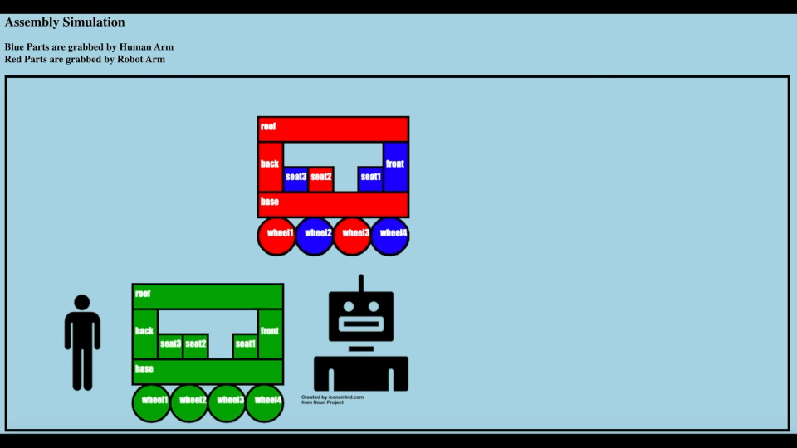
CSK-HRC Animation

