Slide 1
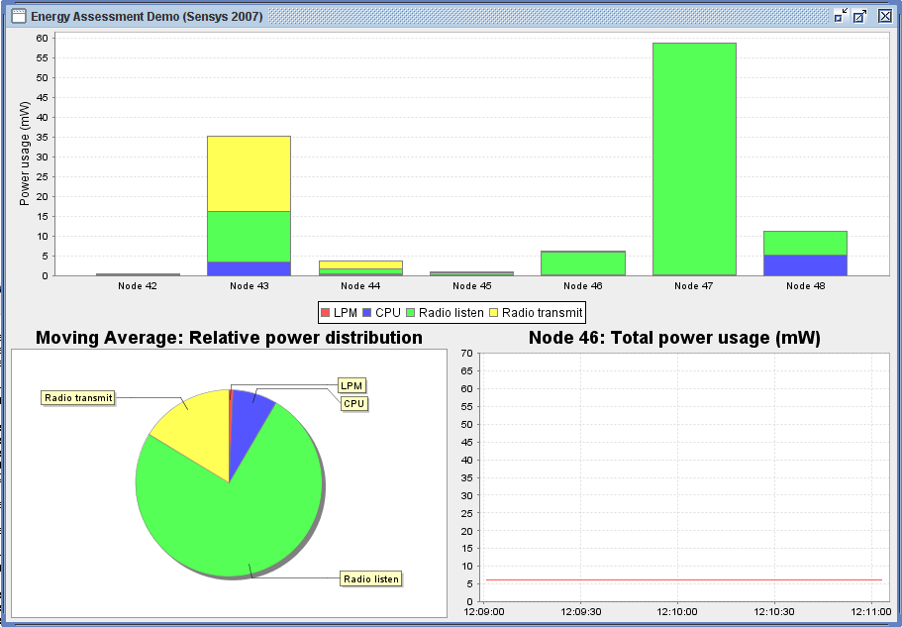
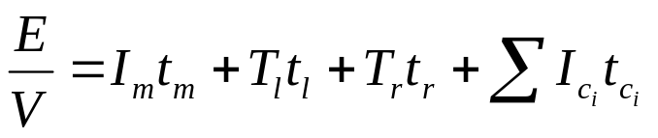
Software-based
Sensor Node Energy Estimation
Adam Dunkels, Fredrik Österlind, Nicolas Tsiftes, Zhitao He
Swedish Institute of Computer Science
Software-based
Novel energy estimation mechanism enabling system-level energy evaluation at an unprecedented scale
Good performance
Good accuracy
Zero hardware costs
Zero deployment costs
Run-time
Network-scale
Full details
Low energy overhead
Uses on-chip timers which allows deep sleep
Current energy consumption is available at run-time
Simple linear energy model
Implemented in Contiki
Only two lines of code in
low-level drivers
Source code available
http://www.sics.se/contiki

