Slide 1
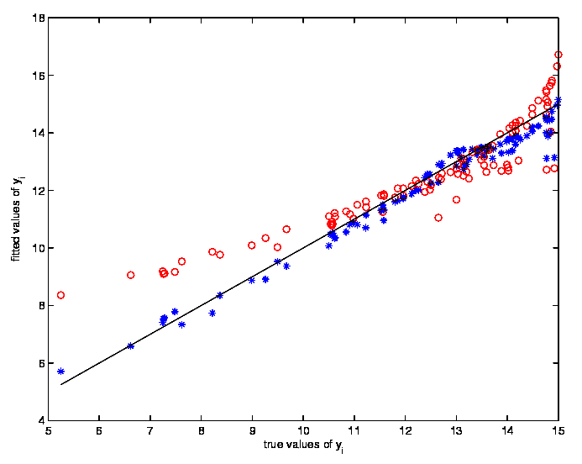
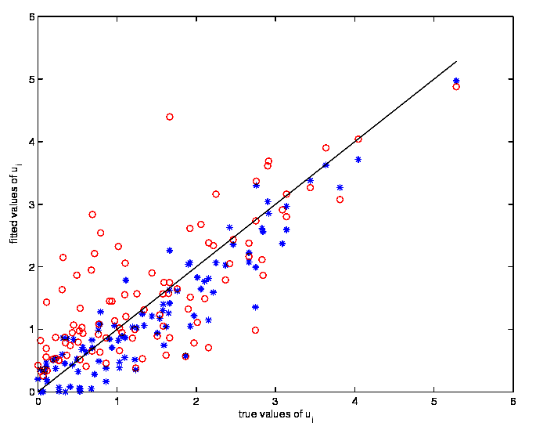
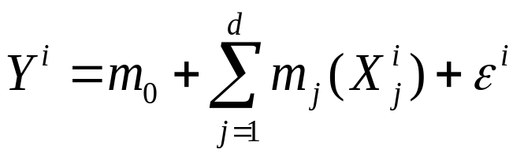
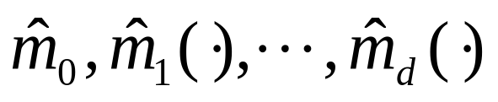
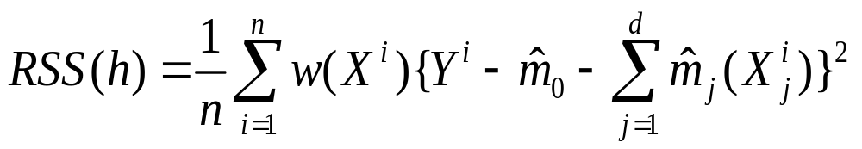
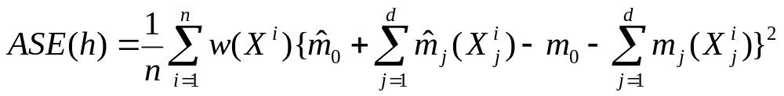
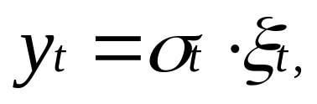
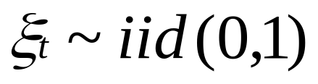
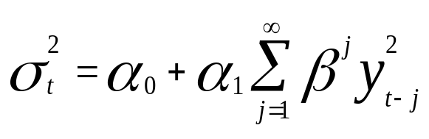
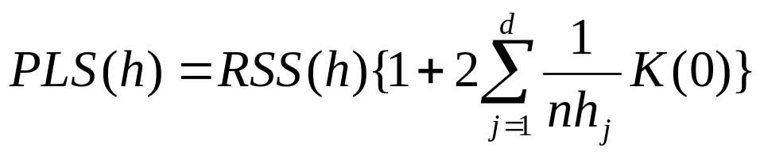
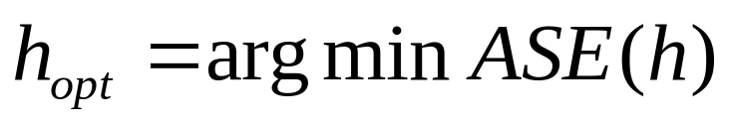
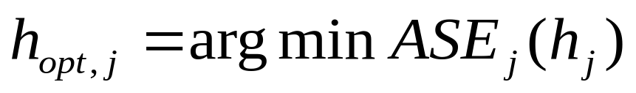
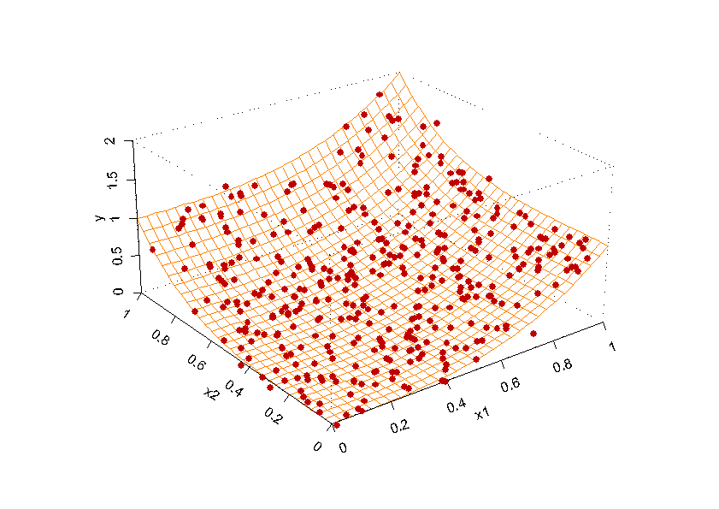
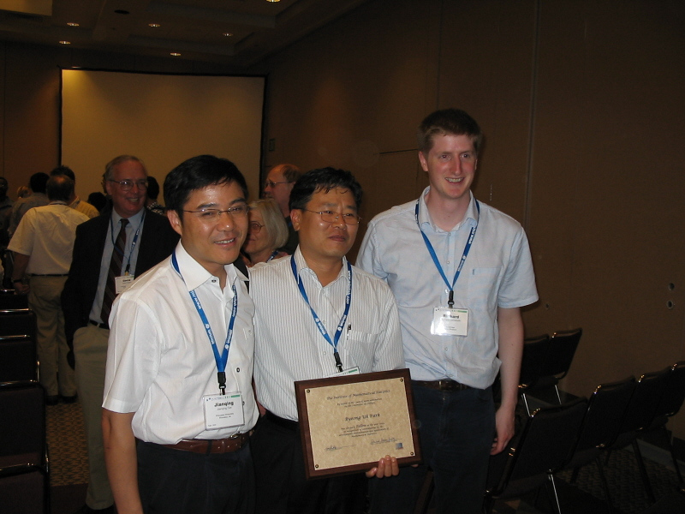
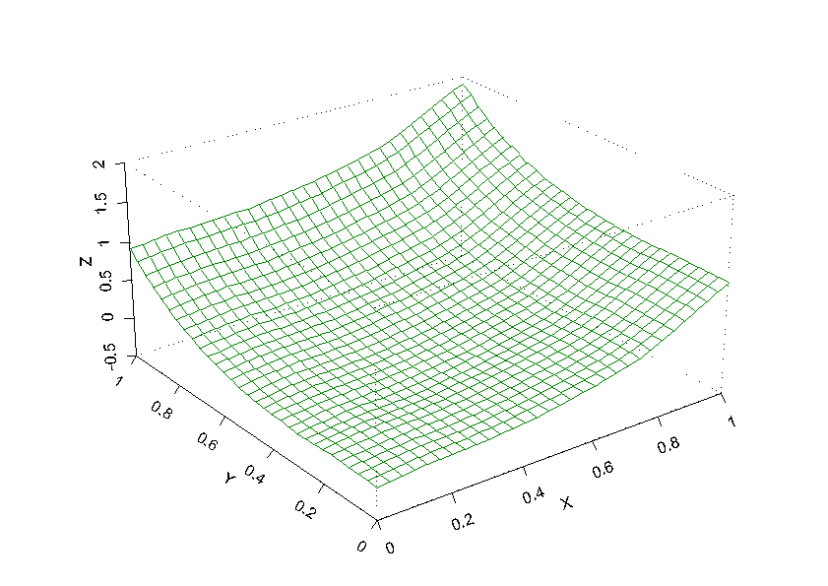
Nonparametric and Semiparametric Function Estimation
비모수적, 준모수적 함수추정 연구팀 (서울대학교 통계학과)
http://stats.snu.ac.kr/~brain03
사업팀 구성
Nonparametric Stochastic Frontier
- A first approach to fit nonparametric stochastic models by local maximum likelihood techniques
- The models encompass anchorage parametric models in a nonparametric way and have convoluted error terms (efficiency plus noise)
- Derive asymptotic properties of the estimators of the stochastic frontier models
- Establish the performance of the estimators with simulated data sets and with a real data on US commercial banks
- The methods are robust, numerically stable and particularly useful for investigating production processes and the derived efficiency scores
- To be published in Journal of Econometrics (2006)
Bivariate example with heteroscedasticity: True against estimated frontier (left panel) and true
against predicted efficiencies (right panel). The asterisks (blue) correspond to the local MLE
and the circles (red) to the MLE of the parametric anchorage model.
Asymptotic Theory for ARCH-SM Models : LAN and Residual Processes
- Propose efficient estimator and model checking procedure in GARCH(p,q) model by investigating LAN property in ARCH(∞) model and the limiting distribution of residual empirical process
- Published in Statistica Sinica (2005)
인력배출
박사 : 이영경(2004), 유규상(2005), 남승민(2005), 윤영주(2005)
석사 : 송효임(2004), 이미희(2004), 최혜정(2004), 정옥경(2005)
기타성과
Professor Byeong Uk Park was elected 2005 Fellow of American Statistical Association and also 2005 Fellow of Institute of Mathematical Statistics, for his outstanding contributions to the statistical profession.
Picture taken after IMS Awards Session, the 165 Annual Joint Meeting,
Minneapolis, Minnesota, U.S.A., August 7-11, 2005
사업팀장 : 박병욱
참여교수 : 김우철, 송문섭, 이상열, 전종우, 조신섭
참여대학원생 :
권성훈, 김주원, 송대건, 연규필, 여동화, 이지연, 이태욱, 하소영
황준혁 (이상 박사과정), 김지영, 정보혜 (이상 석사과정)
신진연구인력 : 이영경, 김영진
사업팀 성과
SCI 논문수 (2003년 이후) : 52편
대표연구업적:
Bandwidth Selection for Smooth Backfitting in Additive Models
- Propose three fully automated bandwidth selection methods for the smooth backfitting in additive models which is known to achieve the oracle efficiency bound
- Derive uniform higher-order stochastic expansions for the residual sums of squares of the smooth backfitting estimators
- Give the large sample properties of the bandwidth selection methods and compare their finite sample properties through simulation experiments
Published in The Annals of Statistics (2005)
A Simple Smooth Backfitting in Additive Models
- Propose a new smooth backfitting estimator for additive nonparametric regression models
- The estimator has the simple structure of Nadaraya-Watson smooth backfitting and achieves the oracle property of local linear smooth backfitting
- Each component function is estimated with the same asymptotic accuracy as if the other components would be known
To be published in The Annals of Statistics (2006)
True function and observed data (left panel); Smooth backfiiting estimate (right panel)
Smooth backfitting additive model :
ARCH(∞) model :
Higher order expansion of
Higher order expansion of
LAN property
Empirical process
Bandwidth selection by
minimizing PLS(h)
Bandwidth selection
by estimating h_{opt}
Bandwidth selection by
estimating h_{opt,j}
Efficient estimator
Goodness of fit
Model check

