Slide 1

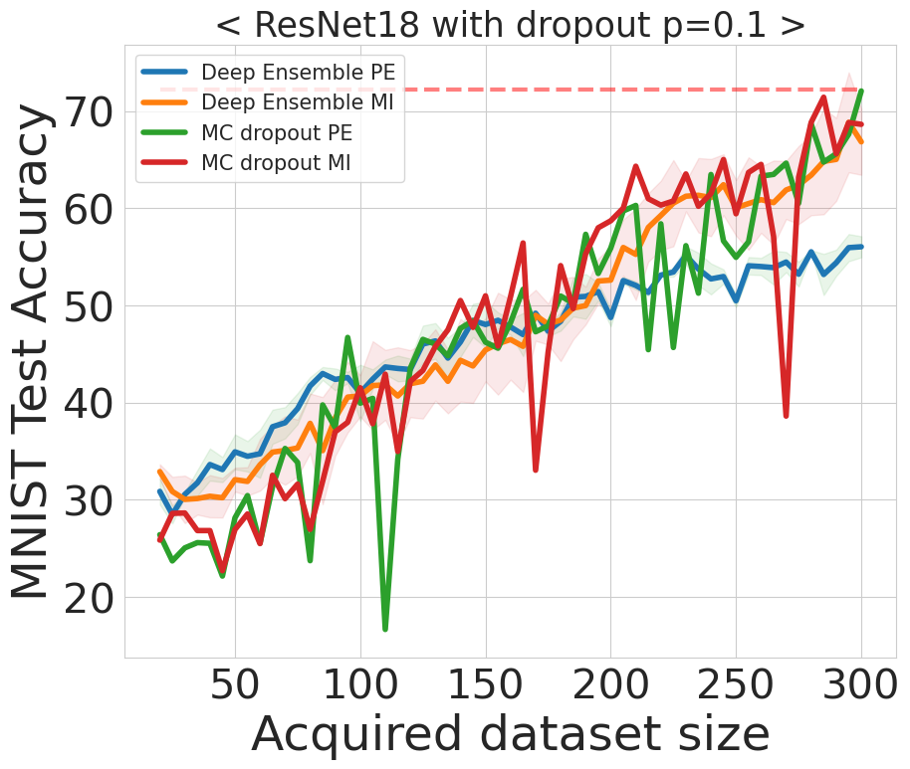
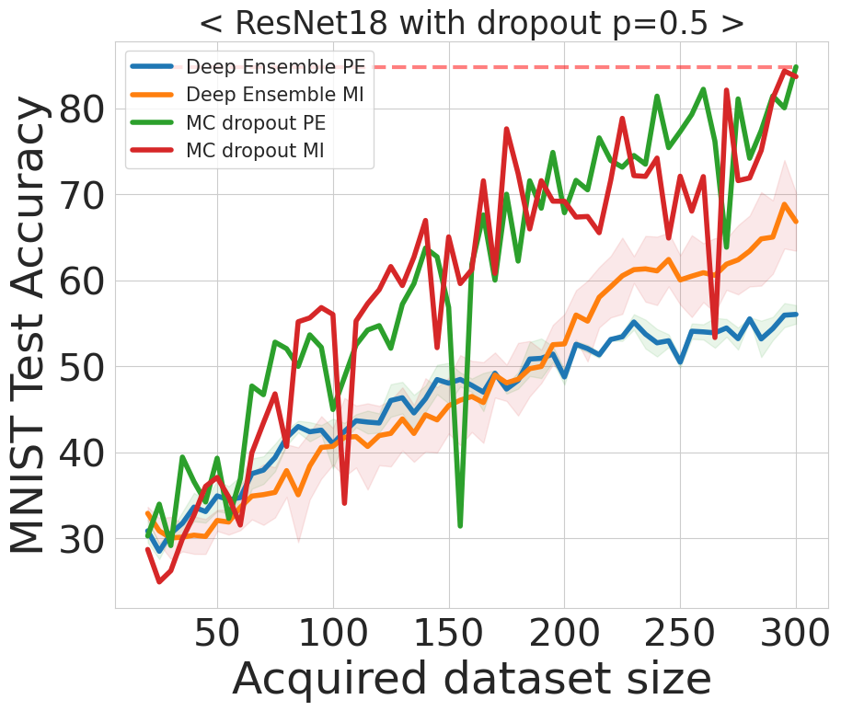
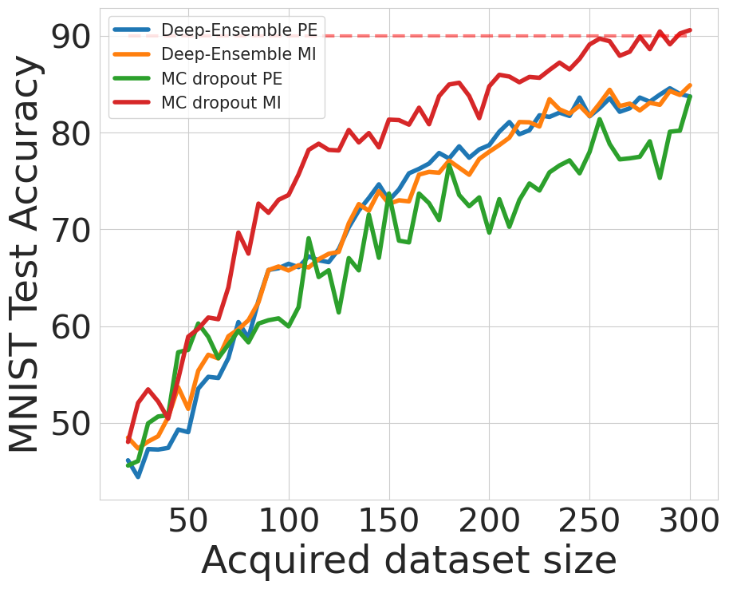
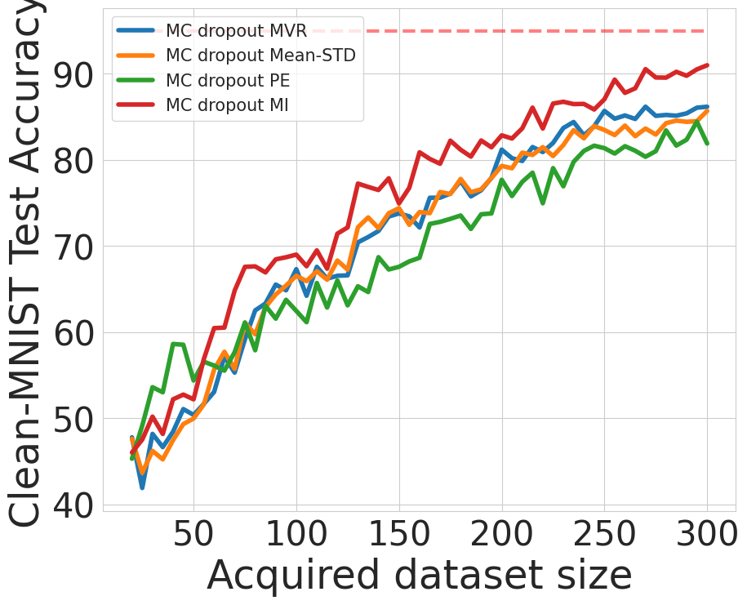
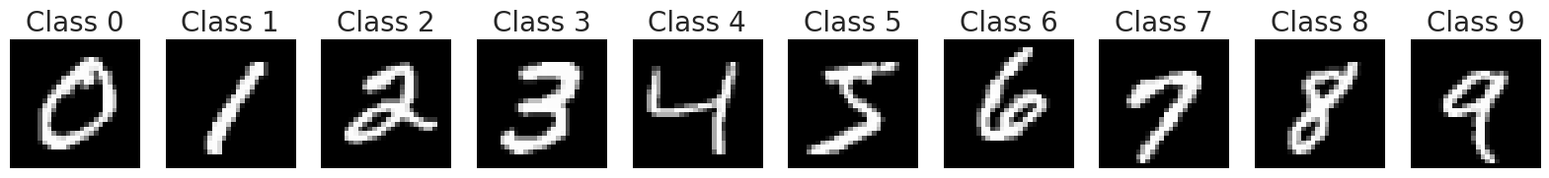
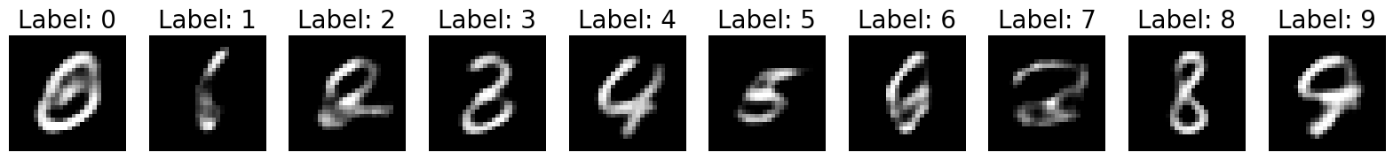
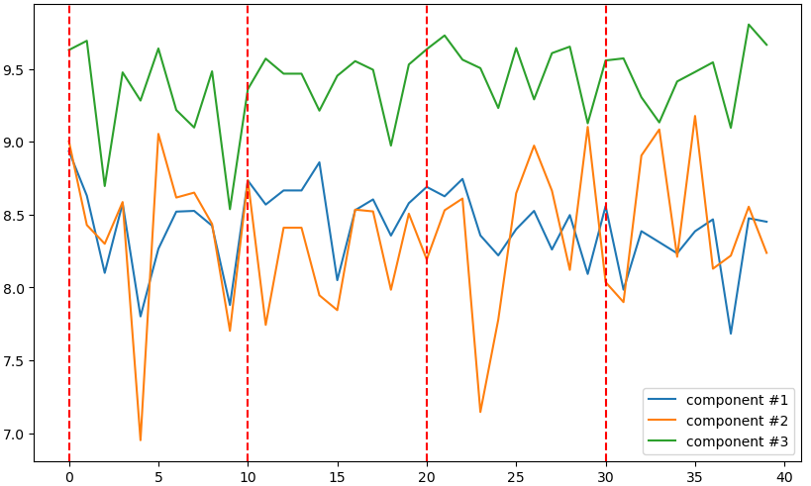
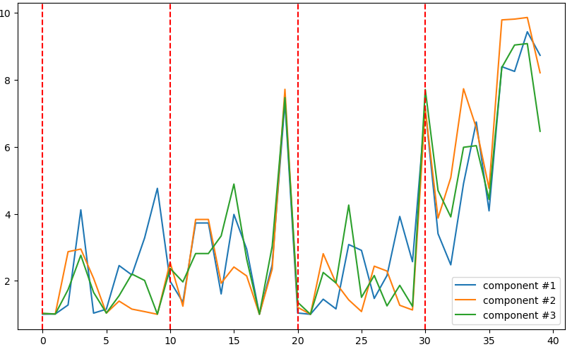
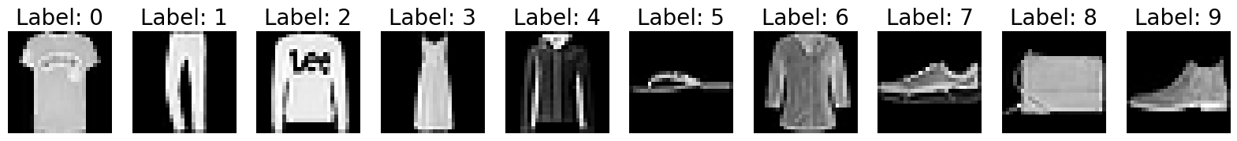
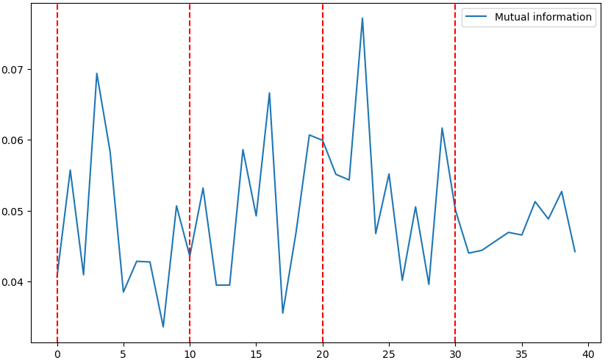
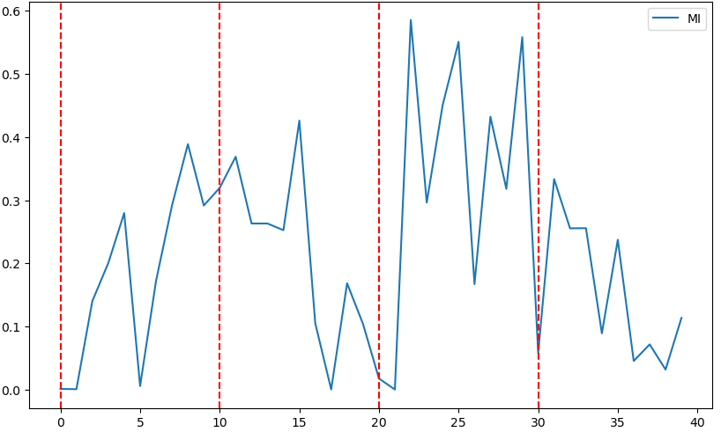

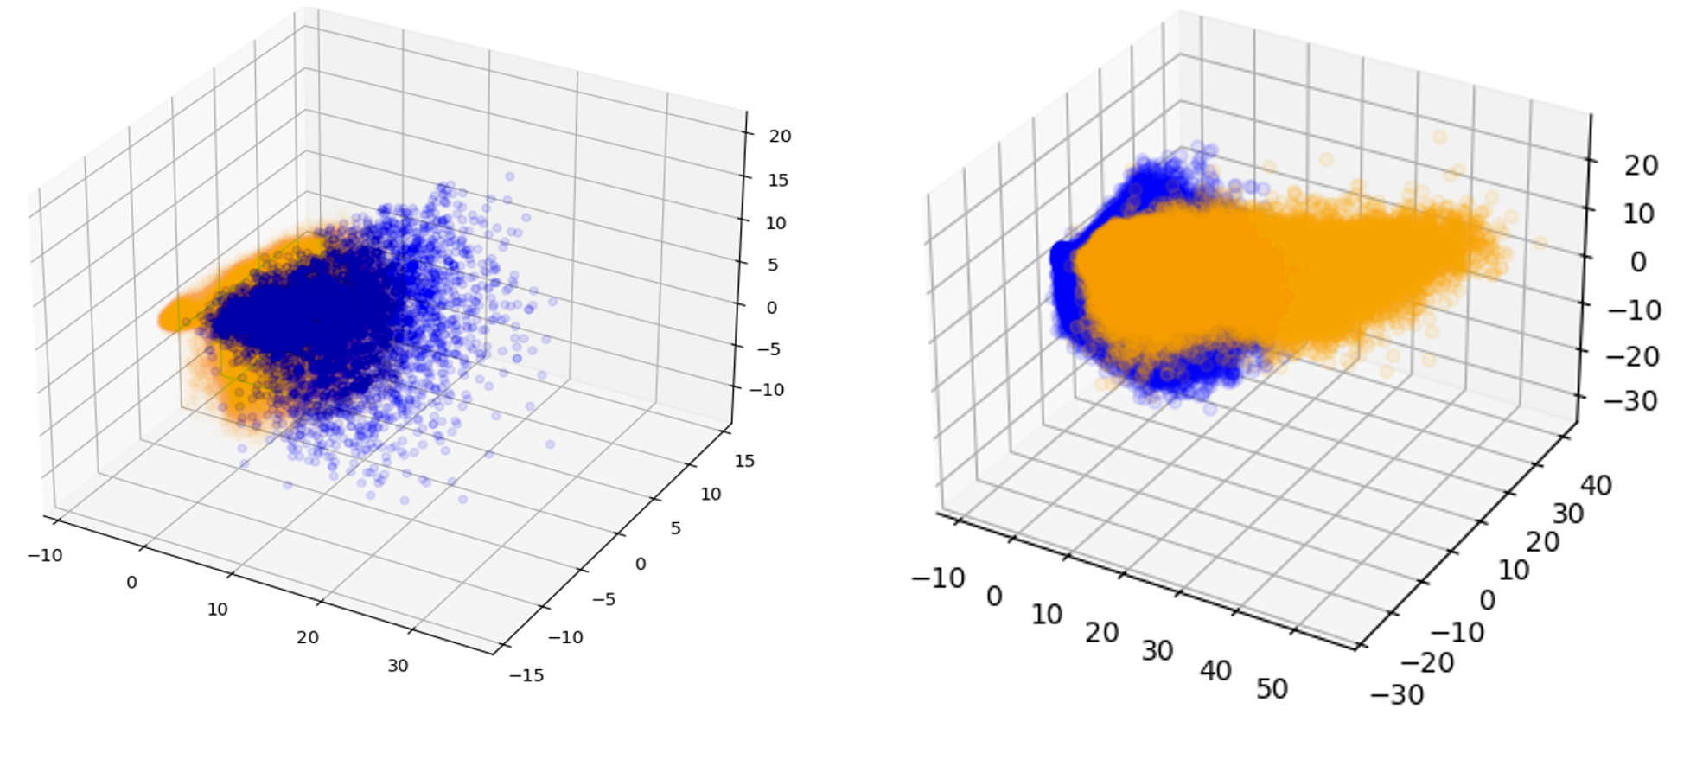

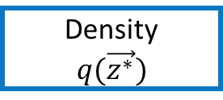
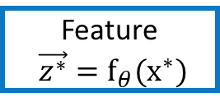
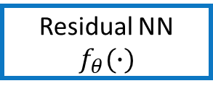
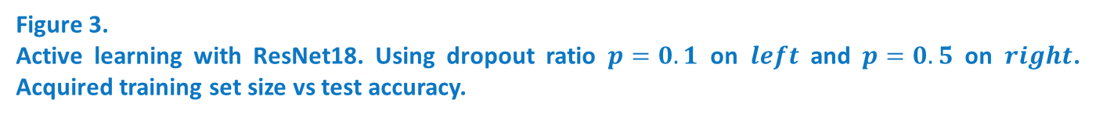
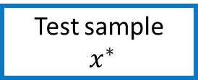
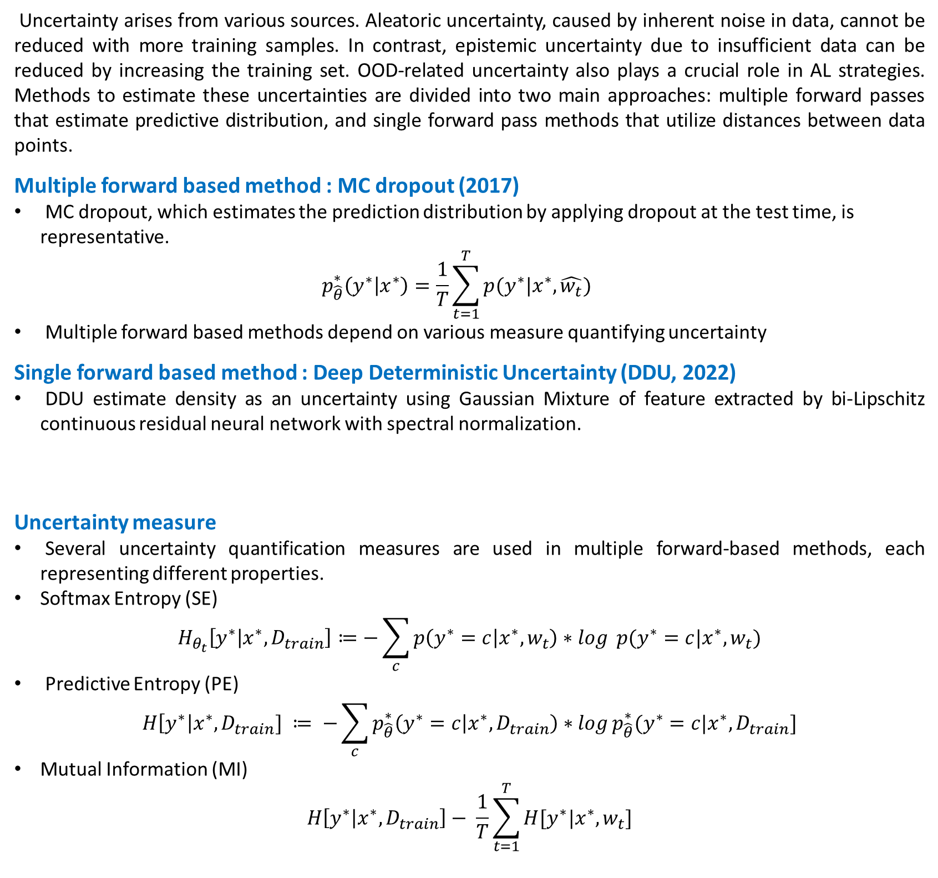
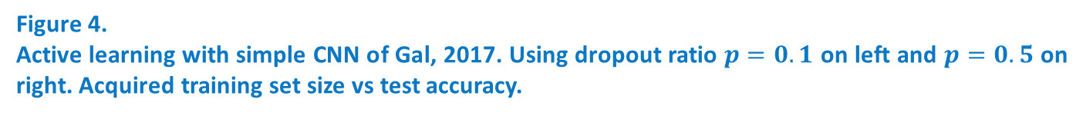
Active learning의 성능 향상을 위한 불확실성 측도 비교
양준성 ¹ · 정혜영 ²
¹한양대학교 일반대학원 응용수학과
²한양대학교 ERICA 수리데이터사이언스학과
Abstract
Experiment
Active learning (AL) aims to enhances the performance of deep learning models by selecting the most informative samples from unlabeled pool set. Even though effective with homogeneous data, AL can struggle with Out-Of-Distribution (OOD) or contaminated data of real world. This study aims to compare and verify the performance of AL using various uncertainty measures with real-world scenarios.
Active Learning at 1 : 60 Pool set
Deep Ensemble with ResNet18, a deep structure, shows clear difference of PE and MI.
MC dropout with ResNet18 can be seen their MI, epistemic uncertainty, was not captured meaningfully, showing unstable learning process, even when $p=0.5$.
Introduction
Uncertainty arises from various sources. Aleatoric uncertainty, caused by inherent noise in data, cannot be reduced with more training samples. In contrast, epistemic uncertainty due to insufficient data can be reduced by increasing the training set. OOD-related uncertainty also plays a crucial role in AL strategies. Methods to estimate these uncertainties are divided into two main approaches: multiple forward passes that estimate predictive distribution, and single forward pass methods that utilize distances between data points.
Multiple forward based method : MC dropout (2017)
MC dropout, which estimates the prediction distribution by applying dropout at the test time, is representative. $p_{\hat{θ}}^{∗}\left(y^{∗} | x^{∗}\right)=\frac{1}{T}\sum_{t=1}^{T}{p(y^{∗}|x^{∗}, \hat{w_{t}})}$
Multiple forward based methods depend on various measure quantifying uncertainty
Single forward based method : Deep Deterministic Uncertainty (DDU, 2022)
DDU estimate density as an uncertainty using Gaussian Mixture of feature extracted by bi-Lipschitz continuous residual neural network with spectral normalization.
Uncertainty measure
Several uncertainty quantification measures are used in multiple forward-based methods, each representing different properties.
Softmax Entropy (SE)
$$H_{θ_{t}}\left[y^{∗} | x^{∗},D_{train}\right]≔−\sum_{c}{p\left(y^{∗}=c | x^{∗}, w_{t}\right)∗\log{ p(y^{∗}=c|x^{∗}, w_{t})}}$$
Predictive Entropy (PE)
$$H\left[y^{∗}\right|x^{∗}, D_{train}] ≔ −\sum_{c}{p_{\hat{θ}}^{∗}\left(y^{∗}=c | x^{∗}, D_{train}\right)∗\log{p_{\hat{θ}}^{∗}(y^{∗}=c|x^{∗}, D_{train}]}}$$
Mutual Information (MI)
$$H\left[y^{∗} | x^{∗}, D_{train}\right]− \frac{1}{T}\sum_{t=1}^{T}{H[y^{∗}|x^{∗}, w_{t}]}$$
Figure 3.
Active learning with ResNet18. Using dropout ratio $p=0.1$ on $left$ and $p=0.5$ on $right$. Acquired training set size vs test accuracy.
Test sample
$x^{∗}$
Residual NN
$$f_{θ}(∙)$$
Feature $\vec{z^{∗}}=f_{θ}(x^{∗})$
GMM
Density
$$q(\vec{z^{∗}})$$
Figure 4.
Active learning with simple CNN of Gal, 2017. Using dropout ratio $p=0.1$ on left and $p=0.5$ on right. Acquired training set size vs test accuracy.
Deep Ensemble with simple CNN shows clear difference of PE and MI, not retaining diversity.
MC dropout with simple CNN shows that greater the diversity secured by the P value, the larger the difference between PE and MI became.
Dataset
Diversity of Softmax Entropy in 3-Ensemble
Sectors are divided into four regions for test sets : Clean MNIST (1), ambiguous Region, clean MIST (2), and fashion MNIST, respectively.
Clean MNIST
Ambiguous MNIST
Fashion MNIST
PCA plot of datasets
Ambiguous MNIST samples are difficult to judge labels but clearly in-distributed, so having similar data manifold to clean MNIST.
Fashion MNIST samples, totally out-of-distributed, shows a data distribution that is clearly different from clean MNIST.
 | ResNet18 ( Deeper model ) |  |  | LeNet ( similar to simple CNN of AL )
Sector | Sec. 1 & 3 | Sec. 2 | Sec.4 | Sec. 1 & 3 | Sec. 2 | Sec.4
Std | 0.0581 | 0.0209 | 0.0233 | 0.2706 | 0.5144 | 0.3330
Table 1. Std of SEs from model in ensemble with different depth.
Figure 5.
SEs and MI of each samples with 3-ensemble of ResNet18 in each sectors.
Figure 6.
SEs and MI of each samples with 3-ensemble of LeNet in each sectors.
Figure 1.
Clean MNIST with Ambiguous MNIST
Figure 2.
Clean MNIST and Fashion MNIST
Table 1, Figure 5, and Figure 6 indicate that diversity in ensemble models may not be ensured depending on the model.
In Figure 6, it can be observed that ambiguous or out-of-distribution (OOD) samples have higher MI compared to clean samples. This could lead to unnecessary time consumption in active learning.
To accurately estimate meaningful uncertainty, multiple forward pass-based methods necessitate diversity across various models.
This is one of the reasons why single forward pass-based methods have been receiving attention recently.
Settings
Pool sets
Unlabeled pool set of real world contains samples with high aleatoric uncertainty.
Size of datasets |  | Mixing Ratio. (clean : ambiguous)
Clean MNIST | Ambiguous MNIST
1,000 samples | 60,000 samples | 1 : 60
Conclusion
In this study, we analyzed the characteristics of two types of uncertainty for effective active learning using a full set that resembles real-world scenarios, as opposed to a benchmark dataset.
Experimental results demonstrated the importance of using appropriate metrics to measure uncertainty in selecting informative data points for active learning.
Additionally, it has been experimentally confirmed that the lack of diversity among different models in multiple forward pass-based methods can act as a potential weakness in accurately measuring uncertainty.
Multiple Forward based Methods
Deep-Ensemble, making multiple outputs with models in ensemble, consumes a lot of inference time and resources.
MC dropout randomly deactivates neurons in the network during each forward pass, even during testing. By applying dropout multiple times to a single input, it produces various outputs.
Multiple forward based method | MC dropout
 | Deep Ensemble
References
Single forward based method
Deep Deterministic Uncertainty, called DDU, use GMM as a feature space density with bi-Lipschitz continuous residual neural network.
[1] Gal, Yarin, Riashat Islam, and Zoubin Ghahramani. "Deep bayesian active learning with image data." International conference on machine learning. PMLR, 2017.
[2] Van Amersfoort, Joost, et al. "Uncertainty estimation using a single deep deterministic neural network." International conference on machine learning. PMLR, 2020.
[3] Mukhoti, Jishnu, et al. "Deep deterministic uncertainty: A new simple baseline." Proceedings of the IEEE/CVF Conference on Computer Vision and Pattern Recognition. 2023.
본 논문은 한국연구재단 연구자지원사업(KRF-2022R1F1A1074939)의 지원을 받아 수행된 연구임.

