Slide 1


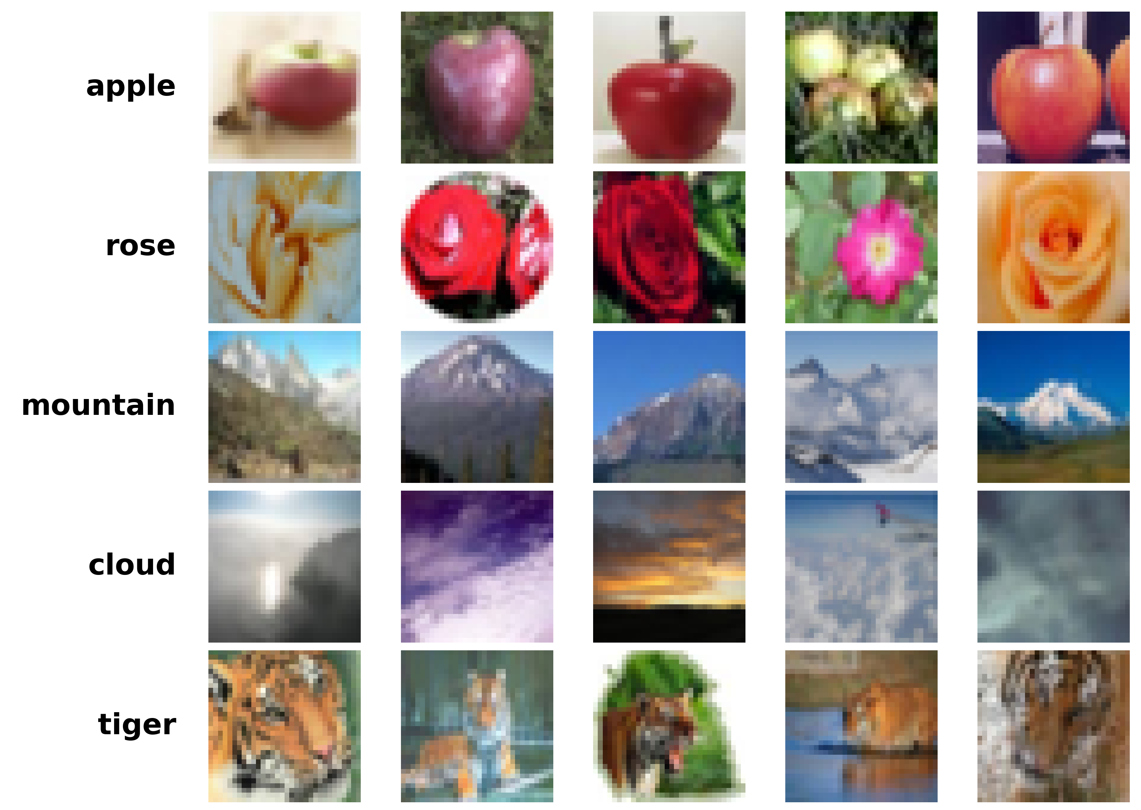
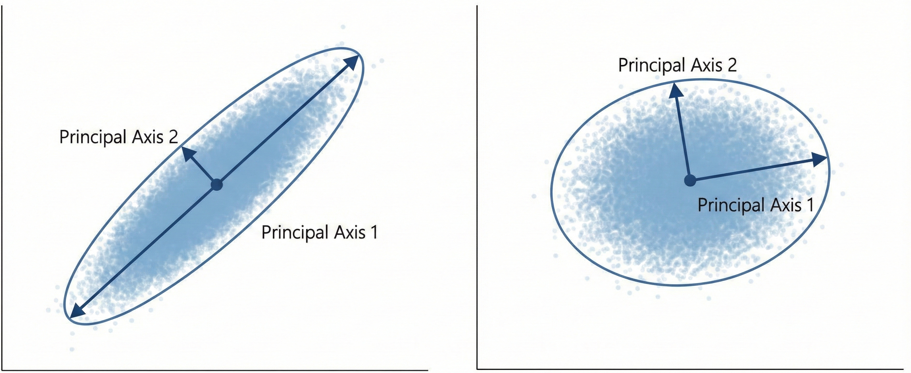
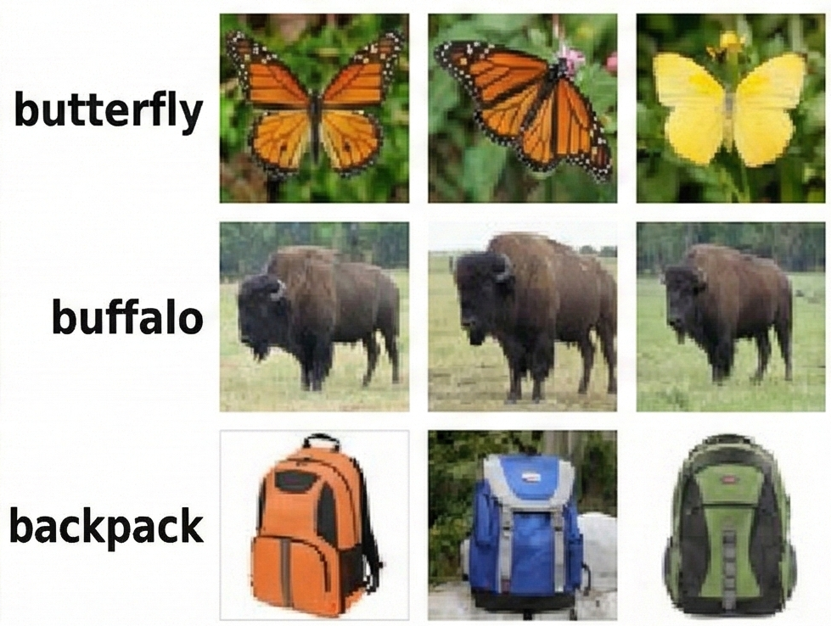
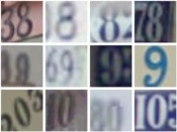
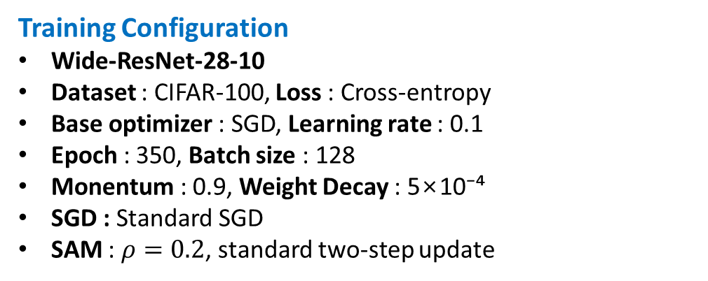
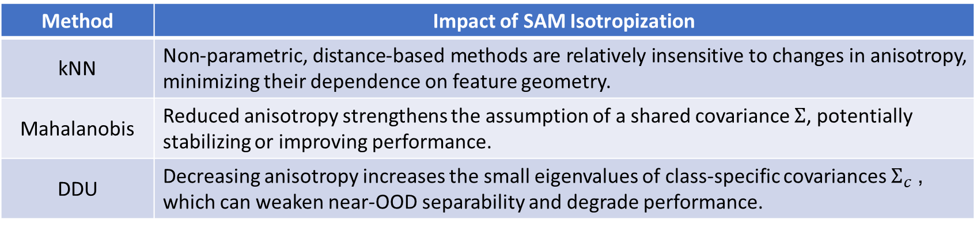
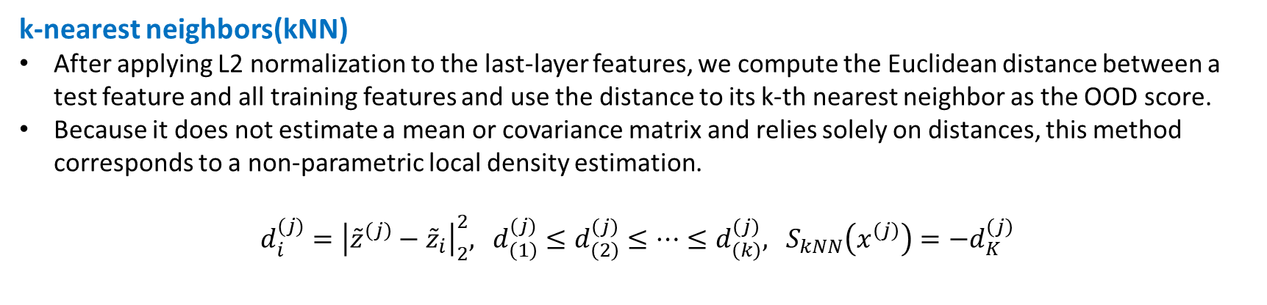
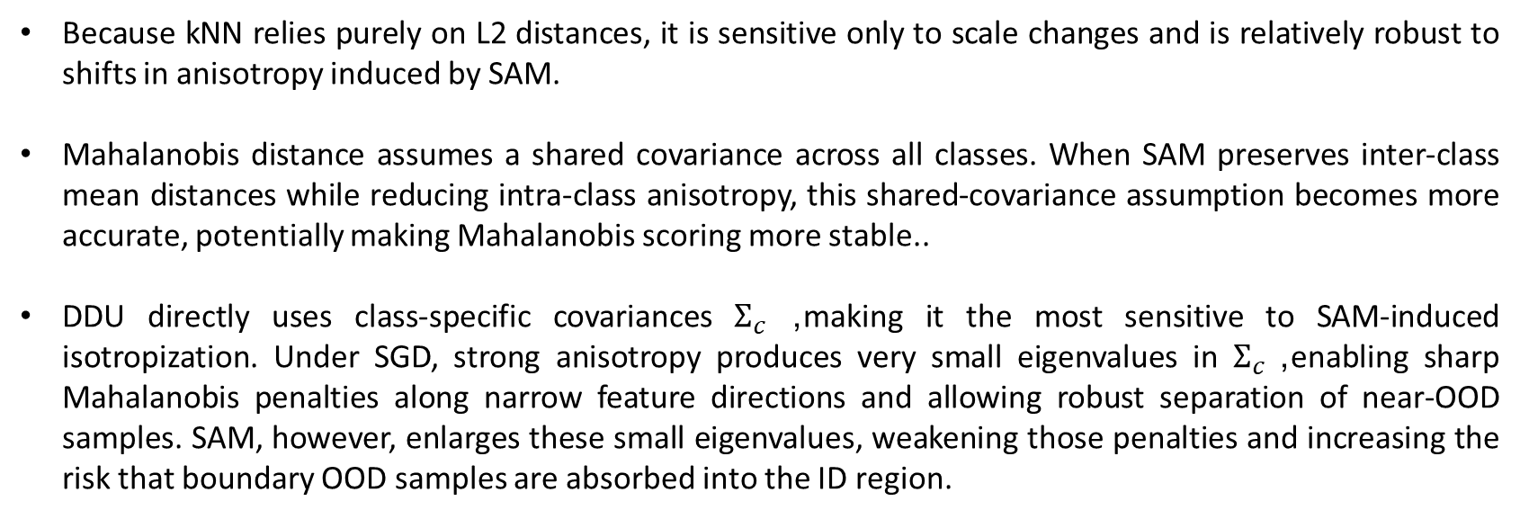
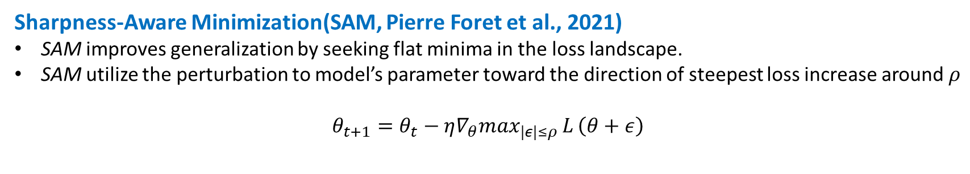
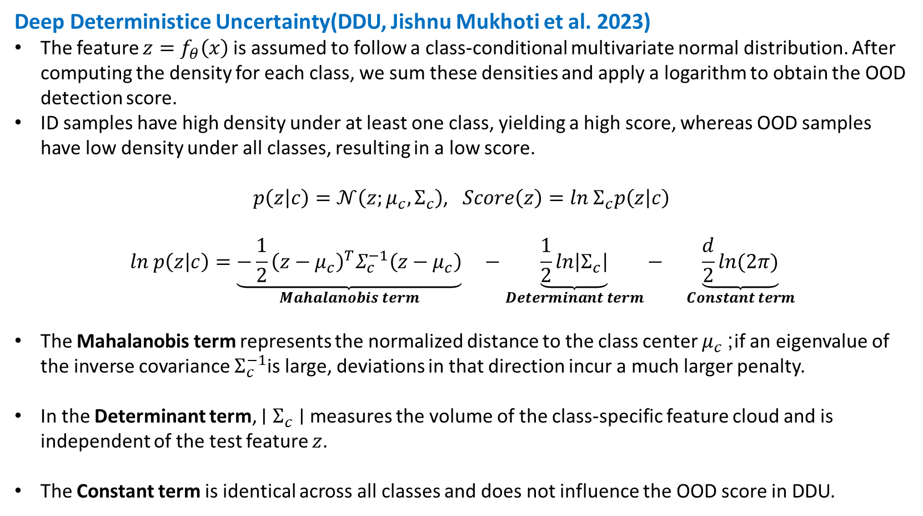
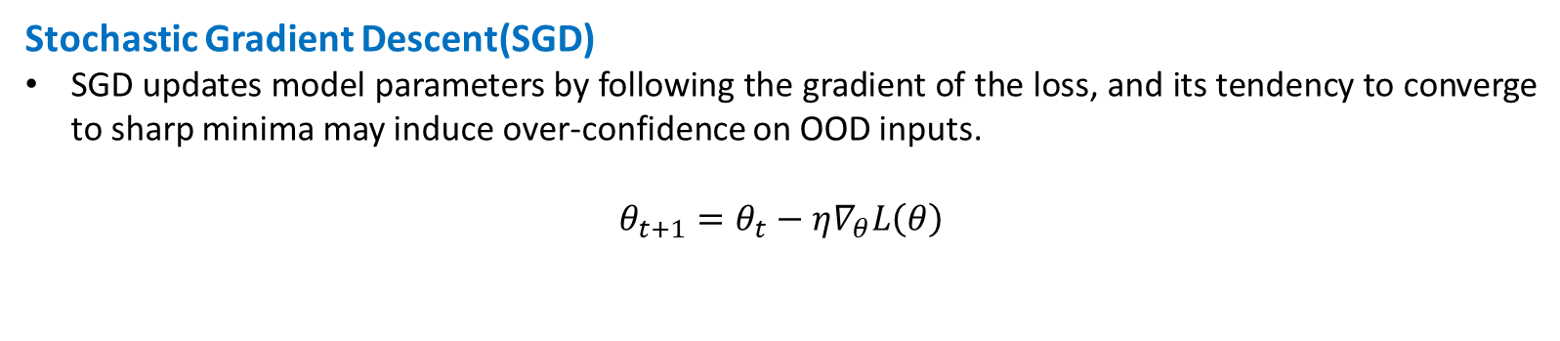
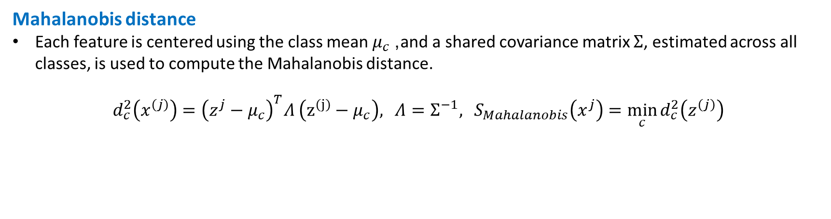
The Effect of Optimization Methods on
OOD Detection Performance Based on
Uncertainty Measures
Gun-Hak Jin · Hye-Young Jung Department of Mathematical Data Science, Hanyang University
Motivation
Deep neural networks often remain over-confident on unseen inputs, motivating interest in methods that improve uncertainty and robustness. Sharpness-Aware Minimization (SAM) has been shown to enhance generalization, reduce ECE, and maintain or improve logit-based OOD detection.
“But do these benefits of SAM also hold for distance-based OOD detection methods, which are highly sensitive to feature-space geometry?”
To answer this, we compare SGD and SAM in terms of how they reshape last-layer feature geometry, and we evaluate how these geometric shifts affect distance-based OOD detectors. Our results show that the interaction among optimizer choice, feature-space geometry, and OOD performance must be jointly considered for reliable deployment
Optimizer
Experimental setup
Stochastic Gradient Descent(SGD)
SGD updates model parameters by following the gradient of the loss, and its tendency to converge to sharp minima may induce over-confidence on OOD inputs.
$$θ_{t+1}=θ_{t}−η∇_{θ}L\left(θ\right)​$$
Training Configuration
Wide-ResNet-28-10
Dataset : CIFAR-100, Loss : Cross-entropy
Base optimizer : SGD, Learning rate : 0.1
Epoch : 350, Batch size : 128
Monentum : 0.9, Weight Decay : 5×10⁻⁴
SGD : Standard SGD
SAM : $ρ=0.2$, standard two-step update
Sharpness-Aware Minimization(SAM, Pierre Foret et al., 2021)
SAM improves generalization by seeking flat minima in the loss landscape.
SAM utilize the perturbation to model’s parameter toward the direction of steepest loss increase around $ρ$
$$θ_{t+1}=θ_{t}−{η∇_{θ}max}_{|ε|≤ρ}{L}\left(θ+ε\right)​$$
Ⅰ
OOD Dectection Evaluation
Near-OOD : TinyImageNet, Far-OOD : SVHN
Metrics : AUROC (kNN, Mahalanobis, DDU)
Evaluate OOD performance changes under different optimizers in near-OOD and far-OOD settings.
SAM and Implicit Regularization of Feature Geometry
Recent work (Andriushchenko et al., 2023) reports that SAM utilizes a larger number of effective principal components in the last feature layer.
This does not necessarily imply that the variance simply becomes larger; rather, it suggests that information is distributed more uniformly within the ID feature cloud, leading to reduced anisotropy.
Train data : CIFAR-100
Feature Geometry Analysis
within-class var, inter-class distance, anisotropy(λ₁/trace)
Quantify geometry changes while keeping all conditions fixed except the optimizer.
SGD High Anisotropy
SAM Anisotropy Reduced
“SAM decreases the anisotropy of the ID feature cloud relative to SGD,
and this geometric shift can substantially influence distance-based OOD detection.”
Near OOD data : TinyImageNet
Far OOD data : SVHN
Distance-based OOD Dectection
Feature geometry & OOD AUROC
k-nearest neighbors(kNN)
After applying L2 normalization to the last-layer features, we compute the Euclidean distance between a test feature and all training features and use the distance to its k-th nearest neighbor as the OOD score.
Because it does not estimate a mean or covariance matrix and relies solely on distances, this method corresponds to a non-parametric local density estimation.
$d_{i}^{(j)}={\left|{\tilde{z}}^{\left(j\right)}−{\tilde{z}}_{i}\right|}_{2}^{2},$ $d_{\left(1\right)}^{(j)}≤d_{\left(2\right)}^{\left(j\right)}≤…≤d_{\left(k\right)}^{\left(j\right)},$ $S_{kNN}\left(x^{\left(j\right)}\right)=−d_{K}^{\left(j\right)}$
Train data feature geometry
Optimizer | Within-class Var | Inter-class mean distance | Anisotropy (λ₁ / trace)
SGD | 7.81 | 14.16 | 0.221
SAM | 16.89 | 12.87 | 0.13
Change | Within-class variance ↑ | No significant change | Reduced by half more isotropic
Mahalanobis distance
Each feature is centered using the class mean $μ_{c}$, and a shared covariance matrix $Σ$, estimated across all classes, is used to compute the Mahalanobis distance.
$d_{c}^{2}\left(x^{\left(j\right)}\right)={\left(z^{j}−μ_{c}\right)}^{T}Λ \left(z^{\left(j\right)}−μ_{c}\right),$ $Λ=Σ^{−1},$ $S_{Mahalanobis}\left(x^{j}\right)=\min_{c}{d_{c}^{2}\left(z^{\left(j\right)}\right)}$
Within-class variance increases under SAM → SAM substantially enlarges the intra-class spread, producing thicker feature clouds relative to SGD.
Inter-class distance remains largely unchanged → Class separation is preserved because class means do not shift significantly.
Anisotropy decreases by roughly half → The eigenvalue spectrum becomes flatter, indicating that feature clouds become more isotropic.
Deep Deterministice Uncertainty(DDU, Jishnu Mukhoti et al. 2023)
The feature $z=f_{θ}\left(x\right)$is assumed to follow a class-conditional multivariate normal distribution. After computing the density for each class, we sum these densities and apply a logarithm to obtain the OOD detection score.
ID samples have high density under at least one class, yielding a high score, whereas OOD samples have low density under all classes, resulting in a low score.
$p\left(z | c\right)=𝒩\left(z;μ_{c},Σ_{c}\right)$, $Score\left(z\right)=ln Σ_{c}p\left(z | c\right)$
$$ln p\left(z | c\right)=\underset{Mahalanobis term}{\underbrace{−\frac{1}{2}{\left(z−μ_{c}\right)}^{T}Σ_{c}^{−1}\left(z−μ_{c}\right)}} −\underset{Determinant term}{\underbrace{\frac{1}{2}ln\left|Σ_{c}\right|}}− \underset{Constant term}{\underbrace{\frac{d}{2}ln(2π)}}$$
The Mahalanobis term represents the normalized distance to the class center $μ_{c}$; if an eigenvalue of the inverse covariance $Σ_{c}^{−1}$is large, deviations in that direction incur a much larger penalty.
In the Determinant term, $∣Σ_{c}∣$measures the volume of the class-specific feature cloud and is independent of the test feature $z$.
The Constant term is identical across all classes and does not influence the OOD score in DDU.
OOD AUROC
Result1 : TinyImageNet (near-OOD)
Optimizer | kNN AUROC | Mahalanobis AUROC | DDU AUROC
SGD | 0.875 | 0.882 | 0.718
SAM | 0.910 | 0.878 | 0.687
Δ (SAM−SGD) | +0.035 | - 0.004 | - 0.03
kNN : AUROC increases under SAM, suggesting that even with more isotropic feature clouds, simple distance-based kNN detection can benefit from smoother feature geometry.
Mahalanobis : The change is minimal (≈ 0.004), indicating that the shared-covariance assumption underlying Mahalanobis distance remains stable despite SAM-induced isotropization.
DDU : AUROC drops from 0.718 → 0.687 (−0.031). Because DDU relies on class-specific covariance matrices Σ₍c₎, the enlargement of small eigenvalues under SAM weakens separation in formerly “thin” directions, making near-OOD instances harder to distinguish.
Impact of SAM Isotropization
Result2 : SVHN (far-OOD)
Distance-based OOD Detection Comparison
Optimizer | kNN AUROC | Mahalanobis AUROC | DDU AUROC
SGD | 0.798 | 0.808 | 0.882
SAM | 0.888 | 0.914 | 0.878
Δ (SAM−SGD) | +0.09 | +0.106 | -0.004
Method | Impact of SAM Isotropization
kNN | Non-parametric, distance-based methods are relatively insensitive to changes in anisotropy, minimizing their dependence on feature geometry.
Mahalanobis | Reduced anisotropy strengthens the assumption of a shared covariance $Σ$, potentially stabilizing or improving performance.
DDU | Decreasing anisotropy increases the small eigenvalues of class-specific covariances $Σ_{c}$, which can weaken near-OOD separability and degrade performance.
kNN : SAM’s isotropization trims anisotropic tails of ID feature clouds, enlarging the ID–far-OOD distance gap and thus improving kNN AUROC.
Mahalanobis : AUROC improves substantially from 0.808 → 0.914 (+0.106). This suggests that SAM’s reduction in anisotropy makes the shared covariance assumption of Mahalanobis distance particularly well-aligned with far-OOD scenarios.
DDU : AUROC changes only marginally (0.882 → 0.878, −0.004), indicating that unlike in near-OOD settings the isotropization induced by SAM has little impact on DDU performance for far-OOD detection.
Because kNN relies purely on L2 distances, it is sensitive only to scale changes and is relatively robust to shifts in anisotropy induced by SAM.
Mahalanobis distance assumes a shared covariance across all classes. When SAM preserves inter-class mean distances while reducing intra-class anisotropy, this shared-covariance assumption becomes more accurate, potentially making Mahalanobis scoring more stable..
DDU directly uses class-specific covariances $Σ_{c}$, making it the most sensitive to SAM-induced isotropization. Under SGD, strong anisotropy produces very small eigenvalues in $Σ_{c}$, enabling sharp Mahalanobis penalties along narrow feature directions and allowing robust separation of near-OOD samples. SAM, however, enlarges these small eigenvalues, weakening those penalties and increasing the risk that boundary OOD samples are absorbed into the ID region.
Conclusion
The experimental results show that SAM reshapes the geometry of the ID feature clouds by increasing within-class variance and reducing anisotropy.
We observe that distance-based OOD detection methods—kNN, Mahalanobis, and DDU—respond differently to these geometric changes.
These findings highlight that optimization choices can inadvertently weaken certain OOD detection methods depending on how they alter feature geometry. Thus, for reliable uncertainty estimation in practical systems, the interaction among optimization, feature geometry, and OOD detection mechanisms must be jointly considered.
“SAM’s isotropization increases the small eigenvalues of $Σ_{c}$,
which can degrade DDU’s ability to separate near-OOD samples.”
This work was supported by the National Research Foundation of Korea (NRF) through the Basic Science Research Program (NRF-2022R1F1A1074939, RS-2024-00392942).

