Slide 1


Integrating KosovoWallet
Developers
Training
Mauro Lucchini
Backend developer @Validated ID

Slide 2

Portfolio
Agenda
Project introduction
Introduction to Self Sovereign Identity
Components
---- Break ----
Inspect the integration
Demo
Integration examples repositories

Slide 3

Validated ID
VIDidentity 2024
Always be yourself
Project Introduction

Slide 4

Project overivew
Validated ID provides an extra layer to the project to introduce KosovoWallet for citizens.
KosovoWallet
Certificate Management System
(CMS)

Slide 5
Certificates
with a Certificate Management System
A certificate is a digital document issued by a trusted authority, typically used to sign documents that provide authenticity and integrity.

Slide 6
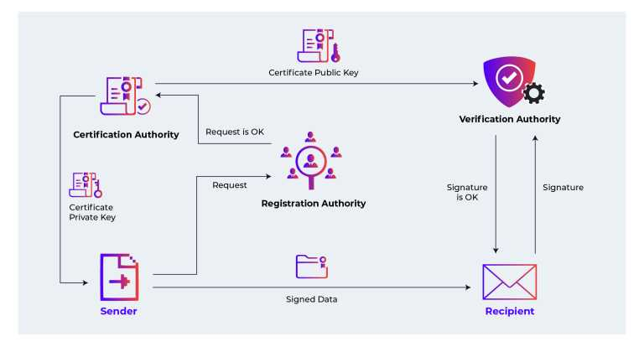
Public Key Infrastructure

Slide 7
Verifiable Credentials
with KosovoWallet
Verifiable credential is a broader concept within decentralized identity systems, representing digitally signed claims or attributes about an individual that can be shared and verified without the need for a central authority.

Slide 8
Project overivew
Authenticate KosovoWallet
CMS
Issue Citizen
credential
KosovoWallet

Slide 9
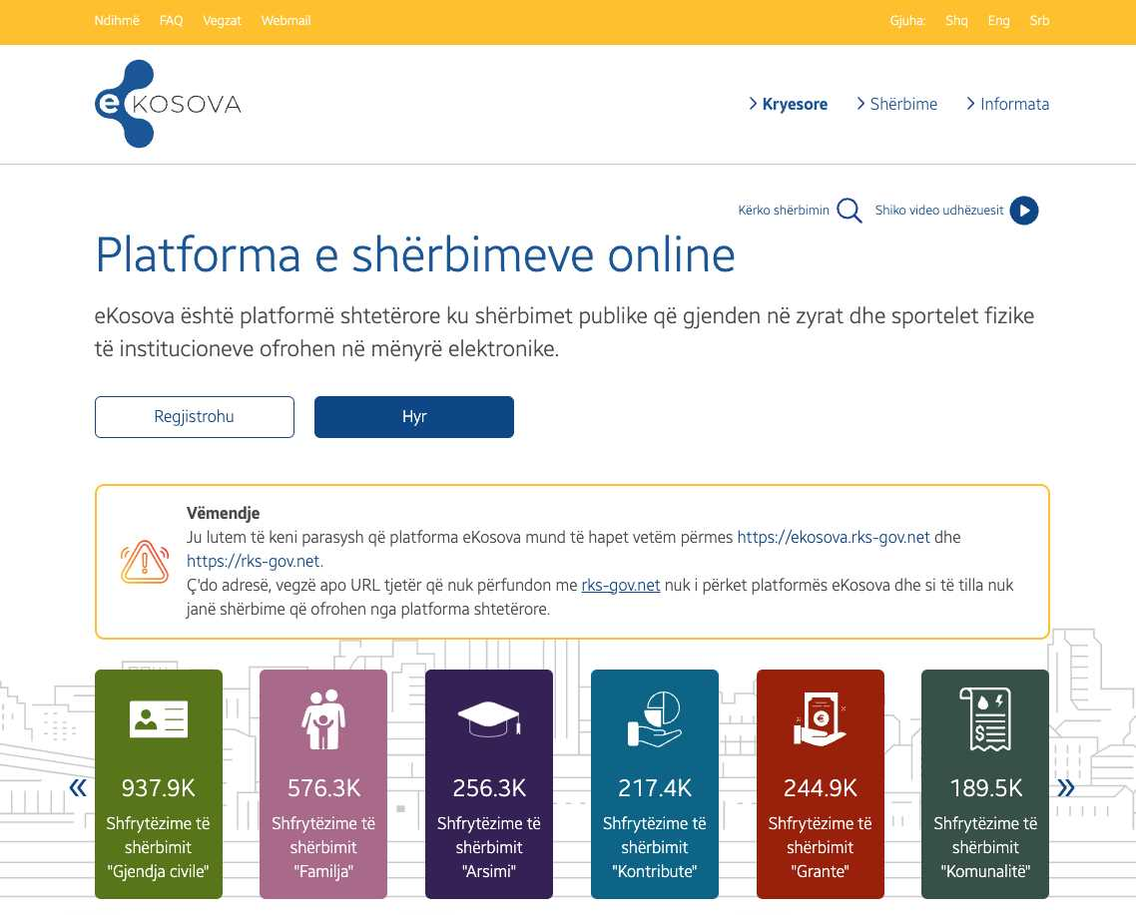
Project overivew
Any governmental portal could request presenting this credential to authenticate citizens.
Authenticate KosovoWallet
with Citizen
credential
KosovoWallet

Slide 10

Validated ID
VIDidentity 2024
Always be yourself
Introduction to
Self Sovereign identity

Slide 11
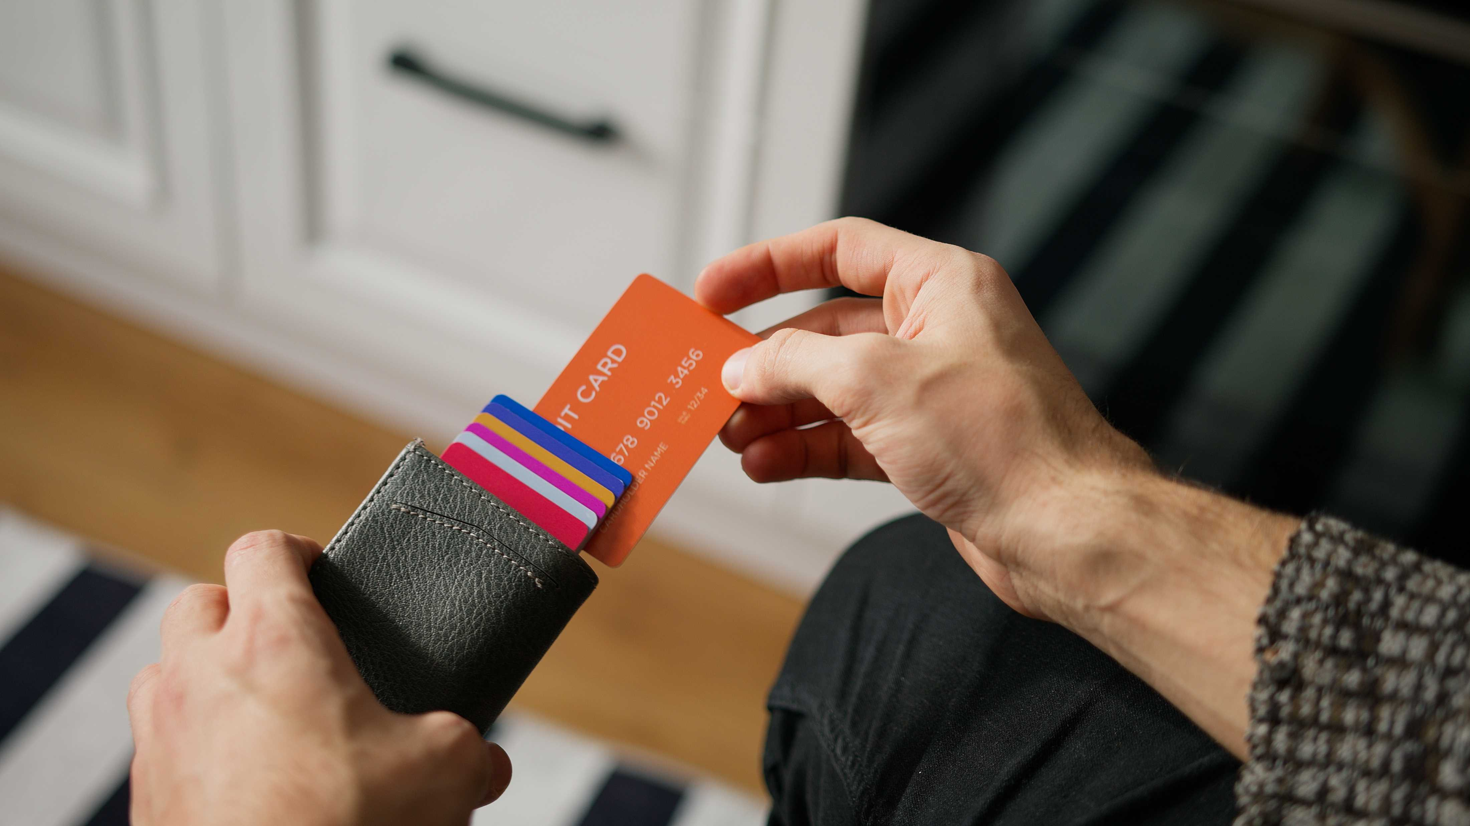

Digital wallets and verifiable credentials

Slide 12
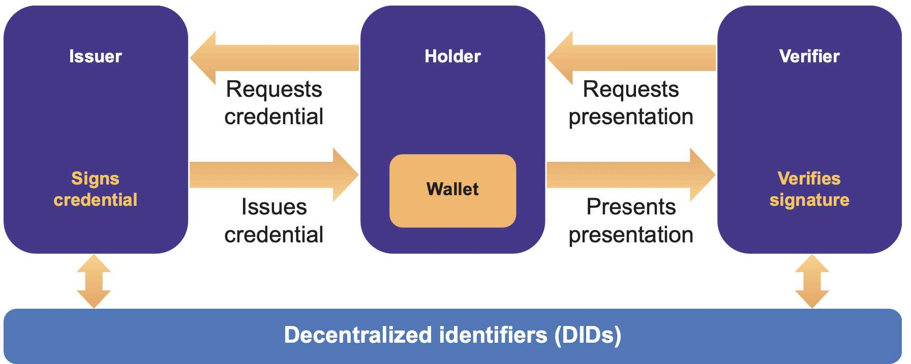
Actors

Slide 13
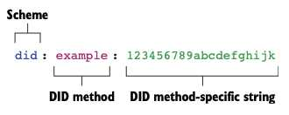
DID: Decentralized Identifiers

Slide 14

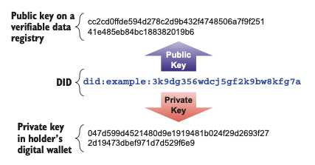
DID: Decentralized Identifiers
Notes:
Asymmetric cryptography - basics

Slide 15



Asymmetric cryptography: Digital Signatures
Compute hash
Cypher with private key
Compute hash
Equal?
Valid
Decypher with public key
Share document
ISSUER
VERIFIER
Notes:
Asymmetric cryptography - basics

Slide 16
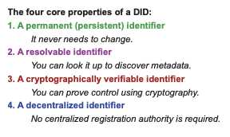
DID: Decentralized Identifiers

Slide 17
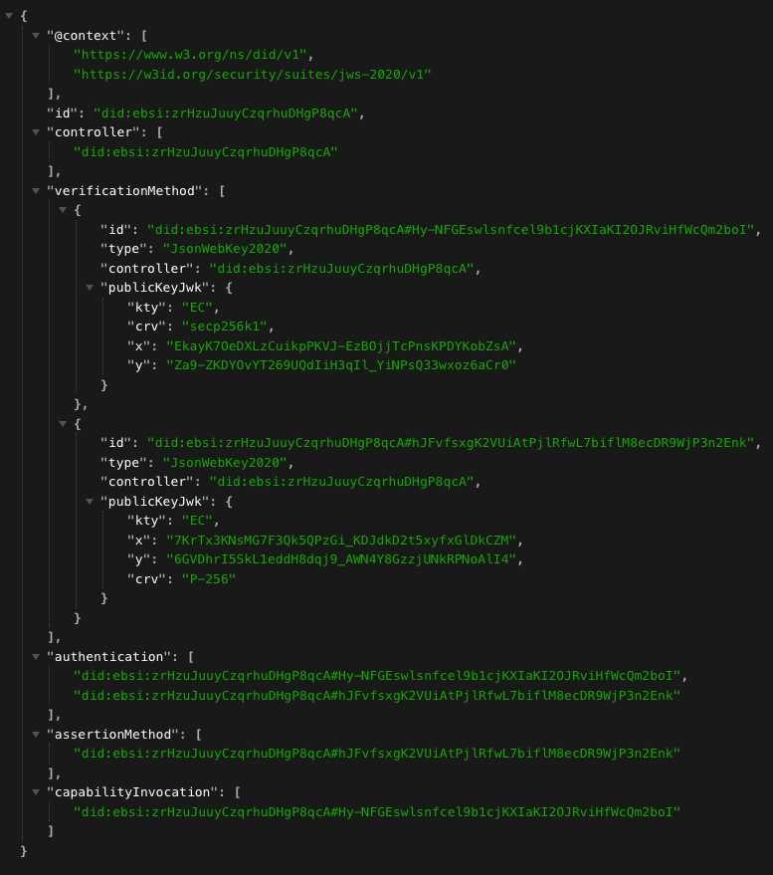
DID documents

Slide 18
VIDidentity 2024
Always be yourself
Components

Slide 19
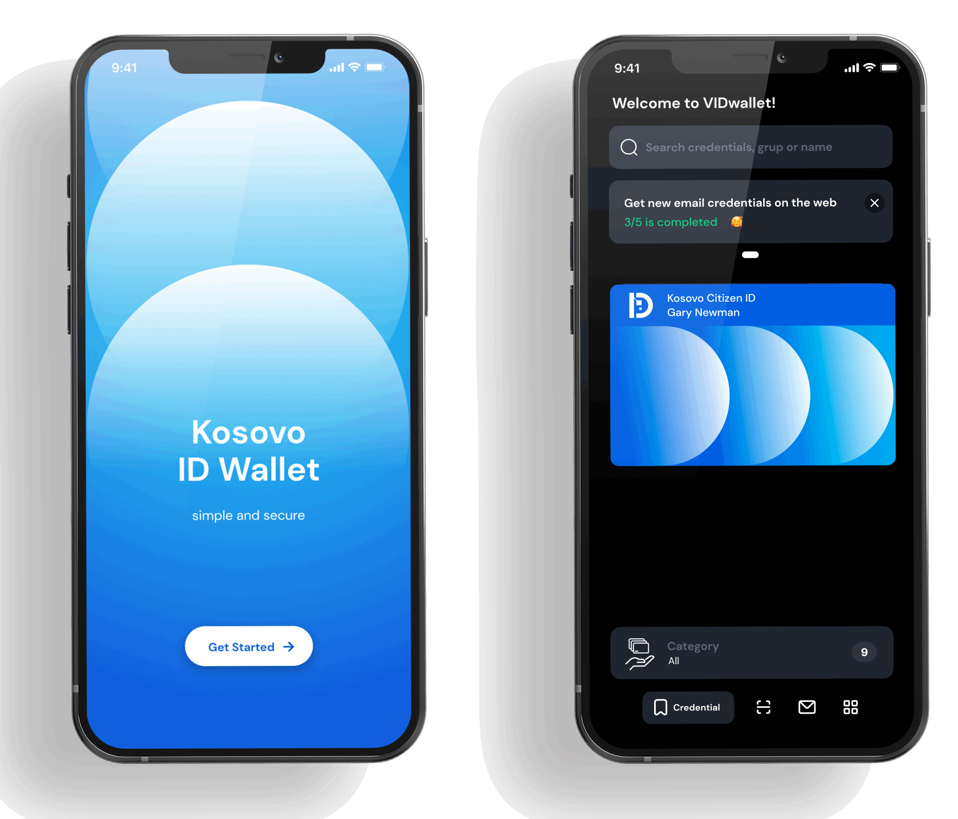
KosovoWallet
A wallet for Kosovo citizens
Receive, maintain, manage and present credentials.
Sort credentials into categories.
Search credentials by name, type….
Use PIN or biometrics to protect access to your data.

Slide 20
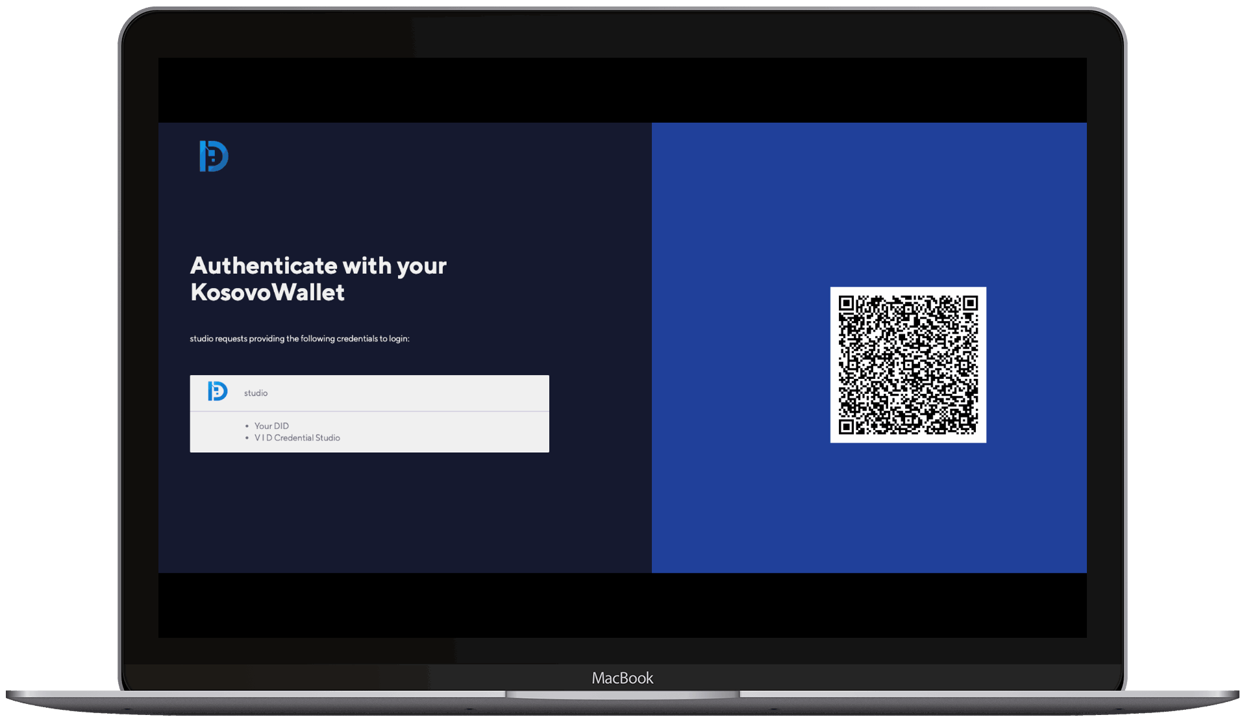
VIDconnect
Citizen credential presentations
Receive, maintain, manage and present credentials.
Sort credentials into categories.
Search credentials by name, type….
Use PIN or biometrics to protect access to your data.

Slide 21
Validated ID
VIDidentity 2024
Always be yourself
Inspect the integration

Slide 22
KosovoWallet
Installation
iOS – Install ipa
Android – Install apk
Send dummy email to mauro.lucchini@validatedid.com
Dummy issuance
Notes:
Issue dummy credential via email

Slide 23
VIDconnect
Check integration example
Client id – Set with your name
Configure default scope
Configure default redirect_uri
Contact administrator

Slide 24
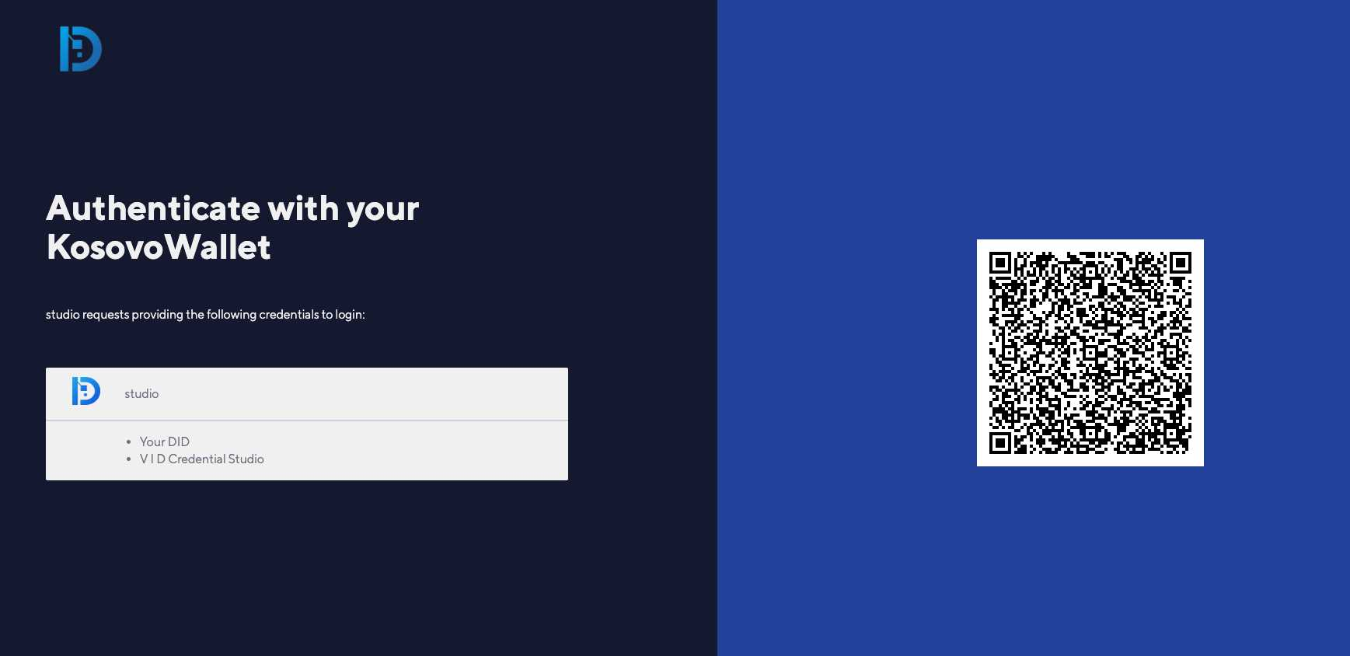
Redirect user to VIDconnect
Integration example
Kosovo verifier frontend
POST /oauth2/auth
VIDconnect
redirect
Kosovo verifier backend

Slide 25
Redirect user to VIDconnect
curl -L -X POST https://staging.vidchain.net/oauth2/auth?
response_type=code
state=08bd09b6-8544-4f8b-9aef-bdd6f17db6f7
redirect_uri=https://kosovo-verifier.com/callback
client_id=internalTesting
scope=openid EmailCredential
nonce=a8d84bc5-1c09-484b-9638-81baf028dfb2

Slide 26
Handle callback to get credential information
Integration example
Kosovo verifier frontend
Redirect redirect_uri
{code}
VIDconnect
Send {code}
to backend
POST /oauth2/token
{code, client_secret}
id_token
Kosovo verifier backend
Decode JWT
Parse Verifiable Presentation

Slide 27
Handle callback to get credential information
curl -L -X POST 'https://staging.vidchain.net/oauth2/token’ \
-H 'Content-Type: application/x-www-form-urlencoded’ \
-H 'Accept: application/json’ \
--data-urlencode 'code=ee4adbeb-5327-4398-974f-24749cdcd03f’ \
--data-urlencode 'client_id=KosovoExampleEntity’ \
--data-urlencode 'client_secret=hw_~._qhncWOZG6OcHdv_iVges’ \
--data-urlencode 'redirect_uri=https://kosovo-verifier.com/callback’ \
--data-urlencode 'grant_type=authorization_code'

Slide 28




Integration examples
Integration example
Kosovo verifier frontend
VIDconnect
Kosovo verifier backend

Slide 29
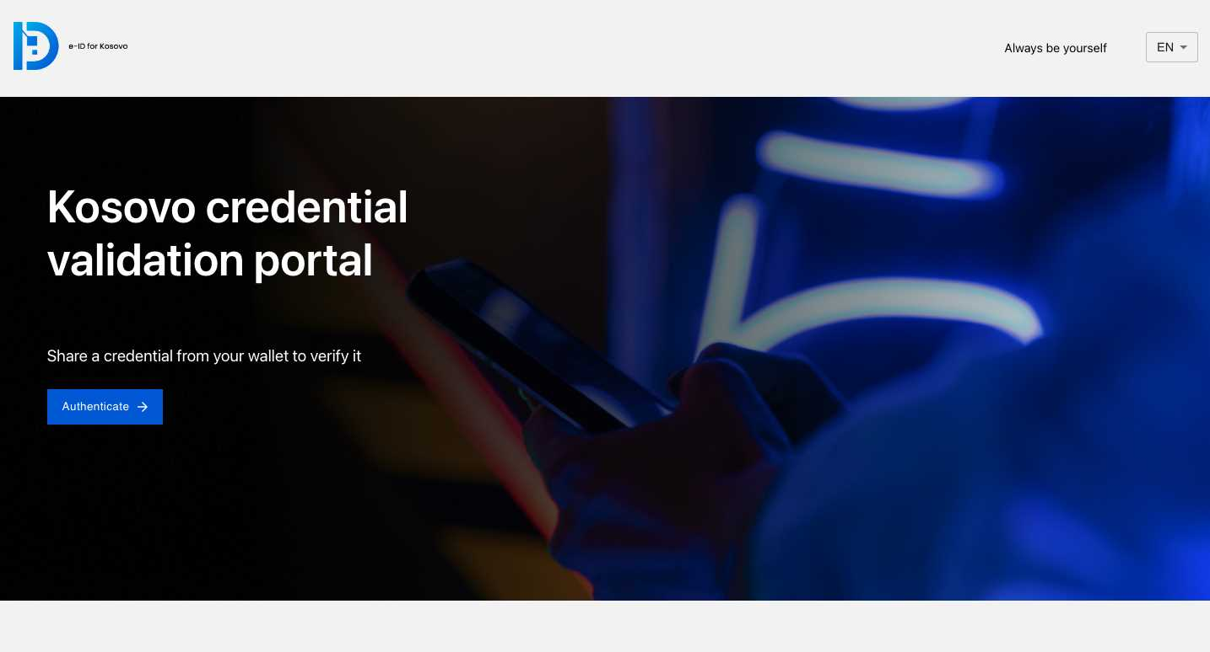
Demo

Slide 30

Integration examples repositories
https://github.com/validatedid/kosovo-universal-verifier
https://github.com/validatedid/kosovo-universal-verifier
https://github.com/validatedid/kosovo-training-java
https://github.com/validatedid/kosovo-training-csharp

Slide 31
MWC 2024
Always be yourself
Thank you

