Slide 1
TEAM “Ancalagon”
Java OOP Advanced
July 2016
Teamwork defense

Slide 2
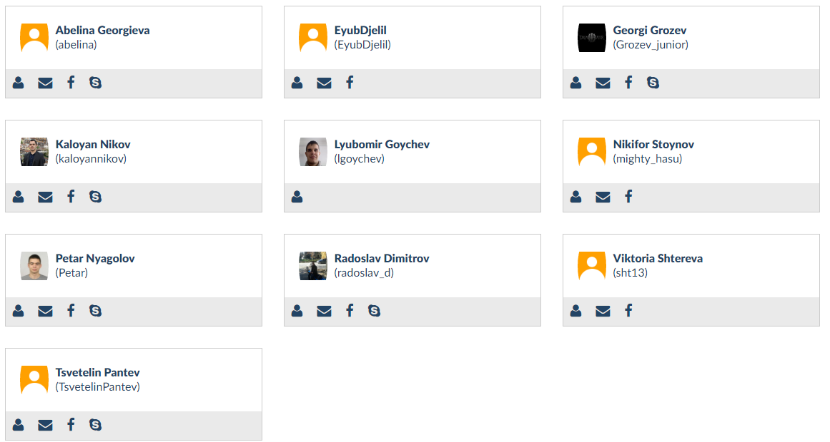
TEAM MEMBERS:
Java OOP Advanced
July 2016

Slide 3



Teamwork Resources:
Java OOP Advanced
July 2016
https://github.com/contracts89/GoToZero

Slide 4

“GoToZero” demo

