Slide 1
Git’n Pro with HTML/CSS
Day 2
July 14th, 2016

Slide 2
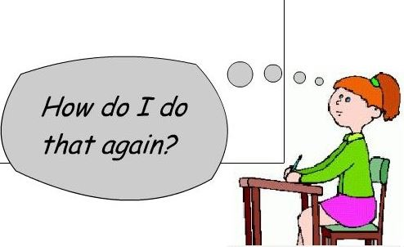
It’s Okay!
Notes:
it's okay if things start to feel like they're moving quickly
The rush and looking back is part of the programming trade.

Slide 3
Admin Items
Notes:
let’s talk through a few admin items

Slide 4
Where to Get Help
Practice, Practice, Practice: Work Individually or in Groups
Review In Class Material (Exercises and Slides): https://unc.bootcampcontent.com/UNC-Coding-Boot-Camp/07-16-Class-Content/tree/master
Re-Watch Class Videos: https://unc.bootcampcontent.com/UNC-Coding-Boot-Camp/07-16-Class-Content
In Class Office Hours: 45 minutes before class, 30 minutes after
Virtual Office Hours: As needed or requested through SSM
One-on-One Sessions: By Announcement through SSM
Contact Student Success: Anytime!
Notes:
first: where to get help
practice code! write it in your free time! - work with people or by yourself
in-class material I’ll post on gitlab after class, as well as recordings (I’ll try to do it the night of most nights
NEXT

Slide 5
Homework #1 - Assignment
Also, at this point everyone should have access to the homework repository in GitLab. https://unc.bootcampcontent.com/UNC-Coding-Boot-Camp/07-16-Class-Content/tree/master/homework-assignments
Homework Assignment #1 is due next week - July 23 at 6 PM
Notes:
should all have access to the homework
questions so far?
did you all at least take a look at the homework? it’s pretty difficult, so get started ASAP

Slide 6
Today’s Class!
Notes:
onward, to today’s material
NEXT

Slide 7
Today’s Objectives
Students will understand the importance of Git Version Control and how to use it.
Students will create GitHub Repositories, push code into them and share with class.
Students will make more HTML documents.
Students will learn to properly use basic HTML tags.
Students will implement basic CSS styling to HTML documents.
Notes:
as promised, we’ll start out with objectives for today
…
any questions? if not

Slide 8
Know Thyself
If you are a complete beginner to HTML/CSS and Coding:
Continue getting comfortable with HTML.
Be able to completely write a basic HTML document (like in last class).
Understand what CSS is, what it’s for and how it works with HTML.
Be able to use Git and GitHub to upload code.
If you’ve had past exposure and felt comfortable with the last lesson:
Aim to build up your skills. Clear up any questions or confusions about HTML.
Become knowledgeable about a wider range of HTML and CSS tags.
Be able to selectively apply CSS to specific HTML elements.
Be able to use Git and GitHub to upload code.
Notes:
make sure you git it together

Slide 9
What / Why Git?
Notes:
Now that you know the objectives, you’re probably wondering what git is and why we’re learning it

Slide 10
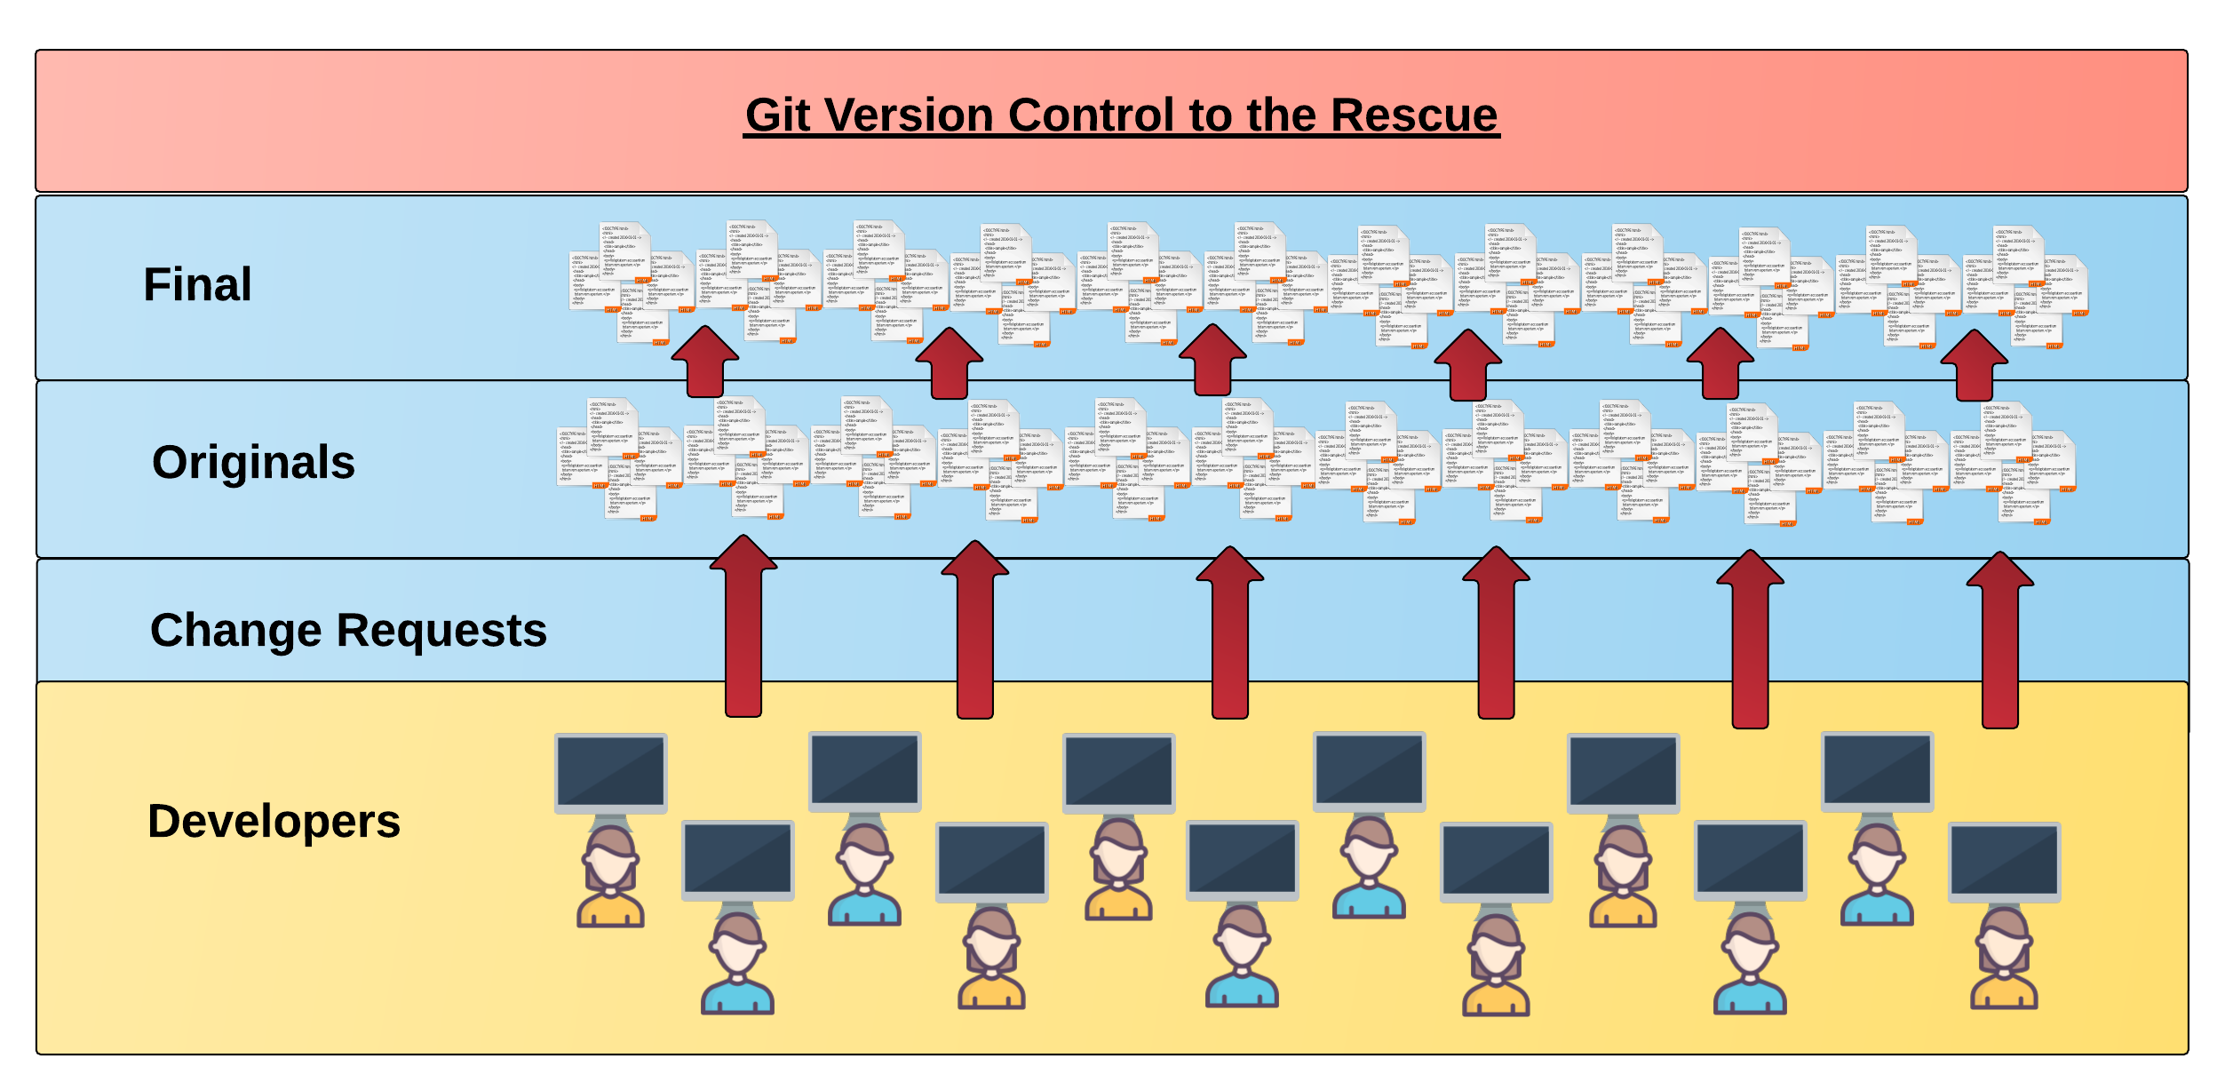
Collaborative Coding
Modern web development is highly collaborative.
Teams are often extremely large and separated across the country — or planet.
Apps sometimes comprise hundreds or even thousands of files.
Notes:
git is a version control system
modern web dev works on large teams,
So, say someone wants to start a project with a team
NEXT

Slide 11

The Group Project
OMG. I HAZ THE GREATEST HTML IDEA!!!!!
SpongeSite.com
Notes:
Spongebob has an idea!
NEXT

Slide 12

The Group Project
Programming Away…
Notes:
on his own machine, starts writing code…
NEXT

Slide 13

The Group Project
Programming Away…
SpongeBob's idea is dumb. We should call it…
KobezzzSite.com
Notes:
Kobe is also on the team and wants to help!

Slide 14
The Group Project
Programming Away…
SpongeBob's Version
Programming Away…
Kobe’s Version
Notes:
they both are coding on their own machines
NEXT

Slide 15
The Group Project
Programming Away…
Now they have two completely different versions.
Programming Away…
Notes:
with two different versions! their code is different, because Kobe disagrees with spongebob

Slide 16
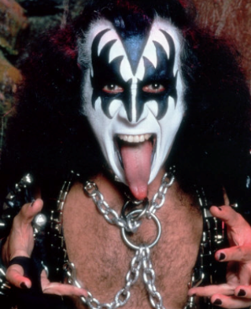
The Group Project
Programming Away…
Programming Away…
Notes:
in comes the third member of the team
NEXT

Slide 17
The Group Project
Programming Away…
Hai guyz!!!
How R Kan help??
Programming Away…
Notes:
he wants to help, but messes up.

Slide 18
The Group Project – Tragedy #2
Programming Away…
OK.
Delete. Delete. Delete. Delete.
Delete. Delete
Programming Away…
Notes:
accidentally deletes all of the code

Slide 19
The Group Project
Lesson:
You should use Version Control.
….And be wary of group members.
Notes:
here’s the problem: we have multiple versions of code floating around, and anyone has the ability to irreversibly destroy everything!
NEXT

Slide 20
Version Control
Git Version Control: Offers a set of commands and an organizational structure for managing code when multiple developers work simultaneously.
Major Benefits come from using Git:
Code Conflict Resolution
Version History
Notes:
talk about benefits, then let’s check out the previous example
NEXT

Slide 21
The Group Project
Programming Away…
Now they have two completely different versions.
Programming Away…
Notes:
spongebob and Kobe still have two versions

Slide 22
The Group Project with Version Control
Main Branch (Spongebob’s)
Spongebob continues programming
1
2
3
4
5
Kobe pushes (uploads) his code changes into the main branch.
Code conflicts are resolved before inclusion.
Kobe’s Branch
Notes:
but Kobe contributes to spongebob’s code instead of maintaining his own
he does this by uploading his changes to spongebob’s version of the code
the primary source of truth for the code is typically called the “main” branch of the code
NEXT

Slide 23
The Group Project – Tragedy 2 (Revisited)
Programming Away…
OK.
Delete. Delete. Delete. Delete.
Delete. Delete
Programming Away…
Notes:
now, guy number three comes in and messes up again…NEXT

Slide 24
The Group Project with version control
Main Branch (Spongebob’s)
1
2
3
4
Kiss Dude pushes his (bad) code deletions
Kiss Dude’s Branch
Notes:
he pushes all of his bad code to the main branch NEXT

Slide 25
The Group Project with version control
Main Branch (Spongebob’s)
1
2
3
4
5
But this time, Spongebob rolls back the code to an earlier version.
Kiss Dude’s Branch
Notes:
but, since we have history, spongebob can easily go back to an earlier version of the code NEXT

Slide 26
The Group Project
Lesson:
You should use Version Control!
Notes:
moral of the story?
yeah, use version control
keeps catastrophes from happening, and helps keep your code organized across a team.
NEXT

Slide 27
Quick Activity!
Suggested Time: 3 min
Turn to your neighbor and have one of you explain to the other:
What the concept of version control is
Then the other should explain :
Two of the key advantages to using a version control system
Notes:
take a few minutes to describe to each other what version control is, and why you’d want to use it
NEXT

Slide 28

So… What’s this GitHub?
GitHub is a Web-Based hosting service to store code online.
It allows developers to pull (download) code or push (upload) code to the same repository (directory).
It also allows developers to view histories of code changes and track issues.

Slide 29




Pushing and Pulling to GitHub
1
2
3
4
GitHub Branch
Pull Code
Push Code
Pull Code
Pull Code
Push Code
Pull Code
Push Code
Notes:
So now that we’ve talked about why it is you need version control
let’s talk about Git
NEXT

Slide 30
Get Started with Git

Slide 31
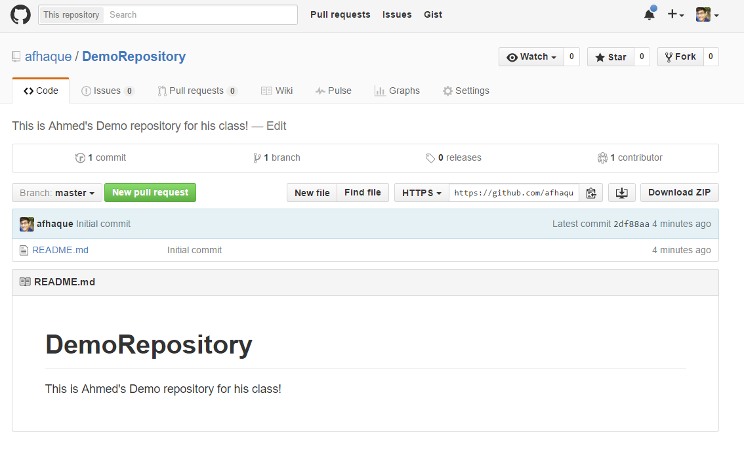
Instructor Git Demo!

Slide 32
Basic Git Commands
At its most basic, these are the five git commands to get started
git clone
git add
git commit
git push
git pull

Slide 33
Basic Git Commands
At its most basic, these are the five git commands to get started
git clone – copies an entire repo (to begin)
git add – adds a file for inclusion in Git
git commit – notes a change to the local repo
git push – sends changes to hosting service
git pull – downloads freshest version of repo

Slide 34
> YOUR TURN!
Activity: Git Add, Commit, Push | Suggested Time: 20 min
Assignment:
Using GitHub and the Command Line:
Create a new public GitHub repository and name it whatever you like. Be sure to check the box for “initialize this repository with a README”
Next, clone the repo to your local directory.
Then create an HTML file inside the local directory.
Add, Commit, and Push the code to GitHub.
Bonus:
Find a partner in class and fork their repository to your own GitHub account. Clone this forked repository to your local directory.
Add, Commit, and Push the code back to your forked copy.
Finally, submit a pull request to send your changes to your partner’s repo.

Slide 35
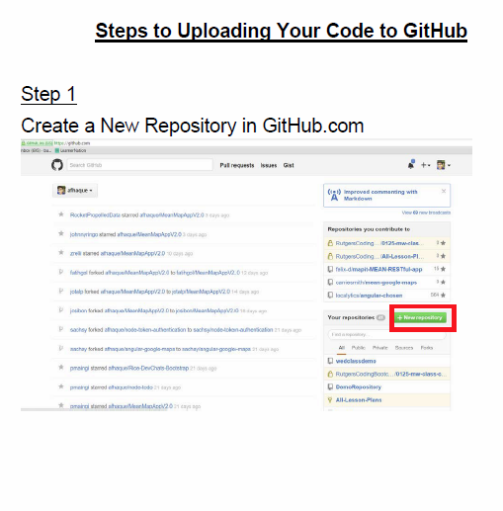
Still a Bit Lost? Never Worry!
Follow this handy Guide!
Practice a few times on your own before our next class.

Slide 36
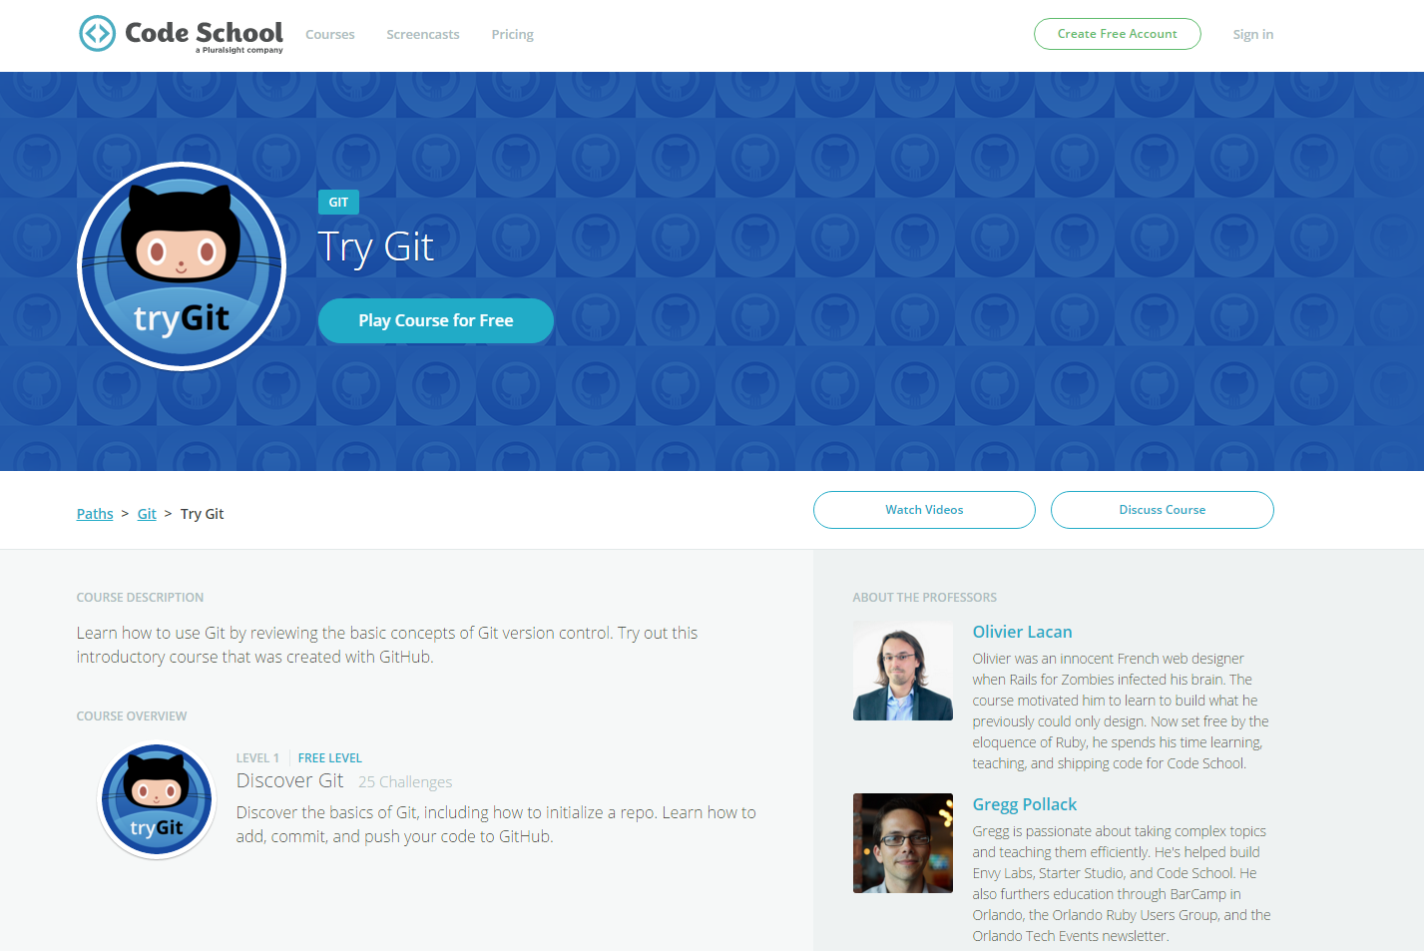
If You’re Still Lost… Here’s a (Free) Course
https://www.codeschool.com/courses/try-git
Notes:
there are also a ton of courses out there on git on codecademy, codeschool, etc.

Slide 37
HTML Round 2

Slide 38
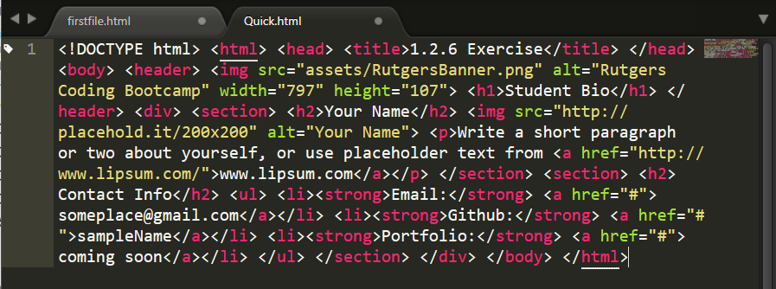
On Ugly HTML
Don’t do this… Use proper indentation and sectioning.
Readable code is easier to maintain.
Invest time to get better about this now. It will pay dividends!

Slide 39
HTML Syntax (Basic)
Content
<h1>
This is Mah House
</h1>
Opening Tag
Closing Tag

Slide 40
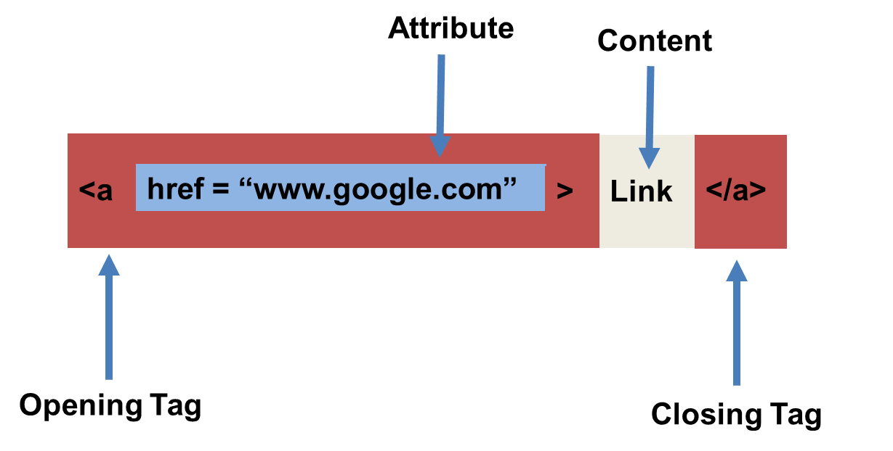
HTML Syntax (with Attribute)

Slide 41
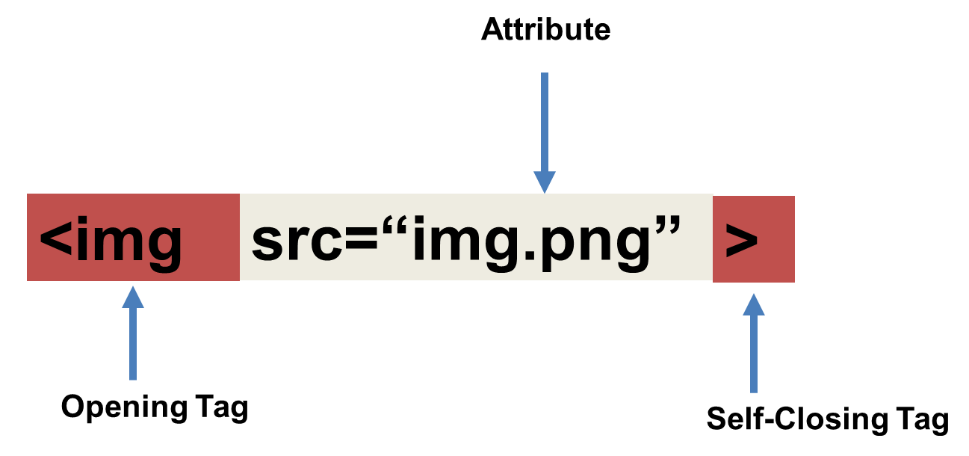
Tricky Tags (Self-Closing)

Slide 42
Important Common Tags
Headers:
<h1> </h1> - Header 1 (Largest Header)
<h2> </h2> - Header 2 (Next Largest Header)
<h3> </h3> - Header 3
…
Containers:
<html> </html> - Wraps the entire page
<head> </head> - Wraps the header of the page
<body> </body> - Wraps the main content
<div> </div> - Logical Container ***
<p> </p> - Wraps individual Paragraphs
Others:
<strong> (bold), <em> (emphasis)
<img> (images), <a href> (links), <li> (list items) , <title> (title), <br> (line break), <table> (tables), <!-- --> (comments)
Notes:
so let’s go a little more in depth in to

Slide 43
Less Common Tags
All HTML Tags are listed here: http://www.w3schools.com/tags/
Don’t try to memorize them! Simply refer back to documentation as needed.
Other tags:
<video> for Videos
<audio> for Audio files
<embed> for Embedded files
<code> for including computer code
<header> for headers
<nav> for navigation bars
<footer> for footers

Slide 44
HTML for Forms
Common UI (User Interface) Form Elements:
<form> - Creates a form section in HTML
<input> - Input boxes
<label> - Labels for boxes
<button> - Button
<textarea> - Large textbox

Slide 45
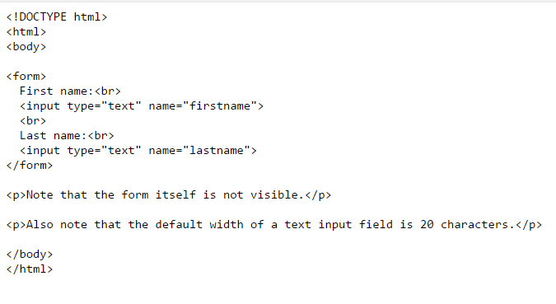
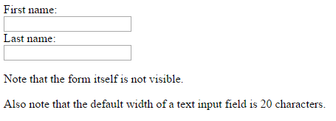
HTML for Forms

Slide 46
> YOUR TURN!
Activity: 1-HTML_Git | Suggested Time: 20 min
Assignment
In this activity, you’ll create a student bio using HTML. You will then add, commit, and push your completed HTML to GitHub for the world to see.
Additional instructions, sent via Slack.

Slide 47
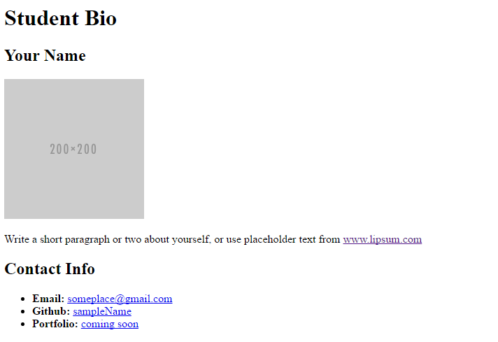
> YOUR TURN!

Slide 48
CSS Stylin’

Slide 49
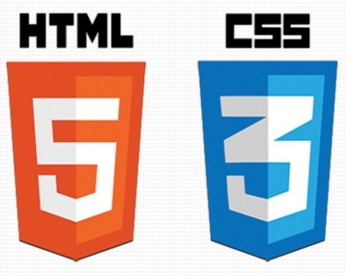

HTML / CSS Definitions (*yawn* unimportant)
HTML: Hypertext Markup Language – (Content)
CSS: Cascading Style Sheets – (Appearance)
HTML/CSS are the “languages of the web.” Together they define both the content and the aesthetics of a webpage – handling everything from the layouts, colors, fonts and content placement. (JavaScript is the third – handling logic, animation, etc.)

Slide 50


HTML / CSS Analogy
HTML Alone
Like writing papers in “Notepad”.
Can only write unformatted text.
HTML / CSS
Like writing papers in Microsoft Word.
Can format text, page settings, alignment, etc. based on “highlighting” and menu options.

Slide 51
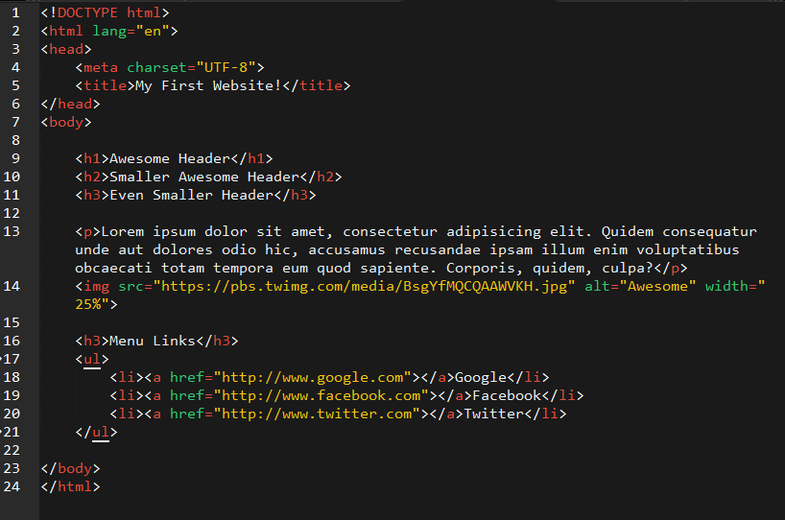
Basic HTML Page

Slide 52
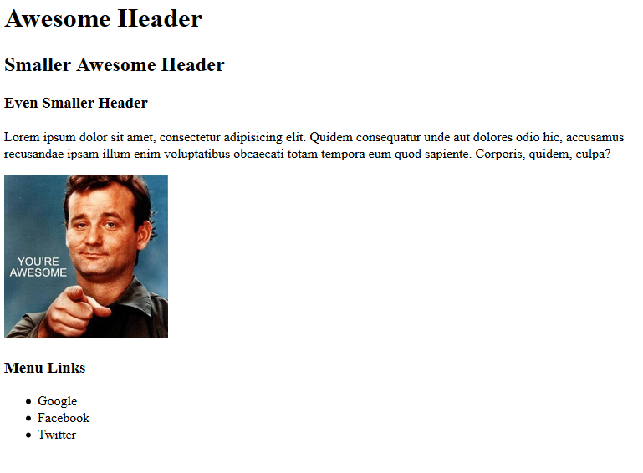
Basic HTML Page - Result

Slide 53
Basic HTML Page - Result
Hella Boring…

Slide 54
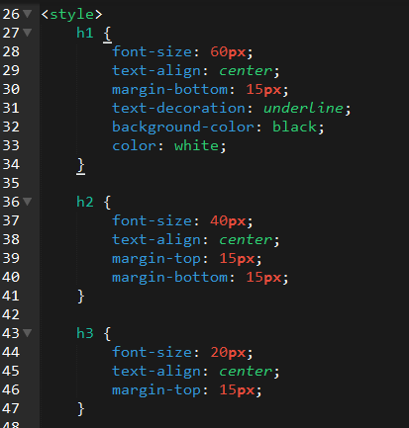
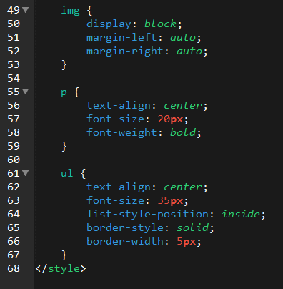
Enter CSS

Slide 55
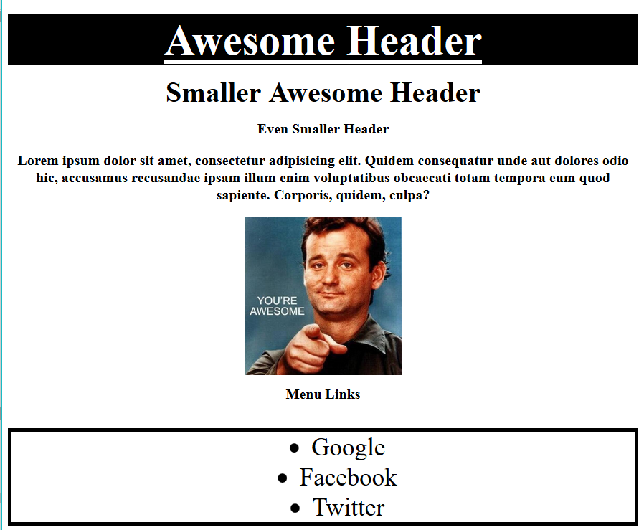
Enter CSS - Result

Slide 56
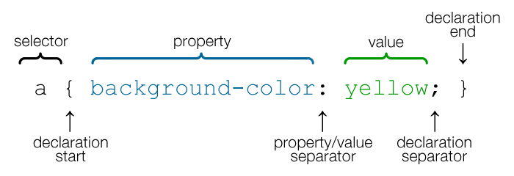
CSS Syntax
CSS works by hooking onto selectors added into HTML using “classes and identifiers.”
Once hooked, we apply styles to those HTML elements using CSS.

Slide 57
CSS Example
In the below example the “Header” would be turned blue and MUCH larger because of the CSS.
We can incorporate an element’s class or ID to apply a CSS style to a particular part of the document.
Just remember to include the necessary symbol before the CSS: “.” for class, “#” for ID.
Example (HTML):
<p class=“bigBlue”>Header</p>
Example (CSS):
.bigBlue
{
font-size: 100px;
color: blue;
}

Slide 58
Key CSS Attributes
Font / Color:
color: Sets color of text.
font-size: Sets size of the font.
font-style: Sets italics.
font-weight: Sets bold .
Alignment / Spacing:
margin-top(bottom/left/right): Adds space between element and its own border.
margin-top (bottom/left/right): Adds space between element and surrounding elements.
float: Forces elements to the sides, centers, or tops.
Background:
background-color: sets background color.
background-image: sets background image.

Slide 59
Powerful Duo
Believe it or not, HTML / CSS is all you need
to develop a vivid, full-blown website.

Slide 60
INSTRUCTOR DEMO
Instructor: Demo
(quickexample_internalcss.html | 2-BasicCSS)

Slide 61
> YOUR TURN!
Activity: 3-HTML_CSS_Layout | Suggested Time: 20 min
Assignment
In this activity, you’ll upgrade your previous HTML bio-page using CSS style rules. Once you’re done, commit and push up your changes to GitHub.
We’ll send you additional instructions via Slack.

Slide 62
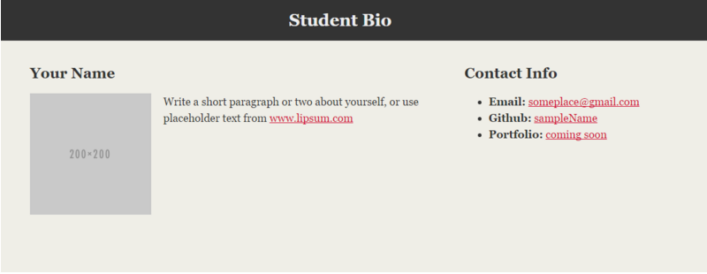
> YOUR TURN!

Slide 63
Recap + Questions

Slide 64
Remember: Know Thyself
If you are a complete beginner to HTML/CSS and Coding:
Continue getting comfortable with HTML.
Be able to completely write a basic HTML document (like in last class).
Understand what CSS is, what it’s for and how it works with HTML.
Be able to use Git and GitHub to upload code.
If you’ve had past exposure and felt comfortable with the last lesson:
Aim to build up your skills. Clear up any questions or confusions about HTML.
Become knowledgeable about a wider range of HTML and CSS tags.
Be able to selectively apply CSS to specific HTML elements.
Be able to use Git and GitHub to upload code.

