Slide 1
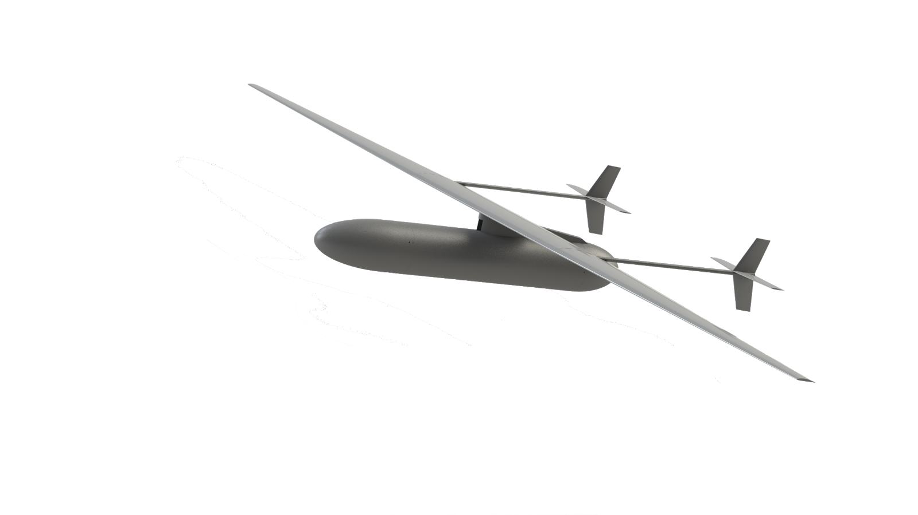
Dart tails
Pylon
Air intake
Engine bay
Fuel bay
Payload and avionics bay

Slide 2
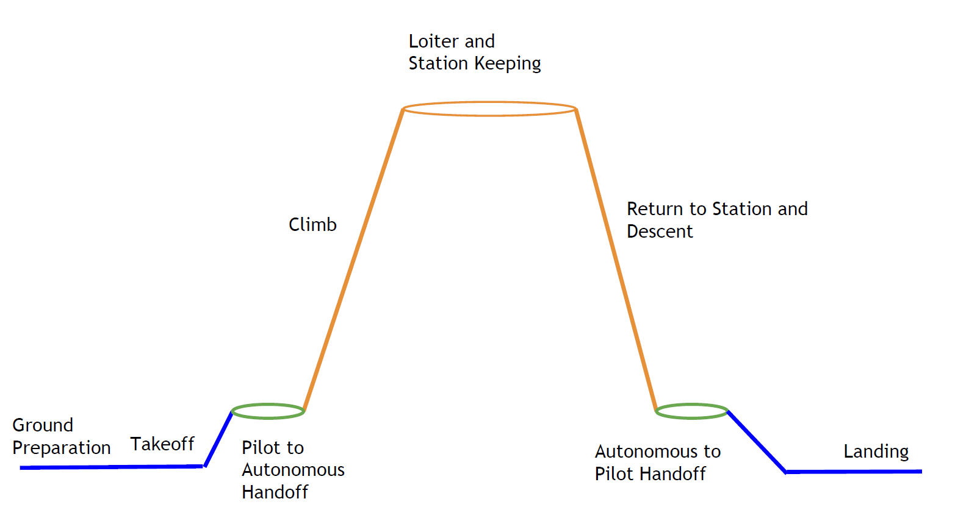
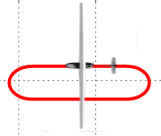
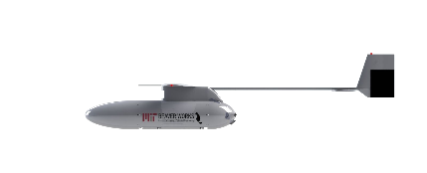
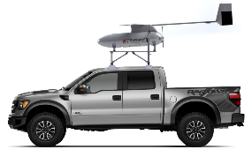
100 km diam. footprint,
5.6 days
Pilot to Autopilot Handoff
Autopilot to Pilot Handoff

Slide 3
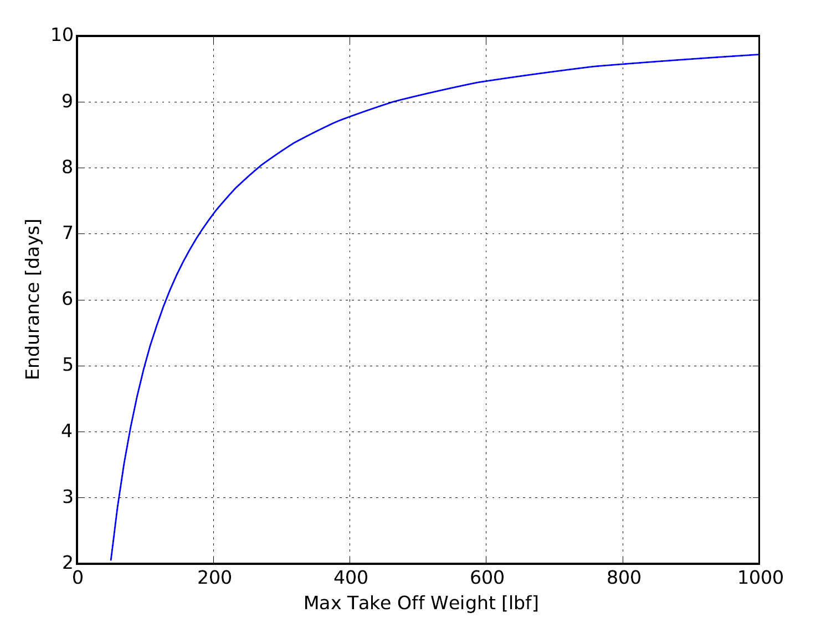
[100 lbs, 5.0 days]

Slide 4
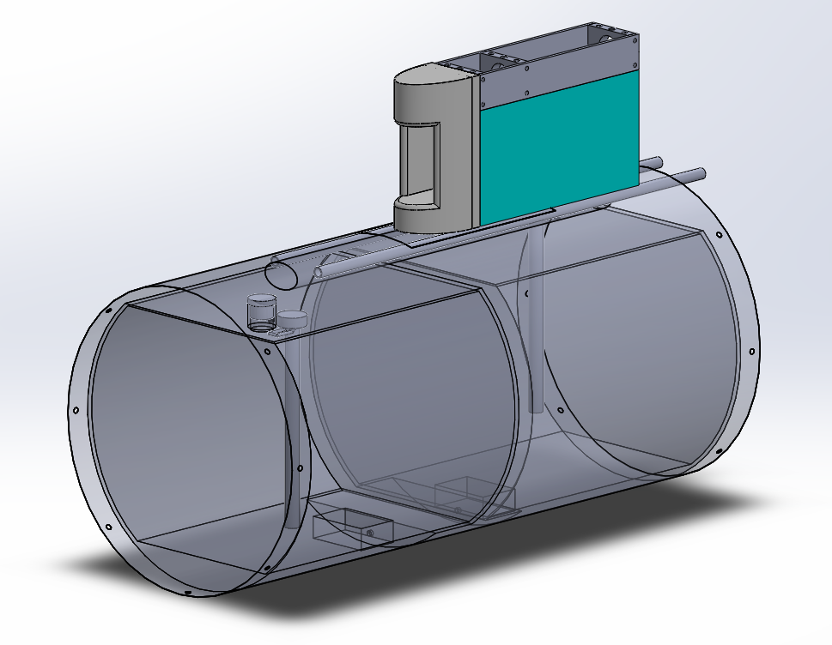
Pylon fairing
Engine intake
Longeron
Fuel tank
Pressure relief valve
Fuel level sensor
Fuel sump
Foam padding

Slide 5
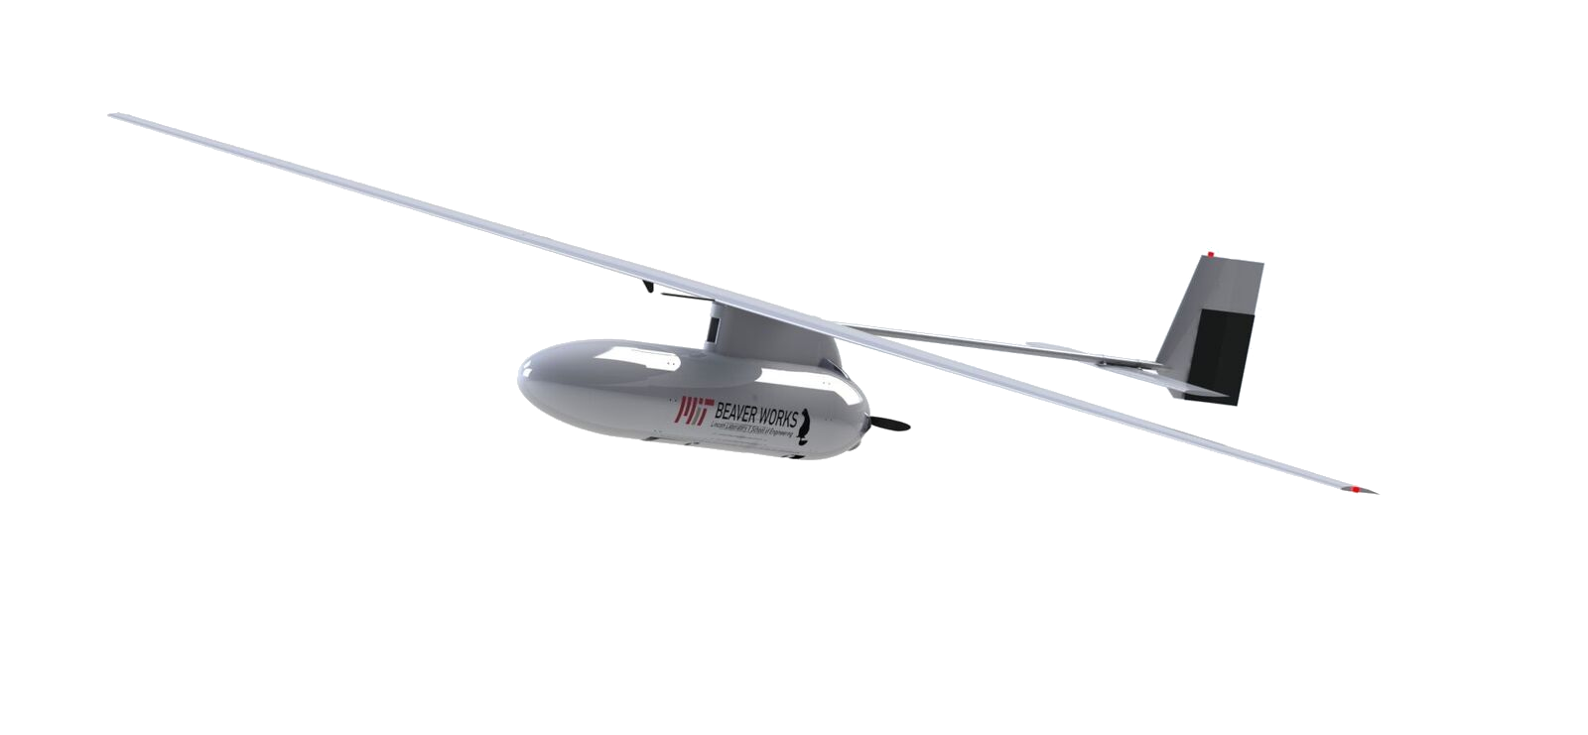
Payload antenna
Conventional tail
Pylon
Pitot tube
ADS-B antenna
Air intake
22”x8” propeller
Engine bay
Payload and avionics bay
Fuel bay

