Slide 1
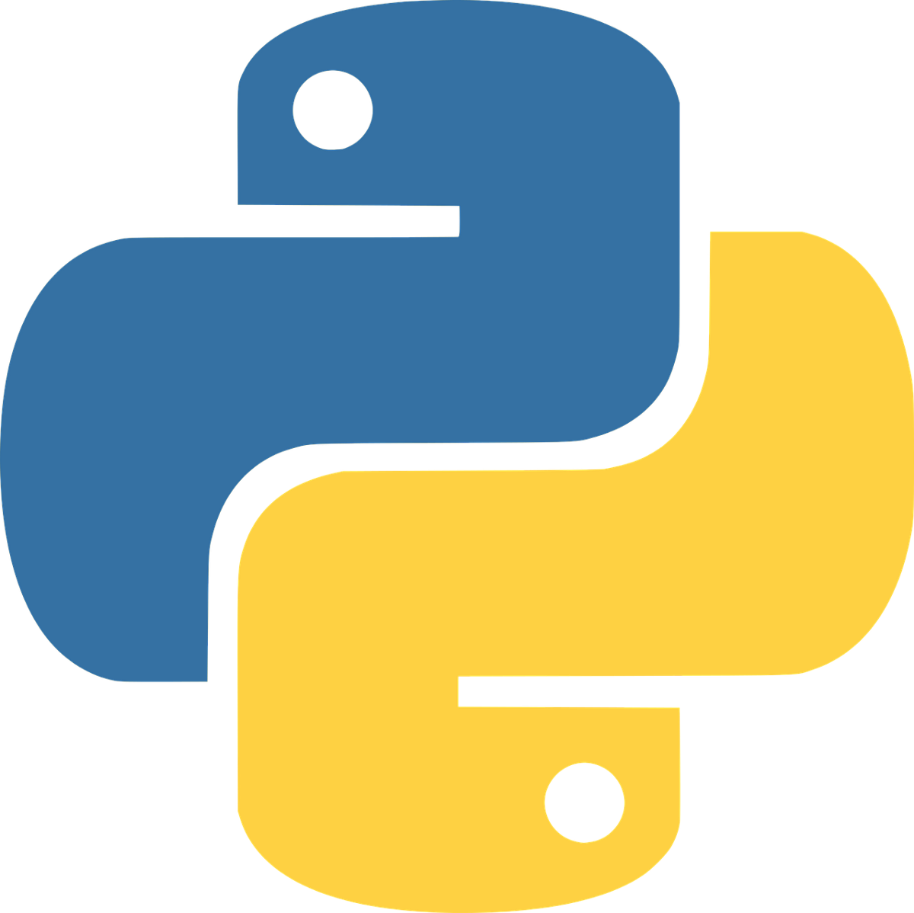

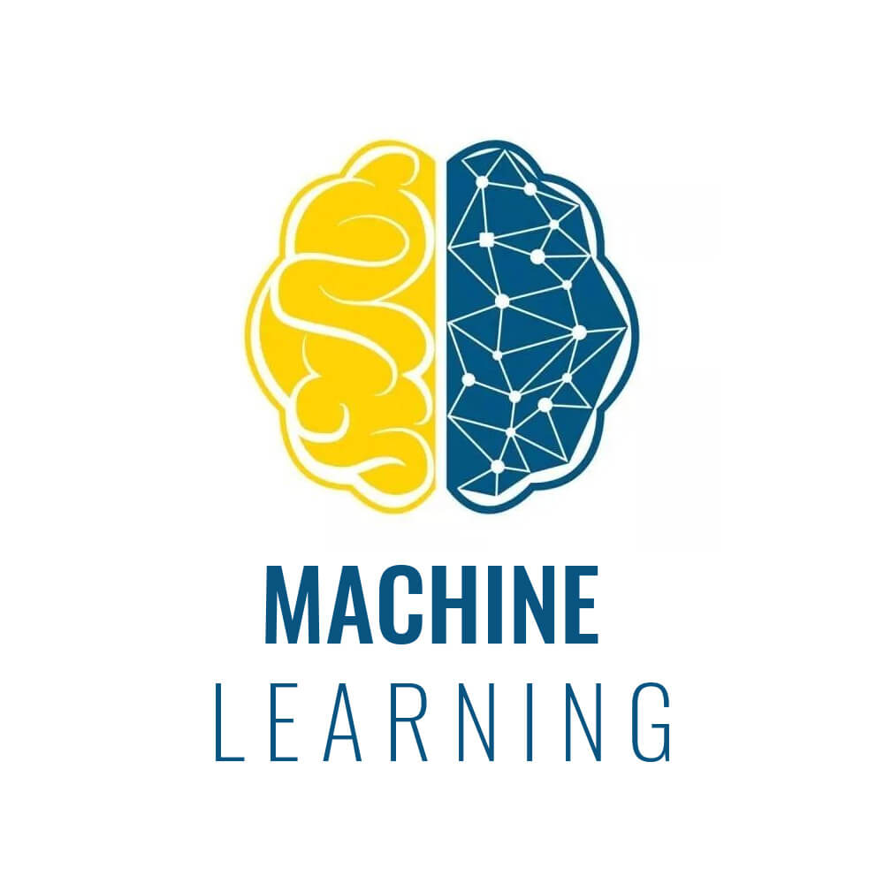


Complete Face Recognition Web Framework

Slide 2
What will you Learn ?

Slide 3
What will you Learn ?
Artificial Intelligence Project
Technology Stack
Python

Slide 4
Model Views Template (MVT) Framework
Models
Templates
Design and Updating
User Input (image)
Views
Complete Data
Display Data

Slide 5


MVT + Machine Learning Framework
Models
Templates
Update into Database
User Input (image)
Views
Display Data
Extract the Data
Preprocessing
Face Detection
Face Identity
Facial Emotion
Machine Learning
Model

Slide 6
Next
Develop MVT + Machine Learning Framework

