Slide 1

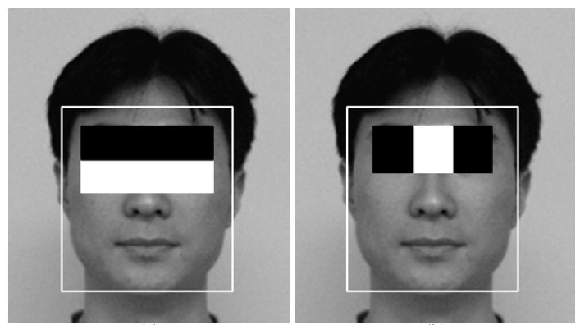
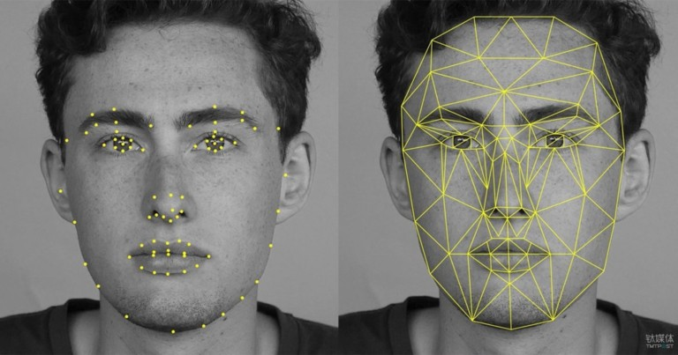
What will you Learn ?
Section-1
Image Basics with OpenCV
Section-2
Object Detection with Viola-Jones
Section-3
Face Detection with DNN

Slide 2
Image Processing with OpenCV
Project Phase - 0

Slide 3
Image Basics with OpenCV
Pixel
Load, Display & Save
Accessing & Manipulate Pixels
Drawings
Line
Rectangle
Circle
Polylines

