Slide 1
PHASE - 1 Train Machine Learning Algorithm

Slide 2
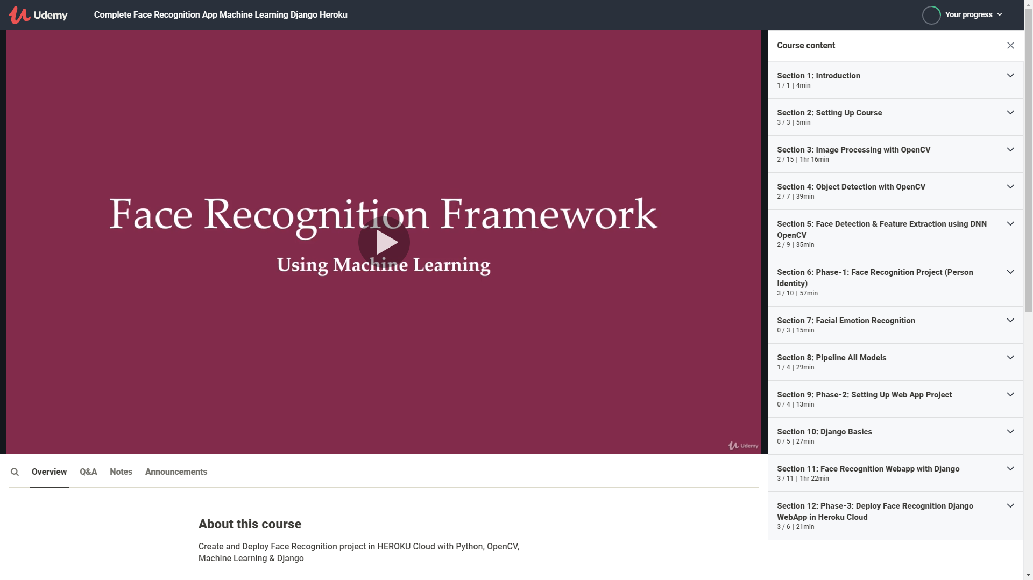

Slide 3
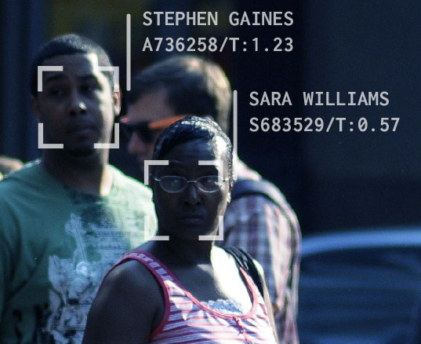


What will you Learn ?
Section-6
Face Recognition
(Person Identify)
Section-7
Facial Emotion
(Happy, Sad, …)
Section-8
Pipeline Model

Slide 4
Key take away

