Slide 1
pixel

Slide 2
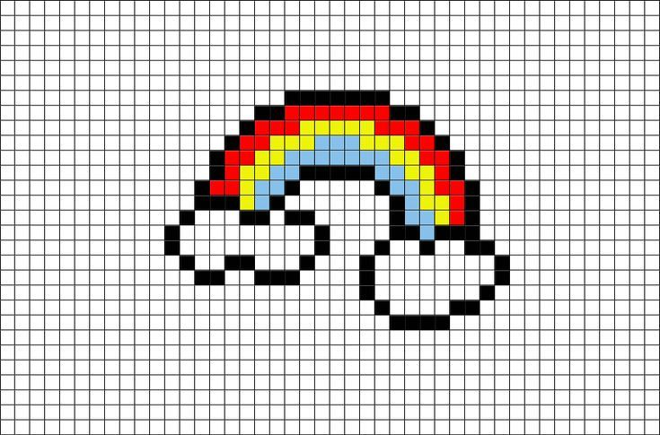
what is pixel ?
Every image consists of a set of pixels. Pixels are the raw building blocks of an image. There is no finer granularity than the pixel.

Slide 3
what is pixel ?
Every image consists of a set of pixels. Pixels are the raw building blocks of an image. There is no finer granularity than the pixel.

Slide 4
activity
Problem Statement:
let’s assume we have an image with a resolution of 500 x 300. This means that our image is represented as a grid of pixels, with 500 rows and 300 columns.
How many pixels are there in an image ?
500 x 300 = 150, 000 pixels in our image.

Slide 5

range of pixel
The range of pixels for an n-bit image is.
$$0 −(2^{n} −1)$$
The range of pixels for an 8-bit image is.
$$0 −255$$

Slide 6
color and grayscale

Slide 7
grayscale
In a grayscale image, each pixel has a value between 0 and 255, where,
zero corresponds to “black”
255 corresponds to “white”.
The values in between 0 and 255 are varying shades of gray.
where values closer to 0 are darker
and values closer to 255 are lighter
255
200
130
65
0

Slide 8
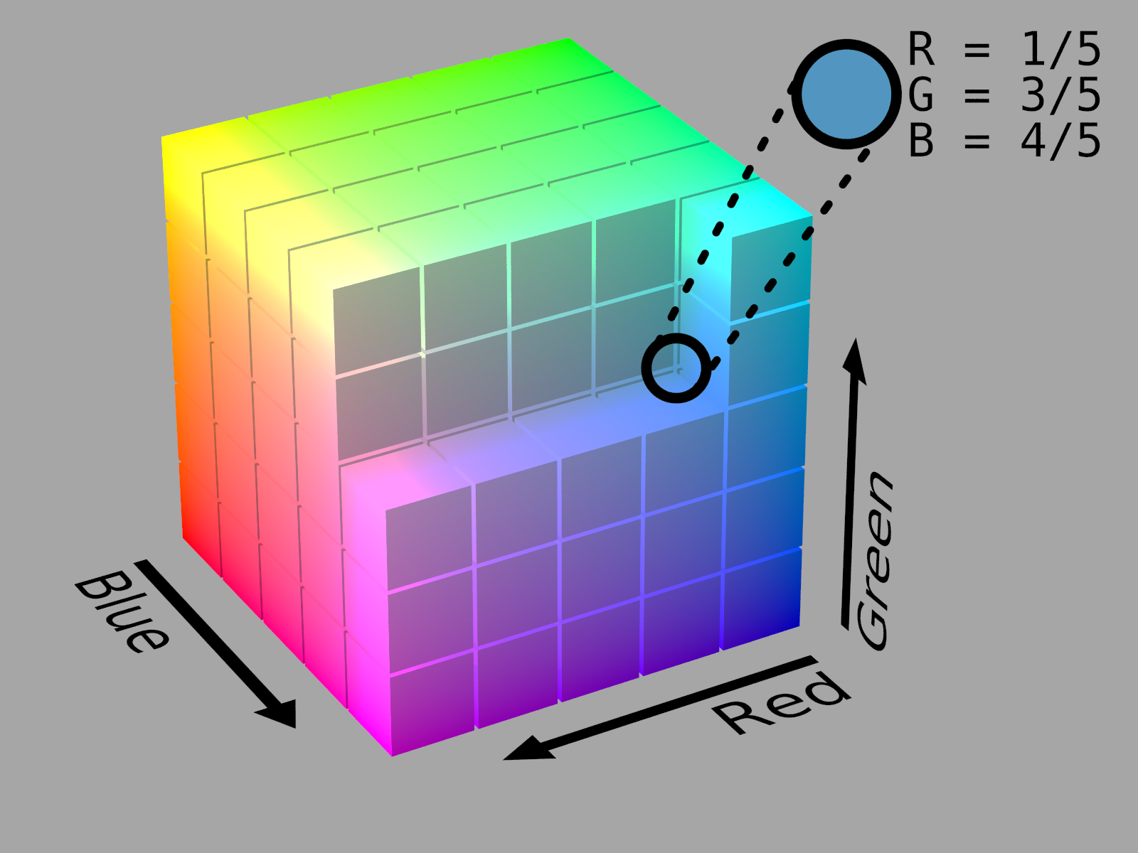
color
Color pixels are normally represented in the RGB color space
one value for the Red component,
one for Green,
and one for Blue.

Slide 9
color
To construct a white color, we would fill up each of the red, green, and blue buckets completely, like this: (255, 255,255).
For your reference, here are some common colors represented
as RGB tuples:
Black: (0,0,0)
White: (255,255,255)
Red: (255,0,0)
Green: (0,255,0)
Blue: (0,0,255)
Aqua: (0,255,255)
Fuchsia: (255,0,255)
Maroon: (128,0,0)
Navy: (0,0,128)
Olive: ( 128,128,0)
Purple: (128,0,128)
Teal: (0,128,128)
Yellow: (255,255,0)

Slide 10
coordinate system of an image

Slide 11



Coordinate System
As I mentioned above, an image is represented as a grid of pixels. Imagine our grid as a piece of graph paper.
Using this graph paper, the point (0, 0) corresponds to the upper left corner of the image. As we move down and to the right, both the x and y values increase.
X
(7,7)
y

Slide 12
Coordinate System
As I mentioned above, an image is represented as a grid of pixels. Imagine our grid as a piece of graph paper.
Using this graph paper, the point (0, 0) corresponds to the upper left corner of the image. As we move down and to the right, both the x and y values increase.
X
y

Slide 13
next
convert color in OpenCV python

