Slide 1
Face Recognition Framework
Using Machine Learning

Slide 2
Face Recognition Framework
Step-1: Extract Features From Faces
Step-2: Train features with Machine Learning Model
Step-3: Save Machine Learning model

Slide 3



Face Recognition Framework
Train Images
Train Machine Learning Model
Model Artifacts
image
image
images
Model Ready
Feature Extraction
Feature Extraction
Training
Save Model

Slide 4

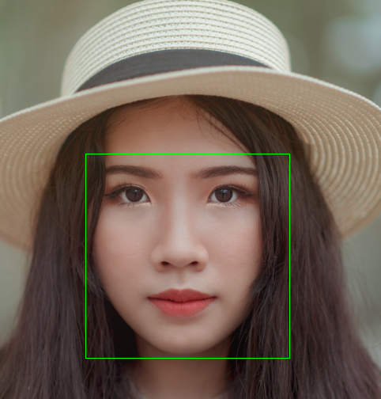

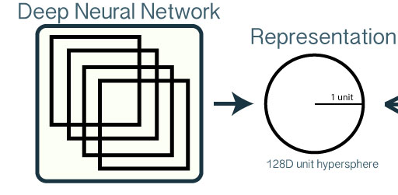
Open-Face Feature Extraction Method
Step-2: Crop
Step-3:
Shape
Predictor
Step-1: Face Detection
Facial Features

Slide 5
Face Recognition Framework
Train Images
Train Machine Learning Model
Model Artifacts
image
image
images
Facial Features
Model Ready
Feature Extraction
Feature Extraction
Training
Save Model

Slide 6
Train Machine Learning
Test Set
Facial Features
Train Set
Evaluate Model
Model Ready
Data
Train ML model

Slide 7
Face Recognition Framework
Train Images
Train Machine Learning Model
Model Artifacts
image
image
images
Make Predictions
Model Ready
Feature Extraction
images
Validation Images
Feature Extraction
Training
Save Model

Slide 8
Next
Develop Machine Learning Based Face Recognition Model

