Slide 1
image transformation

Slide 2
1. Translation 2. Rotation 3. Resizing 4. flipping 5. cropping

Slide 3
Translation
Image transformation

Slide 4
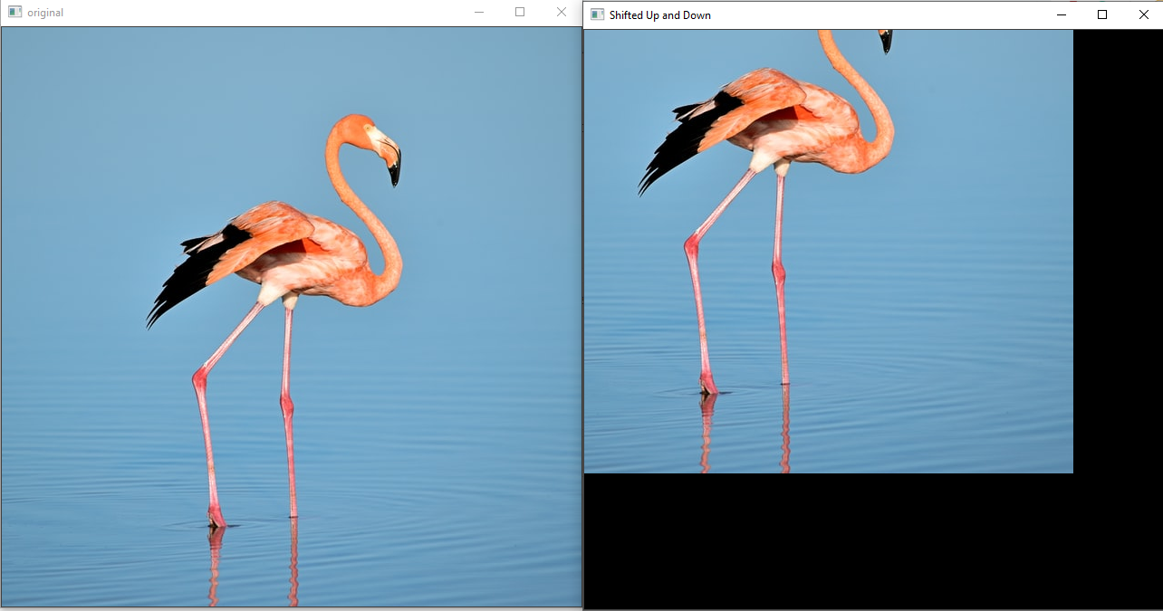
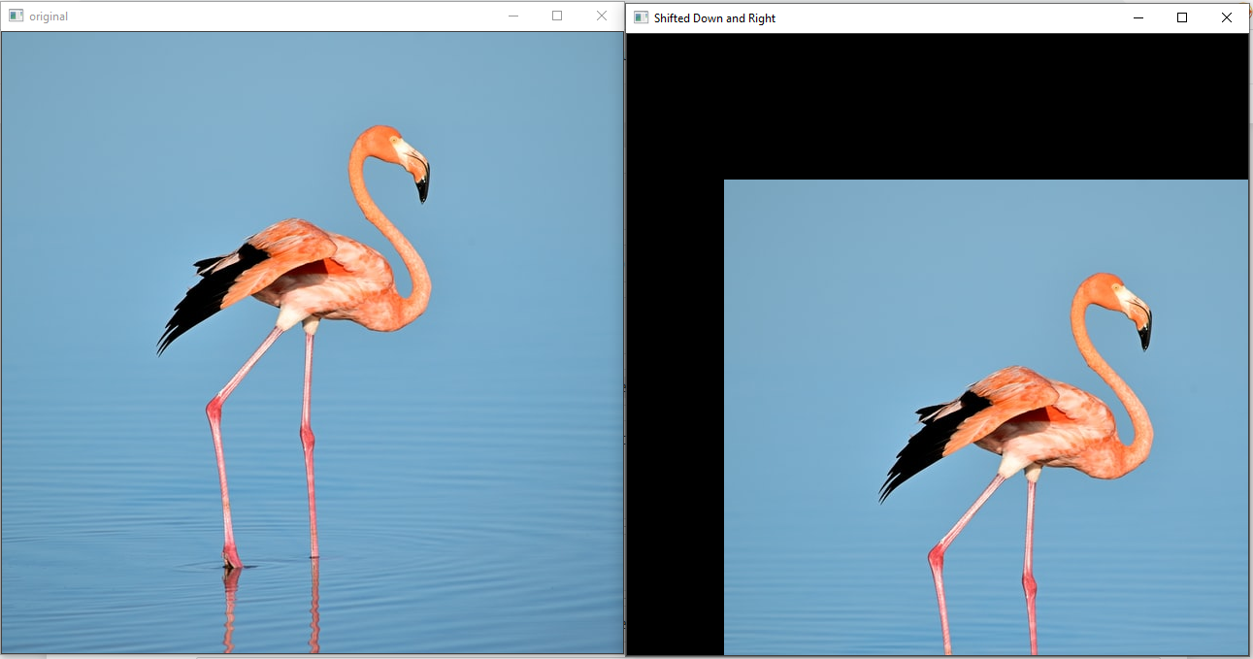
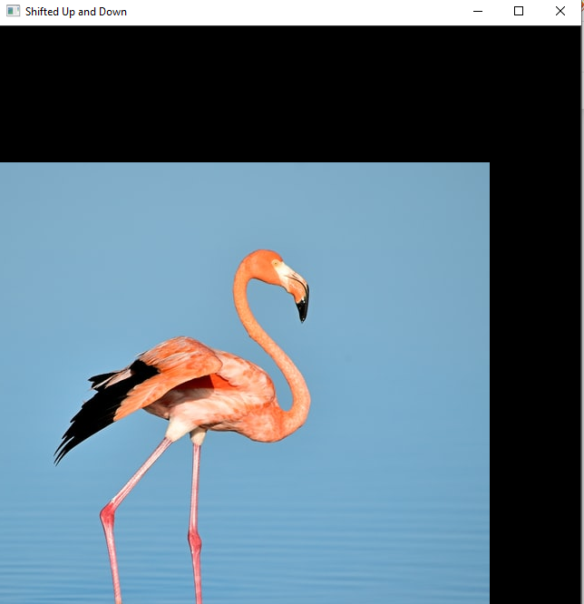

translation
Translation is the shifting of an image along the x and y axis.
Using translation, we can shift an image up, down, left, or right,
$$\text{cv}\text{2.}\text{warpAffine}\text{(}\text{img}\text{,}\text{M}\text{,}\text{dsize}\text{)}$$

Slide 5

translation matrix M
$$M=\left(\begin{matrix}1 & 0 & t_{x} \\ 0 & 1 & t_{y}\end{matrix}\right)$$
$t_{x}$: number of pixels will shift the image to right(+ve values) or left (-ve values)
$t_{y}$: number of pixels will shift the image to down (+ve values) or up (-ve values)

Slide 6

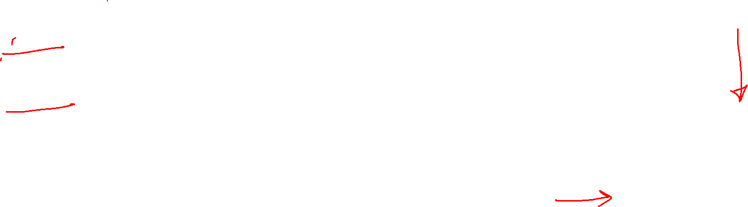
example
$M=\left(\begin{matrix}1 & 0 & 100 \\ 0 & 1 & 150\end{matrix}\right)$
$t_{x}$: image will shift 100 pixels right side
$t_{y}$: image will shift 150 pixels to down

Slide 7

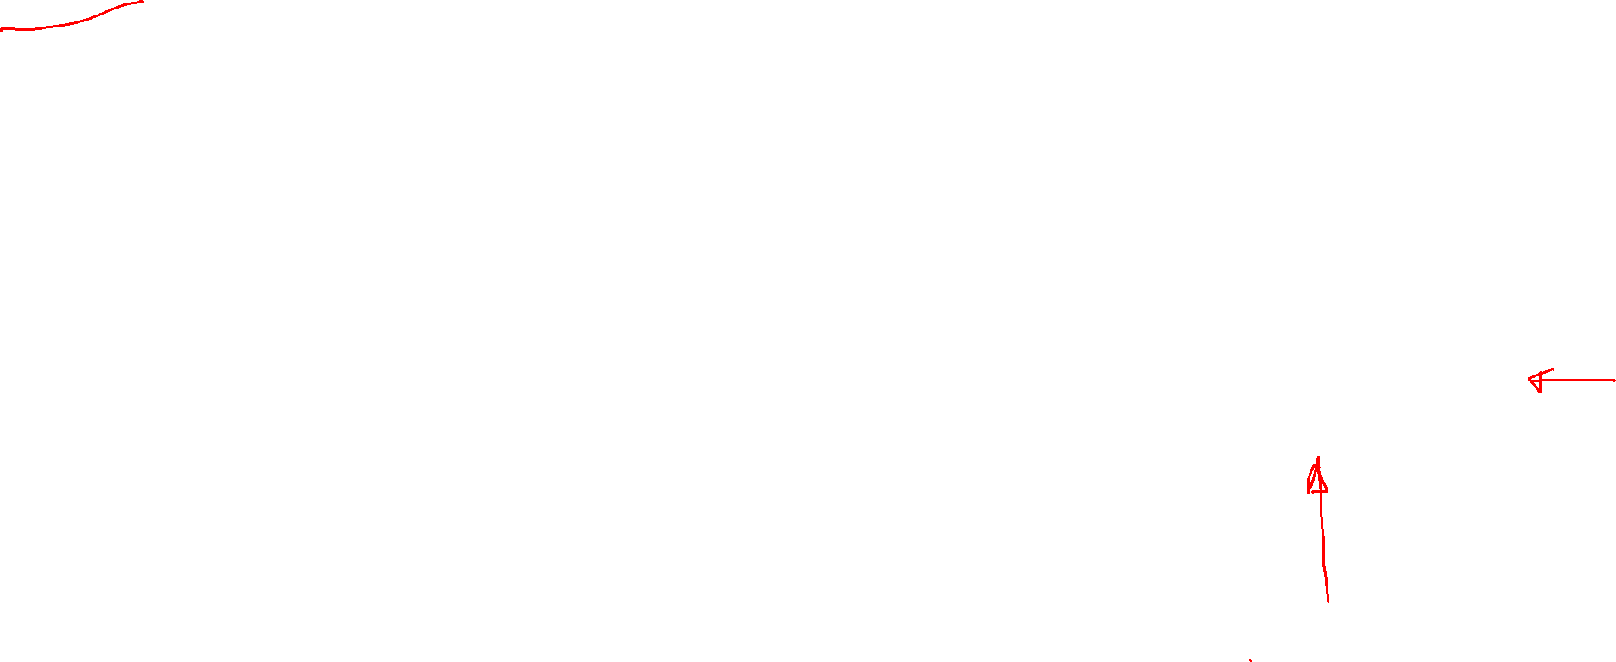
example
$M=\left(\begin{matrix}1 & 0 & −100 \\ 0 & 1 & −150\end{matrix}\right)$
$t_{x}$: image will shift 100 pixels left side
$t_{y}$: image will shift 150 pixels to upwards

Slide 8
Rotation
Image transformation

Slide 9

rotation
We rotate an image for a given specific point.
Use this we can rotate the image at any degree.
$$\text{cv}\text{2.}\text{warpAffine}\text{(}\text{img}\text{,}\text{M}\text{,}\text{dsize}\text{)}$$

Slide 10
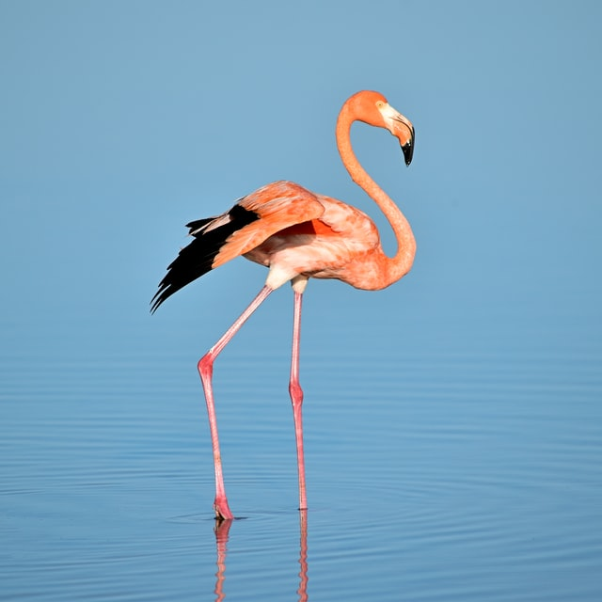
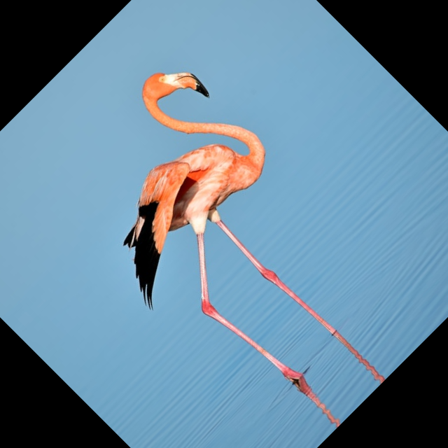
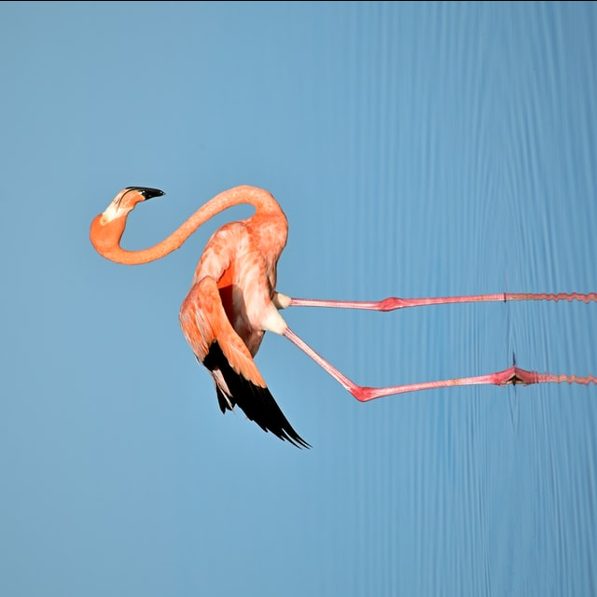
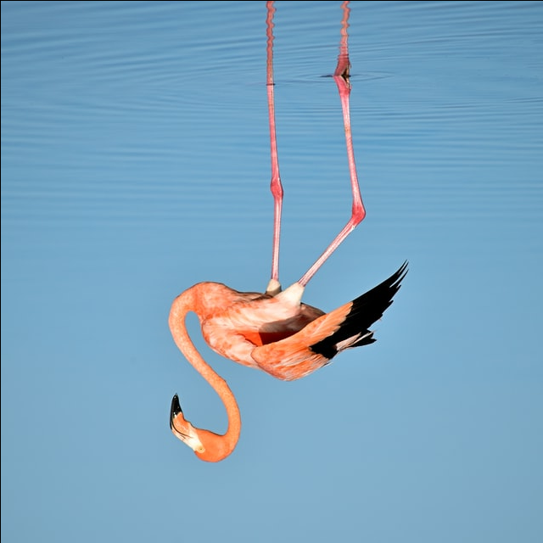
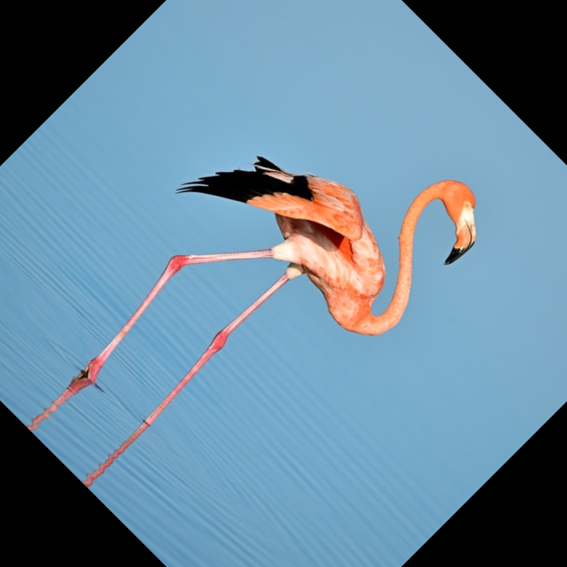
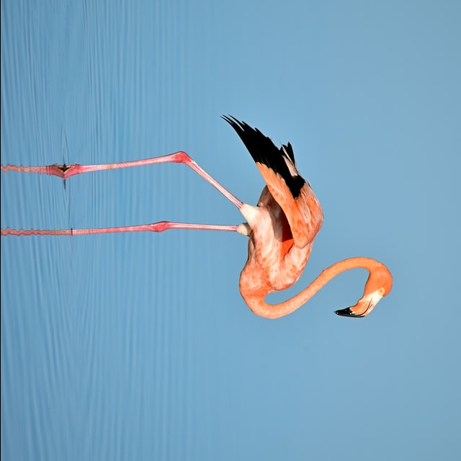
rotation
0
45
90
180
-45
-90

Slide 11


translation matrix M
$$M=\left(\begin{matrix}α & β & \left(1−α\right)∗c_{x} −β∗c_{y} \\ −β & α & β∗c_{x}+\left(1−α\right)∗c_{y}\end{matrix}\right)$$
$α=scale ∗cos\left(θ\right)$
$β=scale ∗sin\left(θ\right)$
$c_{x},c_{y}$ is centre of image
$$\text{cv}\text{2.}\text{getRotationMatrix}\text{2}\text{D}\text{()}$$

Slide 12
Resizing
Image transformation

Slide 13

resize
$$\text{cv}\text{2.}\text{resize}\text{(}\text{img}\text{,}\text{dsize}\text{)}$$

Slide 14
flipping
Image transformation

Slide 15
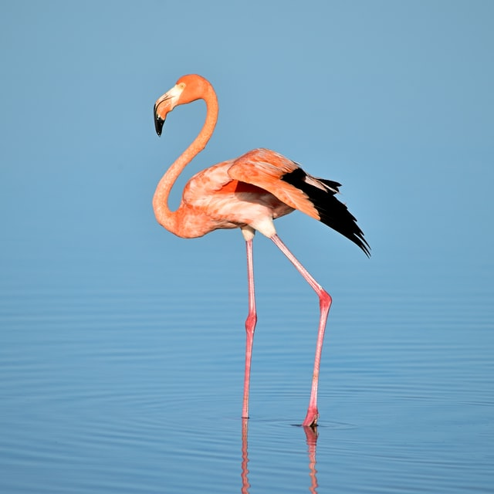
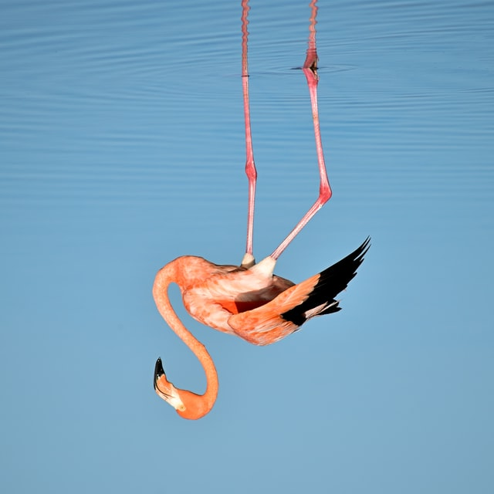
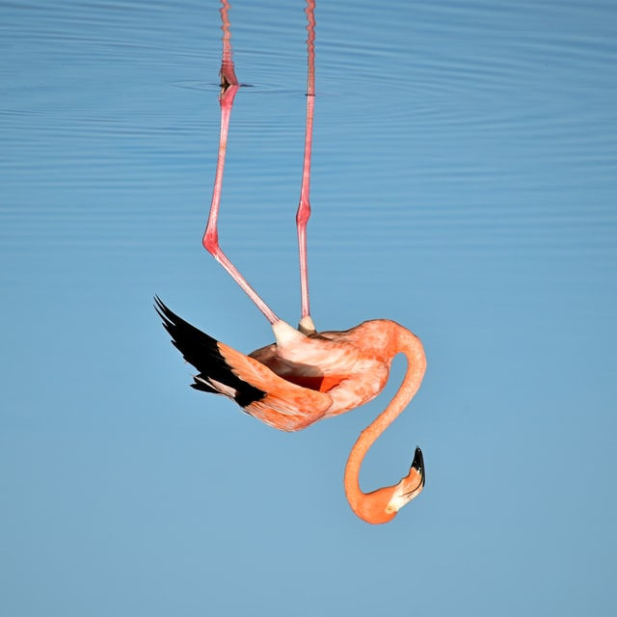

flipping
$$\text{cv}\text{2.}\text{flip}\text{(}\text{img}\text{,}\text{flipCode}\text{)}$$
1
-1
0

Slide 16
next
convert color in opencv python

