Slide 1
Coordinate Transforms
Dhruv Sharma

Slide 2



Example – Transform between lidar and camera frame

Slide 4



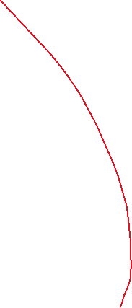
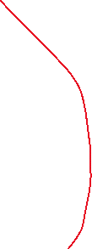





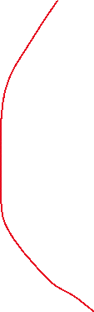




Slide 5
















