Slide 1

Team Viper Are you sick of it?
Project 1:
Exploratory Data Analysis
Notes:
Team Viper Intros
(alphabetical order)
Kyle Conway
Lindsay Hopewell
Amanda Jacobson
Jenny Shea
Hana Zubby

Slide 2
Proposal
Our project is to investigate correlations between the global happiness ranking and heath care. We will examine the out-of-pocket costs, government expenditures, life expectancy and the relationship to happiness on a global level.
Notes:
Hypothesis
We theorize that the self-reported happiest countries will be correlated with those with most public resources directed towards healthcare and the most accessible healthcare providers.

Slide 3


The datasets
Notes:
The datasets
We found the 2016 UN World Happiness Index dataset on Kaggle and were interested in seeing if there was a correlation between public and private health spending and a country’s ranking in the Happiness Index.
We decided to compare the life expectancy from the Happiness Index to the World Bank- World Development Indicators: Health Systems dataset.
Some questions we have started brainstorming in the beginning stages are
1. How does happiness ranking correlate to out of pocket health care costs? 2. How does happiness ranking correlate to government expenditure on health? 3. How does life expectancy correlate to happiness ranking?
We would like to take the time walk thru the datasets to show you what we identified as valuable and explainable from the year of 2016
The UN World Happiness dataset ranked countries based on six values including life expectancy, freedom, generosity, trust in government, and economy per capita. The rankings are based on 3 years of annual surveys of roughly 1,000 respondents from each country, on a scale of 0 to 10, with 10 being a perfect life and 0 being a Dystopia. The life expectancy is not part of the survey. It is based on the World Development Indicators life expectancy at birth, adjusted for
The World Bank health dataset includes Health Expenditures per Capita in US dollars and the percentage of public versus private health care expenditures. It also includes the number of physicians and the number of nurses/midwives per 1,000 people.

Slide 4
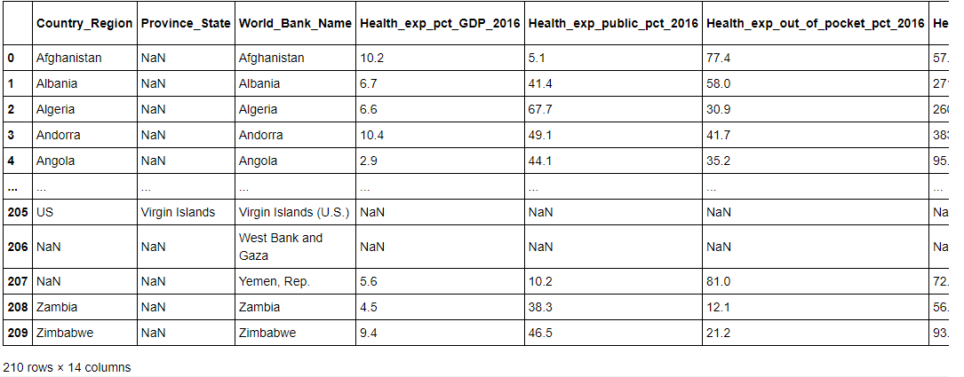
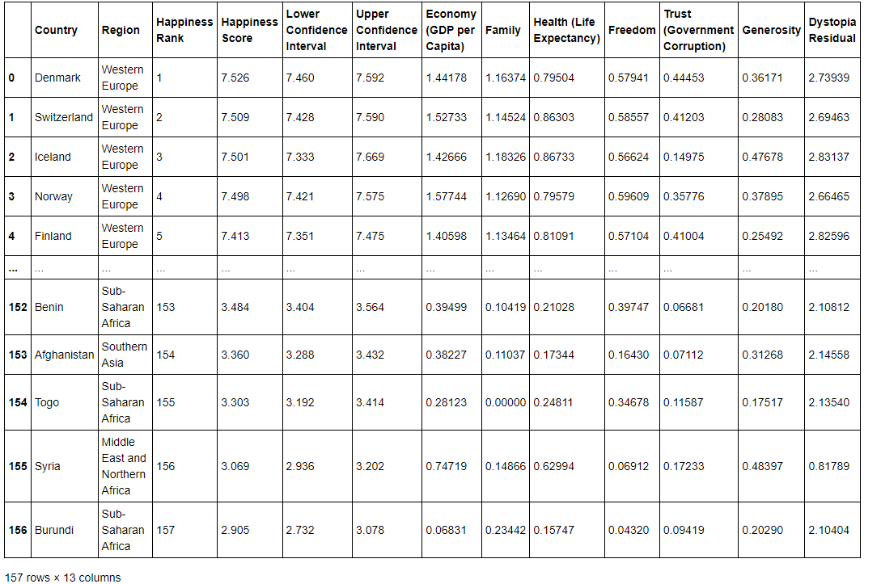
Data Cleanup
2 datasets (Health and Happiness)
Merged on country
Cleaned up column names
Removed NaN from multiple columns
Notes:
Data Cleanup
Hana:
We started with aligning our keys by renaming our columns before merging the datasets.
We removed everything that was NaN due to multiple lines of unusable data
Then we started with a generalization with plotting out the happiness score vs the life expectancy for country.
The linear regression showed the same hypothesis that life expectancy was longer with happier countries.

Slide 5
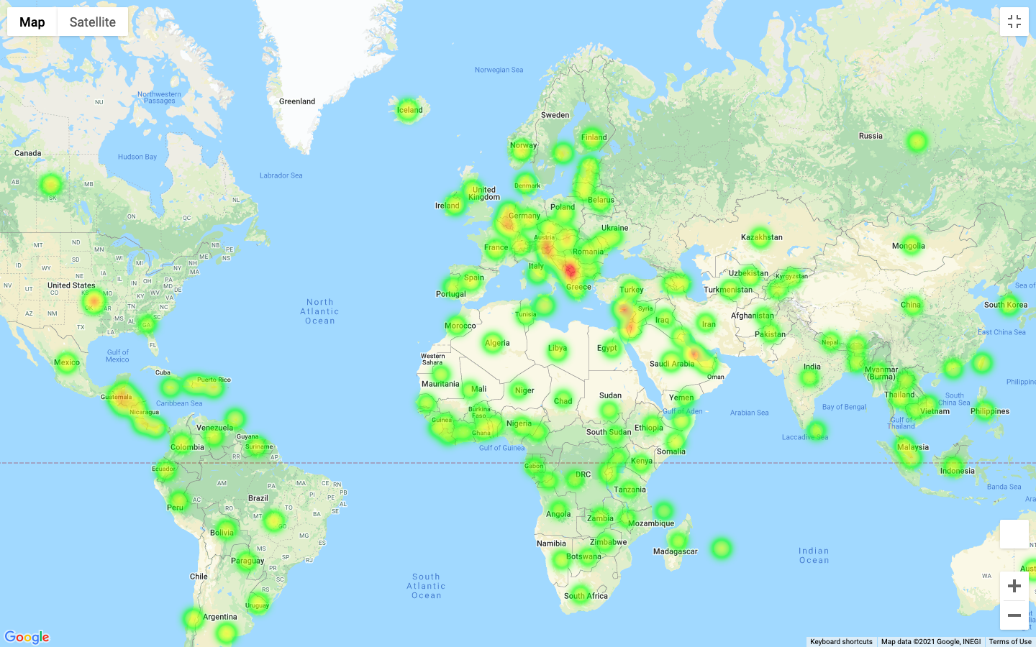
Exploring the results
Notes:
Exploring the results
We tried to group by top 5 and bottom 5 of happiness and life expectancy but the results were inconclusive
We explored both random sampling and top 10 and bottom 10 of happiness and broke them into upper and lower quartiles. The following slides will show how we compared the results.
KYLE: What you're seeing here is a heat map of happiness
(explain the for loop for lats and longs)

Slide 6
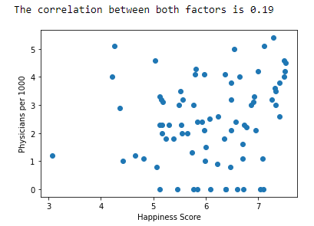
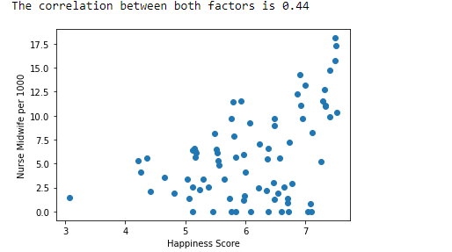
Identifying the right (and wrong) focus
Top half of Happiness
Top Half of Happiness
Notes:
Comparing
Here you can see we did start comparing Happiness vs different Healthcare Providers. They were too separated with these correlation scatter plots that we decided to tackle the data in other ways.

Slide 7
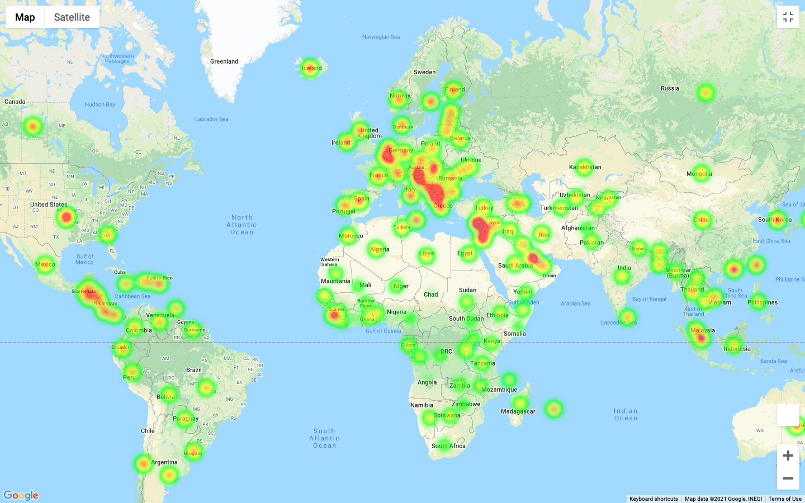
Life Expectancy
Notes:
Life Expectancy
Kyle: share how this was done

Slide 8
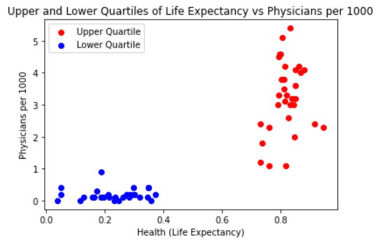
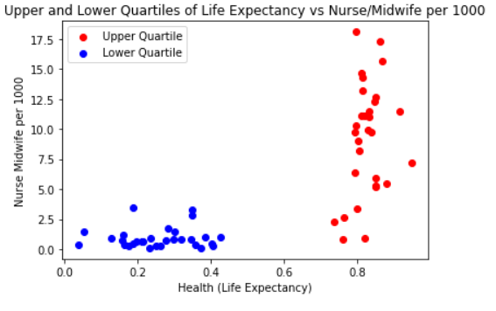
Healthcare and Life Expectancy
Notes:
Healthcare Happiness
Amanda: Here is a 2 scatterplots revealing the correlation of the upper and lower quartiles of the country’s life expectancy vs healthcare practitioners
You will see that this shows that there is a need for more nurses and physicians.

Slide 9
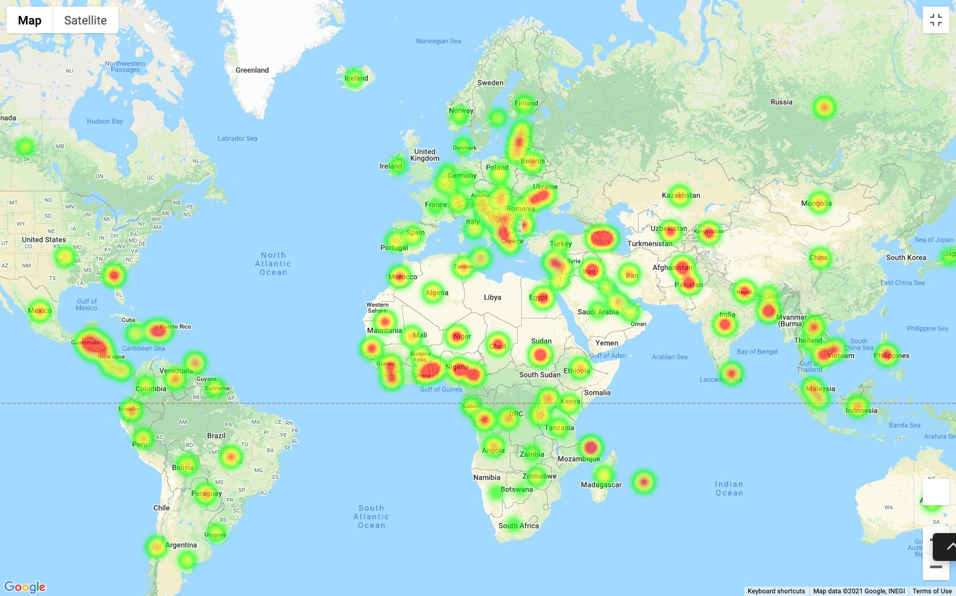
Healthcare Expenditure
Notes:
KYLE

Slide 10
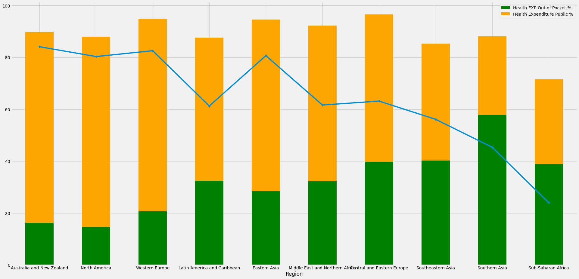
Cost Analysis
Notes:
Cost Analysis
Hana: First we broke down the costs by region and sorted by happiness in descending order
Talk about the r values
Explain the colors of the bar chart
The line is life expectancy

Slide 11
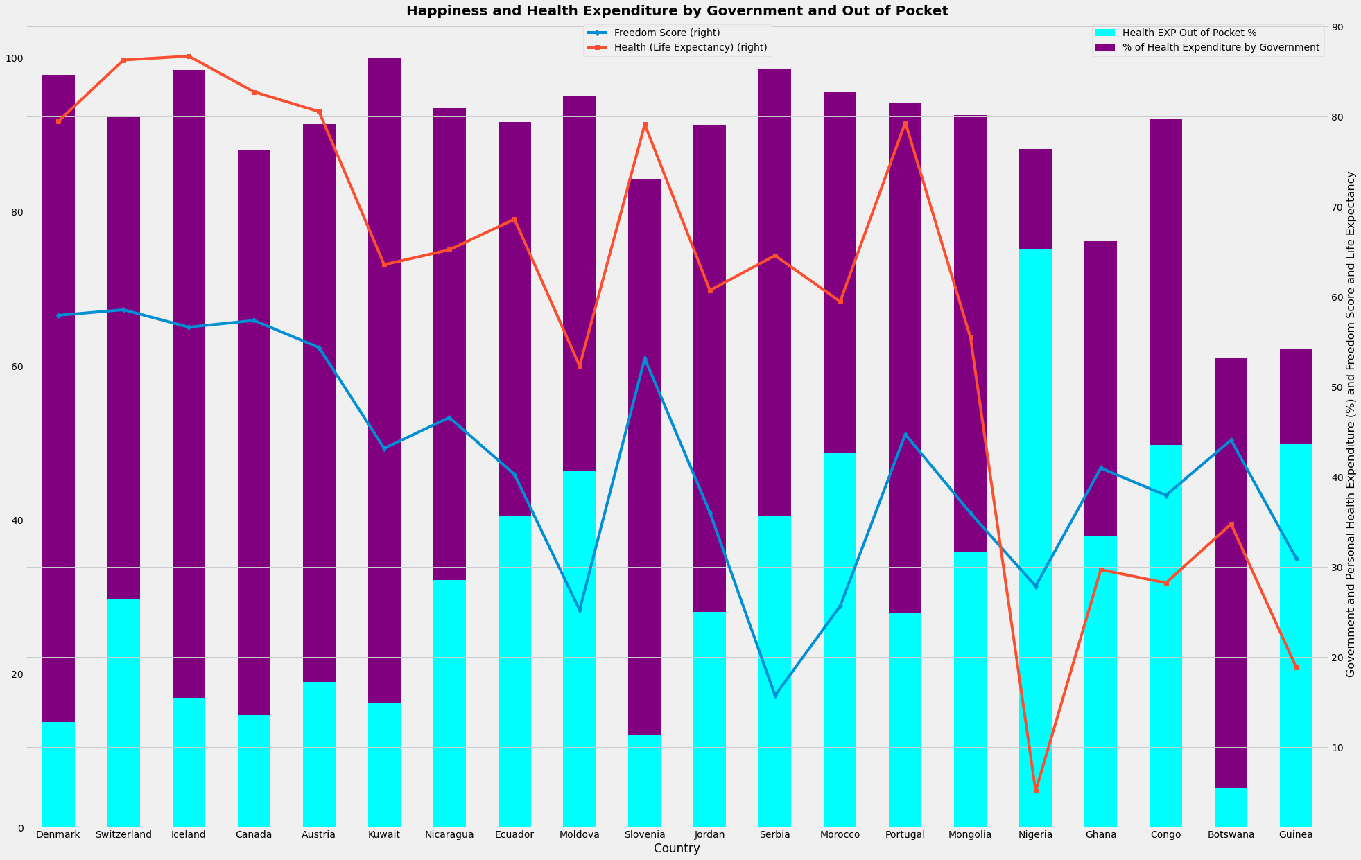
Notes:
Cost analysis
Lindsey: Explain the process of deciding the dataset grouping. Exploring from 10 ten, random samples… etc

Slide 12
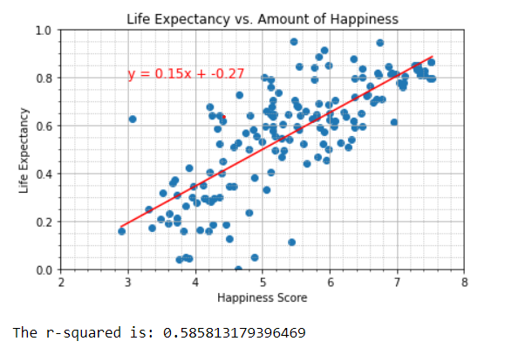
Conclusions
Based on the various visualizations, it is fair to say that there are certain intangible factors not included in the datasets available that affect the level of happiness in a given place.
Notes:
Conclusions:
We premised that there would be a strong trend between the availability of healthcare and the amount of happiness in a given nation. And while it is clear that the citizens of the happiest countries do indeed have access to healthcare, the correlations we observed were not significant enough to support the premise. Based on the various visualizations, it is fair to say that there are certain intangible factors not included in the datasets available that affect the level of happiness in a given place.
Conclusions:- a long life expectancy is a large contributing factor in the happiness ranking. Health care expenditures, both public and private are not as strongly correlated to happiness which leads me to believe that the other factors that contribute to life expectancy such as government stability, clean water, nutrition, education are at least equally important for happiness
Limitations: These datasets over time, separate these countries from universal healthcare to countries that are not. These results are a snapshot of a year, without knowing what other factors could have happened in these countries (examples include wars, pandemics, epidemics, etc.)

Slide 13
Sources
World Happiness Report 2016
https://worldhappiness.report/ed/2016/
World Happiness Report
Network
https://www.kaggle.com/unsdsn/world-happiness
World Bank WDI 2.12 - Health Systems
Evans
https://www.kaggle.com/danevans/world-bank-wdi-212-health-systems?select=2.12_Health_systems
Glossary | DataBank - World Bank
Metadata Glossary. World Bank, Sustainable Energy for All (SE4ALL) database from WHO Global Household Energy database. Access to clean fuels and technologies for cooking is the proportion of total population primarily using clean cooking fuels and technologies for cooking.
https://databank.worldbank.org/metadataglossary/all/series
Notes:
Jenny

Slide 14
Thankssssss.
Notes:
Questions?? Surprises?? Confirmations??

