Slide 1
JMP and Weka

Slide 2
Cross correlations (scatter matrix)
 | Sum of UNITS | Sum of Field_sourceCol_F_value_A2 | Count of VEND | Sum of DOLLARS | Count of ITEM | Sum of Field_sourceCol_D_value_2 | Sum of Field_sourceCol_D_value_1 | Sum of Field_sourceCol_D_value_0 | Sum of Field_sourceCol_F_value_A+ | Sum of Field_sourceCol_F_value_C | Sum of Field_sourceCol_F_value_B | Sum of Field_sourceCol_F_value_A | Sum of Field_sourceCol_F_value_NONE | Sum of PR
Sum of UNITS | 1 | 0.2191 | 0.9919 | 0.9851 | 0.9919 | 0.2163 | 0.2067 | 0.9839 | -0.0322 | 0.026 | 0.0303 | 0.2191 | 0.9883 | 0.3872
Sum of Field_sourceCol_F_value_A2 | 0.2191 | 1 | 0.224 | 0.2575 | 0.224 | 0.0865 | 0.5643 | 0.1601 | 0.202 | 0.1393 | 0.1392 | 1 | 0.1471 | 0.4751
Count of VEND | 0.9919 | 0.224 | 1 | 0.9879 | 1 | 0.2287 | 0.1935 | 0.9933 | -0.034 | 0.0117 | 0.0441 | 0.224 | 0.9961 | 0.3634
Sum of DOLLARS | 0.9851 | 0.2575 | 0.9879 | 1 | 0.9879 | 0.2092 | 0.211 | 0.9797 | -0.0222 | 0.0293 | 0.0654 | 0.2575 | 0.9803 | 0.3687
Count of ITEM | 0.9919 | 0.224 | 1 | 0.9879 | 1 | 0.2287 | 0.1935 | 0.9933 | -0.034 | 0.0117 | 0.0441 | 0.224 | 0.9961 | 0.3634
Sum of Field_sourceCol_D_value_2 | 0.2163 | 0.0865 | 0.2287 | 0.2092 | 0.2287 | 1 | -0.0982 | 0.2031 | -0.0464 | 0.0083 | 0.0413 | 0.0865 | 0.2245 | 0.286
Sum of Field_sourceCol_D_value_1 | 0.2067 | 0.5643 | 0.1935 | 0.211 | 0.1935 | -0.0982 | 1 | 0.0859 | 0.1475 | 0.2256 | 0.2091 | 0.5643 | 0.143 | 0.5233
Sum of Field_sourceCol_D_value_0 | 0.9839 | 0.1601 | 0.9933 | 0.9797 | 0.9933 | 0.2031 | 0.0859 | 1 | -0.0501 | -0.0147 | 0.0191 | 0.1601 | 0.9953 | 0.2993
Sum of Field_sourceCol_F_value_A+ | -0.0322 | 0.202 | -0.034 | -0.0222 | -0.034 | -0.0464 | 0.1475 | -0.0501 | 1 | 0.0164 | -0.0317 | 0.202 | -0.0571 | 0.1857
Sum of Field_sourceCol_F_value_C | 0.026 | 0.1393 | 0.0117 | 0.0293 | 0.0117 | 0.0083 | 0.2256 | -0.0147 | 0.0164 | 1 | 0.1068 | 0.1393 | -0.0249 | 0.2315
Sum of Field_sourceCol_F_value_B | 0.0303 | 0.1392 | 0.0441 | 0.0654 | 0.0441 | 0.0413 | 0.2091 | 0.0191 | -0.0317 | 0.1068 | 1 | 0.1392 | 0.0003 | 0.1313
Sum of Field_sourceCol_F_value_A | 0.2191 | 1 | 0.224 | 0.2575 | 0.224 | 0.0865 | 0.5643 | 0.1601 | 0.202 | 0.1393 | 0.1392 | 1 | 0.1471 | 0.4751
Sum of Field_sourceCol_F_value_NONE | 0.9883 | 0.1471 | 0.9961 | 0.9803 | 0.9961 | 0.2245 | 0.143 | 0.9953 | -0.0571 | -0.0249 | 0.0003 | 0.1471 | 1 | 0.3234
Sum of PR | 0.3872 | 0.4751 | 0.3634 | 0.3687 | 0.3634 | 0.286 | 0.5233 | 0.2993 | 0.1857 | 0.2315 | 0.1313 | 0.4751 | 0.3234 | 1

Slide 3
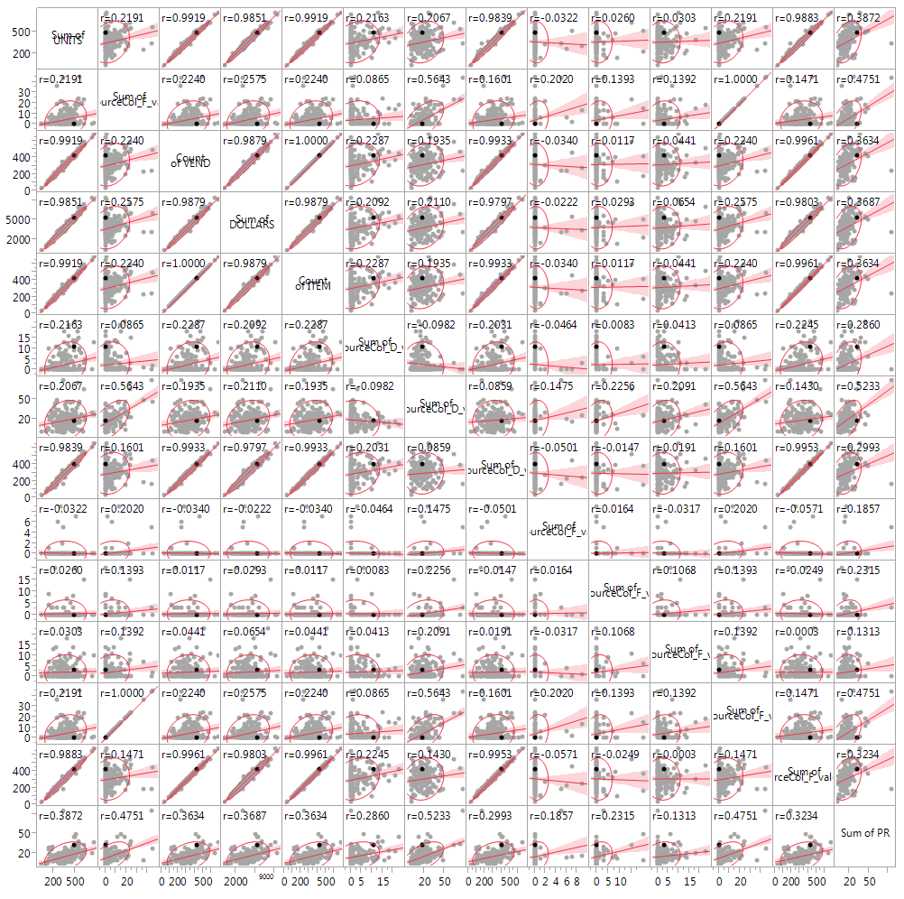
Correlations

Slide 4
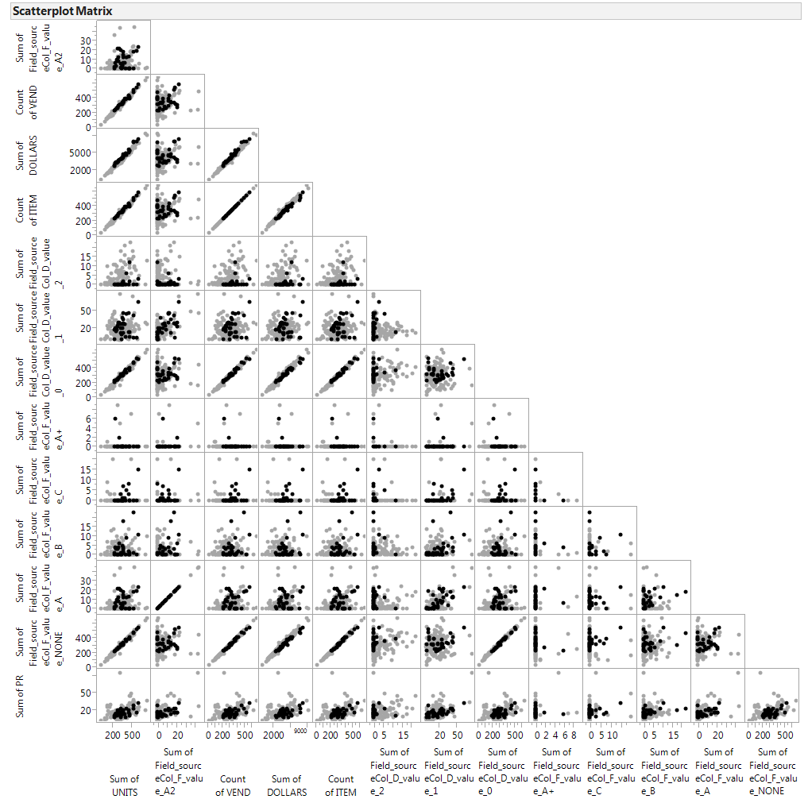

Slide 5
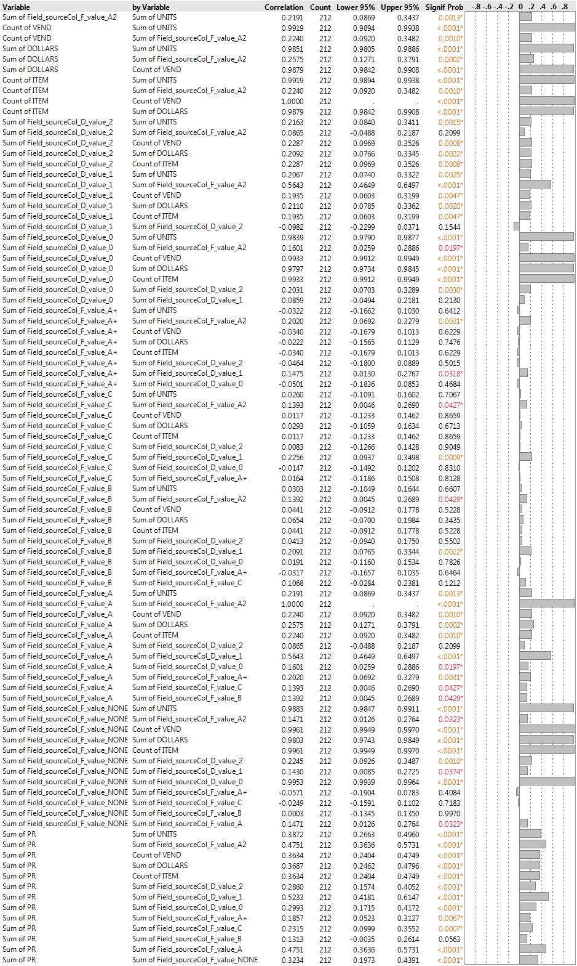
Correlations

Slide 6
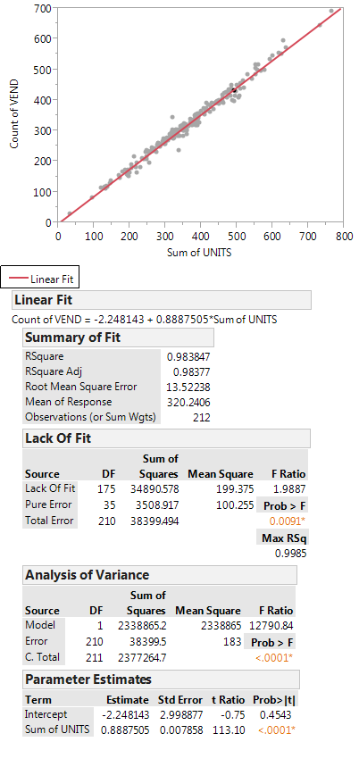
Vendor count vs sum of units

Slide 7
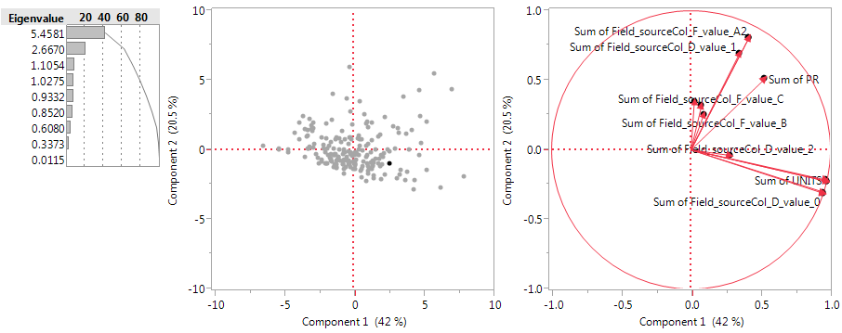
PCA

Slide 8
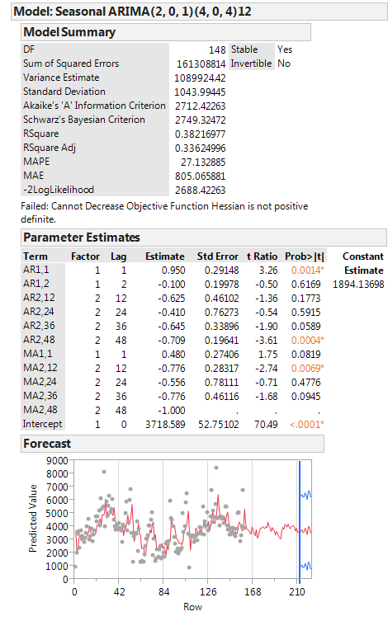
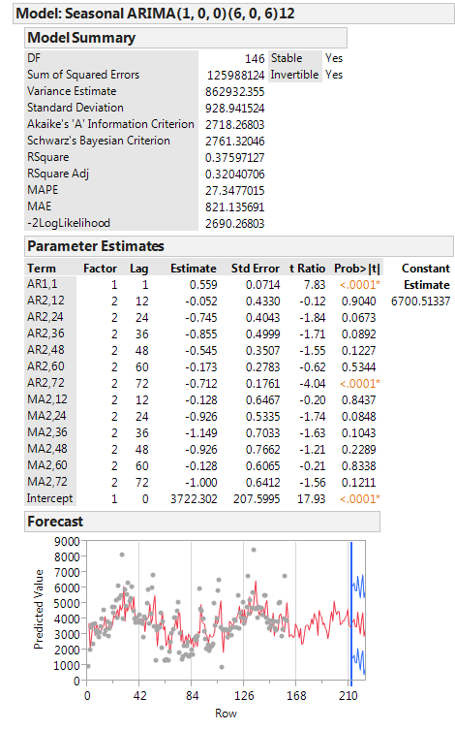
Arima models Using JMP (left off last year), would need to figure out a) what model parameters are b) how to plot last year c) how to compare model prediction and actual

Slide 9
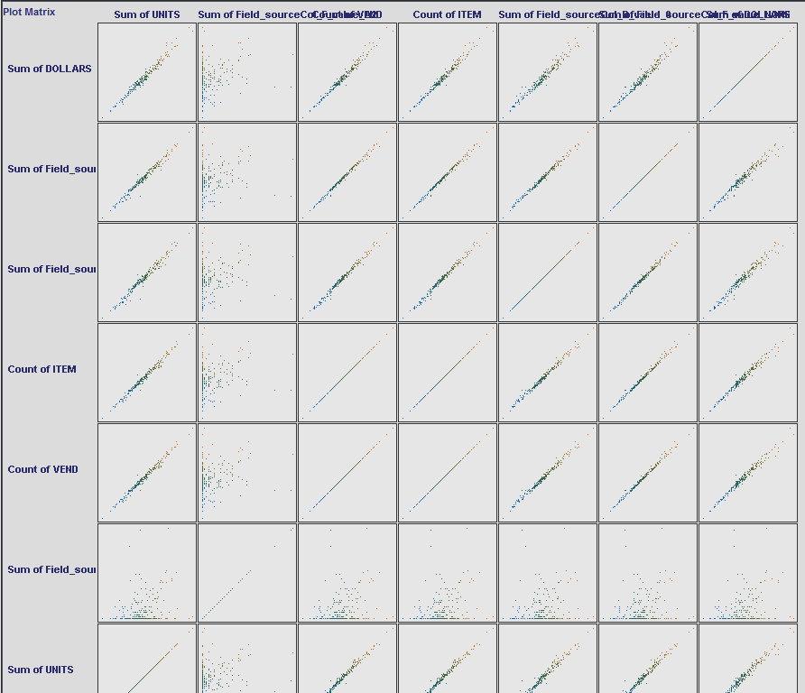
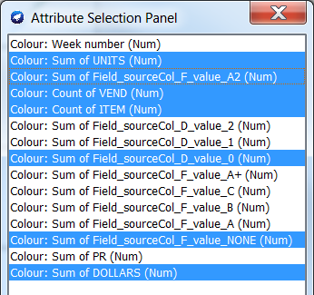
Weka on 215 row

Slide 10
Attribute selection
number of folds (%) attribute
10(100 %) 1 Week number
10(100 %) 2 Sum of UNITS
10(100 %) 3 Sum of Field_sourceCol_F_value_A2
10(100 %) 4 Count of VEND – correlated, plan to delete
10(100 %) 5 Count of ITEM
0( 0 %) 6 Sum of Field_sourceCol_D_value_2
3( 30 %) 7 Sum of Field_sourceCol_D_value_1
3( 30 %) 8 Sum of Field_sourceCol_D_value_0
0( 0 %) 9 Sum of Field_sourceCol_F_value_A+
8( 80 %) 10 Sum of Field_sourceCol_F_value_C
9( 90 %) 11 Sum of Field_sourceCol_F_value_B
8( 80 %) 12 Sum of Field_sourceCol_F_value_A
0( 0 %) 13 Sum of Field_sourceCol_F_value_NONE – correlated plan to delete
0( 0 %) 14 Sum of PR
Best First + CFSsubset Eval

Slide 11
Attribute selection
number of folds (%) attribute
2( 20 %) 1 Week number
9( 90 %) 2 Sum of UNITS
4( 40 %) 3 Sum of Field_sourceCol_F_value_A2
10(100 %) 4 Count of VEND
2( 20 %) 5 Count of ITEM
1( 10 %) 6 Sum of Field_sourceCol_D_value_2
1( 10 %) 7 Sum of Field_sourceCol_D_value_1
1( 10 %) 8 Sum of Field_sourceCol_D_value_0
2( 20 %) 9 Sum of Field_sourceCol_F_value_A+
3( 30 %) 10 Sum of Field_sourceCol_F_value_C
0( 0 %) 11 Sum of Field_sourceCol_F_value_B
3( 30 %) 12 Sum of Field_sourceCol_F_value_A
9( 90 %) 13 Sum of Field_sourceCol_F_value_NONE
3( 30 %) 14 Sum of PR
Evaluator: weka.attributeSelection.WrapperSubsetEval -B weka.classifiers.rules.M5Rules -F 5 -T 0.01 -R 1 -- -M 4.0
Search:weka.attributeSelection.GreedyStepwise -T -1.7976931348623157E308 -N -1
10 folds

Slide 12
Linear Regression
Sum of DOLLARS =
1.7721 * Week number +
4.4501 * Sum of UNITS +
7.5104 * Count of VEND +
7.5104 * Count of ITEM +
1.5229 * Sum of Field_sourceCol_D_value_0 +
-8.881 * Sum of Field_sourceCol_F_value_NONE +
-3.4921 * Sum of PR +
-240.8003
Correlation coefficient 0.9887
Mean absolute error 147.949
Root mean squared error 203.0618
Relative absolute error 14.4225 %
Root relative squared error 14.9373 %
Total Number of Instances 212
Scheme:weka.classifiers.functions.LinearRegression -S 0 -R 1.0E-8
Relation: master_merged_preprocessed_bymonthnyear-weka.filters.unsupervised.attribute.Reorder-R1,2,3,4,5,7,8,9,10,11,12,13,14,15,16,6-weka.filters.unsupervised.attribute.Remove-R1

Slide 13
M5P rules
Sum of DOLLARS =
1.7043 * Week number
+ 4.4092 * Sum of UNITS
+ 8.1073 * Count of VEND
+ 6.1394 * Sum of Field_sourceCol_D_value_2
+ 6.9573 * Sum of Field_sourceCol_D_value_1
+ 8.4227 * Sum of Field_sourceCol_D_value_0
- 8.8155 * Sum of Field_sourceCol_F_value_NONE
- 3.3919 * Sum of PR
- 240.8668
Just 1 Leaf !!, no branching. Vs Linear Regression, no item count,
Correlation coefficient 0.988
Mean absolute error 149.683
Root mean squared error 209.5124
Relative absolute error 14.5915 %
Root relative squared error 15.4118 %
Total Number of Instances 212
Scheme:weka.classifiers.trees.M5P -M 4.0
Relation: master_merged_preprocessed_bymonthnyear-weka.filters.unsupervised.attribute.Reorder-R1,2,3,4,5,7,8,9,10,11,12,13,14,15,16,6-weka.filters.unsupervised.attribute.Remove-R1

Slide 14
SMO Reg
SMOreg
weights (not support vectors):
+ 0.0104 * (normalized) Week number
+ 0.2036 * (normalized) Sum of UNITS
+ 0.0348 * (normalized) Sum of Field_sourceCol_F_value_A2
+ 0.1919 * (normalized) Count of VEND
+ 0.1919 * (normalized) Count of ITEM
- 0.002 * (normalized) Sum of Field_sourceCol_D_value_2
+ 0.018 * (normalized) Sum of Field_sourceCol_D_value_1
+ 0.2014 * (normalized) Sum of Field_sourceCol_D_value_0
+ 0.0099 * (normalized) Sum of Field_sourceCol_F_value_A+
+ 0.0335 * (normalized) Sum of Field_sourceCol_F_value_C
+ 0.0205 * (normalized) Sum of Field_sourceCol_F_value_B
+ 0.0348 * (normalized) Sum of Field_sourceCol_F_value_A
+ 0.1908 * (normalized) Sum of Field_sourceCol_F_value_NONE
- 0.037 * (normalized) Sum of PR
- 0.0125
Fast execution time
Correlation coefficient 0.9884
Mean absolute error 146.1806
Root mean squared error 209.3487
Relative absolute error 14.2501 %
Root relative squared error 15.3998 %
Total Number of Instances 212 Scheme:weka.classifiers.functions.SMOreg -C 1.0 -N 0 -I "weka.classifiers.functions.supportVector.RegSMOImproved -L 0.001 -W 1 -P 1.0E-12 -T 0.001 -V" -K "weka.classifiers.functions.supportVector.PolyKernel -C 250007 -E 1.0"
Relation: master_merged_preprocessed_bymonthnyear-weka.filters.unsupervised.attribute.Reorder-R1,2,3,4,5,7,8,9,10,11,12,13,14,15,16,6-weka.filters.unsupervised.attribute.Remove-R1

Slide 15
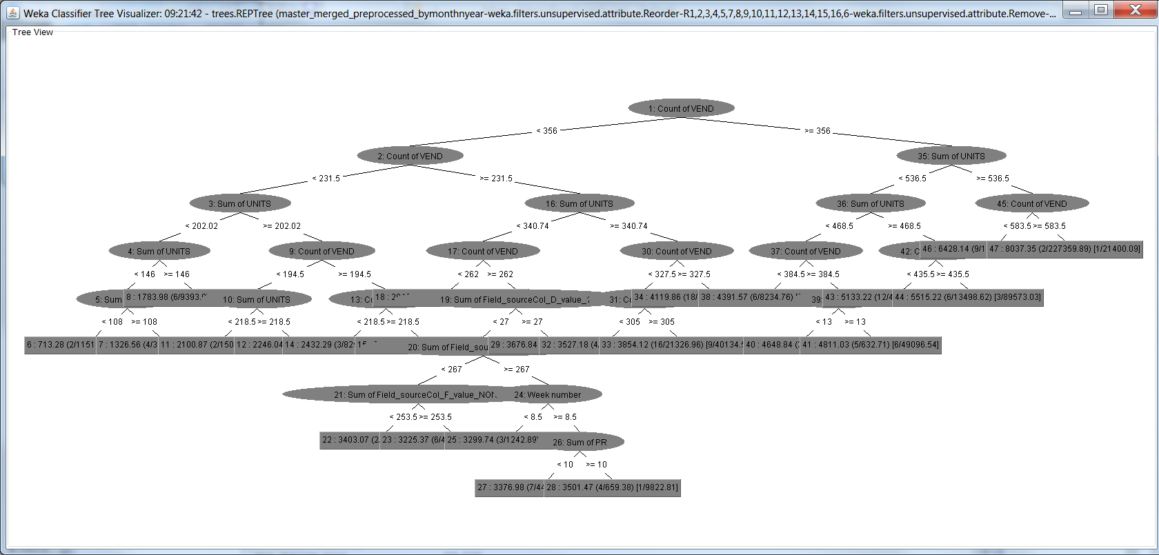
REPtree output

Slide 16
Rotation Forest with M5P
Example LM
Sum of DOLLARS =
-2177.673 * 0.692Count of ITEM_0+0.692Count of VEND_1-0.204Sum of Field_sourceCol_F_value_C_2_0
+ 380.0482 * -0.979Sum of Field_sourceCol_F_value_C_2-0.144Count of ITEM_0-0.144Count of VEND_1_0
+ 2836.5433 * 0.68 Sum of Field_sourceCol_D_value_0_2+0.677Sum of Field_sourceCol_F_value_NONE_0+0.281Sum of Field_sourceCol_F_value_A2_1_1
- 861.4646 * 0.959Sum of Field_sourceCol_F_value_A2_1-0.211Sum of Field_sourceCol_F_value_NONE_0-0.187Sum of Field_sourceCol_D_value_0_2_1
- 1330.5247 * 0.709Sum of Field_sourceCol_D_value_0_2-0.705Sum of Field_sourceCol_F_value_NONE_0-0.017Sum of Field_sourceCol_F_value_A2_1_1
+ 474.8756 * 0.763Sum of Field_sourceCol_F_value_A_2+0.503Sum of UNITS_1+0.405Sum of Field_sourceCol_F_value_B_0_2
- 235.0855 * 0.747Sum of Field_sourceCol_F_value_B_0-0.663Sum of UNITS_1+0.04 Sum of Field_sourceCol_F_value_A_2_2
- 134.5265 * 0.645Sum of Field_sourceCol_F_value_A_2-0.554Sum of UNITS_1-0.527Sum of Field_sourceCol_F_value_B_0_2
+ 53.4333 * 0.643Sum of Field_sourceCol_D_value_2_1-0.624Sum of PR_2+0.444Week number_0_3
+ 88.4645 * 0.665Sum of Field_sourceCol_D_value_1_0+0.665Sum of Field_sourceCol_D_value_1_2+0.342Sum of Field_sourceCol_F_value_A+_1_4
+ 4114.794
Used PCA—again with M5p 1 model/leaf
See coefficients for variable importance.
Correlation coefficient 0.9882
Mean absolute error 150.2555
Root mean squared error 207.785
Relative absolute error 14.6473 %
Root relative squared error 15.2847 %
Total Number of Instances 212
Scheme:weka.classifiers.meta.RotationForest -G 3 -H 3 -P 50 -F "weka.filters.unsupervised.attribute.PrincipalComponents -R 1.0 -A 5 -M -1" -S 1 -I 10 -W weka.classifiers.trees.M5P -- -M 4.0
Relation: master_merged_preprocessed_bymonthnyear-weka.filters.unsupervised.attribute.Reorder-R1,2,3,4,5,7,8,9,10,11,12,13,14,15,16,6-weka.filters.unsupervised.attribute.Remove-R1

Slide 17
Now delete some correlated (non-informative) parameters
Count of Vendors, 0 valued field

Slide 18
Redo Attribute Selection
number of folds (%) attribute
2( 40 %) 1 Week number
5(100 %) 2 Sum of UNITS
3( 60 %) 3 Sum of Field_sourceCol_F_value_A2
5(100 %) 4 Count of ITEM
1( 20 %) 5 Sum of Field_sourceCol_D_value_2
1( 20 %) 6 Sum of Field_sourceCol_D_value_1
1( 20 %) 7 Sum of Field_sourceCol_F_value_A+
0( 0 %) 8 Sum of Field_sourceCol_F_value_C
0( 0 %) 9 Sum of Field_sourceCol_F_value_B
3( 60 %) 10 Sum of Field_sourceCol_F_value_A
0( 0 %) 11 Sum of PR
5 folds this time
Evaluator: weka.attributeSelection.WrapperSubsetEval -B weka.classifiers.rules.M5Rules -F 5 -T 0.01 -R 1 -- -M 4.0
Search:weka.attributeSelection.GreedyStepwise -T -1.7976931348623157E308 -N -1
Relation: master_merged_preprocessed_bymonthnyear-weka.filters.unsupervised.attribute.Reorder-R1,2,3,4,5,7,8,9,10,11,12,13,14,15,16,6-weka.filters.unsupervised.attribute.Remove-R1-weka.filters.unsupervised.attribute.Remove-R4,8,13

Slide 19
Redo Attribute Selection
number of folds (%) attribute
5(100 %) 1 Week number
5(100 %) 2 Sum of UNITS
5(100 %) 3 Sum of Field_sourceCol_F_value_A2
5(100 %) 4 Count of ITEM
0( 0 %) 5 Sum of Field_sourceCol_D_value_2
0( 0 %) 6 Sum of Field_sourceCol_D_value_1
0( 0 %) 7 Sum of Field_sourceCol_F_value_A+
2( 40 %) 8 Sum of Field_sourceCol_F_value_C
4( 80 %) 9 Sum of Field_sourceCol_F_value_B
1( 20 %) 10 Sum of Field_sourceCol_F_value_A
0( 0 %) 11 Sum of PR
5 folds this time
Evaluator: weka.attributeSelection.CfsSubsetEval
Search:weka.attributeSelection.BestFirst -D 1 -N 5
Relation: master_merged_preprocessed_bymonthnyear-weka.filters.unsupervised.attribute.Reorder-R1,2,3,4,5,7,8,9,10,11,12,13,14,15,16,6-weka.filters.unsupervised.attribute.Remove-R1-weka.filters.unsupervised.attribute.Remove-R4,8,13

Slide 20
Linear Regression
Sum of DOLLARS=
1.6956 * Week number +
4.5507 * Sum of UNITS +
4.051 * Sum of Field_sourceCol_F_value_A2 +
7.5224 * Count of ITEM +
9.8466 * Sum of Field_sourceCol_F_value_B +
4.051 * Sum of Field_sourceCol_F_value_A +
-3.6757 * Sum of PR +
-252.876
Correlation coefficient 0.9882
Mean absolute error 150.416
Root mean squared error 207.3127
Relative absolute error 14.663 %
Root relative squared error 15.25 %
Total Number of Instances 212
Scheme:weka.classifiers.functions.LinearRegression -S 0 -R 1.0E-8
Relation: master_merged_preprocessed_bymonthnyear-weka.filters.unsupervised.attribute.Reorder-R1,2,3,4,5,7,8,9,10,11,12,13,14,15,16,6-weka.filters.unsupervised.attribute.Remove-R1-weka.filters.unsupervised.attribute.Remove-R4,8,13

Slide 21
M5P rules
Sum of DOLLARS =
1.6956 * Week number
+ 4.5507 * Sum of UNITS
+ 8.102 * Sum of Field_sourceCol_F_value_A2
+ 7.5224 * Count of ITEM
+ 9.8466 * Sum of Field_sourceCol_F_value_B
- 3.6757 * Sum of PR
- 252.876 [212/14.016%]
Just 1 Leaf !!, no branching. Vs Linear Regression, no item count,
Correlation coefficient 0.9882
Mean absolute error 150.416
Root mean squared error 207.3127
Relative absolute error 14.663 %
Root relative squared error 15.25 %
Total Number of Instances 212
Scheme:weka.classifiers.rules.M5Rules -M 4.0
Relation: master_merged_preprocessed_bymonthnyear-weka.filters.unsupervised.attribute.Reorder-R1,2,3,4,5,7,8,9,10,11,12,13,14,15,16,6-weka.filters.unsupervised.attribute.Remove-R1-weka.filters.unsupervised.attribute.Remove-R4,8,13

Slide 22
SMO Reg
SMOreg
weights (not support vectors):
+ 0.0111 * (normalized) Week number
+ 0.325 * (normalized) Sum of UNITS
+ 0.0297 * (normalized) Sum of Field_sourceCol_F_value_A2
+ 0.6673 * (normalized) Count of ITEM
- 0.0154 * (normalized) Sum of Field_sourceCol_D_value_2
- 0.0178 * (normalized) Sum of Field_sourceCol_D_value_1
+ 0.0091 * (normalized) Sum of Field_sourceCol_F_value_A+
+ 0.0129 * (normalized) Sum of Field_sourceCol_F_value_C
+ 0.0149 * (normalized) Sum of Field_sourceCol_F_value_B
+ 0.0297 * (normalized) Sum of Field_sourceCol_F_value_A
- 0.0171 * (normalized) Sum of PR
- 0.0129
Fast execution time
Correlation coefficient 0.9885
Mean absolute error 146.6427
Root mean squared error 208.6124
Relative absolute error 14.2952 %
Root relative squared error 15.3456 %
Total Number of Instances 212
Scheme:weka.classifiers.functions.SMOreg -C 1.0 -N 0 -I "weka.classifiers.functions.supportVector.RegSMOImproved -L 0.001 -W 1 -P 1.0E-12 -T 0.001 -V" -K "weka.classifiers.functions.supportVector.PolyKernel -C 250007 -E 1.0"
Relation: master_merged_preprocessed_bymonthnyear-weka.filters.unsupervised.attribute.Reorder-R1,2,3,4,5,7,8,9,10,11,12,13,14,15,16,6-weka.filters.unsupervised.attribute.Remove-R1-weka.filters.unsupervised.attribute.Remove-R4,8,13

Slide 23
Rotation Forest with M5P
Example LM
Sum of DOLLARS =
22.3335 * 0.687Sum of Field_sourceCol_F_value_C_0-0.682Sum of Field_sourceCol_D_value_1_2-0.252Sum of Field_sourceCol_D_value_2_1_0
+ 755.2766 * 0.721Sum of Field_sourceCol_F_value_A_2+0.681Sum of UNITS_0+0.131Sum of Field_sourceCol_F_value_A+_1_1
+ 93.2914 * -0.927Sum of Field_sourceCol_F_value_A+_1+0.343Sum of UNITS_0-0.155Sum of Field_sourceCol_F_value_A_2_1
+ 20.8848 * 0.684Sum of Field_sourceCol_F_value_B_0+0.572Week number_1+0.453Sum of PR_2_2
- 46.5919 * 0.806Sum of PR_2-0.59Week number_1-0.041Sum of Field_sourceCol_F_value_B_0_2
- 23.0274 * -0.729Sum of Field_sourceCol_F_value_B_0+0.569Week number_1+0.38 Sum of PR_2_2
- 233.7609 * 0.69 Sum of Field_sourceCol_F_value_A_2+0.69 Sum of Field_sourceCol_F_value_A2_1+0.216Count of ITEM_0_3
- 779.8045 * -0.976Count of ITEM_0+0.153Sum of Field_sourceCol_F_value_A_2+0.153Sum of Field_sourceCol_F_value_A2_1_3
+ 3748.694
Used PCA—again with M5p 1 model/leaf
See coefficients for variable importance.
Correlation coefficient 0.9884
Mean absolute error 150.1257
Root mean squared error 206.1822
Relative absolute error 14.6347 %
Root relative squared error 15.1668 %
Total Number of Instances 212
Scheme:weka.classifiers.meta.RotationForest -G 3 -H 3 -P 50 -F "weka.filters.unsupervised.attribute.PrincipalComponents -R 1.0 -A 5 -M -1" -S 1 -I 10 -W weka.classifiers.trees.M5P -- -M 4.0
Relation: master_merged_preprocessed_bymonthnyear-weka.filters.unsupervised.attribute.Reorder-R1,2,3,4,5,7,8,9,10,11,12,13,14,15,16,6-weka.filters.unsupervised.attribute.Remove-R1-weka.filters.unsupervised.attribute.Remove-R4,8,13

Slide 24
Now delete delete year 2011, redo models, predict 2011 and calculate error

Slide 25
Linear Regression
Sum of DOLLARS =
5.9039 * Sum of UNITS +
5.8388 * Count of ITEM +
5.8252 * Sum of Field_sourceCol_F_value_A +
-3.0693 * Sum of PR +
-180.9078
Correlation coefficient 0.9924
Mean absolute error 128.1557
Root mean squared error 169.7715
Relative absolute error 12.083 %
Root relative squared error 12.2304 %
Total Number of Instances 160
Scheme:weka.classifiers.functions.LinearRegression -S 0 -R 1.0E-8
Relation: master_merged_preprocessed_bymonthnyear3n2011removed-weka.filters.unsupervised.attribute.Remove-R1

Slide 26
M5P- Virtually same as Linear Regression (expected)
Sum of DOLLARS =
5.9039 * Sum of UNITS
+ 5.8252 * Sum of Field_sourceCol_F_value_A2
+ 5.8388 * Count of ITEM
- 3.0693 * Sum of PR
- 180.9078
Correlation coefficient 0.9924
Mean absolute error 128.1557
Root mean squared error 169.7715
Relative absolute error 12.083 %
Root relative squared error 12.2304 %
Total Number of Instances 160
Scheme:weka.classifiers.trees.M5P -M 4.0
Relation: master_merged_preprocessed_bymonthnyear3n2011removed-weka.filters.unsupervised.attribute.Remove-R1

Slide 27
REPTree (41 nodes)
Top 3 branching on: Count of Item
Sum of Units
See splitting on FieldsourceFvalue_A2 and
Sum of PR in nodes.
Correlation coefficient 0.976
Mean absolute error 212.713
Root mean squared error 301.569
Relative absolute error 20.0553 %
Root relative squared error 21.7252 %
Total Number of Instances 160
Scheme:weka.classifiers.trees.M5P -M 4.0
Relation: master_merged_preprocessed_bymonthnyear3n2011removed-weka.filters.unsupervised.attribute.Remove-R1

Slide 28
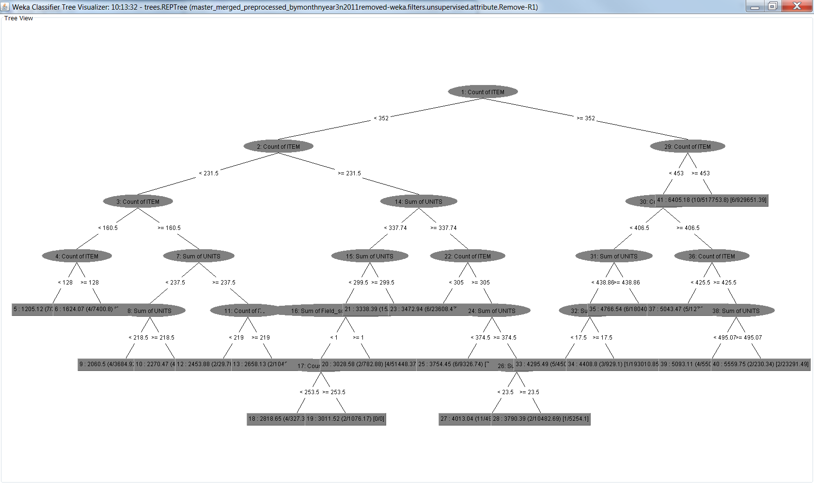
REPTree

Slide 29
SMO Reg
weights (not support vectors):
+ 0.0011 * (normalized) Week number
+ 0.45 * (normalized) Sum of UNITS
+ 0.016 * (normalized) Sum of Field_sourceCol_F_value_A2
+ 0.516 * (normalized) Count of ITEM
+ 0.0133 * (normalized) Sum of Field_sourceCol_D_value_2
+ 0.0067 * (normalized) Sum of Field_sourceCol_D_value_1
+ 0.0022 * (normalized) Sum of Field_sourceCol_F_value_A+
+ 0.0022 * (normalized) Sum of Field_sourceCol_F_value_C
- 0.0004 * (normalized) Sum of Field_sourceCol_F_value_B
+ 0.016 * (normalized) Sum of Field_sourceCol_F_value_A
- 0.0276 * (normalized) Sum of PR
+ 0.0007
Correlation coefficient 0.9921
Mean absolute error 130.5956
Root mean squared error 176.0429
Relative absolute error 12.313 %
Root relative squared error 12.6822 %
Total Number of Instances 160
Scheme:weka.classifiers.functions.SMOreg -C 1.0 -N 0 -I "weka.classifiers.functions.supportVector.RegSMOImproved -L 0.001 -W 1 -P 1.0E-12 -T 0.001 -V" -K "weka.classifiers.functions.supportVector.PolyKernel -C 250007 -E 1.0"
Relation: master_merged_preprocessed_bymonthnyear3n2011removed-weka.filters.unsupervised.attribute.Remove-R1

Slide 30
Predicted vs actual. Actual modelled on yr 8-10.
rmse yr11 | 279.769
rmse yr 8-10 | 181.051
rmse all | 209.613
mean all years | 3855.128
Std all years | 1358.443
mean yr 11 | 4037.870
Std yr 11 | 1171.394
ratio of rms11 to Std yr 11 | 0.239
compare to 3s | 0.080

Slide 31
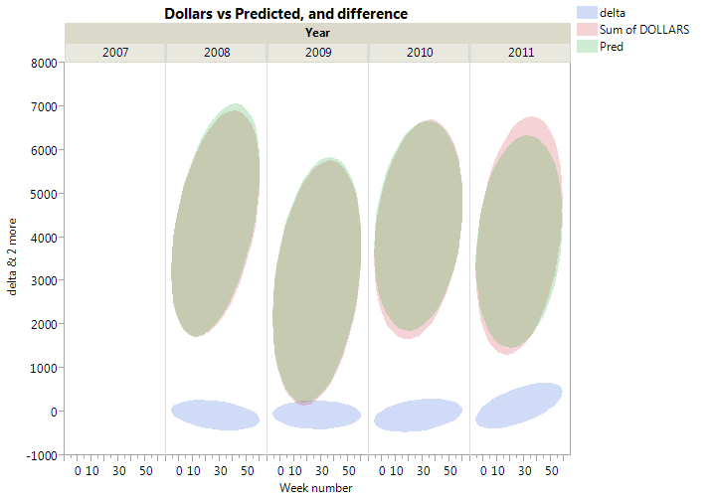
Predicted vs actual. Actual modelled on yr 8-10.
rmse yr11 | 279.769
rmse yr 8-10 | 181.051
rmse all | 209.613
mean all years | 3855.128
Std all years | 1358.443
mean yr 11 | 4037.870
Std yr 11 | 1171.394
ratio of rms11 to Std yr 11 | 0.239
compare to 3s | 0.080

Slide 32
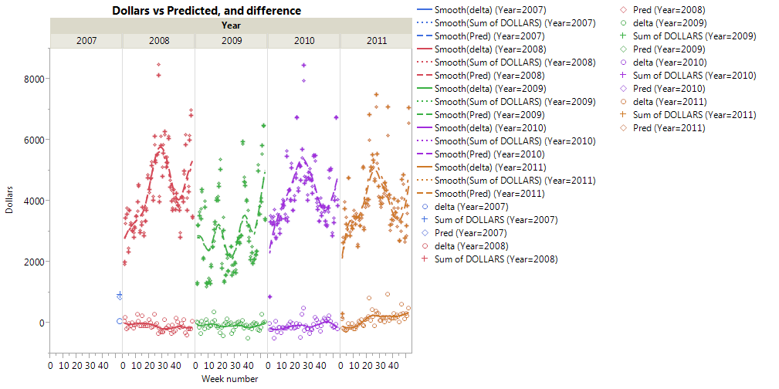
Predicted vs actual. Actual modelled on yr 8-10.
rmse yr11 | 279.769
rmse yr 8-10 | 181.051
rmse all | 209.613
mean all years | 3855.128
Std all years | 1358.443
mean yr 11 | 4037.870
Std yr 11 | 1171.394
ratio of rms11 to Std yr 11 | 0.239
compare to 3s | 0.080

Slide 33
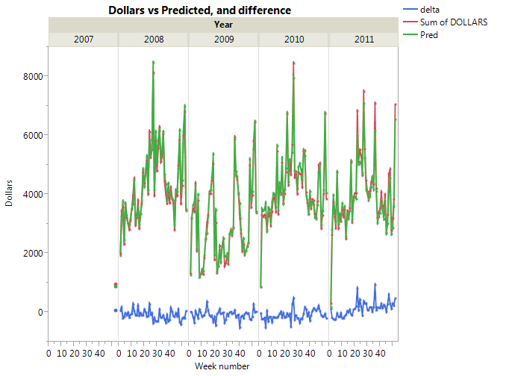
Predicted vs actual. Actual modelled on yr 8-10.
rmse yr11 | 279.769
rmse yr 8-10 | 181.051
rmse all | 209.613
mean all years | 3855.128
Std all years | 1358.443
mean yr 11 | 4037.870
Std yr 11 | 1171.394
ratio of rms11 to Std yr 11 | 0.239
compare to 3s | 0.080

Slide 34
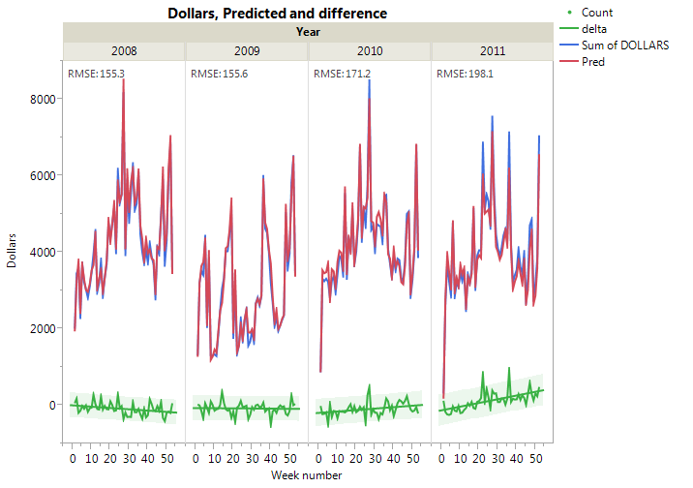
Predicted vs actual. Actual modelled on yr 8-10.
rmse yr11 | 279.769
rmse yr 8-10 | 181.051
rmse all | 209.613
mean all years | 3855.128
Std all years | 1358.443
mean yr 11 | 4037.870
Std yr 11 | 1171.394
ratio of rms11 to Std yr 11 | 0.239
compare to 3s | 0.080

Slide 35
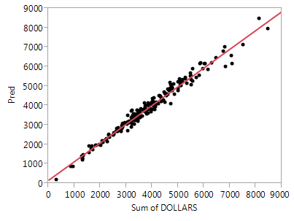
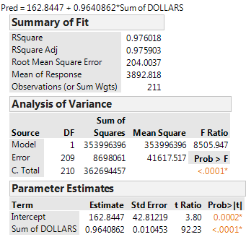
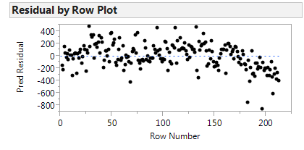
Predicted vs actual. All years

Slide 36
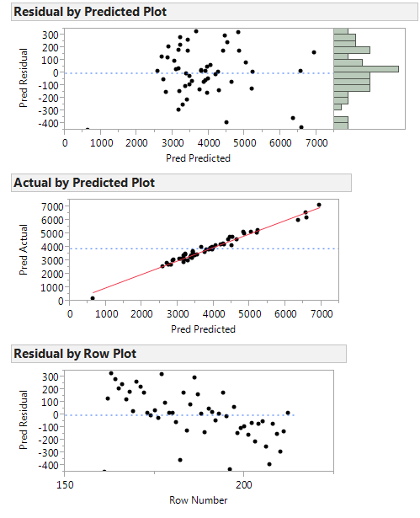
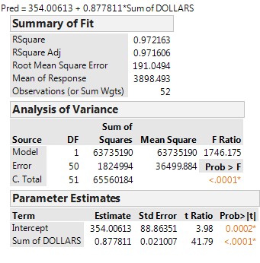
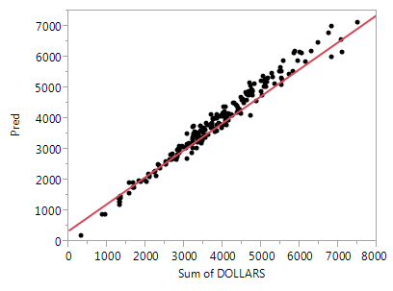
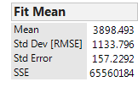
Predicted vs actual. Just 2011

Slide 37
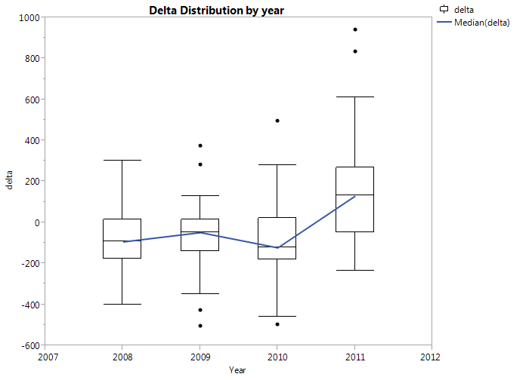
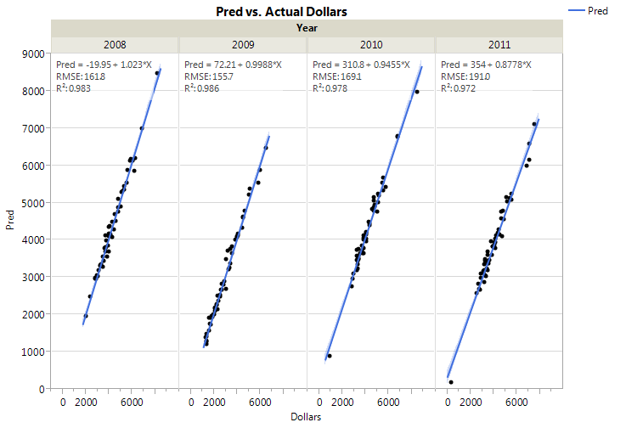
Predicted vs actual. Year by year

Slide 38
Weekly Modeling Methodology and Results
Use all Features
With Some Features removed
Train on year 2008-10
Model type | R^2 Results
Linear Regression | 0.9887
M5P Rules | 0.988
SMO Regression | 0.9884
REP Tree | 0.976
Rotation Forest with M5P | 0.9882
Model type | R^2 Results
Linear Regression | 0.9887
M5P Rules | 0.988
SMO Regression | 0.9884
REP Tree | 0.976
Model type | R^2 Results
Linear Regression | 0.9924
M5P Rules | 0.9924
REP Tree | 0.976
SMO Regression | 0.9921
EX: Sum of dollars = 1.6956 * Week number + 4.5507 * Sum of UNITS + 4.051 * Sum of Field_sourceCol_F_value_A2 + 7.5224 * Count of ITEM + 9.8466 * Sum of Field_sourceCol_F_value_B + 4.051 * Sum of Field_sourceCol_F_value_A + -3.6757 * Sum of PR -252.876
Future Sales Predictions

Slide 39

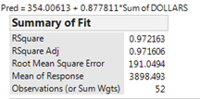
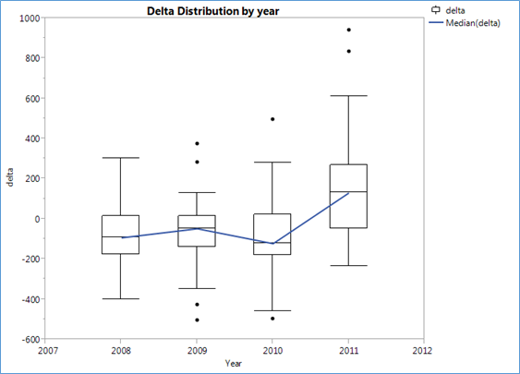
Future Sales Prediction
sum of dollars = 5.9039 * Sum of UNITS + 5.8388 * Count of ITEM + 5.8252 * Sum of Field_sourceCol_F_value_A + -3.0693 * Sum of PR + -180.9078

Slide 40
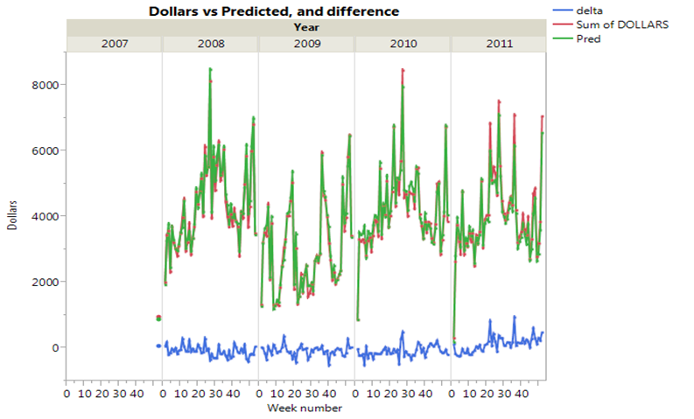
Predicted vs. Actual

Slide 41
Questions to answer
Do promotions have value and is the value expected (ie positive dollars)?
Seems that Field_sourceCol_F_value_A2 promotion has benefit, other F types less so. PR has negative benefit—recommend not continuing PR types.
If we model on 1st 3 years, how good is prediction for 4th?
The R^2 for predicted vs actual was ~0.97. This was slightly worse for year 4 than for years 1-3, and the RMSE and distribution of errors was higher as well.

Slide 42
Linear Regression Model
Sum of DOLLARS =
23.5825 * Week number +
55.8382 * Sum of Field_sourceCol_D_value_2 +
40.8539 * Sum of PR +
2457.409
Time taken to build model: 0.05 seconds
=== Cross-validation ===
=== Summary ===
Correlation coefficient 0.3381
Mean absolute error 952.4735
Root mean squared error 1299.03
Relative absolute error 92.8499 %
Root relative squared error 95.557 %
Total Number of Instances 212

Slide 43
m5p
=== Cross-validation ===
=== Summary ===
Correlation coefficient 0.2718
Mean absolute error 979.5536
Root mean squared error 1377.6695
Relative absolute error 95.4897 %
Root relative squared error 101.3418 %
Total Number of Instances 212

Slide 44
weights (not support vectors):
+ 0.0733 * (normalized) Week number
+ 0.0364 * (normalized) Sum of Field_sourceCol_F_value_A2
+ 0.0778 * (normalized) Sum of Field_sourceCol_D_value_2
+ 0.1345 * (normalized) Sum of Field_sourceCol_D_value_1
- 0.0856 * (normalized) Sum of Field_sourceCol_F_value_A+
- 0.0386 * (normalized) Sum of Field_sourceCol_F_value_C
- 0.0736 * (normalized) Sum of Field_sourceCol_F_value_B
+ 0.0364 * (normalized) Sum of Field_sourceCol_F_value_A
+ 0.4167 * (normalized) Sum of PR
+ 0.2889
Number of kernel evaluations: 22578 (89.484% cached)
Time taken to build model: 0.08 seconds
=== Cross-validation ===
=== Summary ===
Correlation coefficient 0.3559
Mean absolute error 923.8002
Root mean squared error 1282.7556
Relative absolute error 90.0547 %
Root relative squared error 94.3599 %
Total Number of Instances 212

Slide 45
Rotation forest
=== Cross-validation ===
=== Summary ===
Correlation coefficient 0.4114
Mean absolute error 913.5827
Root mean squared error 1243.2357
Relative absolute error 89.0587 %
Root relative squared error 91.4528 %
Total Number of Instances 212

Slide 46
REPTree
============
Sum of PR < 18.5
| Sum of PR < 5.5 : 2269.14 (6/1341280.87) [6/1453694.37]
| Sum of PR >= 5.5
| | Sum of Field_sourceCol_F_value_C < 8.5
| | | Sum of PR < 8.5 : 3229.43 (28/381602.82) [8/736185.73]
| | | Sum of PR >= 8.5
| | | | Week number < 13.5 : 3259.89 (15/508561.46) [12/284512.73]
| | | | Week number >= 13.5 : 3992.82 (55/1122986.44) [26/1261838.61]
| | Sum of Field_sourceCol_F_value_C >= 8.5 : 1771.39 (2/210355.24) [0/0]
Sum of PR >= 18.5
| Week number < 23.5 : 3848.69 (10/2890454.86) [6/3654088.58]
| Week number >= 23.5
| | Week number < 29.5 : 6186.08 (7/1220894.11) [3/2886670.95]
| | Week number >= 29.5
| | | Week number < 50
| | | | Week number < 37 : 5309.42 (7/242220.67) [6/1875081.34]
| | | | Week number >= 37 : 3898.74 (8/170554.45) [4/161598.5]
| | | Week number >= 50 : 6524.19 (3/134543.85) [0/0]
Size of the tree : 19
Time taken to build model: 0.01 seconds
=== Cross-validation ===
=== Summary ===
Correlation coefficient 0.3914
Mean absolute error 938.8124
Root mean squared error 1255.3562
Relative absolute error 91.5181 %
Root relative squared error 92.3444 %
Total Number of Instances 212

