Slide 1
UCSD Data Science Engineering
DSE 220
Final Project
Predicting consumer demand on sale of Beer
Proudly Brewed by:
John Gill
Kevin Dyer
Conway Wong
Jordan Levin
Abhijeet Gulati

Slide 2

Introduction
Goal:
To study IRI dataset and develop models that can predict sales of beer
Apply the CRISP-DM methodology:
Business understanding
Data understanding
Data preparation
Modeling
Evaluation
Deployment

Slide 3
Business Understanding
Business Objective:
Identify factors that influence transaction price of Beer
Analyze how store promotions influence sale of Beer
Forecast future sales of Beer
Data Mining Objective:
Identify dominant features that influence sale of Beer
Success Criteria:
A model that can predict sales of Beer with reasonable accuracy

Slide 4
Data understanding
Included Panelist and Store data from Years 2008 - 2011
Achieve minute granularity
Obtain promotion, display, price reduction info
Excluded Delivery Stores, Demographics, Product Attributes and Panel Trips
Delivery Stores : Panelist data files were from only two regions
Demographics : Information not required to achieve Business Objective
Product Attributes : Transactions present in the panelist data was centered around a small subset of items
Panel Trips : Information not required to achieve Business Objective

Slide 5
Data understanding - Challenges
Store Data manually entered (IRI_KEY with value starting “99”)
Records did not contain promotion/display data
Minimal variance across Store Type
Grocery store transactions made up 67891 of the 67965 total transactions
DK, MK, and KK transactions excluded from modeling
Unbalanced data:
Panelist data sets contained sale transactions for only two regions: Eau Claire, WI and Pittsfield, MA.
Panelist dataset contained only 29 unique stores

Slide 6
Data preparation
Conversion of MINUTE, WEEK
Conversion of COLUPC
Join of panel and store data set
Hot1Encoding of Feature F, D
Final Data Frame: 67000 rows X 30 features
Eliminate 13 of 30 features
Uniquely identifiable (IRI_KEY, TRANSACTION_TIME_EPOCH_S)
Unnecessary (time based, using day of week)
Negligible variance (SY, GE)
Group Data Frame By Day of Week (0-6) : Daily Analysis
Group Data Frame By Week Num(1-53) : Weekly Analysis

Slide 7
Data Modeling - Daily
Feature Importance:
sklearn.feature_selection.SelectKBest
sklearn.feature_selection.f_regression
Feature Selection
Individual Regressors
Stacking Ensemble

Slide 8
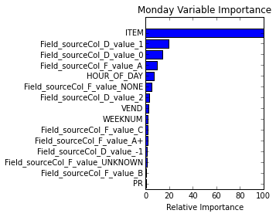
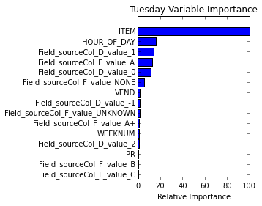
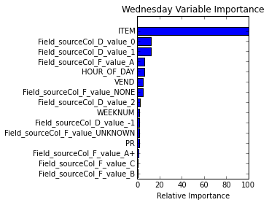
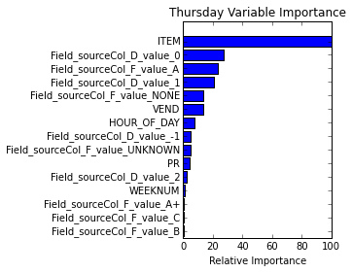
Feature Importance

Slide 9
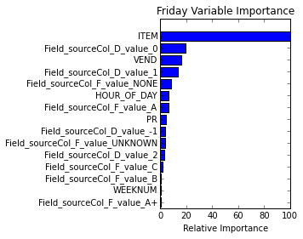
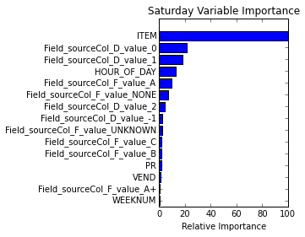
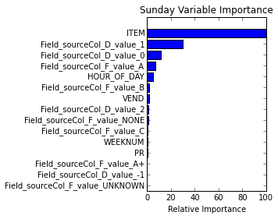
Feature Importance

Slide 10
Feature Selection and Individual Regressors
Feature Name
Field_sourceCol_F_value_NONE
ITEM
VEND
Field_sourceCol_F_value_A
HOUR_OF_DAY
Field_sourceCol_D_value_1
Field_sourceCol_D_value_0
Regressor | R2Score
Linear | 0.059
Ridge | 0.0596
Decision Tree | 0.448
Random Forest | 0.424
Gradient Boosting | 0.0283
Ada Boost | 0.194
SVR | 0.150
NuSVR | 0.150

Slide 11
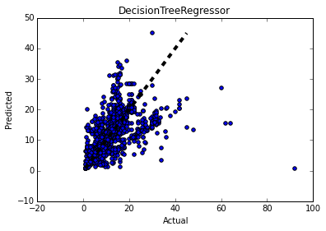
Sample Individual Regressor - DecisionTree
Score=0.448296055005

Slide 12
Stacking Ensemble
Selected the following five Level 0 Regressors:
Random Forest
Decision Tree
Gradient Boosting
Ada Boost
NuSVR
Used LinearRegression for Level 1 Combiner

Slide 13
Stacking Ensemble – Daily Results
Day | R2Score
Monday | 0.492
Tuesday | 0.547
Wednesday | 0.521
Thursday | 0.480
Friday | 0.552
Saturday | 0.539
Sunday | 0.578

Slide 14
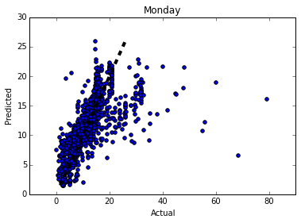
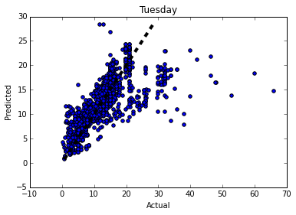
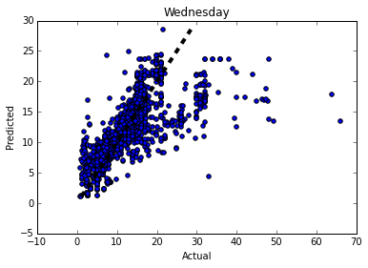
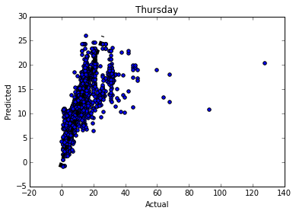
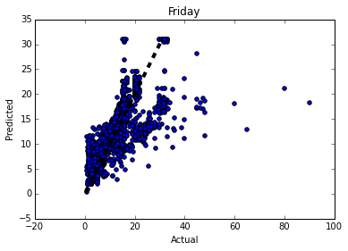
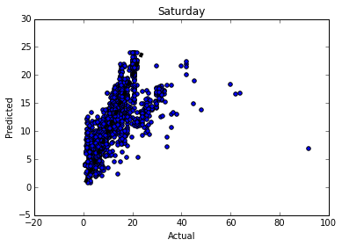
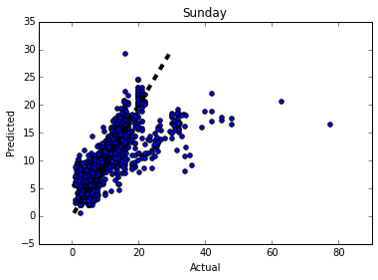
Stacking Ensemble – Daily Results

Slide 15
Weekly Modeling Methodology and Results
Use all Features
With Some Features removed
Train on year 2008-10
Model type | R^2 Results
Linear Regression | 0.9887
M5P Rules | 0.988
SMO Regression | 0.9884
REP Tree | 0.976
Rotation Forest with M5P | 0.9882
Model type | R^2 Results
Linear Regression | 0.9887
M5P Rules | 0.988
SMO Regression | 0.9884
REP Tree | 0.976
Model type | R^2 Results
Linear Regression | 0.9924
M5P Rules | 0.9924
REP Tree | 0.976
SMO Regression | 0.9921
EX: Sum of dollars = 1.6956 * Week number + 4.5507 * Sum of UNITS + 4.051 * Sum of Field_sourceCol_F_value_A2 + 7.5224 * Count of ITEM + 9.8466 * Sum of Field_sourceCol_F_value_B + 4.051 * Sum of Field_sourceCol_F_value_A + -3.6757 * Sum of PR -252.876
Future Sales Predictions

Slide 16
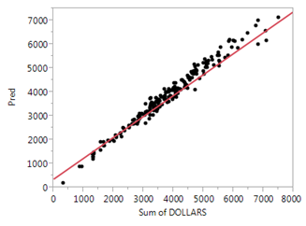
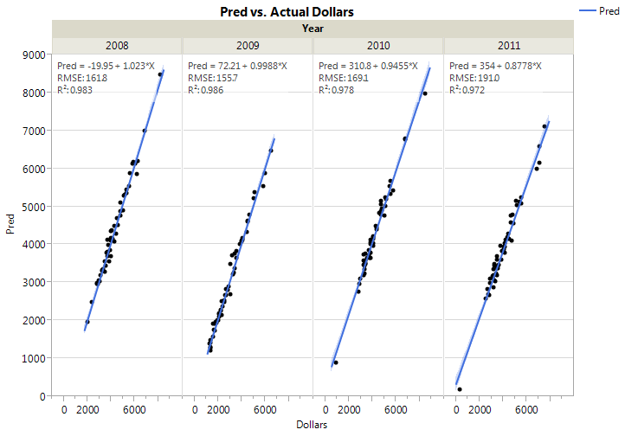
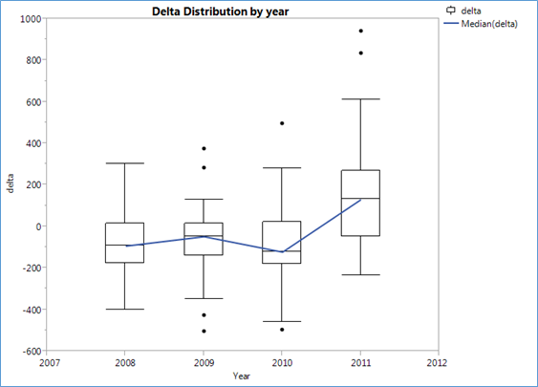
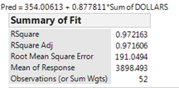
Future Sales Prediction
sum of dollars = 5.9039 * Sum of UNITS + 5.8388 * Count of ITEM + 5.8252 * Sum of Field_sourceCol_F_value_A + -3.0693 * Sum of PR + -180.9078

Slide 17
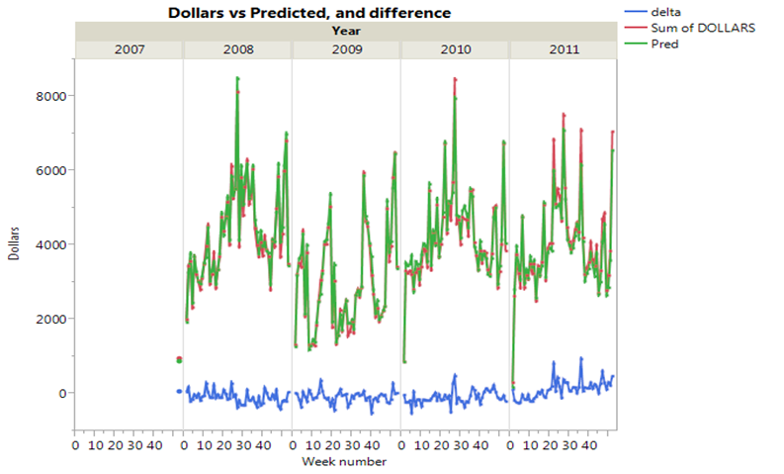
Predicted vs. Actual

Slide 18
Conclusion
Daily transaction predictors for Stores
Does the store have a promotion/display?
Specific beer product offered at a store
Vendors of beer a particular store offers
Does the store have an advertisement out?
What hour of the day does the store typically sell most beer
Promotion/Display/Price Reduction Effects
Advertisement/coupons/rebates increase sales
Price reduction decrease sales

Slide 19
Conclusion
Weekly sales predictors
Sum of units sold in a week
Count of items sold in a week
Use of Large Ad
Avoid use of price rebates

Slide 20
Q & A Thank you

