Slide 1
Core java
Jun 17, 2014
By : Ghanshyam Dhomse

Slide 2
Agenda
What is JAVA?
Features of Java
Hello World Program
Brief Concept JDK , JRE and JVM
Java OOP Concepts

Slide 3
Project Execution Traditional Approach
History Of Java?
Programming Language &
a Platform
Java Version?
Where it is used?
Features of java??
What comes to your mind ???
Java Runtime Environment
Java OOP Concepts?
Java New features
Java Virtual Machine
Java Development Kit

Slide 4
What is Java?
Java is a Programming language and a Platform
Any hardware or software environment in which a program runs, known as a platform. Since Java has its own Runtime Environment (JRE) and API, it is called platform.
Java Version
JDK Alpha and Beta (1995) JDK 1.0 (23rd Jan, 1996)
JDK 1.1 (19th Feb, 1997) J2SE 1.2 (8th Dec, 1998)
J2SE 1.3 (8th May, 2000) J2SE 1.4 (6th Feb, 2002)
J2SE 5.0 (30th Sep, 2004) Java SE 6 (11th Dec, 2006)
Java SE 7 (28th July, 2011)

Slide 5
What it is Used?
Desktop Applications such as acrobat reader, media player, antivirus etc.
Web Applications such as irctc.co.in..etc.
Enterprise Applications such as banking applications.
Mobile
Embedded System
Smart Card
Robotics
Games etc.

Slide 6
Types of Java Application?
There are mainly 4 type of applications that can be created using java:
1) Standalone Application
It is also known as desktop application or window-based application. An application that we need to install on every machine such as media player, antivirus etc. AWT and Swing are used in java for creating standalone applications.
2) Web Application
An application that runs on the server side and creates dynamic page, is called web application. Currently, servlet, jsp, struts, jsf etc. technologies are used for creating web applications in java.

Slide 7
Types of Java Application
3) Enterprise Application
An application that is distributed in nature, such as banking applications etc. It has the advantage of high level security, load balancing and clustering. In java, EJB is used for creating enterprise applications.
4) Mobile Application
An application that is created for mobile devices. Currently Android and Java ME are used for creating mobile applications.

Slide 8
Brief History of JAVA
James Gosling, Mike Sheridan, and Patrick Naughton initiated the Java language project in June 1991.
originally designed for small, embedded systems in electronic appliances like set-top boxes.
initially called Oak and was developed as a part of the Green project
In 1995, Oak was renamed as "Java". Java is just a name not an acronym.
originally developed by James Gosling at Sun Microsystems(which is now a subsidiary of Oracle Corporation) and released in 1995.
JDK 1.0 released in(January 23, 1996).

Slide 9
Features of Java
Simple
Object-Oriented
Platform Independent
Secured
Robust
Architecture Neutral
Portable
High Performance
Distributed
Multi-threaded

Slide 10
Java is Simple??
Java is simple in the sense that:
syntax is based on C++ (so easier for programmers to learn it after C++).
removed many confusing and/or rarely-used features e.g., explicit pointers, operator overloading etc.
No need to remove unreferenced objects because there is Automatic Garbage Collection in java.

Slide 11
Java is Object Oriented?
Object-oriented means we organize our software as a combination of different types of objects that incorporates both data and behaviour.
Object-oriented programming(OOPs) is a methodology that simplify software development and maintenace by providing some rulues.
Basic concepts of OOPs are:
  1. Object
  2. Class
  3. Inheritance
  4. Polymorphism
  5. Abstraction
  6. Encapsulation

Slide 12
Java is Platform Independent?
A platform is the hardware or software environment in which a program runs. There are two types of platforms software-based and hardware-based. Java provides software-based platform. The Java platform differs from most other platforms in the sense that it's a software-based platform that runs on top of other hardware-based platforms. It has two components:
Runtime Environment & API(Application Programming Interface)
Java code can be run on multiple platforms e.g. Windows,Linux,Sun Solaris,Mac/OS etc.
Java code is compiled by the compiler and converted into bytecode.
This bytecode is a platform independent code because it can be run on multiple platforms i.e. Write Once and Run Anywhere(WORA).

Slide 13
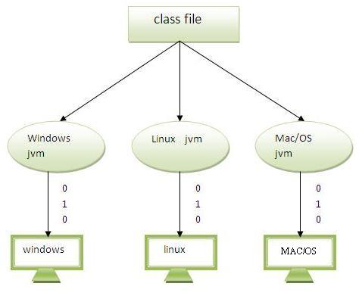
Platform Independent

Slide 14
Java is Secure
Java is Secured because:
• No explicit pointer
• Programs run inside virtual machine sandbox.
• Class loader- adds security by separating the package for the classes of the local file system from those that are imported from network sources.
• Byte code Verifier- checks the code fragments for illegal code that can violate accesss right to objects.
• Security Manager- determines what resources a class can access such as reading and writing to the local disk.
Some sucurity can also be provided by through SSL, JAAS,cryptography etc.

Slide 15
Java is Robust
Java is Robust because -
Robust simply means strong. Java uses strong memory management. There are lack of pointers that avoids security problem. There is automatic garbage collection in java. There is exception handling and type checking mechanism in java. All these points makes java robust.
Architecture-neutral
There is no implementation dependent features e.g. size of primitive types is set.

Slide 16
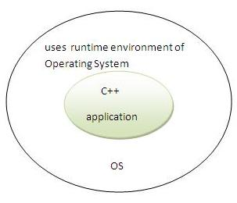
C++ Program Execution

Slide 17
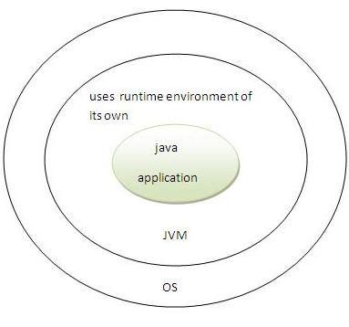
Java Program Execution

Slide 18
Portable High-Performance Distributed
Portable
We may carry the java byte code to any platform.
High-performance
Java is faster than traditional interpretation since byte code is "close" to native code still somewhat slower than a compiled language (e.g., C++)
Distributed
We can create distributed applications in java. RMI and EJB are used for creating distributed applications. We may access files by calling the methods from any machine on the internet.

Slide 19
Multi-Threaded
Multi-threaded
A thread is like a separate program, executing concurrently. We can write Java programs that deal with many tasks at once by defining multiple threads. The main advantage of multi-threading is that it shares the same memory. Threads are important for multi-media, Web applications etc.

Slide 20
Hello Word Java Program!!
Requirement for Hello Java Example
For executing any java program, you need to
• create the java program.
• install the JDK if you don't have installed it You may also use the eclipse different version.
• set path of the bin directory under jdk. In Case of Eclipse you may also do the same.
• compile and execute the program.

Slide 21
Hello Word Java Program!!
Creating hello java example
Let's create the hello java program:
class Simple{
public static void main(String args[]){
System.out.println("Hello Java")
}
}
save this file as Simple.java

Slide 22
Understanding First Java Program
class is used to declare a class in java.
public is an access modifier which represents visibility, it means it is visible to all.
static is a keyword, if we declare any method as static, it is known as static method. The core advantage of static method is that there is no need to create object to invoke the static method. The main method is executed by the JVM, so it doesn't require to create object to invoke the main method. So it saves memory.
void is the return type of the method, it means it doesn't return any value.

Slide 23
Understanding First Java Program
main represents startup of the program.
String[] args is used for command line argument. We will learn it later.
System.out.println() is used print statement.
To write the simple program, open notepad and write simple program as displayed below:

Slide 24
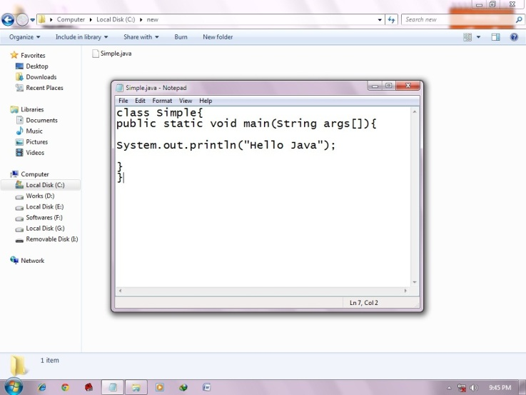
Understanding First Java Program

Slide 25
Understanding First Java Program
write the simple program of java in notepad and saved it as Simple.java.
To compile and run this program, you need to open command prompt by start -> All Programs -> Accessories -> command prompt.-> set path
To compile:
javac Simple.java
To execute:
java Simple
Output: Hello Java

Slide 26
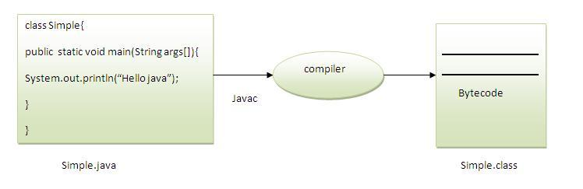
What happen at Compile Time?
At compile time, java file is compiled by Java Compiler (It does not interact with OS) and converts the java code into bytecode.

Slide 27
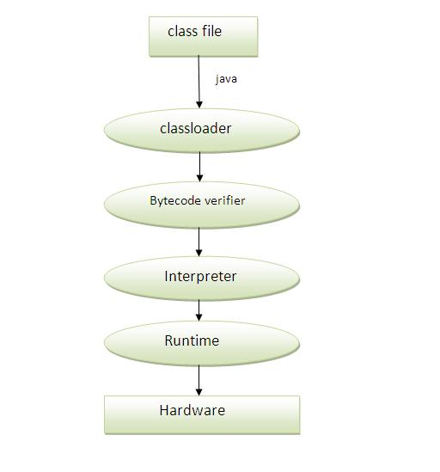
Step follow at Compile Time..

Slide 28
How many ways, we can write a java program?
There are many ways to write a java program. The modifications that can be done in a java program are given below:
1) By changing sequence of the modifiers, method prototype is not changed.
Let's see the simple code of main method.
static public void main(String args[])
2) subscript notation in java array can be used after type, before variable or after variable.
Let's see the different codes to write the main method.
public static void main(String[] args)
public static void main(String []args)
public static void main(String args[])

Slide 29
How many ways, we can write a java program?
3) You can provide var-args support to main method by passing 3 ellipses (dots)
Let's see the simple code of using var-args in main method. We will learn about var-args later in Java New Features chapter.
public static void main(String... args)
4) Having semicolon at the end of class in java is optional.
Let's see the simple code.
class A{
static public void main(String... args){
System.out.println("hello java4"); } };

Slide 30
How to Set Permanent Path of JDK?
Class loader: is the subsystem of JVM that is used to load class files.
Bytecode Verifier: checks the code fragments for illegal code that can violate accesss right to objects.
Interpreter: read bytecode stream then execute the instructions.
Setting Permanent Path of JDK in Windows:
For setting the permanent path of JDK, you need to follow these steps:
Go to MyComputer properties -> advanced tab -> environment variables -> new tab of user variable -> write path in variable name -> write path of bin folder in variable value -> ok -> ok -> ok

Slide 31
How to Set Permanent Path of JDK?
Click on new tab of user variables
write path in variable name
Copy the path of bin folder
Paste path of bin folder in variable value
Click on ok button
Click on ok button
Now your permanent path is set. You can now execute any program of java from any drive.

Slide 32
Difference between JDK,JRE and JVM
Difference between JDK,JRE and JVM
1. Brief summary of JVM
2. Java Runtime Environment (JRE)
3. Java Development Kit (JDK)
JVM
JVM (Java Virtual Machine) is an Abstract Machine. It is a specification that provides runtime environment in which java bytecode can be executed.
JVMs are available for many hardware and software platforms (i.e.JVM is plateform dependent).

Slide 33
Difference between JDK,JRE and JVM
The JVM performs four main tasks:
Loads code
Verifies code
Executes code
Provides runtime environment
JRE
JRE is an acronym for Java Runtime Environment. It is used to provide runtime environment. It is the implementation of JVM. It physically Exists. It contains set of libraries + other files that JVM uses at runtime.

Slide 34
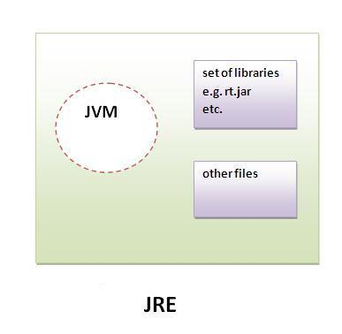
Difference between JDK,JRE and JVM

Slide 35
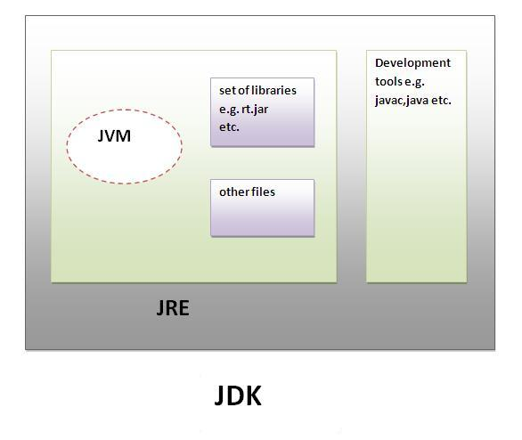
Difference between JDK,JRE and JVM
JDK
JDK is an acronym for Java Development Kit. It physically exists. It contains JRE + development tools.

Slide 36
JVM (Java Virtual Machine)
JVM (Java Virtual Machine) is an abstract machine. It is a specification that provides runtime environment in which java bytecode can be executed.
JVMs are available for many hardware and software platforms (i.e.JVM is plateform dependent).
The JVM performs four main tasks:
Loads code
Verifies code
Executes code
Provides runtime environment

Slide 37
JVM (Java Virtual Machine)
JVM provides definitions for the:
Memory area
Class file format
Register set
Garbage-collected heap
Fatal error reporting etc.

Slide 38
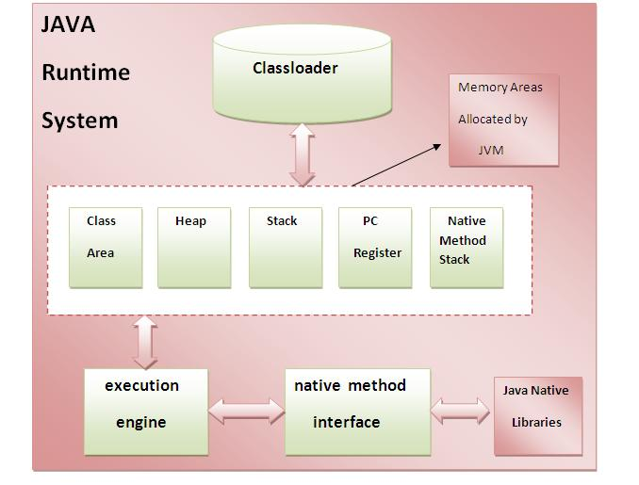
Internal Architecture of Java

Slide 39
Internal Architecture of Java
1) Classloader: Class loader is a subsystem of JVM it is used to load class files.
2) Class(Method) Area: stores per-class structures such as the runtime constant pool, field and method data, the code for methods.
3) Heap: It is the runtime data area in which objects are allocated.
4) Stack: Java Stack stores frames. It holds local variables and partial results, and plays a part in method invocation and return. Each thread has a private JVM stack, created at the same time as thread.
A new frame is created each time a method is invoked. A frame is destroyed when its method invocation completes.
5) Program Counter Register: PC (program counter) register. It contains the address of the Java virtual machine instruction currently being executed.

Slide 40
Internal Architecture of Java
6) Native Method Stack:
It contains all the native methods used in the application.
7) Execution Engine:
It contains:
1) A virtual processor
2) Interpreter: Read byte code stream then execute the instructions.
3) Just-In-Time(JIT) compiler:It is used to improve the performance.JIT compiles parts of the byte code that have similar functionality at the same time, and hence reduces the amount of time needed for compilation. Here the term ?compiler? refers to a translator from the instruction set of a Java virtual machine (JVM) to the instruction set of a specific CPU.

Slide 41
Variable Declaration and Operator
Program of swapping two numbers without using third variable.
class SwapTwoNumbers{
public static void main(String args[]){
int a=40,b=5;
a=a*b;
b=a/b;
a=a/b;
System.out.println("a= "+a);
System.out.println("b= "+b); } }

Slide 42
Java OOPs Concepts
OOPs (Object Oriented Programming System)
Object means a real word entity such as pen, chair, table etc.
Object-Oriented Programming is a methodology or paradigm to design a program using classes and objects. It simplifies the software development and maintenance by providing some concepts:
Object
Class
Inheritance
Polymorphism
Abstraction & Encapsulation

Slide 43
Advantage of OOPs over Procedure-oriented programming language
1) OOPs makes development and maintenance easier where as in Procedure-oriented programming language it is not easy to manage if code grows as project size grows.
2) OOPs provides data hiding whereas in Procedure-oriented prgramming language a global data can be accessed from anywhere.
3) OOPs provides ability to simulate real-world event much more effectively. We can provide the solution of real word problem if we are using the Object-Oriented Programming language.

Slide 44
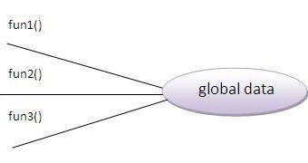
What is difference between object-oriented programming language and object-based programming language?
Object based programming language follows all the features of OOPs except Inheritance. JavaScript and VBScript are examples of object based programming lang
usages.

Slide 45
Naming convention
Naming convention
A naming convention is a rule to follow as you decide what to name your identifiers (e.g. class, package, variable, method, etc.), but it is not mandatory to follow that is why it is known as convention not rule.
Advantage:
By using standard Java naming conventions they make their code easier to read for themselves and for other programmers. Readability of Java code is important because it means less time is spent trying to figure out what the code does.

Slide 46
Naming Convention
Class Name - should begin with uppercase letter and be a noun
e.g. String, System,Thread etc.
Interface name -should begin with uppercase letter and be an adjective (whereever possible). e.g. Runnable, ActionListener etc.
Method name - should begin with lowercase letter and be a verb.
e.g. main(),print(),println(),actionPerformed() etc.
variable name - should begin with lowercase letter
e.g. firstName,orderNumber etc.
Package name- should be in lowercase letter. e.g. java,lang,sql,util etc.
constants name - should be in uppercase letter.
e.g. RED,YELLOW,MAX_PRIORITY etc.

Slide 47
Object and Class (Object-Oriented Programming)
Object and Class (Object-Oriented Programming)
1. Object
2. Class
3. Instance Variable
4. Method
5. Advantage of Method
6. new keyword
7. Example of Object and class that maintains the records of student
8. Different ways to create an object in java
9. Anonymous Object
10. Creating multiple objects by one type

Slide 48
Object
Object
A runtime entity that has state and behaviour is known as an object. For example: chair, table, pen etc. It can be tengible or intengible (physical or logical).
An object has three characteristics:
state: represents the data of an object.
behavior: represents the behavior of an object.
identity: Object identity is typically implemented via a unique ID. The value of the ID is not visible to the external user, but is used internally by the JVM to identify each object uniquely.

Slide 49
Class
For Example: Pen is an object. Its name is Reynolds, color is white etc. known as its state. It is used to write, so writing is its behavior.
Object is an instance of a class. Class is a template or blueprint from which objects are created. So object is the instance(result) of a class.
Class - A class is a group of objects that have common property.
It is a template or blueprint from which objects are created.
A class in java can contain: Data member
Method
Constructor
Block

Slide 50
Syntax of Class declaration
Syntax to declare a class:
class <class_name>
{
data member;
method;
}
We are creating the object of the Student class by new keyword and printing the objects value.

Slide 51
Simple Example of Object and Class
class Student {
int id; //data member (also instance variable)
String name; //data member(also instance variable)
public static void main(String args[])
{
Student s1=new Student(); //creating an object of Student
System.out.println(s1.id+" "+s1.name);
}
} Output: 0 null

Slide 52
Simple Example of Object and Class
Instance variable
A variable that is created inside the class but outside the method, is known as instance variable.Instance variable doesn't get memory at compile time.It gets memory at runtime when object(instance) is created.That is why, it is known as instance variable.
Method
In java, a method is like function i.e. used to expose behaviour of an object.
Advantage of Method
Code Reusability & Code Optimization
new keyword - The new keyword is used to allocate memory at runtime.

Slide 53
Example of Object and class that maintains the records of students
In this example, we are creating the two objects of Student class and initializing the value to these objects by invoking the insertRecord method on it. Here, we are displaying the state (data) of the objects by invoking the displayInformation method.
class Student {
int rollno;
String name;
void insertRecord(int r, String n) { //method
rollno=r;
name=n;
}

Slide 54
Example of Object and class that maintains the records of students
void displayInformation() { System.out.println(rollno+" "+name);}//method
public static void main(String args[]) {
Student s1=new Student();
Student s2=new Student();
s1.insertRecord(111,"Karan");
s2.insertRecord(222,"Aryan");
s1.displayInformation();
s2.displayInformation();
} }
Output: 111 Karan
222 Aryan

Slide 55
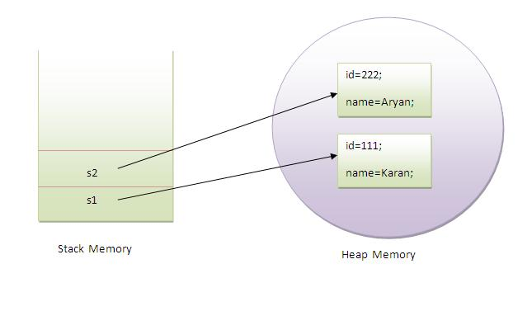
Diagram View
object gets the memory in Heap area and reference variable refers to the object allocated in the Heap memory area. Here, s1 and s2 both are reference variables that refer to the objects allocated in memory.

Slide 56
Another Example
class Rectangle {
int length;
int width;
void insert(int l,int w){
length=l;
width=w;
}
void calculateArea(){System.out.println(length*width);}
public static void main(String args[]) {

Slide 57
Rectangle r1=new Rectangle();
Rectangle r2=new Rectangle();
r1.insert(11,5);
r2.insert(3,15);
r1.calculateArea();
r2.calculateArea();
}
}
Output:55
45

Slide 58
Different ways to create an object in Java?
What are the different ways to create an object in Java?
There are many ways to create an object in java.
They are:
By new keyword
By newInstance() method
By clone() method
By factory method etc.
Annonymous object
Annonymous simply means nameless. An object that have no reference is known as annonymous object.

Slide 59
Anonymous Object is Use only Once.
class Calculation{
void fact(int n){
int fact=1;
for(int i=1;i<=n;i++){
fact=fact*i;
}
System.out.println("factorial is "+fact);
}
public static void main(String args[]){
new Calculation().fact(5); //calling method with annonymous object
} } Output: Factorial is 120

Slide 60
Method Overloading in Java
1. Different ways to overload the method ?
By changing the no. of arguments
By changing the datatype
2. Why method overloading is not possible by changing the return type?
3. Can we overload the main method?
method overloading with Type Promotion?
If a class have multiple methods by same name but different parameters, it is known as Method Overloading

Slide 61
Method Overloading in Java
If we have to perform only one operation, having the same name of the methods increases the readability of the program.
Advantage of method overloading?
Method overloading increases the readability of the program.
Different ways to overload the method
There are two ways to overload the method in java
By changing number of arguments
By changing the data type
Note: In java, Method Overloading is not possible by changing return type of the method.

Slide 62
Example of Method Overloading by changing the no. of arguments
In this example, we have created two overloaded methods, first sum method performs addition of two numbers and second sum method performs addition of three numbers.
class Calculation{
void sum(int a,int b){System.out.println(a+b);}
void sum(int a,int b,int c){System.out.println(a+b+c);}
public static void main(String args[]){
Calculation obj=new Calculation();
obj.sum(10,10,10);
obj.sum(20,20);
}
} Output: 30 40

Slide 63
Why Method Overloading is not possible by changing the return type of method?
In java, method overloading is not possible by changing the return type of the method because there may occur ambiguity. Let's see how ambiguity may occur:
class Calculation { int sum(int a,int b) { System.out.println(a+b); }
double sum(int a,int b)
{
System.out.println(a+b);
}
public static void main(String args[])
{
Calculation obj=new Calculation();
int result=obj.sum(20,20); //Compile Time Error } }
int result=obj.sum(20,20); //Here how can java determine which sum() method should be called

Slide 64
Can we overload main() method?
Can we overload main() method?
Yes, by method overloading. You can have any number of main methods in a class by method overloading.
class Simple
{
public static void main(int a)
{
System.out.println(a);
}
public static void main(String rags[])
{
System.out.println("main() method invoked");
main(10);
} }
Output: main() method invoked 10

Slide 65
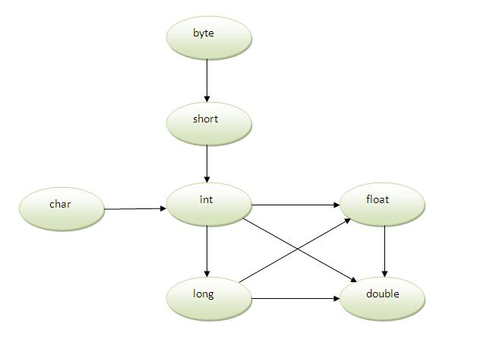
Method Overloading and TypePromotion

Slide 66
Method Overloading and TypePromotion
Example of Method Overloading with TypePromotion
class Calculation { void sum(int a,long b)
{ System.out.println(a+b); }
void sum(int a,int b,int c) { System.out.println(a+b+c); }
public static void main(String args[])
{
Calculation obj=new Calculation(); obj.sum(20,20); / /now second int literal will be promoted to long
obj.sum(20,20,20); }}
Output:40 60 If the matching Type Argument give the compiler Error

Slide 67
Constructor
Types of constructors
Default Constructor
Parameterized Constructor
2. Constructor Overloading
3. Does constructor return any value ?
4. Copying the values of one object into another?
5. Does constructor perform other task instead initialization?

Slide 68
Constructor
Constructor is a special type of method that is used to initialize the state of an object.
Constructor is invoked at the time of object creation.
It constructs the values i.e. data for the object that is why it is known as constructor.
Constructor is just like the instance method but it does not have any explicit return type.
Rules for creating constructor
There are basically two rules defined for the constructor.
Constructor name must be same as its class name
Constructor must have no explicit return type

Slide 69
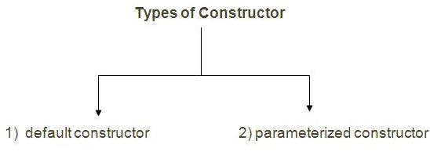
Types of constructors
Types of constructors
There are two types of constructors:
default constructor (no-arg constructor)
parameterized constructor

Slide 70
Default Constrcture
1) Default Constructor
A constructor that have no parameter is known as default constructor.
Syntax of default constructor:
<class_name>(){} Example of default constructor
In this example, we are creating the no-arg constructor in the Bike class. It will be invoked at the time of object creation.
//example of default constructor
class Bike { Bike() { System.out.println("Bike is created");}
public static void main(String args[]){ Bike b=new Bike(); } }
Output:Bike is created 0 and null values are provided by default constructor.

Slide 71
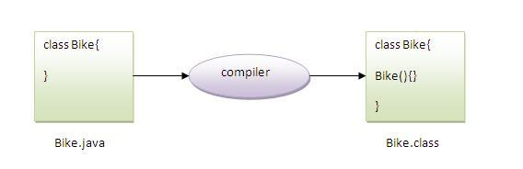
No Constructer in Class Automatically created By Comipler

Slide 72
Parameterized Constructor
Parameterized constructor
A constructor that have parameter is known as parameterized constructor.
Why use parameterized constructor?
Parameterized constructor is used to provide different values to the distinct objects.
Example of parameterized constructor
In this example, we have created the constructor of Student class that have two parameters. We can have any number of parameters in the constructor.

Slide 73
Example
class Student{
int id;
String name;
Student(int i,String n){
id = i;
name = n;
}
void display(){System.out.println(id+" "+name);}
public static void main(String args[]){
Student s1 = new Student(111,"Karan");
Student s2 = new Student(222,"Aryan");
s1.display();
s2.display(); } } Output:111 Karan 222 Aryan

Slide 74
Constructor Overloading
Constructor Overloading
Constructor overloading is a technique in Java in which a class can have any number of constructors that differ in parameter lists. The compiler differentiates these constructors by taking into account the number of parameters in the list and their type.
Example of Constructor Overloading
//Program of constructor overloading
class Student
{ int id; String name; int age;

Slide 75
Constructor Overloading Example
Student(int i,String n)
{ id = i; name = n; }
Student(int i,String n,int a)
{ id = i; name = n; age=a; }
void display()
{ System.out.println(id+" "+name+" "+age);}
public static void main(String args[]){
Student s1 = new Student(111,"Karan");
Student s2 = new Student(222,"Aryan",25); s1.display(); s2.display(); }} Output:1 11 Karan 0 222 Aryan 25

Slide 76
What is the difference between constructor and method ?
Constructor vs Method
Constructor is used to initialize the state of an object.
Method is used to expose behavior of an object.
Constructor must not have return type.
Method must have return type.
Constructor is invoked implicitly.
Method is invoked explicitly.
The java compiler provides a default constructor if you don't have any constructor.
Method is not provided by compiler in any case.
Constructor name must be same as the class name.
Method name may or may not be same as class name.

Slide 77
Copying the values of one object to another like copy constructor in C++
Does constructor return any value?
Ans: yes,that is current class instance (You cannot use return type yet it returns a value).
Copying the values of one object to another like copy constructor in C++
There are many ways to copy the values of one object into another. They are:
By constructor
By assigning the values of one object into another
By clone() method of Object class
In this example, we are going to copy the values of one object into another using constructor.

Slide 78
Example
//Program of Copying the values of one object to another
class Student{
int id;
String name;
Student(int i,String n) {
id = i;
name = n;
}
Student(Student s){
id = s.id;
name =s.name;
}

Slide 79
Example
void display(){System.out.println(id+" "+name);}
public static void main(String args[]){
Student s1 = new Student(111,"Karan");
Student s2 = new Student(s1);
s1.display();
s2.display();
}} Output:111 Karan 111 Karan

Slide 80
Copying the values of one object to another without constructor
Copying the values of one object to another without constructor
We can copy the values of one object into another by assigning the objects values to another object. In this case, there is no need to create the constructor.
//Anoter program of Copying the values of one object to another
class Student{ int id; String name;
Student(int i,String n) { id = i; name = n; }
void display(){System.out.println(id+" "+name);}
public static void main(String args[]){
Student s1 = new Student(111,"Karan");
Student s2 = new Student();

Slide 81
Copying the values of one object to another without constructor
s2.id=s1.id;
s2.name=s1.name;
s1.display();
s2.display();
}
}
Output:111 Karan
111 Karan
Can constructor perform other tasks instead of initialization?
Yes, like object creation, starting a thread, calling method etc. You can perform any operation in the constructor as you perform in the method.

Slide 82
static keyword
1. Static variable
2. Program of counter without static variable
3. Program of counter with static variable
4. Static method
5. Restrictions for static method
6. Why main method is static ?
7. Static block
8. Can we execute a program without main method ?

Slide 83
Static variable
The static keyword is used in java mainly for memory management. We may apply static keyword with variables, methods and blocks. The static keyword belongs to the class than instance of the class.
The static can be:
variable (also known as class variable)
method (also known as class method)
block
1) static variable
If you declare any variable as static, it is known static variable.
The static variable can be used to refer the common property of all objects (that is not unique for each object) e.g. company name of employees, college name of students etc.

Slide 84
Advantages Of Static variable
The static variable gets memory only once in class area at the time of class loading.
Advantage of static variable
It makes your program memory efficient (i.e it saves memory).
Understanding problem without static variable
class Student { int rollno; String name; String college="ITS";}
Suppose there are 500 students in my college, now all instance data members will get memory each time when object is created.
All student have its unique rollno and name so instance data member is good. Here, college refers to the common property of all objects.
If we make it static, this field will get memory only once. Note:static field is shared by all objects.

Slide 85
Example of static variable
Example of static variable
//Program of static variable
class Student{
int rollno;
String name; static String college ="ITS";
Student(int r,String n){
rollno = r; name = n;
}
void display (){System.out.println(rollno+" "+name+" "+college);}
public static void main(String args[]){
Student s1 = new Student (111,"Karan"); Student s2 = new Student (222,"Aryan");
s1.display(); s2.display(); } }
Output:111 Karan ITS 222 Aryan ITS

Slide 86
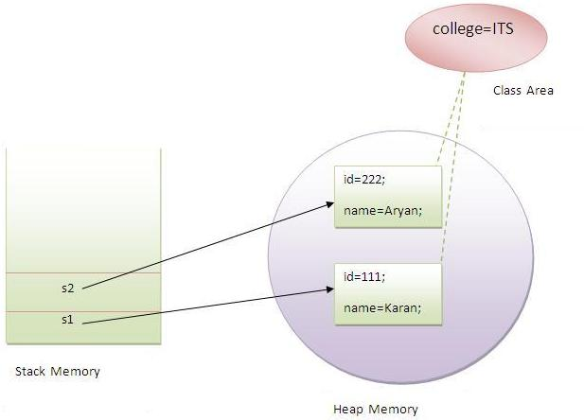
Static Diagram

Slide 87
Program of counter without static variable
Program of counter without static variable
In this example, we have created an instance variable named count which is incremented in the constructor. Since instance variable gets the memory at the time of object creation, each object will have the copy of the instance variable, if it is incremented, it won't reflect to other objects. So each objects will have the value 1 in the count variable.
class Counter{int count=0; //will get memory when instance is created
Counter(){ count++; System.out.println(count); }
public static void main(String args[]){
Counter c1=new Counter();
Counter c2=new Counter();
Counter c3=new Counter(); }} Output:1 1 1

Slide 88
Program of counter by static variable
Program of counter by static variable
As we have mentioned above, static variable will get the memory only once, if any object changes the value of the static variable, it will retain its value.
class Counter{
static int count=0; //will get memory only once and retain its value
Counter(){ count++; System.out.println(count); }
public static void main(String args[]){
Counter c1=new Counter(); Counter c2=new Counter(); Counter c3=new Counter();
}}
Output: 1 2 3

Slide 89
static method
2) static method
If you apply static keyword with any method, it is known as static method.
• A static method belongs to the class rather than object of a class.
• A static method can be invoked without the need for creating an instance of a class.
• static method can access static data member and can change the value of it.
Example of static method
//Program of changing the common property of all objects(static field).
class Student{
int rollno; String name; static String college = "ITS";
static void change(){ college = “SNJB"; }

Slide 90
Example of static method
Student(int r, String n){
rollno = r; name = n; }
void display () {System.out.println(rollno+" "+name+" "+college);}
public static void main(String args[]){
Student.change();
Student s1 = new Student (111,"Karan");
Student s2 = new Student (222,"Aryan");
Student s3 = new Student (333,"Sonoo");
s1.display(); s2.display(); s3.display(); } }
Output:111 Karan SNJB 222 Aryan SNJB 333 Sonoo SNJB

Slide 91
Restrictions for static method
Restrictions for static method
There are two main restrictions for the static method. They are:
1. The static method can not use non static data member or call non-static method directly.
2. this and super cannot be used in static context.
//Program of accessing non-static data member directly from static method main
class A{
int a=40; //non static
public static void main(String args[]){
System.out.println(a); } } Output: Compile Time Error

Slide 92
why main method is static?
why main method is static?
Ans) because object is not required to call static method if it were non-static method, jvm creates object first then call main() method that will lead the problem of extra memory allocation.
3) static block:
Is used to initialize the static data member.
It is executed before main method at the time of class loading.

Slide 93
Example of static block
Example of static block
//Program of static block
class A
{ static{System.out.println("static block is invoked");}
public static void main(String args[])
{ System.out.println("Hello main"); }}
Output:static block is invoked Hello main
Can we execute a program without main() method?
Ans) Yes, one of the way is static block but in previous version of JDK not in JDK 1.7.

Slide 94
this keyword
1. this keyword
2. Usage of this keyword
to refer the current class instance variable
to invoke the current class constructor
to invoke the current class method
to pass as an argument in the method call
to pass as an argument in the constructor call
to return the current class instance
3. Proving this keyword

Slide 95
Usage of this keyword
Usage of this keyword
Here is given the 6 usage of this keyword.
this keyword can be used to refer current class instance variable.
this() can be used to invoke current class constructor.
this keyword can be used to invoke current class method (implicitly)
this can be passed as an argument in the method call.
this can be passed as argument in the constructor call.
this keyword can also be used to return the current class instance.
Suggestion:If you are beginner to java, lookup only two usage of this keyword.

Slide 96

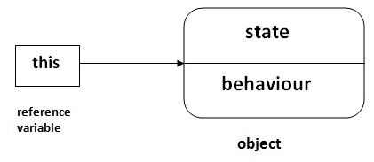
Usage of this keyword

Slide 97
this keyword usages
1) The this keyword can be used to refer current class instance variable.
If there is ambiguity between the instance variable and parameter, this keyword resolves the problem of ambiguity.
Understanding the problem without this keyword
Let's understand the problem if we don't use this keyword by the example given
c lass student{
int id; String name; student(int id,String name){ id = id; name = name; }
void display(){System.out.println(id+" "+name);}
public static void main(String args[]){
student s1 = new student(111,"Karan"); student s2 = new student(321,"Aryan");
s1.display(); s2.display(); } } Output:0 null 0 null

Slide 98
Solution of the above problem by this keyword
In the above example, parameter (formal arguments) and instance variables are
same that is why we are using this keyword to distinguish between local variable
and instance variable.
Solution of the above problem by this keyword
class Student{ int id; String name;
student(int id,String name) { this.id = id; this.name = name; }
void display(){System.out.println(id+" "+name);}
public static void main(String args[]){
Student s1 = new Student(111,"Karan"); Student s2 = new Student(222,"Aryan");
s1.display(); s2.display(); }} Output:111 Karan 222 Aryan

Slide 99
Program where this keyword is not required
If local variables(formal arguments) and instance variables are different, there is
no need to use this keyword like in the following program:
Program where this keyword is not required
class Student{ int id; String name;
student(int i,String n){ id = i; name = n; }
void display(){System.out.println(id+" "+name);}
public static void main(String args[]){
Student e1 = new Student(111,"karan"); Student e2 = new Student(222,"Aryan");
e1.display(); e2.display(); } }
Output:111 Karan 222 Aryan

Slide 100
this() invoke current class constructor
2) this() can be used to invoked current class constructor.
The this() constructor call can be used to invoke the current class constructor. This approach is better if you have many constructors in the class and want to reuse that constructor.
Program of this() constructor call
class Student{ int id; String name;
Student (){System.out.println("default constructor is invoked");}
Student(int id,String name){
this (); //it is used to invoked current class constructor.
this.id = id; this.name = name; }

Slide 101
Example
void display(){System.out.println(id+" "+name);}
public static void main(String args[]){
Student e1 = new Student(111,"karan");
Student e2 = new Student(222,"Aryan");
e1.display(); e2.display();
} }
Output:
default constructor is invoked default constructor is invoked
111 Karan 222 Aryan

Slide 102
Where to use this() constructor call?
Where to use this() constructor call?
The this() constructor call should be used to reuse the constructor in the constructor. it maintains the chain between the constructors i.e. it is used for constructor chaining. Let's see the example given below that displays the actual use of this keyword.
class Student{ int id; String name; String city; Student(int id,String name){
this.id = id; this.name = name; } //this always write first statement else give compile time error
Student(int id,String name,String city){
this(id,name); //now no need to initialize id and name
this.city=city; }

Slide 103
Example
void display(){System.out.println(id+" "+name+" "+city);}
public static void main(String args[]){
Student e1 = new Student(111,"karan");
Student e2 = new Student(222,"Aryan","delhi");
e1.display();
e2.display();
} }
Output:111 Karan null 222 Aryan delhi

Slide 104
this keyword invoke the current class method (implicitly)
3)The this keyword can be used to invoke current class method (implicitly).
You may invoke the method of the current class by using the this keyword. If you don't use the this keyword, compiler automatically adds this keyword while invoking the method.
class S{ void m(){ System.out.println("method is invoked"); }
void n(){ this.m(); //no need because compiler does it for you. }
void p(){ n(); //complier will add this to invoke n() method as this.n()
}
public static void main(String args[]){
S s1 = new S(); s1.p(); } } Output:method is invoked

Slide 105
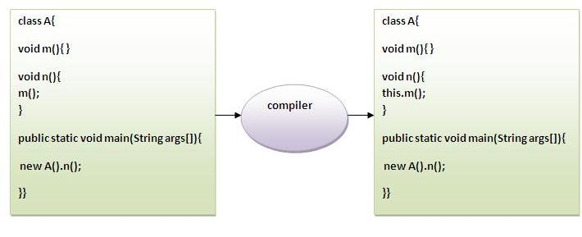
Compiler add this keyword ( implicitly )

Slide 106
this keyword passed as an argument in the method
4) The this keyword can be passed as an argument in the method.
The this keyword can also be passed as an argument in the method. It is mainly used in the event handling.
class S { void m(S obj){ System.out.println("method is invoked"); }
void p(){ m(this); }
public static void main(String args[]){
S s1 = new S();
s1.p();
} }
Output: method is invoked
Application of this that can be passed as an argument: In event handling (or) in a situation where we have to provide reference of a class to another one.

Slide 107
this keyword can be passed as argument in the constructor call
5) The this keyword can be passed as argument in the constructor call.
We can pass the this keyword in the constructor also. It is useful if we have to use
one object in multiple classes. Let's see the example:
class B{ A obj; B(A obj){ this.obj=obj; }
void display(){ System.out.println(obj.data); //using data member of A class
} }
class A{ int data=10; A(){ B b=new B(this); b.display(); }
public static void main(String args[]){
A a=new A();
} }
Output:10

Slide 108
this keyword can be used to return current class instance.
6) The this keyword can be used to return current class instance.
We can return the this keyword as an statement from the method. In such case,
return type of the method must be the class type (non-primitive). Let's see the
Syntax of this that can be returned as a statement
return_type method_name() { return this; }
Example of this keyword that you return as a statement from the method
class A{ A getA(){ return this; } void msg(){System.out.println("Hello java");} }
class Test{
public static void main(String args[]){
new A().getA().msg();
} } Output:Hello java

Slide 109
Inheritance (Object-Oriented Programming)
Inheritance (Object-Oriented Programming)
1. Inheritance
2. Types of Inheritance
3. Why multiple inheritance is not possible in java in case of class?
Inheritance is a mechanism in which one object acquires all the properties and behaviors of parent object.
The idea behind inheritance is that you can create new classes that are built upon existing classes. When you inherit from an existing class, you reuse (or inherit) methods and fields, and you add new methods and fields to adapt your new class to new situations. Inheritance represents the IS-A relationship.
Why use Inheritance?
For Method Overriding (So Runtime Polymorphism).
For Code Reusability.

Slide 110
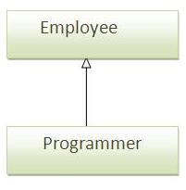
Syntax of inheritance
Syntax of Inheritance
class Subclass-name extends Superclass-name { //methods and fields}
The keyword extends indicates that you are making a new class that derives from an existing class. In the terminology of Java, a class that is inherited is called a super class.
The new class is called a subclass.

Slide 111
Example of inheritance
class Employee{ int salary=40000; }
class Programmer extends Employee{
int bonus=10000;
Public Static void main(String args[]){
Programmer p=new Programmer();
System.out.println("Programmer salary is:"+p.salary);
System.out.println("Bonus of Programmer is:"+p.bonus);
} }
Output:Programmer salary is:40000 Bonus of programmer is:10000
In the above example, Programmer object can access the field of own class as well as of Employee class i.e. code reusability.

Slide 112
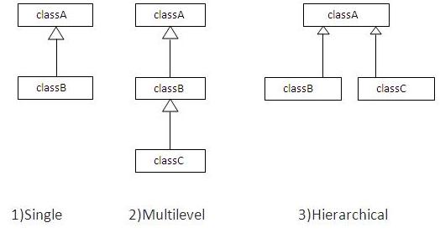
Types of Inheritance:

Slide 113
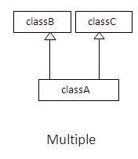
Multiple inheritance is not supported in java in case of class.
Multiple inheritance is not supported in java in case of class.
When a class extends two classes i.e. known as multiple inheritance.
Why multiple inheritance is not supported in java?
To reduce the complexity and simplify the language,multiple inheritance is not supported in java.For Example:

Slide 114
Aggregation in Java
If a class have an entity reference, it is known as Aggregation.
Aggregation represents HAS-A relationship.
Consider a situation, Employee object contains many informations such as id, name, emailId etc. It contains one more object named address, which contains its own informations such as city, state, country, zipcode etc. as given below.
class Employee { int id; String name; Address address; //Address is a class...}
In such case, Employee has an entity reference address, so relationship is Employee HAS-A address.
Why use Aggregation?
For Code Reusability.

Slide 115
Simple Example of Aggregation
In this example, we have created the reference of Operation class in the
Circle class.
class Operation{ int square(int n){ return n*n; } }
class Circle{
Operation op; //aggregation
double pi=3.14; double area(int radius){ op=new Operation();
int rsquare=op.square(radius); / /code reusability (i.e. delegates the method call).
return pi*rsquare; }
public static void main(String args[]){ Circle c=new Circle(); double result=c.area(5);
System.out.println(result); } } Output:78.5

Slide 116
When use Aggregation?
When use Aggregation?
Code reuse is also best achieved by aggregation when there is no is-a relationship.
Inheritance should be used only if the relationship is-a is maintained throughout the lifetime of the objects involved; otherwise, aggregation is the best choice
Understanding meaningful example of Aggregation
In this example, Employee has an object of Address, address object contains its own informations such as city, state, country etc. In such case relationship is Employee HAS-A address.

Slide 117
Example
Address.java
public class Address { String city, state, country;
public Address (String city, String state, String country)
{ super(); this.city = city; this.state = state; this.country = country;} }
Emp.java
public class Emp {int id; String name; Address address;
public Emp(int id, String name,Address address)
{ this.id = id; this.name = name; this.address=address; } void display() {System.out.println(id+"+name);
System.out.println(address.city+" "+address.state+" "+address.country);}

Slide 118
Example
public static void main(String[] args)
{Address address1=new Address("gzb","UP","india");
Address address2=new Address("gno","UP","india");
Emp e=new Emp(111,"varun",address1);
Emp e2=new Emp(112,"arun",address2);
e.display();e2.display(); }}

Slide 119
Method Overriding in Java
1. Understanding problem without method overriding
2. Can we override the static method
3. method overloading vs method overriding
Having the same method in the subclass as declared in the parent class is known as method overriding. If a subclass provides a specific implementation of a method that is already provided by its super class, it is known as Method Overriding.
Advantage of Method Overriding
Method Overriding is used to provide specific implementation of a method that is already provided by its super class.
Method Overriding is used for Runtime Polymorphism

Slide 120
Rules for Method Overriding
Rules for Method Overriding:
1. method must have same name as in the parent class
2. method must have same parameter as in the parent class.
Understanding the problem without mehtod overriding
Let's understand the problem that we may face in the program if we don't use method overriding. //Problem without method overriding
class Vehicle{ void run(){System.out.println("Vehicle is running");} }
class Bike extends Vehicle{ public static void main(String args[]){
Bike obj = new Bike(); obj.run(); }
} Output: Vehicle is running
Problem is that I have to provide a specific implementation of run() method in subclass that is why we use method overriding.

Slide 121
Example of method overriding
Example of method overriding
In this example, we have defined the run method in the subclass as defined in the parent class but it has some specific implementation. The name and parameter of the method is same and there is IS-A relationship between the classes, so there is method overriding.
//Example of method overriding
class Vehicle{ void run(){System.out.println("Vehicle is running");} }
class Bike extends Vehicle{ void run(){System.out.println("Bike is running safely");}
public static void main(String args[]){ Bike obj = new Bike(); obj.run(); } }
Output:Bike is running safely

Slide 122
Difference between method Overloading and Method Overriding.
Can we override static method?
No, static method cannot be overridden. It can be proved by runtime polymorphism so we will learn it later.
Why we cannot override static method?
because static method is bound with class whereas instance method is bound with object. Static belongs to class area and instance belongs to heap area.
Difference between method Overloading and Method Overriding.
There are three basic differences between the method overloading and method overriding. They are as follows:

Slide 123
Difference between method Overloading and Method Overriding.
Method Overloading vs Method Overriding
1) Method overloading is used to increase the readability of the program.
Method overriding is used to provide the specific implementation of the method that is already provided by its super class.
2) method overlaoding is performed within a class.
Method overriding occurs in two classes that have IS-A relationship.
3) In case of method overloading parameter must be different.
In case of method overriding parameter must be same.

Slide 124
super keyword
super keyword:
super is a reference variable that is used to refer immediate parent class object.
Uses of super Keyword:
super is used to refer immediate parent class instance variable.
super() is used to invoke immediate parent class constructor.
super is used to invoke immediate parent class method.

Slide 125
Problem without super keyword
1. super is used to refer immediate parent class instance variable.
Problem without super keyword
class Vehicle{ int speed=50; }
class Bike extends Vehicle{ int speed=100;
void display(){ System.out.println(speed);//will print speed of Bike }
public static void main(String args[]){
Bike b=new Bike(); b.display(); } } Output:100
In the above example Vehicle and Bike both class have a common property speed. Instance variable of current class is referred by instance by default, but I have to refer parent class instance variable that is why we use super keyword to distinguish between parent class instance variable and current class instance variable

Slide 126
Solution by super keyword
Solution by super keyword //example of super keyword
class Vehicle{ int speed=50; }
class Bike extends Vehicle{ int speed=100;
void display(){ System.out.println(super.speed);//will print speed of Vehicle now }
public static void main(String args[]){ Bike b=new Bike(); b.display();
}}Output:50
2. super is used to invoke parent class constructor.
The super keyword can also be used to invoke the parent class constructor as given
Example of super keyword
class Vehicle{ Vehicle(){System.out.println("Vehicle is created");} }

Slide 127
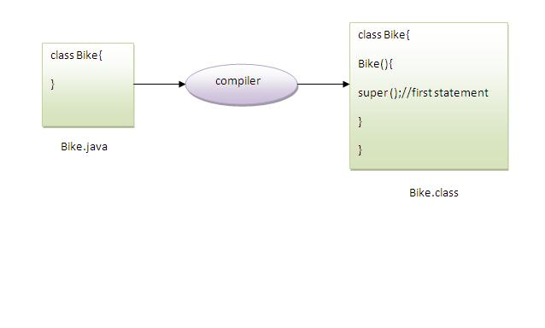
Example of super keyword
class Bike extends Vehicle{ Bike(){ super();//will invoke parent class constructor
System.out.println("Bike is created"); }
public static void main(String args[]){
Bike b=new Bike();
} } Output:Vehicle is created
Bike is created
Note:super() is added in each class
construtor automatically by compiler.

Slide 128
Super() provide the first statement by compiler
As we know well that default constructor is provided by compiler automatically but it also adds super() for the first statement. If you are creating your own constructor and you don't have either this() or super() as the first statement, compiler will provide super() as the first statement of the consructor.

Slide 129
super() is provided by the compiler(implicitely)
super keyword where super() is provided by the compiler implicitly.
class Vehicle { Vehicle() { System.out.println("Vehicle is created");} }
class Bike extends Vehicle{ int speed; Bike(int speed){ this.speed=speed;
System.out.println(speed); } public static void main(String args[]){
Bike b=new Bike(10); } }
Output: Vehicle is created 10
3. super can be used to invoke immediate parent class method.
The super keyword can also be used to invoke parent class method. It should be used in case subclass contains the same method as parent class as in the example given below:

Slide 130
Program of super that can be used to invoke method of parent class
class Person{ void message() { System.out.println("welcome");} }
class Student extends Person{
void message() {System.out.println("welcome to java"); }
void dislay(){ message(); //will invoke current class message() method
super.message(); //will invoke parent class message() method }
public static void main(String args[]) { Student s=new Student(); s.display(); } }
Output: welcome to java
In the above example Student and Person both classes have message() method if we call message() method from Student class, it will call the message() method of Student class not of Person class because priority is given to local.

Slide 131
Program in case super is not required
In case there is no method in subclass as parent, there is no need to use super. In the example given below message() method is invoked from Student class but Student class does not have message() method, so you can directly call message() method.
Program in case super is not required
class Person{void message(){System.out.println("welcome");}}
class Student extends Person{ void dislay(){message();//will invoke parent class message() method }
public static void main(String args[]){Student s=new Student();s.display();}} Output:welcome

Slide 132
Instance initializer block:
1. Instance initializer block
2. Example of Instance initializer block
3. What is invoked firstly instance initializer block or constructor?
4. Rules for instance initializer block
5. Program of instance initializer block that is invoked after super()
Instance Initializer block is used to initialize the instance data member.
It run each time when object of the class is created.
The initialization of the instance variable can be directly but there can be performed extra operations while initilizing the instance variable in the instance initializer block.

Slide 133
Why use instance intializer block
What is the use of instance initializer block while we can directly assign a value in instance data member? For example:
class Bike{ int speed=100;}
Why use instance initializer block?
Suppose I have to perform some operations while assigning value to instance data member e.g. a for loop to fill a complex array or error handling etc.

Slide 134
Example of Instance initializer block
Example of Instance initializer block
Let's see the simple example of intance initializer block the performs initialization.
//Program of instance initializer block that initializes values to the instance variable
class Bike{ int speed; Bike(){System.out.println("speed is "+speed);} {speed=100;}
public static void main(String args[]){
Bike b1=new Bike(); Bike b2=new Bike(); } }
Output:speed is 100
speed is 100
There are three places in java where you can perform
Operations Method constructor block

Slide 135
What is invoked firstly instance initializer block or constructor?
What is invoked firstly instance initializer block or constructor?
Bike(){System.out.println("constructor is invoked");}
{System.out.println("instance initializer block invoked");}
public static void main(String args[]) { Bike b1=new Bike(); Bike b2=new Bike(); } } Output:instance initializer block invoked
constructor is invoked
instance initializer block invoked
constructor is invoked
In the above example, it seems that instance initializer block is firstly invoked but NO. Instance intializer block is invoked at the time of object creation. The java compiler copies the instance initializer block in the costructor after the first statement super(). So firstly, constructor is invoked.

Slide 136
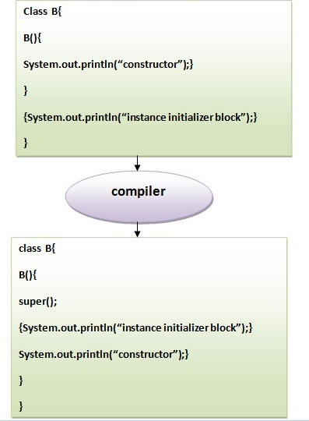
The java compiler copies the code of instance initializer block in every constructor.

Slide 137
final keyword:
final keyword:
1. Final variable
2. Final method
3. Final class
4. Is final method inherited ?
5. Blank final variable
6. Static blank final variable
7. Final parameter
8. Can you declare a final constructor

Slide 138
final keyword
The final keyword in java is used to restrict the user. The final keyword can be used in many context. Final can be:
variable
method
class
The final keyword can be applied with the variables, that have no value it is called blank final variable. It can be initialized in the constructor only. The blank final variable can be static also which will be initialized in the static block only. We will have detailed learning of these. Let's first learn the basics of final keyword.

Slide 139
final variable
1) final variable:
If you make any variable as final, you cannot change the value of final variable(It will be constant).
Example of final variable
There is a final variable speedlimit, we are going to change the value of this variable, but It can't be changed because final variable once assigned a value can never be changed.
class Bike{ final int speedlimit=90;//final variable
void run(){ speedlimit=400; } public static void main(String args[]){ Bike obj=new Bike(); obj.run(); }} Output:Compile Time Error

Slide 140
final method
2) final method
If you make any method as final, you cannot override it.
Example of final method
class Bike { final void run(){System.out.println("running");}}
class Honda extends Bike{ void run(){System.out.println("running safely with 100kmph");}
public static void main(String args[])
{
Honda honda= new Honda(); honda.run(); }}
Output:Compile Time Error

Slide 141
final class
3) final class:
If you make any class as final, you cannot extend it.
Example of final class
final class Bike{}
class Honda extends Bike{
void run(){System.out.println("running safely with 100kmph");}
public static void main(String args[]){
Honda honda= new Honda(); honda.run();
} }
Output: Compile Time Error

Slide 142
Is final method inherited?
Is final method inherited?
Ans)Yes, final method is inherited but you cannot override it.
For Example:
class Bike
{
final void run(){System.out.println("running...");}}
class Honda extends Bike
{ public static void main(String args[])
{ new Honda().run(); }} Output:running...

Slide 143
What is blank final variable?
What is blank final variable?
A final variable that is not initalized at the time of declaration is known as blank final variable. If you want to create a variable that is initialized at the time of creating object and once initialized may not be changed, it is useful. For example PAN CARD number of an employee. It can be initialized only in constuctor.
Can we intialize blank final variable?
Yes, but only in constructor.
class Bike { final int speedlimit;//blank final variable Bike(){ speedlimit=70; System.out.println(speedlimit); }
public Static void main(String args[])
{ new Bike(); } } Output:70

Slide 144
static blank final variable
static blank final variable
A static final variable that is not initalized at the time of declaration is known as static blank final variable. It can be initialized only in static block.
Example of static blank final variable
class A { static final int data; //static blank final variable
static{ data=50;}
public Static void main(String args[])
{
System.out.println(A.data);
}}

Slide 145
What is final parameter?
What is final parameter?
If you declare any parameter as final, you cannot change the value of it.
class Bike {
int cube(final int n){ n=n+2; //can't be changed as n is final n*n*n;
}
public Static void main(String args[]){ Bike b=new Bike(); b.cube(5); }} Output: Compile Time Error
Can we declare a constructor as final?
No, because constructor is never inherited.

Slide 146
Abstract class in Java
Abstraction
Abstraction is a process of hiding the implementation details and showing only functionality to the user. Another way, it shows only important things to the user and hides the internal details.
Abstraction lets you focus on what the object does instead of how it does it.
Ways to achieve Abstaction
There are two ways to achieve abstraction in java
Abstract class (0 to 100%)
Interface (100%)

Slide 147
Abstract class
Abstract class
A class that is declared as abstract is known as abstract class.It needs to be extended and its method implemented. It cannot be instantiated.
Syntax to declare the abstract class
abstract class <class_name>{} abstract method
A method that is declared as abstract and does not have implementation is known as abstract method.
Syntax to define the abstract method
abstract return_type <method_name>();//no braces{}

Slide 148
Example of abstract class
Example of abstract class that have abstract method
In this example, Bike the abstract class that contains only one abstract method run. It implementation is provided by the Honda class.
abstract class Bike { abstract void run(); }
class Honda extends Bike{ void run(){ System.out.println("running safely..");}
public static void main(String args[])
{ Bike obj = new Honda(); obj.run(); }}
Output:running safely..

Slide 149
Real scenario of abstract class
In this example, Shape is the abstract class, its implementation is provided by the Rectangle and Circle classes. Mostly, we don't know about the implementation class (i.e. hidden to the end user) and object of the implementation class is provided by the factory method.
A factory method is the method that returns the instance of the class
In this example, if you create the instance of Rectangle class, draw method of Rectangle class will be invoked.
abstract class Shape{
abstract void draw();
}

Slide 150
Real scenario of abstract class
class Rectangle extends Shape{
void draw(){System.out.println("drawing rectangle");}
}
class Circle extends Shape{
void draw(){System.out.println("drawing circle");}
}
class Test{ public static void main(String args[]){
Shape s=new Circle();
//In real scenario, Object is provided through factory method
s.draw(); } } Output:drawing circle

Slide 151
Example of abstract class that have method body
Abstract class having constructor, data member, methods etc.
Note: An abstract class can have data member,abstract method,method body, constructor and even main() method.
//example of abstract class that have method body
abstract class Bike{
abstract void run();
void changeGear(){System.out.println("gear changed");}
}
class Honda extends Bike{ void run(){System.out.println("running safely..");}
public static void main(String args[]){ Bike obj = new Honda(); obj.run();
obj.changeGear(); } } Output:running safely..

Slide 152
Example of abstract class having constructor, field and method
abstract class Bike
{
int limit=30; Bike() {System.out.println("constructor is invoked");}
void getDetails(){System.out.println("it has two wheels");} abstract void run(); }
class Honda extends Bike{
void run(){System.out.println("running safely..");}
public static void main(String args[]){ Bike obj = new Honda(); obj.run();
obj.getDetails(); System.out.println(obj.limit); } }
Output:constructor is invoked
running safely..
it has two wheels 30

Slide 153
Rules for abstract class
Rule: If there is any abstract method in a class, that class must be abstract.
class Bike{ abstract void run(); } Output:compile time error
Rule: If you are extending any abstact class that have abstract method, you must either provide the implementation of the method or make this class abstract.
Another real scenario of abstract class
The abstract class can also be used to provide some implementation of the interface. In such case, the end user may not be forced to override all the methods of the interface.

Slide 154
Interface implementation using abstract
The abstract class can also be used to provide some implementation of the interface. In such case, the end user may not be forced to override all the methods of the interface.
Note: If you are beginner to java, learn interface first and skip this example.
interface A{
void a(); void b(); void c(); void d(); }
abstract class B implements A{
public void c(){System.out.println("I am C");}
}

Slide 155
Interface implementation using abstract
class M extends B
{
public void a(){System.out.println("I am a");}
public void b(){System.out.println("I am b");}
public void d(){System.out.println("I am d");}
}
class Test{
public static void main(String args[]){
A a=new M(); a.a(); a.b(); a.c(); a.d(); }}
Output: I am a I am b I am c I am d

Slide 156
interface
Interface
What do you mean Interface
Example of Interface
Multiple inheritance by Interface
Why multiple inheritance is supported in Interface while it is not supported in case of class.
Marker Interface
Nested Interface

Slide 157
interface
An interface is a blueprint of a class. It has static constants and abstract methods.
The interface is a mechanism to achieve abstraction in java. There can be only abstract methods in the interface. It is used to achieve fully abstraction and multiple inheritance in Java.
Why use Interface?
There are mainly three reasons to use interface. They are given below.
It is used to achieve fully abstraction.
By interface, we can support the functionality of multiple inheritance.
It can be used to achieve loose coupling.

Slide 158
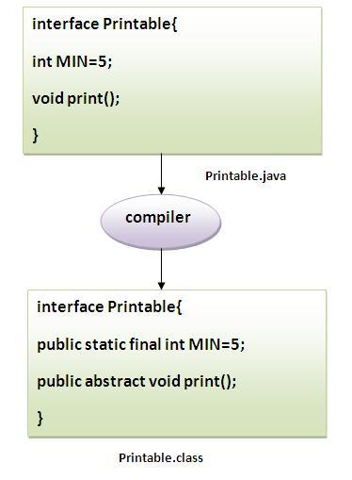
The java compiler converts methods of interface as public and abstract, data members as public, final and static by default

Slide 159
Simple example of Interface
In this exmple, Printable interface have only one method, its implemenation is provided in the A class.
interface printable
{ void print(); }
class A implements printable{
public void print(){System.out.println("Hello");}
public static void main(String args[]){ A obj = new A(); obj.print();
} }
Output:Hello

Slide 160
Multiple inheritance by interface
A class cannot extend two classes but it can implement two interfaces. For example:
interface printable{ void print(); }
interface Showable{ void show(); }
class A implements printable,Showable{
public void print(){System.out.println("Hello");}
public void show(){System.out.println("Welcome");}
public static void main(String args[]){ A obj = new A(); obj.print(); obj.show(); } }
Output: Hello Welcome
Multiple inheritance is not supported in case of class but it is supported in case of interface, why? Ans - multiple inheritance is not supported in case of class. But it is supported in case of interface because there is no ambiguity as implmentation is provided by the implementation class.

Slide 161
interface
interface Printable{ void print(); }
interface Showable{ void print(); }
class A implements Printable,Showable{
public void print(){System.out.println("Hello");}
public static void main(String args[]){ A obj = new A(); obj.print(); } }
Output:Hello
As you can see in the above example, Printable and Showable interface have same methods but its implementation is provided by class A, so there is no ambiguity.

Slide 162
A class implements interface but One interface extends another interface .
interface Printable{ void print(); }
interface Showable extends Printable{ void show(); }
class A implements Showable{
public void print(){System.out.println("Hello");}
public void show(){System.out.println("Welcome");}
public static void main(String args[]){
A obj = new A();
obj.print();
obj.show();
} } Output:Hello
Welcome

Slide 163
What is marker or tagged interface ?
What is marker or tagged interface ?
An interface that have no member is known as marker or tagged interface. For example: Serializable, Cloneable, Remote etc. They are used to provide some essential information to the JVM so that JVM may perform some useful operation.
// How Serializable interface is written?
public interface Serializable{ }
Note: An interface can have another interface i.e. known as nested interface. We will learn it in detail in the nested classes chapter. For example:
interface printable{ void print(); interface MessagePrintable{ void msg();
} }

Slide 164
Runtime Polymorphism
1. Runtime Polymorphism
2. Upcasting
3. Example of Runtime Polymorphism
4. Runtime Polymorphism with data members
Runtime polymorphism or dynamic method dispatch is a process in which a call to an overridden method is resolved at runtime rather than at compile-time.
In this process, an overridden method is called through the reference variable of a superclass. The determination of the method to be called is based on the object being referred to by the reference variable.

Slide 165
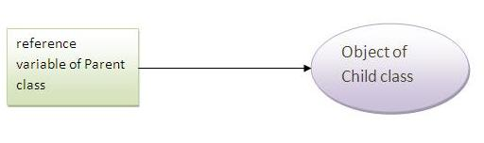
Upcasting
Upcasting
When reference variable of Parent class refers to the object of Child class, it is known as upcasting.
class A{}
class B extends A{}
A a=new B();//upcasting

Slide 166
Example of Runtime Polymorphism
In this example, we are creating two classes Bike and Splendar. Splendar class extends Bike class and overrides its run() method. We are calling the run method by the reference variable of Parent class. Since it refers to the subclass object and subclass method overrides the Parent class method, subclass method is invoked at runtime. Since it is determined by the compiler, which method will be invoked at runtime, so it is known as runtime polymorphism.
class Bike{ void run(){System.out.println("running");} }
class Splender extends Bike{ void run(){
System.out.println("running safely with 60km");}
public static void main(String args[]){ Bike b = new Splender();//upcasting b.run(); } }
Output: running safely with 60km.

Slide 167
Runtime Polymorphism with data member
Runtime Polymorphism with data member
Method is overriden not the datamembers, so runtime polymorphism can't be achieved by data members.
In the example given below, both the classes have a datamember speedlimit, we are accessing the datamember by the reference variable of Parent class which refers to the subclass object. Since we are accessing the datamember which is not overridden, hence it will access the datamember of Parent class always.

Slide 168
Runtime polymorphism can't be achieved by data members
Rule: Runtime polymorphism can't be achieved by data members.
class Bike{
int speedlimit=90; }
class Honda extends Bike{ int speedlimit=150;
public static void main(String args[]) { Bike obj=new Honda(); System.out.println(obj.speedlimit);//90 }}
Output: 90

Slide 169
Static Binding and Dynamic Binding
Binding:
Connecting a method call to a method body is called binding.It can be of two types:
static binding(early binding).
dynamic binding(late binding).
About type:
1) variables have a type
For example: int data=30; //Here data variable is a type of int.
2) References have a type
class Dog { public static void main(String args[]){ Dog d1;//Here d1 is a type of Dog }}

Slide 170
Static Binding and Dynamic Binding
3) Objects have a type
An object is an instance of particular java class,but it is also an instance of its superclass.
class Animal{}
class Dog extends Animal
{ public static void main(String args[]){
Dog d1=new Dog(); }} //Here d1 is an instance of Dog class, but it is also an instance of Animal.

Slide 171
Static Binding
static binding
When type of the object is determined at compiled time(by the compiler), it is known as static binding.
If there is any private,final or static method in a class,it is static binding.
Example of static binding:
class Dog{
private void eat(){System.out.println("dog is eating...");}
public static void main(String args[]){
Dog d1=new Dog(); d1.eat(); } }

Slide 172
Dynamic Binding
Dynamic binding:
When type of the object is determined at run-time, it is known as dynamic binding.
Example of dynamic binding:
class Animal{
void eat(){System.out.println("animal is eating...");} }
class Dog extends Animal{
void eat(){System.out.println("dog is eating...");}
public static void main(String args[]){
Animal a=new Dog(); a.eat(); } } Output:dog is eating...

Slide 173
instanceof operator
1. The instanceof operator
2. Example of instanceof operator
3. Applying the instanceof operator with a variable the have null value
4. Downcasting with instanceof operator
5. Downcasting without instanceof operator
The instanceof operator is used to test whether the object is an instance of the specified type (class or subclass or interface).
The instanceof operator is also known as type comparison operator because it compares the instance with type. It returns either true or false. If we apply the instanceof operator with any variable that have null value, it returns false.

Slide 174
Simple example of instanceof operator
simple example of instance operator where it tests the current class.
class Simple{
public static void main(String args[]){
Simple s=new Simple();
System.out.println(s instanceof Simple);//true
}
}
Output: true

Slide 175
instanceof operator with a variable that have null value
instanceof operator with a variable that have null value
If we apply instanceof operator with a variable that have null value, it ruturns false. Let's see the example given below where we apply instanceof operator with the variable that have null value.
class Dog{
public static void main(String args[]){
Dog d=null;
System.out.println(d instanceof Dog);//false
} }
Output:false

Slide 176
Downcasting with instanceof operator
When Subclass type refers to the object of Parent class, it is known as downcasting. If we perform it directly, compiler gives Compilation error. If you perform it by typecasting, ClassCastException is thrown at runtime. But if we use instanceof operator, downcasting is possible.
Dog d=new Animal();//Compilation error
If we perform downcasting by typecasting, ClassCastException is thrown at runtime.
Dog d=(Dog)new Animal();
//Compiles successfully but ClassCastException is thrown at runtime

Slide 177
downcasting with instanceof operator
Possibility of downcasting with instanceof operator
Let's see the example, where downcasting is possible by instanceof operator.
class Animal { }
class Dog extends Animal {
static void method(Animal a) {
if(a instanceof Dog){
Dog d=(Dog)a;//downcasting
System.out.println("ok downcasting performed");
} }
public static void main (String [] args) {
Animal a=new Dog(); Dog.method(a); } } Output:ok downcasting performed

Slide 178
Down casting without the use of instanceof operator
Down casting can also be performed without the use of instanceof operator as displayed in the following example:
class Animal { } class Dog extends Animal {
static void method(Animal a) {
Dog d=(Dog)a;//downcasting
System.out.println("ok downcasting performed"); }
public static void main (String [] args) {
Animal a=new Dog(); Dog.method(a); } }
Output:ok downcasting performed
Let's take closer look at this, actual object that is referred by a, is an object of Dog class. So if we downcast it, it is fine. But what will happen if we write:
Animal a=new Animal();Dog.method(a);

Slide 179
Package
Package
Example of package
3. Accessing package
4. By import packagename.*
5. By import packagename.classname
6. By fully qualified name
7. Subpackage

Slide 180
Package
A package is a group of similar types of classs, interfaces and sub-packages.
Package can be categorized in two form, built-in package and user-defined package. There are many built-in packages such as java, lang, awt, javax, swing, net, io, util, sql etc.
In this page, we will have the detailed learning of creating user-defined packages.
Advantage of Package
Package is used to categorize the classes and interfaces so that they can be easily maintained.
Package provids access protection & Package removes naming collision.

Slide 181
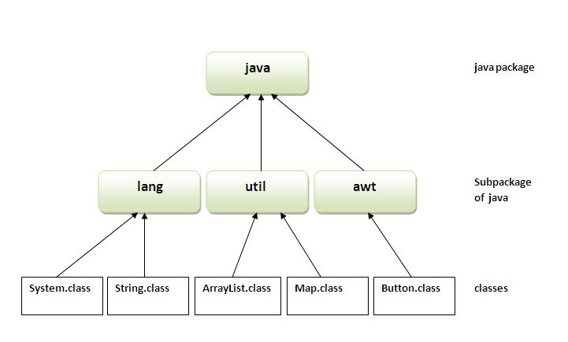
Package diagram

Slide 182
Example of Package
The keyword package is used to create a package.
//save as Simple.java package mypack;
public class Simple{
public static void main(String args[]){
System.out.println("Welcome to package");
} }
To Compile: javac -d . Simple.java To Run: java mypack.Simple
Output:Welcome to package
The -d is a switch that tells the compiler where to put the class file i.e. it represents destination. The . represents the current folder.

Slide 183
How to access package from another package?
There are three ways to access the package from outside the package.
import package.*;
import package.classname;
fully qualified name.
If you use package.* then all the classes and interfaces of this package will be accessible but not subpackages.
The import keyword is used to make the classes and interface of another package accessible to the current package.

Slide 184
Example of package that import the packagename.*
Example of package that import the packagename.*
//save by A.java
package pack;
public class A{
public void msg(){System.out.println("Hello");}
}
//save by B.java
package mypack;
import pack.*;
class B{ public static void main(String args[]){ A obj = new A(); obj.msg(); } }
Output:Hello

Slide 185
Example
  If you import package.classname then only declared class of this package will be accessible but not subpackages.
  Example of package by import package.classname
  //save by A.java
  package pack; public class A{ public void msg(){System.out.println("Hello");}
  }
  //save by B.java
  package mypack; import pack.A; class B{
  public static void main(String args[]){
  A obj = new A();
  obj.msg(); } } Output:Hello

Slide 186
Example of package by import fully qualified name
If you use fully qualified name then only declared class of this package will be accessible. Now there is no need to import. But you need to use fully qualified name every time when you are accessing the class or interface.
//save by A.java
package pack; public class A{ public void msg(){System.out.println("Hello");} }
//save by B.java
package mypack;
class B{
public static void main(String args[]){
pack.A obj = new pack.A();//using fully qualified name
obj.msg(); } } Output:Hello

Slide 187
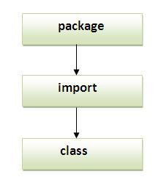
Sequence of the program must be package then import then class.
Subpackage - Package inside the package is called the subpackage.
It should be created to categorize the package further. Let's take an example, Sun Microsystem has definded a package named java that contains many classes like System, String, Reader, Writer, Socket etc. These classes represent a particular group e.g. Reader and Writer classes are for Input/Output operation, Socket and ServerSocket classes are for networking etc and so on. So, Sun has subcategorized the java package into subpackages such as lang, net, io etc. and put the Input/Output related classes in io package, Server and ServerSocket classes in net packages and so on.

Slide 188
Example of subpackage
package com.
javatpoint.core;
class Simple{ public static void main(String args[]){ System.out.println("Hello subpackage"); }}
To Compile: javac -d . Simple.java
To Run: java com.javatpoint.core.Simple
Output:Hello subpackageNote:
If you import a package, all the classes and interface of that package will be imported excluding the classes and interfaces of the subpackages. Hence, you need to import the subpackage as well.

Slide 189
Access Modifiers
1. private access modifier
2. Role of private constructor
3. default access modifier
4. protected access modifier
5. public access modifier
6. Applying access modifer with method overriding
There are two types of modifiers access modifier and non-access modifier. The access modifiers specifies accessibility (scope) of a datamember, method, constructor or class. There are 4 types of access modifiers:

Slide 190
Types of Access modifier
private
default
protected
public
There are many non-access modifiers such as static, abstract, synchronized, native, volatile, transient etc. Here, we will learn access modifiers.
1) private
The private access modifier is accessible only within class.

Slide 191
Example of private access modifier
In this example, we have created two classes A and Simple. A class contains private data member and private method. We are accessing these private members from outside the class, so there is compile time error.
class A{
private int data=40;
private void msg(){System.out.println("Hello java");} }
public class Simple{ public static void main(String args[]){
A obj=new A(); System.out.println(obj.data);//Compile Time Error
obj.msg();//Compile Time Error } }

Slide 192
Role of Private Constructor
If you make any class constructor private, you cannot create the instance of that class from outside the class. For example:
class A{
private A(){}//private constructor
void msg(){System.out.println("Hello java");} }
public class Simple{
public static void main(String args[]){
A obj=new A();//Compile Time Error
} }
Note: A class cannot be private or protected except nested class.

Slide 193
default
2) default
If you don't use any modifier, it is treated as default modifier bydefault. The default modifier is accessible only within package.
Example of default access modifier
In this example, we have created two packages pack and mypack. We are accessing the A class from outside its package, since A class is not public, so it cannot be accessed from outside the package.
//save by A.java
package pack;
class A{
void msg(){System.out.println("Hello");}

Slide 194
Example of default
//save by B.java
package mypack;
import pack.*;
class B{
public static void main(String args[]){
A obj = new A();//Compile Time Error
obj.msg();//Compile Time Error
} }
In the above example, the scope of class A and its method msg() is default so it cannot be accessed from outside the package.

Slide 195
Protected
3) protected
The protected access modifier is accessible within package and outside the package by only through inheritance. The protected access modifier can be applied on the data member, method and constructor. It can't be applied on the class.
Example of protected access modifier
In this example, we have created the two packages pack and mypack. The A class of pack package is public, so can be accessed from outside the package. But msg method of this package is declared as protected, so it can be accessed from outside the class only through inheritance.

Slide 196
Example of protected
//save by A.java
package pack; public class A{
protected void msg(){System.out.println("Hello");}
}
//save by B.java
package mypack;
import pack.*;
class B extends A{
public static void main(String args[]){
B obj = new B(); obj.msg(); } } Output:Hello

Slide 197
public
4) public
The public access modifier is accessible everywhere. It has the widest scope among all other modifiers.
Example of public access modifier
//save by A.java
package pack;
public class A{
public void msg(){System.out.println("Hello");}
} //save by B.java
package mypack;import pack.*; class B{ public static void main(String args[]){ A obj = new A(); obj.msg(); }} Output:Hello

Slide 198
Encapsulation
Encapsulation is a process of wrapping code and data together into a single unit. It is a way to achieve data hiding.
Simple example:
//save as Student.java
package mypack;
public class student{ private string name; public String getName(){
return name; }
public void setName(String name){ this.name=name } } package mypack;
class Test
public static void main(){ Student s=new Student(); s.setname("vijay");
System.out.println(s.getName()); } }

Slide 199
Object Class
The Object class is the super class of all the classes in java. The Object is beneficial if you want to refer any object whose type you don't know. Notice that parent class reference variable can refer the child class object, know as upcasting.
The Object class provides some common behaviours to all the objects such as object can be compared, object can be cloned, object can be notified etc.
Methods of Object class
The Object class provides many methods. They are as follows:
public final Class getClass() returns the Class class object of this object. The Class class can further be used to get the metadata of this class.
public int hashCode() returns the hashcode number for this object.
public boolean equals(Object obj) compares the given object to this object.

Slide 200
Object class Method
protected Object clone() throws CloneNotSupportedException creates and returns the exact copy (clone) of this object.
public String toString() returns the string representation of this object.
public final void notify() wakes up single thread, waiting on this object's monitor.
public final void notifyAll() wakes up all the threads, waiting on this object's monitor.
public final void wait(long timeout)throws InterruptedException causes the current thread to wait for the specified miliseconds, until another thread notifies (invokes notify() or notifyAll() method).
public final void wait(long timeout,int nanos)throws InterruptedExceptioncauses the current thread to wait for the specified miliseconds and nanoseconds, until another thread notifies (invokes notify() or notifyAll() method).
public final void wait()throws InterruptedException causes the current thread to wait, until another thread notifies (invokes notify() or notifyAll() method).
protected void finalize()throws Throwable is invoked by the garbage collector before object is being garbage collected.

Slide 201
clone() method (Object Cloning in Java)
The clone() method (Object Cloning in Java)
The object cloning is a way to create exact copy of an object. For this purpose, clone() method of Object class is used to clone an object.
The java.lang.Cloneable interface must be implemented by the class whose object clone we want to create. If we don't implement Cloneable interface, clone() method gives CloneNotSupportedException. The clone() method is defined in the Object class. Syntax of the clone() method is as follows:
protected Object clone() throws CloneNotSupportedException

Slide 202
Why use clone() method ?
The clone() saves the extra processing task for creating the exact copy of an object. If we perform it by using the new keyword, it will take a lot of processing to be performed that is why we use object cloning.
Example of clone() method (Object cloning)
class Student implements Cloneable{
int rollno; String name;
Student(int rollno,String name){
this.rollno=rollno; this.name=name;
}
public Object clone()throws CloneNotSupportedException{
return super.clone(); }

Slide 203
Example of clone method
public static void main(String args[]){
try{ Student s1=new Student(101,"amit");
Student s2=(Student)s1.clone();
System.out.println(s1.rollno+" "+s1.name);
System.out.println(s2.rollno+" "+s2.name); }catch(CloneNotSupportedException c){}
} } Output:101 amit 101 amit
in the above example, both reference variables have the same value. Thus, the clone() copies the values of an object to another. So we don't need to write explicit code to copy the value of an object to another. If we create another object by new keyword and assign the values of another object to this one, it will require a lot of processing on this object. So to save the extra processing task we use clone() method.

Slide 204
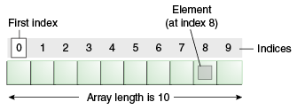
Array in Java
Array in Java
Normally, array is a collection of similar type of elements that have contigious memory location.
In java, array is an object the contains elements of similar data type. It is a data structure where we store similar elements. We can store only fixed elements in an array.
Array is index based, first element of the array is stored at 0 index.

Slide 205
Advantage of Array
Advantage of Array
Code Optimization: It makes the code optimized, we can retrive or sort the data easily.
Random access: We can get any data located at any index position.
Disadvantage of Array
Size Limit: We can store only fixed size of elements in the array. It doesn't grow its size at runtime. To solve this problem, collection framework is used in java.
Types of Array
Two types of array. - Single Dimensional Array & Multidimensional Array
Single Dimensional Array
Syntax to Declare an Array in java
dataType[] arrayRefVar; (or) dataType []arrayRefVar; (or) dataType arrayRefVar[];

Slide 206
Instantiation of an Array in java
arrayRefVar=new datatype[size];
Example of single dimensional java array
Let's see the simple example of java array, where we are going to declare, instantiate, initialize and traverse an array.
class B{
public static void main(String args[]){
int a[]=new int[5]; //declaration and instantiation
a[0]=10;//initialization a[1]=20; a[2]=70; a[3]=40; a[4]=50;
//printing array
for(int i=0;i<a.length;i++)//length is the property of array
System.out.println(a[i]); }} Output: 10 20 70 40 50

Slide 207
Declaration, Instantiation and Initialization of Java Array
We can declare, instantiate and initialize the java array together by:
int a[]={33,3,4,5};//declaration, instantiation and initialization
Let's see the simple example to print this array.
class B{
public static void main(String args[]){
int a[]={33,3,4,5};//declaration, instantiation and initialization
//printing array
for(int i=0;i<a.length;i++)//length is the property of array
System.out.println(a[i]); }}
Output: 33 3 4 5

Slide 208
Passing Java Array in the method
We can pass the array in the method so that we can reuse the same logic on any array. Let's see the simple example to get minimum number of an array using method.
class B{
static void min(int arr[]){
int min=arr[0];
for(int i=1;i<arr.length;i++) if(min>arr[i]) min=arr[i]; System.out.println(min);
} public static void main(String args[]){
int a[]={33,3,4,5};
min(a);//passing array in the method
}}
Output:3

Slide 209
Multidimensional array
Data is stored in row and column based index (also known as matrix form).
Syntax to Declare Multidimensional Array in java
dataType[][] arrayRefVar; (or) dataType [][]arrayRefVar; (or)
dataType arrayRefVar[][]; (or) dataType []arrayRefVar[];
Example to initantiate Multidimensional Array in java
int[][] arr=new int[3][3];//3 row and 3 column
Example to initialize Multidimensional Array in java
arr[0][0]=1; arr[0][1]=2; arr[0][2]=3; arr[1][0]=4; arr[1][1]=5;
arr[1][2]=6; arr[2][0]=7; arr[2][1]=8; arr[2][2]=9;

Slide 210
Example of Multidimensional java array
Example 2Dimensional array.
class B{
public static void main(String args[]){
//declaring and initializing 2D array
int arr[][]={{1,2,3},{2,4,5},{4,4,5}};
//printing 2D array
for(int i=0;i<3;i++){
for(int j=0;j<3;j++){
System.out.print(arr[i][j]+" "); } System.out.println(); } }}
Output:1 2 3
2 4 5
4 4 5

Slide 211
What is class name of java array?
In java, array is an object. For array object, an proxy class is created whose name can be obtained by getClass().getName() method on the object.
class B{
public static void main(String args[]){
int arr[]={4,4,5};
Class c=arr.getClass();
String name=c.getName(); System.out.println(name); } }}
Output:[I Copying an array
We can copy an array to another by the arraycopy method of System class.
Syntax of arraycopy method
public static void arraycopy( Object src, int srcPos,Object dest, int destPos, int length )

Slide 212
Example of arraycopy method
Example of arraycopy method
class ArrayCopyDemo {
public static void main(String[] args) {
char[] copyFrom = { 'd', 'e', 'c', 'a', 'f', 'f', 'e',
'i', 'n', 'a', 't', 'e', 'd' };
char[] copyTo = new char[7];
System.arraycopy(copyFrom, 2, copyTo, 0, 7);
System.out.println(new String(copyTo));
}
}
Output:caffein

Slide 213
Call by Value in Java
There is only call by value in java, not call by reference. If we call a method passing a value, it is known as call by value. The changes being done in the called method, is not affected in the calling method.
In case of call by value original value is not changed. Let's take a simple example:
class Operation{
int data=50; void change(int data){ data=data+100;//changes will be in the local variable only }
public static void main(String args[]){
Operation op=new Operation();
System.out.println("before change "+op.data); op.change(500);
System.out.println("after change "+op.data); } }
Output: before change 50 after change 50

Slide 214
Another Example of call by value in java
In case of call by reference original value is changed if we made changes in the called method. If we pass object in place of any primitive value, original value will be changed. In this example we are passing object as a value.
class Operation2{
int data=50;
void change(Operation op){
op.data=op.data+100;//changes will be in the instance variable }
public static void main(String args[]){ Operation2 op=new Operation2();
System.out.println("before change "+op.data);
op.change(op);//passing object
System.out.println("after change "+op.data); } } Output:before change 50 after change 150

Slide 215
What we will learn in OOPs Concepts ?
Advantage of OOPs
Naming Convention Object and class Method overloading
Constructor static keyword this keyword with 6 usage
Inheritance Aggregation Method Overriding
Covariant Return Type super keyword Instance Initializer block
final keyword Abstract class Interface
Runtime Polymorphism Static Binding Dynamic Binding
Package Access Modifiers Encapsulation
Object Cloning Downcasting with instanceof operator

Slide 216
Questions ?
Feel Free to Contact: dhomase.ghanshyam@gmail.com

