Slide 1
STALE-ANSWER DETECTOR / TAVILY + BIFROST
Answers have an
expiration date.
2024-10-22
INSUFFICIENT EVIDENCE
ClaimClock checks claims in an old answer, one by one,
showing what changed, when, and the evidence behind it.
2026-11-10
REFUTED · Maintenance since 2024-10-22
CLAIMCLOCK / HACKCULTURE GLOBAL AI HACKATHON
01 / 09

Slide 2
01 / PROBLEM
The question matters more than the search result
“Is this answer still true today?”
TODAY’S FAILURE
CLAIMCLOCK RESPONSE
One paragraph can contain many claims
The newest page may not answer each one
Authorship and evidence dates differ
Find evidence for each claim
Verify quoted text against the source
Separate Supported, Refuted, and Insufficient evidence
Sources and dates stay visible. The score is a review priority, never a probability of truth.
CLAIMCLOCK / HACKCULTURE GLOBAL AI HACKATHON
02 / 09

Slide 3
02 / PRODUCT
Turn answers into claims you can review
1
2
3
4
Extract
Search
Judge
Plan
Split the answer into
verifiable claims
Tavily finds current
evidence candidates
Gemini checks the relation
and verifies the quote
Score, timeline, and
next review date
Users review the evidence. ClaimClock never edits an answer or sends messages automatically.
CLAIMCLOCK / HACKCULTURE GLOBAL AI HACKATHON
03 / 09

Slide 4
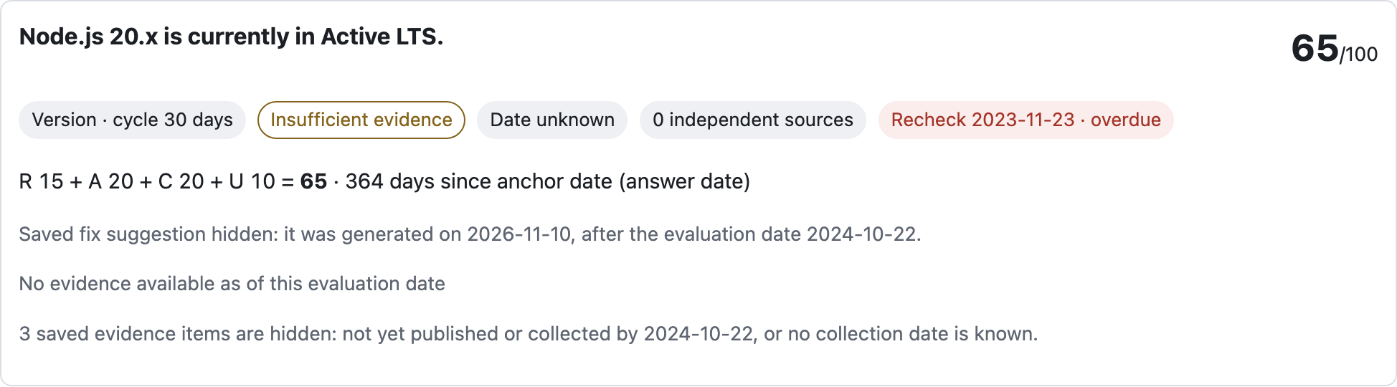
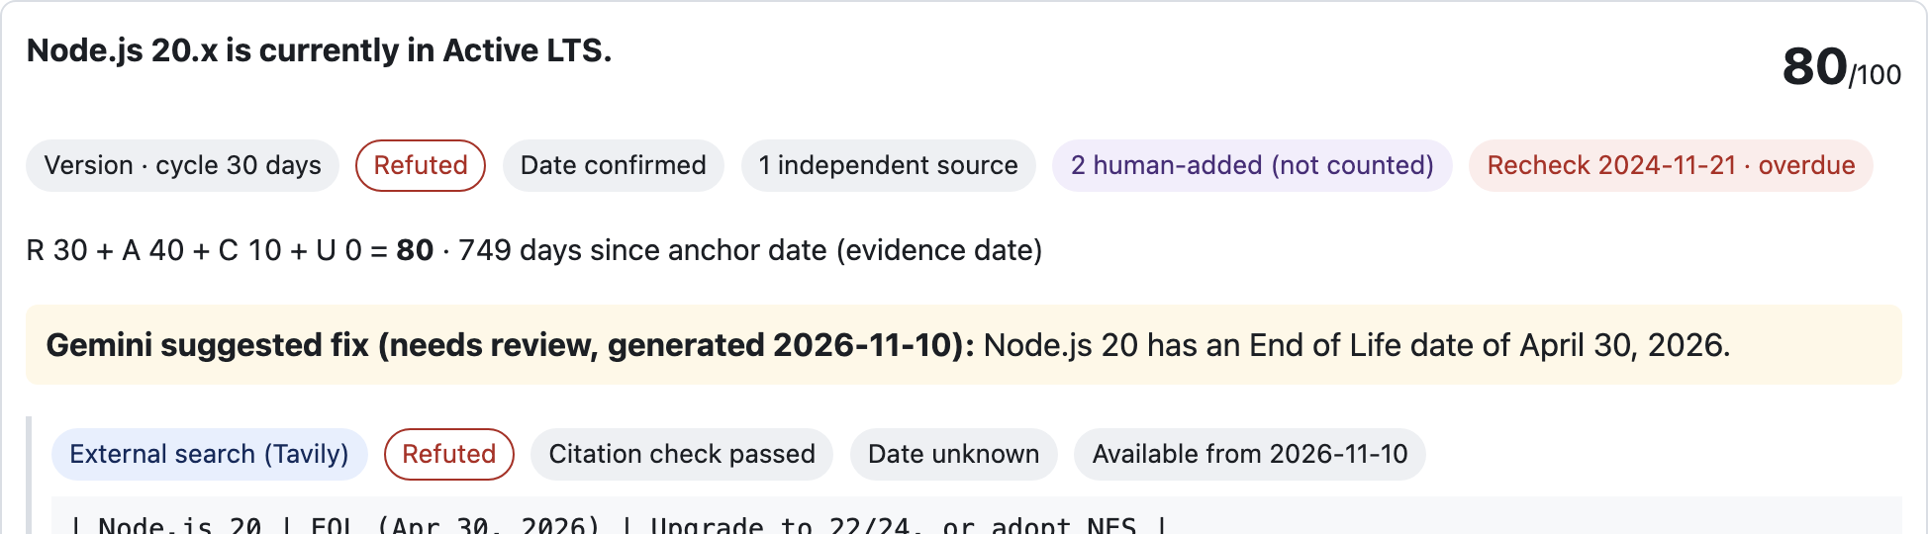
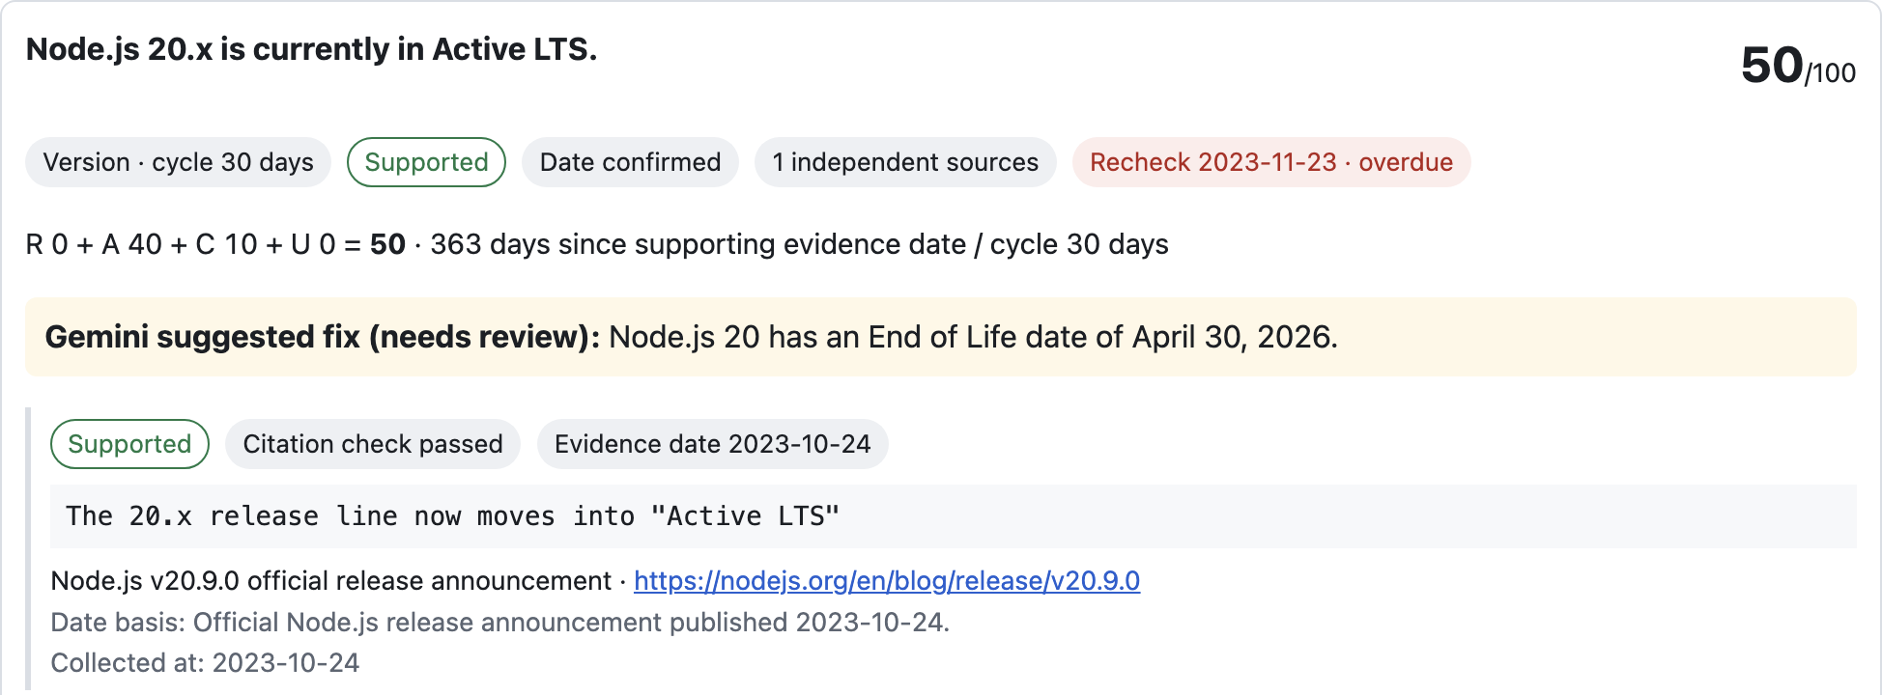
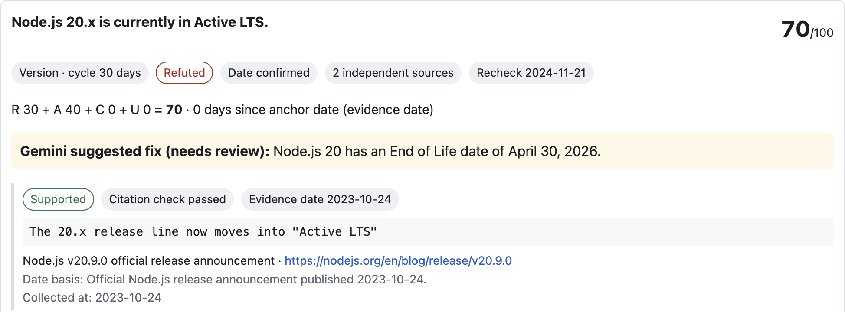
03 / KEY INTERACTION
A historical view must not borrow future evidence
2024-10-22 · HISTORICAL VIEW
2026-11-10 · CURRENT EVIDENCE
INSUFFICIENT EVIDENCE
REFUTED
Evidence collected later and the 2026 fix stay hidden.
1 independent source; 2 manually added references are not counted.
Event: 2024-10-22 · Collected: 2026-11-10. Later evidence is never backfilled into earlier views.
CLAIMCLOCK / HACKCULTURE GLOBAL AI HACKATHON
04 / 09

Slide 5
04 / ARCHITECTURE
Search and model calls stay separately logged
Tavily Search
Generated query · URLs · excerpts
ClaimClock
Node.js backend
Bifrost Gateway
Gemini · virtual key
Gemini
Claim classification
Virtual key only · direct-key bypass off · daily limits: 100 requests / 50,000 tokens · guard usage $0.0147 / $0.10 · cache savings not measured (no Valkey/Redis runtime available).
CLAIMCLOCK / HACKCULTURE GLOBAL AI HACKATHON
05 / 09

Slide 6
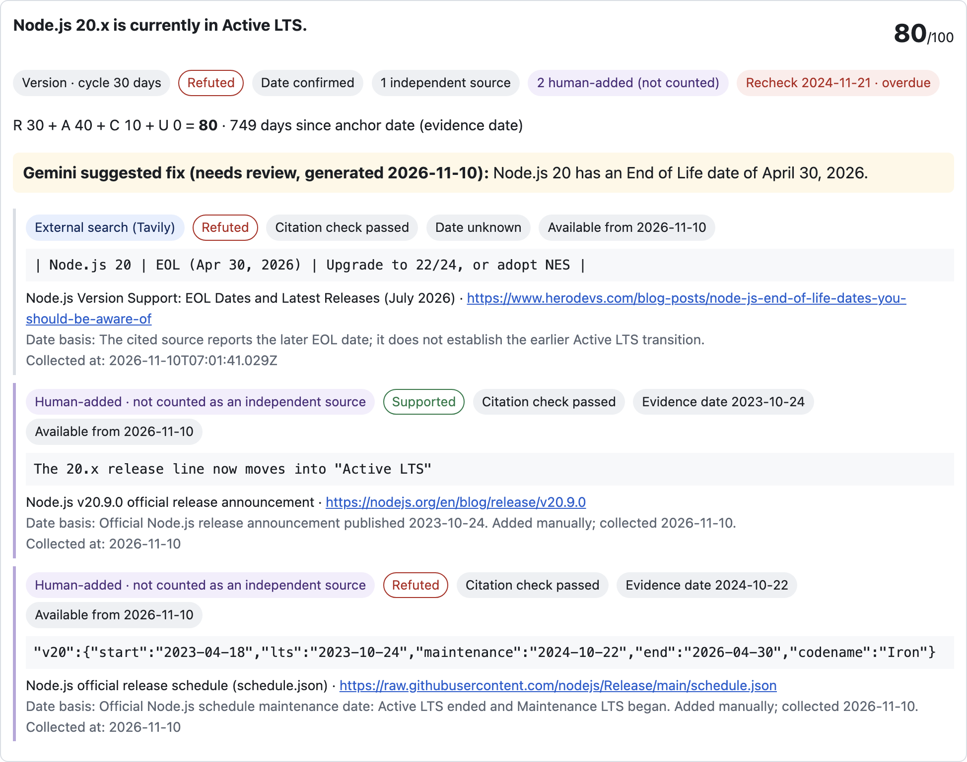
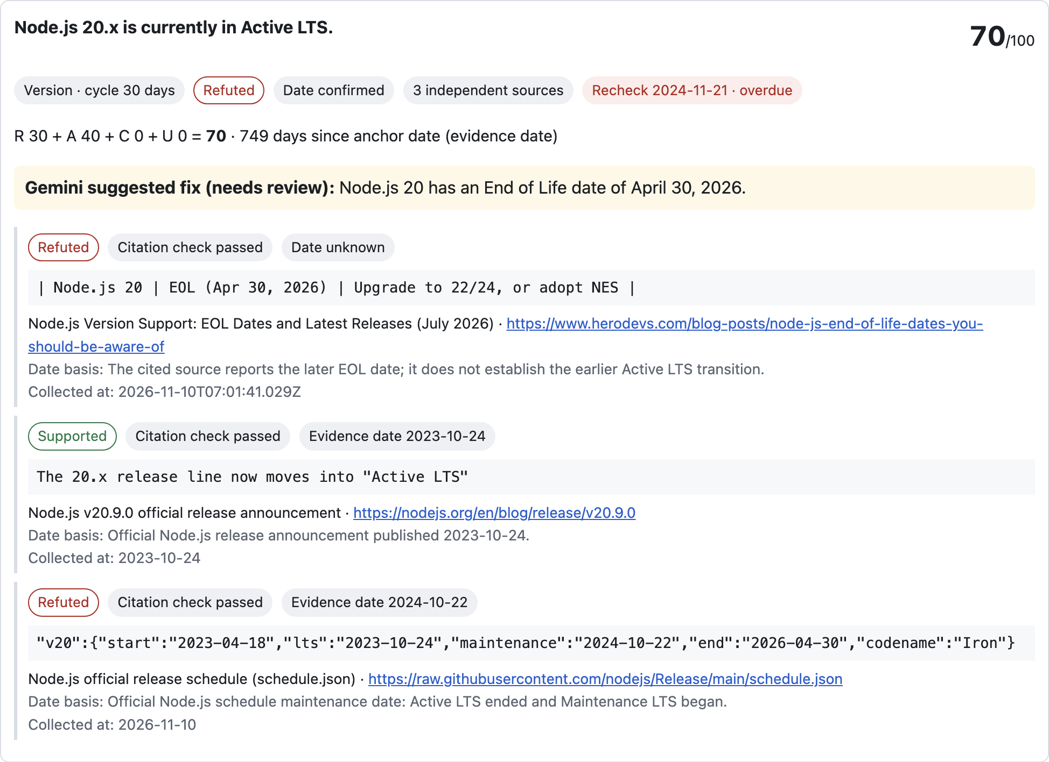
05 / EVIDENCE
Evidence origin and availability stay visible
PRE-REGISTERED EVALUATION · N=15
12/15 exact human-label agreement · 80%
Status shifts: 5/8 · stable codenames: 7/7
Tavily: 18 evaluation calls · 38/50 cumulative
Bifrost: 49 attempts · 37 successful responses
Evaluation usage: 25,161 tokens
Daily policy meter: 38/100 requests · 25,169/50k tokens
Guard meter: $0.0147 / $0.10
Queries passed unchanged; prompts stayed fixed.
2026-11-10 replay · 1 independent source · 2 manual refs excluded · no new API calls.
CLAIMCLOCK / HACKCULTURE GLOBAL AI HACKATHON
06 / 09

Slide 7
06 / SCORING
Scores prioritize what to review next
Relation risk
R
R + A + C + U
Evidence age
A
Relation risk + evidence age + source gap + date uncertainty
Maximum 100 · not a truth probability
Source corroboration gap
C
Date uncertainty
U
Only cited evidence available by the evaluation date counts. Event/publication and collection dates both matter; unknown dates are never backdated.
CLAIMCLOCK / HACKCULTURE GLOBAL AI HACKATHON
07 / 09

Slide 8
07 / SCOPE & LIMITATIONS
What this build demonstrates and what it does not
DEMONSTRATED
LIMITATIONS
• 15 pre-registered Node.js cases; 12/15 exact matches
• Status transitions: 5/8 · stable codenames: 7/7
• Gemini queries passed to Tavily unchanged
• Prompts stayed fixed; no post-evaluation tuning
• Unknown event dates remain unknown
• Small, Node.js-specific sample; no general accuracy claim
• Three status shifts were mislabeled; stale sources remain a risk
• Cache not measured; no Valkey/Redis runtime
• No autonomous edits or outbound actions
AI disclosure: Tavily search; Gemini claim extraction and judgment through Bifrost v2.5.0 virtual-key routing; Claude Code assisted development. Gold labels were frozen before calls.
CLAIMCLOCK / HACKCULTURE GLOBAL AI HACKATHON
08 / 09

Slide 9
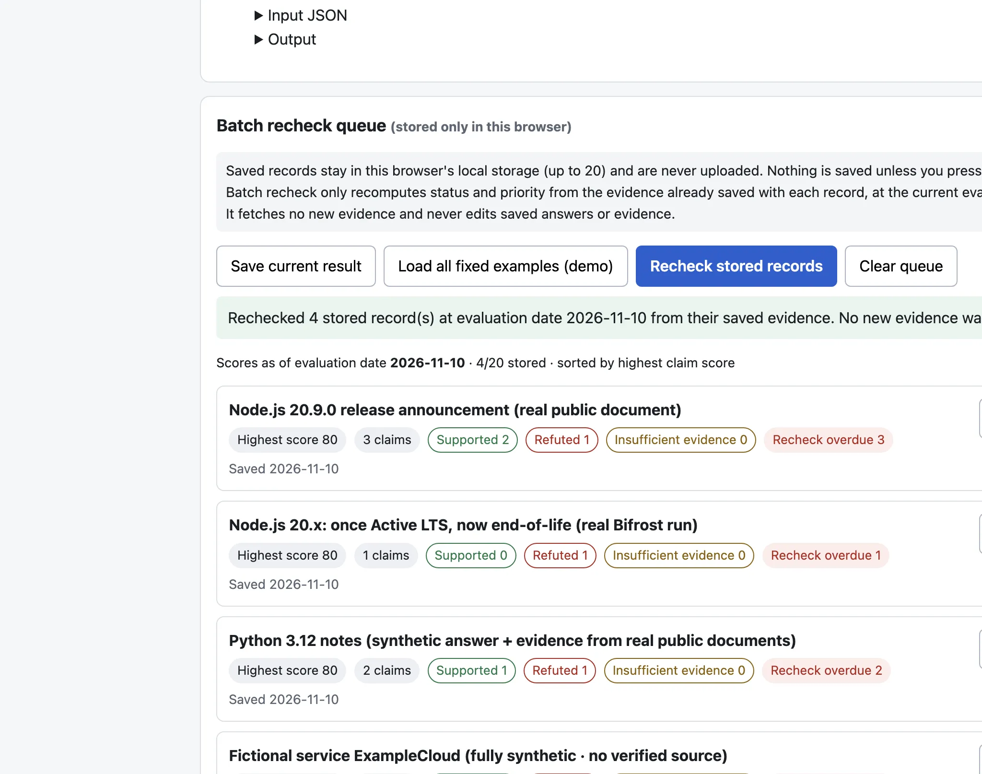
08 / AUDIENCE
Who should use ClaimClock?
DESIGNED FOR
Teams maintaining saved answers
RAG and AI-product operators
Support and documentation owners
Internal knowledge-library teams
WORKFLOW
Saved
answers
›
Priority
queue
›
Human
review
Team · solo
Repo · https://github.com/coo001/claimclock
Demo · https://coo001.github.io/claimclock/
Public demo is still commit ce6c2c5. The queue screenshot is from the local build and is not published yet.
Browser-local recheck of four saved records; no new evidence fetched.
CLAIMCLOCK / HACKCULTURE GLOBAL AI HACKATHON
09 / 09

