Slide 1
STALE-ANSWER DETECTOR / TAVILY + BIFROST
“Node.js 20.x is currently in Active LTS.”
Answers have an
expiration date.
2023-10-25
SUPPORTED
v20.9.0 announcement: 20.x moves into Active LTS (Wayback capture)
ClaimClock checks the claims in an old answer, one by one,
showing what changed, when, and the evidence behind it.
2024-10-22
REFUTED
Official schedule: Active LTS ends, Maintenance begins
2026-11-10
12/19
100 / 50k
No key
REFUTED
Tavily search + Gemini via Bifrost: EOL 2026-04-30
real answers in a small keyword-picked set held a claim that is no longer true
daily request and token cap on the Bifrost virtual key
needed for the public replay demo
CLAIMCLOCK / HACKCULTURE GLOBAL AI HACKATHON
01 / 11

Slide 2
01 / PROBLEM
The question matters more than the search result
“Is this answer still true today?”
TODAY’S FAILURE
CLAIMCLOCK RESPONSE
One paragraph can contain many claims
The newest page may not answer each one
Authorship and evidence dates differ
Find evidence for each claim
Verify quoted text against the source
Separate Supported, Refuted, and Insufficient evidence
Sources and dates stay visible. The score is a review priority, never a probability of truth.
CLAIMCLOCK / HACKCULTURE GLOBAL AI HACKATHON
02 / 11

Slide 3
02 / PRODUCT
Turn answers into claims you can review
1
2
3
4
Extract
Search
Judge
Plan
Split the answer into verifiable claims
Tavily finds current evidence candidates
Gemini checks the relation and verifies the quote
Score, timeline, and next review date
WHAT YOU GET FOR EACH CLAIM
Status
Evidence dates
Review plan
Supported, Refuted, or Insufficient evidence, with the cited quote
What was published and when it was collected, so a past view stays honest
Priority score and a recheck date you can export as an ICS file
Users review the evidence. ClaimClock never edits an answer or sends messages automatically.
CLAIMCLOCK / HACKCULTURE GLOBAL AI HACKATHON
03 / 11

Slide 4
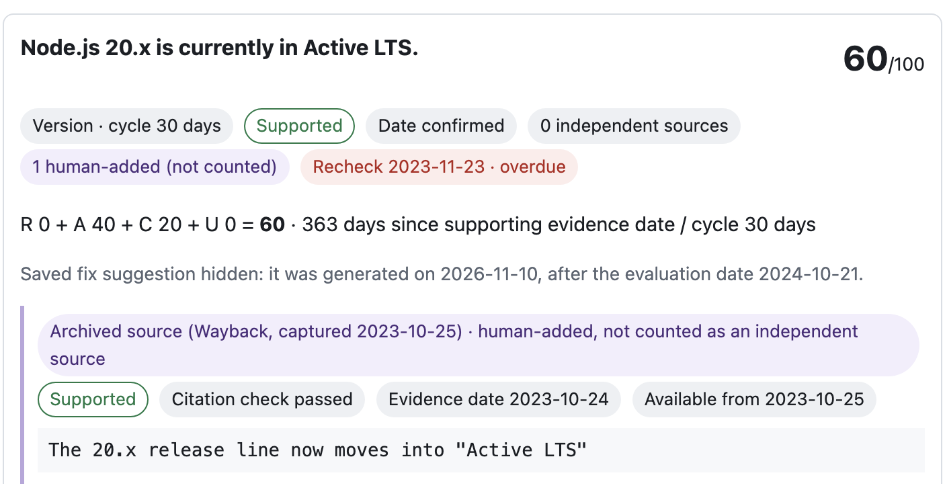
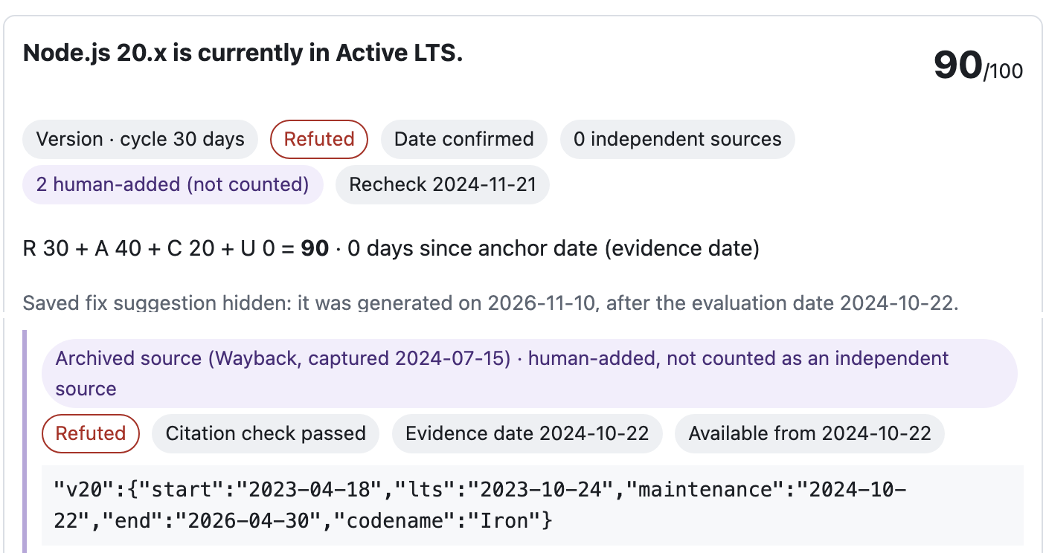
03 / KEY INTERACTION
A past view must not borrow future evidence
2024-10-21 · SUPPORTED
2024-10-22 · REFUTED
Only the Wayback capture of the v20.9.0 announcement is available.
Schedule capture of 2024-07-15 takes effect on 2024-10-22.
Each evidence item is available only from the later of its event date and its collection date. The 2026 search result and the 2026 fix stay hidden in both views. Images are excerpts of the app.
CLAIMCLOCK / HACKCULTURE GLOBAL AI HACKATHON
04 / 11

Slide 5
04 / ARCHITECTURE
Search and model calls stay separately logged
Tavily Search
Run record
Generated query · URLs · excerpts
Queries, URLs, requests, and token usage saved as JSON
ClaimClock
Node.js backend · claim extraction, date rules, scoring
Bifrost Gateway
Gemini
Virtual key · limits · request log
Claim extraction, judgment, and rewrite
Virtual key: N=15/N=6 evaluations, the corpus run and fresh live runs (Deno 2.0, stale-claims run) · Python example: direct-key mode · daily limits 100 requests / 50,000 tokens · guard $0.0147 / $0.10 · cache not measured.
CLAIMCLOCK / HACKCULTURE GLOBAL AI HACKATHON
05 / 11

Slide 6
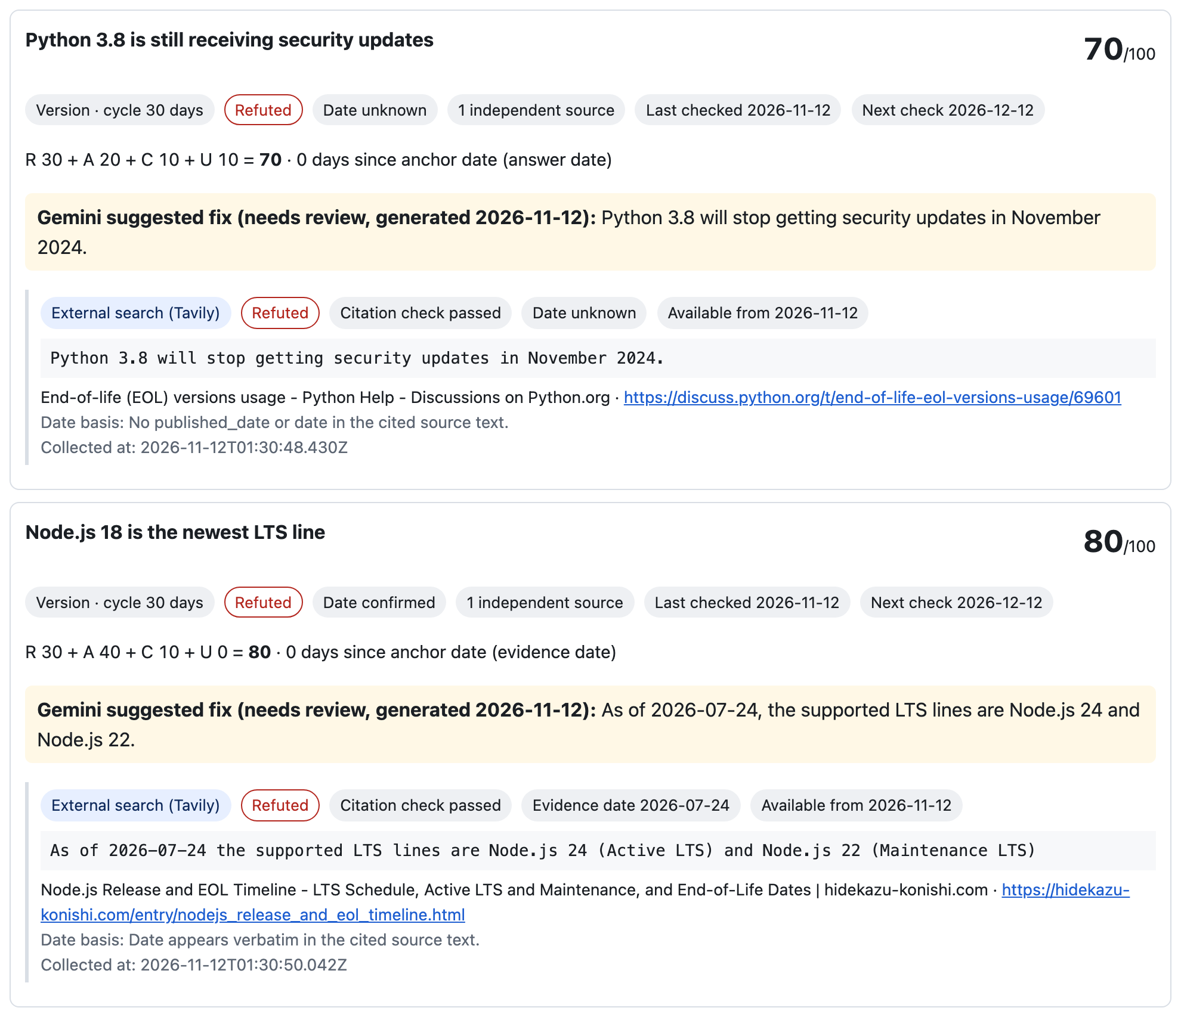
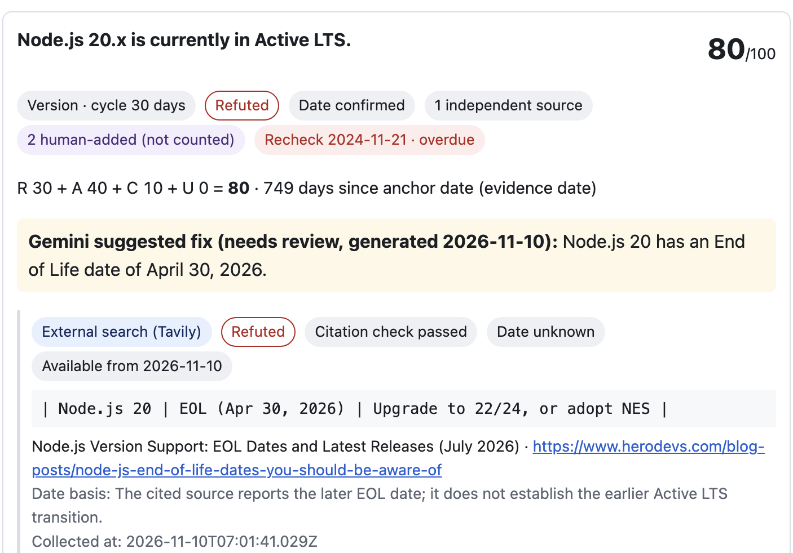
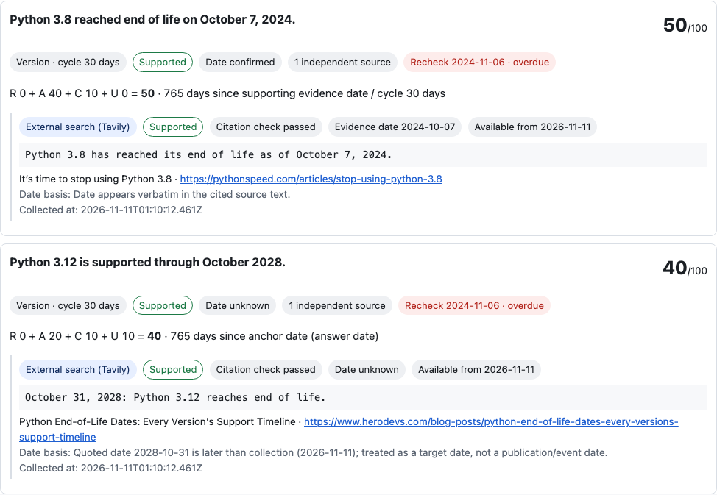
05 / EVIDENCE
Evidence origin and availability stay visible
PRE-REGISTERED EVALUATION · N=15
12/15
exact human-label
agreement · 80%
5/8
7/7
status shifts
stable codenames
Tavily
18 N=15 eval calls · 43/50 known cumulative
Bifrost
49 attempts · 37 successful responses
Usage
25,161 tokens in the evaluation
Daily meter
38/100 requests · 25,169/50k tokens
Guard meter
$0.0147 / $0.10
Live run on 2026-11-12, answer dated 2023-06-01: two claims Refuted. Model verdicts from third-party pages, not verified ground truth. Official check (PEP 569, Node.js schedule.json): both verdicts agree, both suggested fixes are inaccurate.
Queries passed unchanged. Run with judge prompt 1.
CLAIMCLOCK / HACKCULTURE GLOBAL AI HACKATHON
06 / 11

Slide 7
06 / REAL ANSWERS
Stale claims are easy to find in real answers
MEASURED · 19 REAL ANSWERS FROM 2023–2024
HOW TO READ THIS
• 12 of 19 contain a statement that is no longer true (9 changed status, 3 expired relative dates)
• ClaimClock marked a claim Refuted in 8 of those 12, and in 0 of the 7 still-valid answers
• Ranked by score, the top 12 hold 10 of the 12 stale answers
• Skipping the 7 all-Supported answers saves 7 of 19 reads and misses 1 stale answer
• Keyword-selected, enriched set: 63% is not a rate for Stack Overflow or for answers in general
• Labels: AI-assisted comparison with primary sources; no independent annotator
• Search was supplied from stored primary-source excerpts (0 Tavily calls); retrieval not tested
• Judge prompt was adjusted on this same set (first prompt flagged 2 of 12); not held-out
• Counts of answers, not timed reviewer effort
Method: six keyword queries to the public Stack Exchange API → 153 answers → fixed regex → 25 read → 6 excluded, 19 labeled against stored primary-source excerpts. Evaluation date 2026-11-12. Data and both runs: public/corpus-stale-v1*.json; details in the README.
CLAIMCLOCK / HACKCULTURE GLOBAL AI HACKATHON
07 / 11

Slide 8
07 / SCORING
Scores prioritize what to review next
R + A + C + U
EXAMPLE · NODE.JS 20 CLAIM ON 2026-11-10 · 80 / 100
R
Relation risk (refuted)
30 / 30
Relation risk + evidence age + source gap + date uncertainty.
Maximum 100.
A
Evidence age
40 / 40
A review priority, not a probability of truth.
C
Source gap (1 of 2 sources)
10 / 20
U
Date uncertainty (date known)
0 / 10
Only cited evidence available by the evaluation date counts. Event/publication and collection dates both matter; unknown dates are never backdated.
CLAIMCLOCK / HACKCULTURE GLOBAL AI HACKATHON
08 / 11

Slide 9
08 / SCOPE & LIMITATIONS
What this build demonstrates and what it does not
DEMONSTRATED
LIMITATIONS
• 15 pre-registered Node.js claims; 12/15 exact matches (judge prompt 1)
• 5/8 status shifts matched; stable codenames matched 7/7
• Live run: two stale claims refuted from third-party sources; official schedules agree, fixes inaccurate
• 19 real answers: 8 of 12 stale ones flagged, 0 of 7 valid ones flagged
• Unknown event dates remain unknown
• Small samples; no general accuracy, stale-rate or time-saved claim
• Corpus: keyword-selected, no independent labels, no live search, prompt adjusted on it
• Three of eight status shifts were mislabeled; third-party sources remain a risk
• Cache not measured; no autonomous edits or outbound actions
AI disclosure: Tavily search; Gemini via Bifrost v2.5.0 (virtual key for the N=15/N=6 evaluations, the corpus run and fresh live runs such as Deno 2.0 and the stale-claims run; direct key for the Python example). AI coding agents assisted development, including corpus collection and labeling. N=15 gold labels were frozen before calls.
CLAIMCLOCK / HACKCULTURE GLOBAL AI HACKATHON
09 / 11

Slide 10
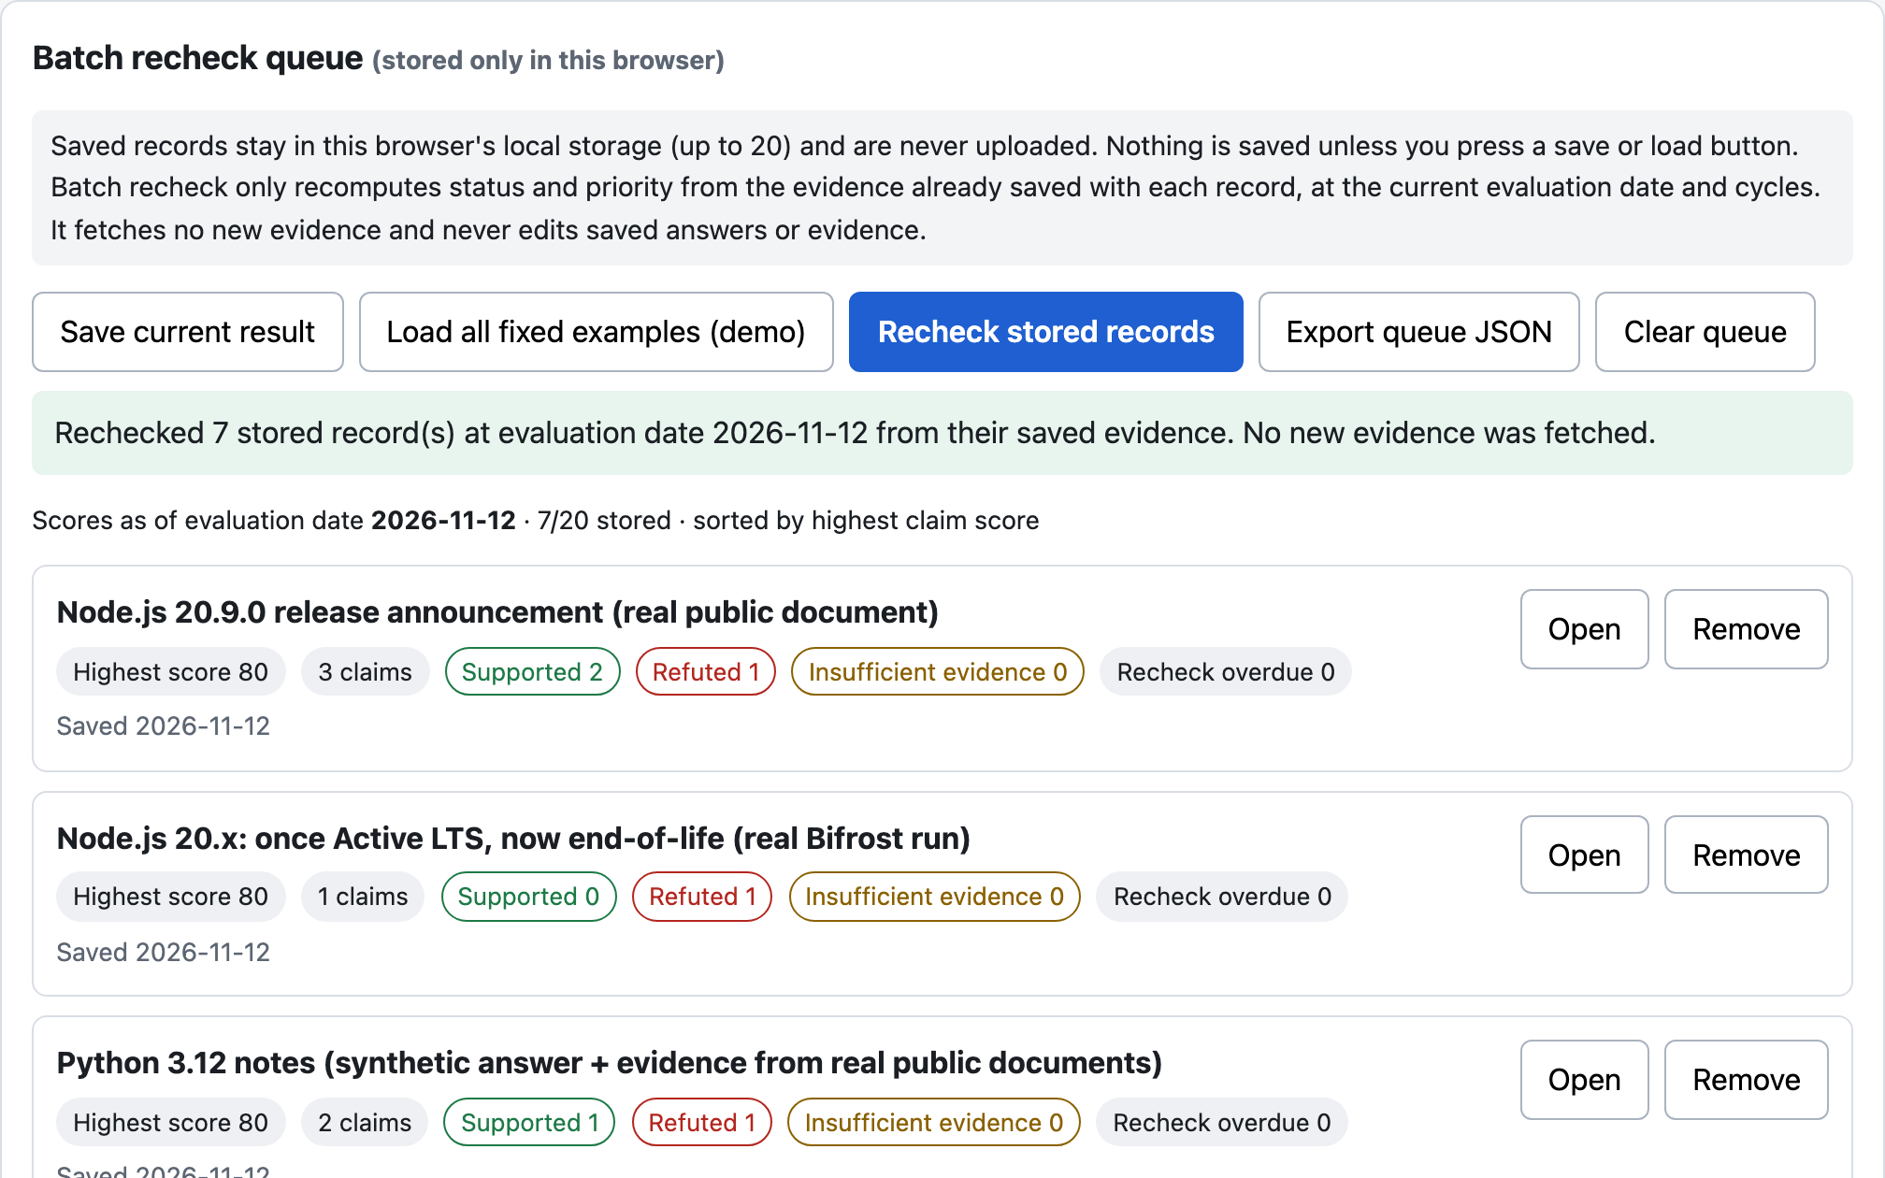
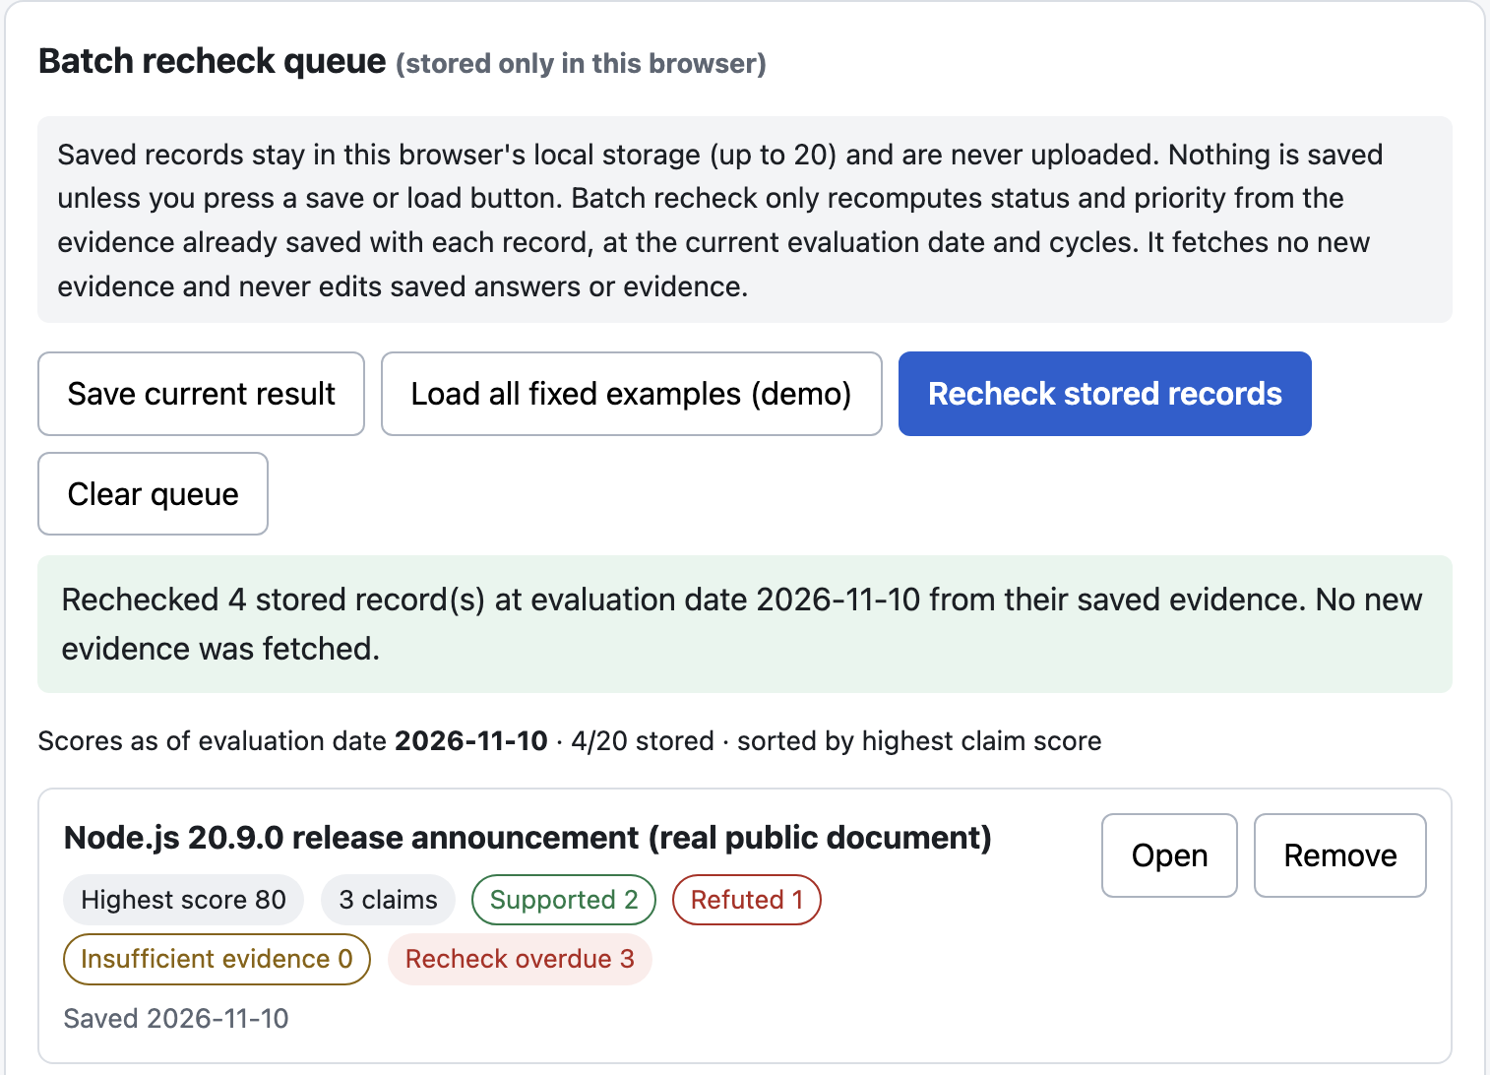
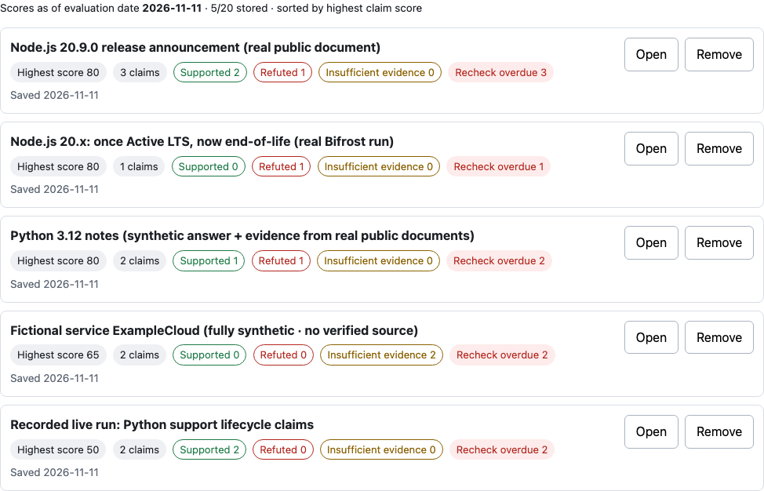
09 / AUDIENCE
Who should use ClaimClock?
DESIGNED FOR
Teams maintaining saved answers
RAG and AI-product operators
Support and documentation owners
Internal knowledge-library teams
WORKFLOW
Saved answers
Priority queue
Human review
Team Solo
Repo github.com/coo001/claimclock
Seven records sorted locally by highest claim score. Export queue JSON feeds the recheck CLI. Saved evidence only.
Demo coo001.github.io/claimclock
Live runs (stale claims refuted, Python, Deno 2.0) are selectable in the public replay demo.
Watch demo · silent 1080p · 127 sec
CLAIMCLOCK / HACKCULTURE GLOBAL AI HACKATHON
10 / 11

Slide 11
10 / SCALABILITY & UNIT ECONOMICS
A measured baseline makes recurring checks estimable
MEASURED · N=15 CLAIMS
NORMALIZED · PER CLAIM
ILLUSTRATION · MONTHLY
25,161 tokens
49 Bifrost attempts · 37 successful
18 Tavily search attempts
$0.0147018 Bifrost meter
~1,677 tokens
~$0.00098 model cost
3.27 gateway attempts
1.2 Tavily searches
1,000 answers × 3 claims
= 3,000 checks
~5.03M tokens · ~$2.94
~9,800 gateway attempts
~3,600 Tavily searches
Recorded evaluation; retries included.
Historical ratios, not a benchmark.
Assumes the observed model, prompt, retry mix and pricing; excludes infrastructure, caching, rate limits, and price changes. Tavily credits assume 1 credit per basic search. Batch recheck scores saved evidence only; fresh evidence still requires live calls.
CLAIMCLOCK / HACKCULTURE GLOBAL AI HACKATHON
11 / 11

