Slide 1
STALE-ANSWER DETECTOR / TAVILY + BIFROST
“Node.js 20.x is currently in Active LTS.”
Answers have an
expiration date.
2023-10-25
SUPPORTED
v20.9.0 announcement: 20.x moves into Active LTS (Wayback capture)
ClaimClock checks the claims in an old answer, one by one,
showing what changed, when, and the evidence behind it.
2024-10-22
REFUTED
Official schedule: Active LTS ends, Maintenance begins
2026-11-10
12/15
100 / 50k
No key
REFUTED
Tavily search + Gemini via Bifrost: EOL 2026-04-30
pre-registered Node.js cases match the human labels
daily request and token cap on the Bifrost virtual key
needed for the public replay demo
CLAIMCLOCK / HACKCULTURE GLOBAL AI HACKATHON
01 / 09

Slide 2
01 / PROBLEM
The question matters more than the search result
“Is this answer still true today?”
TODAY’S FAILURE
CLAIMCLOCK RESPONSE
One paragraph can contain many claims
The newest page may not answer each one
Authorship and evidence dates differ
Find evidence for each claim
Verify quoted text against the source
Separate Supported, Refuted, and Insufficient evidence
Sources and dates stay visible. The score is a review priority, never a probability of truth.
CLAIMCLOCK / HACKCULTURE GLOBAL AI HACKATHON
02 / 09

Slide 3
02 / PRODUCT
Turn answers into claims you can review
1
2
3
4
Extract
Search
Judge
Plan
Split the answer into verifiable claims
Tavily finds current evidence candidates
Gemini checks the relation and verifies the quote
Score, timeline, and next review date
WHAT YOU GET FOR EACH CLAIM
Status
Evidence dates
Review plan
Supported, Refuted, or Insufficient evidence, with the cited quote
What was published and when it was collected, so a past view stays honest
Priority score and a recheck date you can export as an ICS file
Users review the evidence. ClaimClock never edits an answer or sends messages automatically.
CLAIMCLOCK / HACKCULTURE GLOBAL AI HACKATHON
03 / 09

Slide 4
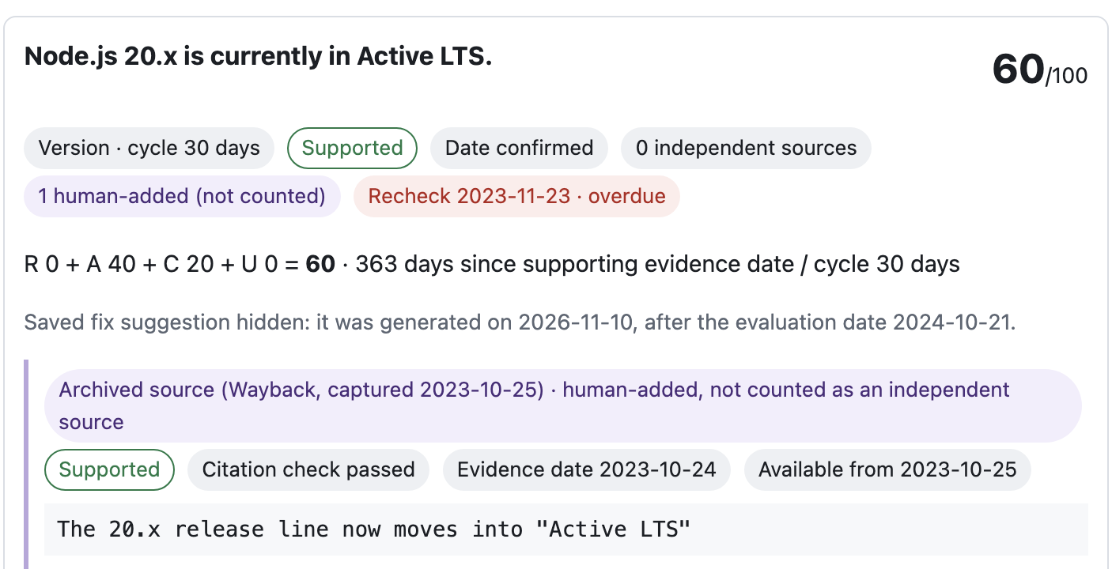
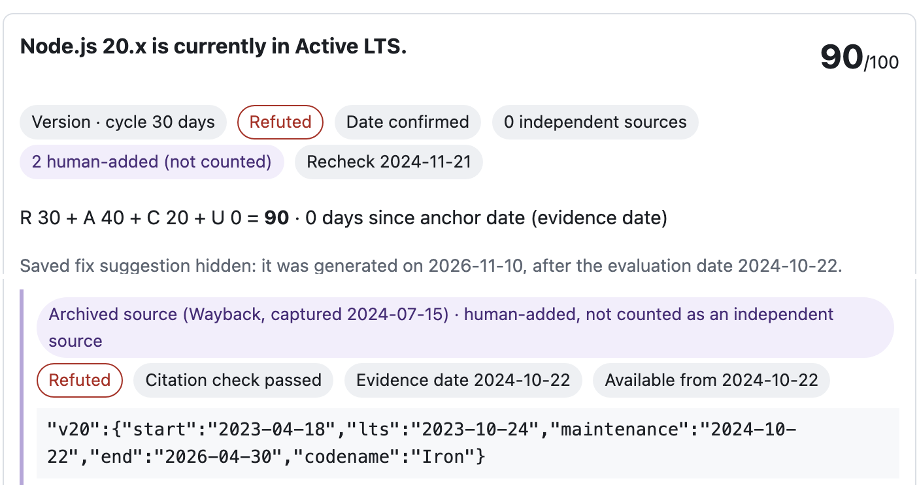
03 / KEY INTERACTION
A past view must not borrow future evidence
2024-10-21 · SUPPORTED
2024-10-22 · REFUTED
Only the Wayback capture of the v20.9.0 announcement is available.
Schedule capture of 2024-07-15 takes effect on 2024-10-22.
Each evidence item is available only from the later of its event date and its collection date. The 2026 search result and the 2026 fix stay hidden in both views. Images are excerpts of the app.
CLAIMCLOCK / HACKCULTURE GLOBAL AI HACKATHON
04 / 09

Slide 5
04 / ARCHITECTURE
Search and model calls stay separately logged
Tavily Search
Run record
Generated query · URLs · excerpts
Queries, URLs, requests, and token usage saved as JSON
ClaimClock
Node.js backend · claim extraction, date rules, scoring
Bifrost Gateway
Gemini
Virtual key · limits · request log
Claim extraction, judgment, and rewrite
Virtual key only · direct-key bypass off · daily limits 100 requests / 50,000 tokens · guard usage $0.0147 / $0.10 · cache savings not measured (no Valkey/Redis runtime).
CLAIMCLOCK / HACKCULTURE GLOBAL AI HACKATHON
05 / 09

Slide 6
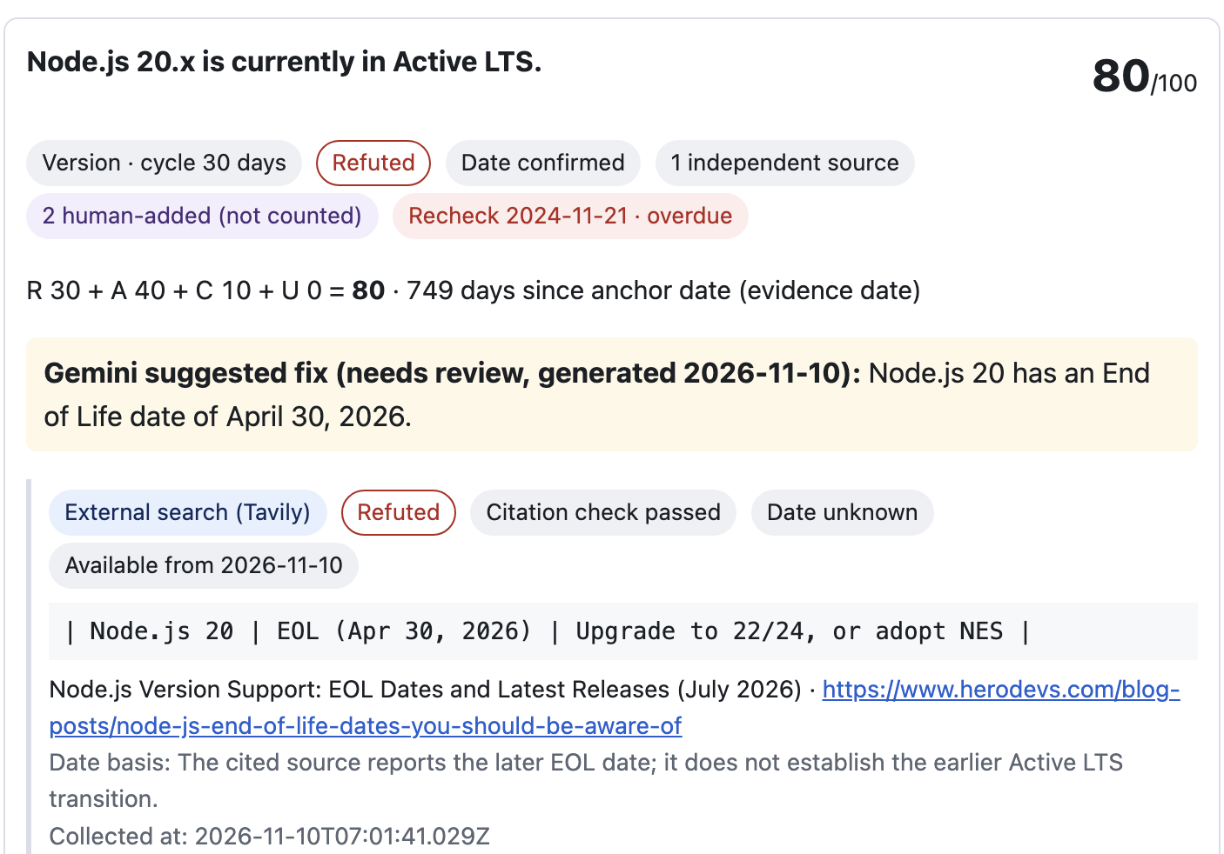
05 / EVIDENCE
Evidence origin and availability stay visible
PRE-REGISTERED EVALUATION · N=15
12/15
exact human-label
agreement · 80%
5/8
7/7
status shifts
stable codenames
Tavily
18 evaluation calls · 38/50 cumulative
Bifrost
49 attempts · 37 successful responses
Usage
25,161 tokens in the evaluation
Daily meter
38/100 requests · 25,169/50k tokens
Guard meter
$0.0147 / $0.10
2026-11-10 view, top of the claim card and its Tavily evidence item. The two Wayback items follow below it in the app.
Queries passed unchanged; prompts stayed fixed.
CLAIMCLOCK / HACKCULTURE GLOBAL AI HACKATHON
06 / 09

Slide 7
06 / SCORING
Scores prioritize what to review next
R + A + C + U
EXAMPLE · NODE.JS 20 CLAIM ON 2026-11-10 · 80 / 100
R
Relation risk (refuted)
30 / 30
Relation risk + evidence age + source gap + date uncertainty.
Maximum 100.
A
Evidence age
40 / 40
A review priority, not a probability of truth.
C
Source gap (1 of 2 sources)
10 / 20
U
Date uncertainty (date known)
0 / 10
Only cited evidence available by the evaluation date counts. Event/publication and collection dates both matter; unknown dates are never backdated.
CLAIMCLOCK / HACKCULTURE GLOBAL AI HACKATHON
07 / 09

Slide 8
07 / SCOPE & LIMITATIONS
What this build demonstrates and what it does not
DEMONSTRATED
LIMITATIONS
• 15 pre-registered Node.js cases; 12/15 exact matches
• Status transitions 5/8 · stable codenames 7/7
• Gemini queries passed to Tavily unchanged
• Prompts stayed fixed; no post-evaluation tuning
• Unknown event dates remain unknown
• Small, Node.js-specific sample; no general accuracy claim
• Three status shifts were mislabeled; stale sources remain a risk
• Cache not measured; no Valkey/Redis runtime
• No autonomous edits or outbound actions
AI disclosure: Tavily search; Gemini claim extraction and judgment through Bifrost v2.5.0 virtual-key routing; AI coding agents assisted development. Gold labels were frozen before calls.
CLAIMCLOCK / HACKCULTURE GLOBAL AI HACKATHON
08 / 09

Slide 9
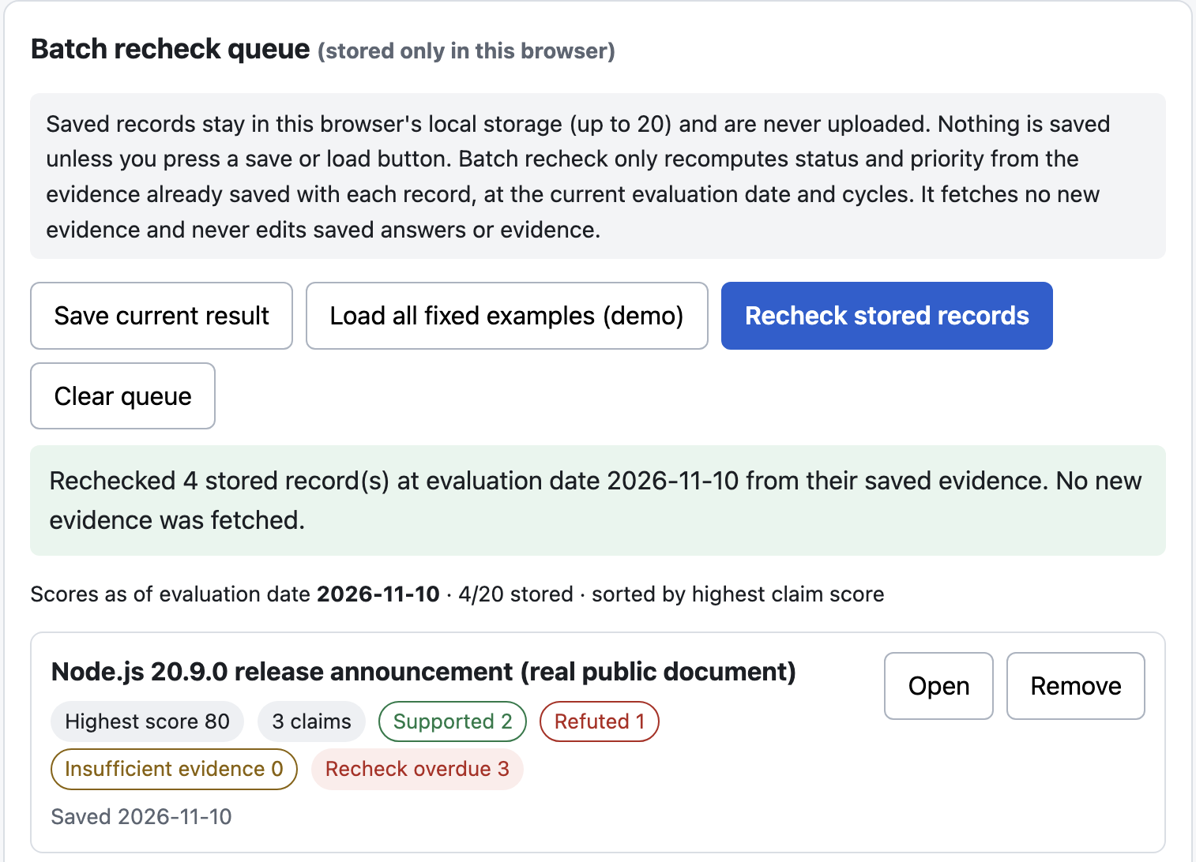
08 / AUDIENCE
Who should use ClaimClock?
DESIGNED FOR
Teams maintaining saved answers
RAG and AI-product operators
Support and documentation owners
Internal knowledge-library teams
WORKFLOW
Saved answers
Priority queue
Human review
Team Solo
Repo github.com/coo001/claimclock
Demo coo001.github.io/claimclock
Browser-local recheck of four saved records (first record shown); no new evidence.
Screenshots come from the local build of the latest main; Pages is redeployed from main.
CLAIMCLOCK / HACKCULTURE GLOBAL AI HACKATHON
09 / 09

