Slide 1
STALE-ANSWER DETECTOR / TAVILY + BIFROST
Answers have an
expiration date.
2023-10-24
SUPPORTED
ClaimClock checks claims in an old answer, one by one,
showing what changed, when, and the evidence behind it.
2026-11-10
REFUTED · Maintenance since 2024-10-22
CLAIMCLOCK / HACKCULTURE GLOBAL AI HACKATHON
01 / 08

Slide 2
01 / PROBLEM
The question matters more than the search result
“Is this answer still true today?”
TODAY’S FAILURE
CLAIMCLOCK RESPONSE
One paragraph can contain many claims
The newest page may not answer each one
Authorship and evidence dates differ
Find evidence for each claim
Verify quoted text against the source
Separate Supported, Refuted, and Insufficient evidence
Sources and dates stay visible. The score is a review priority, never a probability of truth.
CLAIMCLOCK / HACKCULTURE GLOBAL AI HACKATHON
02 / 08

Slide 3
02 / PRODUCT
Turn answers into claims you can review
1
2
3
4
Extract
Search
Judge
Plan
Split the answer into
verifiable claims
Tavily finds current
evidence candidates
Gemini checks the relation
and verifies the quote
Score, timeline, and
next review date
Users review the evidence. ClaimClock never edits an answer or sends messages automatically.
CLAIMCLOCK / HACKCULTURE GLOBAL AI HACKATHON
03 / 08

Slide 4
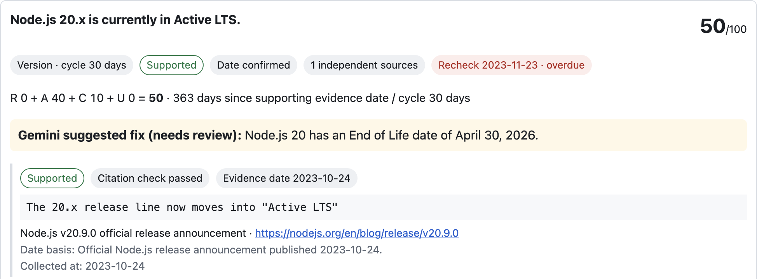
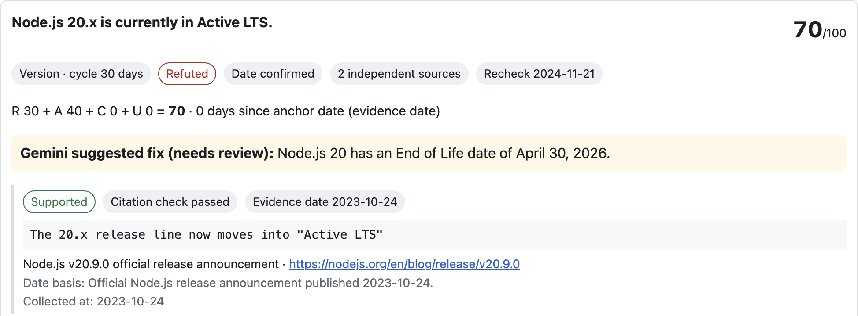
03 / KEY INTERACTION
A one-day shift crosses the LTS boundary
2024-10-21 · BEFORE TRANSITION
2024-10-22 · MAINTENANCE START
SUPPORTED
REFUTED
The official release announcement still supports the claim.
The official schedule moves v20 into Maintenance LTS.
Official schedule: maintenance starts 2024-10-22; EOL is 2026-04-30. Page update dates are not event dates.
CLAIMCLOCK / HACKCULTURE GLOBAL AI HACKATHON
04 / 08

Slide 5
04 / ARCHITECTURE
Search and model calls stay separately logged
Tavily Search
Generated query · URLs · excerpts
ClaimClock
Node.js backend
Bifrost Gateway
Gemini · virtual key
Gemini
Claim classification
Virtual key only · direct-key bypass off · daily limits: 100 requests / 50,000 tokens · guard usage $0.0147 / $0.10 · cache not measured (no Valkey runtime).
CLAIMCLOCK / HACKCULTURE GLOBAL AI HACKATHON
05 / 08

Slide 6
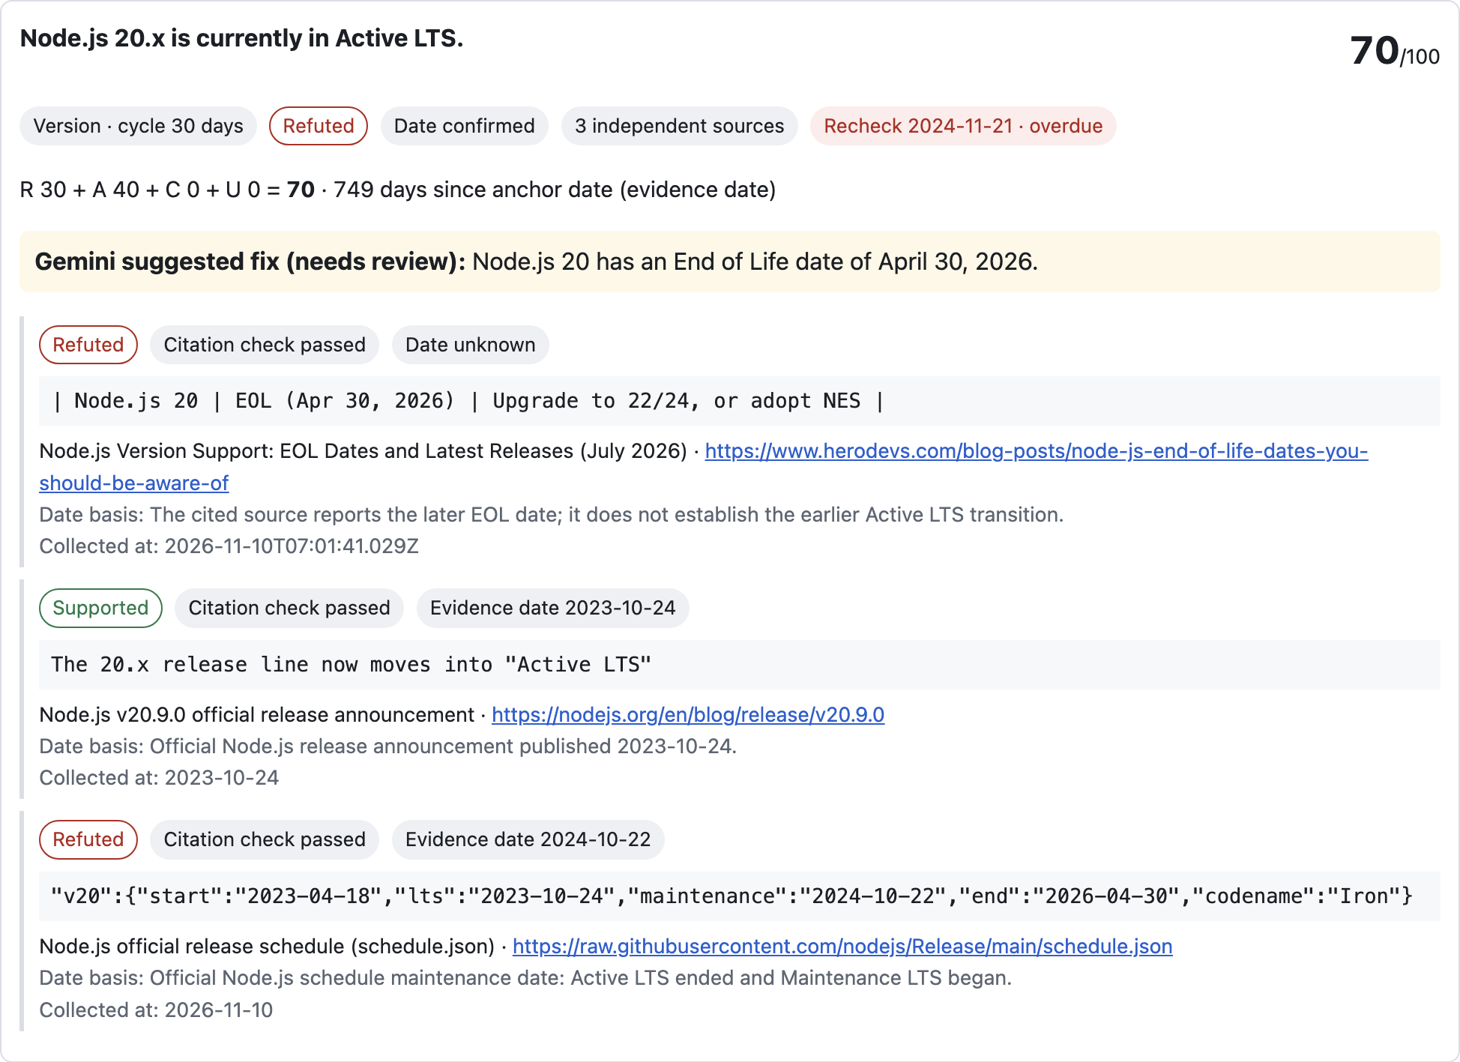
05 / EVIDENCE
Each claim is paired with its evidence
PRE-REGISTERED EVALUATION · N=15
12/15 exact human-label agreement · 80%
Status shifts: 5/8 · stable codenames: 7/7
Tavily: 18 evaluation calls · 38/50 cumulative
Bifrost: 49 attempts · 37 successful responses
Evaluation usage: 25,161 tokens
Daily policy meter: 38/100 requests · 25,169/50k tokens
Guard meter: $0.0147 / $0.10
Queries passed unchanged; prompts stayed fixed.
App card: stored live Bifrost output replayed; no new API calls.
CLAIMCLOCK / HACKCULTURE GLOBAL AI HACKATHON
06 / 08

Slide 7
06 / SCORING
Scores prioritize what to review next
Relation risk
R
R + A + C + U
Evidence age
A
Relation risk + evidence age + source gap + date uncertainty
Maximum 100 · not a truth probability
Source corroboration gap
C
Date uncertainty
U
Only citation-verified evidence available by the evaluation date counts. Missing dates stay unknown; they are never backdated.
CLAIMCLOCK / HACKCULTURE GLOBAL AI HACKATHON
07 / 08

Slide 8
07 / SCOPE & LIMITATIONS
What this build demonstrates and what it does not
DEMONSTRATED
LIMITATIONS
• 15 pre-registered Node.js cases; 12/15 exact matches
• Status transitions: 5/8 · stable codenames: 7/7
• Gemini queries passed to Tavily unchanged
• Prompts stayed fixed; no post-evaluation tuning
• Unknown event dates remain unknown
• Small, Node.js-specific sample; no general accuracy claim
• Three status shifts were mislabeled; stale sources remain a risk
• Cache not measured; no Valkey/Redis runtime
• No autonomous edits or outbound actions
AI disclosure: Tavily search; Gemini claim extraction and judgment through Bifrost v2.5.0 virtual-key routing; Claude Code assisted development. Gold labels were frozen before calls.
CLAIMCLOCK / HACKCULTURE GLOBAL AI HACKATHON
08 / 08

