Slide 1
VE280 Programming and Elementary Data Structures
Introduction

Slide 2
VE280: Programming and Elementary Data Structures
Time: Monday 4:00-5:40 pm, Wednesday 8:00-9:40 am, and Friday 2:55-3:40 pm.
Location: Dong Zhong Yuan 2-103
Textbook Recommended (Not Required):
“Absolute C++, 4th Edition,” by Walter Savitch, Addison Wesley Publishing, 2009.
“Problem Solving with C++, 8th Edition,” by Walter Savitch, Addison Wesley Publishing, 2011.

Slide 3
Instructor
Weikang Qian
Email: qianwk@sjtu.edu.cn
Phone: 3420-4020
Office: Room 119, JI Building
Office hour
Wednesday 10:00 – 11:00 am
Friday 10:00 – 11:00 am
Or by appointment

Slide 4
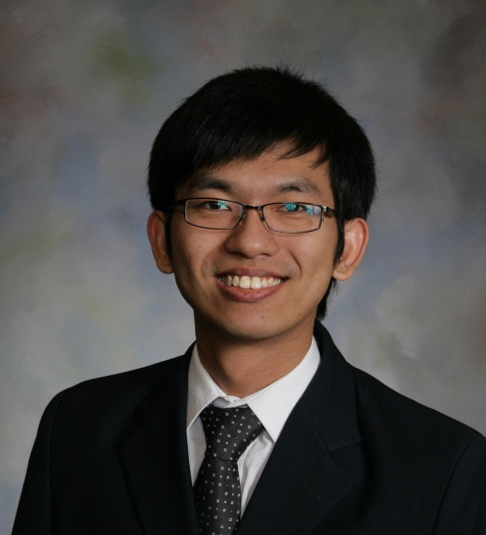
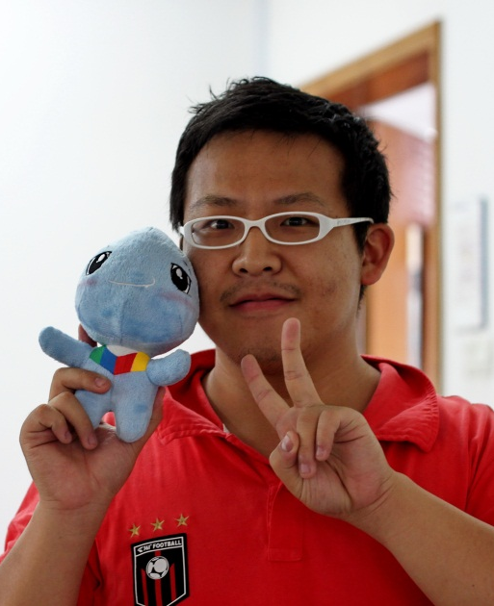
Teaching Assistants
Jinze Yu
Email: yujinze@umich.edu
Cell phone: 13818269059
Yuhang Zhang
Email: zhangyuhang@sjtu.edu.cn
Cell phone: 15121036028

Slide 5
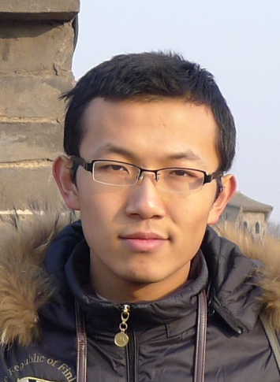
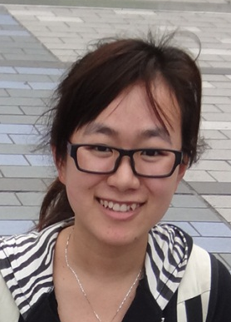
Teaching Assistants
Songzhe Cheng
Email: chengsongzhe@gmail.com
Cell phone: 15121035695
Xuebin Yan
Email: yxb0923@gmail.com
Cell phone:13641787225

Slide 6
Some Administrative Details Grades
Composition
Five programming projects: 50%
Midterm exam: 20%
Final exam: 30%
We will assign grades on a curve, in keeping with past grades given in this course.
Questions about the grading?
Must be mentioned to TAs or instructor within one week after receiving the item.
Notes:
We will adjust the curve up or down if the class as a whole does better or worse than past instances. In particular, if everyone does exceptionally well, then everyone will get an exceptionally good grade.

Slide 7
Some Administrative Details Project Details
Projects require:
Read and understand a problem specification
Design a solution to this problem
Implement this solution simply and elegantly
Convince yourself that your solution is correct
Grading projects will be done by a combination of testing (correctness) and reading (correctness and simplicity/elegance).
We will give you a few simple test cases to get started, but we will not tell you everything we will be testing for. It is up to you to figure out your own set of tests, and we will spend a lecture on how to do this.
No late in submitting your programming assignments!

Slide 8
Some Administrative Details Collaboration and Cheating
All of your code must be your own.
You may not discuss the specifics of your solution with anyone other than TAs and instructor.
We will run an automated test to check for unusually similar programs. Those that are similar to the extent that they appear to be derived from the same code base - in whole or in part - will be referred to the appropriate honor council.
See the syllabus (to be posted) on Sakai for the full policy.

Slide 9
Some Administrative Details Sakai
Log into Sakai: http://202.120.46.228/portal
Check the class webpage on the Sakai regularly for
Announcements
Slides
Grades

Slide 10
Some Administrative Details Getting Help
If you have questions, come to see TAs and instructor during the office hour!
We will hardly answer your questions through email, because it is inefficient.
Office hours
To be announced on Sakai

Slide 11
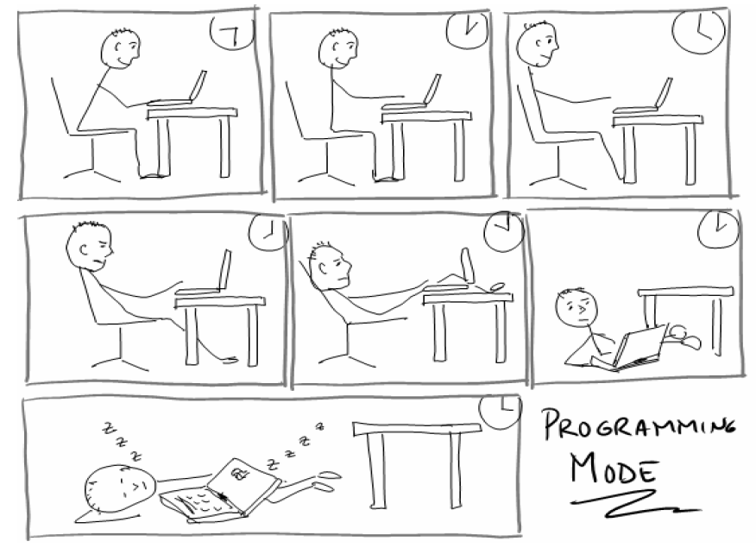
What’s Programming?

Slide 12




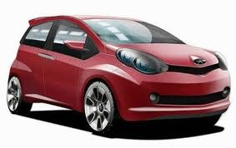
What’s Programming?
A Powerful Skill
Command the computer!

Slide 13


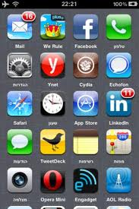

What’s Programming?
An Art
Keyword: Create

Slide 14
What’s Programming? An Art
At least, write the program in an ELEGANT way
Comments
// Evaluate the polynomial on x
int poly_eval(int x, int *coef, unsigned degree) {
int result = 0;
int x_power = 1;
for(unsigned i = 0; i <= degree; i++) {
result += coef[i] * x_power;
x_power *= x;
}
return result;
}
Meaningful Naming
Indention
Consistency!

Slide 15
What’s Programming? An Art
An inelegant example
int f(int a, int *b, unsigned c)
{
int s = 0; int p = 1;
for(unsigned i = 0; i <= c; i++) {
s = s + b[i] * p;
p = p * x; }
return s; }

Slide 16
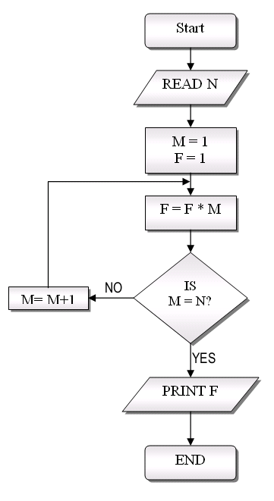
What’s Programming?
A Science
Implement algorithm: An abstract sequence of actions composed to solve a problem.
Behind algorithm: Mathematics and logic

Slide 17

What’s Programming?
An Engineering
How to tradeoff among space (memory usage), speed, time to implement, and maintainability?

Slide 18
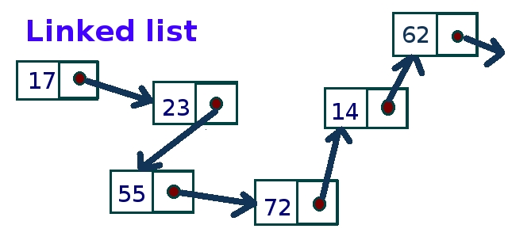
What’s Data Structure?
A particular way of storing and organizing data in a computer so that it can be used efficiently.
Example: Store numbers by a linked list

Slide 19
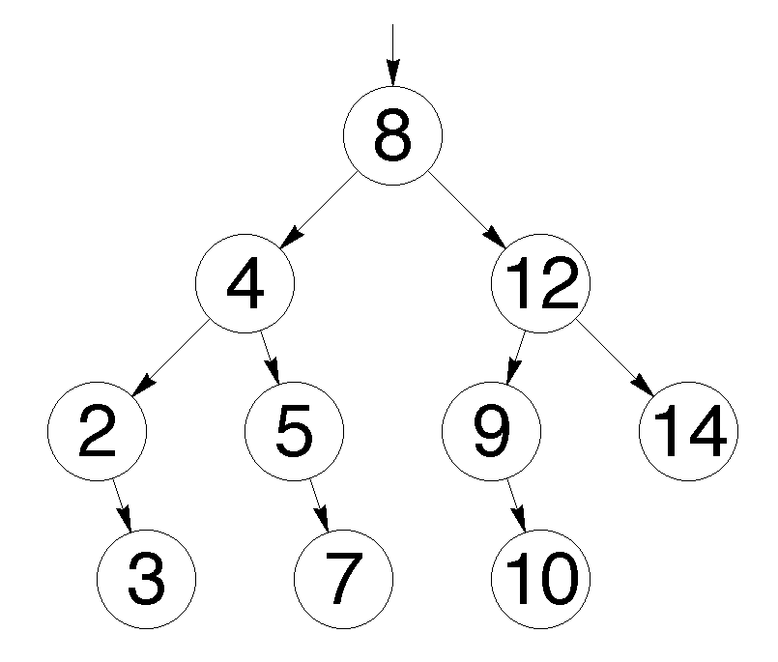
What’s Data Structure?
Tree

Slide 20
The Task of Programming
Accept a possibly incomplete and/or imprecise specification of the problem.
Problem solving phase:
Design an effective algorithm that
correctly satisfies the specification.
is efficient in its (asymptotic) usage of space and time.
Implementation phase:
Implement the algorithm correctly and efficiently
An implementation of an algorithm is correct if it behaves as the algorithm is intended for all inputs and in all situations. Correctness is never negotiable!
Efficient can mean fast, simple, and/or elegant.
Notes:
Design the algorithm first. Then implement the algorithm.

Slide 21
Problem Solving Phase
Be certain the task is completely specified
What is the input?
What is the required output?
Develop the algorithm before implementation
Experience shows this saves time in getting your program to run.
Test the algorithm for correctness

Slide 22
Implementation Phase
Translate the algorithm into a programming language
Compile the source code
Locate errors in using the programming language
Run the program on sample data
Verify correctness of results
Results may require modification of the algorithm and program

Slide 23
The Task of Programming
Two more pieces of the programming puzzle:
Testing
Maintenance
These are often be overlooked when a deadline approaches. However, they are very important!
Notes:
Maintenance: correct defects and improve efficiency

Slide 24
The Task of Programming
This doesn’t seem too difficult, right?
What's the big deal?

Slide 25
Programming Challenges Conflicting goals
Engineering Goals: Faster, Better, Cheaper (pick two)
Unfortunately, our goals are often in conflict.
The easiest programs to understand/modify are often not the simplest to write.
Example: Linked-list
Programs that are simple to write/understand are often not the absolute fastest possible solution to a problem.
The most efficient algorithms for a given problem are often subtle and difficult to implement correctly.

Slide 26
Programming Challenges The list of “If you can only do’s…”
If you can only do one thing…
…write a correct program.
If you can only do two things…
…write an elegant program that is correct.
If you can only do three things…
…write a simple and elegant program that is correct.
Only after you get a simple, elegant, and correct program should you worry about its efficiency.
Notes:
Elegance: Improve/adapt the implementation to more general or closely related algorithms.

Slide 27
Programming Challenges Language constraints
The languages in which we program have only a small number of relatively simple elements from which all programs must be composed.
Luckily for us, these elements are "complete" in some interesting, formal sense.
But, any interesting program must necessarily be large and complex.

Slide 28
Programming Challenges The complexity of testing
It is impossible to test programs for correctness in all cases.
Consider multiplying two 32-bit numbers that produce a 64-bit result.
Each 32-bit number can represent nearly 4.3 billion different values and the 64-bit result can represent more than 18 quintillion different values (18,446,744,073,709,551,616).
If you could verify one unique combination every nanosecond (millionth of a second), it would take you almost three hundred thousand years to check them all!
Now, imagine ensuring that Windows Vista never crashes…

Slide 29
Programming Challenges The complexity of testing – cont’d
You must learn techniques to produce programs that we have reason to believe are correct rather than simply using the build-it-and-try technique.
So, we need specifications and invariants to meet them. This will make testing easier by ensuring that a specific set of requirements will be met.

Slide 30
Programming Challenges Problem sizes
For a single class of problem, the problem instances can range across a wide variety of sizes.
Designing for the worst case usually results in a waste of resources (assuming you know what the worst case is).
Therefore, we need a set of techniques that scale to problem sizes and allow for dynamic resource management.

Slide 31
“What VE280 is about…”
Procedural Abstraction: specification, invariants
Data Abstraction: specification, invariants
Dynamic Resource Management

Slide 32
“Why VE280 is interesting…”
Complexity is all around us, and resources are always limited.
Specification, invariants, abstraction, and dynamic resource management turn out to be surprisingly useful!
Programs are composed of pure “thought-stuff” that result in real, tangible products – it’s magic!

Slide 33
“Why VE280 isn’t about programming…”
This course is more about computer science than computer programming in C++.
There are many dark corners of the language we will not even touch.

Slide 34
My Research
Electronic Design Automation
Novel logic synthesis algorithms and data structures
Computer-aided verification
Digital Circuit Design
Logical computation on stochastic bit streams
Fault-tolerant computing with error-prone devices
Low-power design techniques
Computer Architecture
Novel architecture for machine learning, signal processing, etc.
Recruiting undergraduate research assistants. Students interested in please contact me at qianwk@sjtu.edu.cn

Slide 35
Wish you have fun with VE280!

