Slide 1
Ve 280 Programming and Elementary Data Structures
Debugging with GDB

Slide 2
Review
Procedural Abstraction: described using specifications comments
REQUIRES: the pre-conditions that must hold, if any.
MODIFIES: how inputs are modified, if any.
EFFECTS: what the procedure computes given legal inputs.
Function Call Stack
When a function is called, an activation record (also known as stack frame: hold the function's formal parameters and local variables.
int add(int a, int b): a = 5, b = 5, result = 0

Slide 3
Call Stacks How a function call really works
When a function is called, an activation record for this invocation is added to the “top” of the stack.
When that function returns, it's activation record is removed from the “top” of the stack.
double add(double a, double b): a = 1, b = 0, result = 0
double sin(double x): x = 1, result = 0
int main(): x = 1, sinResult = 0

Slide 4
Overview
Run GDB
Stop and Continue
Examine Data
Examine Call Stack

Slide 5
Introduction
Frequently, when you write a program, it is not correct at first, although it compiles successfully.
We need to DEBUG it to find which part is wrong.
GDB is used for debugging on Linux.
Prepare: compile you code with “-g” option
g++ -g …

Slide 6
Run GDB
Start GDB: gdb [program_name] E.g., gdb hello_world
You are now in GDB environment with “(gdb)” as your command prompt
As we will see in later lectures, your program can take arguments, just like linux command, e.g., cp file1 file2.
Pass arguments to your program: set args [argu1] [argu2] …
E.g., set args file1 file2
Run your program: run/r
Redirect the input and output: run < [input_file] run > [output_file]
Exit the debugger: quit/q
Not EXCITING, huh?

Slide 7
Stop Your Program
During debugging, you need to stop your program. To do so, you sometimes need to specific a location to stop.
Specify a LOCATION:
[line_number] E.g., 15
[file_name]:[line_number] E.g., func.C:15
[function] E.g., factorial(int) (hint: you can use tab to autocomplete)
Set a breakpoint -- Tell GDB to explicitly stop at a certain point in the source code: break/b LOCATION
E.g., break func.C:18
E.g., b factorial(int)

Slide 8
Control Execution
Resume program execution: continue/c
Can be provided an option [ignore_count]. E.g., c 5
Execute one line of code: step/s
If the code is a function call, GDB will step into the function.
Continue to the next source line in the current function: next/n
DOES NOT step into the function
Step out a function: finish
Continue running until just after function returns.

Slide 9
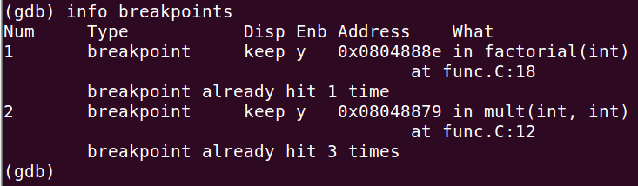
List Breakpoints
When you set a breakpoint, it is assigned a breakpoint number [bnum]
List breakpoints: info breakpoints/break
Also display a count of the number of times the breakpoint has been hit.

Slide 10
Delete and Enable/Disable Breakpoints
Delete a breakpoint: delete/d [bnum]
E.g., d 2
Permanently!
Disable a breakpoint: disable/dis [bnum]
E.g., dis 1
Temporarily!
Enable a breakpoint: enable/en [bnum]
E.g., en 1

Slide 11
Break Conditions
The simplest sort of breakpoint breaks every time your program reaches a specified place.
You can also specify a condition for a breakpoint.
A condition is just a Boolean expression in C++
A breakpoint with a condition evaluates the expression each time your program reaches it, and your program stops only if the condition is true.
Command: condition [bnum] [expression]
E.g., condition 2 i==4
Remove the condition form: condition [bnum]
E.g., condition 2

Slide 12
Break Conditions
Stop only when the breakpoint has been reached a certain number of times: ignore [bnum] [count]
The breakpoint [bnum] does not stop the next [count] times your program reaches it.
E.g., ignore 2 4

Slide 13
Another Way to Stop: Set Watchpoints
You can use a watchpoint to stop execution whenever the value of an expression changes
without having to predict a particular place where this may happen.
Command: watch [expression]
[expression] could be either variable or variable expression
Variable example: watch i
Basic expression example: watch a*b+2
Array element example: watch array[2]

Slide 14
More about Watchpoints
Watchpoint is a type of breakpoint.
It is assigned a breakpoint number
Many commands for breakpoints can be used for watchpoints.
List watchpoints: info breakpoints
Delete/Disable/Enable watchpoints: d/dis/en [bnum]

Slide 15
Examine Data
Examining Data: print/p [expression]
[expression] could be either variable or variable expression
Variable example: p i
Basic expression example: p a*b+2
Array element example: p array[2]
Function example: p factorial(n)
Print an array of elements: print *[array_start_pointer]@[length] E.g., print *array@3

Slide 16
Examine Data
Change output format: p /[format_letter] [expression] E.g., p /t a
Set (or change) the value of a variable: p [variable]=[value]
E.g., p i=5
Sometimes you can use this method to correct a wrong value
format_letter | x | d | u | t | c
format | hexa-decimal | signed decimal | unsigned decimal | binary | character

Slide 17

Automatic Display
If you find that you want to print the value of an expression frequently (to see how it changes), you might want to add it to the automatic display list so that GDB prints its value each time your program stops.
Command: display [expression]
[expression] could be either variable or variable expression
E.g., display a*b
Each expression added to the list is given an ID number

Slide 18
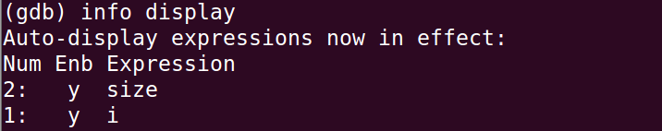
Automatic Display
Print the list of expressions set up to display automatically: info display
Remove from the list of expressions to display: delete display [display_num] E.g., delete display 1
Disable an item for display: disable display [display_num]
Enable an item for display: enable display [display_num]

Slide 19
View Source Code
View source code: list/l LOCATION
list/l [line_number]: l 9
list/l [file_name]:[line_number]: l func.C:9
list/l [function]: l factorial(int)
By default, 10 lines are printed.
Typically, print lines centered around the target.
Print lines just before the lines last printed: list –

Slide 20
Examine Call Stack: Stack Frame
When your program has stopped, the first thing you need to know is where it stopped and how it got there.
It usually stops at a certain function.
Recall: When we call a function, an “activation record” is created to hold the function's formal parameters and local variables.
Activation record is also known as stack frame.
int add(int a, int b): a = 5, b = 5, result = 0

Slide 21
Call Stack
A function is usually called by another function. Stack frames are stacked:
When a function is called, a stack frame for this invocation is added to the “top” of the stack.
When that function returns, it's stack frame is removed from the “top” of the stack.
Stack frames are allocated in a region of memory called call stack.
double add(double a, double b): a = 1, b = 0, result = 0
double sin(double x): x = 1, result = 0
int main(): x = 1, sinResult = 0

Slide 22
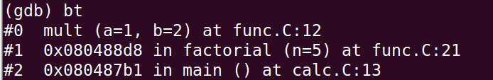
Examine Call Stack: Backtrace
A summary of how your program got where it is. It shows one line per stack frame for all the frames.
Print a backtrace of the entire call stack: backtrace/bt
GDB assigns a number to each stack frame

Slide 23
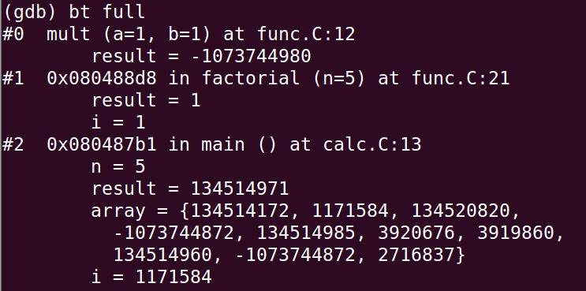
Backtrace
Print more information about call stack: backtrace/bt full
Print the values of the local variables also.

Slide 24
Other Commands
Auto completion: press <TAB>
Set breakpoint at the beginning and run: start
Get help: help/h
help (without NO arguments): show a list of topics
help [topic]: show a list of commands related to that topic
help [command]: show the help for the command

Slide 25
References
Official Documentation: http://sources.redhat.com/gdb/documentation/
http://www.yolinux.com/TUTORIALS/GDB-Commands.html
http://www.cs.umd.edu/class/sum2005/cmsc420/gdb.html

