Slide 1
Ve 280 Programming and Elementary Data Structures
Compiling and C++ Basics

Slide 2
Developing Program on Linux Single Source File
Write the source code
Compile the program
Compiler: g++
Command: g++ -o program source.C # -o option tells what to name the output file
Useful options
-g: Put debugging information in the executable file
-Wall: Turn on all warnings!
-O: (Capital O!) Optimize the code and reduce the execution time
Run the program: ./program

Slide 3
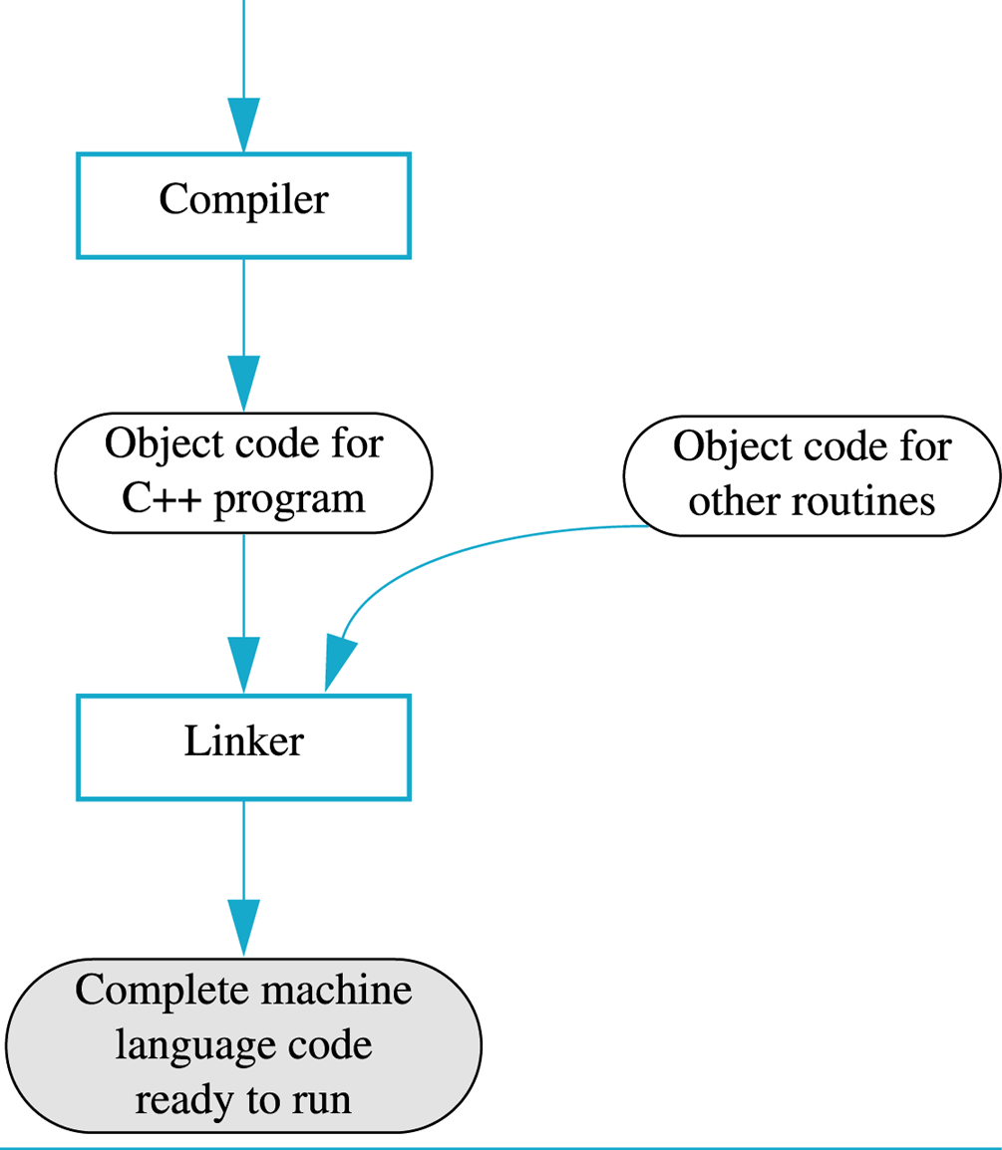
Compile a Program
g++ -o program source.C
C++ Source Code

Slide 4
Developing Program on Linux Multiple Source Files
Simple but inefficient way:
g++ -o program source1.C source2.C
Efficient but complicated way:
g++ -c source1.C
-c option tells compiler to compile and not to link
The output is an object file source1.o
g++ -c source2.C
g++ -o program source1.o source2.o
Link object files together to produce the executable
Is there any simple and efficient way?

Slide 5
Makefile Example
all: multi_source
multi_source: multi_source.o say_hello.o
g++ -o multi_source multi_source.o say_hello.o
multi_source.o: multi_source.C
g++ -c multi_source.C
say_hello.o: say_hello.C
g++ -c say_hello.C
clean:
rm multi_source *.o
A Rule
Target: Dependency
<Tab> Command
Don’t forget the Tab!

Slide 6
Makefile Introduction
Target: Dependency
<Tab> Command
say_hello.o: say_hello.C
g++ -c say_hello.C
Rules
Dependencies: A list of files that the target depends on
When is the command executed? The dependency is more recent than the target
Update recursively
You should name you document as “Makefile”
Type “make” build the default target “all”
Dummy target: “clean”. Type “make clean”
all: multi_source
clean:
rm multi_source *.o

Slide 7
Makefile Macros
Why use macros?
CC = g++
all: multi_source
multi_source: multi_source.o say_hello.o
$(CC) -o multi_source multi_source.o say_hello.o
multi_source.o: multi_source.C
$(CC) -c multi_source.C
say_hello.o: say_hello.C
$(CC) -c say_hello.C
clean:
rm multi_source *.o
Define a macro
Easy to make changes
Use the macro
(g++ -c multi_source.C)

Slide 8
Makefile Macros
CC = g++
MAINSRCS = multi_source.C
OTHSRCS = say_hello.C
CFLAGS = -g -Wall
SRCS = $(MAINSRCS) $(OTHSRCS)
OBJS = $(SRCS:.C=.o)
TARGETS = $(MAINSRCS:.C=)
%.o: %.C
$(CC) $(CFLAGS) -o $@ -c $<
all: $(TARGETS)
$(TARGETS): $(OBJS)
$(CC) $(CFLAGS) -o $(TARGETS) $(OBJS)
clean:
rm -f $(OBJS) $(TARGETS)
(SRCS = multi_source.C say_hello.C)
(OBJS = multi_source.o say_hello.o)
(TARGETS = multi_source)
*.o depends on *.C
Special macro $@: the left side of ‘:’
Special macro $<: the first item on the right side of ‘:’

Slide 9
Reference
http://www.cs.colby.edu/maxwell/courses/tutorials/maketutor/

Slide 10
C++ Basics

Slide 11
Variables
C++ variables are names for memory locations
We can write a value in them
We can change the value stored there
But, we cannot erase the memory location
Some value is always there
Use meaningful names
x =y * z versus distance = speed * time

Slide 12
Built-in Data Types
int
double
char
bool
Type conversion, e.g., int ←→ double, int ←→ char

Slide 13
Arithmetic Operator
+, −, *
/
Caution on operator types
double: exact result.
int: truncated integer. E.g., 5/3 = 1
%
Gives the remainder from integer division. E.g., 5%3 = 2
Only applicable to int
Shorthand operator +=, −=, *=, /=, %=
a += 2 is equivalent to a = a + 2

Slide 14
Comparison Operators
<, >, <=, >=
!=
==
Typical mistake: use “=” (the assignment operator) instead
What’s the effect of if(x = 5)?
Write if(5 == x) to prevent the mistake
Combining of Boolean Expression
AND: && E.g., if((2 < x) && (x < 7))
OR: || E.g., if((7 < x) || (x < 2))
NOT: ! E.g., if(!(5 == x))
TRUE!

Slide 15
Increment/Decrement
++ increment operator
Adds 1 to the value of a variable “ x++; ” is equivalent to “ x = x + 1; ”
-- decrement operator
Subtracts 1 from the value of a variable “ x--; ” is equivalent to “ x = x – 1; ”
Difference between x++ and ++x
x = 1; y = x++;
x = 1; y = ++x;
What’s the value of x?
What’s the value of y?

