Slide 1
Ve 280 Programming and Elementary Data Structures
C++ Basics and Procedural Abstraction

Slide 2
Announcement
Project One uploaded on Sakai
Due by 11:59pm, June 3rd, 2012

Slide 3
Review
Compiling
g++
Makefile
Macro
C++ Basics
Variable
Built-in type, e.g., int
Arithmetic operator
Comparison operator
Increment/Decrement operator

Slide 4
Outline
C++ Basics
Order of Precedence
Branch
Loop
Procedural Abstraction
Function
Specification

Slide 5
Operators
Arithmetic: +, −, *, /, %
Comparison: <, <=, >, >=, !=, ==
Boolearn: &&, ||, !
++, −−

Slide 6
Order of Precedence
How should we evaluate the following expression? 4 * y – 1 < 3 || 2 + x / 4 >= 2
Actually: (((4 * y) – 1) < 3) || ((2 + (x / 4)) >= 2)
If parentheses are omitted, the default precedence of operations is:
Perform binary arithmetic operations *,/,% first
Perform binary arithmetic operations +,− next
Perform relational operations such as <, >= next
Perform | | operations last

Slide 7
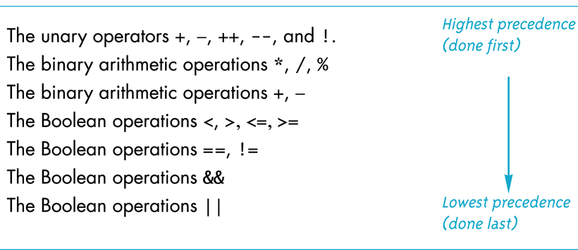
Precedence Rules
Good Practice: Use parentheses to make things clear!

Slide 8
Flow of Control: Branch Basic Style
if(Boolean_Expression) {
True_Statements
}
else {
False_Statements
}
Boolean expressions are expressions that are either true or false

Slide 9
Flow of Control: Branch Nested Branches
if(Boolean_Expression_1) {
if(Boolean_Expression_2) {
Ture_Statements
}
else {
False_Statements
}
}
Although it is fine to omit the outside braces, but it is a good practice to keep them!

Slide 10
Flow of Control: Branch A Multiway if-else statement
if(Boolean_Expression_1) Statement_1 else if (Boolean_Expression_2) Statement_2 … else if (Boolean_Expression_n) Statement _n else Statement_For_All_Other_Possibilities

Slide 11
Flow of Control: Branch Switch Statements
switch (Controlling_Expression) { case Constant_1: Statement_Sequence_1 break; case Constant_2: Statement_Sequence_2 break; . . . case Constant_n: Statement_Sequence_n break;
default: Default_Statement_Sequence }
Good Practice: Include “default”

Slide 12
Flow of Control: Loop While Loop
While loop
while(Boolean expression is true) {
Statements to repeat
}
Do-while loop
do {
Statements to repeat
} while(Boolean expression is true);
May never be executed!
What’s the difference?
Executed at least once!

Slide 13
Flow of Control: Loop For Loop
for(Initilization; Boolean_Expression; Update_Action) {
Statements to Repeat;
}
Example:
for(n = 0; n < 10; n += 2) {
cout << n << endl;
}

Slide 14
Debugging Loops Common Errors
Off-by-one errors in which the loop executes one too many or one too few times
Infinite loops usually result from a mistake in the Boolean expression that controls the loop
The following code is supposed to conclude with the variable product containing the product of the numbers 2 through 5 int next = 2, product = 1; while (next < 5) { next++; product = product * next; }
Anything wrong?

Slide 15
Loop Testing Guidelines
Every loop should at least be tested using input to cause:
Zero iteration of the loop body
One iteration of the loop body
One less than the maximum number of iterations
The maximum number of iterations

Slide 16
Procedural Abstraction

Slide 17
Abstraction
The black box analogy
A black box refers to something that we know how to use, but the method of operation is unknown
A person using a program needs to know what the program does, not how it does it
Abstraction
Provides only those details that matter.
Eliminates unnecessary details and reduces complexity.

Slide 18
Abstraction
Example: Multiplication algorithm
Many ways to do: table lookup, summing, etc.
Each looks quite different internally than the other, but they do the same thing.
In general, a user won’t care how it’s done, just that it multiplies.
There are two types of abstraction:
Procedural
Data
Focus of our next few lectures

Slide 19
Procedural Abstraction
Decomposing a program into functions is a way of providing “computational” abstractions.
Rather than simply being collections of commonly used code, functions provide a useful tool for implementing procedural abstraction within a program.

Slide 20
Procedural Abstraction
For any function, there is a person who implements the function (the author) and a person who uses the function (the client).
The author needs to think carefully about what the function is supposed to do, as well as how the function is going to do it.
In contrast, the client only needs to consider the what, not the how.
Since how is much more complicated, this is a Big Win for the client!
In individual programming, you will often be the author and the client. Sometimes it is to your advantage to “forget the details” and only concentrate on higher levels of functionality.
Notes:
Client and Producer

Slide 21
Procedural Abstraction
Procedural abstractions, done properly, have two important properties:
Local: the implementation of an abstraction does not depend on any other abstraction implementation.
Substitutable: you can replace one (correct) implementation of an abstraction with another (correct) one, and no callers of that abstraction will need to be modified.
Locality and substitutability only apply to implementations of abstractions, not the abstractions themselves.
If you change the abstraction that is offered, the change is not local, nor is the new version substitutable.
It is CRITICALLY IMPORTANT to get the abstractions right before you start writing a bunch of code.
Notes:
No locality: change of abstraction will result the caller also be changed. No substitutability: you cannot substitute an abstraction with another. For example, you cannot substitute multiplication with addition.

Slide 22
Procedural Abstraction
Unfortunately, abstraction limits the scope of change.
If you need to change what a procedural abstraction does, it can involve many different changes in the program.
However, if a change can be limited to replacing the implementation of an abstraction with a substitutable implementation, then you are guaranteed that no other part of the project needs to change.
This is vital for projects that involve many programmers.

Slide 23
Procedural Abstraction Function Declarations vs. Definitions
Function declaration (or function prototype)
Shows how the function is called.
Must appear in the code before the function can be called.
Syntax: Type_returned Function_Name(Parameter_List); //Comment describing what function does
Function definition
Describes how the function does its task.
Can appear before or after the function is called.
Syntax: Type_returned Function_Name(Parameter_List) { //function code }
int add(int a, int b); //Comment
int add(int a, int b) { return (a + b); }

Slide 24
Function Declaration
Tells the return type
Tells how many arguments are needed
Tells the types of the arguments
Tells the name of the function
Tells the formal parameter names
Formal parameters are like placeholders for the actual arguments used when the function is called
Formal parameter names can be any valid identifier
Example: double total_cost(int number_par, double price_par); // Compute total cost including 5% sales tax on // number_par items at cost of price_par each
Type Signature
Formal Parameter Names

Slide 25
Function Definition
Provides the same information as the declaration
Describes how the function does its task
Example: double total_cost(int number_par, double price_par) { const double TAX_RATE = 0.05; //5% tax double subtotal; subtotal = price_par * number_par; return (subtotal + subtotal * TAX_RATE); }
function header
function body

Slide 26
Procedural Abstraction Function Definitions vs. Declarations
In small programs, often we just define functions before they are used.
In larger programs, it is useful to separate the declaration of a function from its definition.
Function declarations can be placed in their own file and accessed using the preprocessor directive #include.

Slide 27
Procedural Abstraction Function Details
All C++ functions take zero or more arguments and return a result of some type.
There is a special type, called “void”, that means “no result is returned”.
Typically, a function's signature defines all of the state, in the form of explicit arguments, needed by the procedure to accomplish its goal.
However, sometimes there are also implicit arguments: elements of the global environment that are used by the procedure.
E.g., some global variables.

Slide 28
Procedural Abstraction Function Details
The type signature of a function can be considered part of the abstraction – if you change it, customers (callers) must also change.
However, as long as a new implementation of an abstraction does the “same thing” as some old (correct) implementation, you can replace the old one with the new one.
Of course, now we need to know what we mean by the “same thing”. This boils down to describing the abstraction (not implementation) of the function. We use specifications to do this.

Slide 29
References
Problem Solving with C++, 8th Edition
Chapter 2.3, 2.4
Chapter 3
Chapter 4.3, 4.4

