Slide 1
Channel Allocation Protocols

Slide 2
Dynamic Channel Allocation Parameters
Station Model.
  N independent stations, each acting as a Poisson Process for the purpose protocol analysis
Single Channel Assumption.
  A single channel is available for all communication.
Collision Assumption.
  If transmitted frames overlap in time, the resulting signal is garbled.
Transmission Discipline:
  Continuous time
    Frames can be transmitted at any time
  Slotted time
    Frames can be transmitted at particular time points
Sensing capability:
  Station cannot sense the channel before trying to use it.
  Stations can tell if the channel is in use before trying to use it

Slide 3
Poisson Process
The Poisson Process is a celebrated model used in Queuing Theory for “random arrivals”. Assumptions leading to this model include:
  The probability of an arrival during a short time interval Δt is proportional to the length of the interval, and does not depend on the origin of the time interval (memory-less property)
  The probability of having multiple arrivals during a short time interval Δt approaches zero.

Slide 4
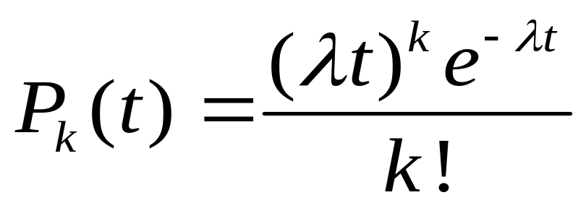
Poisson Distribution
The probability of having k arrivals during a time interval of length t is given by:
where λ is the arrival rate. Note that this is a single-parameter model; all we have to know is λ.

Slide 5
Pure ALOHA Protocol
While there is a new frame A to send DO
  Send frame A and wait for ACK
  If after “some” time ACK is not received (timer times out), wait a random amount of time and go to 1.
End

Slide 6
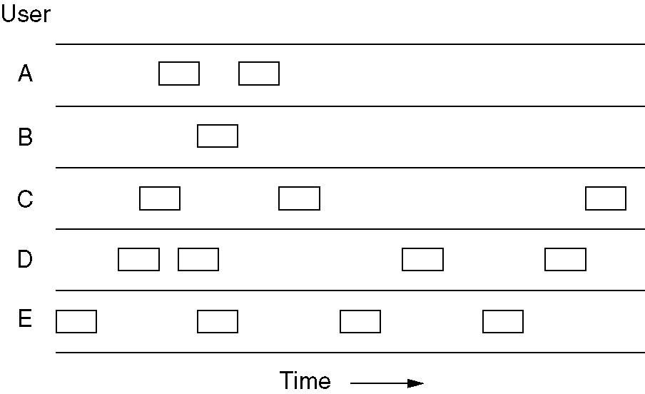
Pure ALOHA
In pure ALOHA, frames are transmitted at completely arbitrary times.

Slide 7
Analysis of Pure ALOHA
Notation:
  T_{f} = frame time (processing, transmission, propagation)
  S: Average number of successful transmissions per T_{f} ; that is, the throughput or efficiency.
  G: Average number of total frames transmitted per T_{f}
  D: Average delay between the time a packet is ready for transmission and the completion of successful transmission.
We will make the following assumptions
  All frames are of constant length
  The channel is noise-free; the errors are only due to collisions.
  Frames do not queue at individual stations
  The channel acts as a Poisson process.

Slide 8
Analysis of Pure ALOHA…
Since S represents the number of “good” transmissions per frame time, and G represents the total number of attempted transmissions per frame time, then we have:
S = G × (Probability of good transmission)
The vulnerable time for a successful transmission is 2T_{f}
So, the probability of good transmission is not to have an “arrival” during the vulnerable time .

Slide 9
Analysis of Pure ALOHA (4)
Collides with
the start of
the shaded
frame
Collides with
the end of
the shaded
frame
t
t₀
t₀ + t
t₀ + 2t
t₀ + 3t
Vulnerable
Time
Vulnerable period for the shaded frame
Notes:
2

Slide 10

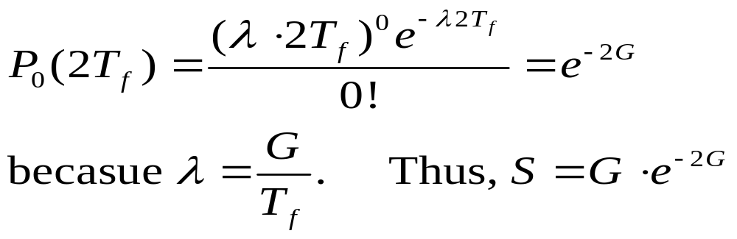
Analysis of Pure ALOHA…
Using:
And setting t = 2T_{f} and k = 0, we get

Slide 11
Analysis of Pure ALOHA…
If we differentiate S = Ge^{-2G} with respect to G and set the result to 0 and solve for G, we find that the maximum occurs when
G = 0.5,
and for that S = 1/2e = 0.18. So, the maximum throughput is only 18% of capacity.
ALOHANET uses a data rate of 9600bps. This means the maximum total throughput (sum of data arriving from all user nodes) is only 0.18 × 9600 = 1728bps.
Notes:
2

Slide 12
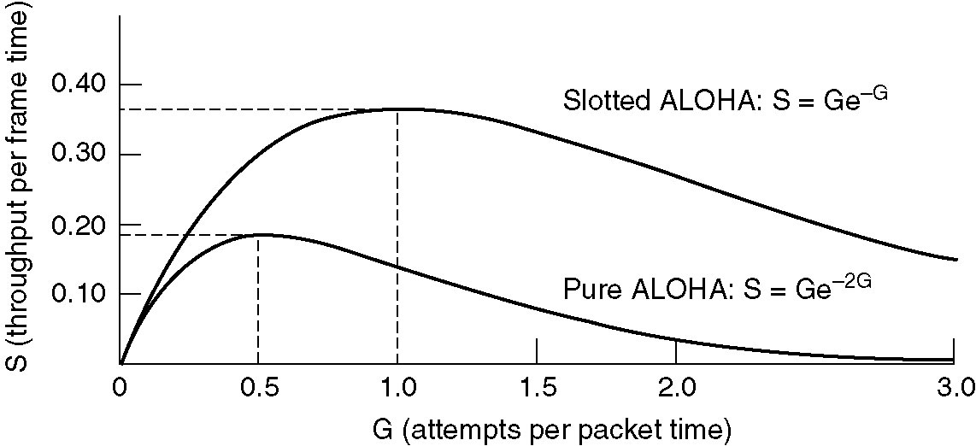
Pure ALOHA …
Throughput versus offered traffic for ALOHA systems.

Slide 13
Analysis of Pure ALOHA; another approach
There are N stations
Each station transmits with probability p
For a typical node i to have a successful transmission means that there was no prior overlapping transmissions before or after, each with probability (1-p)^{N-1}
Thus the probability of node i having a successful transmission is p (1-p)^{2(N-1)}
Therefore, the probability of a successful transmission is Np (1 ₋ p)^{2(N-1)}
The maximum value for the above term when N is large is 1/2e

Slide 14
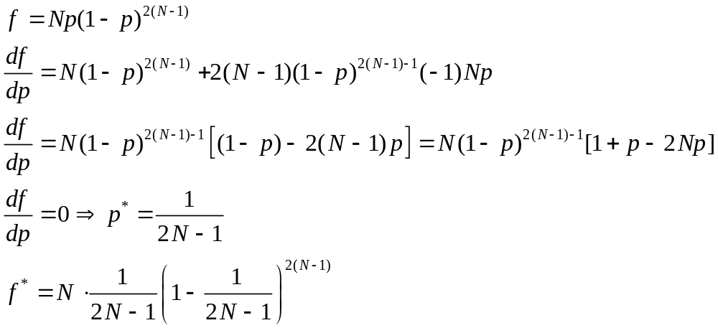
Analysis of Pure ALOHA; another approach…

Slide 15
Expected number of transmissions
In Pure ALOHA, what is the expected number of transmissions per frame?
  Let x be the random variable representing the number of transmissions. Thus, x will take on values 1, 2, 3, …, etc
  The probability P_{k} that x takes value k is when we have (k-1) unsuccessful transmissions followed by a successful transmission.
  For PURE ALOHA, the probability of a successful transmission is e^{-2G}

Slide 16
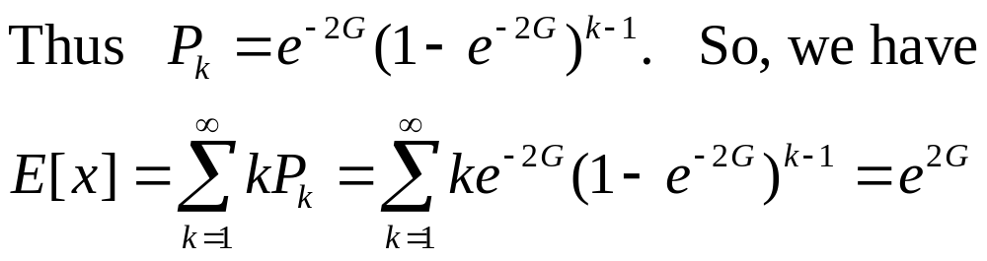
Expected number of transmissions
Thus E[x] grows exponentially with G, which means that a small increase in the channel load, that is G, can drastically reduce its performance. The ALOHA protocol is an example of an unstable protocol.

Slide 17
Slotted ALOHA
Channel is organized into uniform slots whose size equals the frame transmission time. Transmission is permitted only to begin at a slot boundary. Here is the procedure:
While there is a new frame A to send do
  Send frame A at a slot boundary and wait for ACK
  If after “some” time ACK is not received, wait a random amount of time and go to 1.
End
Notes:
2

Slide 18
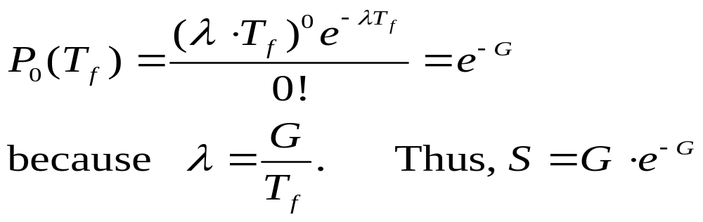
Analysis of Slotted ALOHA
Note that the vulnerable period is now reduced in half. Using:
And setting t = T_{f} and k = 0, we get

Slide 19
Slotted ALOHA
Throughput versus offered traffic for ALOHA systems.

Slide 20
Alternate Analysis for Slotted Aloha
Use of alternate approach for throughput of slotted aloha is left as exercise

Slide 21
Carrier Sense Multiple Access (CSMA)
Additional assumption:
  Each station is capable of sensing the medium to determine if another transmission is underway

Slide 22
Non-persistent CSMA
While there is a new frame A to send DO
  Check the medium
  If the medium is busy, wait some time, and go to 1.
  (medium idle) Send frame A and wait for ACK
  If after some time ACK is not received (timer times out), wait a random amount of time and go to 1.
End

Slide 23
1-persistent CSMA
While there is a new frame A to send do
  Check the medium
  If the medium is busy, go to 1.
  (medium idle) Send frame A and wait for ACK
  If after some time ACK is not received (timer times out), wait a random amount of time and go to 1.
End.

Slide 24
p-persistent CSMA
While there is a new frame A to send do
  Check the medium
  If the medium is busy, go to 1.
  (medium idle) With probability p send frame A and the go to 4, and probability (1- p) delay one time slot and go to 1.
  If after some time ACK is not received (timer times out), wait a random amount of time and go to 1.
End.

Slide 25
CSMA Summary
Nonpersistent
1-persistent
p-persistent
CSMA persistence and backoff
Non-persistent:
Transmit if idle
Otherwise, delay, try again
Constant or variable
Delay
Channel busy
Time
Ready
1-persistent:
Transmit as soon as
channel goes idle
If collision, back off and try again
p-persistent:
Transmit as soon as channel goes
idle with probability p
Otherwise, delay one slot, repeat process
Notes:
2

Slide 26
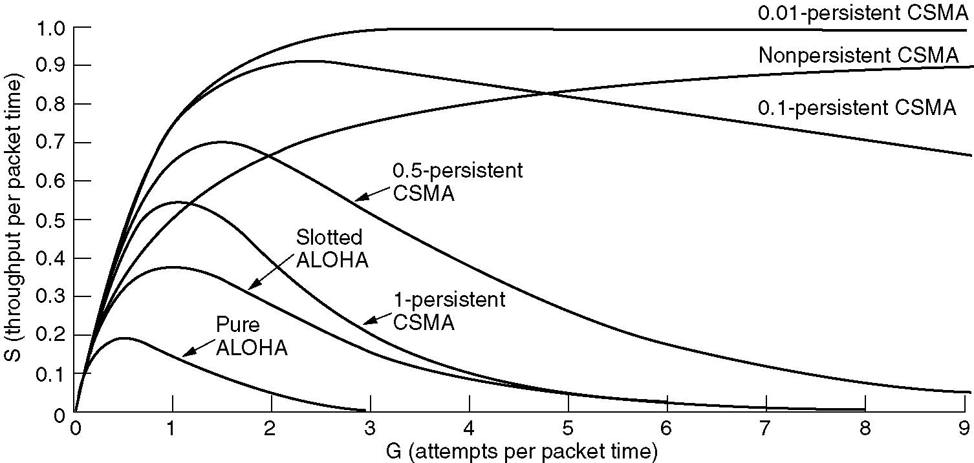
Persistent and Non-persistent CSMA
Comparison of throughput versus load for various random access protocols.

Slide 27
CSMA with Collision Detection
Stations can sense the medium while transmitting
A station aborts its transmission if it senses another transmission is also happening (that is, it detects collision)
Question: When can a station be sure that it has seized the channel?
  Minimum time to detect collision is the time it takes for a signal to traverse between two farthest apart stations.

Slide 28
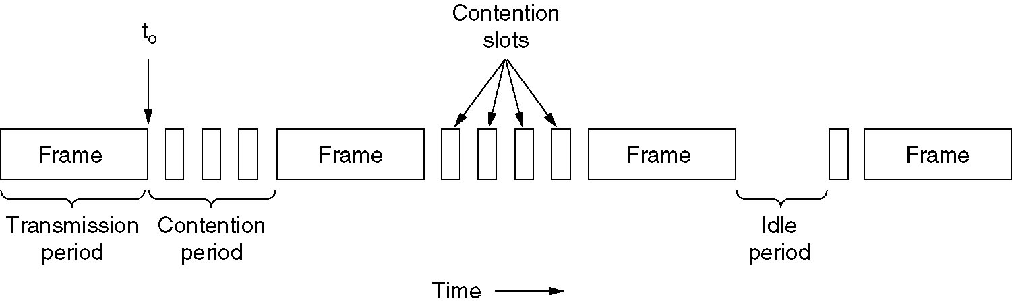
CSMA with Collision Detection
CSMA/CD can be in one of three states: contention, transmission, or idle.

Slide 29
CSMA/CD
A station is said to seize the channel if all the other stations become aware of its transmission.
There has to be a lower bound on the length of each frame for the collision detection feature to work out.
Ethernet uses CSMA/CD

Slide 30
CSMA/CA
Identical to CSMA/CD but used when listening is not possible while transmitting
Idle channel reservation is done by sending a short request message asking other nodes to defer transmission
If collison is detected then, then random wait is used
Wireless IEEE 802.11 uses CSMA/CA with an RTS/CTS mechanism

