Slide 1
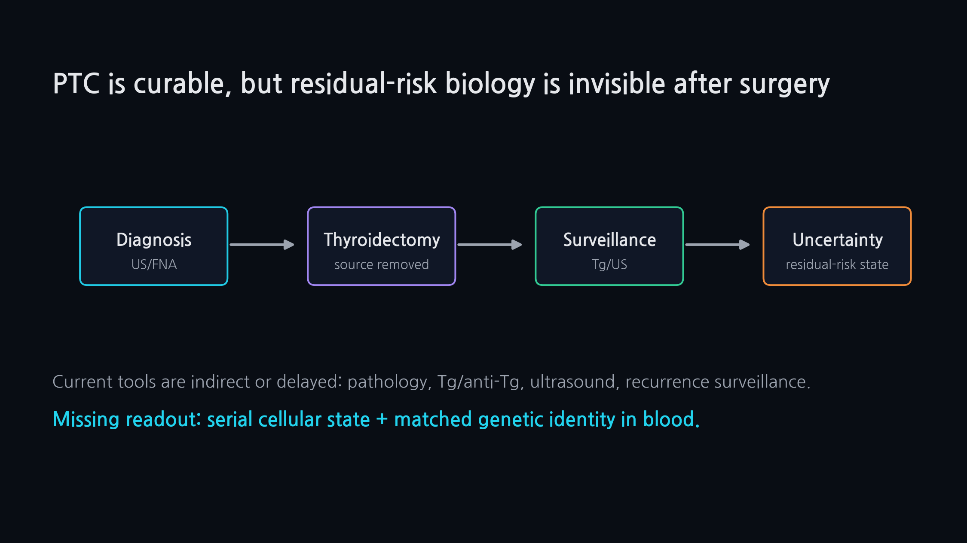
PTC CTC-EMT | SAMSUNG FUTURE TECHNOLOGY PROGRAM
SCIENCE TRACK | MECHANISM
01
PTC is curable, but residual-risk biology is invisible after surgery
Current postoperative tools cannot read the real-time residual tumor-cell state.
Proposal concept for Samsung Science Program
One disease | one perturbation | one transition | one genetic anchor

Slide 2
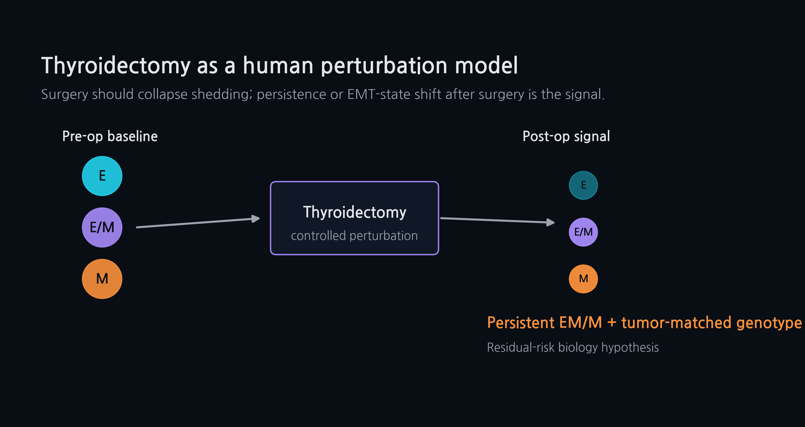
PTC CTC-EMT | SAMSUNG FUTURE TECHNOLOGY PROGRAM
SCIENCE TRACK | MECHANISM
02
Thyroidectomy as a human perturbation model
Surgery should collapse tumor shedding; persistence or EMT-state shift after surgery is the signal.
Proposal concept for Samsung Science Program
One disease | one perturbation | one transition | one genetic anchor

Slide 3
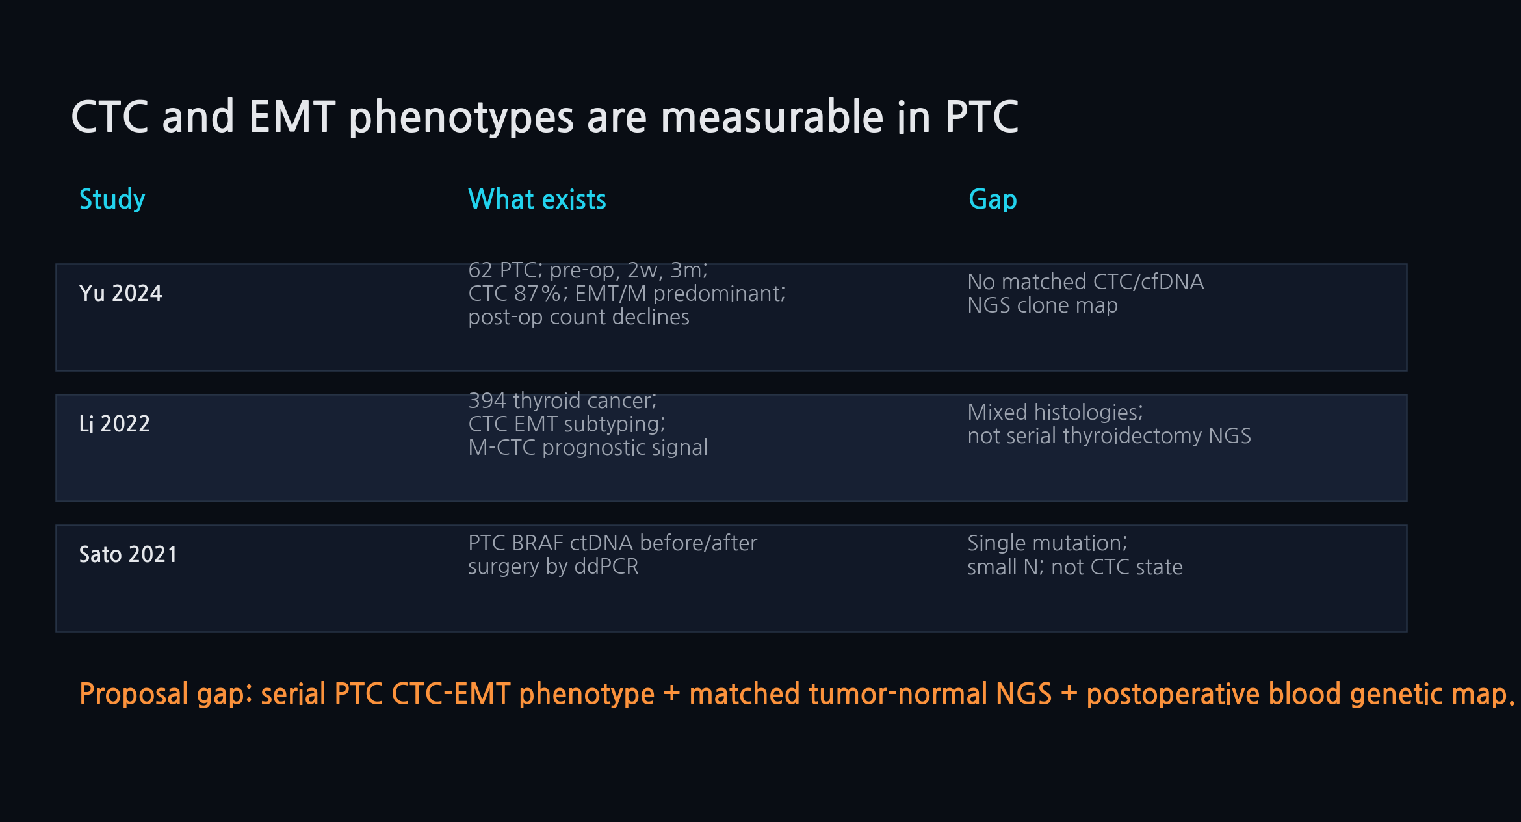
PTC CTC-EMT | SAMSUNG FUTURE TECHNOLOGY PROGRAM
SCIENCE TRACK | MECHANISM
03
CTC and EMT phenotypes are measurable in PTC
The feasibility anchor exists, but the genetic map is missing.
Proposal concept for Samsung Science Program
One disease | one perturbation | one transition | one genetic anchor

Slide 4
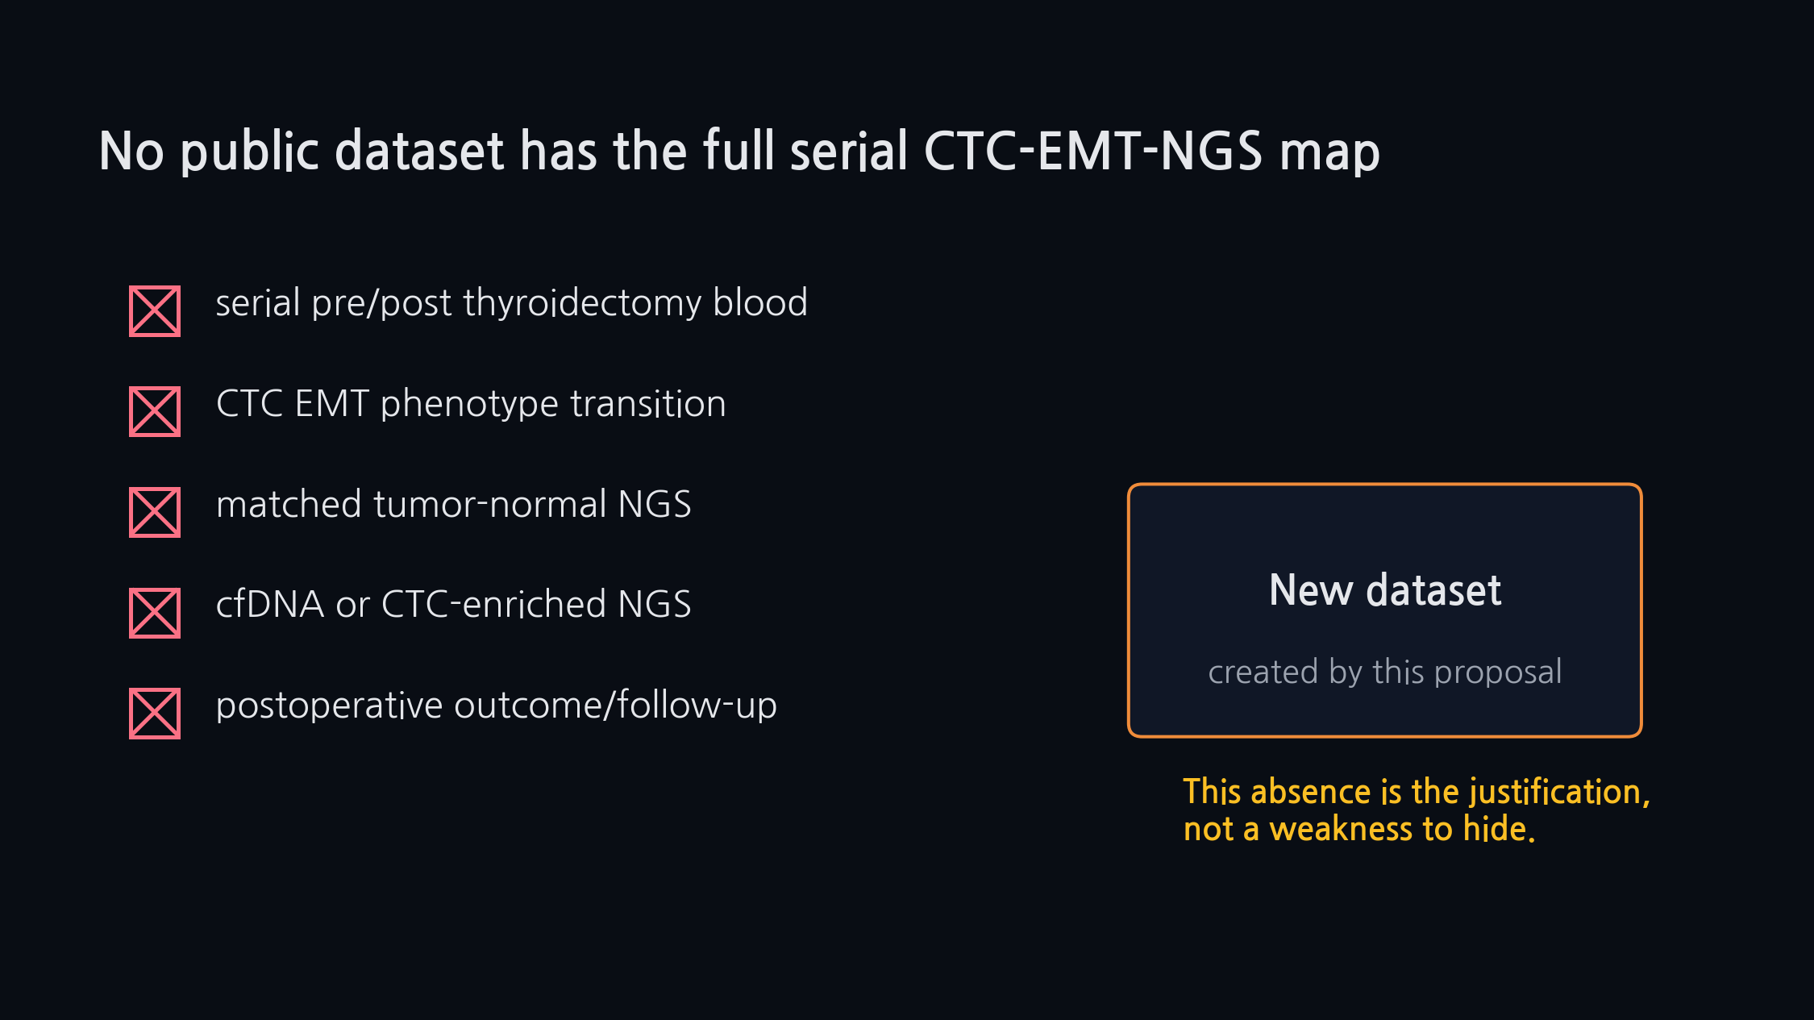
PTC CTC-EMT | SAMSUNG FUTURE TECHNOLOGY PROGRAM
SCIENCE TRACK | MECHANISM
04
No public dataset has the full serial CTC-EMT-NGS map
This absence is the proposal's core justification.
Proposal concept for Samsung Science Program
One disease | one perturbation | one transition | one genetic anchor

Slide 5
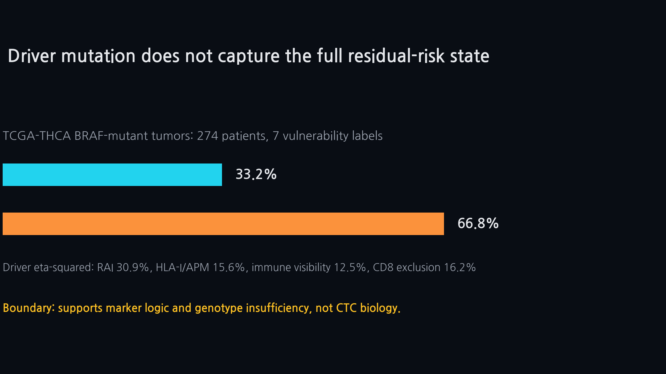
PTC CTC-EMT | SAMSUNG FUTURE TECHNOLOGY PROGRAM
SCIENCE TRACK | MECHANISM
05
Driver mutation does not capture the full residual-risk state
Local public pilot shows tissue states split beyond mutation group.
Proposal concept for Samsung Science Program
One disease | one perturbation | one transition | one genetic anchor

Slide 6
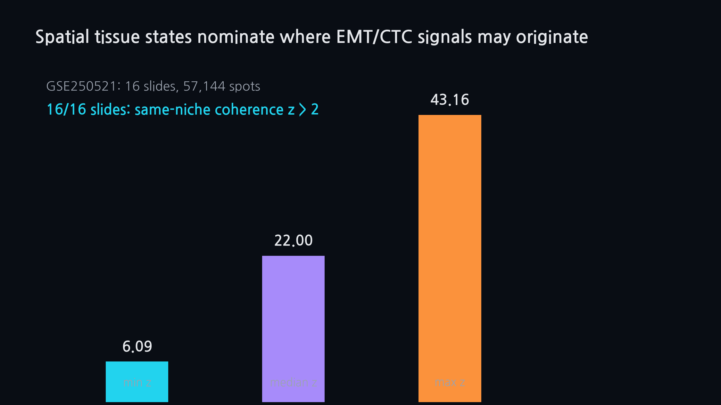
PTC CTC-EMT | SAMSUNG FUTURE TECHNOLOGY PROGRAM
SCIENCE TRACK | MECHANISM
06
Spatial tissue states nominate where EMT/CTC signals may originate
Spatial tissue states are organized, but not yet CTC proof.
Proposal concept for Samsung Science Program
One disease | one perturbation | one transition | one genetic anchor

Slide 7
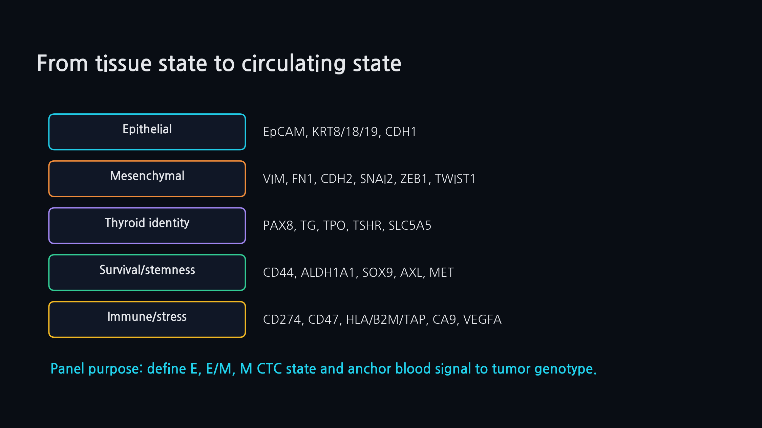
PTC CTC-EMT | SAMSUNG FUTURE TECHNOLOGY PROGRAM
SCIENCE TRACK | MECHANISM
07
From tissue state to circulating state
Markers define CTC state and NGS interpretation.
Proposal concept for Samsung Science Program
One disease | one perturbation | one transition | one genetic anchor

Slide 8
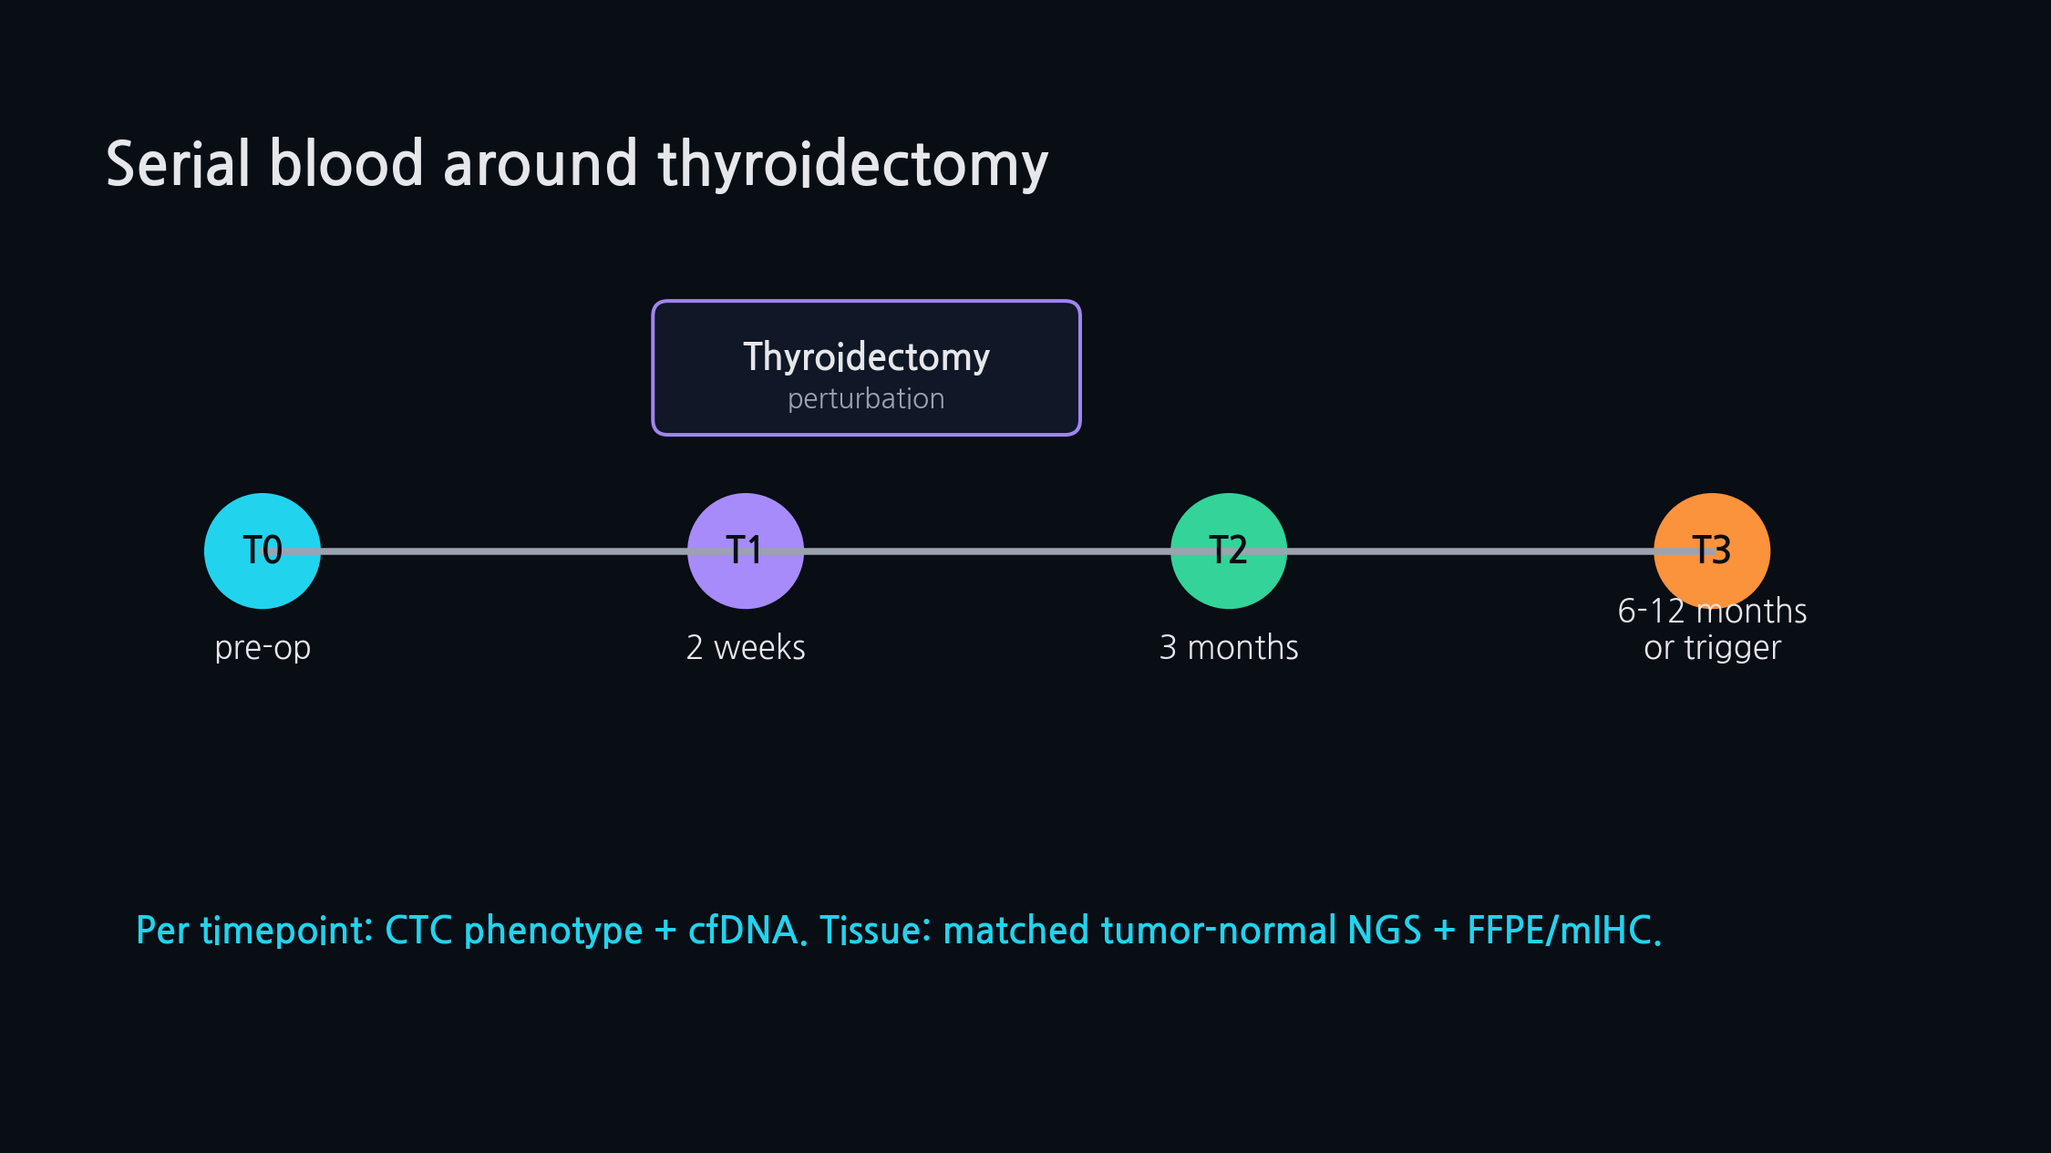
PTC CTC-EMT | SAMSUNG FUTURE TECHNOLOGY PROGRAM
SCIENCE TRACK | MECHANISM
08
Serial blood around thyroidectomy
The study converts surgery into a time-resolved perturbation experiment.
Proposal concept for Samsung Science Program
One disease | one perturbation | one transition | one genetic anchor

Slide 9
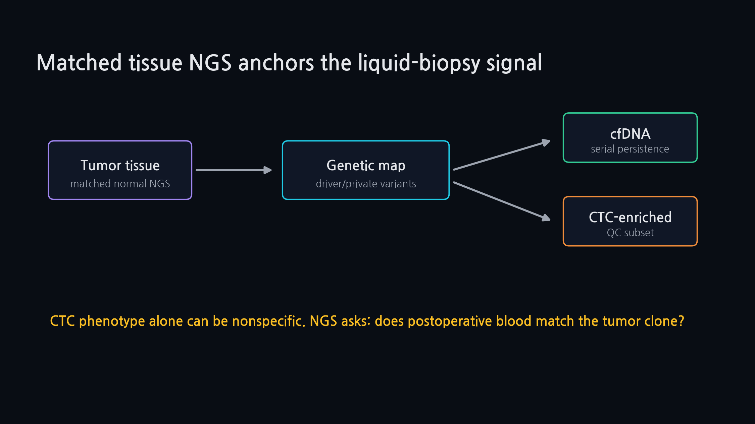
PTC CTC-EMT | SAMSUNG FUTURE TECHNOLOGY PROGRAM
SCIENCE TRACK | MECHANISM
09
Matched tissue NGS anchors the liquid-biopsy signal
CTC phenotype alone can be nonspecific; NGS provides clone identity.
Proposal concept for Samsung Science Program
One disease | one perturbation | one transition | one genetic anchor

Slide 10
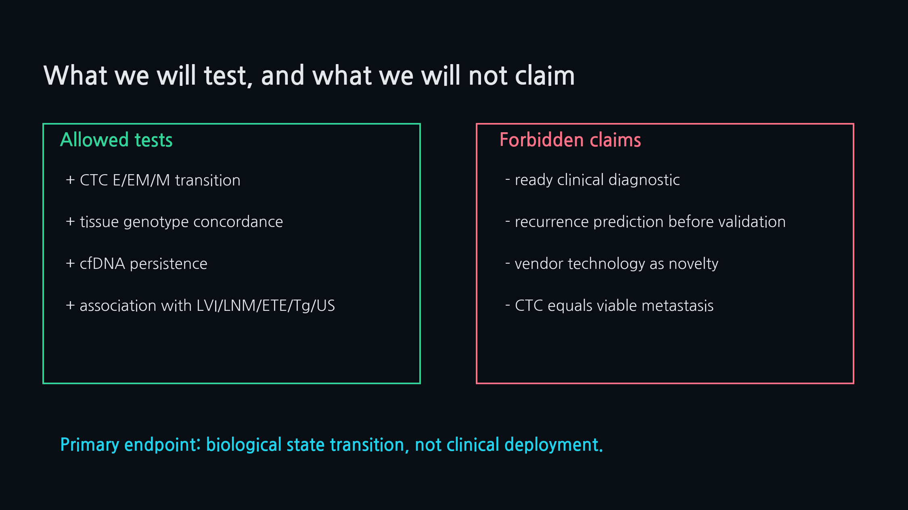
PTC CTC-EMT | SAMSUNG FUTURE TECHNOLOGY PROGRAM
SCIENCE TRACK | MECHANISM
10
What we will test, and what we will not claim
Primary endpoint is biological state transition, not clinical deployment.
Proposal concept for Samsung Science Program
One disease | one perturbation | one transition | one genetic anchor

Slide 11
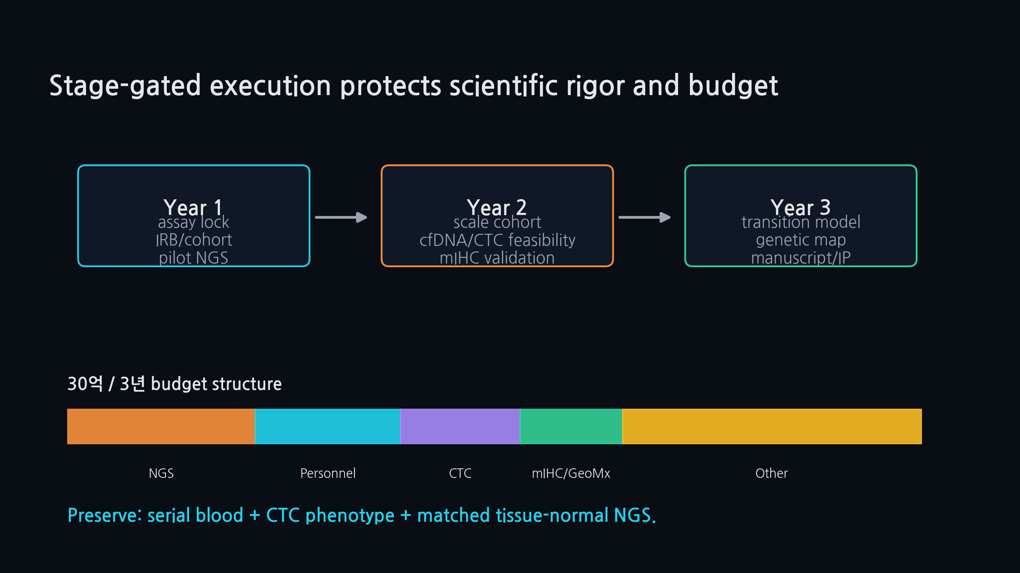
PTC CTC-EMT | SAMSUNG FUTURE TECHNOLOGY PROGRAM
SCIENCE TRACK | MECHANISM
11
30억 / 3년 stage-gated execution
Preserve serial blood, CTC phenotype, matched tissue-normal NGS.
Proposal concept for Samsung Science Program
One disease | one perturbation | one transition | one genetic anchor

Slide 12
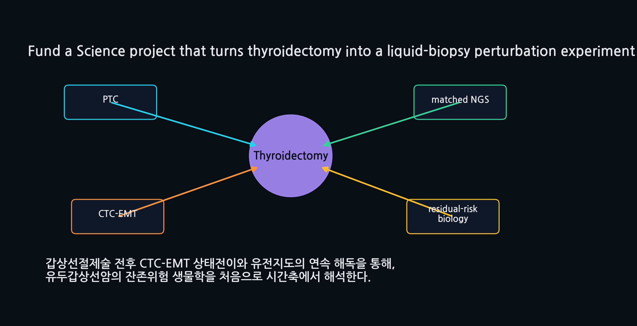
PTC CTC-EMT | SAMSUNG FUTURE TECHNOLOGY PROGRAM
SCIENCE TRACK | MECHANISM
12
Turn thyroidectomy into a liquid-biopsy perturbation experiment
The first PTC serial CTC-EMT genetic map after thyroidectomy.
Proposal concept for Samsung Science Program
One disease | one perturbation | one transition | one genetic anchor

