Slide 1
Cookbook.com
Revature Group 1 - Project 2

Slide 2
Project Overview: Description
A website that users can look up recipes for meals on, and if they create an account can save recipes for later. They can look up specific recipes by keyword, or they can click a button that presents them a random recipe. Recipe information includes the name of the recipe, ingredients required, steps required and a small picture accompanying it. Users that are logged on may also like other recipes, add recipes to their cookbooks and follow other users or cookbooks. Users may also create their own recipes.

Slide 3
Project Overview: User Stories
As an anonymous user, I want to be able to…
Search for recipes (optionally by ingredient, type, area, prep time)
Look up random recipes
As a logged in user, I want to be able to...
Save meals to my account
Create my own recipe
Follow other users
Leave a review on other recipes

Slide 4
Project Overview: MVP
Searching recipes with optional filters
Creating and storing users
Register yourself as a new user
Login
Usernames should be hashed
Passwords should be salted and hashed
Random meal button

Slide 5
Project Overview: MVP Cont.
When showing recipes
Show thumbnail of meal
Show ingredients included
Show steps in recipe
Ability for users to create different “cookbooks”
Ability for users to add recipes to their “cookbooks”

Slide 6
Project Overview: Stretch Goals
Users can like recipes
Ability for users to follow other users
Ability for users to follow different “cookbooks”
Users can leave a review for recipes
Ability for users to download recipes
Ability for users to create new recipes

Slide 7
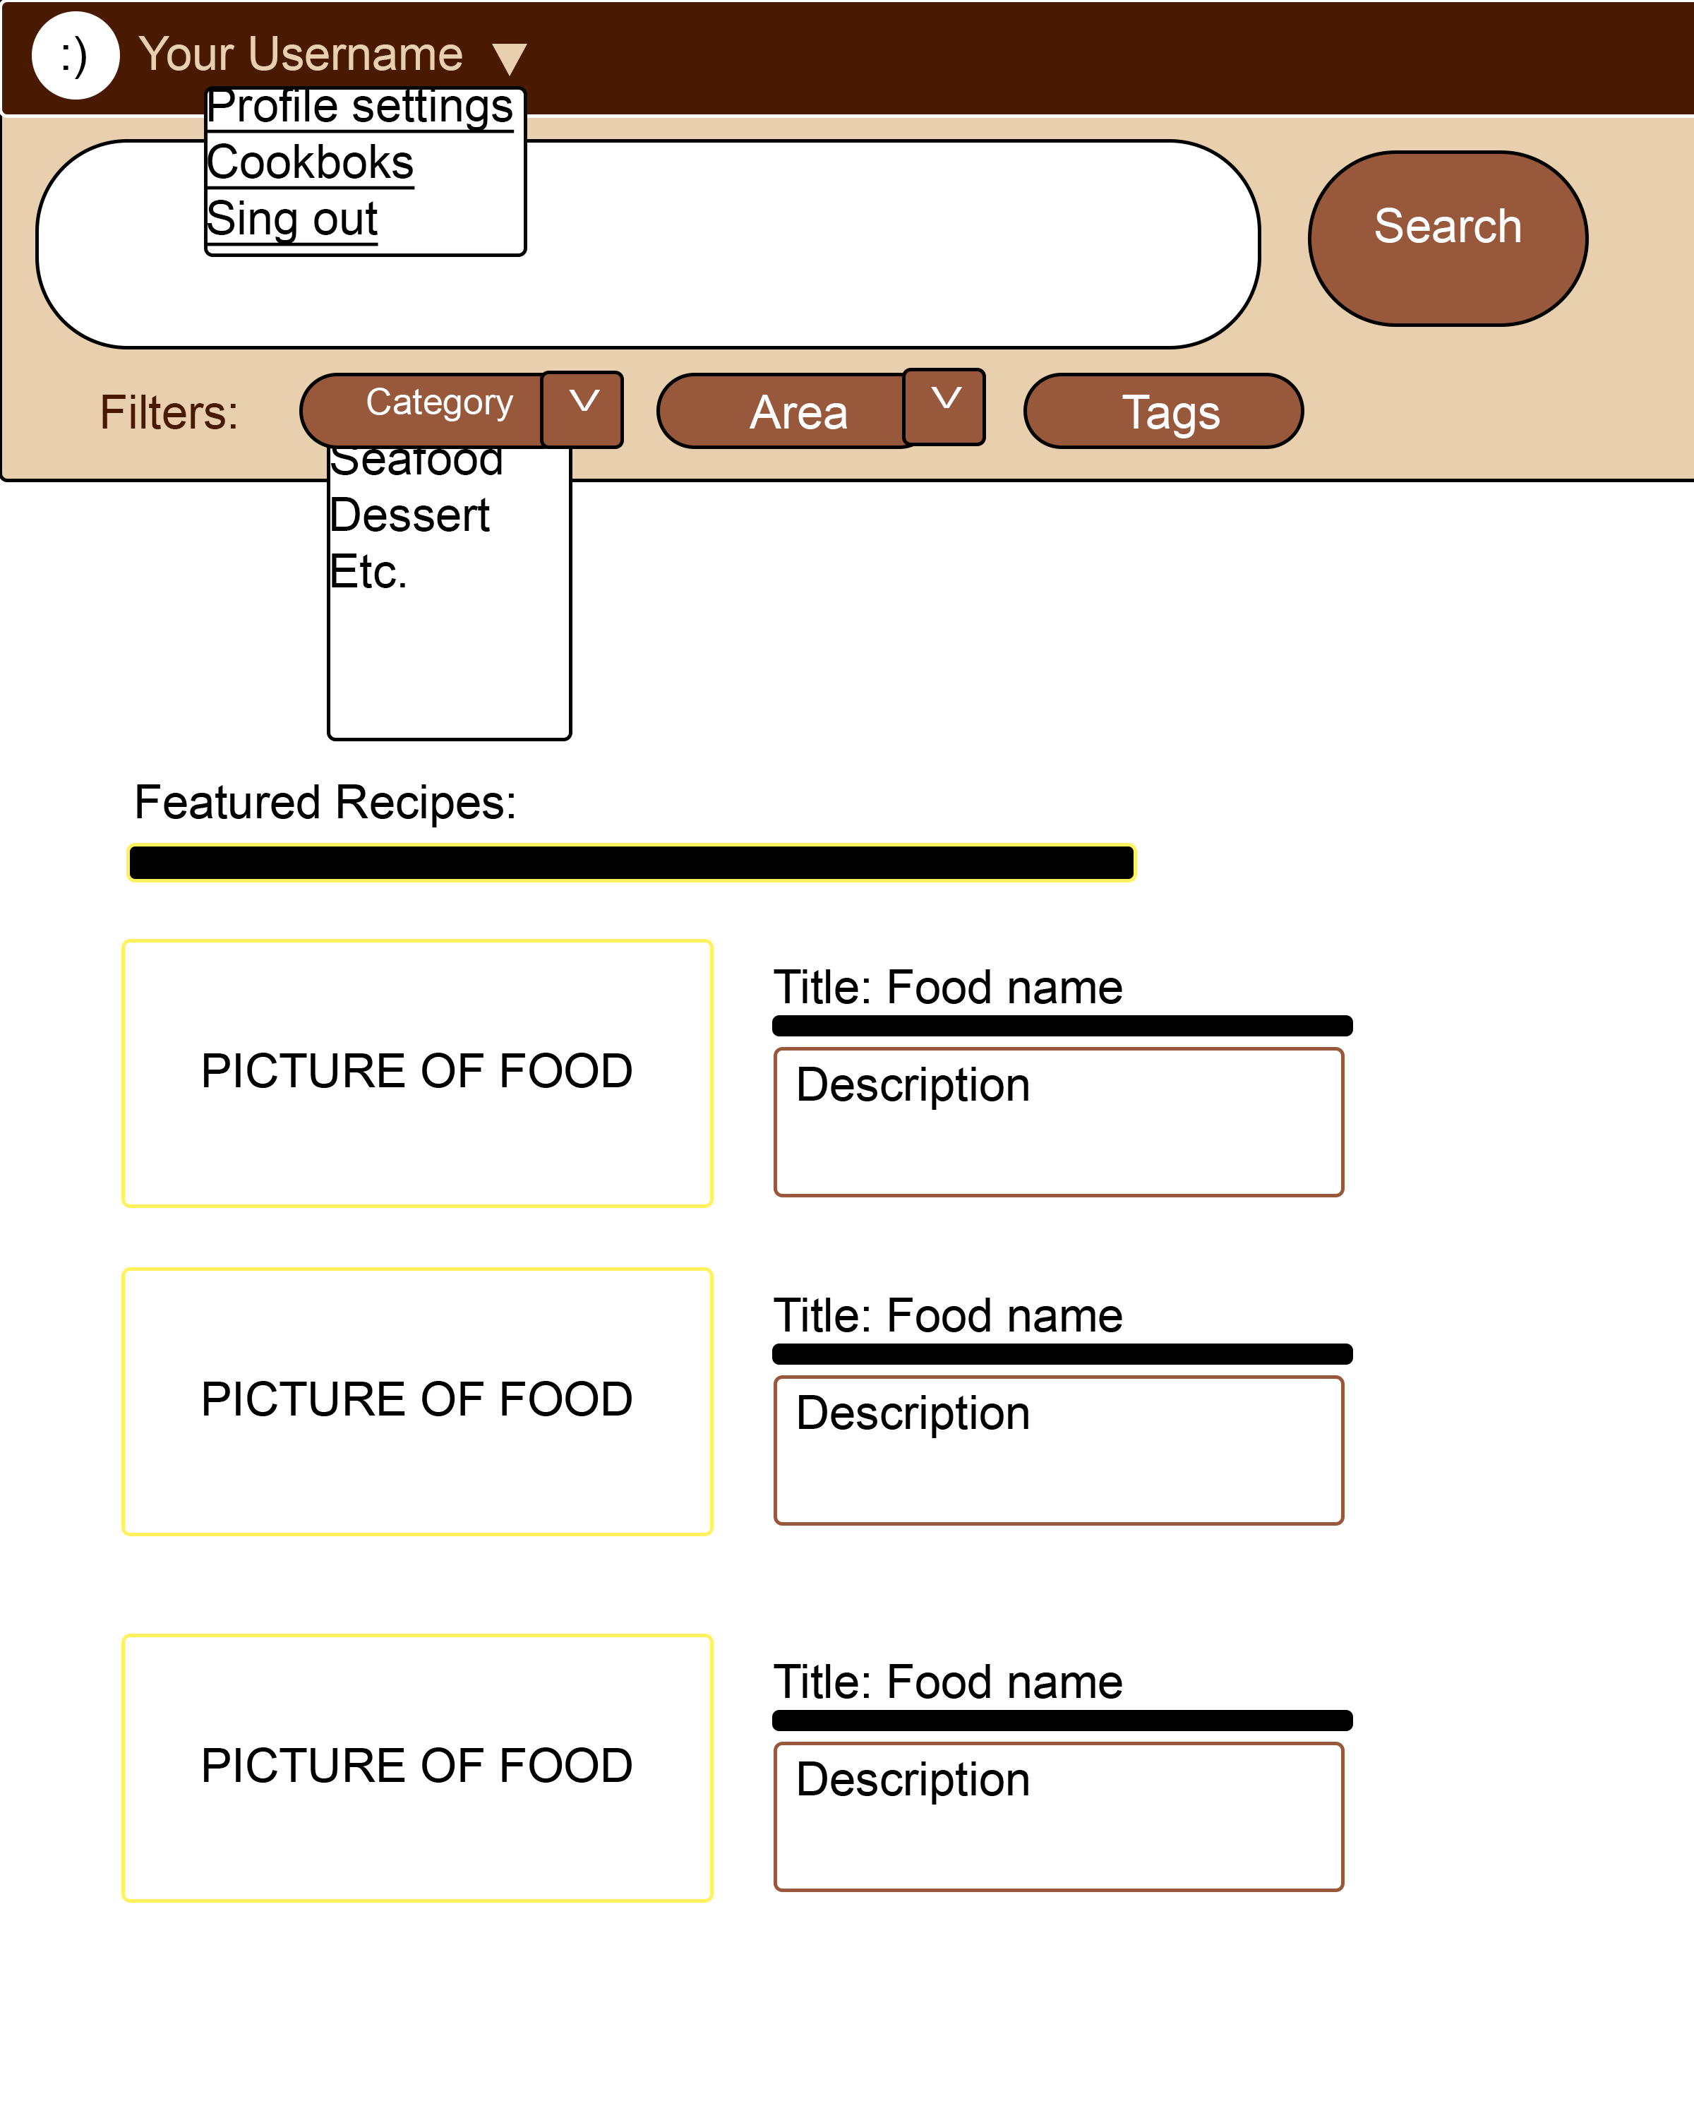
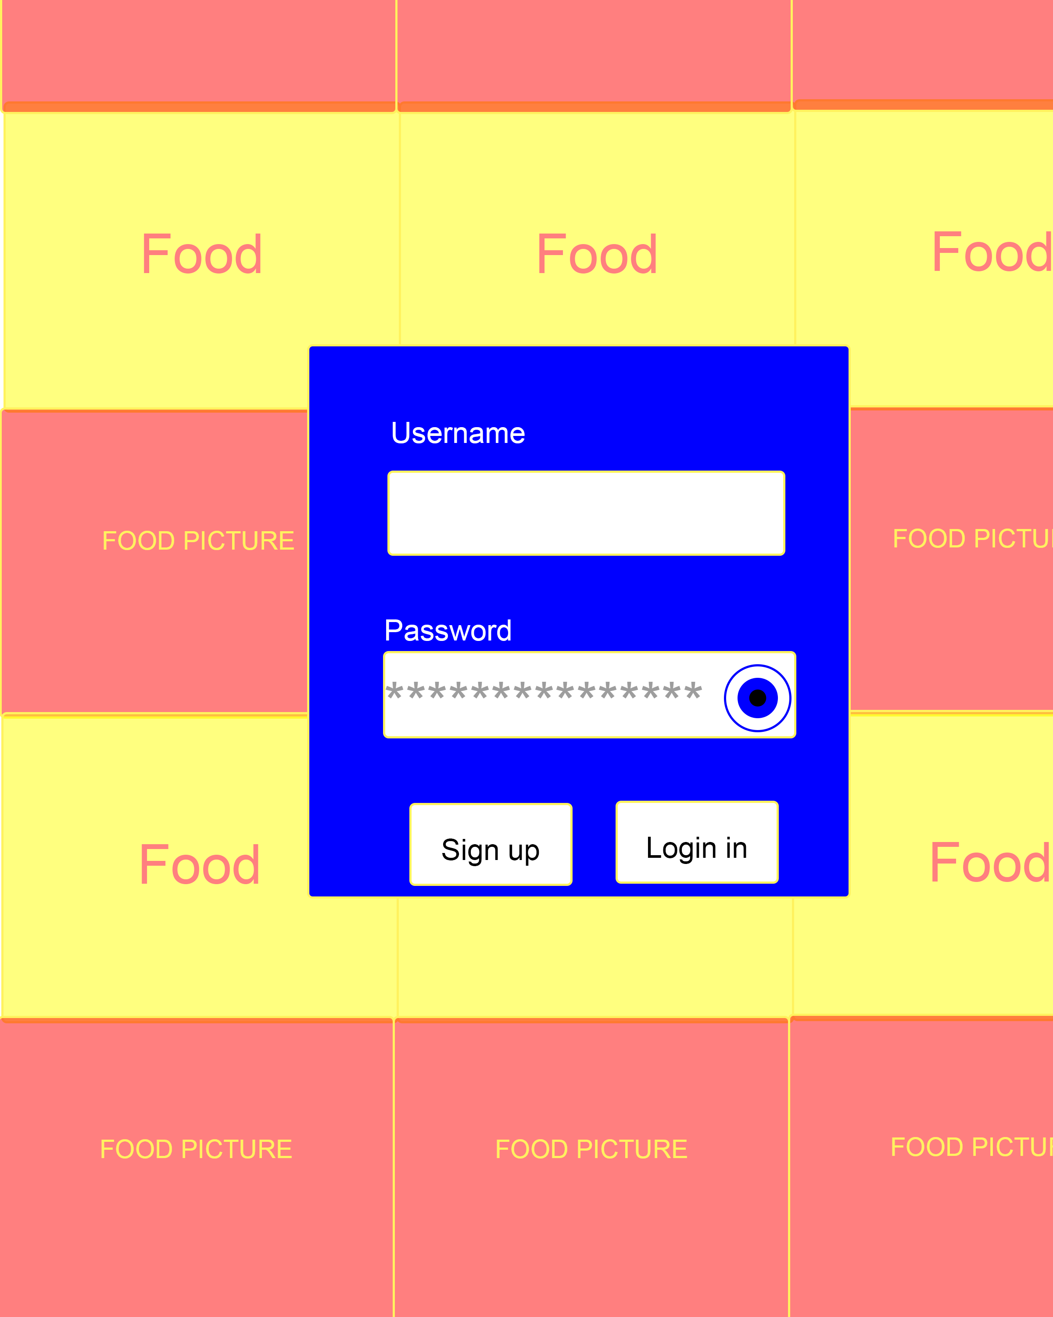
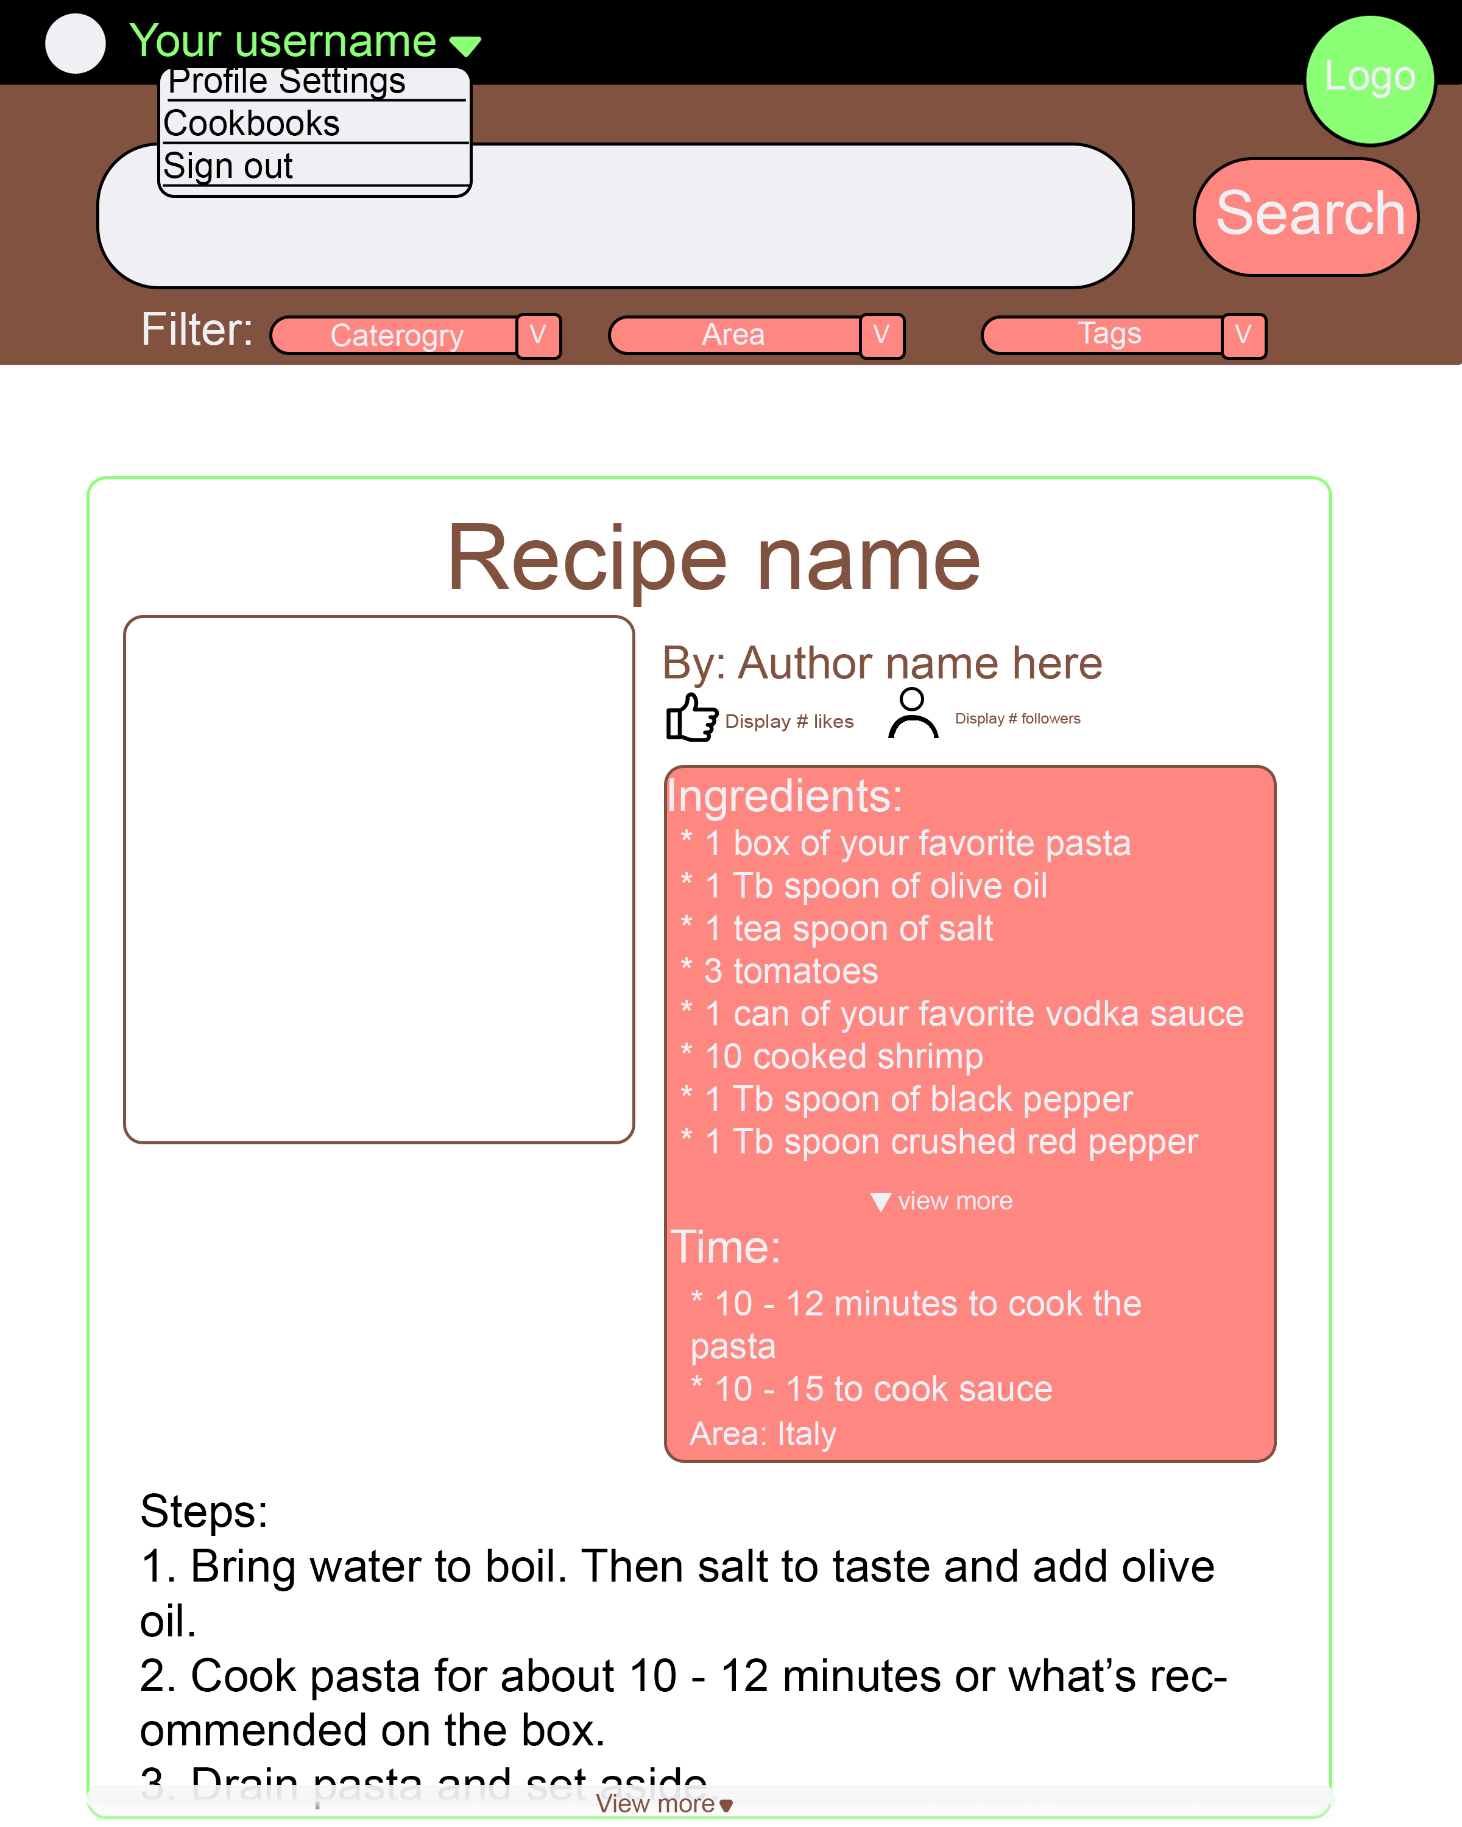
Project Overview: Concept Pages
Main/Welcome Page
Login Page
Recipe Page

Slide 8
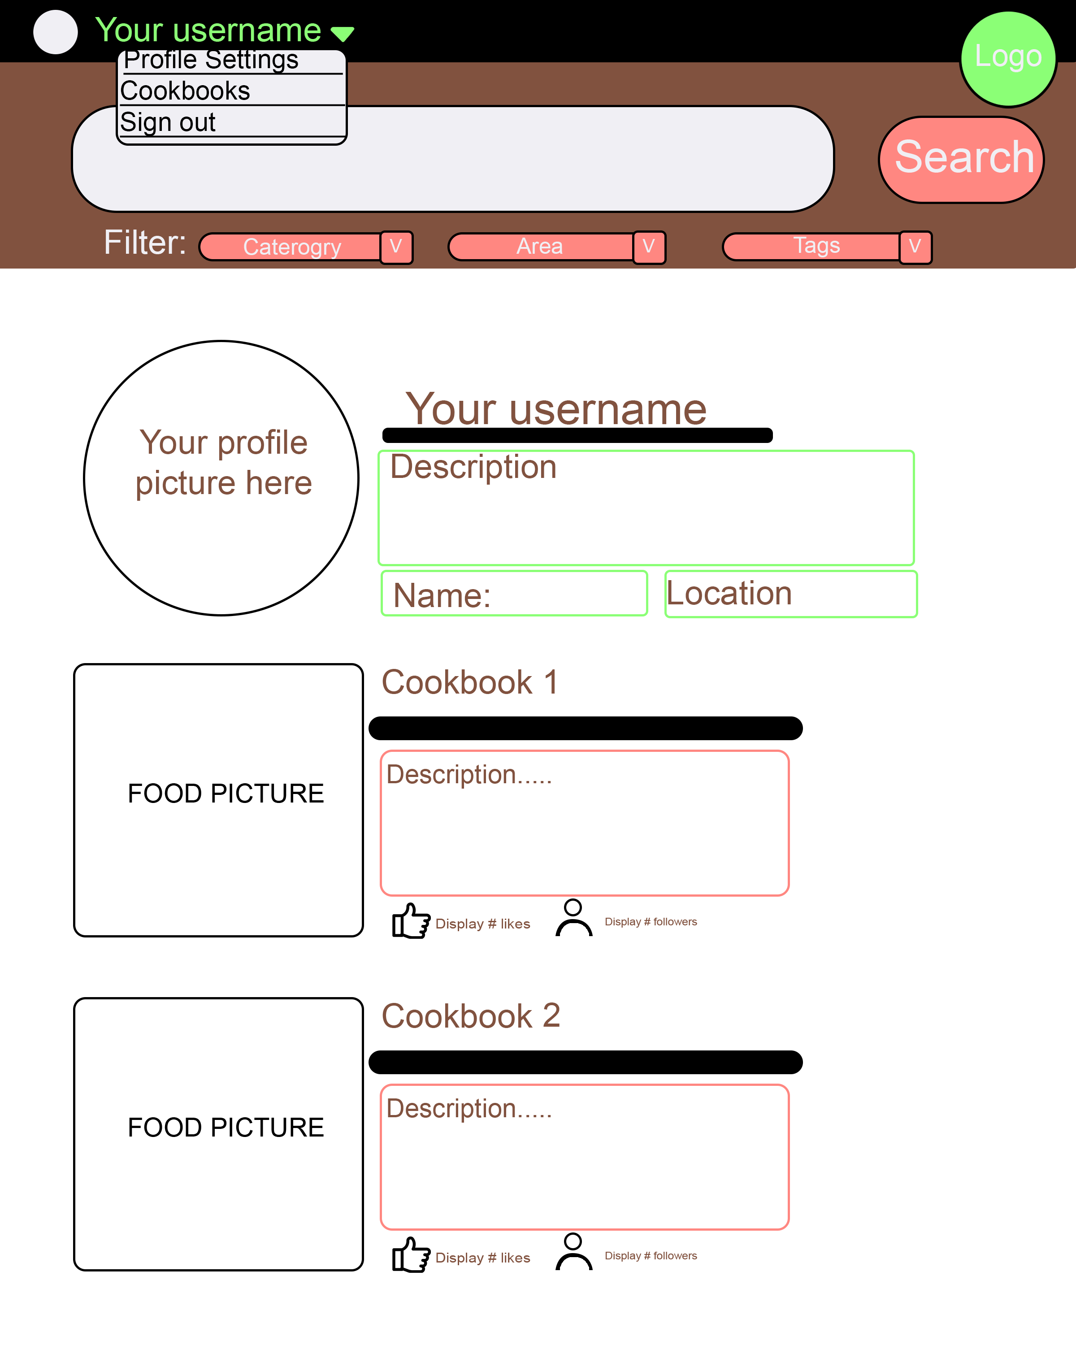
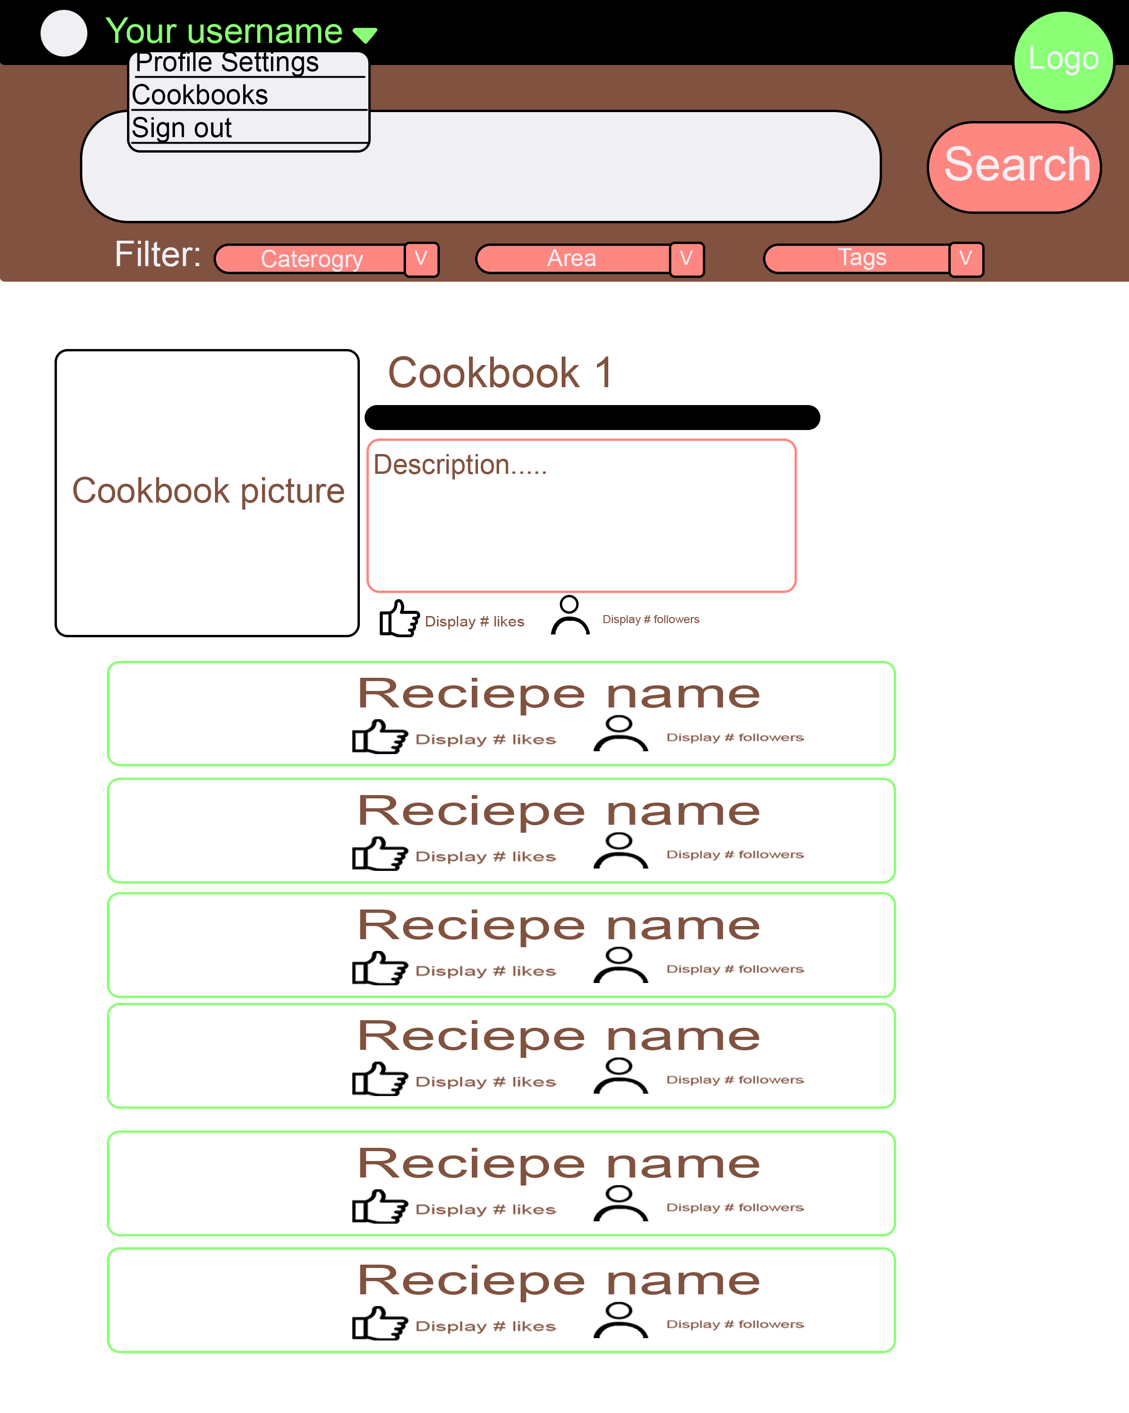
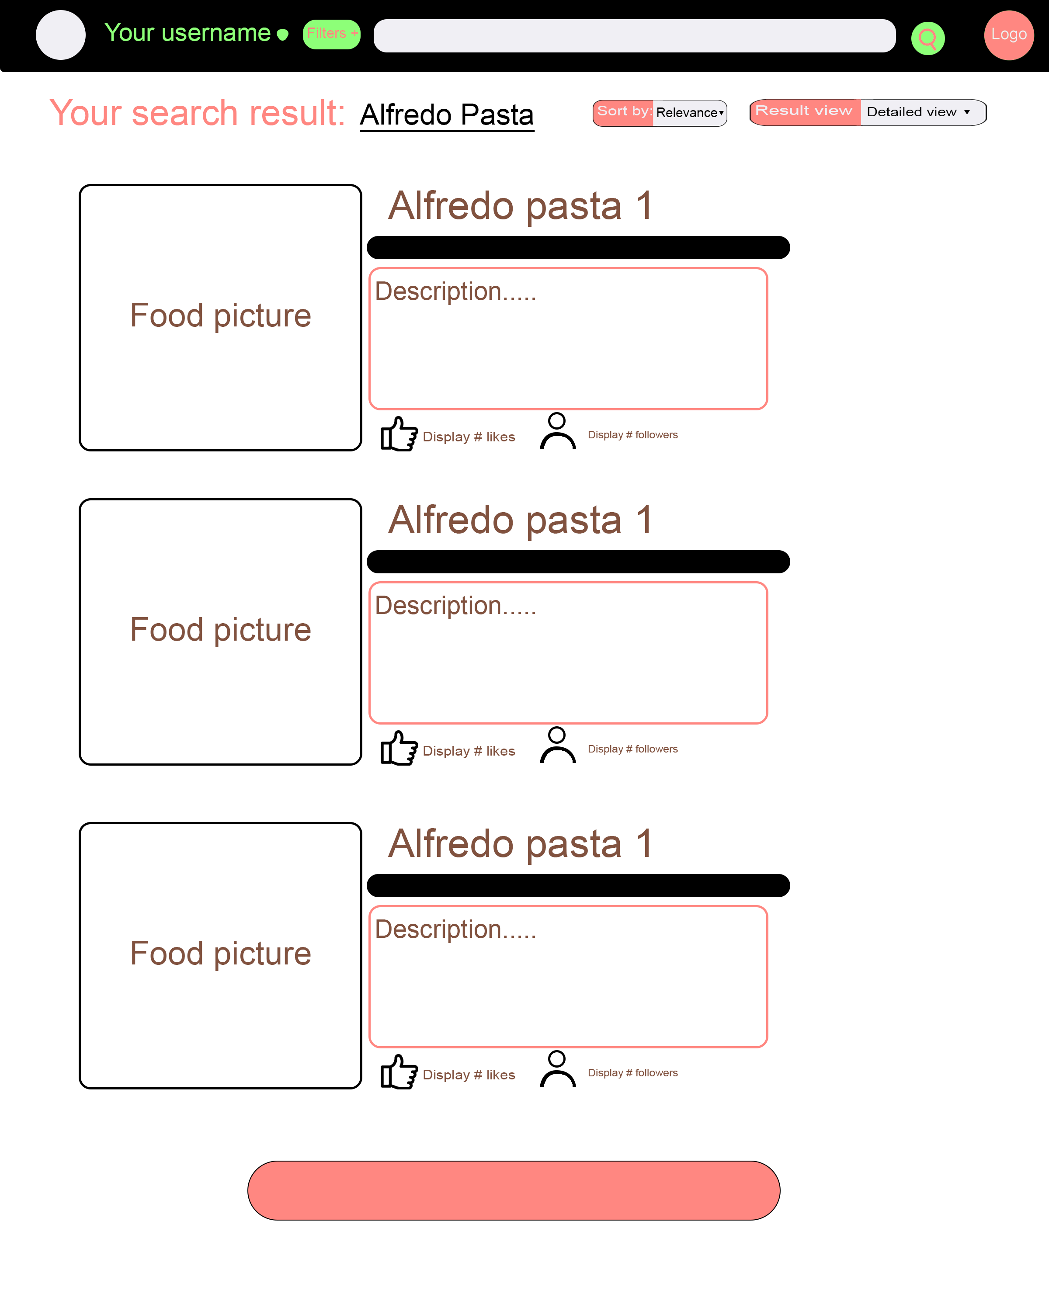
Project Overview: Concept Pages Cont.
Profile Page
Cookbook Page
Search Results Page

Slide 9
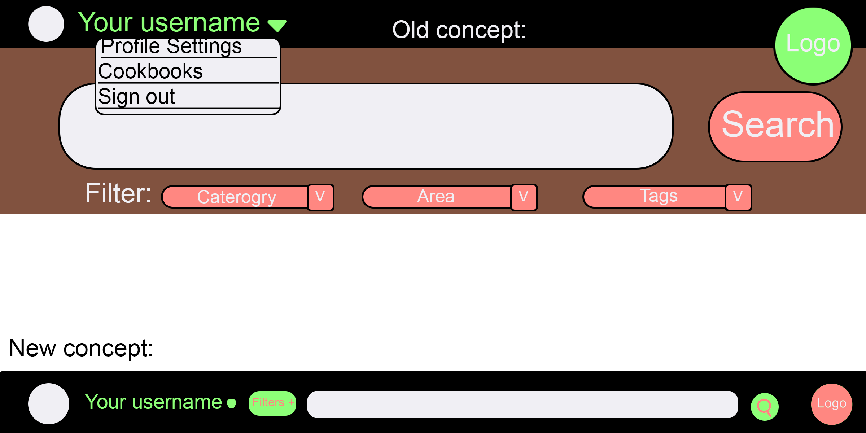
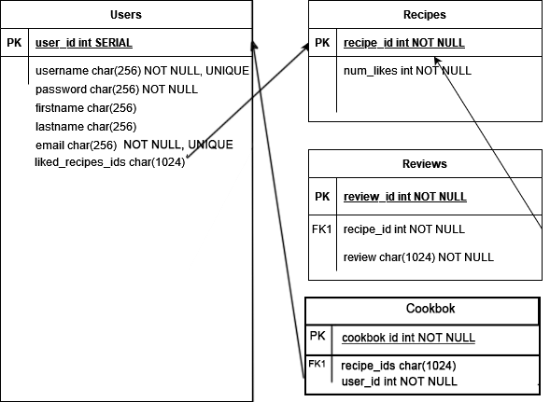
Project Overview: Concept Pages Cont.
Database Tables
Navbar Alternative

Slide 10
Technologies Used: Backend
Spring Framework, Spring Boot, Web
Hibernate
Logback
Maven
Junit5 (testing)
Mockito (testing)
H2 Database (testing)

Slide 11
Technologies Used: Frontend
Angular/NodeJS
Bulma
MealDB (external API)
Cucumber
Selenium

Slide 12
Technologies Used: Project Management
AWS RDS
AWS EC2
Git
SonarCloud

Slide 13
Design/Development Philosophies
Behavior/Test Driven Development
Scrum
RESTful Web Service Design
3-Tiered architecture

Slide 14
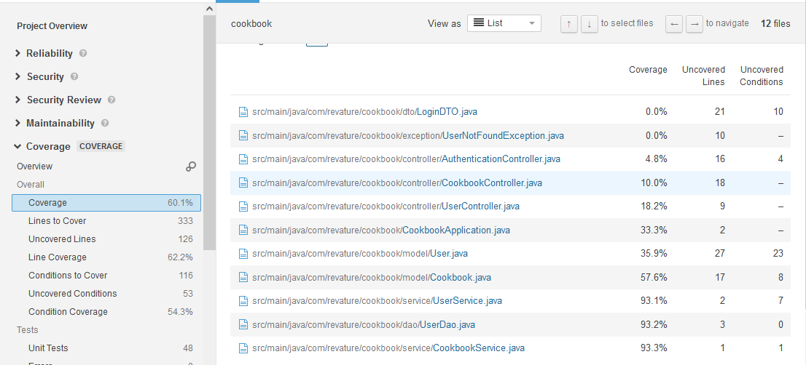
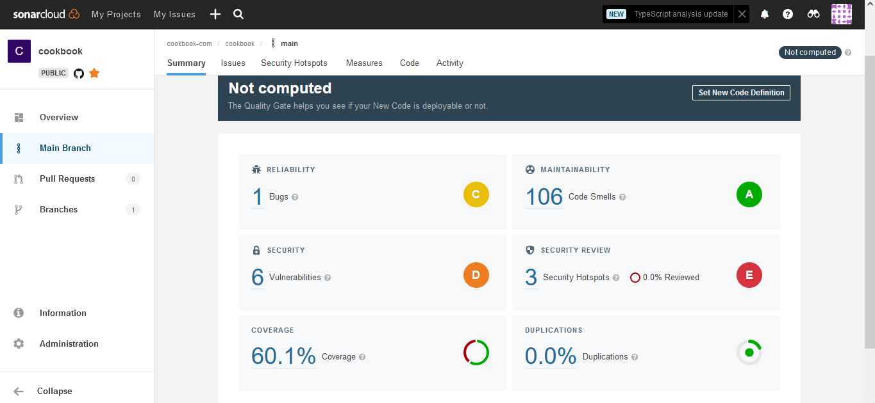
Unit Tests and Code Coverage
SonarCloud Stats
Code Coverage

Slide 15
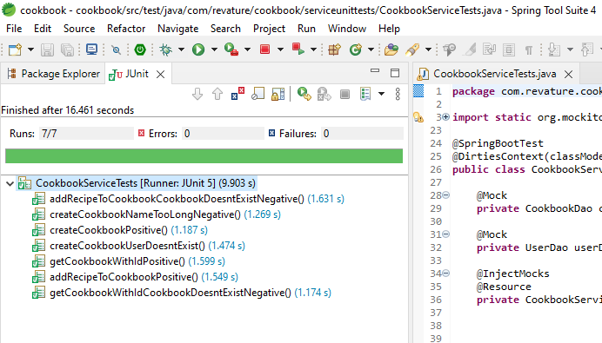
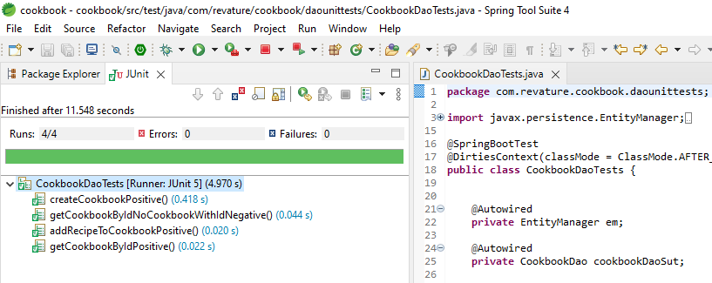
Unit Tests
Cookbook Data Access Layer Unit Tests
Cookbook Service Layer Unit Tests

Slide 16
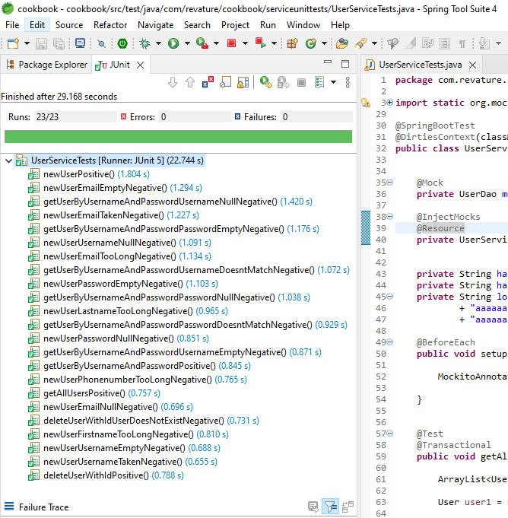
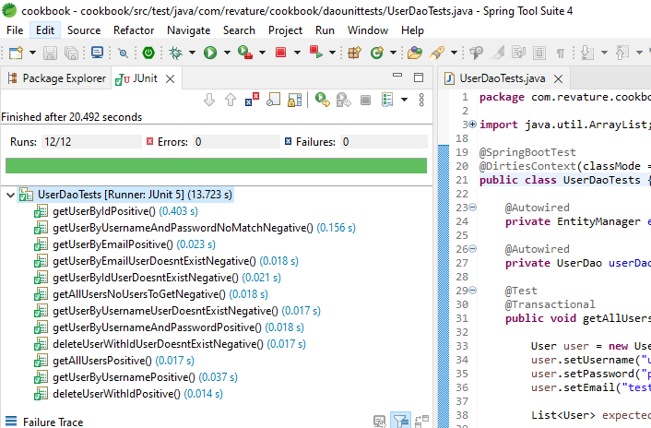
Unit Tests
User Data Access Layer Unit Tests
User Service Layer Unit Tests

Slide 17
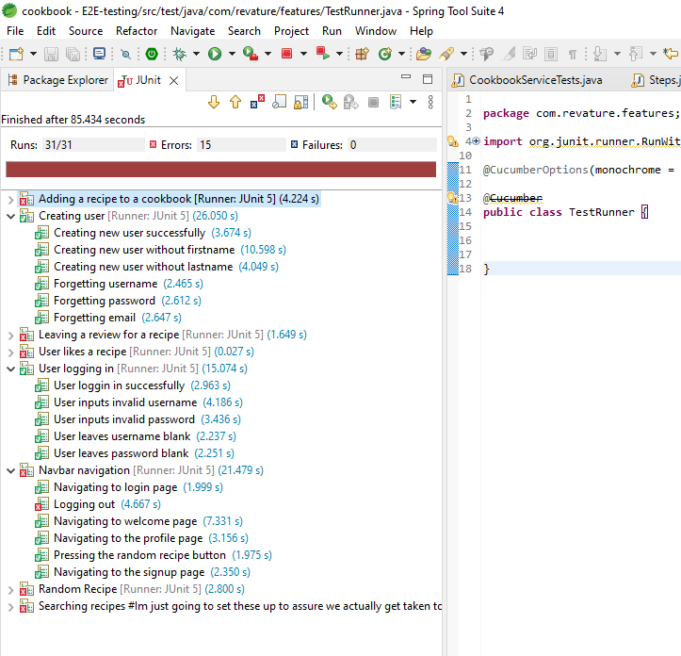
End to End Testing

Slide 18
Live Demo
http://ec2-18-117-174-173.us-east-2.compute.amazonaws.com:8082

